Slide 1
Probability
Probability and Statistics for Data Science
Part 2

Slide 2
What have we learned last time
Sampling space
Event set and probability on events
Independence
Conditional and marginal probability
Bayes theorem and the law of total probability
Random variables
Some useful distributions
Uniform
Binomial
Geometric
Negative binomial

Slide 3
Expectation

Slide 4
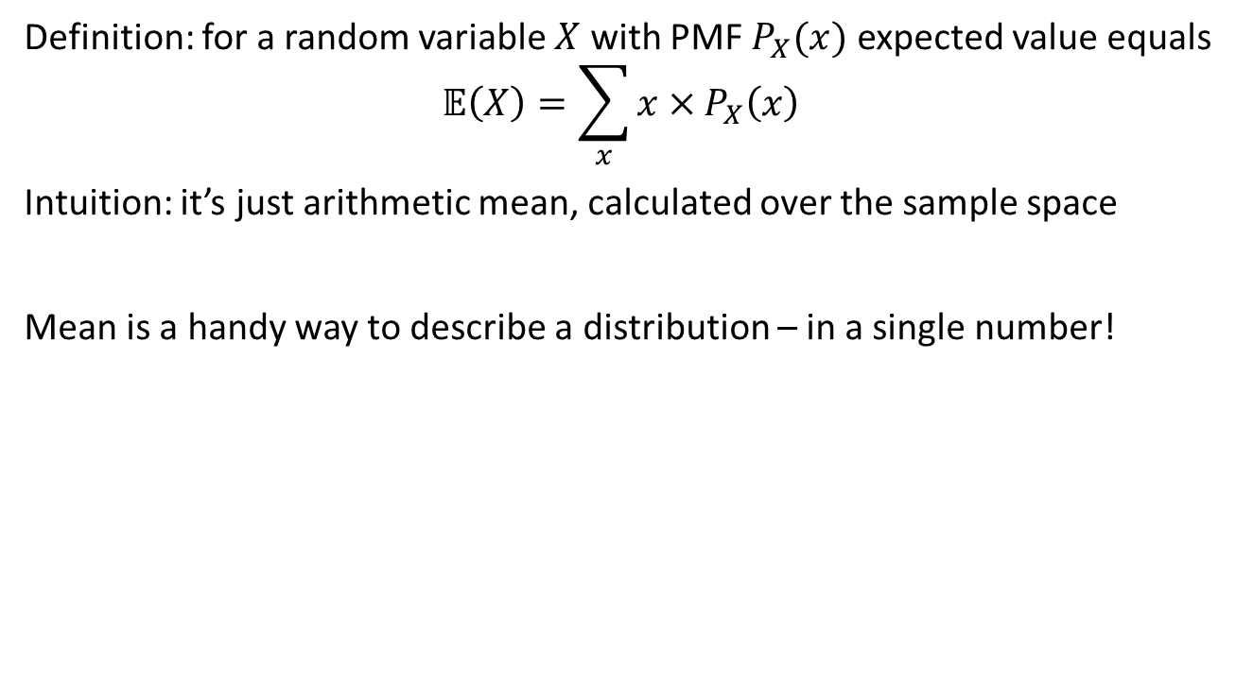
Expectation a.k.a. mean
Notes:
The expectation is intuitively what we call the average. However, it is not the average, because ti is defined using th edistribution itself.
For example, what is the average number of successes in 10 coin tosses? We would say 5, because we accumulate the number of successes, times the probability of getting that number.
Another way of calculating the mean would be trial and error. This works, because this is the definition of probability: The limit of an infinite number of repetitions.

Slide 5
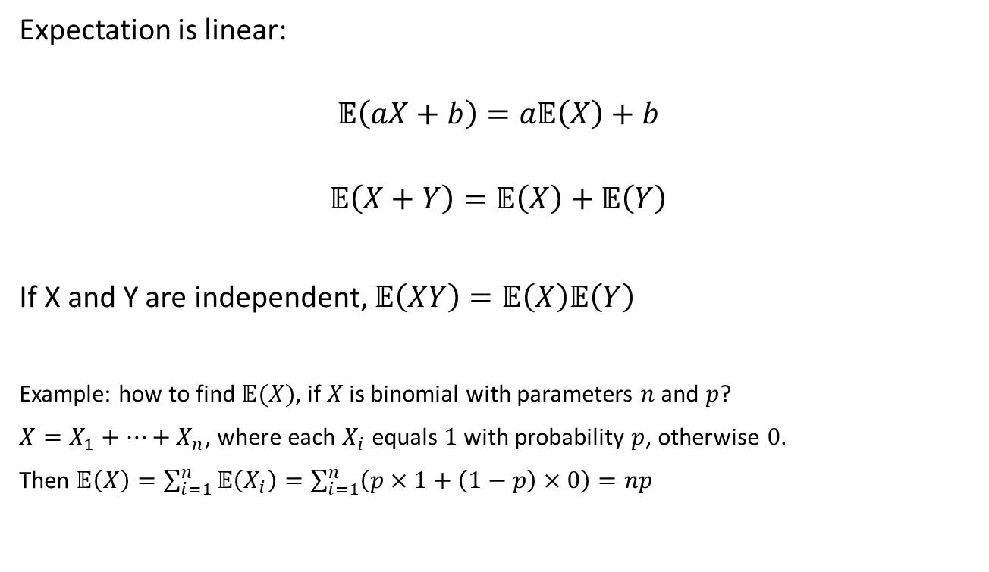
Properties of expectation
Notes:
If you add a constant to a random variable. If instead of counting the number of successes, we count the number of success times 2. The expectation would shift by two (which we see in the linearity of expectation).

Slide 6
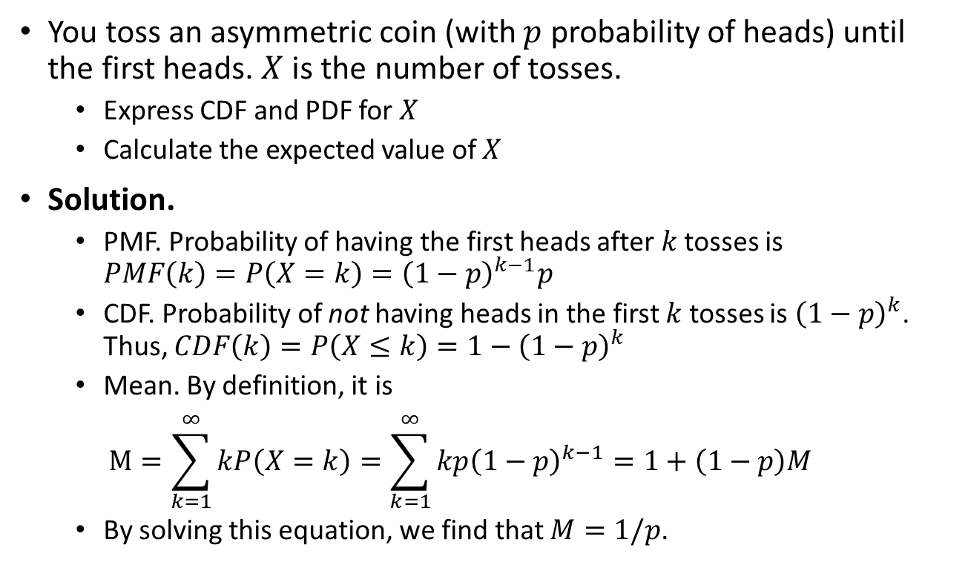
Example: Geometric trials
Notes:
The probability of doing k trials before getting the x success, = (1-p) ^(k-1) * P.
The expectation is the sum of kp(1-p) ^(k-1) = 1/p (after derivation).

Slide 7
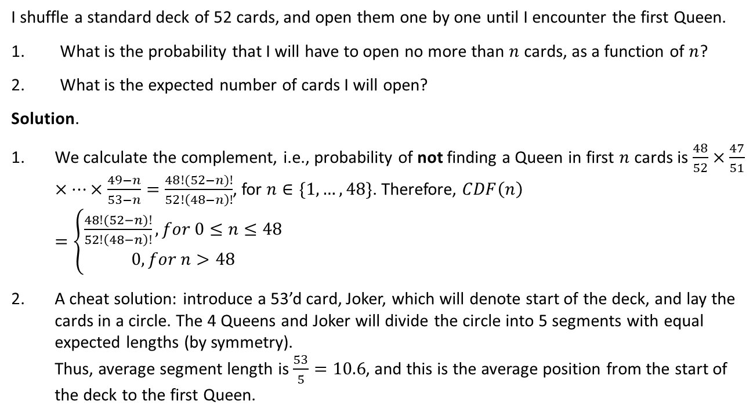
Example: Queens
Notes:
(Amend: CDF(n) should be PDF(n)
In this case, we don’t return the card.
The probability of drawing any card and not getting a queen is 48/52. The next draw, if we didn’t get a queen, then nect probability would be 47/51. We continue with this. Doing this until n draws gives us… (above). So the CDF = (above).
In the trick at the bottom for the expected number of cards we will open before the first queen, we have to add one more card to create a starting point of our circle.

Slide 8
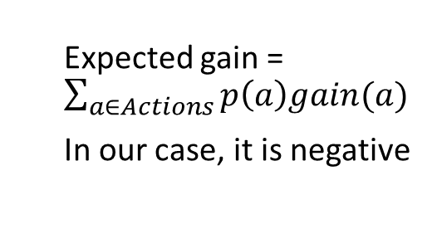
Example: stories recommender
A bank can show stories in the mobile app.
For any story, profit from showing it depends on the user reaction.
For a particular story, there are probabilities of various reactions, predicted by an ML model. Should we show it?
Action | Reward | Predicted probability
Dislike | -10 | 10%
Skip | -0.1 | 20%
View | +0.1 | 30%
Like | +0.5 | 40%
Notes:
Calculating the EV here, we get -0.79, which to the EV is not a good idea to show the ads.

Slide 9
Gambling
Which lottery is better?
Don’t gamble at all
Pay $1, win $200 with 1% probability
Pay $10, win $300 with 3% probability
Pay $2, win $100 with 5% probability
Pay $3, win $50 with 10% probability
Pay $4, win $50% with 10% or $10 with 10% probability
Expected gains are $0, $1, -$1, $3, $2 and $2

Slide 10
Why expectation is not enough?
Other things matter:
Funds are limited
Value of money can be non-linear
The more times you are going to play, the less these factors are important
The law of large numbers: as the number of games grows, the nearly-average outcome gets more and more likely (we’ll prove it)
Thus, if in every game you maximize expected gain, then most probably your total gain in the long run will be maximal

Slide 11
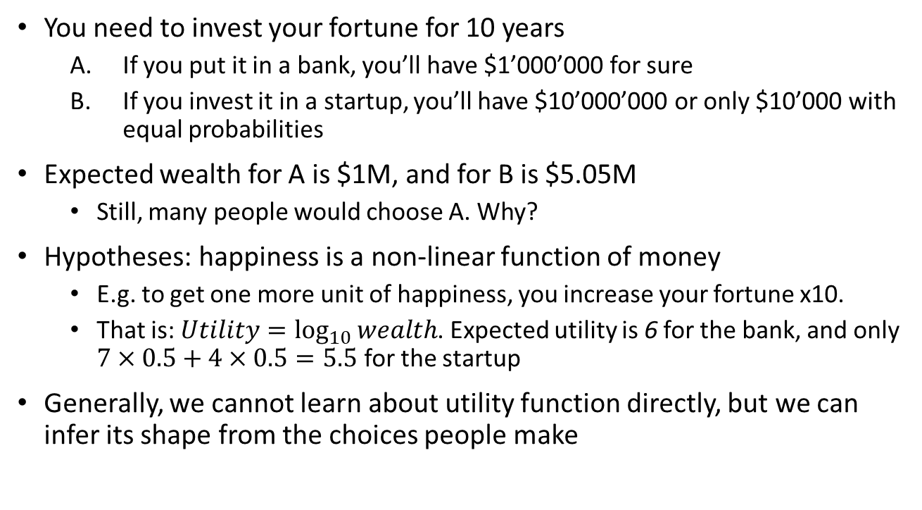
Expected utility

Slide 12
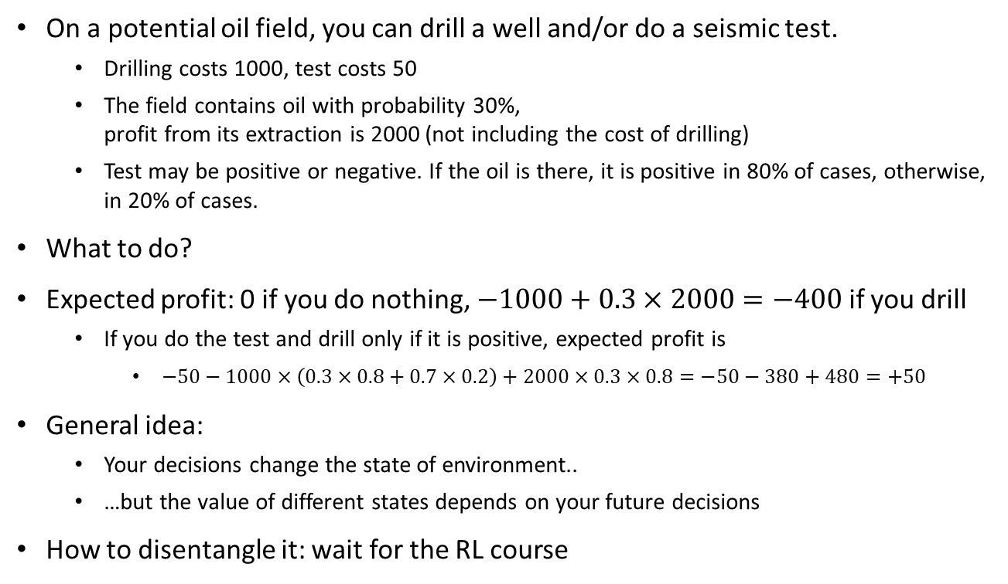
Sequential decisions
Notes:
We can see how calculating sequential decisions can be complicated…

Slide 13
Markov Chains

Slide 14
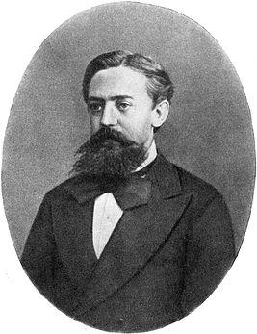
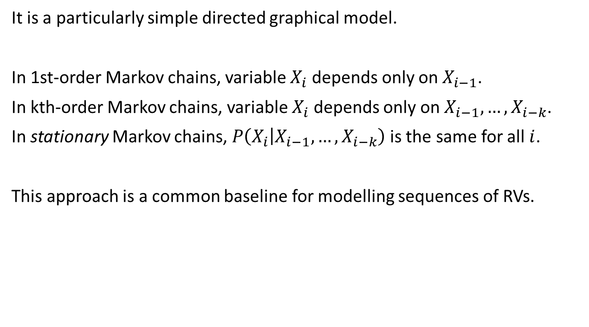





Markov chain
Notes:
The assumption here is that in order to calculate the prob of the second event, we must know what happened in the previous event. In the third event, we need to know only the probability of the second event.
X3 is conditionally independent of X1, given X2.
Example:
X3 is prob of dying, X2 is having cancer, X1 is a test for cancer.
Given that you know you don’t have cancer (x2), then the probability of dying is independent of the test.
In other words, in this case, X3 is conditioned on X1, but it isn’t conditioned on X1 given X2.

Slide 15
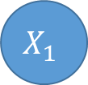
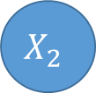
Diving deeper into Markov chains
 | I | A | D | X | C
I | 0.5 | 0.4 | 0.0 | 0.0 | 0.1
A | 0.2 | 0.7 | 0.1 | 0.0 | 0.0
D | 0.1 | 0.6 | 0.2 | 0.1 | 0.0
X | 0.0 | 0.0 | 0.0 | 1.0 | 0.0
C | 0.0 | 0.0 | 0.0 | 0.0 | 1.0
Stationary Markov chains can be represented with a table of transition probabilities.
Notes:
If we are on the initial case (lets say it is I), we have the prob of 0.5 to remain at I, but we also have a probability to move to both C and to A (I to C should have been 0.1).
The table is the probability of transitioning from the row to the column. (Moving from I to A equals 0.4).
So the sum of each row equals 1.
In this case, X and C are both equal to 1, so they are called absorbing states. So if this process runs long enough, we would end up in either X or C no matter what.

Slide 16
And deeper
0.4
0.2
I
A
0.5
0.7
0.1
0.6
 | I | A | D | X | C
I | 0.5 | 0.4 | 0.0 | 0.0 | 0.1
A | 0.2 | 0.7 | 0.1 | 0.0 | 0.0
D | 0.1 | 0.6 | 0.2 | 0.1 | 0.0
X | 0.0 | 0.0 | 0.0 | 1.0 | 0.0
C | 0.0 | 0.0 | 0.0 | 0.0 | 1.0
0.1
0.2
0.1
C
D
X
1.0
0.2
1.0
Stationary Markov chains can be represented with a table of transition probabilities.
Or with a transition graph.

Slide 17
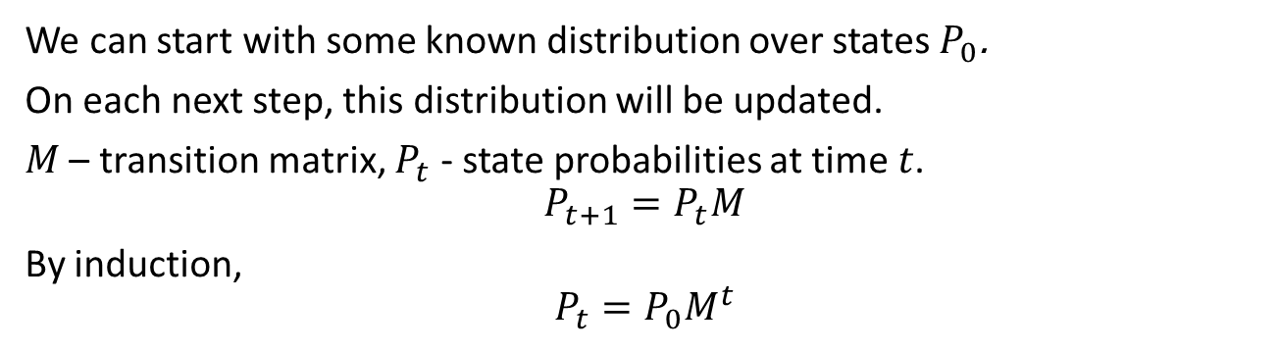
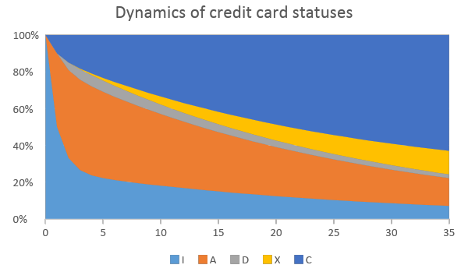
And deeper
Notes:
In our case, the initial distribution is the initial position (I). This isn’t always the case though , as we can have any initial position.
After we apply t
his transition state ones, and we keep applying it, and we end up converging towards the distribution.

Slide 18
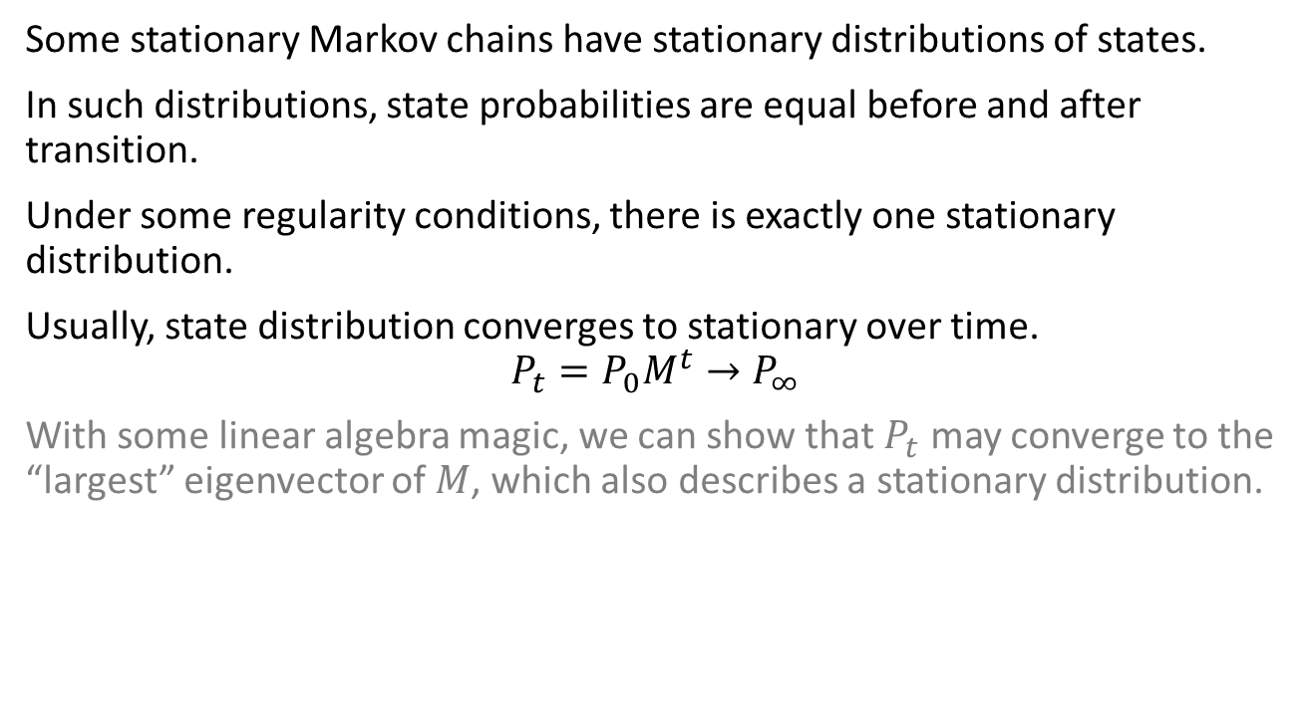
And even deeper
Notes:
To take the exponential of the matrix, sometimes its easier to…

Slide 19
Example: Weather
The weather in London can be summarized as:
if it rains one day there's a 70% chance it will rain the following day;
if it's sunny one day there's a 40% chance it will be sunny the following day.
What fraction of days on average will be rainy?
Using this answer as the prior probability that it rained yesterday, what is the probability that it was raining yesterday given that it's sunny today?
Notes:
We have two states: Sunny and Rainy. Our transition matrix is:
R-R = 0.7
R-S = 0.3
S-S = 0.4
S-R = 0.6
We can already see that regardless of our initial distribution (initial position), we can already tell that rainy is the converging position. However, we can calculate anyways (next slide)

Slide 20
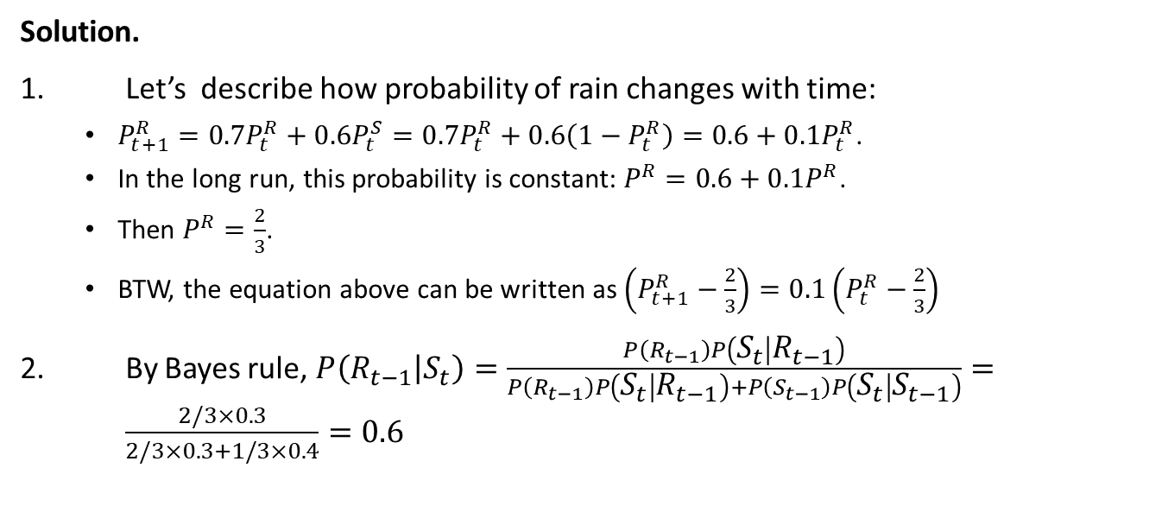
Example: Weather
Notes:
P^r – 0.1P^r = 0.6 = 2/3

Slide 21
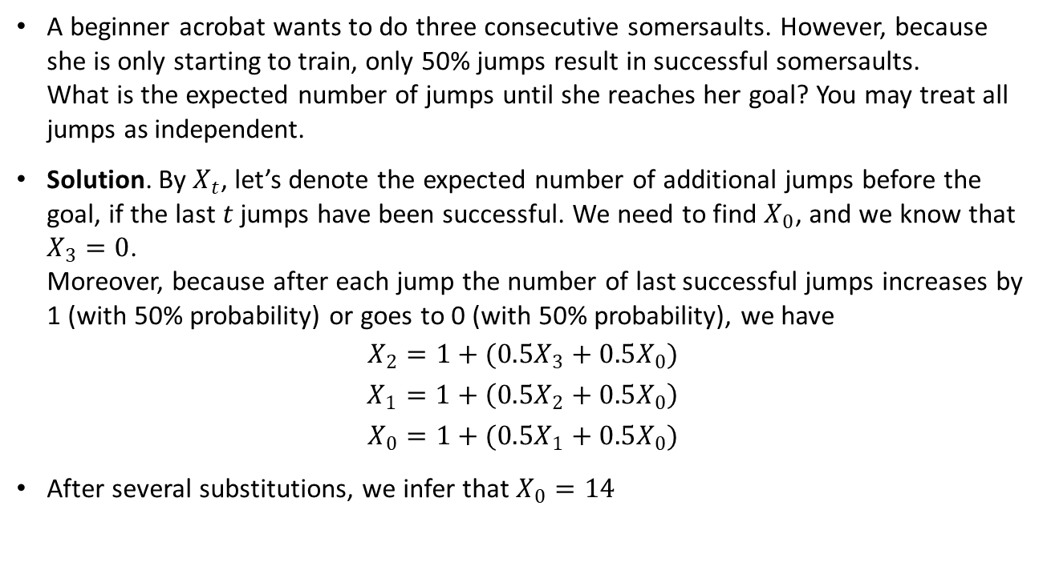
Example: Jumping

Slide 22
Example: Jumping
A beginner acrobat wants to do three consecutive somersaults. However, because she is only starting to train, only 50% jumps result in successful somersaults. What is the expected number of jumps until she reaches her goal? You may treat all jumps as independent.

Slide 23
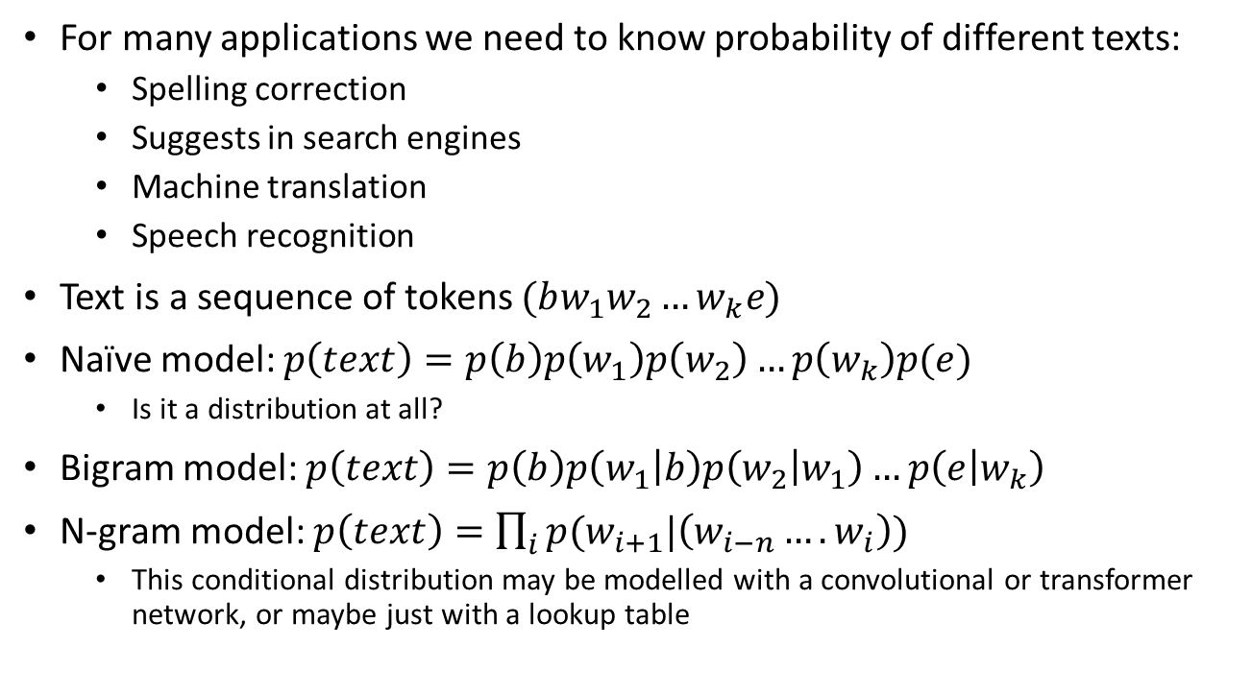
Language models

Slide 24
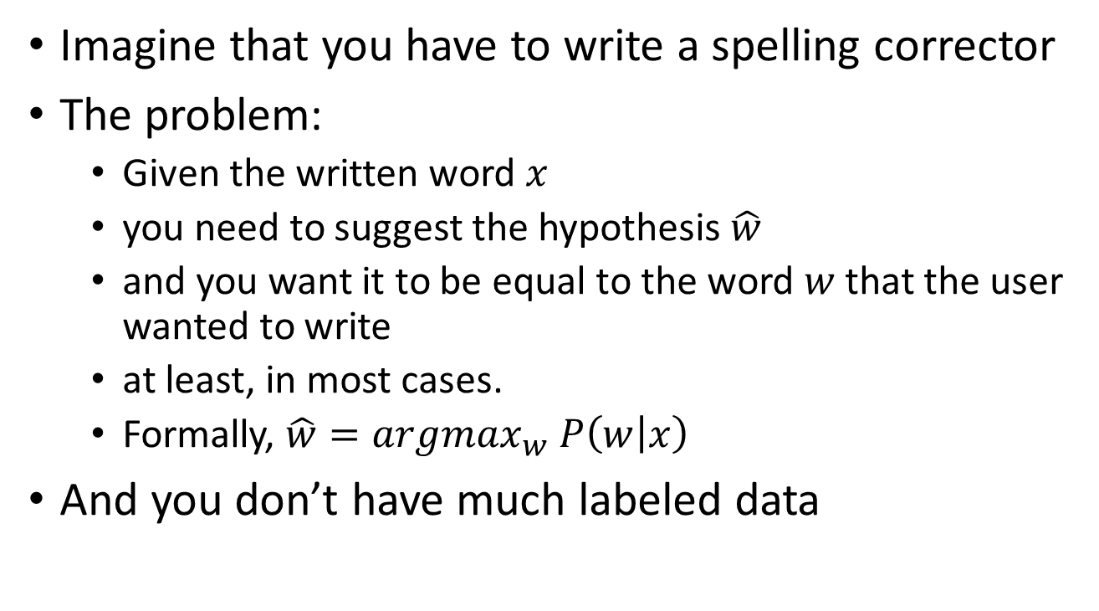
Spelling correction problem

Slide 25
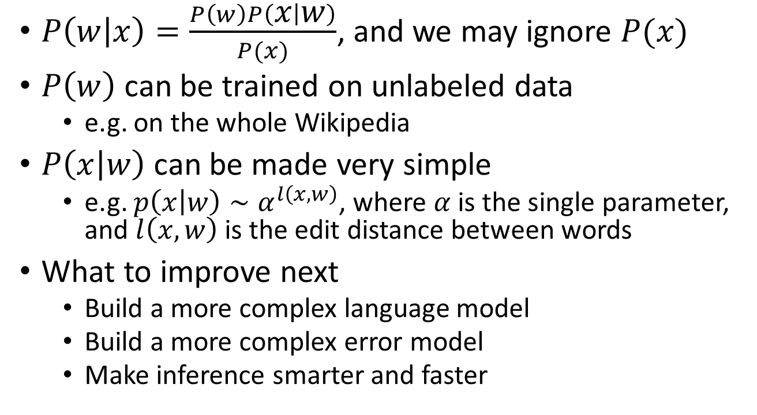
Noisy channel model

Slide 26
Continuous probability

Slide 27
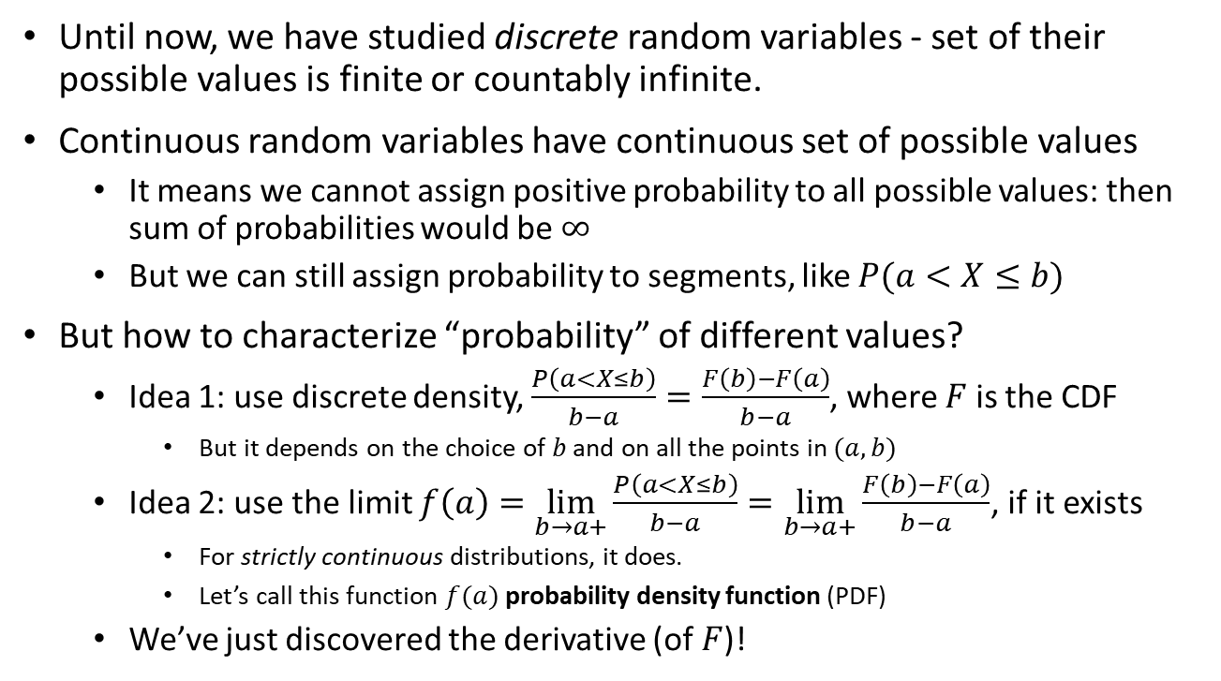
Continuous density

Slide 28
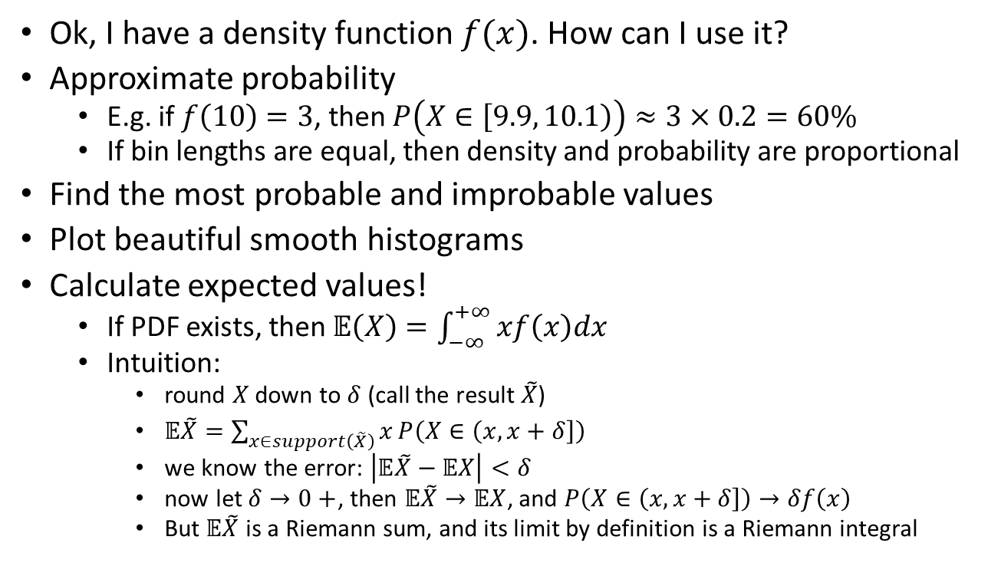
How to apply density

Slide 29
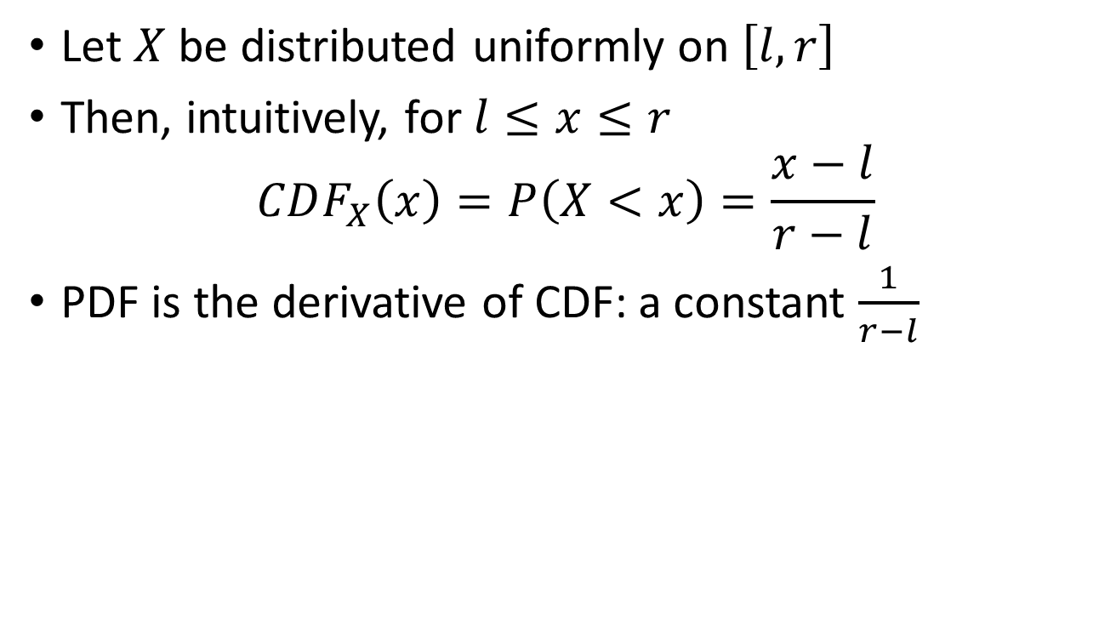
Example: continuous uniform

Slide 30
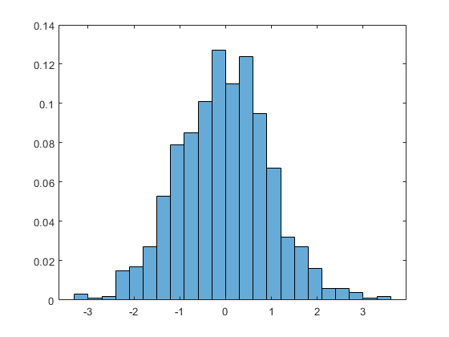
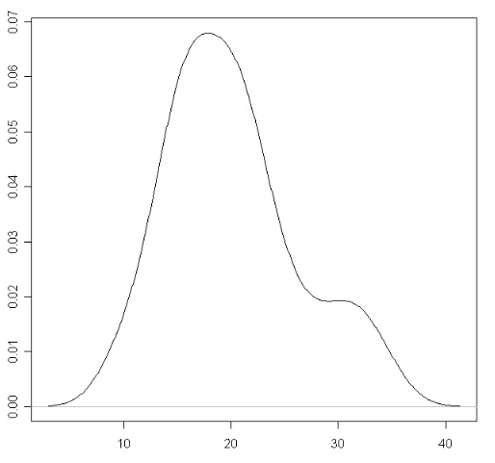
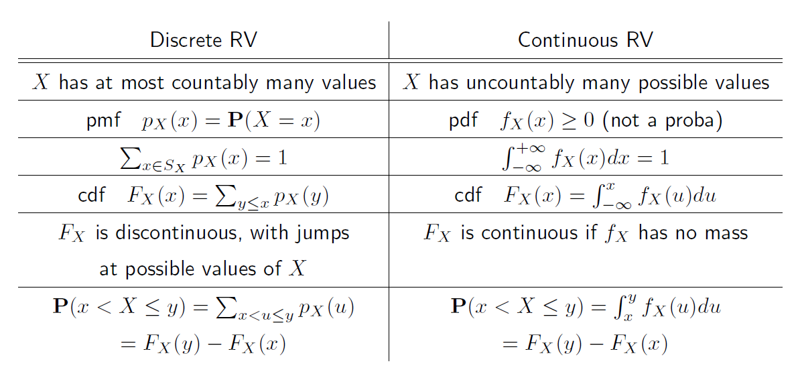
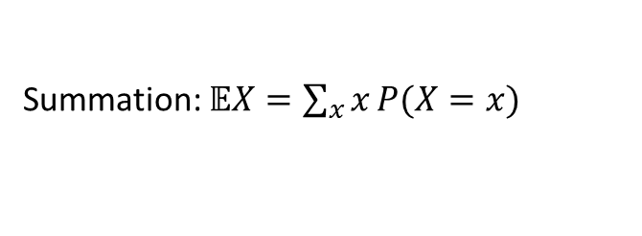
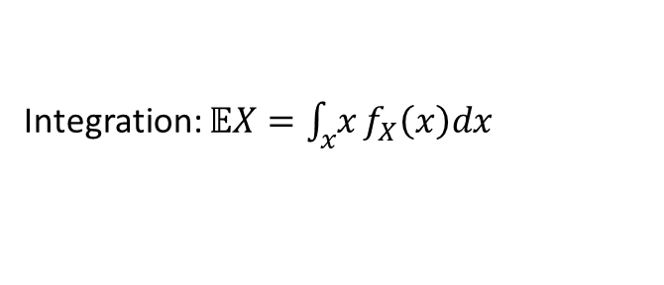
Discrete vs continuous
Finite or countable number of outcomes
Uncountable number of outcomes
PMF (tabular form or formula)
PDF (only formula)

Slide 31
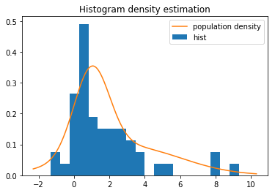
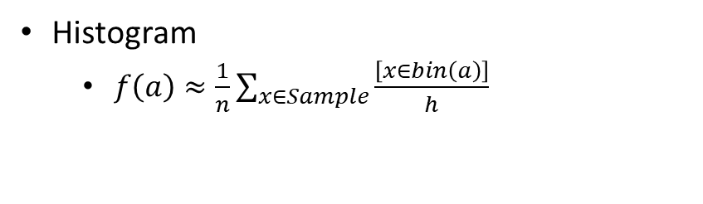
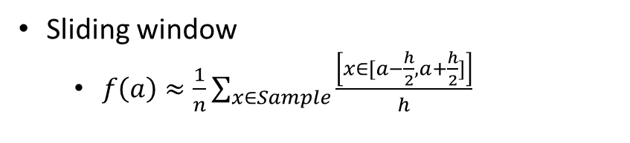
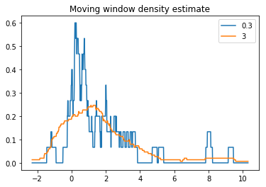
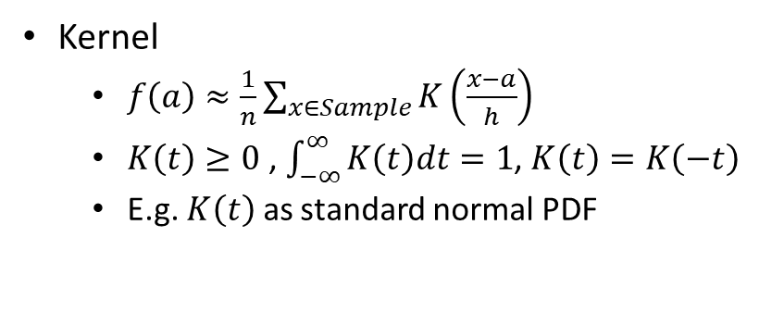
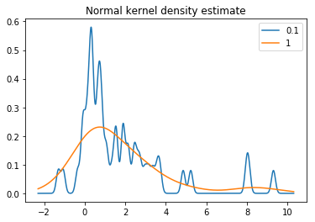
Estimation of density
Or just fit a parametric distribution

Slide 32
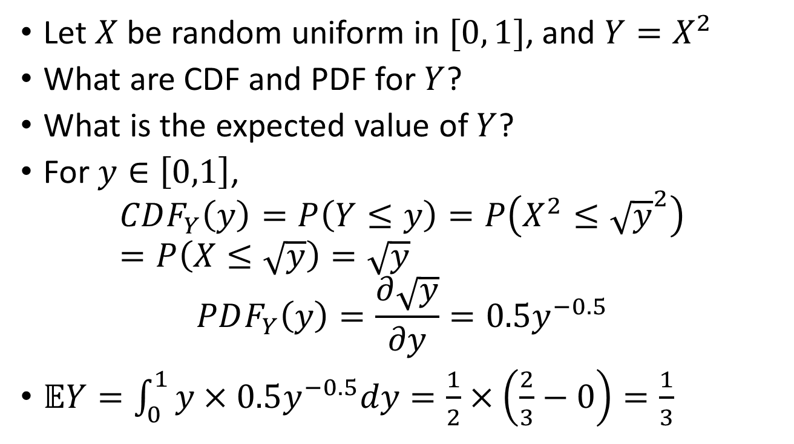
Example: transforming CDFs

Slide 33
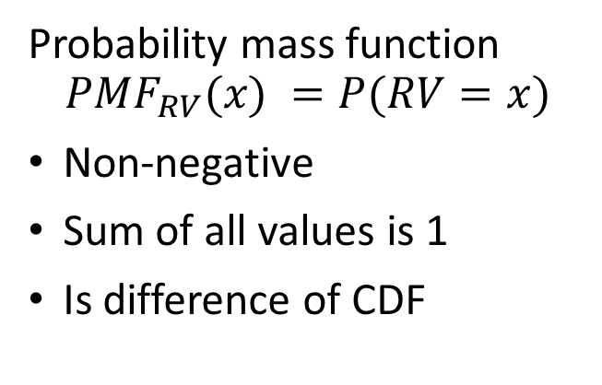
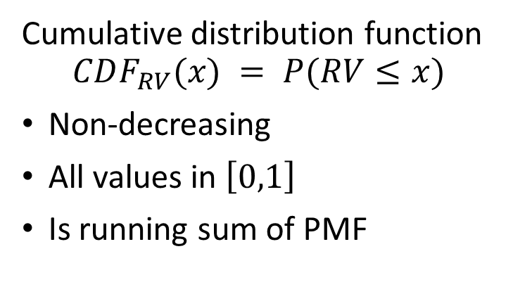
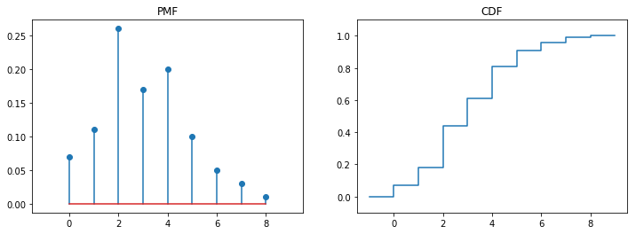
Recap: PMF and CDF

Slide 34
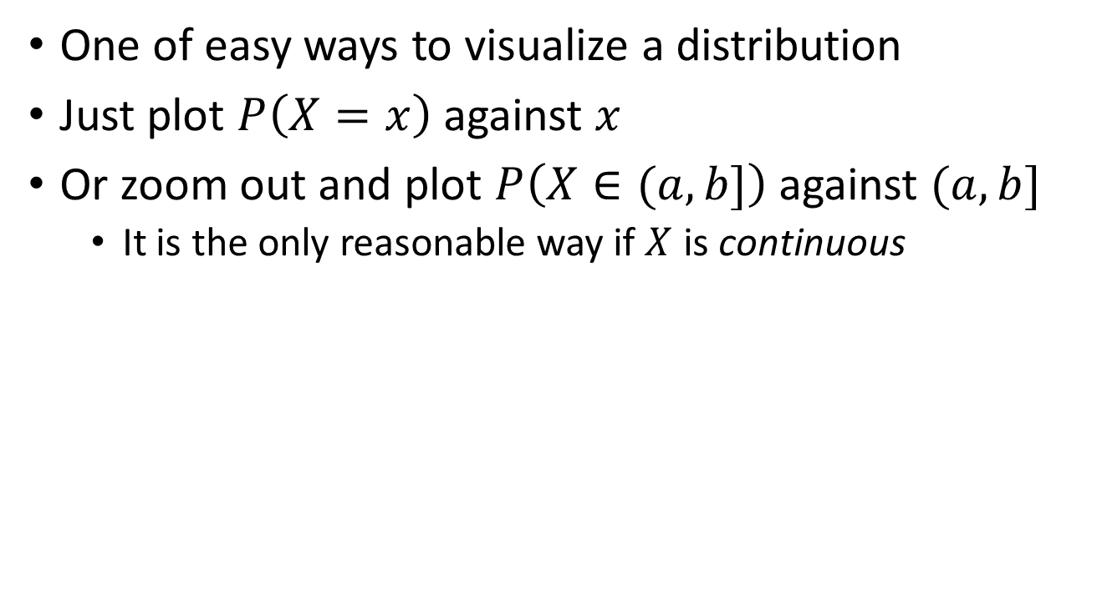
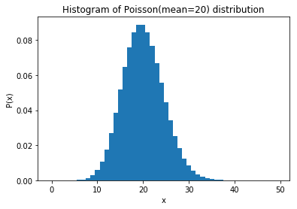
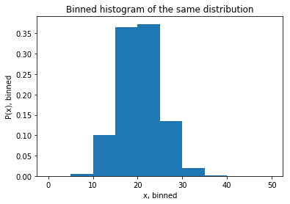
Histograms

Slide 35
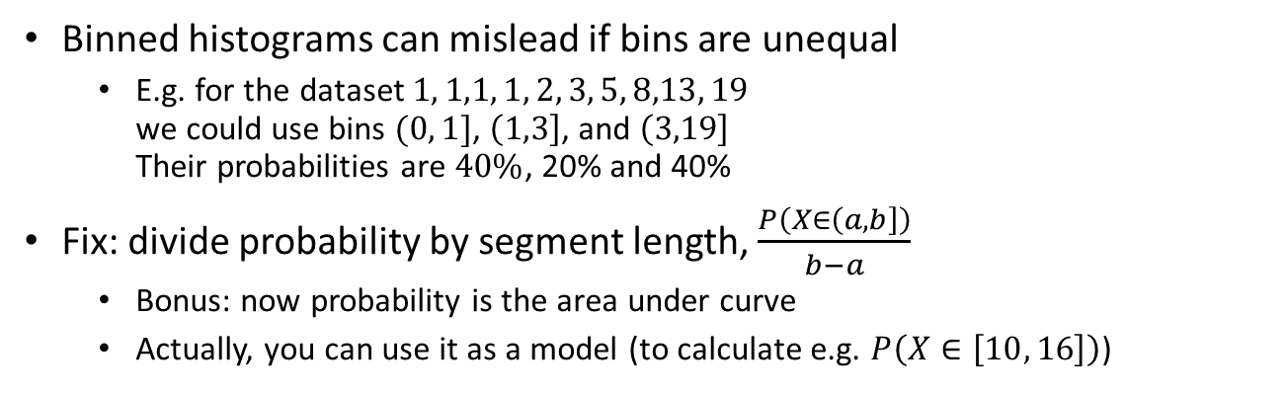
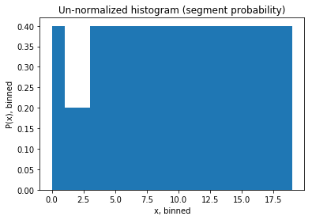
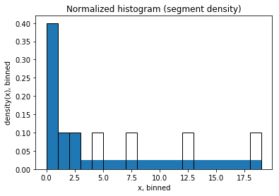
The idea of density

Slide 36
Moments of Distribution

Slide 37
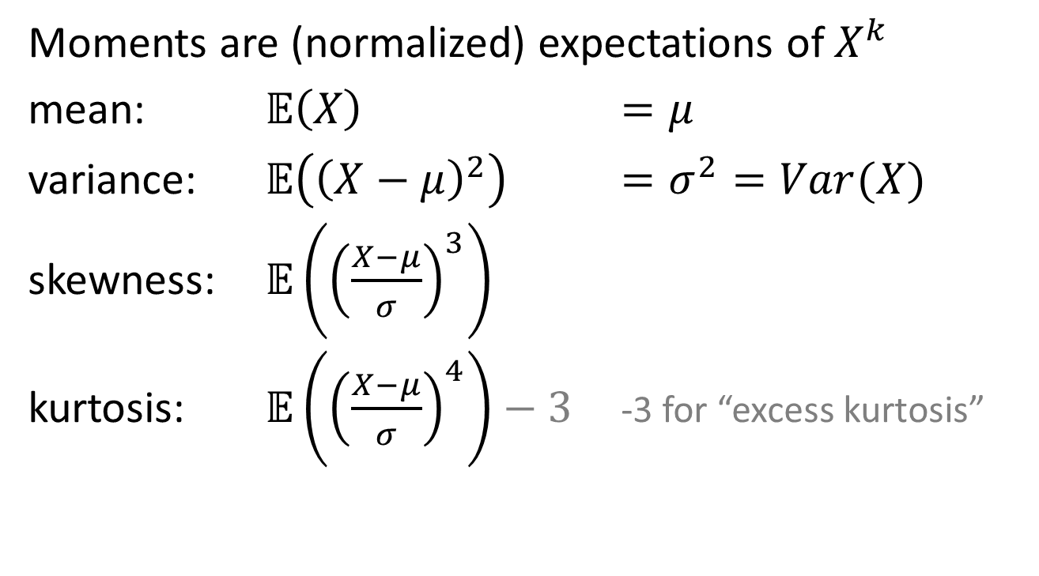
Moments

Slide 38
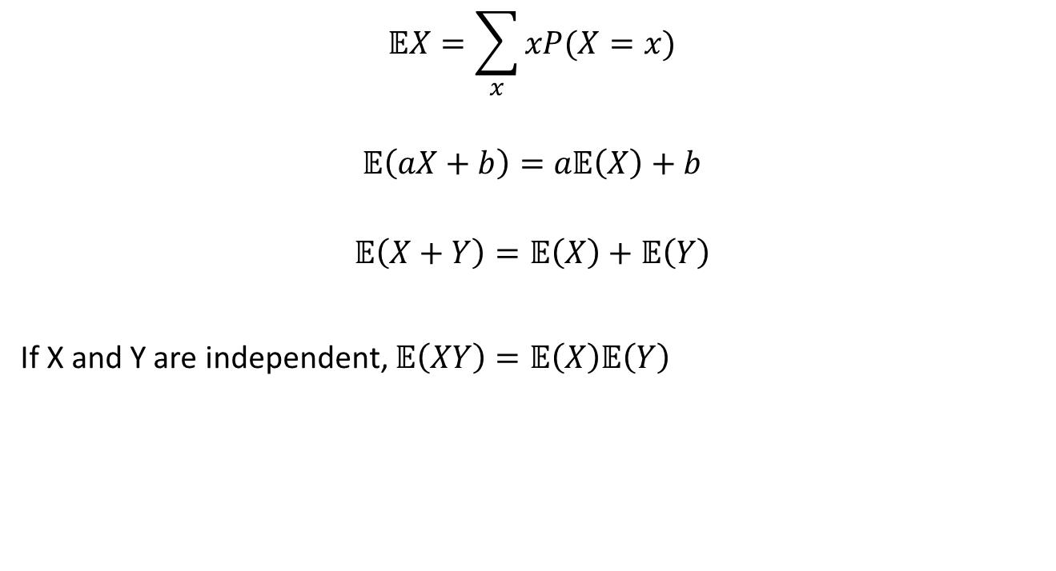
Properties of expectation

Slide 39
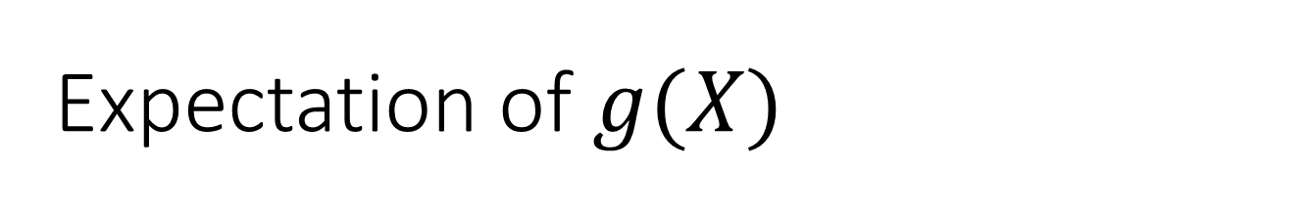
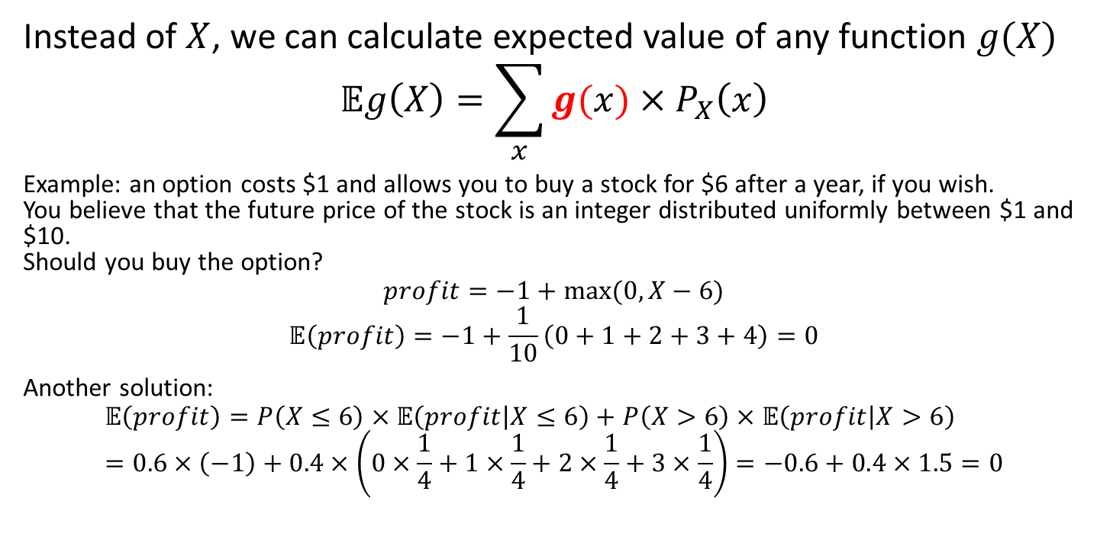

Slide 40
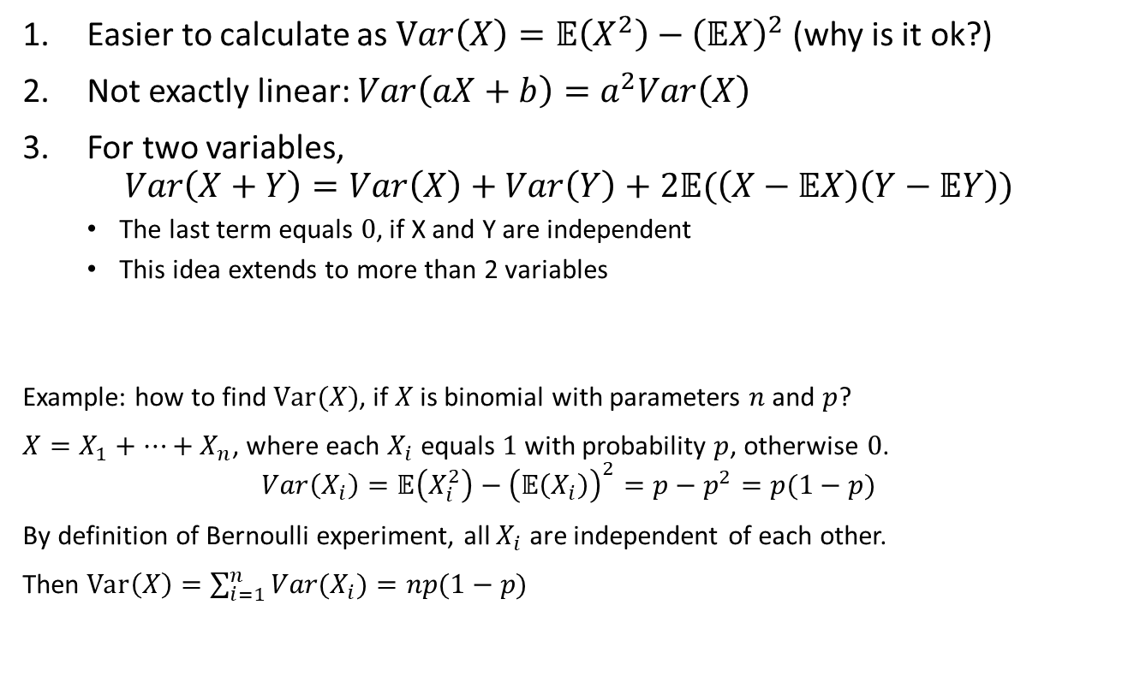
Properties of variance

Slide 41
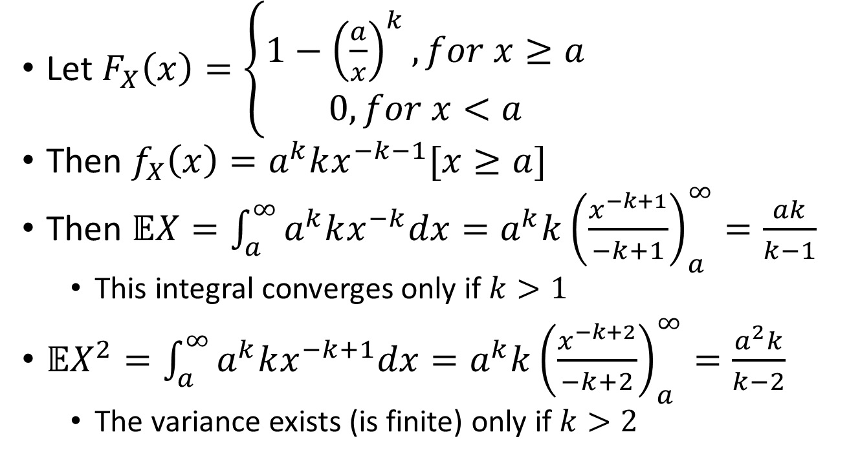
Example: Pareto moments

Slide 42
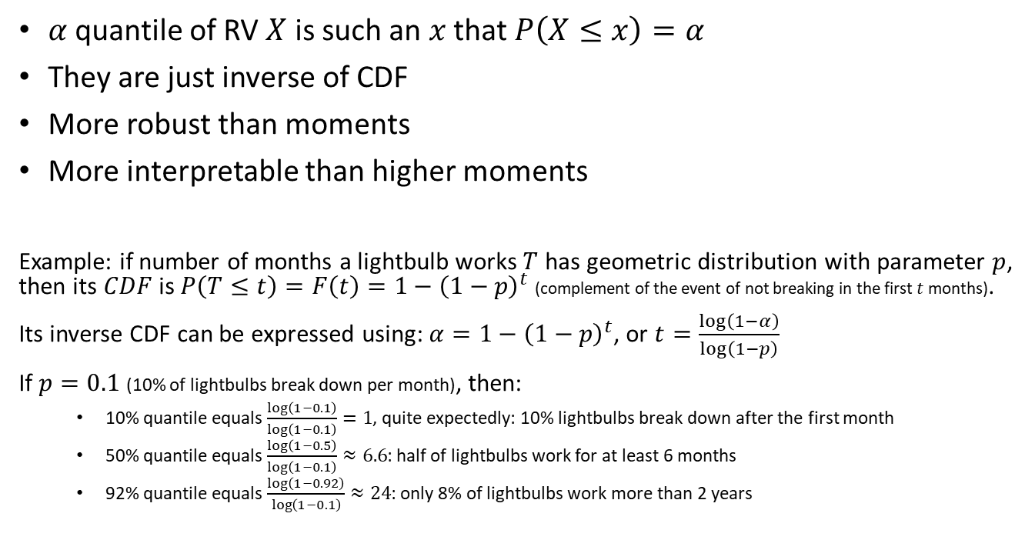
Quantiles

Slide 43
A few more distributions

Slide 44
RVs based on Bernoulli process
Variable | Distribution | PMF
Number of successes in the first n trials | Binomial
Number of failures before the first success | Geometric
Number of failures before the r-th success | Negative binomial
 | Poisson

Slide 45
















How distributions arise
Each distribution corresponds to some random process
Lognormal
Uniform
Exponential (=Geometric)
Normal (=Binomial)
Pareto (power law)

Slide 46


Poisson vs Exponential

Slide 47
















On normal distribution
Probability density
Value of X
This looks terrible, but it’s just a limiting case of binomial distribution (sum of many independent coin tosses).

Slide 48

How to calculate with normal distribution

Slide 49
How to create new distributions
Decompose your variable into simpler variables and/or events
Apply the rules of probability (addition, multiplication, etc.) to express the CDF of your variable
From CDF you can derive PDF and then moments

Slide 50

Example: exponential lightbulbs

Slide 51

Conditional distributions

Slide 52



Mixtures

Slide 53
Plotting distributions

Slide 54

What can we plot
Histogram (binned / smoothed)
Logarithmic scale sometimes helps

Slide 55

What can we plot
CDF, or 1-CDF

Slide 56

What can we plot
Boxplot, or violin plot

Slide 57

What can we plot
Quantiles of theoretical distribution against the same quantiles of the sample

Slide 58

More methods
https://www.darkhorseanalytics.com/blog/visualizing-distributions-3

Slide 59

More methods
https://www.darkhorseanalytics.com/blog/visualizing-distributions-3

Slide 60
LLN & CLT – convergence

Slide 61

Sample mean vs expectation
We know that sample mean is “usually close” to the expected value in the population. What does it exactly mean? Experiment: increase sample size, track the sample mean

Slide 62

The law of large numbers

Slide 63

Proof of the LLN

Slide 64


The Central limit theorem

Slide 65

CLT, more examples

Slide 66

How can I use this all?

Slide 67

MGF and a draft proof of the CLT

Slide 68

Definitions of convergence

Slide 69
Why is normal distribution so common?
Linear transformation of a normal RV is normal
Sum of jointly normal RV’s is exactly normal
Sum of many independent same-variance RV’s is nearly normal
Any transformation of RV, that discards information but preserves variance, makes distribution “more normal”
Because normal distribution has the maximal entropy

Slide 70

Entropy

Slide 71
Principle of maximal entropy
If we tried to “generate” distributions by randomly allocating “quanta” of probability between values, then the distribution with highest entropy would be the most probable
If entropy-increasing transformations are at work out there in the world, then long-term distributions must have maximal entropy
If you know nothing, don’t make informative assumptions
If you are not sure, choose the distribution with the highest entropy for your model!

Slide 72
High-entropy distributions
Assumptions | Maximum entropy distribution
 | discrete univariate
 | univariate
 | geometric
 | exponential
 | normal
 | Pareto

Slide 73
References
Introduction to Probability by M. Grinstead and J. Snell. Explain most topics on Probability in a gentle way.
Probability by A.N. Shiryaev. An old and very comprehensive book that covers most of the theory of our course.
Probability theory: the language of science by E.T. Jaynes. A fundamental explanation of the Bayesian approach to probability theory.
Bayesian Reasoning and Machine Learning by D. Barber. Focused mostly on graphical models, but covers lots of different topics in Probability and ML
Off-topic:
Thinking, fast and slow by D. Kahneman. It is a book on psychology, but it shows many interesting examples of how people perceive probability.
Speech and Language Processing by D. Jurafsky. NLP is a discipline on its own, but chapters 4 and 5.6 describe n-gram (Markov) language models and the Noisy channel for spelling well.

