Slide 1
Probability
Probability and Statistics for Data Science
Part 2

Slide 2
What have we learned last time
Sequential dependency
Markov chains
Continuous random variables
CDF, PDF and PMF
Properties of the Expectation
Transformations of PDF
Notes:
We began to study about continuos variables. WE need to define a new type of function which was an analog for the mass function. In the continuous domain, its hard to do this, and we must find the pdf. We do so by taking the integral of the cdf.
Sequential dependency: X1 and X2 are not independent. However, given X2, we don’t need X1. It is a conditional independence, but not a full independence.

Slide 3
Moments of Distribution

Slide 4
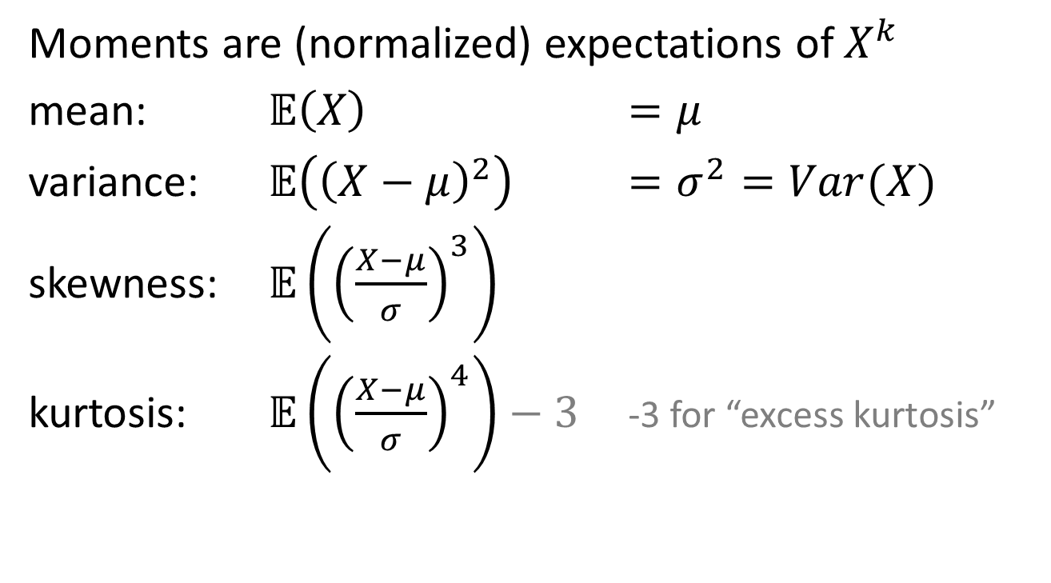
Moments
Notes:
Any distribution has moments, which we can formally define.
A moment is the expectation of X to the k. Different types of moments are the following:
The intuitive meaning of the expectation is the point where everything is centered around. Instead of the CDF to describe a function, choosing the expectation seems reasonable.
The variance is the deviation from the mean. The variance is not a moment, but rather a centralized moment. We use the variance to show how spread out the values are.
Skewness is how tilted the distribution is (is it tending to the left or the right.)
Kurtosis is how much excessive spread which is above the normal. The motivation for this is to get a feeling for distribution. Higher kurtosis shows that it is more spread in the sense of the rare events (in the tails).
We subtract 3, because we want to see how much spread over normal we are (?)

Slide 5
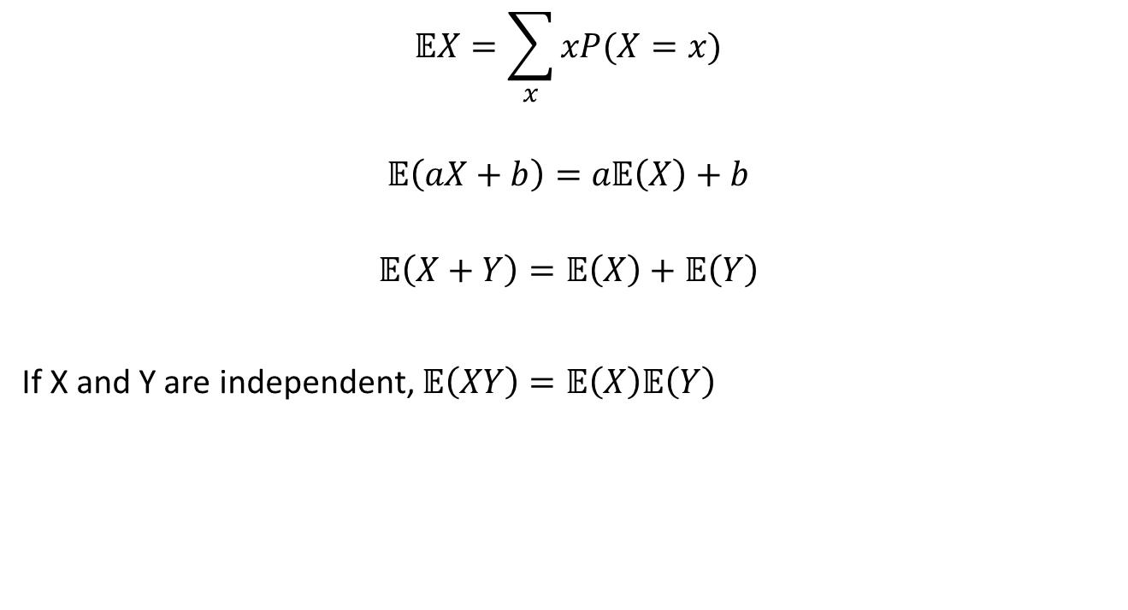
Properties of expectation
Notes:
We have seen the linearity of the properties of expectation. For independent variables, it is multiplicative (we can derive these properties using integration).

Slide 6
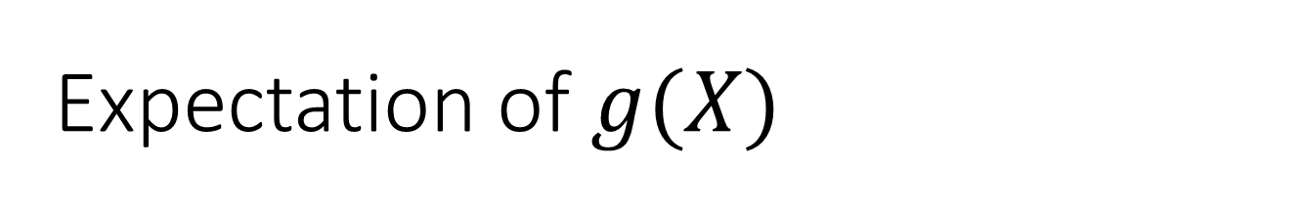
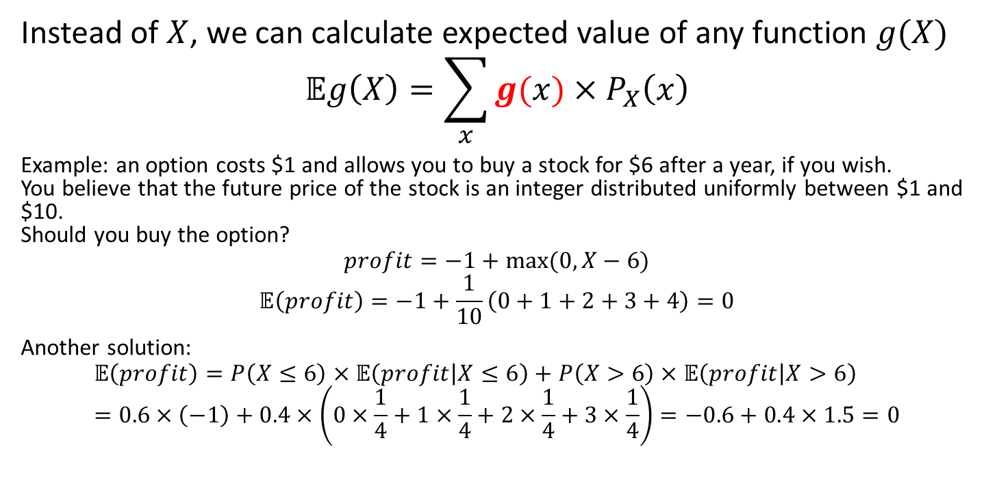
Notes:
Using the properties of expectation, we can look at the expectation of a function
A function says, that given a random variable x, who’s PDF is P(x), calculate the expectation of a function of it. The distribution of x does not change, but the function of x can change.
For example…

Slide 7
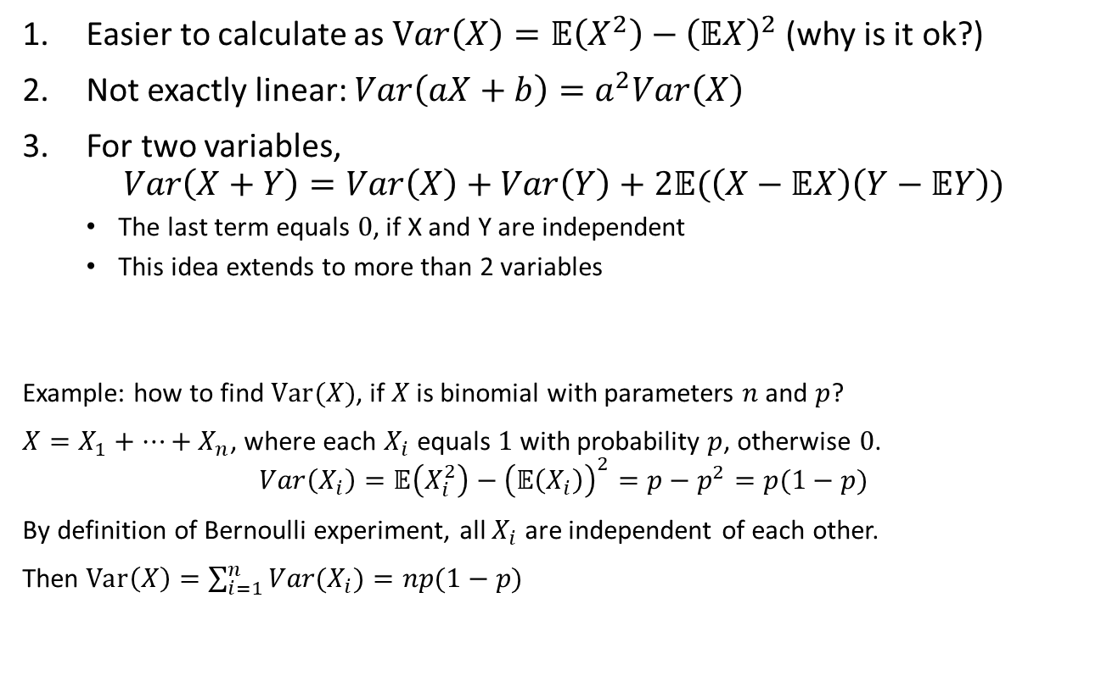
Properties of variance
Notes:
We can calculate Var(x) as such because of the linearity of expectation.
Variance isn’t completely linear–
3) For two variables: The last term, when independent is equal to 0. However, if they are dependent on each other, this is the covariance.

Slide 8
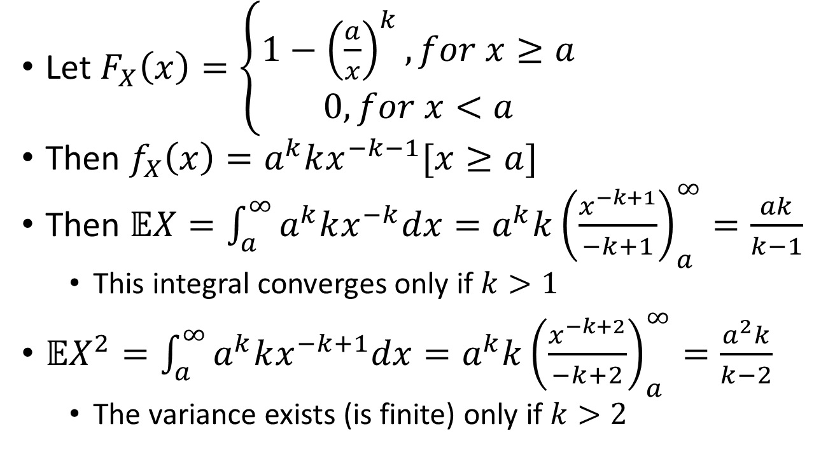
Example: Pareto moments
Notes:
Pareto has a quick drop in the beginning, and then drops very slowly afterwards. The PDF (fx(x)) would be the derivative of the CDF (Fx(x)).
The expectation…
Suppose k = 2, then we have an expectation as it is well defined. If k = 1 though, then the denominator is 0 and undefined- the expectation would be infinite.
We have a similar idea by the variance, just only when the variance is grater than 2.

Slide 9
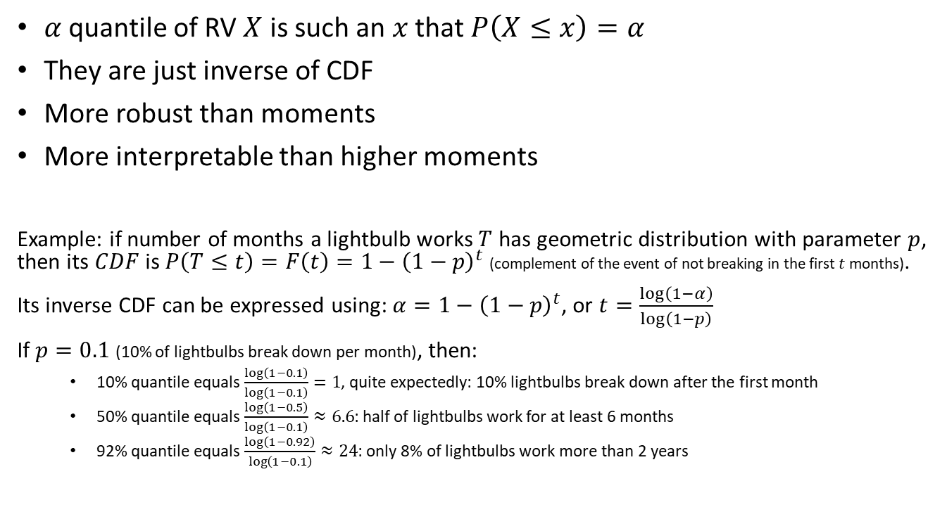
Quantiles
Notes:
Instead of working on moments which are functions, another way we can describe distribution is by their quantiles. A quantile is a way of saying, how much of a distribution is below this number. In other words, it’s sort of a discrete way to define the cdf.
Percentiles are simple and robust. For finite samples, for example, it might be hard to say if its normal, pareto, exponential, etc. When we use quantiles though, its easy to describe: What is the prob that one would be below some value, then I would look at the quantiles which are near these values, and I can… Meaning, I can control the level of details I want to give. With a small sample, my details are not that defined, so I must interpolate.
The question one might ask is what’s the probability that a lightbulb will last for x months.
The inverse question is: suppose I am the manufacturer, and I want to give you a probabilistic guarantee that the lightbulbs will last for five months with a probability x (meaning, we want to solve for t where the distribution is below a) then I want to know the quantile of X of my distribution. Therefore we inverse the problem, and solve for t in terms of alpha (which is x).

Slide 10
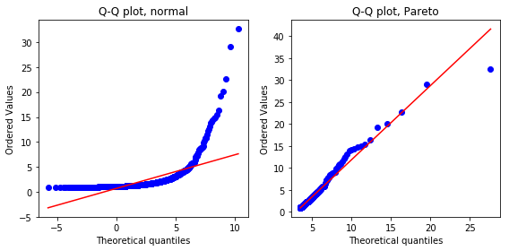
What can we plot
Quantiles of theoretical distribution against the same quantiles of the sample
Notes:
A q-q plot can be between two empirical distributions, or one empirical and one theoretical.
Suppose I want to say my data is normal (theoretical), with mu and sima x and b. We can then commit what the quantiles are, and then we can go to the data and plot what the quantiles are for each point in the data. The red line is the theoretical belief in the distribution, and I can check how it matches with the quantiles. If it matches well, then I can say that it more or less fits my theoretical assumptions.
Meaning, a q-q plot is a way to visualize my assumptions.

Slide 11
A few more distributions

Slide 12
RVs based on Bernoulli process
Variable | Distribution | PMF
Number of successes in the first n trials | Binomial
Number of failures before the first success | Geometric
Number of failures before the r-th success | Negative binomial
 | Poisson
Notes:
In poisson, we assume there are an infinite number of trials. However, the probability is a fixed P*n– the rate (lambda) of success is constant.
So given that we have some sort of rate of success, how many events would happen in a unit of time. The Bernoulli process which corresponds to this is the limit when n goes to infinity, but instead of having a constant probability, we take the probability to be lambda/n.

Slide 13
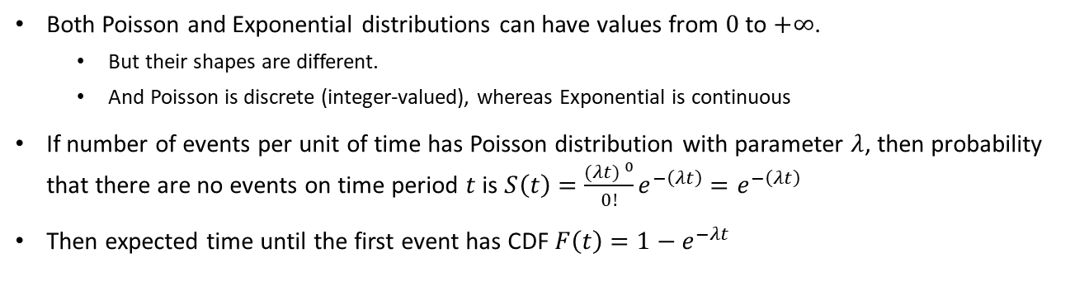
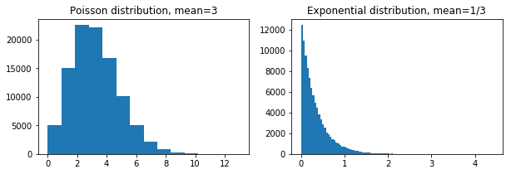
Poisson vs Exponential
Notes:
So poisson is kind of a descrete random variable, arises from the continuous limit over a Bernoulli process.

Slide 14
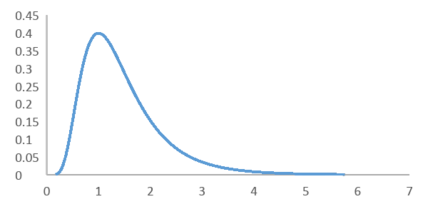
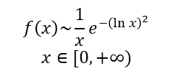


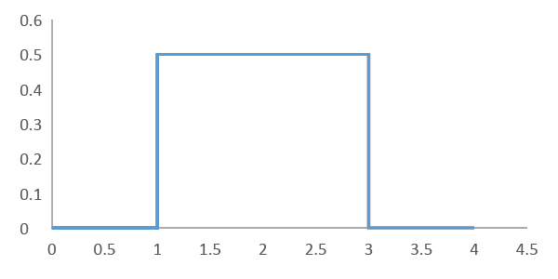
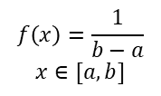
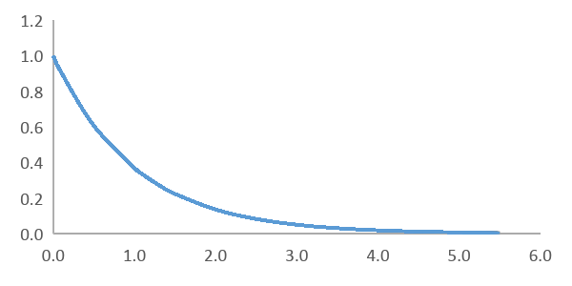



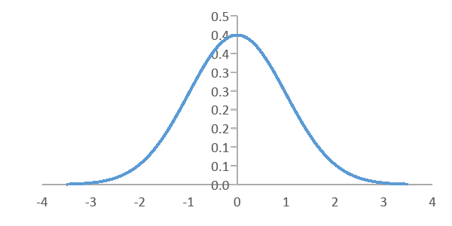

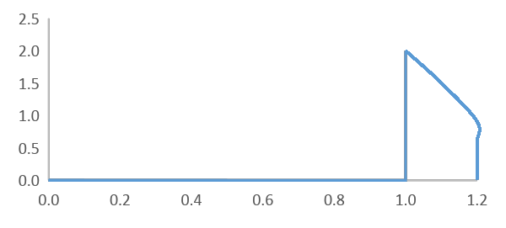
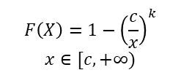


How distributions arise
Each distribution corresponds to some random process
Lognormal
Uniform
Exponential (=Geometric)
Normal (=Binomial)
Pareto (power law)
Notes:
Uniform is very common. It is the same as the discrete uniform, just without having specific discrete values.
The normal distribution arises from a sum of many independent variables, and is therefore the reason why it is so common. E.g., if we do some lab tests many many times, we would sum up to a normal distribution.
The lognormal distribution is used whenever you think the log of your random variable is x + noise (used heavily in finance). Meaning, in finance we assume everythong is multiplicative scale.
An exponential distribution is the continuos version of the geometric distribution. Geometric was given a probability of success, how many times should I try before x success. This is discrete. However, if we want to ask about the rate of success, we get an exponential case.

Slide 15
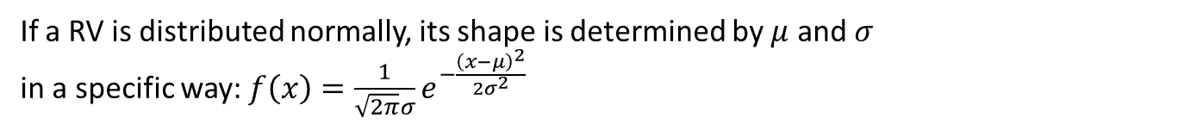

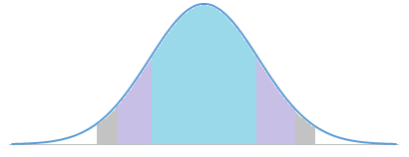












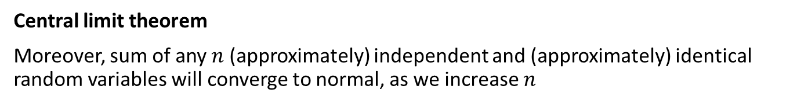
On normal distribution
Probability density
Value of X
This looks terrible, but it’s just a limiting case of binomial distribution (sum of many independent coin tosses).
Notes:
Normal distribution is used extensively in statistics. For example, you give one group a drug and not the other, and we see some impact. We want to test whether this happened by chance or not. If the probability is outside 2sigma, then we…

Slide 16
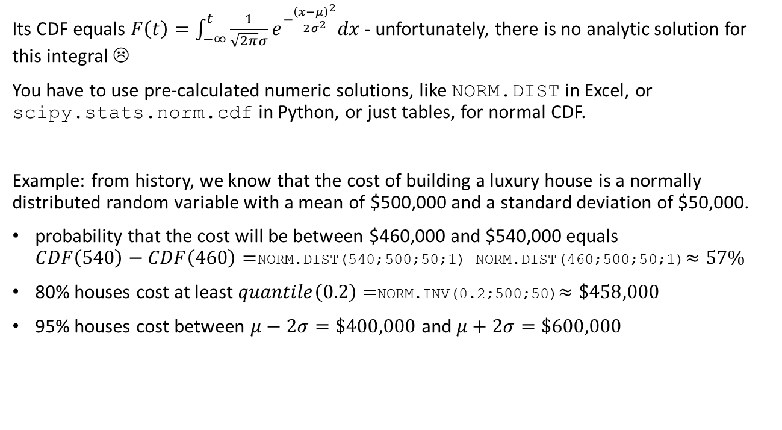
How to calculate with normal distribution

Slide 17
How to create new distributions
Decompose your variable into simpler variables and/or events
Apply the rules of probability (addition, multiplication, etc.) to express the CDF of your variable
From CDF you can derive PDF and then moments

Slide 18
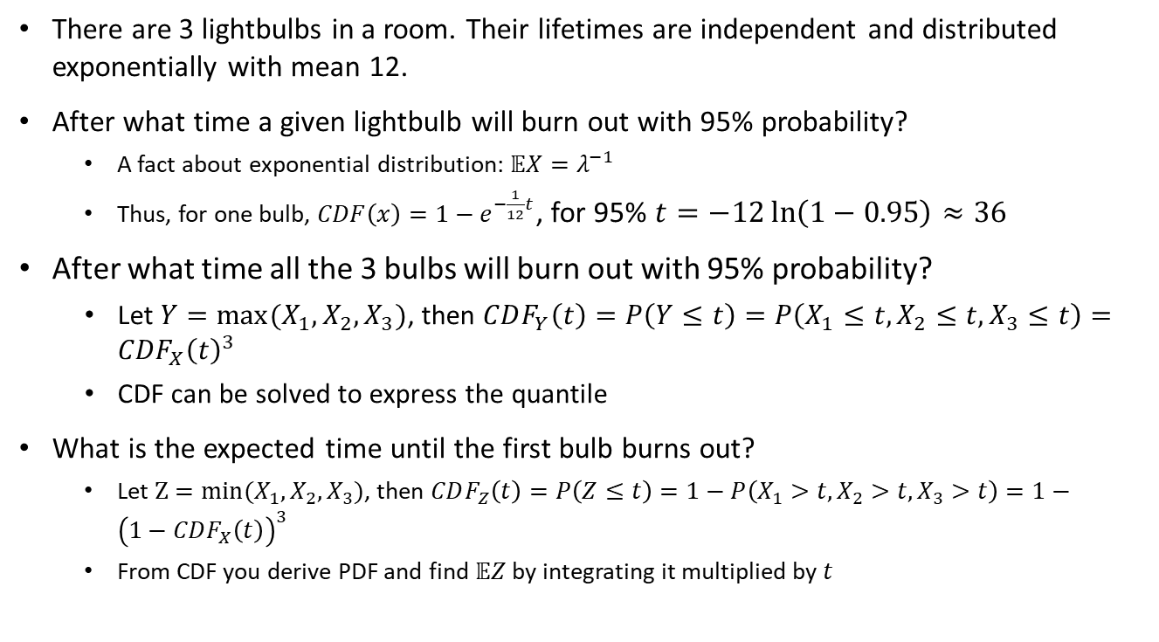
Example: exponential lightbulbs

Slide 19
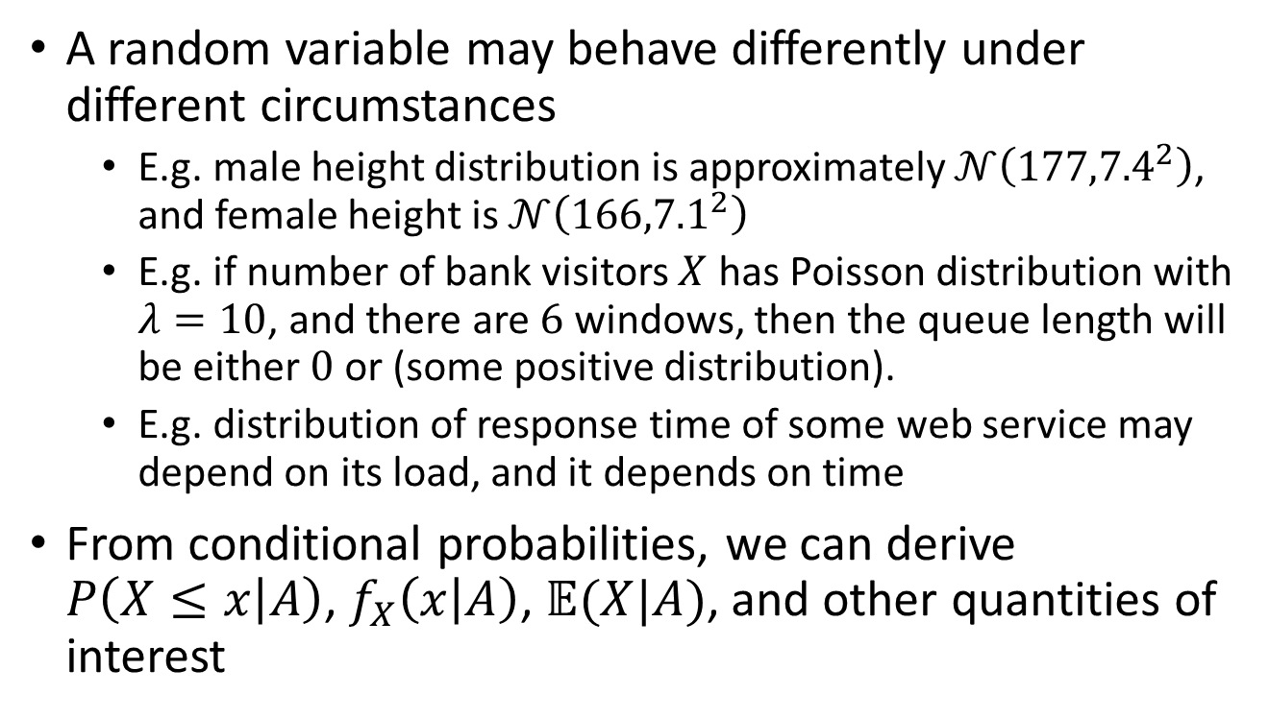
Conditional distributions

Slide 20
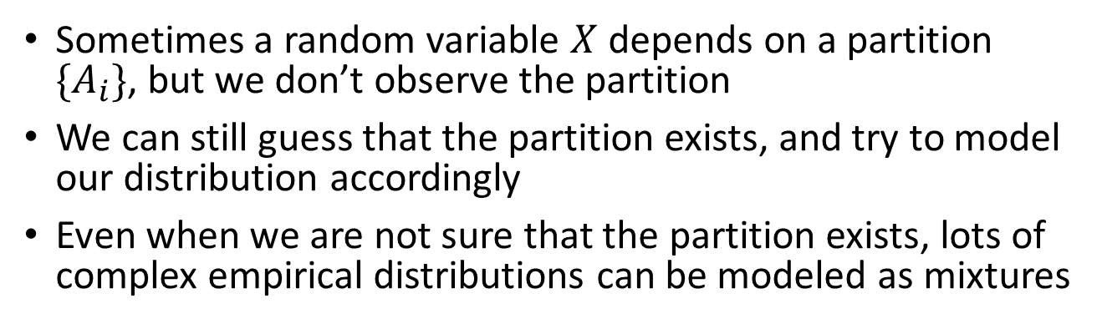
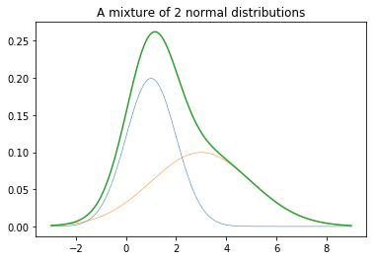
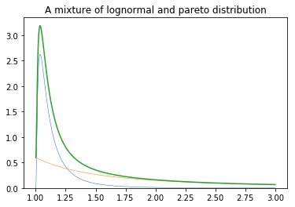
Mixtures
Notes:
Even though male and female heights separately are normal distributions, combining them is not a normal distribution.

Slide 21
Multivariate distributions

Slide 22
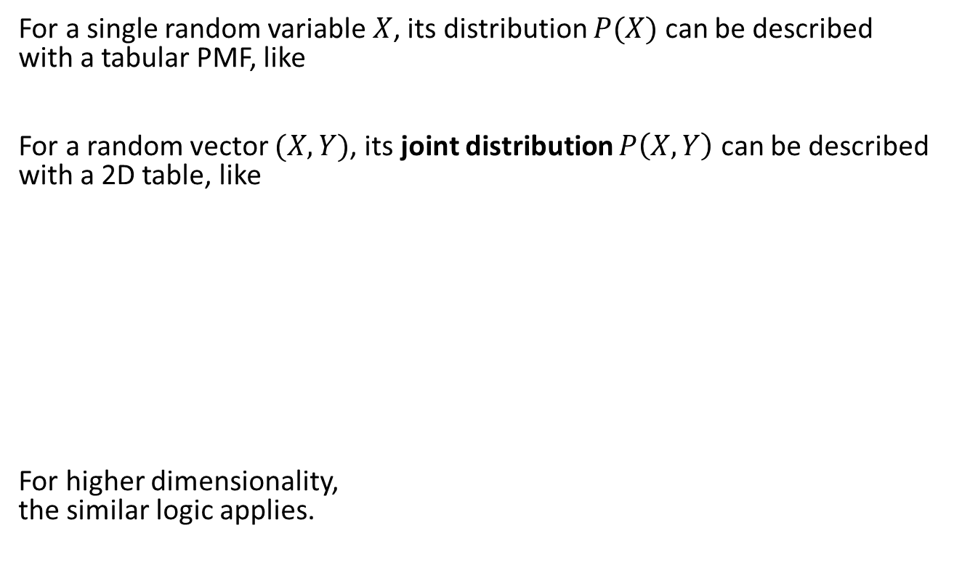
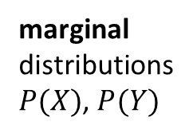
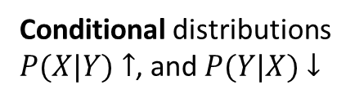
Joint discrete distribution
event
 | 0.2 | 0.3 | 0.5
 | 0.1 | 0.2 | 0.2
 | 0.1 | 0.1 | 0.3
0.5
0.5
 | 0.2 | 0.4 | 0.4
 | 0.2 | 0.2 | 0.6
 | 0.2 | 0.3 | 0.5
 | 0.5 | 0.67 | 0.4
 | 0.5 | 0.33 | 0.6

Slide 23
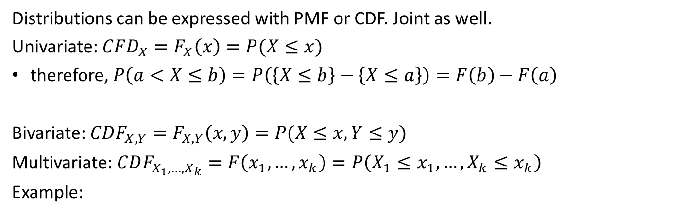
Joint CDF
PMF
CDF
 | 0.1 | 0.2 | 0.2
 | 0.1 | 0.1 | 0.3
 | 0 | 0 | 0 | 0
 | 0 | 0.1 | 0.3 | 0.5
 | 0 | 0.1 | 0.3 | 0.5
 | 0 | 0.2 | 0.5 | 1
 | 0 | 0.2 | 0.5 | 1

Slide 24
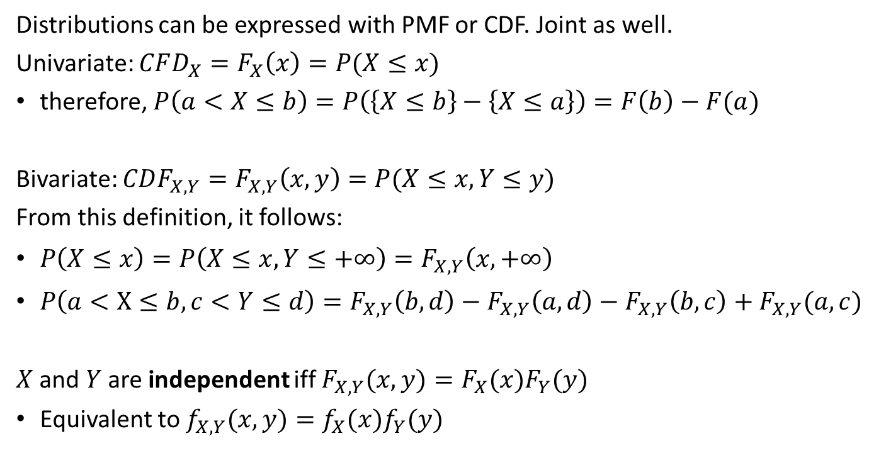


Joint CDF
d
+-
+
c
+--+
+-
a
b

Slide 25
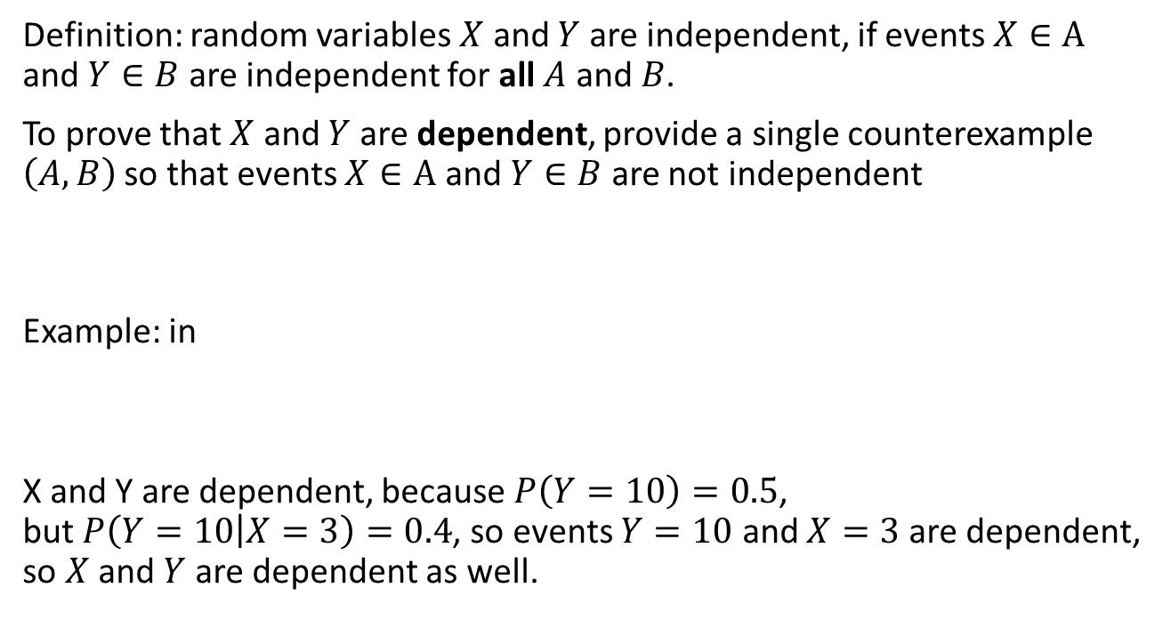
Independence
 | 0.1 | 0.2 | 0.2
 | 0.1 | 0.1 | 0.3

Slide 26
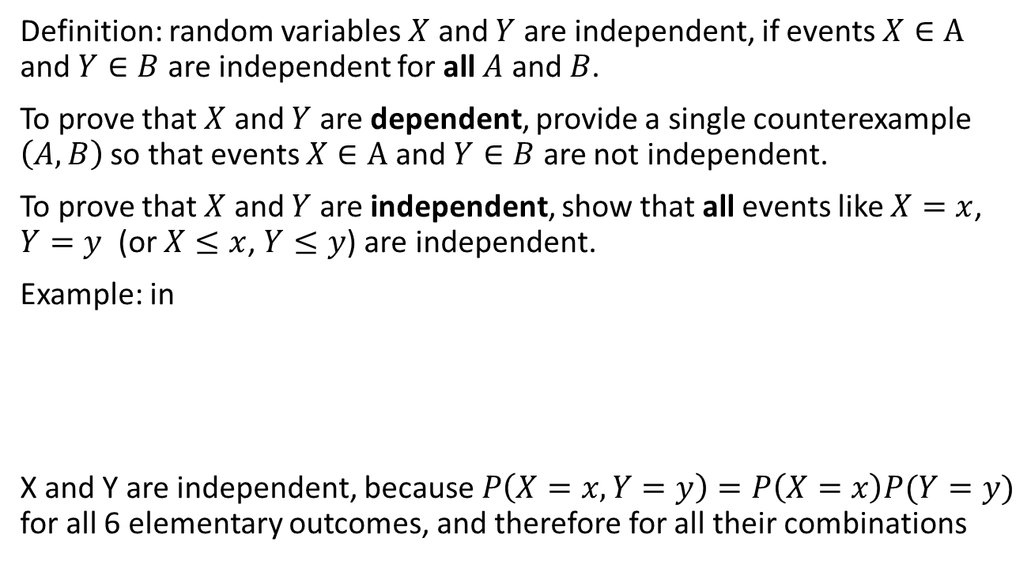
Independence
 | 0.12 | 0.18 | 0.3 | 0.6
 | 0.08 | 0.12 | 0.2 | 0.4
 | 0.2 | 0.3 | 0.5

Slide 27
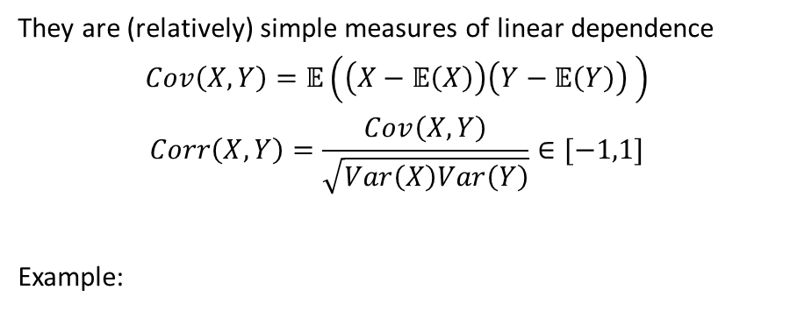
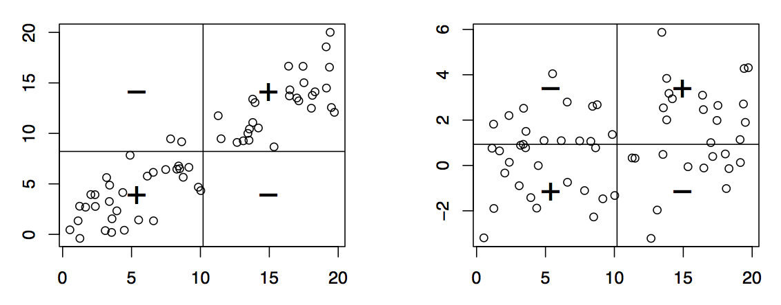
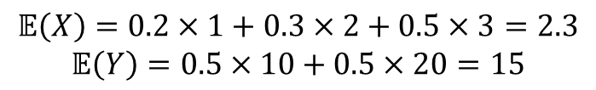
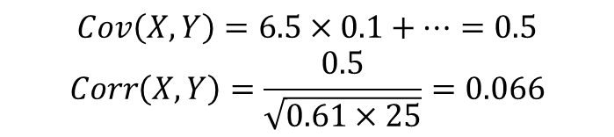
Covariance + correlation
 | 0.1 | 0.2 | 0.2
 | 0.1 | 0.1 | 0.3
 | 6.5 | 1.5 | -3.5
 | -6.5 | -1.5 | 3.5

Slide 28
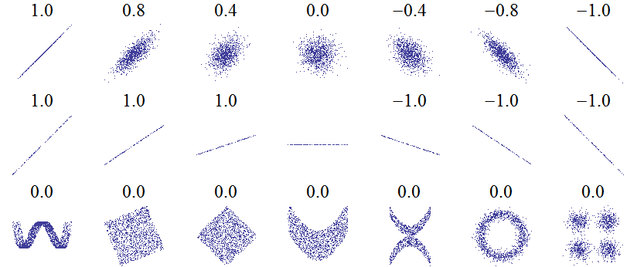
Correlation, visualized
NaN

Slide 29
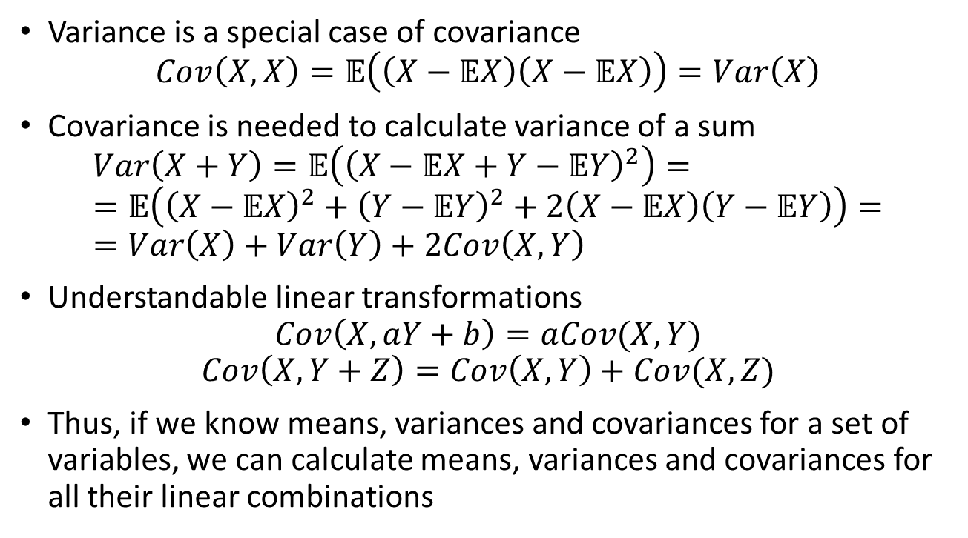
Properties of covariance

Slide 30
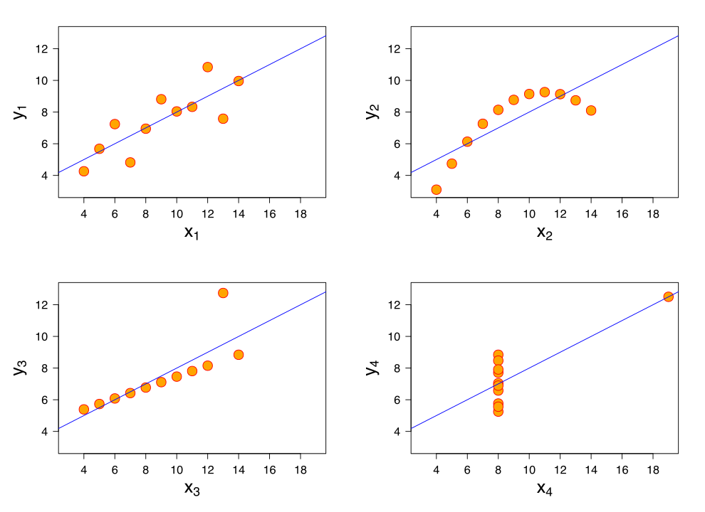
When moments (1 and 2) are not enough
All these datasets have the same mean, variance and covariance
We see that for some datasets these parameters don’t show the whole picture
Notes:
Mean and variance don’t always tell us the whole picture, when dealing with non normal distributions.

Slide 31
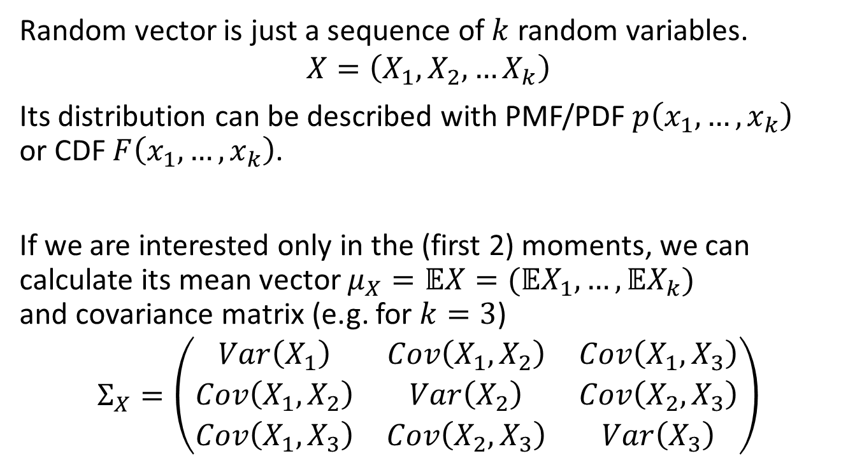
Random vectors
Notes:
Sometimes, we look at the random vector (may be all dependent, may be mutually dependent, could be conditionally independent given some intermediate variable, etc.).

Slide 32
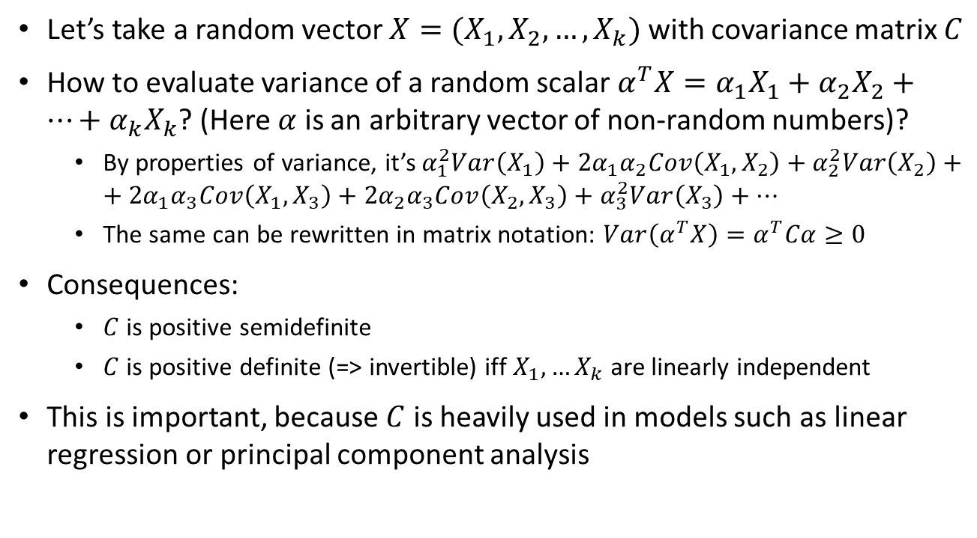
Covariance matrix

Slide 33
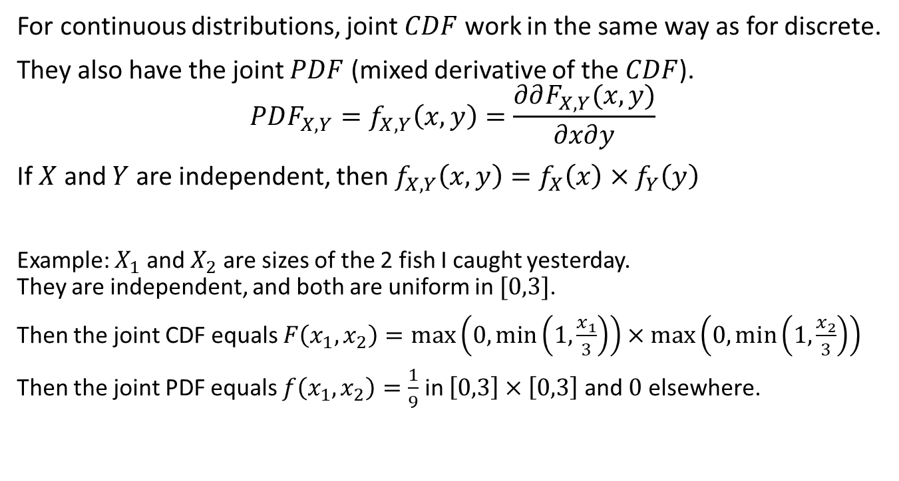
Joint continuous distributions

Slide 34
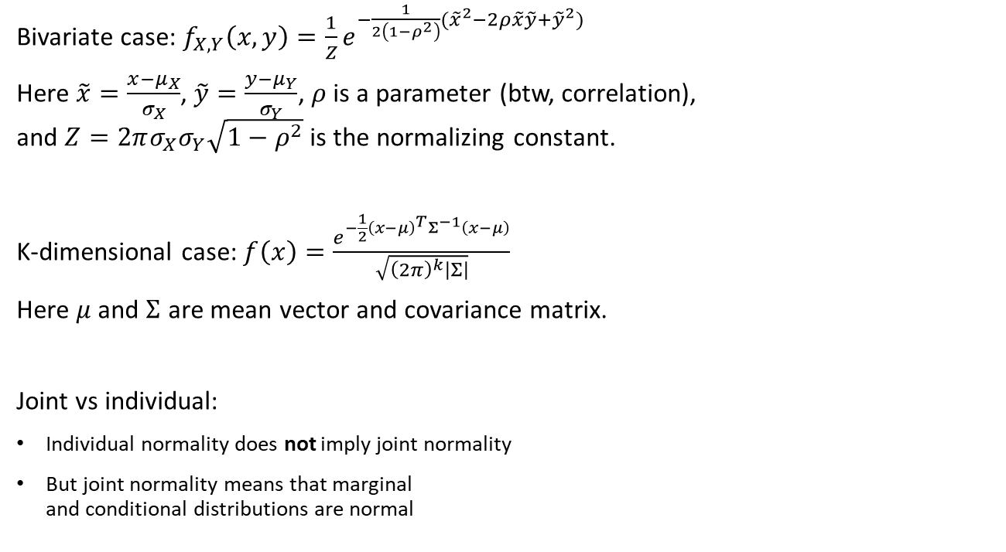
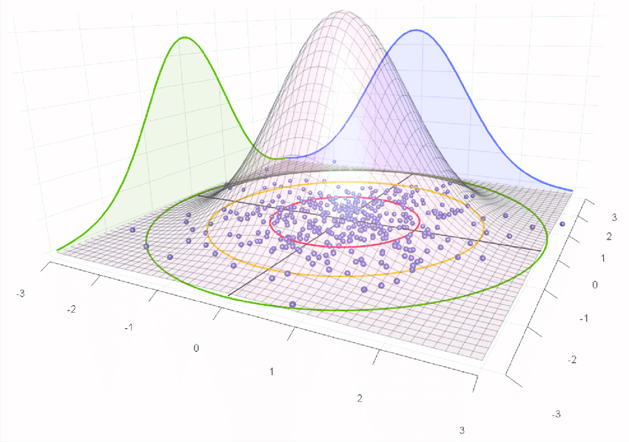
Joint normal

Slide 35
More on conditional distributions

Slide 36
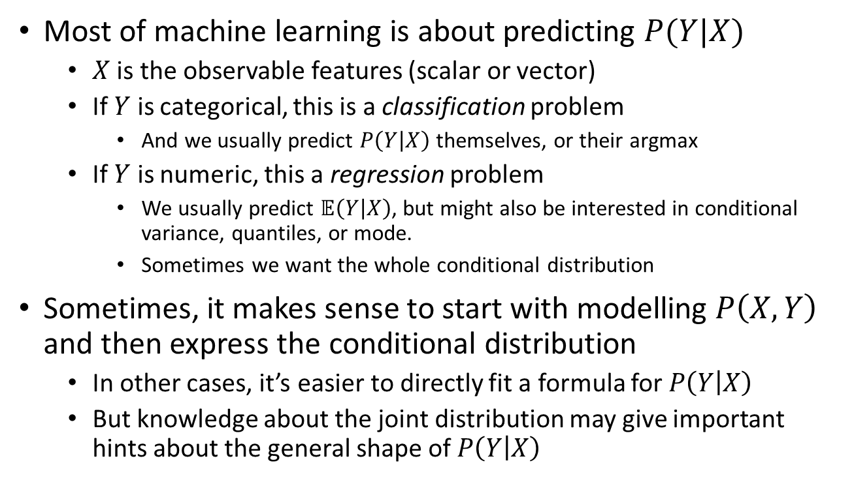
Why conditional distributions?

Slide 37
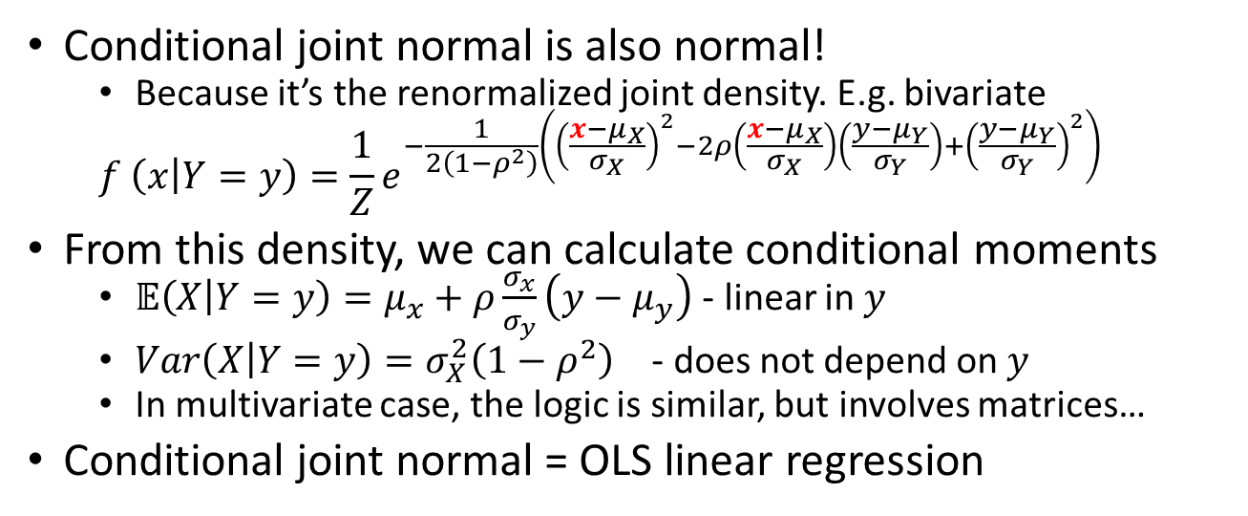
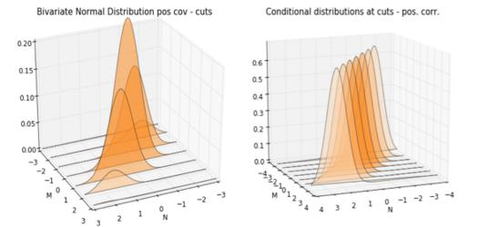
Conditional normal distribution

Slide 38
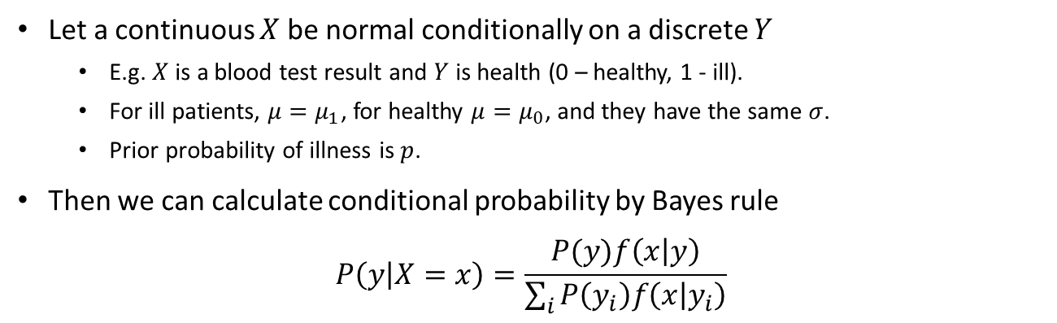


Separating the normal mixture

Slide 39


Separating the normal mixture (2)
Logistic curve

Slide 40

Separating the normal mixture (3)

Slide 41
LLN & CLT – convergence

Slide 42

Sample mean vs expectation
We know that sample mean is “usually close” to the expected value in the population. What does it exactly mean? Experiment: increase sample size, track the sample mean

Slide 43

The law of large numbers

Slide 44

Proof using Markov inequality

Slide 45


The Central limit theorem

Slide 46

CLT, more examples

Slide 47

How can I use this all?

Slide 48
Why is normal distribution so common?
Linear transformation of a normal RV is normal
Sum of jointly normal RV’s is exactly normal
Sum of many independent same-variance RV’s is nearly normal
Any transformation of RV, that discards information but preserves variance, makes distribution “more normal”
Because normal distribution has the maximal entropy

Slide 49
Entropy

Slide 50
Entropy

Slide 51

Cross entropy and KL divergence

Slide 52

Cross-entropy as a loss function

Slide 53
Principle of maximal entropy
If we tried to “generate” distributions by randomly allocating “quanta” of probability between values, then the distribution with highest entropy would be the most probable
If entropy-increasing transformations are at work out there in the world, then long-term distributions must have maximal entropy
If you know nothing, don’t make informative assumptions
If you are not sure, choose the distribution with the highest entropy for your model!

Slide 54
High-entropy distributions
Assumptions | Maximum entropy distribution
 | discrete univariate
 | univariate
 | geometric
 | exponential
 | normal
 | Pareto

Slide 55
Maxent classifier

Slide 56
Auxiliary slides – if time permits

Slide 57








More about the fish

Slide 58

Conditional everything

Slide 59


The fish illustrated

