Slide 1
Hypotheses testing
Probability and Statistics for Data Science
Part 5

Slide 2
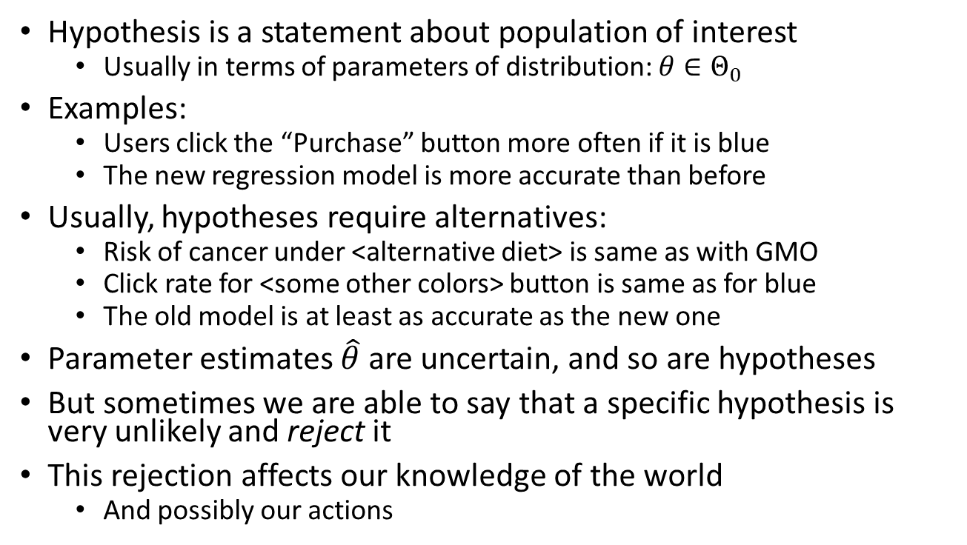
What are hypotheses and why test them?
Hypothesis is a statement about population of interest
Usually in terms of parameters of distribution: $θ∈Θ_{0}$
Examples:
Users click the “Purchase” button more often if it is blue
The new regression model is more accurate than before
Usually, hypotheses require alternatives:
Risk of cancer under <alternative diet> is same as with GMO
Click rate for <some other colors> button is same as for blue
The old model is at least as accurate as the new one
Parameter estimates $\hat{θ}$ are uncertain, and so are hypotheses
But sometimes we are able to say that a specific hypothesis is very unlikely and reject it
This rejection affects our knowledge of the world
And possibly our actions
Notes:
Hypothesis is something we infer about the data, and we want to check it. Usually, we infer parameters of the data, and now we want to ask questions about these parameters. However, anything we infer about the data can be described as an hypothesis. For example, if you change a color of a button on a website, will people click it more or less?
In order to test something, you need to do some sort of comparison- we want to compare one option to the alternative. Based off these hypothesis, we want to take actions.
If we have a high cost of making a type of error, we need more confidence that the evidence we have is well established (such as in medicine). So other than the hypothesis test itself, we have an extra parameter of how confident we want to be in our parameter.

Slide 3
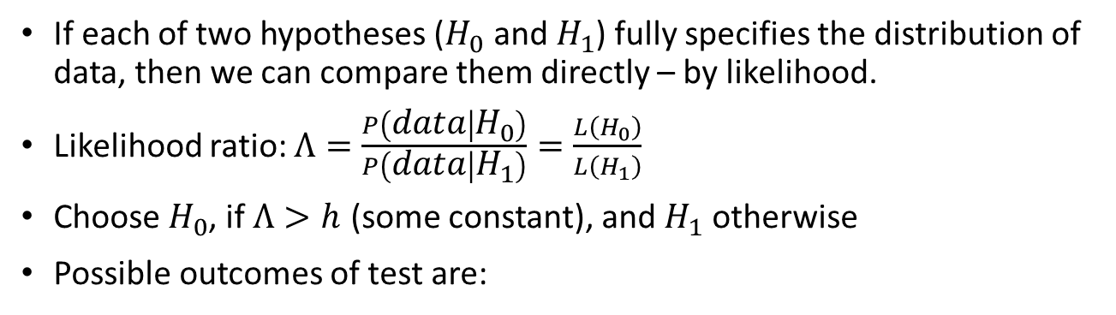
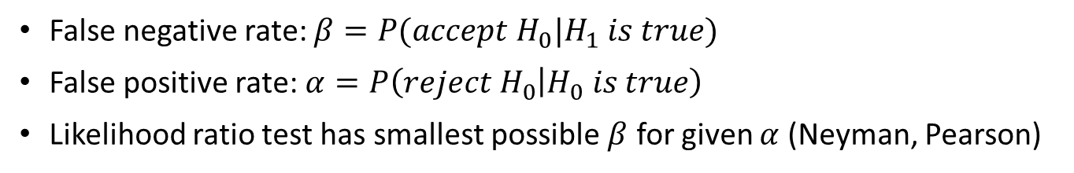
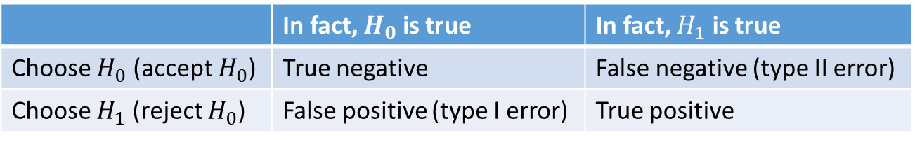
Comparing simple hypotheses
If each of two hypotheses ($H_{0}$ and $H_{1}$) fully specifies the distribution of data, then we can compare them directly – by likelihood.
Likelihood ratio: $Λ=\frac{P\left(data | H_{0}\right)}{P\left(data | H_{1}\right)}=\frac{L\left(H_{0}\right)}{L\left(H_{1}\right)}$
Choose $H_{0}$, if $Λ>h$ (some constant), and $H_{1}$ otherwise
Possible outcomes of test are:
 | In fact, $H_{0}$ is true | In fact, $H_{1}$ is true
Choose $H_{0}$ (accept $H_{0}$) | True negative | False negative (type II error)
Choose $H_{1}$ (reject $H_{0}$) | False positive (type I error) | True positive
False negative rate: $β=P(accept H_{0}|H_{1} is true)$
False positive rate: $α=P\left(reject H_{0} | H_{0} is true\right)$
Likelihood ratio test has smallest possible $β$ for given $α$ (Neyman, Pearson)
Notes:
The easiest case is what we call a simple hypothesis: If the hypothesis defines exactly the CDF, then it is called simple. For example, we want to compare between two probabilities of a coin- 1 quarter heads and ¾ tails, or 50:50. These are the two alternatives which we want to compare. Each of these hypotheses defines the CDF exactly.
A compound hypothesis, is if this is a variety of CDFs (probability that coins equal one half each, and the probability that the prob of heads is greater than 0.7. One is simple, and one is composed of many cases).
In the Simple case:
If we have two simple hypothesis, we can calculate the parameters, and the likelihood of the data under this assumption (which is possible because the function specifically defines a CDF).
If we were forced to choose one: likelihood of the first hypothesis and likelihood of the second one, we obviously would choose the greater one. However, we can ask ourselves, what is the odds this difference happened by chance? IF we divide both likelihoods, we get this Uppercase Lambda in the slide. This statistic is the likelihood ratio– This says that asymptotically, this has a known distribution. Then, we test if this ratio is larger than something
Usually in the real world, we don’t have such a simple case though.
The 2X2 table here comes up a lot in machine learning:

Slide 4
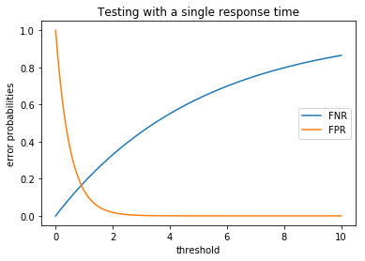
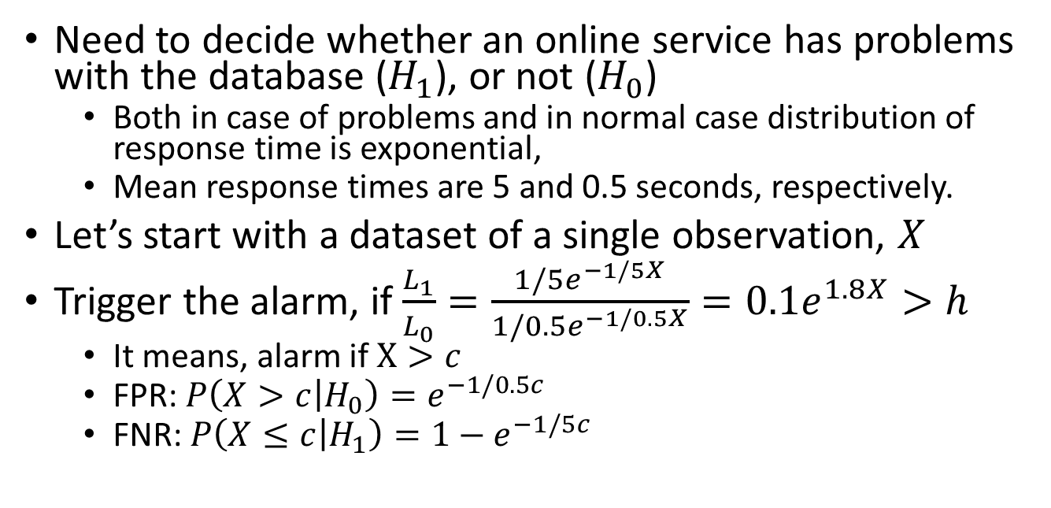
Example of a test
Need to decide whether an online service has problems with the database ($H_{1}$), or not ($H_{0}$)
Both in case of problems and in normal case distribution of response time is exponential,
Mean response times are 5 and 0.5 seconds, respectively.
Let’s start with a dataset of a single observation, $X$
Trigger the alarm, if $\frac{L_{1}}{L_{0}}=\frac{1/5e^{−1/5X}}{1/0.5e^{−1/0.5X}}=0.1e^{1.8X}>h$
It means, alarm if $X>c$
FPR: $P\left(X>c | H_{0}\right)=e^{−1/0.5c}$
FNR: $P\left(X≤c | H_{1}\right)=1−e^{−1/5c}$
Notes:
H0 means the database is ok, and if the DB is okay, then we assume the response time should be, on average, 0.5 seconds. We also know/assume that the distribution is exponential. We are only comparing between the good case of 0,5, and the bad case of 5.
If we have just a single example, we can calculate the likelihood of seeing this example. If we have many examples, we can multiply them the expression from 1 to N, using Xi instead of x. We then calculate this for the alternative hypothesis. Then, we divide them and get a likelihood ratio.

Slide 5
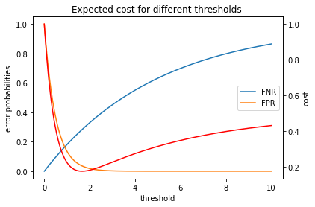
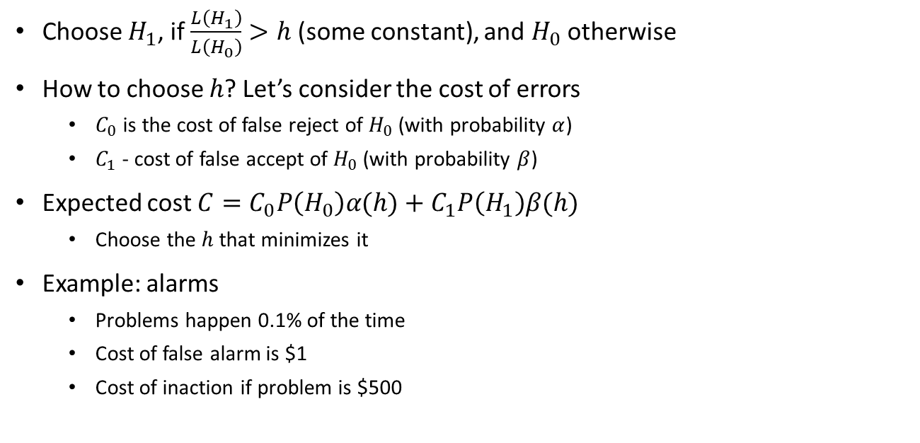
Decision making
Choose $H_{1}$, if $\frac{L\left(H_{1}\right)}{L\left(H_{0}\right)}>h$ (some constant), and $H_{0}$ otherwise
How to choose $h$? Let’s consider the cost of errors
$C_{0}$ is the cost of false reject of $H_{0}$ (with probability $α$)
$C_{1}$ - cost of false accept of $H_{0}$ (with probability $β$)
Expected cost $C=C_{0}P\left(H_{0}\right)α(h)+C_{1}P\left(H_{1}\right)β(h)$
Choose the $h$ that minimizes it
Example: alarms
Problems happen 0.1% of the time
Cost of false alarm is $1
Cost of inaction if problem is $500
Notes:
How do we choose the threshold h?
A good way to choose it would be to give some sort of cost, if possible, to each error. For example, if both hypotheses are okay for me, then I can choose a very balanced h (1). Usually this is not the case though, and we want to choose it based off what it will cost me. Traditionally, this is 5%.

Slide 6
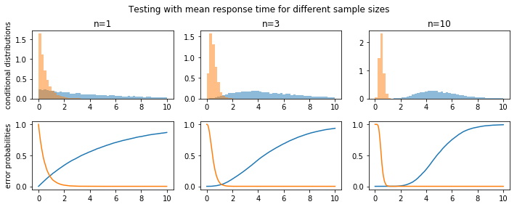
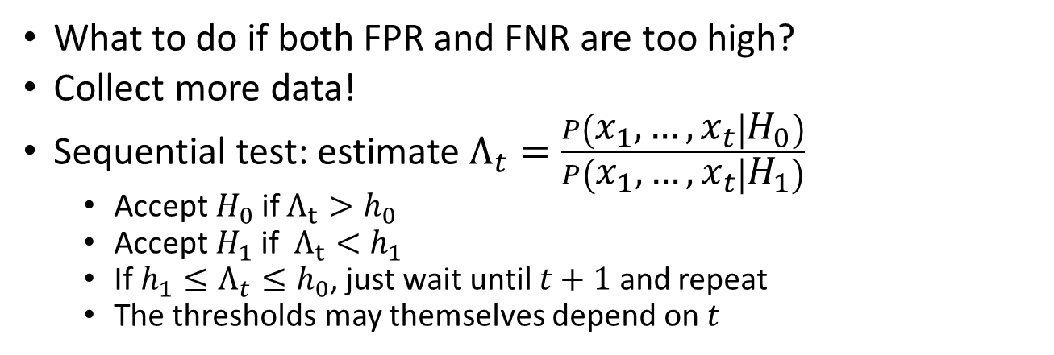
Sequential testing
What to do if both FPR and FNR are too high?
Collect more data!
Sequential test: estimate $Λ_{t}=\frac{P\left(x_{1},…,x_{t} | H_{0}\right)}{P\left(x_{1},…,x_{t} | H_{1}\right)}$
Accept $H_{0}$ if $Λ_{t}>h_{0}$
Accept $H_{1}$ if $Λ_{t}<h_{1}$
If $h_{1}≤Λ_{t}≤h_{0}$, just wait until $t+1$ and repeat
The thresholds may themselves depend on $t$
Notes:
Suppose we want to be 5% confident. Given this 5% confidence, we are not satistfied with our data– Beta is very high. What should we do? We remain with H0. However, we may collect more data until we may be able to reject the null hypothesis.
This si the idea of sequential tests: We star the experiment, but we aren’t sure how big the effect will have. If it is a small effect, and we calculated using 100 people and our alpha wasn’t good enough; then we go collect more data (this happens often in experiments, because we take prelimary assumptions that can turn out wrong).

Slide 7
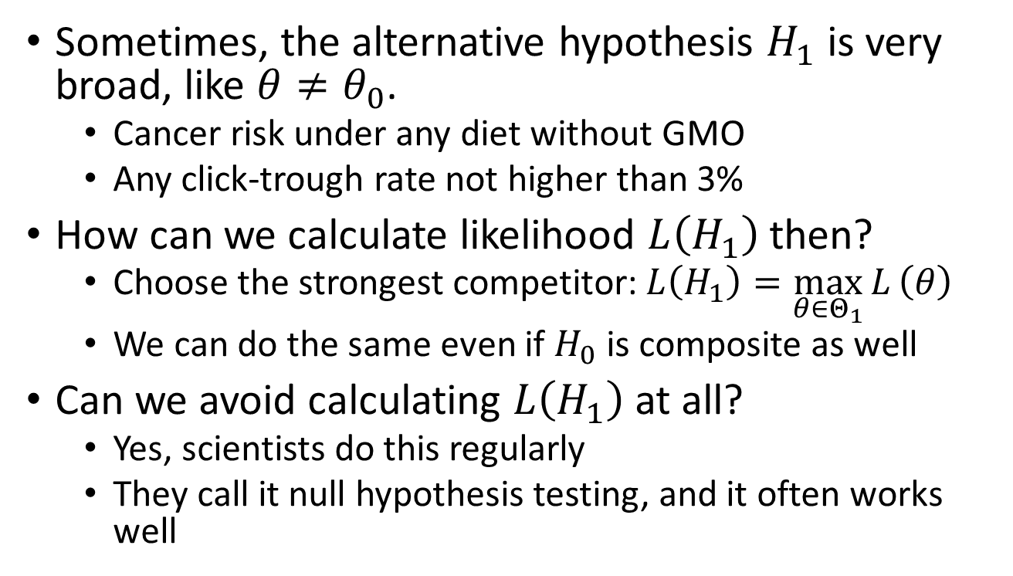
Composite hypotheses
Sometimes, the alternative hypothesis $H_{1}$ is very broad, like $θ≠θ_{0}$.
Cancer risk under any diet without GMO
Any click-trough rate not higher than 3%
How can we calculate likelihood $L\left(H_{1}\right)$ then?
Choose the strongest competitor: $L\left(H_{1}\right)=\max_{θ∈Θ_{1}}{L}\left(θ\right)$
We can do the same even if $H_{0}$ is composite as well
Can we avoid calculating $L\left(H_{1}\right)$ at all?
Yes, scientists do this regularly
They call it null hypothesis testing, and it often works well
Notes:
What happens though, when we have a compounded hypothesis? It isn’t a simple case, rather a case of probability being x, and probability being larger than x?
We choose the hypothesis amongst all of the possible hypothesis of “greater than x” which is most likely. This is the most conservative decision. Then, we have two simple hypothesis.
The case where both H0 and H1 are composite is different, and depends on how conservative we want to be. We could take the Max of both sets and compare, however there are other options as well.
Commonly in scientific experiences, however, we avoid calculating the likelihood of H1 entirely.

Slide 8
Significance testing

Slide 9
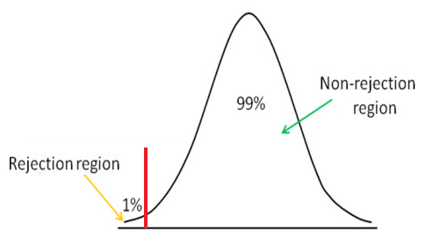
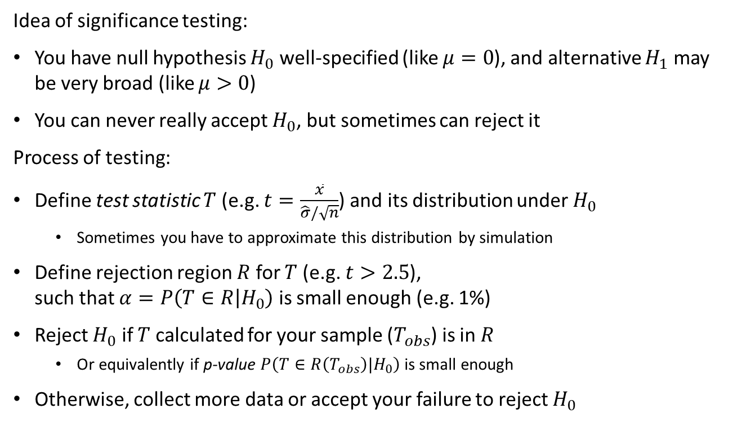
Null hypothesis (significance) testing
Idea of significance testing:
You have null hypothesis $H_{0}$ well-specified (like $μ=0$), and alternative $H_{1}$ may be very broad (like $μ>0$)
You can never really accept $H_{0}$, but sometimes can reject it
Process of testing:
Define test statistic $T$ (e.g. $t=\frac{\overline{x}}{\hat{σ}/\sqrt{n}}$) and its distribution under $H_{0}$
Sometimes you have to approximate this distribution by simulation
Define rejection region $R$ for $T$ (e.g. $t>2.5$), such that $α=P\left(T∈R | H_{0}\right)$ is small enough (e.g. 1%)
Reject $H_{0}$ if $T$ calculated for your sample ($T_{obs}$) is in $R$
Or equivalently if p-value $P\left(T∈R\left(T_{obs}\right)|H_{0}\right)$ is small enough
Otherwise, collect more data or accept your failure to reject $H_{0}$
Notes:
WE start an experiment, we collect samples. We calculate the average. Suppose that the average is -0.03. Are we confident that Mu is not 0? This depends on N, but if the mean is quite close to 0, we can not reject. If however, the mean is -10, then we are quite confiedent we can reject the hypothesis of mean = 0.
Meaning, if we have a single value, and we calculate that it is really improbable to get this value, then we can reject it.
In the normal case, we know that the average of the sample converges to the mean of the distribution. We also know that the average divided by the sigma/root of n…
So if we get that this value is below our alpha, then we can reject it.

Slide 10
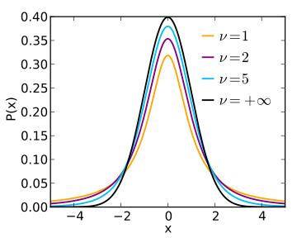

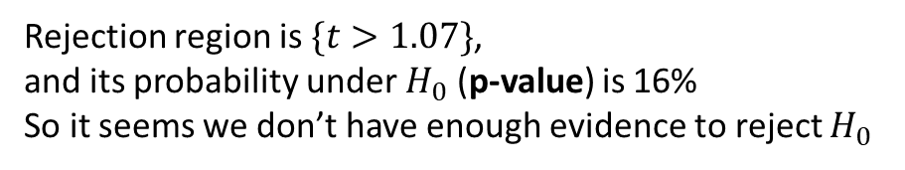

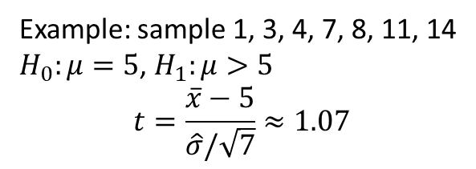
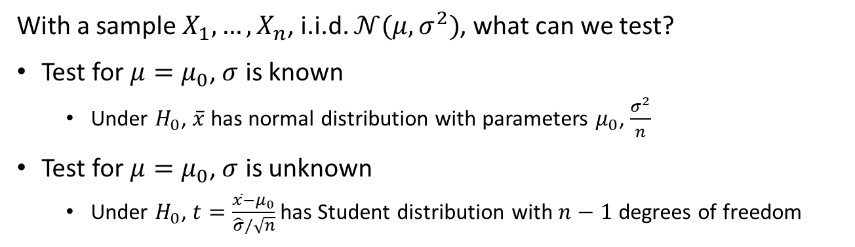
Distributions under $H_{0}$: Student
With a sample $X_{1},…, X_{n}$, i.i.d. $𝒩(μ,σ^{2})$, what can we test?
Test for $μ=μ_{0}$, $σ$ is known
Under $H_{0}$, $\overline{x}$ has normal distribution with parameters $μ_{0}$, $\frac{σ^{2}}{n}$
Test for $μ=μ_{0}$, $σ$ is unknown
Under $H_{0}$, $t=\frac{\overline{x}−μ_{0}}{\hat{σ}/\sqrt{n}}$ has Student distribution with $n−1$ degrees of freedom
Example: sample 1, 3, 4, 7, 8, 11, 14
$H_{0}:μ=5$, $H_{1}:μ>5$
$$t=\frac{\overline{x}−5}{\hat{σ}/\sqrt{7}}≈1.07$$
Rejection region is $\{t>1.07\}$, and its probability under $H_{0}$ (p-value) is 16%
So it seems we don’t have enough evidence to reject $H_{0}$
Notes:
If sigma is known in the normal case, then the average is distributed like sigma squared / N.
IF it is unknown though, then the calculation is much harder, and the statistic we should use is the T test (student distribution). The T distribution has an extra parameter, which is the number of degrees of freedom.
T decays slower than normal, and has more kurtosis. Intuitively, this is because we are estimating an extra parameter (sigma).

Slide 11
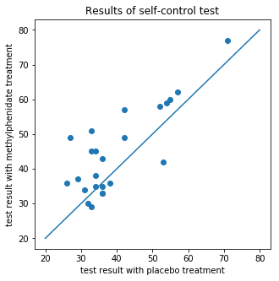
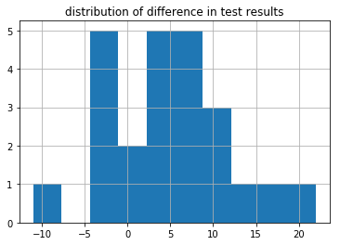
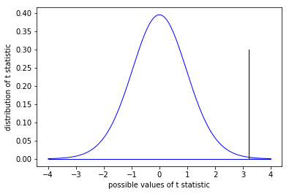
Student test (T-test) for paired samples
If $X_{1},…X_{n}$ are i.i.d. normal, then $T=\frac{\overline{X}−𝔼X}{{\hat{σ}}_{X}^{}/\sqrt{n}}∼t_{n−1}$
Example: null hypothesis is that methylphenidate does not help to treat ADHD (we would like to reject it),
In the experiment, 24 children were treated in turn with placebo and methylphenidate , and took test for self control
Source: Pearson D.A, Santos C.W., Casat C.D., et al. (2004)
We believe that differences in test results are i.i.d. normal, and want to test whether their mean is 0 (against the alternative that it is positive)
In our example, $T=3.22$, and for 23 degrees of freedom probability of larger values is $0.18\%$
This probability is low enough to reject $H_{0}$, and allow ourselves to believe that methylphenidate is effective
Notes:
Paired T test: I give someone one treatment today, and a different treatment tomorrow. I do this with several patients. These are paired: I want to compare myself with treatment A and Treatment B- each sample comes in pairs (today and tomorrow).
We want to ask if each treatment was effective.
If we believe the difference in the cases are normal… Our null hypothesis is that mean = 0- no effect.

Slide 12
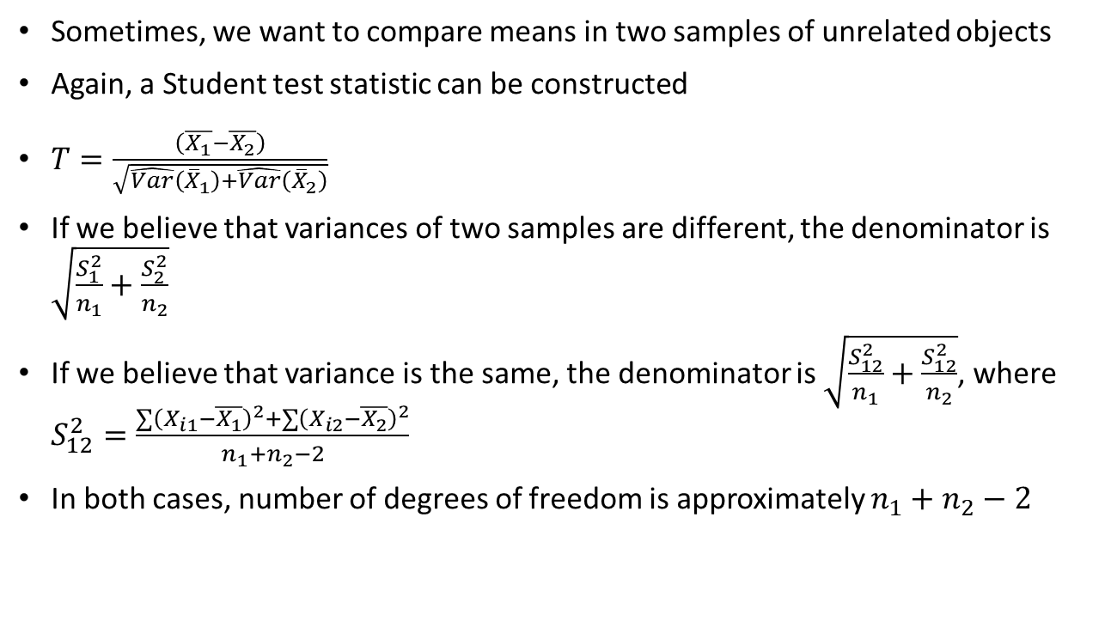
Comparing means of independent samples
Sometimes, we want to compare means in two samples of unrelated objects
Again, a Student test statistic can be constructed
$T=\frac{\left(\overline{X_{1}}−\overline{X_{2}}\right)}{\sqrt{\hat{Var}\left({\overline{X}}_{1}\right)+\hat{Var}\left({\overline{X}}_{2}\right)}}$
If we believe that variances of two samples are different, the denominator is $\sqrt{\frac{S_{1}^{2}}{n_{1}}+\frac{S_{2}^{2}}{n_{2}}}$
If we believe that variance is the same, the denominator is $\sqrt{\frac{S_{12}^{2}}{n_{1}}+\frac{S_{12}^{2}}{n_{2}}}$, where $S_{12}^{2}=\frac{∑{\left(X_{i1}−\overline{X_{1}}\right)}^{2}+∑{\left(X_{i2}−\overline{X_{2}}\right)}^{2}}{n_{1}+n_{2}−2}$
In both cases, number of degrees of freedom is approximately $n_{1}+n_{2}−2$
Notes:
In many cases however, we don’t have paired samples. We have one set of kids with one treatment, and another set of kids with a different treatment.
To try and ensure randomness, we try and randomize the samples as much as possible with stratification. After we did this, we have an assumption that each set comes from the normal distribution (but they aren’t paired). The statistic for this case is the T test above– the difference of the averages, divided by the standard deviation of both tests.

Slide 13
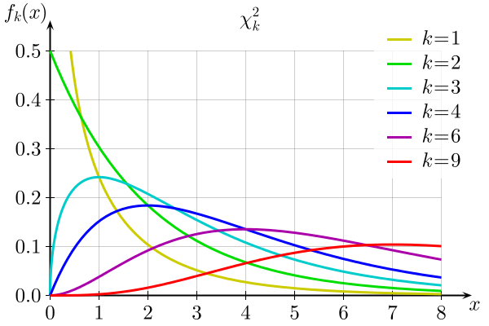
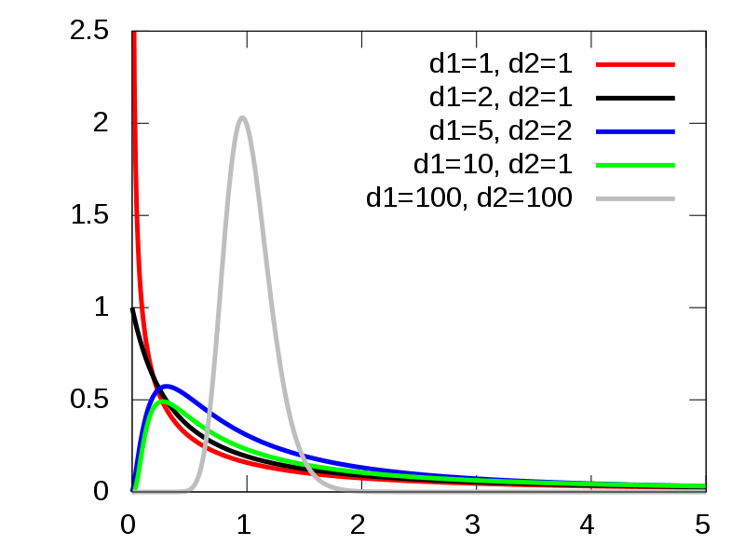
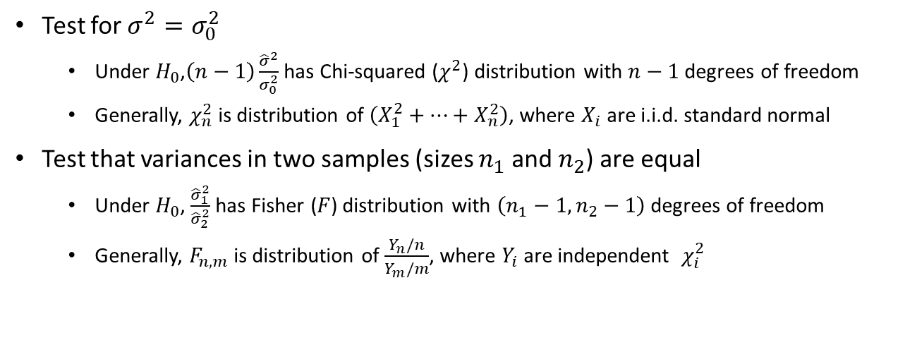


Tests for variance: $χ^{2}$ and Fisher
Test for $σ^{2}=σ_{0}^{2}$
Under $H_{0}$,$\left(n−1\right)\frac{{\hat{σ}}^{2}}{σ_{0}^{2}}$ has Chi-squared ($χ^{2}$) distribution with $n−1$ degrees of freedom
Generally, $χ_{n}^{2}$ is distribution of $\left(X_{1}^{2}+…+X_{n}^{2}\right)$, where $X_{i}$ are i.i.d. standard normal
Test that variances in two samples (sizes $n_{1}$ and $n_{2}$) are equal
Under $H_{0}$, $\frac{{\hat{σ}}_{1}^{2}}{{\hat{σ}}_{2}^{2}}$ has Fisher ($F$) distribution with $\left(n_{1}−1, n_{2}−1\right)$ degrees of freedom
Generally, $F_{n,m}$ is distribution of $\frac{Y_{n}/n}{Y_{m}/m}$, where $Y_{i}$ are independent $χ_{i}^{2}$
$χ^{2}$ PDF for different d.o.f.
F PDF for different d.o.f.

Slide 14
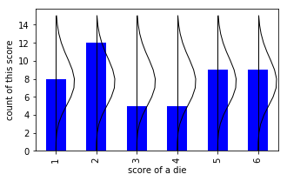
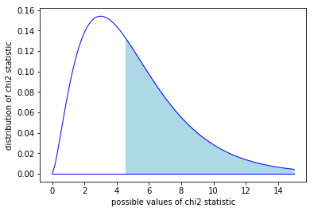
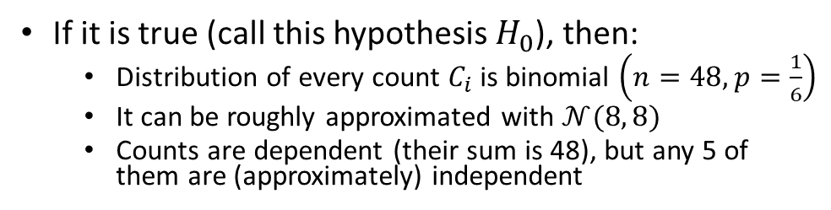
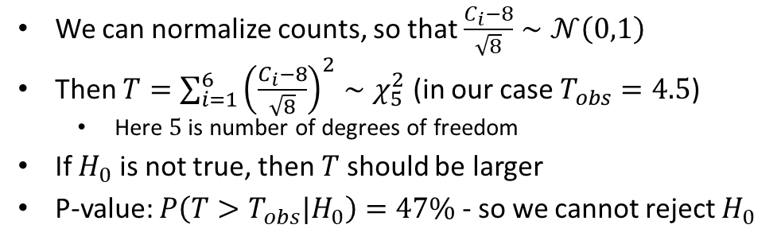
Chi-squared test
Chi-squared test for discrete variables
Goodness of fit for a particular distribution
Comparison of distribution for two samples
Checking independence of two variables
Example: is a die fair?
Score | 1 | 2 | 3 | 4 | 5 | 6
count | 8 | 12 | 5 | 5 | 9 | 9
expected | 8 | 8 | 8 | 8 | 8 | 8
If it is true (call this hypothesis $H_{0}$), then:
Distribution of every count $C_{i}$ is binomial $\left(n=48, p=\frac{1}{6}\right)$
It can be roughly approximated with $𝒩(8, 8)$
Counts are dependent (their sum is 48), but any 5 of them are (approximately) independent
We can normalize counts, so that $\frac{C_{i}−8}{\sqrt{8}}∼𝒩\left(0,1\right)$
Then $T=\sum_{i=1}^{6}{{\left(\frac{C_{i}−8}{\sqrt{8}}\right)}^{2}∼χ_{5}^{2}}$ (in our case $T_{obs}=4.5$)
Here $5$ is number of degrees of freedom
If $H_{0}$ is not true, then $T$ should be larger
P-value: $P\left(T>T_{obs}|H_{0}\right)=47\%$ - so we cannot reject $H_{0}$

Slide 15
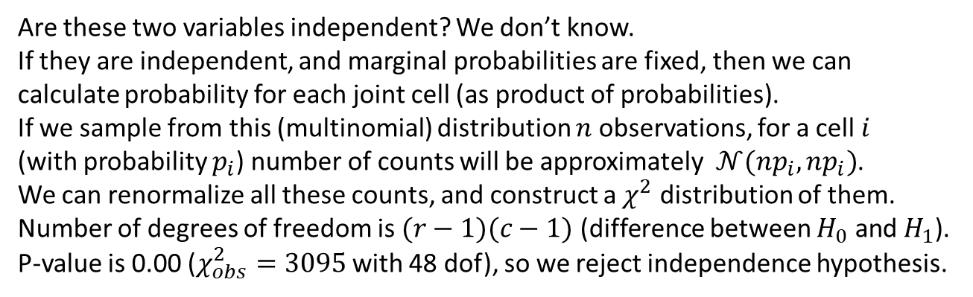
Example: test for independence
 | sales_channel_id
education | 2 | 3 | 4 | 5 | 6 | 10 | 13 | 14 | 16 | All
A | 1254 | 128 | 0 | 39 | 189 | 0 | 0 | 0 | 4 | 1614
H | 105874 | 24262 | 13 | 3078 | 11065 | 17 | 581 | 28 | 345 | 145263
HH | 6311 | 955 | 2 | 225 | 1038 | 1 | 15 | 0 | 41 | 8588
S | 10724 | 1288 | 2 | 204 | 1361 | 1 | 64 | 0 | 37 | 13681
SS | 55070 | 10035 | 14 | 1010 | 5007 | 11 | 400 | 5 | 107 | 71659
UH | 20031 | 3615 | 2 | 761 | 4001 | 2 | 156 | 6 | 72 | 28646
US | 622 | 84 | 0 | 15 | 168 | 0 | 0 | 1 | 5 | 895
All | 199886 | 40367 | 33 | 5332 | 22829 | 32 | 1216 | 40 | 611 | 270346
Are these two variables independent? We don’t know.
If they are independent, and marginal probabilities are fixed, then we can calculate probability for each joint cell (as product of probabilities).
If we sample from this (multinomial) distribution $n$ observations, for a cell $i$ (with probability $p_{i}$) number of counts will be approximately ${𝒩(np}_{i}, np_{i})$.
We can renormalize all these counts, and construct a $χ^{2}$ distribution of them.
Number of degrees of freedom is $(r−1)(c−1)$ (difference between $H_{0}$ and $H_{1}$).
P-value is 0.00 ($χ_{obs}^{2}=3095$ with 48 dof), so we reject independence hypothesis.

Slide 16
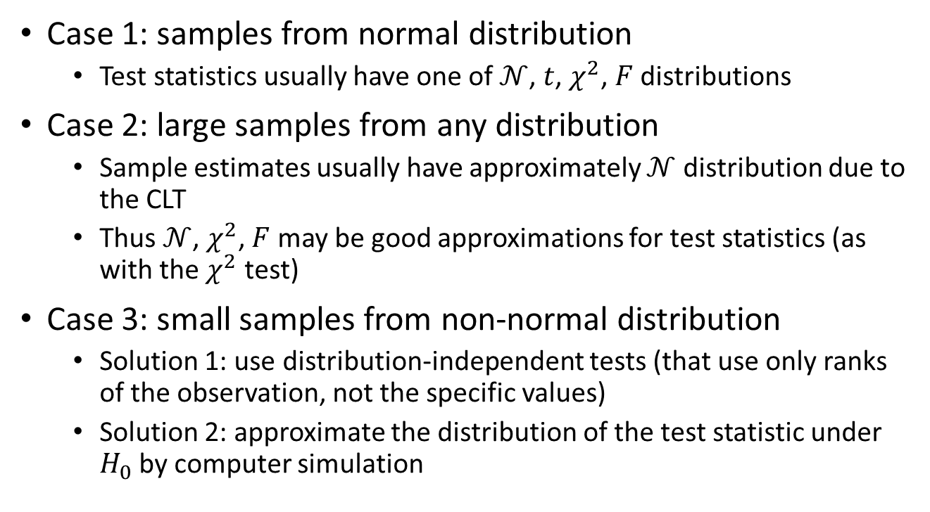
Other statistics and distributions
Case 1: samples from normal distribution
Test statistics usually have one of $𝒩$, $t$, $χ^{2}$, $F$ distributions
Case 2: large samples from any distribution
Sample estimates usually have approximately $𝒩$ distribution due to the CLT
Thus $𝒩$, $χ^{2}$, $F$ may be good approximations for test statistics (as with the $χ^{2}$ test)
Case 3: small samples from non-normal distribution
Solution 1: use distribution-independent tests (that use only ranks of the observation, not the specific values)
Solution 2: approximate the distribution of the test statistic under $H_{0}$ by computer simulation
Notes:
Case 3 is a very important case.

Slide 17
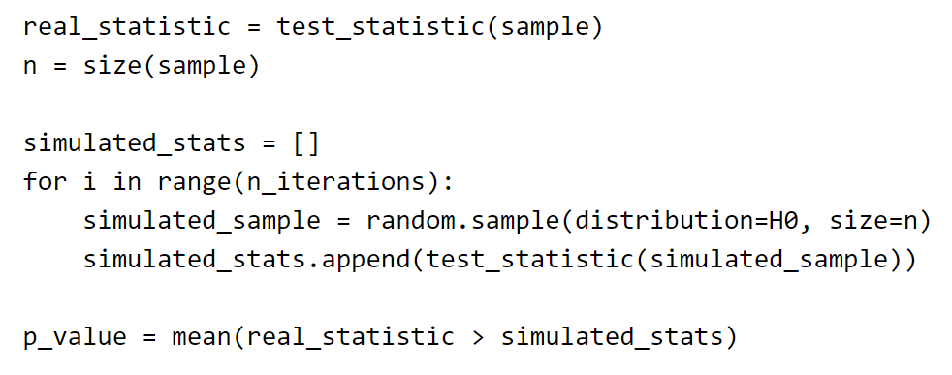
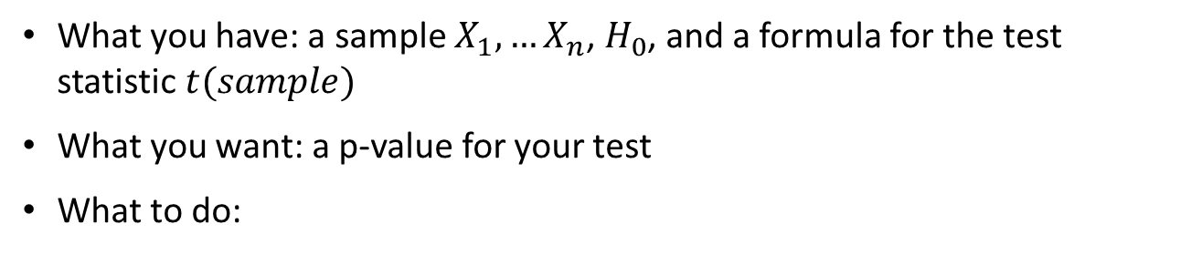
Simulating a distribution
What you have: a sample $X_{1},…X_{n}$, $H_{0}$, and a formula for the test statistic $t(sample)$
What you want: a p-value for your test
What to do:

Slide 18
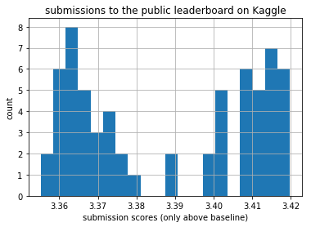
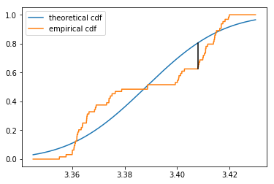
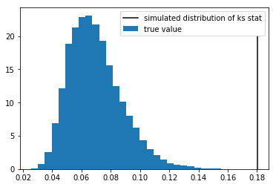
KS test for CDF goodness of fit
How to generally tell whether a CDF describes the distribution of your sample well?
A recipe from Kolmogorov and Smirnov:
Take your hypothetical CDF $F_{0}(x)$
Calculate the empirical CDF $F_{n}\left(x\right)=\frac{1}{n}\sum_{i=1}^{n}{[x_{i}≤x]}$
Calculate their maximum difference: $K=\max_{x}\left(\left|F_{0}\left(x\right)−F_{n}\left(x\right)\right|\right)$
This $K$ under $H_{0}$ has known $KS$ disribution
Notes:
kolmogorov Smirnov: I think that my data is exponential with some lambda. I draw the blue line, which is the theoretical case. I get a sample of 1000 values, and I want to know if these samples are a good approximation for this distribution. So we want the orange line to be close to the blue line (we can also do this to compare two empirical distributions, to see if they are the same).
What we do is, we find the largest deviation from the line, and that defines the distribution. For a larger K, we would reject, because it means we have large deviation.

Slide 19
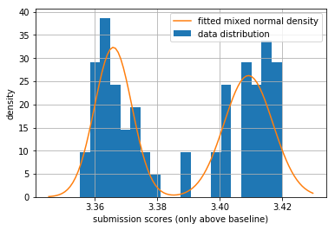
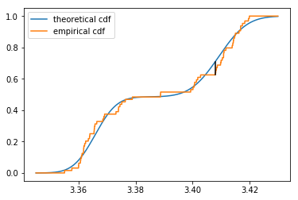
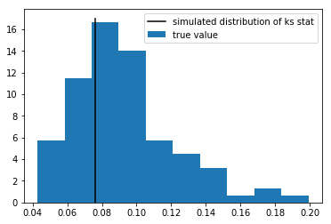
More KS testing
If one normal distribution contradicts the data, maybe a mixture of two normal distributions is ok?
It seems so, but we have to maximize likelihood numerically to find the best parameters.
Fortunately, scipy can do this for us.

Slide 20
Conclusions

Slide 21
A zoo of different tests
Over 100 years of mathematical statistics, lots of tests:
T-test (for comparing means of normal variables)
Chi-squared test (for categorical goodness of fit or independence)
Kolmogorov-Smirnov test (continuous goodness of fit)
Mann-Whitney test (for comparing medians)
Wilcoxon test (test for paired change direction in non-normal variables)
ANOVA (F-test): (for comparing means and variances in groups)
Hard (and not necessary) to learn them all
With large samples, almost any test is good
If there is no known test for your case, you can use simulation or bootstrap (and need to invent a test statistic)

Slide 22
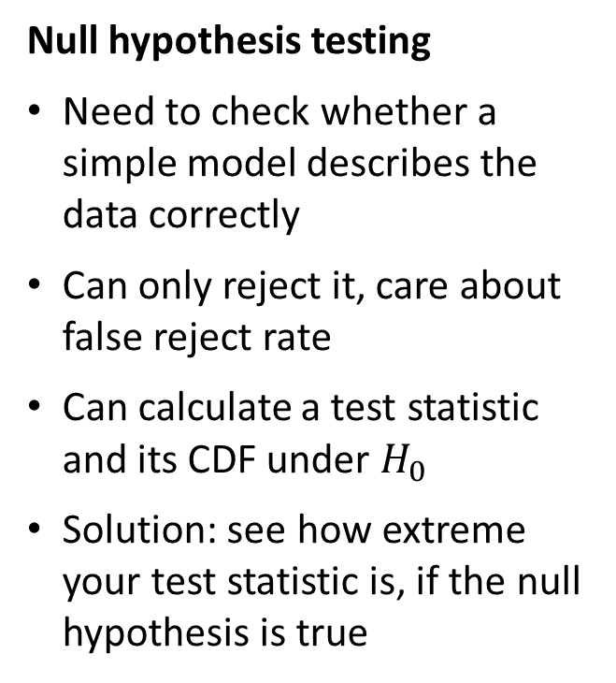
Two approaches to hypotheses
Comparing hypotheses
Need to choose one of the two competing models
Care about balance of false positive and negative rate
Solution: compare (maximized) likelihoods of hypotheses
It can be easily extended to sequential problems
Null hypothesis testing
Need to check whether a simple model describes the data correctly
Can only reject it, care about false reject rate
Can calculate a test statistic and its CDF under $H_{0}$
Solution: see how extreme your test statistic is, if the null hypothesis is true

Slide 23
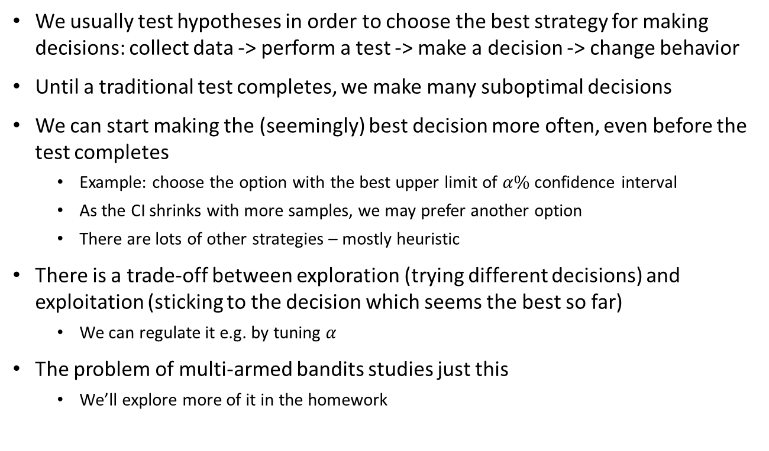
Alternative: multi-armed bandits
We usually test hypotheses in order to choose the best strategy for making decisions: collect data -> perform a test -> make a decision -> change behavior
Until a traditional test completes, we make many suboptimal decisions
We can start making the (seemingly) best decision more often, even before the test completes
Example: choose the option with the best upper limit of $α\%$ confidence interval
As the CI shrinks with more samples, we may prefer another option
There are lots of other strategies – mostly heuristic
There is a trade-off between exploration (trying different decisions) and exploitation (sticking to the decision which seems the best so far)
We can regulate it e.g. by tuning $α$
The problem of multi-armed bandits studies just this
We’ll explore more of it in the homework

Slide 24
Conclusion
Hypotheses testing = answering questions how well one or another distribution describes the data
If two hypotheses describe the distribution completely, we can just compare likelihoods
If only one hypothesis is detailed enough, we can try to reject it by looking at test statistics
There is a large zoo of test statistics for all kinds of hypotheses

Slide 25
What to do next
6 more problems to solve
Due in 2 weeks
A small python notebook on multi-armed bandits
Recommended reading/watching:
A Modern Introduction to Probability and Statistics by F.M. Dekking - chapters 25-28
Probability and Statistics in Data Science using Python course on EDX – topic 13

