Slide 1





Object-Oriented Design with Python
CSCI 5448: Object – Oriented A & D Presentation
Yang Li

Slide 2

Summary
This presentation assumes audience have the knowledge of Object-Oriented A & D and emphasize on OOP programming with python
Introduces Python’s special methods to realize class definition, inheritance, multiple inheritance, accessibility, polymorphism, encapsulation.
This presentation indicates the difference of how to realize OOP method between python and other OOP language
Compare Python’s OOP methods with other OOP
languages. Analyze their advantages and disadvantages.

Slide 3

What’s Python?
Python is a general-purpose, interpreted high-level
programming language.
Its syntax is clear and emphasize readability.
Python has a large and comprehensive standard library.
Python supports multiple programming paradigms, primarily but not limited to object-oriented, imperative and, to a lesser extent, functional programming styles.
It features a fully dynamic type system and automatic memory management

Slide 4

Advantages of Python
Simple
Easy to study
Free and open source
High-level programming language
Portability
Expansibility
Embedability
Large and comprehensive standard libraries
Canonical code

Slide 5

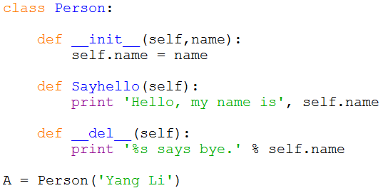
A Example of Python Class
This example includes
class definition, constructor function, destructor function, attributes and methods definition and object definition.
These definitions and uses will be introduced specifically in the following.
Notes:
The constructor is a custom initiation of a class.
(In python, you don’t need the __del__ constructor. In C++ though it is needed, to free up memory).

Slide 6

Class Definition and Object Instantiation
Class definition syntax:
class subclass[(superclass)]: [attributes and methods]
Object instantiation syntax: object = class()
Attributes and methods invoke: object.attribute()
object.method()

Slide 7

Special Class Attributes in Python
Except for self-defined class attributes in Python, class has some special attributes. They are provided by object module.
Attributes Name | Description
__dict__ | Dict variable of class name space
__doc__ | Document reference string of class
__name__ | Class name
module | Module name consisting of class
bases | The tuple including all the superclasses

Slide 8

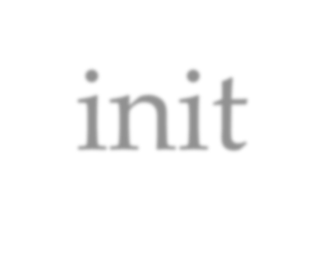
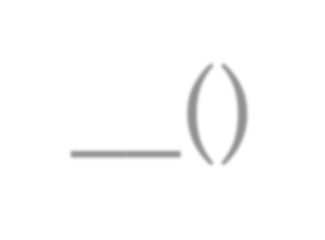
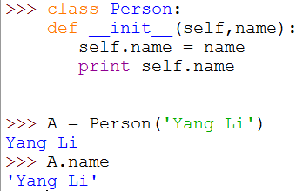
Constructor: __init ()
The init method is run as soon as an object of a class is instantiated. Its aim is to initialize the object.
From the code , we can see that after instantiate object, it automatically invokes __init__()
As a result, it runs
self.name = ‘Yang Li’,
and
print self.name

Slide 9

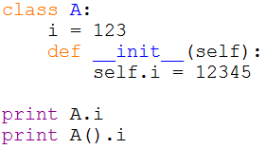

Form and Object for Class
Class includes two members: form and object.
The example in the following can reflect what is the difference between object and form for class.
Invoke form: just invoke data or
method in the class, so i=123
Invoke object: instantialize object Firstly, and then invoke data or Methods.
Here it experienced __init__(),
i=12345
Notes:
There are two members for a class: A form and an object
A form is when we define a variable outside the init function (I = 123). This is a fixed variable which will not change within my class.
An object is created after the init function.

Slide 10

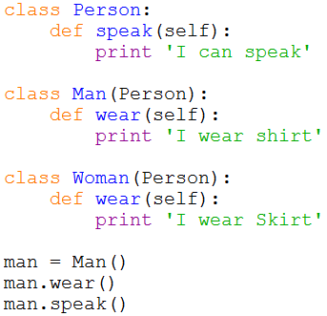

Inheritance
Inheritance in Python is simple,
Just like JAVA, subclass can invoke
Attributes and methods in superclass.
From the example, Class Man inherits Class Person, and invoke speak() method In Class Person
Inherit Syntax:
class subclass(superclass):
…
…
In Python, it supports multiple inheritance,
In the next slide, it will be introduced.
Notes:
Inheritance is one of the great things about OOP.
We have the class ‘Person’, with a function that says ‘I can speak’. We want to build other classes. However, we don’t want to reimplement for all of them the function ‘Speak’– we want Man and woman to ‘Inherit’ the function ‘Speak’.
So in the Man class, we place ‘Person’ in it, to have Man inherit the functionality of ‘Person’.

Slide 11

Multiple Inheritance
Python supports a limited form of multiple inheritance.
A class definition with multiple base classes looks as follows:
class DerivedClass(Base1, Base2, Base3 …)
<statement-1>
<statement-2>
…
The only rule necessary to explain the semantics is the resolution rule used for class attribute references. This is depth-first, left-to-right. Thus, if an attribute is not found in DerivedClass, it is searched in Base1, then recursively in the classes of Base1, and only if it is not found there, it is searched in Base2, and so on.

Slide 12

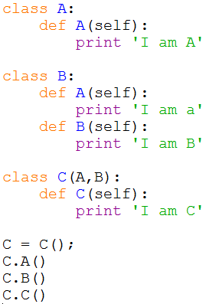
An Example of Multiple Inheritance
C multiple-inherit A and B, but since A is in the left of B, so C inherit A and invoke A.A() according to the left-to-right sequence.
To implement C.B(), class A does not have B() method, so C inherit B for the second priority. So C.B() actually invokes B() in class B.
Notes:
Notice how there are two ‘A’s. In class A, it prints the large A, and in class B, it prints the small ‘a’.
The inheritance inherits from left to right. However, proper coding says to not create functions with the same names to avoid this.

Slide 13
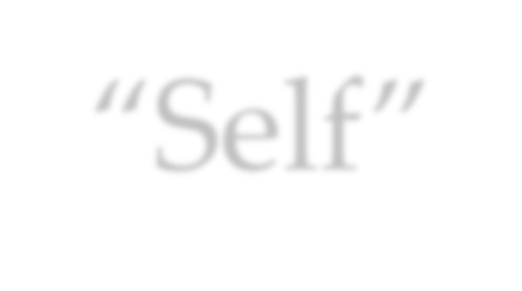
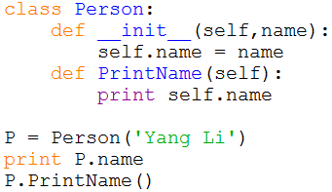
“Self”
“Self” in Python is like the pointer “this” in C++. In
Python, functions in class access data via “self”.
“Self” in Python works as a variable of function but it
won’t invoke data.

Slide 14



Encapsulation – Accessibility (1)
In Python, there is no keywords like ‘public’, ‘protected’ and ‘private’ to define the accessibility. In other words, In Python, it acquiesce that all attributes are public.
But there is a method in Python to define Private:
Add “ ” in front of the variable and function name can hide them when accessing them from out of class.
Notes:
The default in Python is that all attributes are public. If you want a variable to be private, it requires the underscore underneath to prevent access from the outside (see example).
This is used for example, that you know that you only want this function used within your function, and you don’t want anyone to be able to access it outside the class.

Slide 15

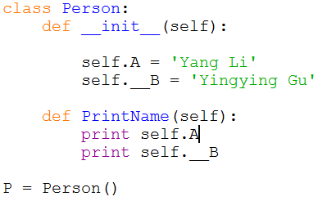
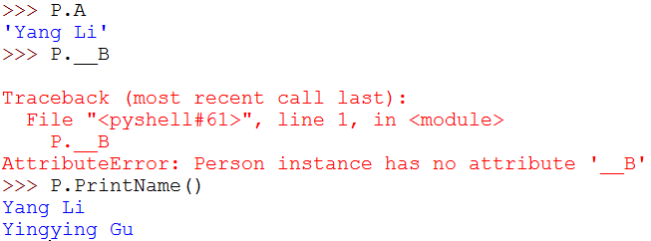
An Example of Private
Public variable
Private variable
Invoke private variable in class
Access public variable out of class, succeed Access private variable our of class, fail
Access public function but this function access Private variable __B successfully since they are in the same class.

Slide 16



Encapsulation – Accessibility (2)
Actually, the private accessibility method is just a rule,
not the limitation of compiler.
Its fact is to change name of private name like variable
or function() to
_ClassName function().
because of wrong names.
_ClassName variable or So we can’t access them
We even can use the special syntax to access the private data or methods. The syntax is actually its changed name. Refer to the following example in the next slide.

Slide 17

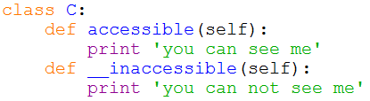
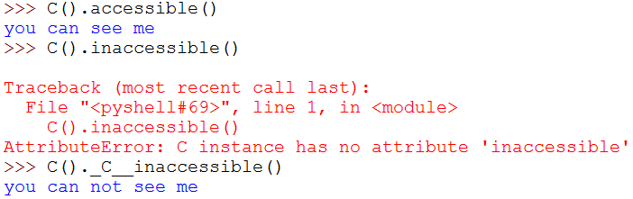
An example of Accessing Private
Define public function
Define private function
Access public function
Can’t access private function
Access private function via changed name

Slide 18
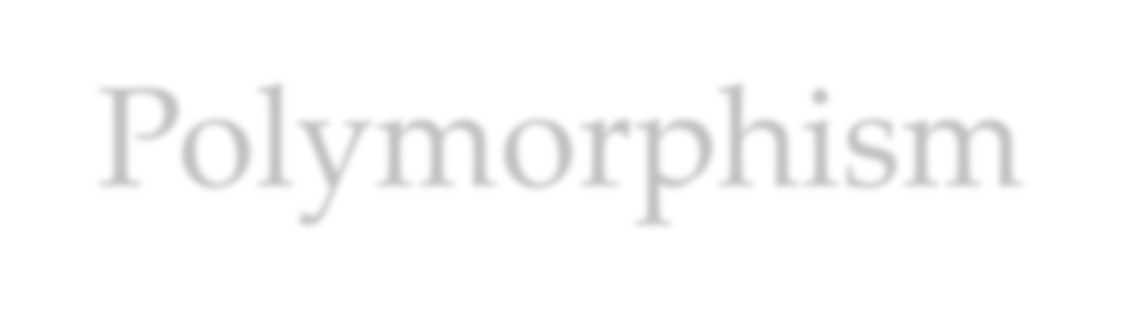

Polymorphism
Polymorphism is an important definition in OOP. Absolutely, we can realize polymorphism in Python just like in JAVA. I call it “traditional polymorphism”
In the next slide, there is an example of polymorphism in Python.
But in Python,
Only traditional polymorphism exist?

Slide 19

Compare Accessibility of Python and Java
Java is a static and strong type definition language. Java
has strict definition of accessibility type with keywords.
While Python is a dynamic and weak type definition language. Python acquiesces all the accessibility types are public except for supporting a method to realize private accessibility virtually.
Someone think Python violates the requirement of encapsulation. But its aim is to make language simple.

Slide 20
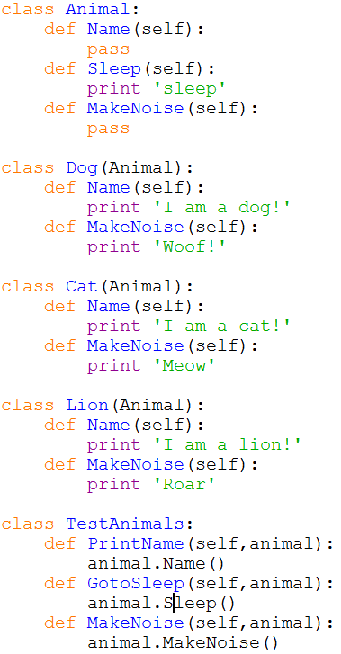
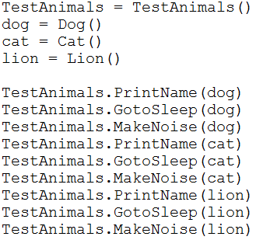
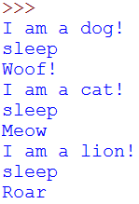
Traditional Polymorphism Example
Notes:
You can see how the…
Now we want to implement each specific animal, which all inherit from the class ‘Animal’. If we call Dog.maknoise, it will create ‘woof’– this overrides the function which was in the base class ‘Animal’.
You can pass to the function a class, who’s base has an attribute. So you can do a for loop, throw in Dog cat and lion, and they will all print their name.

Slide 21


Everywhere is polymorphism in Python (1)
Since Python is a dynamic programming language, it means Python is strongly typed as the interpreter keeps track of all variables types. It reflects the polymorphism character in Python.
Dynamic language
Polymorphism
Track variables types

Slide 22


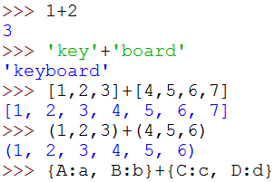
Everywhere is polymorphism in Python (2)
So, in Python, many operators have the property of polymorphism. Like the following example:
Looks stupid, but the key is that variables can support any objects which support ‘add’ operation. Not only integer but also string, list, tuple and dictionary can realize their relative ‘add’ operation.

Slide 23


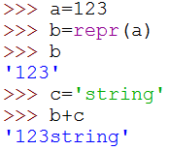
Everywhere is polymorphism in Python (3)
Some methods in Python also have polymorphism character like ‘repr’ function.
For ‘repr’ method, it can transfer any kinds of data to string type. In the above example, it converts integer 123 to string ‘123’ and it can even added to string c ‘string’ to get ‘123string’.

Slide 24

Avoid Destroying Polymorphism!
Many operators and functions in Python are polymorphic. So as long as you use the polymorphic operators and functions, polymorphism will exist even if you don’t have this purpose.
The only way to destroy polymorphism is check types by using functions like ‘type’, ‘isinstance’ and ‘issubclass’ etc.
So in the programming, we should avoid using these methods which might destroy polymorphism except for compiler design.
The most important thing is to let objects to work according to
your requirements rather than mind if they have right types

Slide 25

How to Affect Polymorphism
Traditional polymorphism design
Polymorphic operators and methods
Polymorphism
Functions of ‘type’, ‘isinstance’,
‘issubclass’ etc

Slide 26

Conclusion
As a OOP language, Python has its special advantages but also has its disadvantages.
Python can support operator overloading and multiple inheritance etc. advanced definition that some OOP languages don’t have.
The advantages for Python to use design pattern is that it supports dynamic type binding. In other words, an object is rarely only one instance of a class, it can be dynamically changed at runtime.
But Python might ignore a basic regulation of OOP: data and methods hiding. It doesn’t have the keywords of ‘private’, ‘public’ and ‘protected’ to better support encapsulation. But I think it aims to guarantee syntax simple. As the inventor of Python, Guido Van Rossum said: “abundant syntax bring
more burden than help”.

