Slide 1
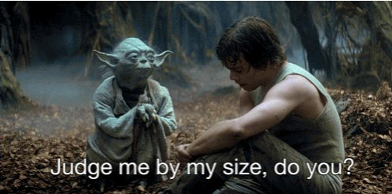


Slide 2
Outline
Introduction
Research question
Pipeline

Slide 3


Slide 4
Introduction

Slide 5
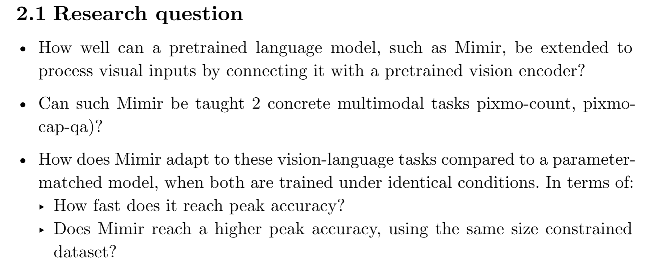
Research question

Slide 6
HRM-Text

Slide 7
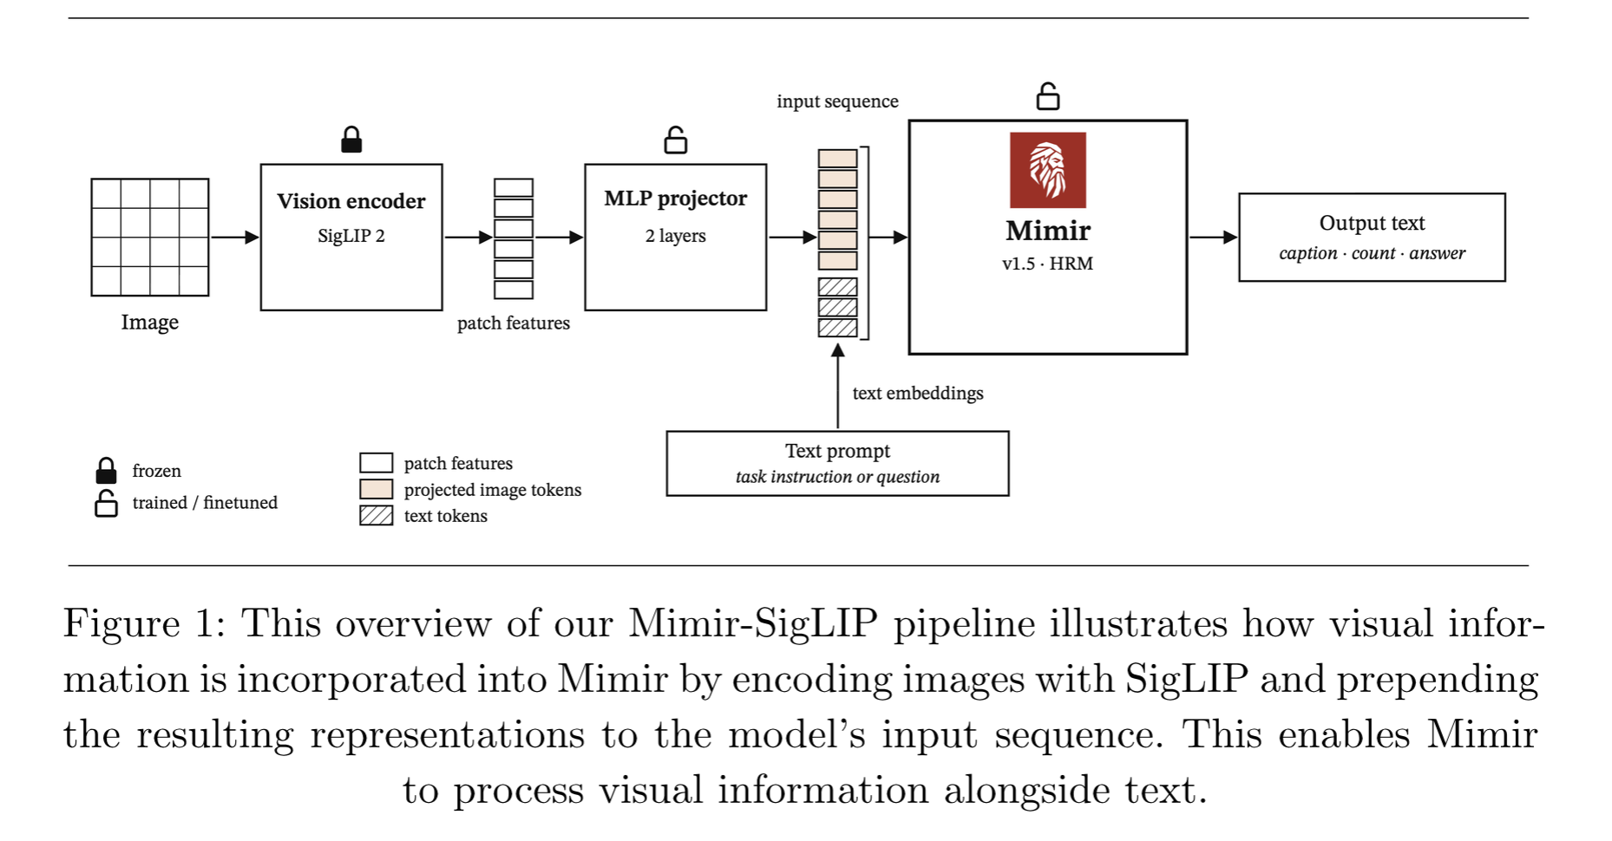
Pipeline

Slide 8
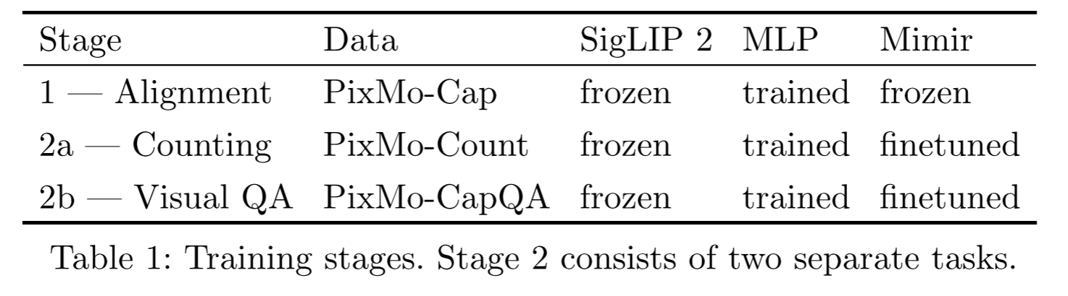
Training & datasets

Slide 9
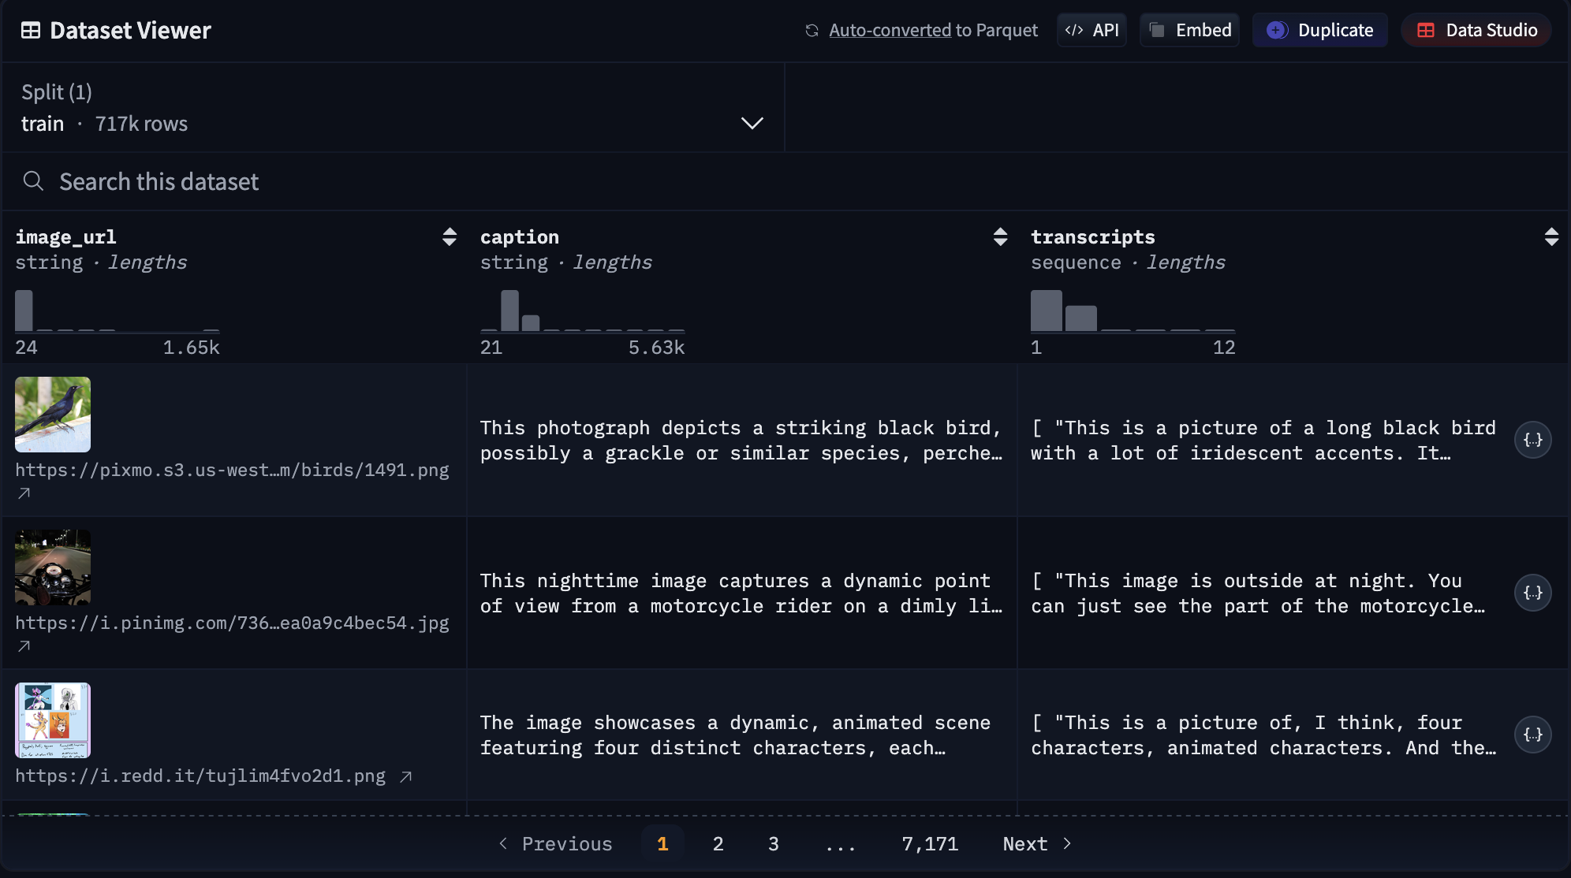
pixmo-cap

Slide 10
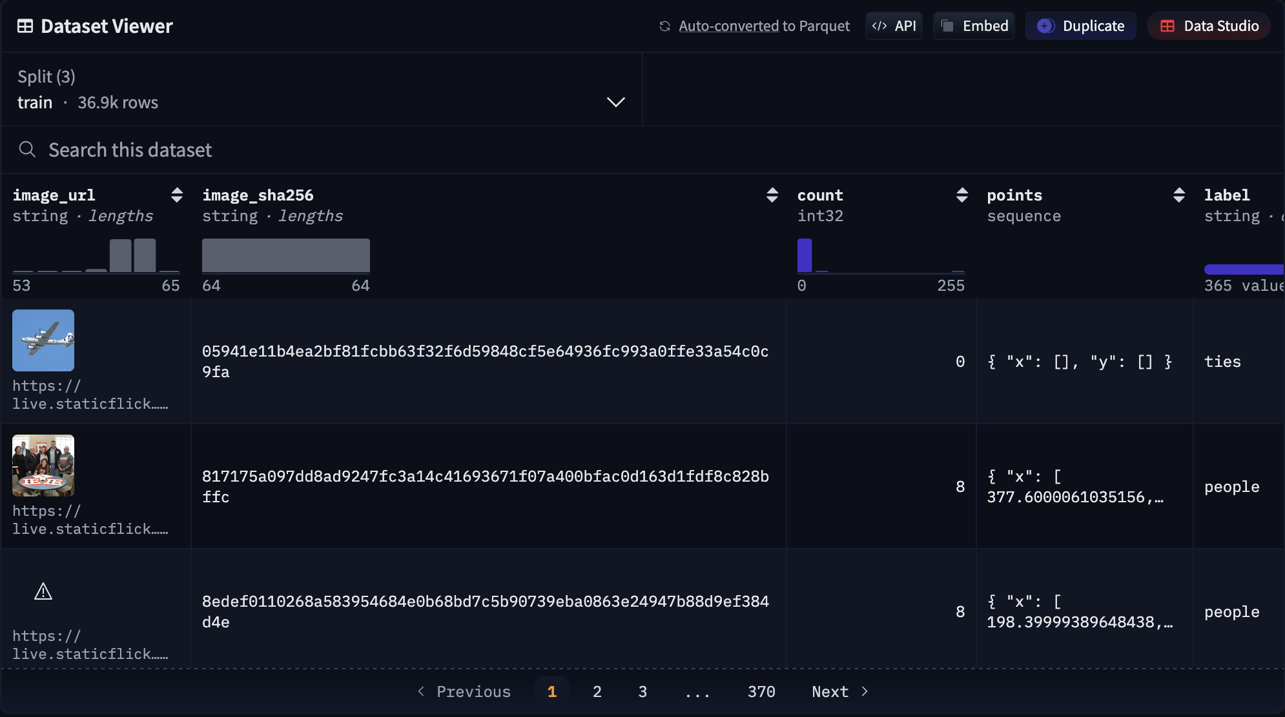
pixmo-count

Slide 11
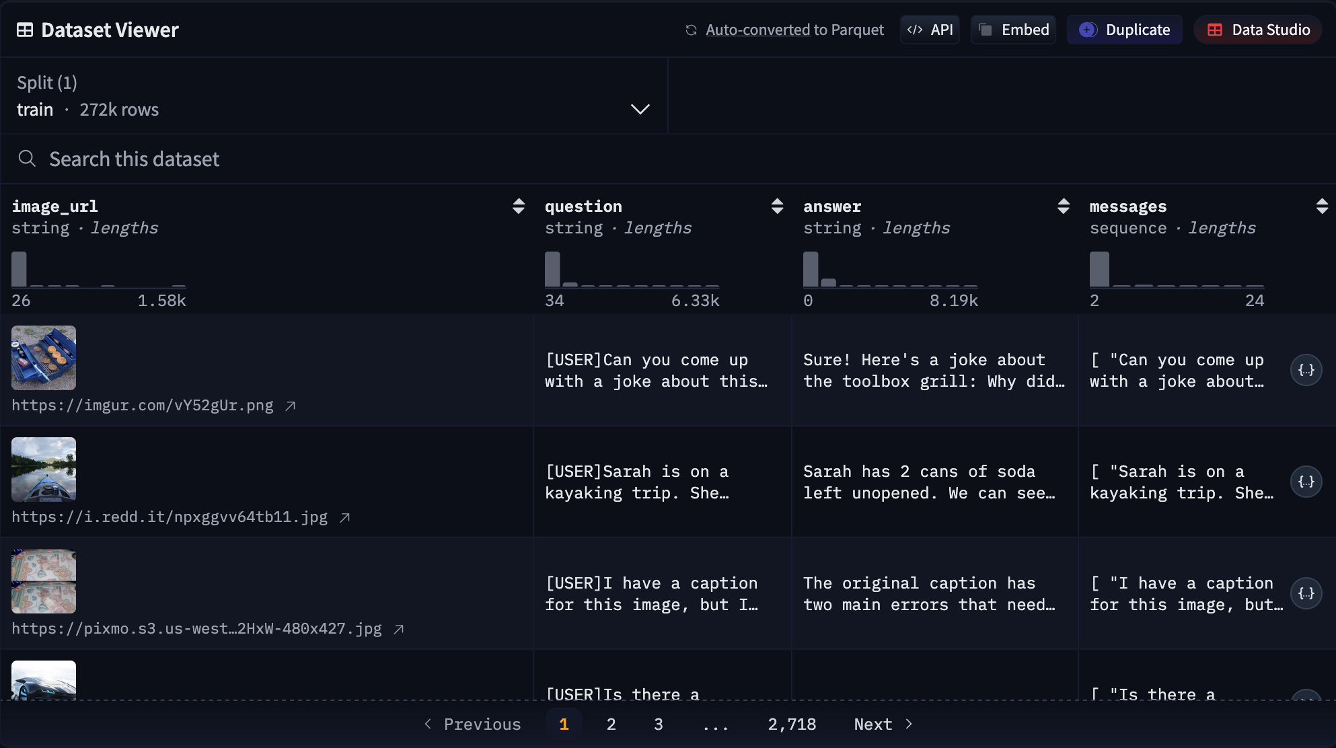
pixmo-cap-qna

Slide 12
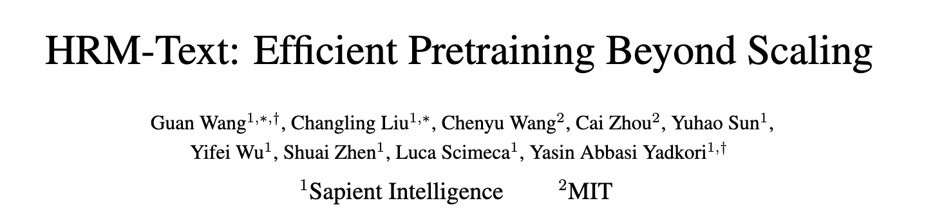
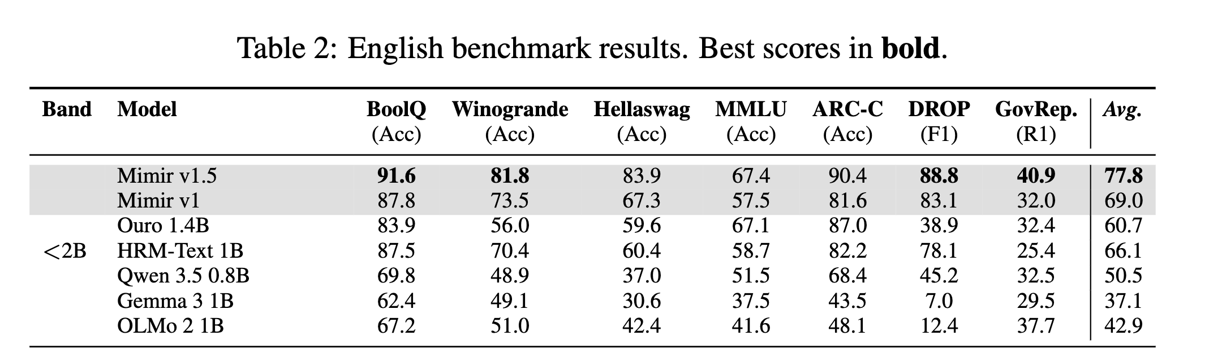
Comparison models – HMR-Text

Slide 13

Comparison models – Qwen 3.5 4B
- 4B

Slide 14
Evaluation

Slide 15
Bibliography

