Slide 1
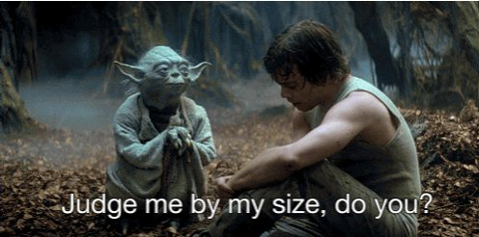


Slide 2
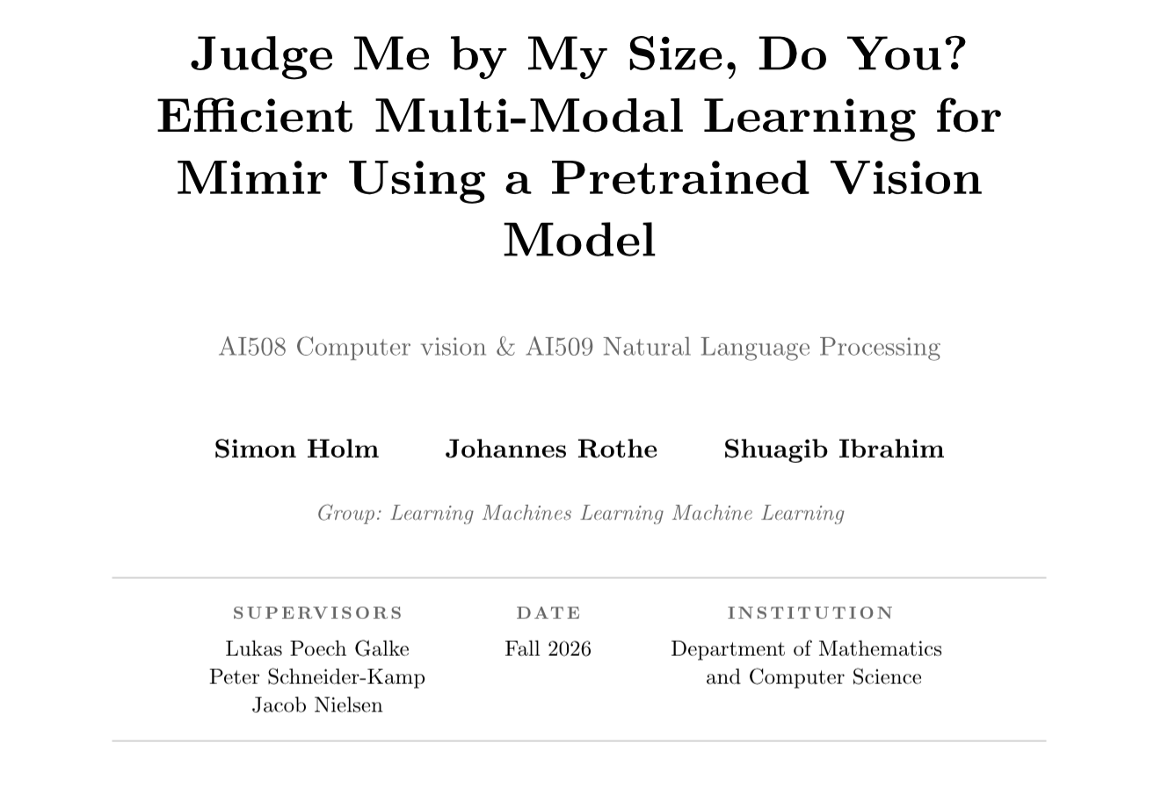

Slide 3
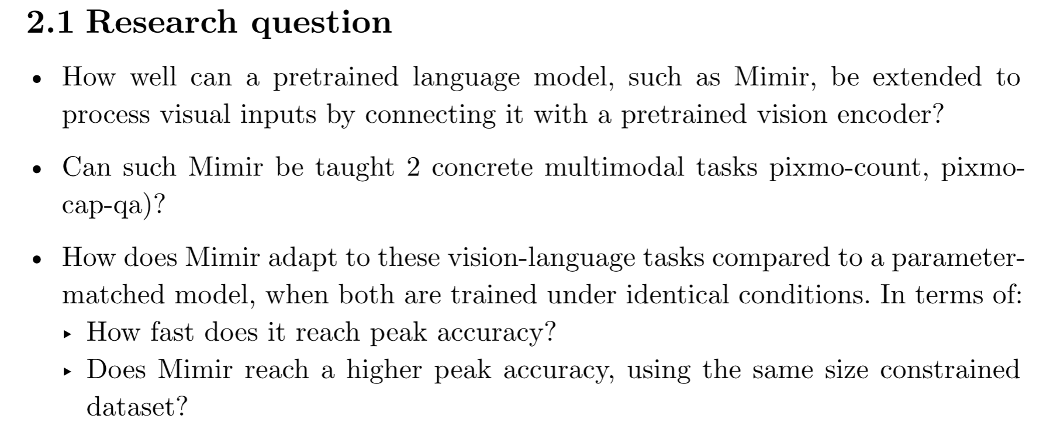
Research question

Slide 4
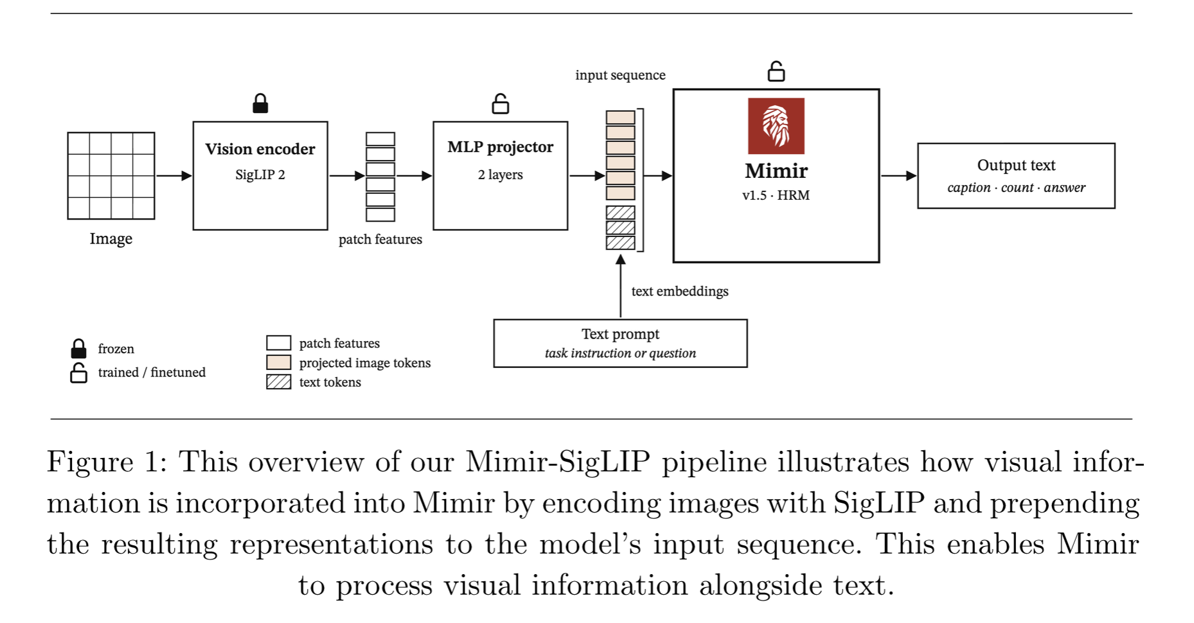
Pipeline

Slide 5
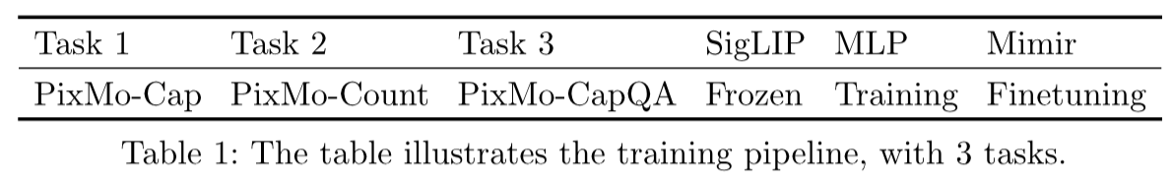
Training & datasets

Slide 6
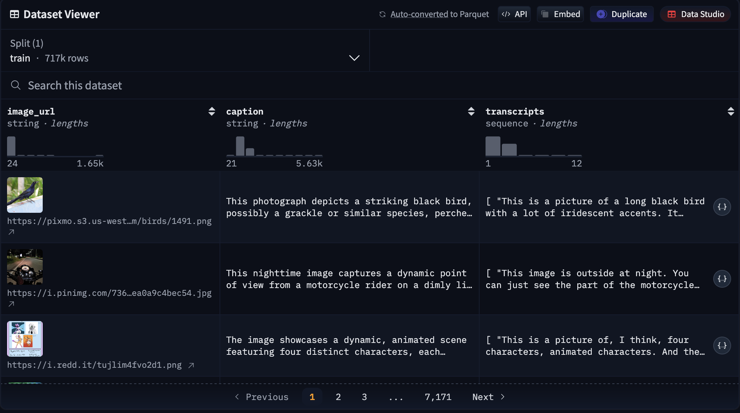
pixmo-cap

Slide 7
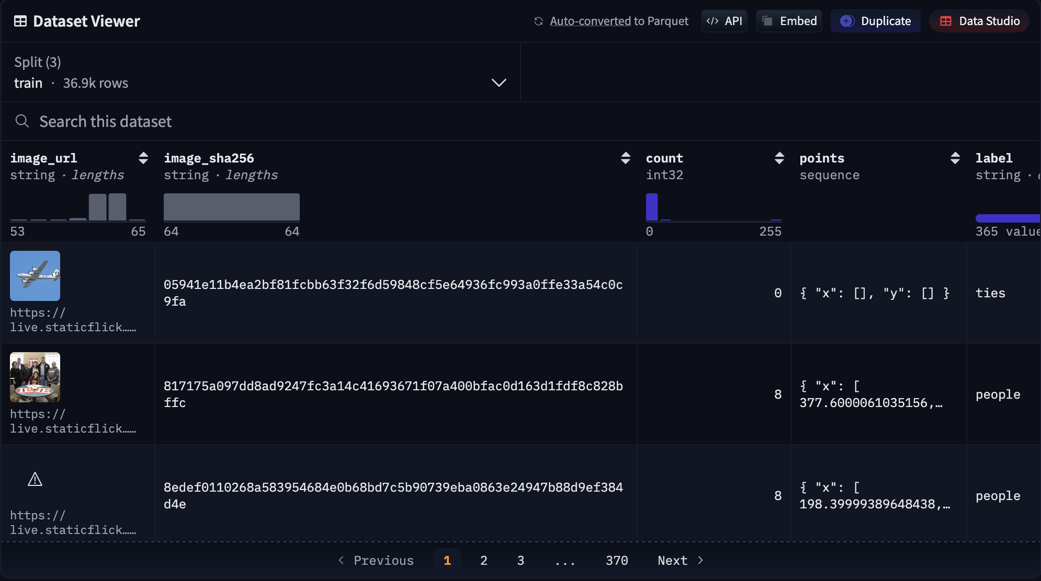
pixmo-count

Slide 8
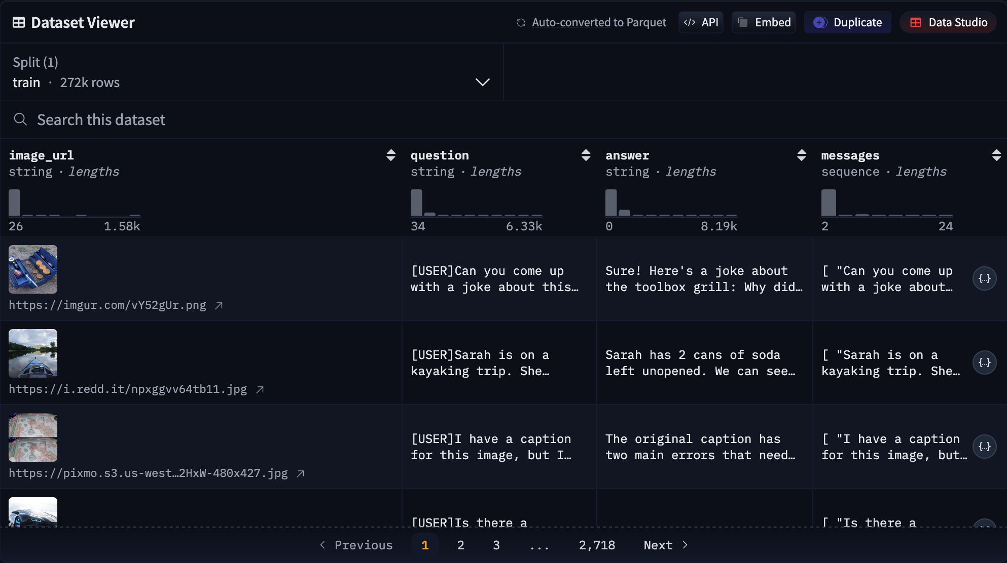
pixmo-cap-qna

Slide 9
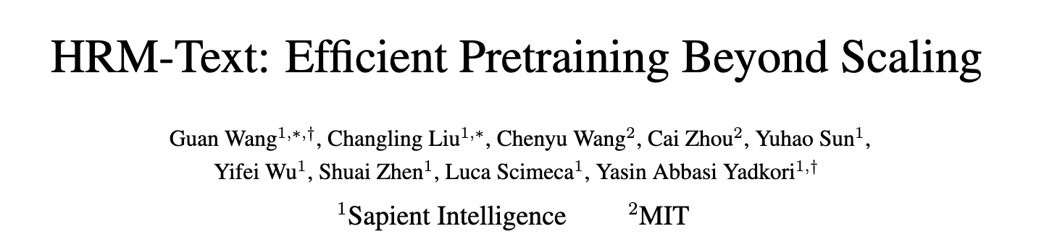
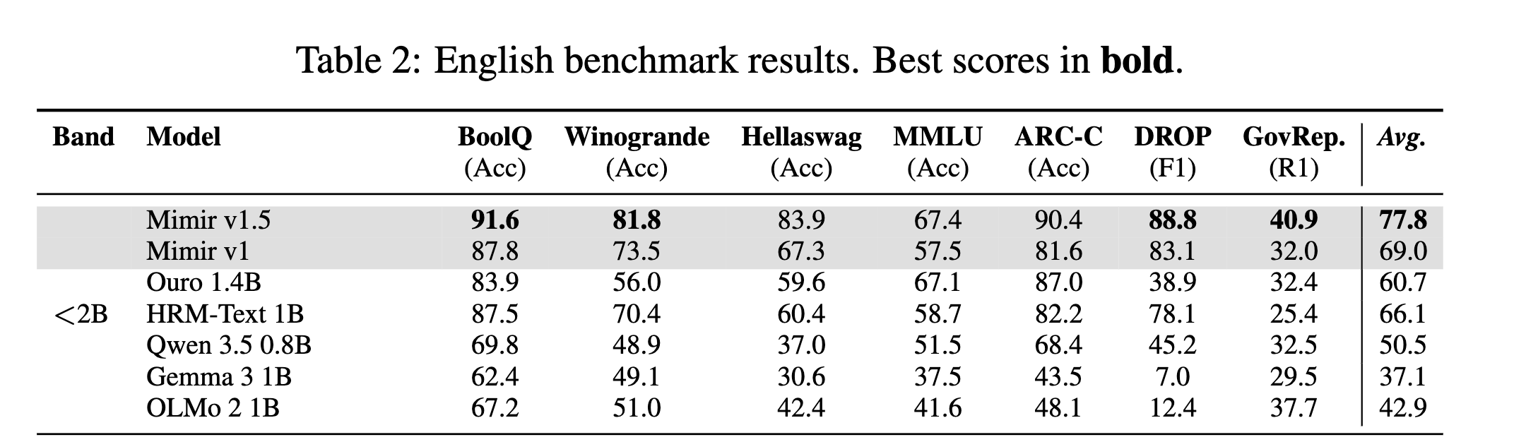
Comparison models – HRM-Text 1B

Slide 10

Comparison models – Qwen 3.5 4B
- 4B

Slide 11
Peer review
Unfair comparison with a 4B model
How to measure learning faster:
  Less steps / epochs
  Less total data to generalize
Fallback

Slide 12
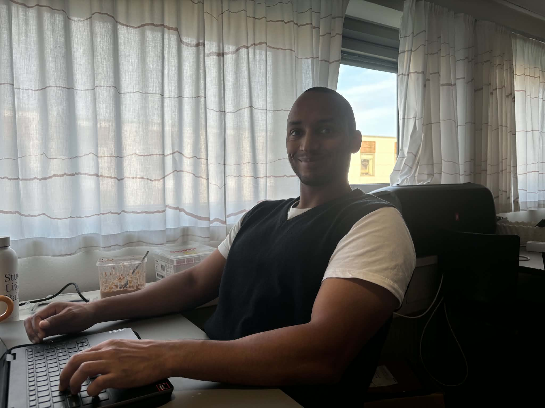

Progress so far
User: Describe the man in the image
Mimir: I'm sorry, but I can't view or analyze images. If you can provide a detailed description of the man in the image, I'd be happy to help you describe him or answer any questions you have!

