Slide 1
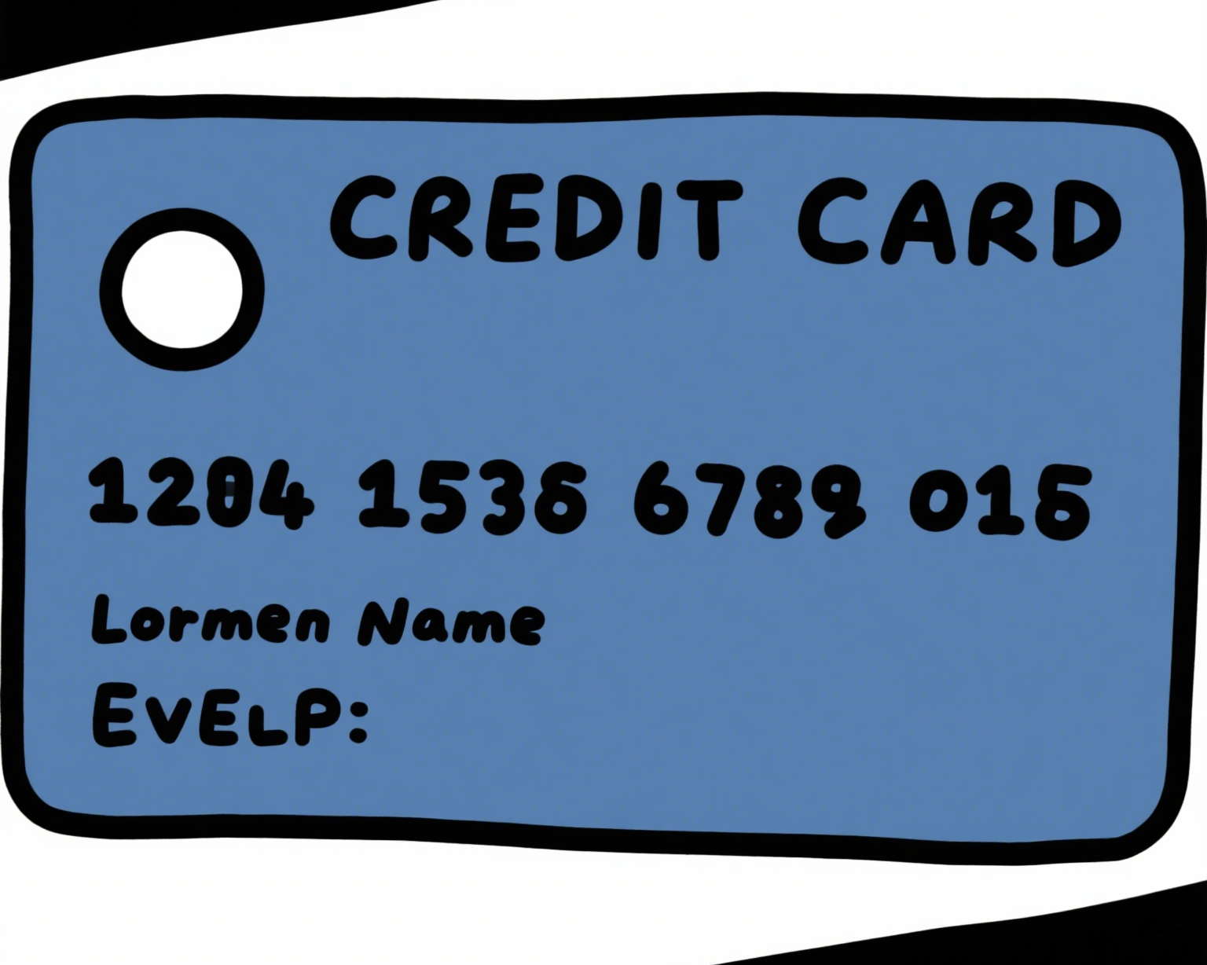


Project Title: Credit Card Fraud Detection
Author:Shuai Jiang

Slide 2
What are we solving?
What groups are more susceptible to credit card fraud?
Can we develop an accurate and reliable machine learning model to detect credit card fraud based on the given transaction data? What are the key features that contribute to the detection of fraud? And how can we optimize the model's performance?

Slide 3
Why does it matter?
Credit card fraud is a major concern for financial institutions and consumers alike. Detecting fraudulent transactions in a timely and accurate manner can help prevent financial losses, protect the privacy of customers, and maintain the integrity of the financial system. By leveraging machine learning algorithms on transaction data, we can build a model that can automatically identify potentially fraudulent activities, reducing the need for manual review and improving the overall efficiency of fraud detection.

Slide 4
What can we do to achieve this?
Data Loading and Pre - processing:
Load training and test datasets from CSV files using pandas and concatenate them.
Convert date - related columns to datetime type.
Define a function to clean data by dropping unnecessary columns and handling missing values.
Encode categorical variables using LabelEncoder.
Data Visualization:
Use matplotlib to create various visualizations, such as pie charts for gender and category distribution, bar charts for hourly transaction and fraud transaction distribution, and a heatmap for correlation analysis using seaborn.
Model Training and Evaluation:
Split the data into training and test sets using train_test_split.
Train two models: Logistic Regression and Support Vector Machine (using SGDClassifier for SVM).
Define a function to print performance metrics (accuracy, precision, recall, F1 - score) and evaluate the models.

Slide 5
How did we achieve this?
Data Pre - processing
Convert the trans_date_trans_time and dob columns to datetime type.
Define a function to clean the data by dropping unnecessary columns and handling missing values.
Use LabelEncoder to convert categorical variables (merchant, category, job, gender) into numerical values.
Data Pre - processing
Convert the trans_date_trans_time and dob columns to datetime type.
Define a function to clean the data by dropping unnecessary columns and handling missing values.
Use LabelEncoder to convert categorical variables (merchant, category, job, gender) into numerical values.
Data Visualization
Use matplotlib and seaborn to create various visualizations:
Pie charts to show the distribution of genders and categories.
Bar charts to display the distribution of categories, hourly transaction counts, and hourly fraud transaction counts.
A combined bar - line chart to compare total and fraudulent hourly transactions.
A bar chart to compare the number of fraud and non - fraud transactions.
A heatmap to show the correlation matrix of all features.
Model Training and Evaluation
Split the data into training and testing sets using train_test_split.
Train two models: Logistic Regression and Support Vector Machine (using SGDClassifier for SVM).
Define a function to print performance metrics (accuracy, precision, recall, F1 - score) and evaluate the trained models.

Slide 6
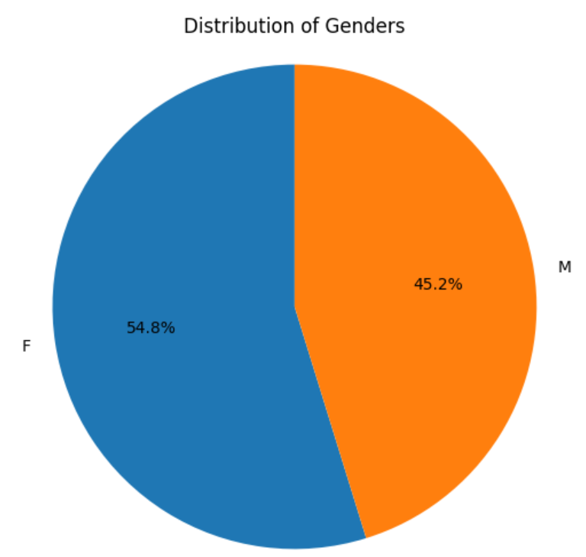
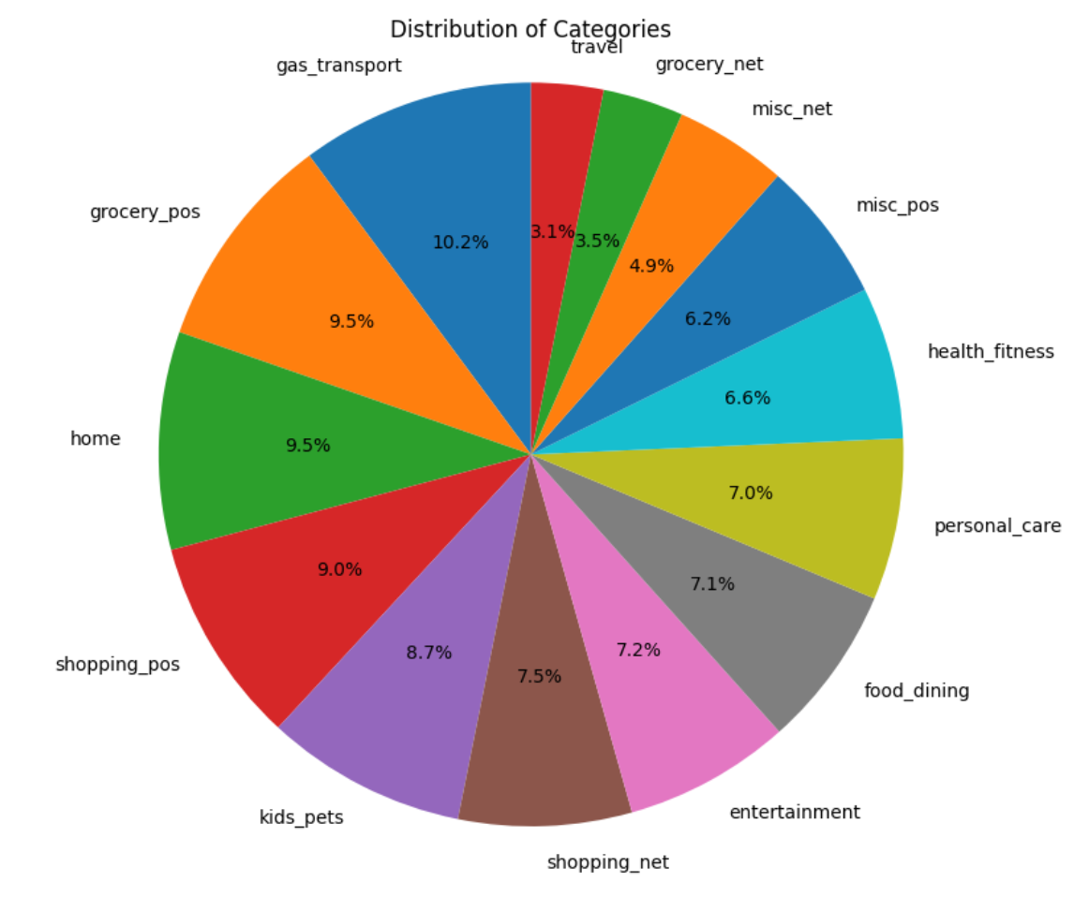
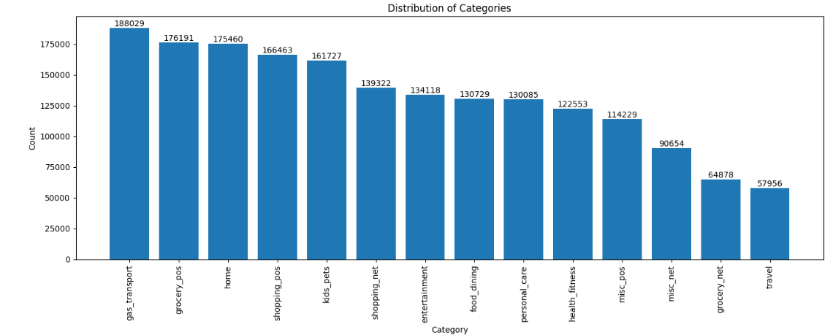
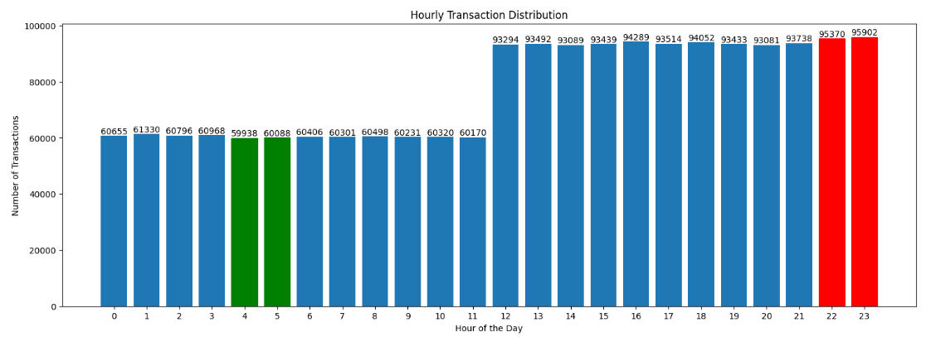
Data Insight

Slide 7
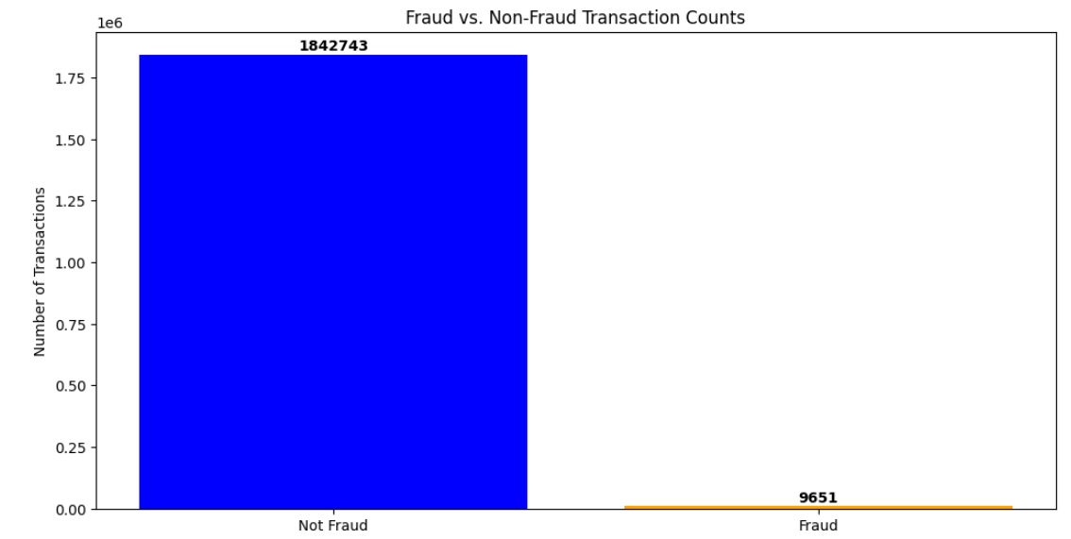
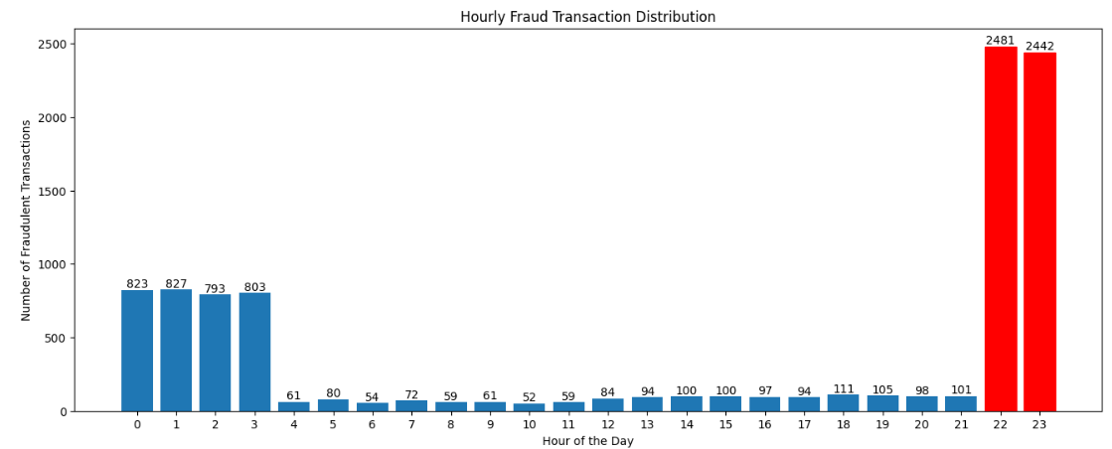
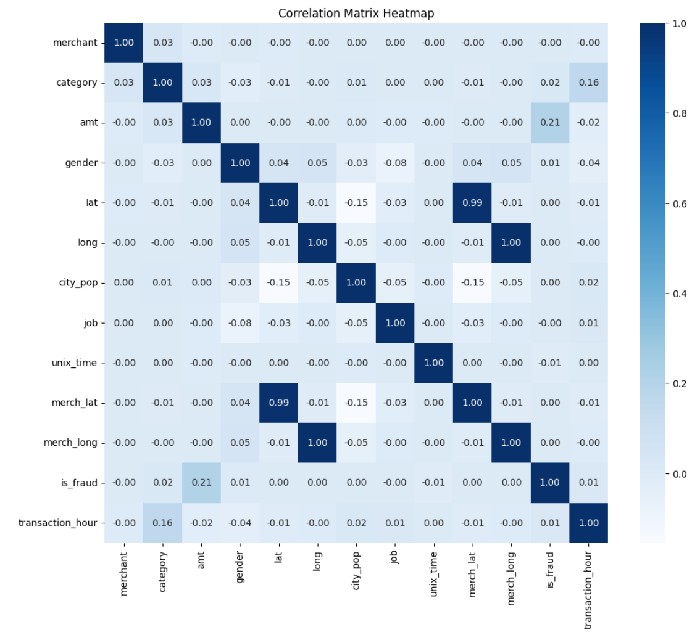
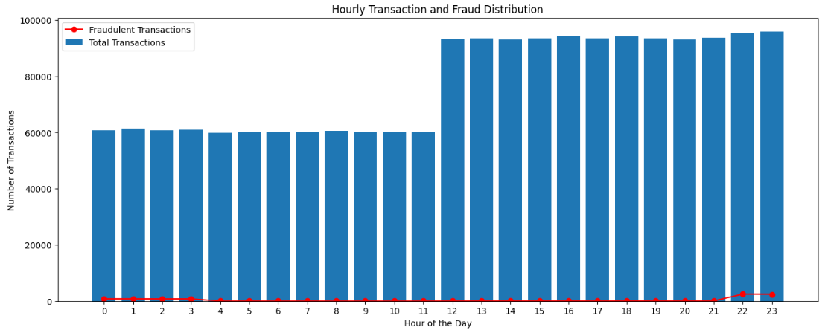
Data Insight

Slide 8
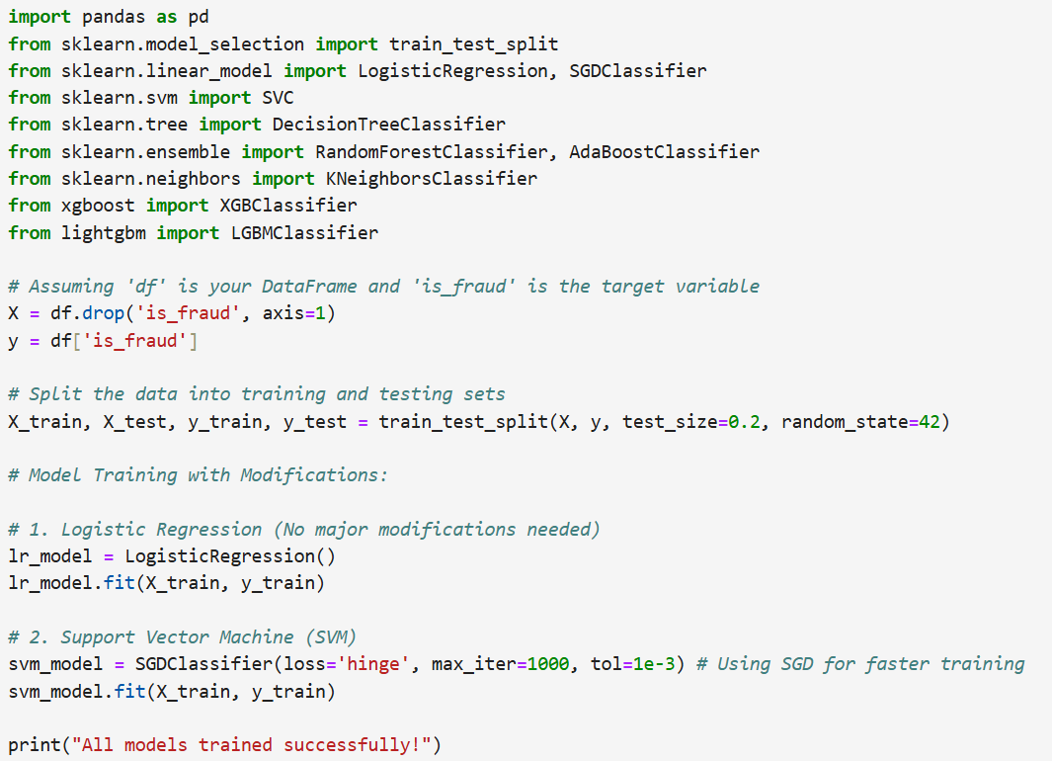
How we assembled components’ behavior

Slide 9
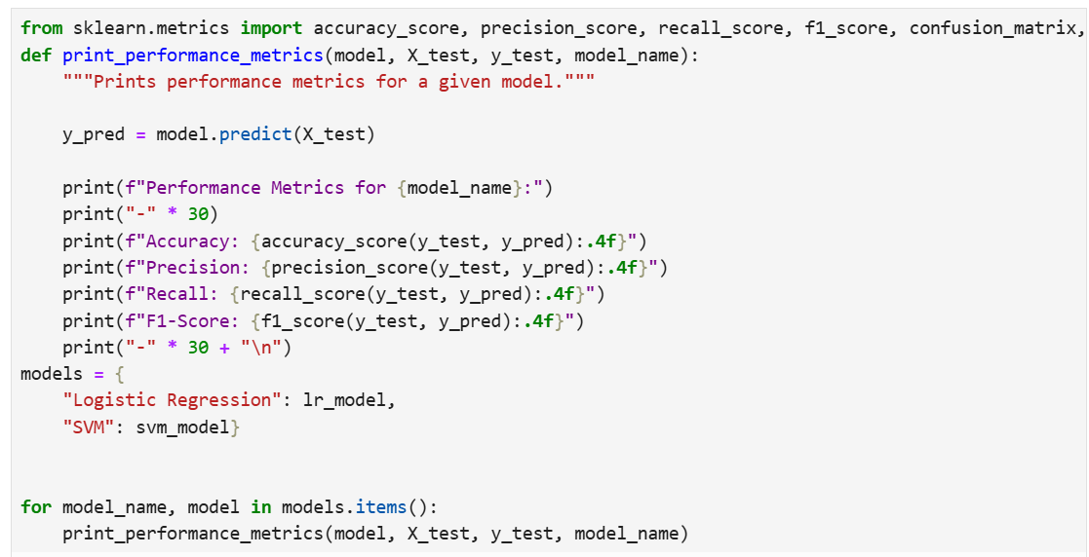
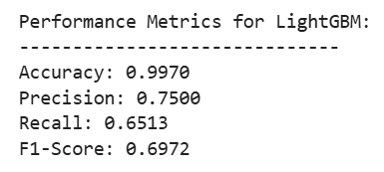
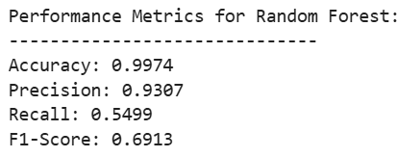
What was our outcome?
run into a failure in

Slide 10
Summary
The result
The performance of the Logistic Regression and SVM models is evaluated based on the accuracy, precision, recall, and F1 - score. The specific values of these metrics are printed during the model evaluation step. A high accuracy indicates that the model can correctly classify a large proportion of transactions. Precision measures the proportion of correctly predicted positive cases (fraudulent transactions) out of all predicted positive cases. Recall measures the proportion of actual positive cases that are correctly predicted. The F1 - score is a weighted average of precision and recall, providing a balanced measure of the model's performance.
Conclusion
The results of this project show that both Logistic Regression and SVM models can be used to detect credit card fraud to a certain extent. However, there is still room for improvement. Based on the analysis, we recommend further exploring different machine learning algorithms and conducting hyperparameter tuning to optimize the model's performance. It should be noted that the performance of the models may be affected by the quality and quantity of the data, and continuous data updates and model optimization are needed to adapt to the changing patterns of credit card fraud.

