Slide 1

Tasking
Smart Task Allocation System for Small and Medium Enterprises
User Tutorial
Topic Number CSIT-26-S2-04 Group Number FYP-26-S2-35
Notes:
Welcome to Tasking. Our group number is FYP-26-S2-35, This video will show you how to use our system.

Slide 2
THE HIERARCHY
Roles and Permission Scope
Internal Hierarchy
External Roles
Each level fully contains every level below it
Never inherited by the hierarchy
Owner
Entire company and all departments
Casual Worker
Only the jobs they accepted
▼
Partner
Entire company, minus 6 admin operations
▼
Guest User
Manager
Own department only
Public job board only
▼
Employee
Own shifts and tasks only
Assignment flows one level down only
Notes:
Tasking has six roles. These four on the left form a strict hierarchy, where each level can do everything the level below it can, and more. Owner covers the whole company. Partner is nearly identical. Manager is limited to their own department. Employee sees only their own work.
These two on the right sit outside that chain. Casual Workers see only the jobs they personally accepted, and Guests see only the public job board.
One rule runs through the entire system is that work is always assigned exactly one level down.

Slide 3
SCOPE
Roles Demonstrated in This Video
Demonstrated
✔
Owner
✔
Manager
✔
Employee
✔
Casual Worker
Entire company
Own department
Own work + supervises CWs
Own accepted jobs
Not Demonstrated
✘
Partner
Functionally ~99% identical to Owner. Only minor admin operations are restricted
✘
Guest User
Everything a Guest can do is already covered by the Casual Worker.
Notes:
We will demonstrate four of them: Owner, Manager, Employee and Casual Worker.
Partner is skipped, because it is about ninety-nine percent identical to Owner.
Guest is skipped, because everything it can do is already covered by the Casual Worker.

Slide 4
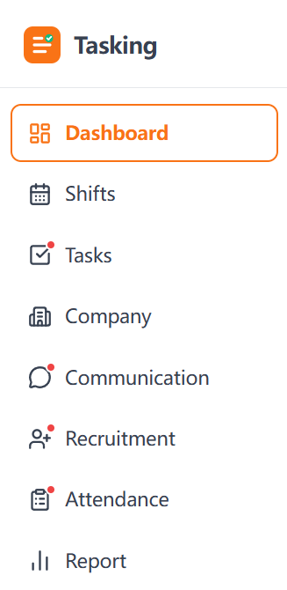
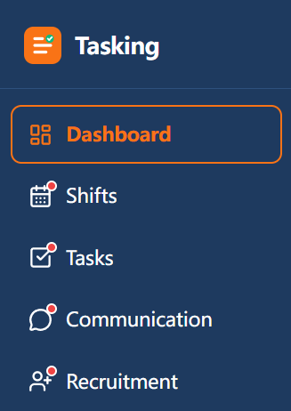
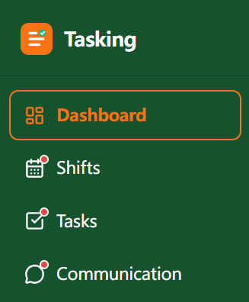
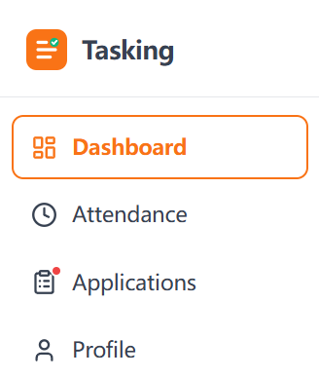
READING THE INTERFACE
How to Tell Which Role Is on Screen
Every role shares one interface. Only the sidebar colour and the number of menu items change.
Paste
Owner
sidebar
screenshot
Paste
Manager
sidebar
screenshot
Owner
Manager
Employee
Casual Worker
White · 8 items
Navy blue · 5 items
Dark green · 4 items
White · 4 items
Dashboard · Shifts · Tasks · Company
Communication · Recruitment
Attendance · Report
Dashboard · Shifts · Tasks
Communication · Recruitment
Dashboard · Shifts
Tasks · Communication
Dashboard · Attendance
Applications · Profile
Notes:
Every role shares the same interface. Only two things change: the sidebar color, and how many menu items it has.
Owner has a white sidebar with eight items. Manager is navy blue with five. Employee is dark green with four. Casual Worker is white again, but with four items comparing to Owner.

Slide 5
SYSTEM MAP
Eight Functional Modules
Arrows show dependency: a module needs the data produced by the one before it.
Account & Auth
Team / Company
Recruitment
Register · sign in
Departments · members
Hire casual workers
Shift
Communication
Schedule who works when
Announcements
and messages
Independent of the
chain above. Runs
across every module
and every role.
Task
Attendance
Assign · track · rework
Clock in · swap · off day
Report
Historical analytics
Notes:
The system has eight modules, and they depend on each other in this order.
You register and set up the company first.
Recruitment brings in casual workers.
Shifts decide who works when.
Tasks and attendance both sit on top of shifts.
Report reads from everything above it.
Communication is independent, and runs across all of them.

Slide 6
WHAT COMES NEXT
Structure of This Video
PART 1 Feature walkthrough, module by module
PART 2 The Storyline
A single role's perspective per module.
Goal: learn how each feature works.
One real business flow, across four roles.
Post a job
# | Module | Role | Length | Focus | Timestamp
0 | Account & Auth | All four |  | Sign in as each role, compare sidebars
1 | Team / Company | Owner |  | Departments, invite members, company profile
2 | Recruitment | Owner |  | Job templates, posting states, applicant list
3 | Shift | Owner |  | Manual create, templates, drag to adjust, publish
4 | Task | Owner |  | Manual assign, sub-tasks, 4-state board, archive
5 | Attendance | Owner |  | Records calendar, edit clock time, approvals
6 | Communication | Owner |  | Announcement scope, message threads
7 | Report | Owner |  | Page structure, chart types
Hire
Schedule
Assign work
Execute
Clock in
Review
Goal: understand how roles hand off work and how permissions take effect.
Notes:
This video has two parts. Part one walks through the features module by module, so you learn each one on its own.
Part two follows one real business flow across four roles, so you can see how they hand off work to each other.
Timestamps for every section are listed here, so feel free to jump ahead.

