Slide 1
Q1: How many family movies are rented out in each category?
We can see that among family movies, animation is the most popular type, which was rented out 1166 times. Music is the least popular type, which was rented out 830 times.
SQL query is attached as Query 1 in txt file.
Counts
Category

Slide 2
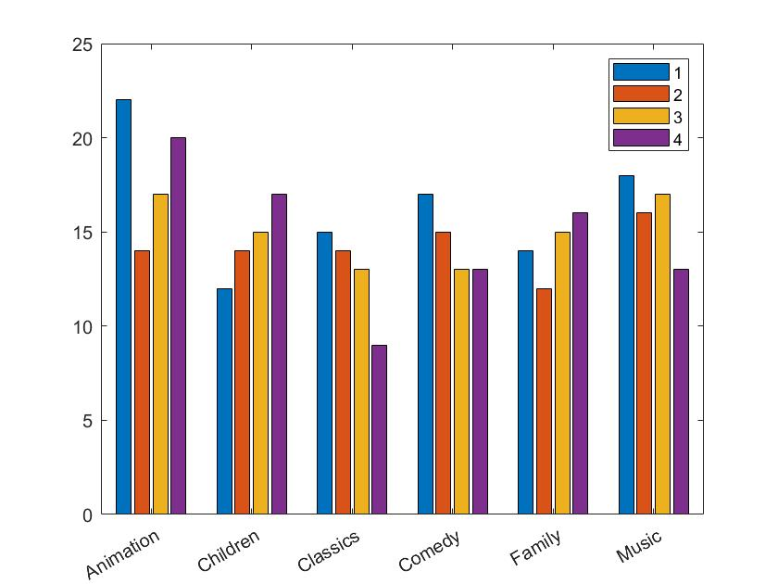
Q2: For family movies, what are the counts for each combination of film type and its corresponding rental duration category?
Number of counts for different film types and their rental duration category
This figure shows the count for each combination of the film type and its corresponding rental duration category. Notice that the rental duration is categorized by the quantile level (0%-25%, level 1; 25%-50%, level 2; 50%-75%, level 3, 75%-100%, level 4) across all film types. We can see that for a majority of the family movies, the rental durations are rather short, since the maximum counts usually happen in the first quantile. The exceptions are Children and Family type.
SQL query is attached as Query 2 in txt file.
Counts
Category

Slide 3
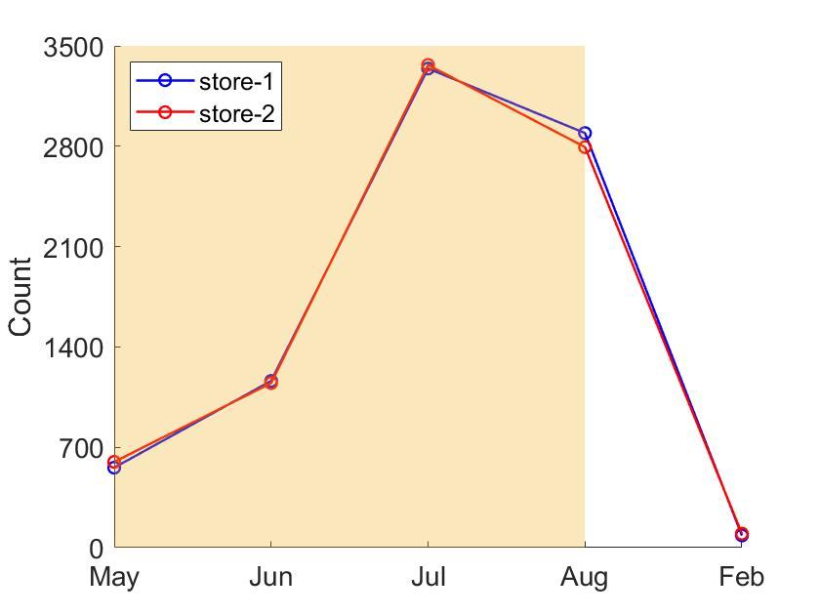
Q3: how the two stores compare in their count of rental orders during every month for all the years?
Number of rental orders for two stores
We can see that both stores have achieved similar number of rental orders over the months.
SQL query is attached as Query 3 in txt file.
Counts
2005
2006
Category

Slide 4
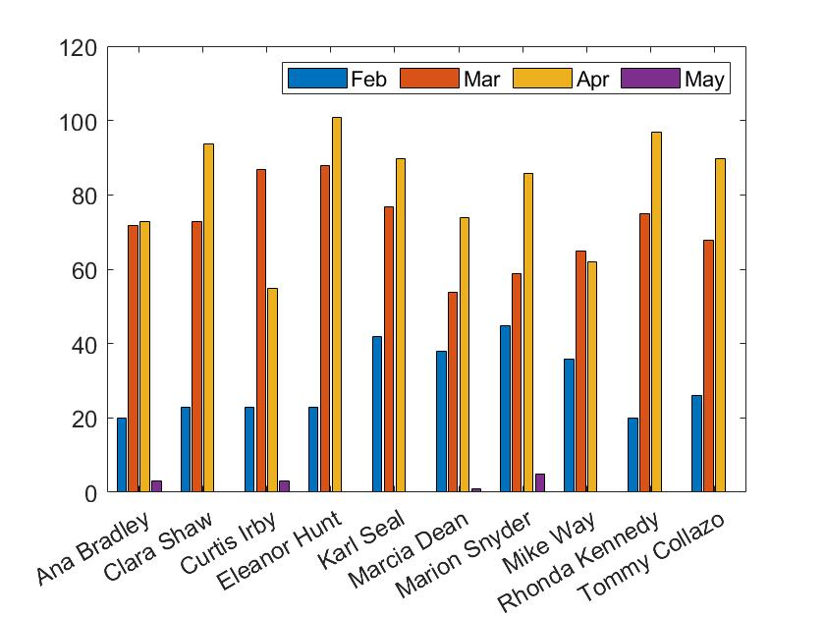
Q4: For top 10 customers, what were the amounts of their monthly payments during 2007?
Monthly payments of top 10 customers
We can see that, for the top 10 customers, most of their payments were made in March and April.
SQL query is attached as Query 4 in txt file.
Payment amount
Customer

