Slide 1
ALPHA-GPT 3.0
A Multi-Agent Debate Framework
for Quantitative Investment Research
Ronald Liu · Shuai Meng · Hao Wang
University of California, Berkeley

Slide 2
THE PROBLEM
Turning Trading Ideas into
Testable Formulas Is Hard
1
2
3
Ambiguous Ideas
Brittle Formulas
No Interpretability
A researcher says "buy undervalued momentum stocks" — but what counts as undervalued? What time window?
A single AI pass often produces invalid math expressions, wrong operators, or formulas that don't match the intent.
One-shot generation is a black box — there's no reasoning trail explaining why a formula was chosen.

Slide 3
OUR APPROACH
Two-Stage Multi-Agent Debate
Instead of one AI writing a formula in a single pass, we have multiple AI agents debate in two stages — first about what to test, then about how to express it mathematically.
STAGE 1
STAGE 2
Idea Debate
Formula Debate
→
"What should we test?"
Three agents independently interpret the trading idea, then critique each other's reasoning.
They converge on a shared hypothesis with clearly defined signals, data sources, and risk factors.
"How do we express it?"
Agents translate the agreed hypothesis into candidate math formulas.
They review each other's formulas for correctness, then revise. Only valid formulas proceed to backtesting.

Slide 4
DEBATE IN ACTION
How Agents Reach Consensus
Input: "Stocks with high momentum and low valuation tend to outperform"
Momentum Agent
Mean-Reversion Agent
Fundamental Agent
Proposes riding price trends with volatility adjustment for safety.
Proposes betting against the crowd — short stocks that are popular.
Proposes combining momentum with quality filters (profitability checks).
ACCEPTED
REJECTED
ACCEPTED

Slide 5
RESULTS
Ablation Study: Does Debate Help?
We test 4 approaches on 500 U.S. stocks (2010–2023). Each method generates candidate trading formulas from the same idea, backtested on held-out data (2021–2023).
Method | What It Does | IC | ICIR | Sharpe
Random GP | Random math search, no AI | 0.029 | 0.182 | 0.45
Single Agent | One AI, one pass | -0.003 | -0.019 | -0.45
Single Agent + GP | One AI + random search | -0.007 | -0.044 | -0.56
Debate (Ours) | Multi-agent debate | 0.007 | 0.033 | 0.39
Key Finding: The single AI agent (with or without random search) produces formulas that often go the wrong direction (negative Sharpe). Debate keeps the signal positive and more reliable across runs.

Slide 6
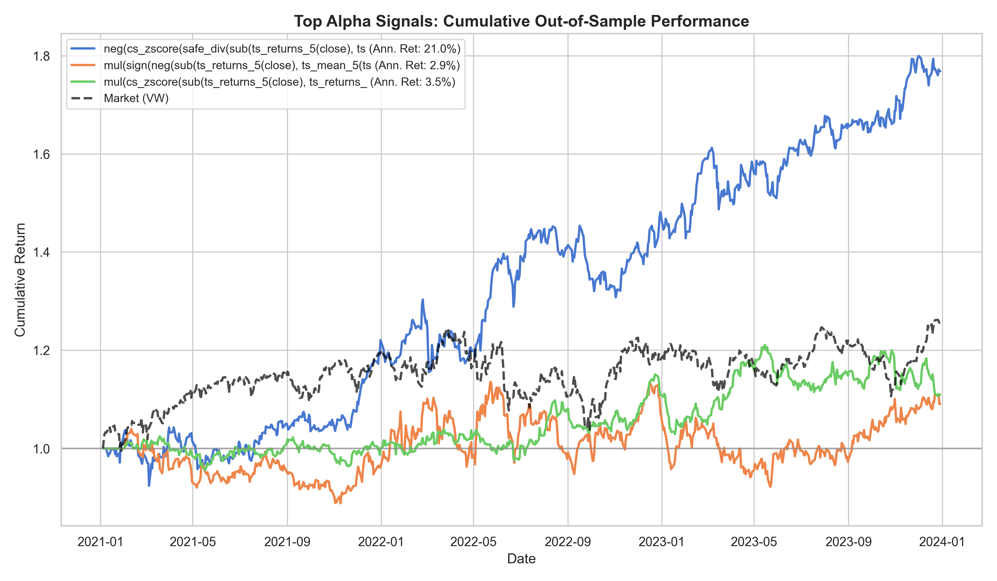
BEST RESULT
Top Alpha from Debate Pipeline
21.0%
1.28
-11.4%
AI Interpretation
Short-term mean reversion: bet that sharp recent moves will reverse.
Annual Return
Sharpe Ratio
Max Drawdown

Slide 7
Key Takeaways
1
Debate beats single-pass generation
Multiple AI agents debating produces more reliable trading signals than a single AI working alone.
2
Structured reasoning = interpretability
The two-stage design creates a clear paper trail: why a hypothesis was chosen, and how it became a formula.
3
LLMs can do useful quant research
With the right framework, language models can generate trading formulas that actually work out-of-sample.
Thank you!

