Slide 1


INFO
6210
Fitness Database
Northeastern University Information Systems
Group 9: Yiyu Chen, Mengyu Zhu, Shuai Shao, Kaidong Shen

Slide 2
Purpose:
Our team is working on a gym company called Fitness, which provides services only to registered members, including training plans and physical fitness treatments. There are also completed training facilities and equipment in the whole building which will provide excellent experience to all the members.

Slide 3
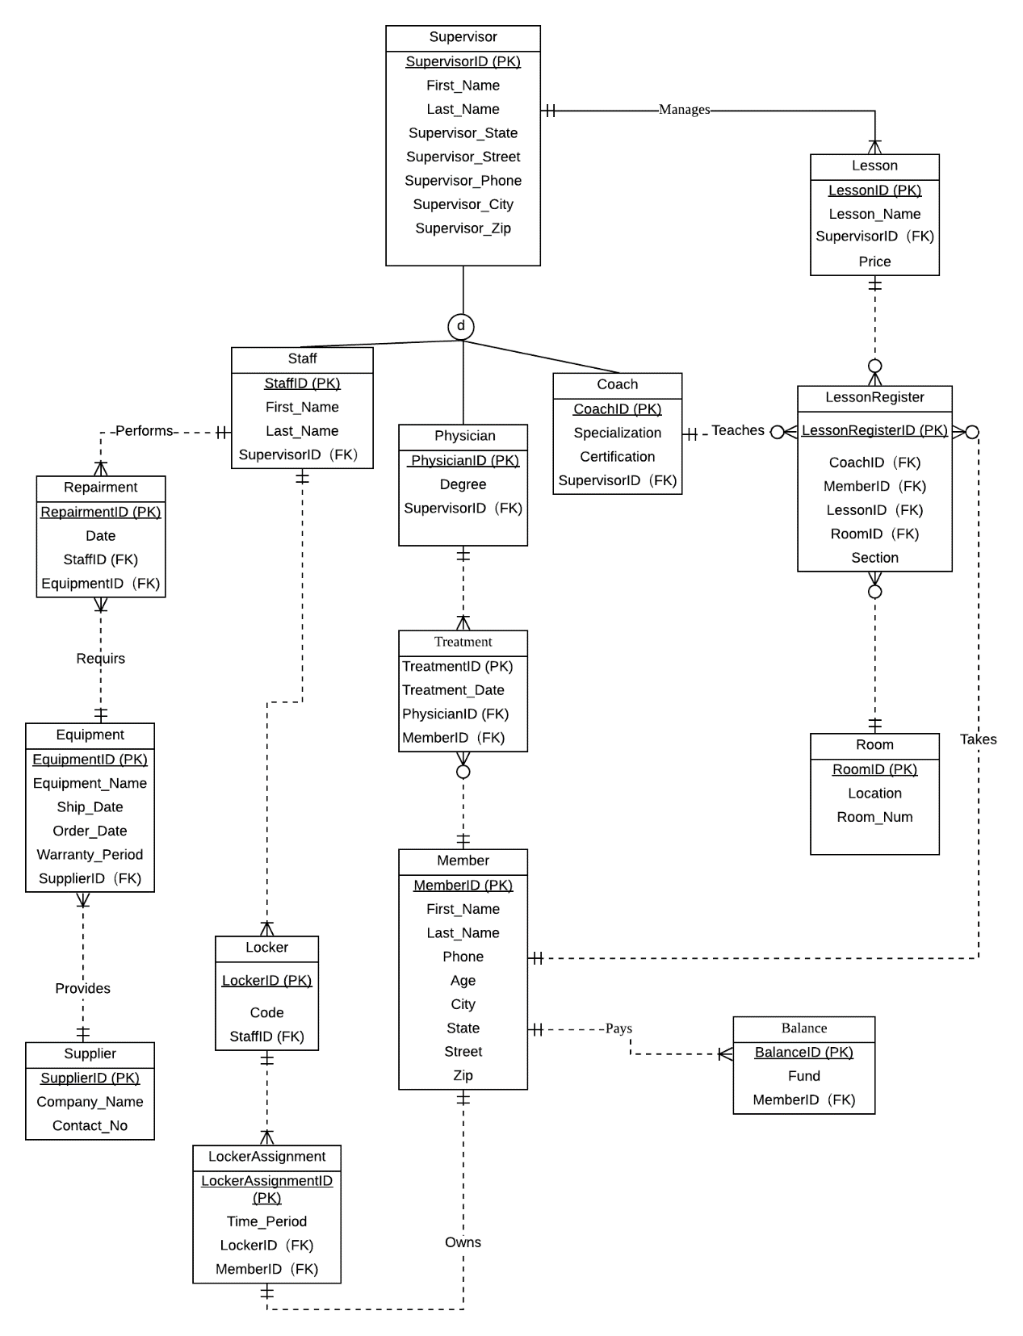
6210 Project
Fitness Database

Slide 4
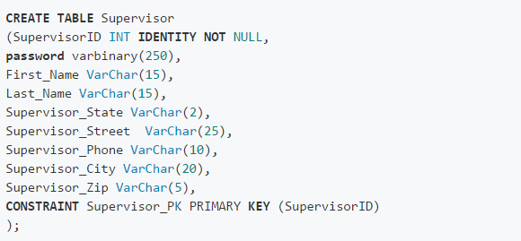
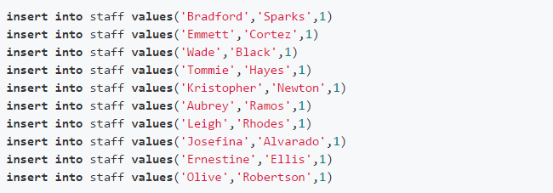
DB Implementation
Create database, tables and relationship
Created a new database to work on our project
Data insertion
Split the work and took charge of different entities

Slide 5
Functions and Views:
Encryption | Functions | Views
Encrypted the password column data in the supervisors table with a symmetric key to blur the data. | Check that if members are injured, they can not register lessons. Check the equipment shipping date and warranty period. Calculate the current balance of members, then add a computed column to the Balance entity. | View the Members whose funds are larger than the average fund. View the Coach ranks.

Slide 6
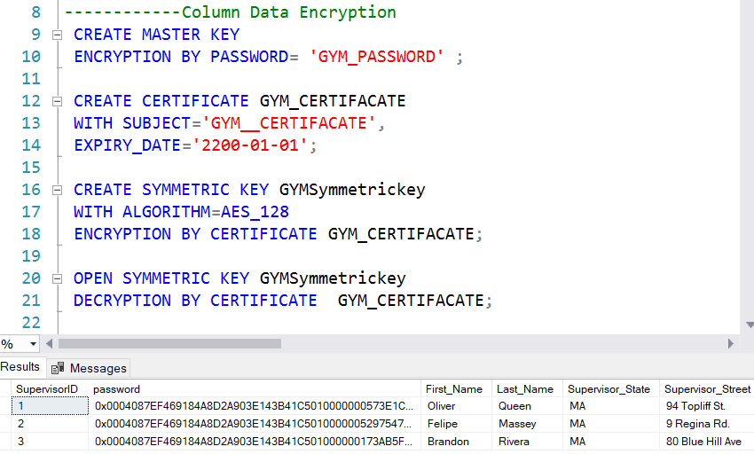

Encryption
Encrypting the passwords of supervisors

Slide 7
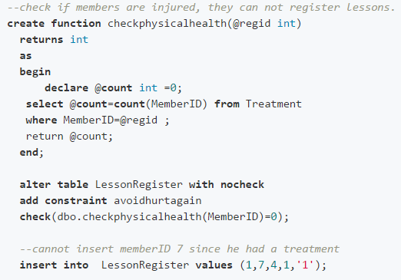
Function checkphysicalhealth
Injured member！
Cannot insert memberID 7 since he had a treatment.

Slide 8
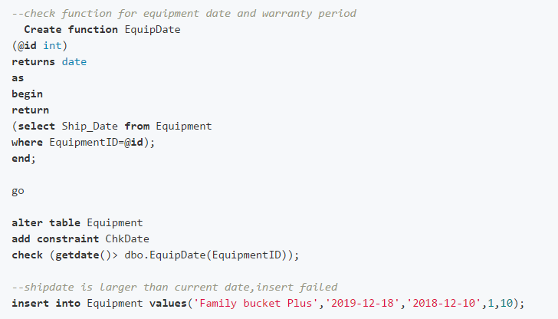
Function EquipDate

Slide 9
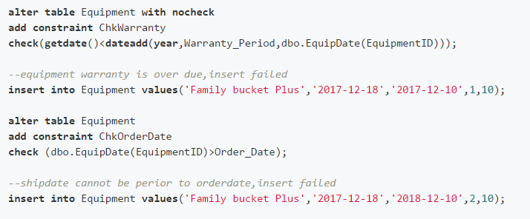
Function EquipDate

Slide 10
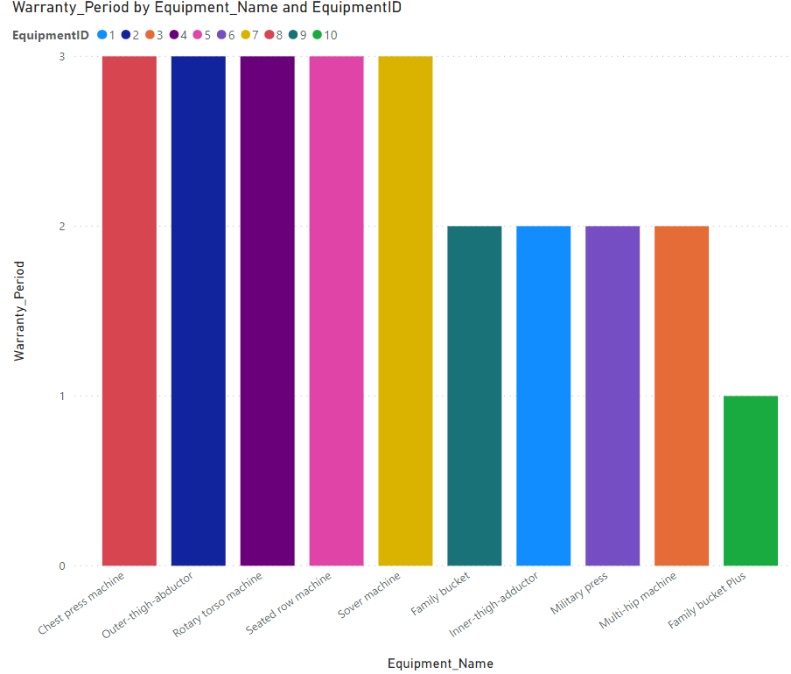
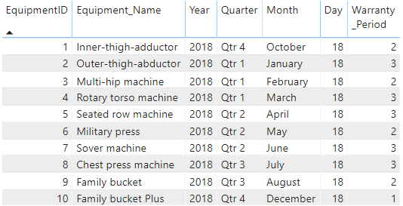
Function EquipDate
Check Warranty Period function for equipment ship date.

Slide 11

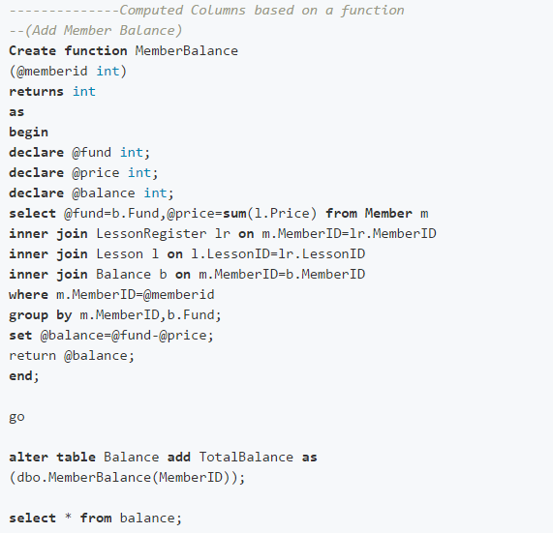
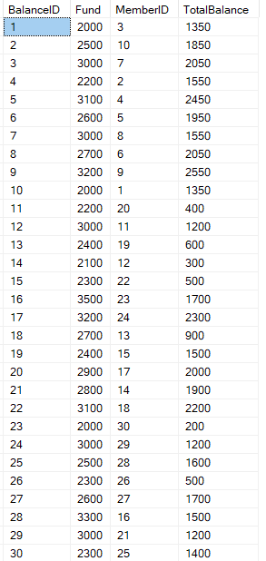
Function
The altered Balance table:

Slide 12
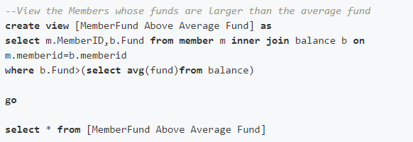
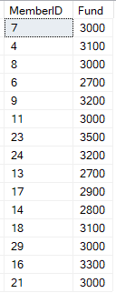
View : MemberFund Above Average Fund
Result of the view
where average fund is 2663:

Slide 13
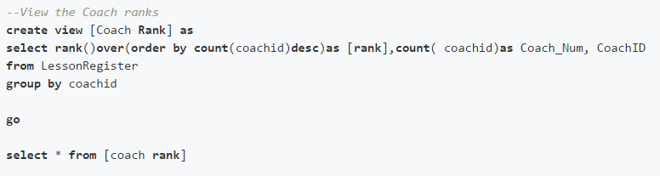
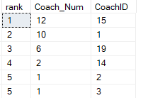
View : Coach Rank
Result of the view:

Slide 14
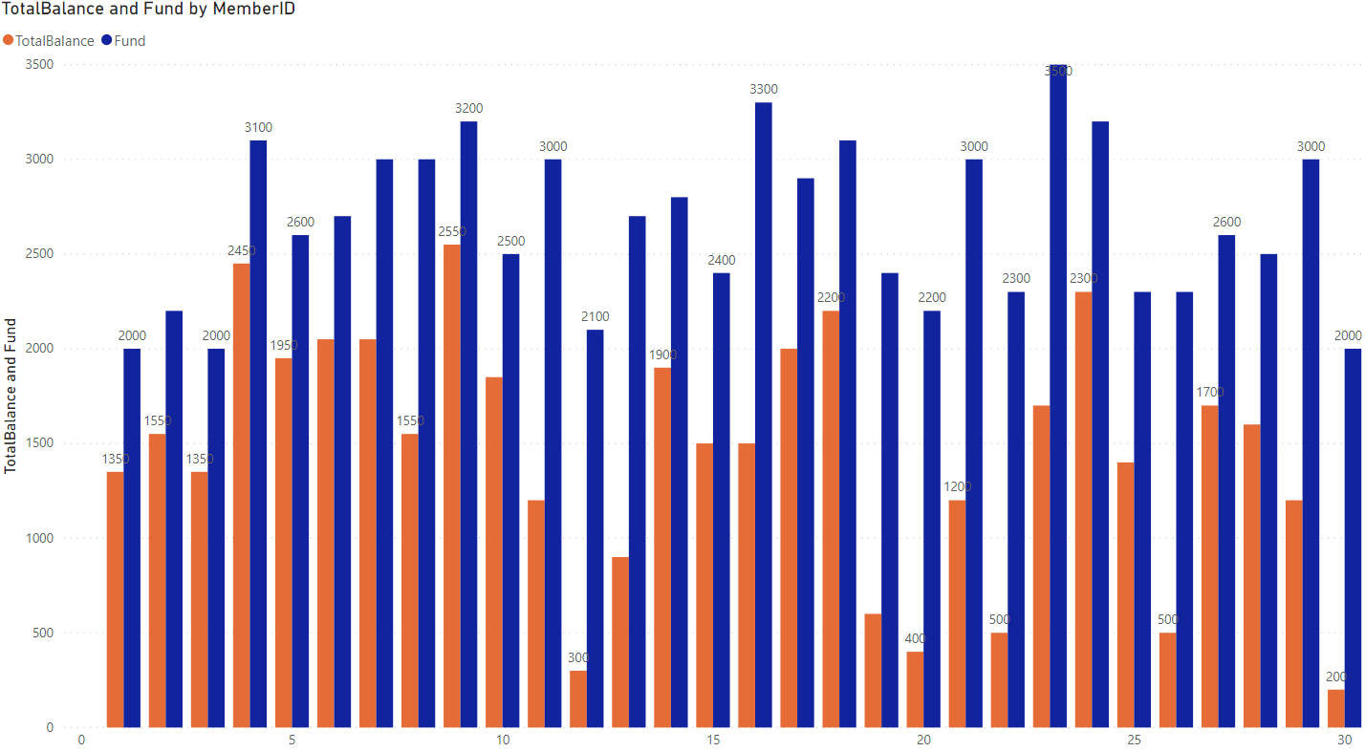
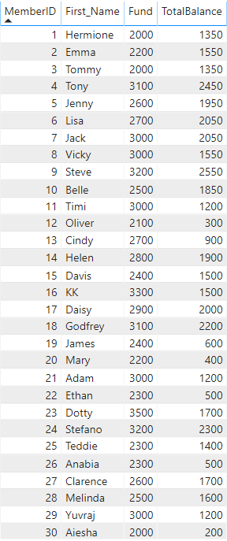
Visualizations Members Balance
The status of everyone's total banlance

Slide 15
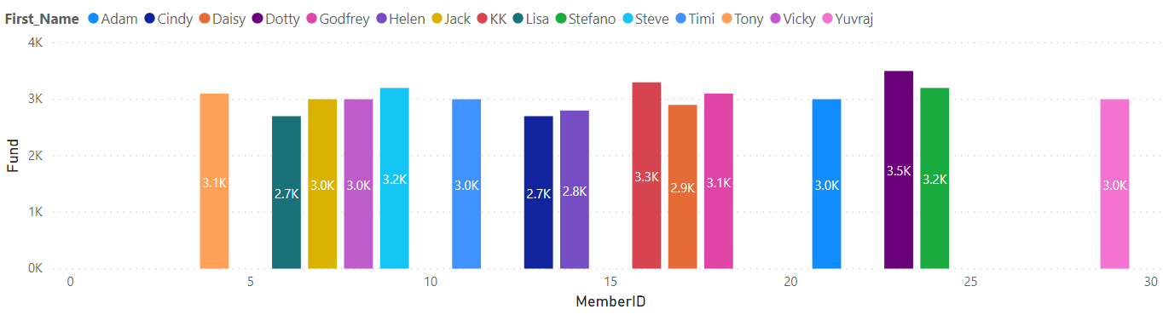
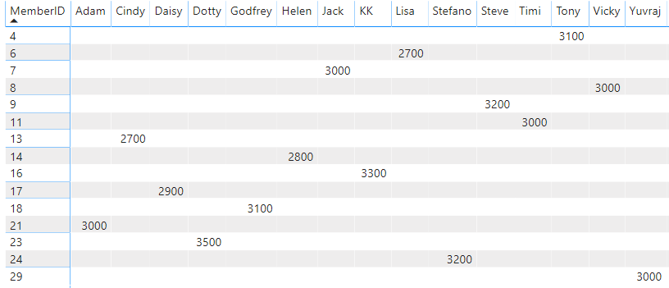
Visualizations Members Balance
The users with funds above the average
Average fund is 2663

Slide 16
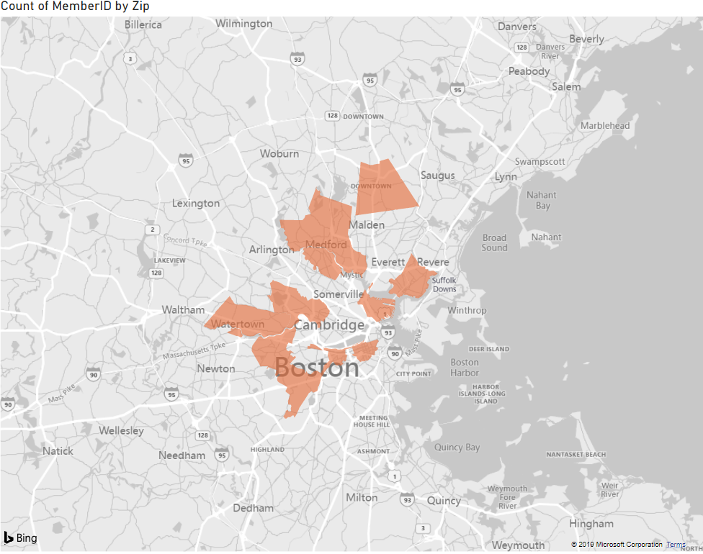
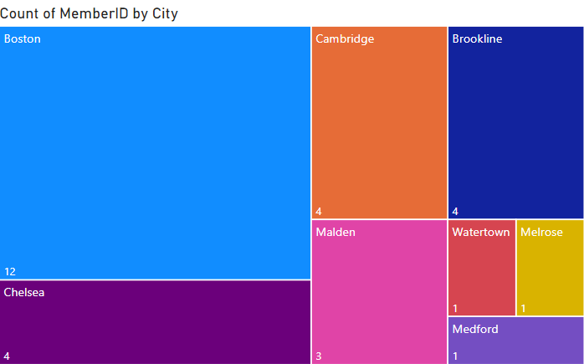
Visualizations Members Location
The distribution of population in different regions
The area covered by Fitness

Slide 17
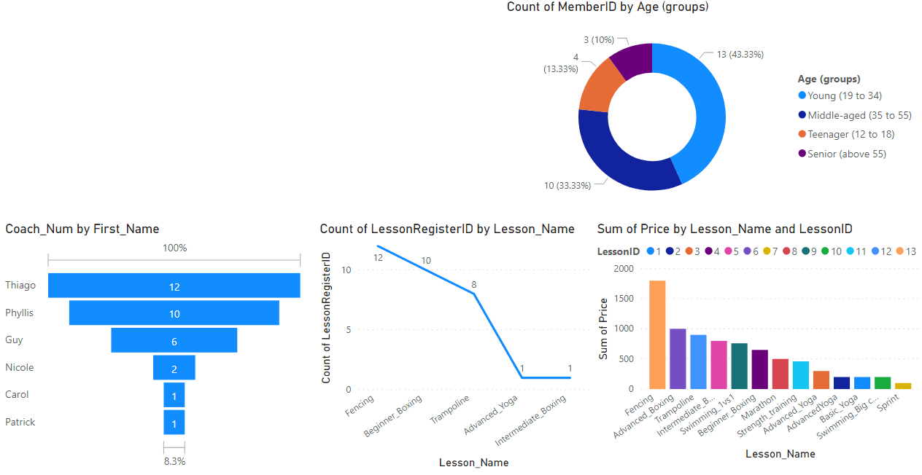
Visualizations Members Information
1. The most popular coach in the gym is Thiago.
2. The most popular lesson is fencing, which is also the most expensive.
3. The main users of the gym are young people between the ages of 20 and 34.

Slide 18
INFO
6210
THANKS
Fitness Database
Northeastern University Information Systems
Group 9: Yiyu Chen, Mengyu Zhu, Shuai Shao, Kaidong Shen

Slide 19

Q&A

