Slide 1
Escape From Wildness
ShuaihaoZhao
Jinpeng Chen

Slide 2
Environment
PC standalone game
Unity3D as the game engine
Writing API using c#
Mixamo website, it's a animated 3d characters model website
Cgtrader website, it's contains models that could be used for the terrian building

Slide 3
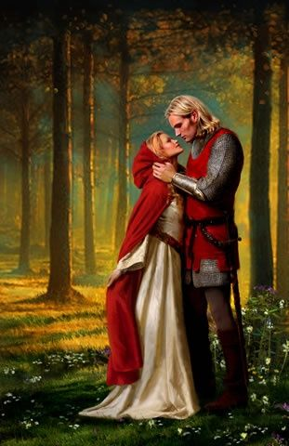
Game Script
Introduction
An medieval knight fell in love with the princess of the king. However, the king had decided to set a marriage with the prince of neighboring country in order to seek peace during this rattled period. Love encourages them to elopement, and they escaped the casle at night... When the king knew this, he was fury and ordered his subordinates to bring the princess back and kill the knight. Finally, they met at the wildness...
medieval paintings of knights,Vickie Brown

Slide 4
Game Design
1. Game Start Design
Using the UI system, tell a story to the user by adding different pictures and words
Add the aduio source during this process
***If time allows, we'll try to make the openning animation instead of just pictures and words

Slide 5
Game Design
2. Game Process Design
Four different scenes systems which are the fighting system, maze system, equipment system and NPC system.
Players can fight, equip and have the conversation with NPCs.
They may also get clues to get out of the maze

Slide 6
Game Design
3. Game End Design
At the end of the game, there is also an end story.(end animation if possiable)
Also an general UI to show the time player use, number of clues they get from NPCs etc.

Slide 7
Reference
Vickie Brown, medieval paintings of knights, https://www.pinterest.ph/pin/525021269056174790
Roland Warren, april 26, 2016 http://www.patheos.com/blogs/rolandwarren/2016/04/130/

Slide 8

Questions

