Slide 1





WSN
IoT Server
User Clients

Slide 2












Radio Frequency
WIFI
3D Printed Case
MQTT
RGBLED
Local
Internet
Input
Output
Communication
Interfacing
Main Control
Perception
Arduino Uno
R4 Wifi
Power System
MPU6050
Storage
Battery Management System
Acceleration
TF Card
Notes:
HARDWARE ABSTRACTION [D]

Slide 3
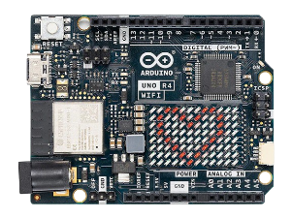
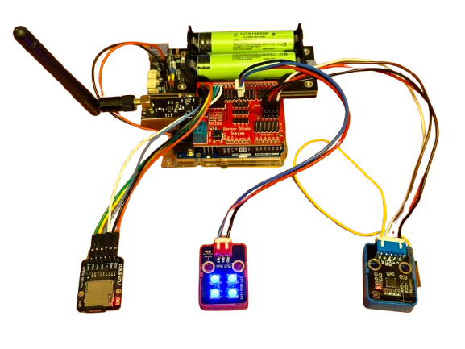
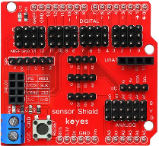
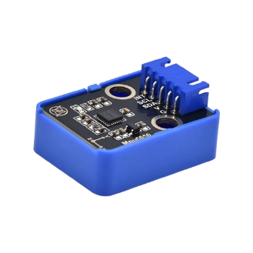
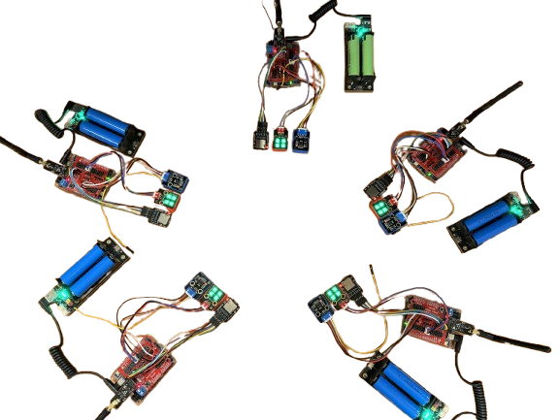
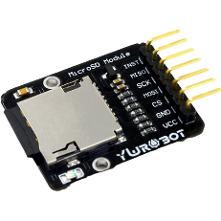
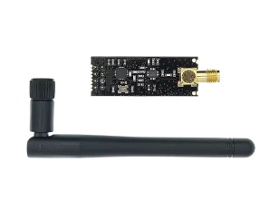
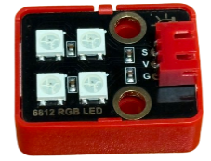
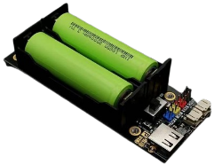
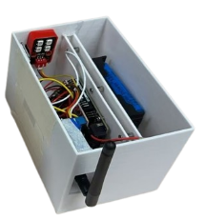
Arduino
Sensor Board
Single ArduinoNode
MPU6050
TF Card
nRF24L01
ArduinoNode WSN
RGB-LED
Battery & BMS
Enclosure
Notes:
HARDWARE

Slide 4

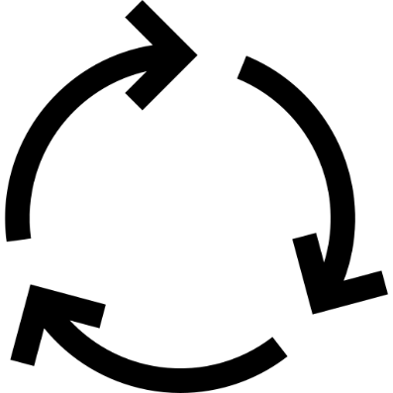


Initialization
Infinite Loop
User Input
Indicators
State
Machine
Foreground
Background
Notes:
HARDWARE

Slide 5
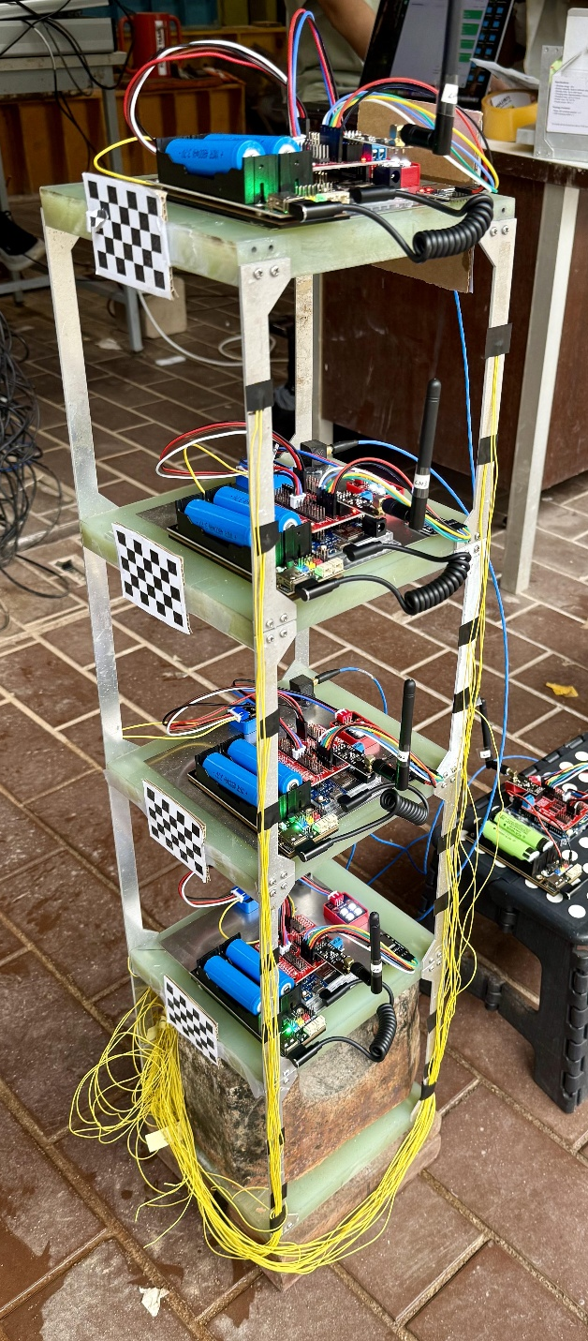


(b)
(a)
(c)
Notes:
HARDWARE

Slide 6
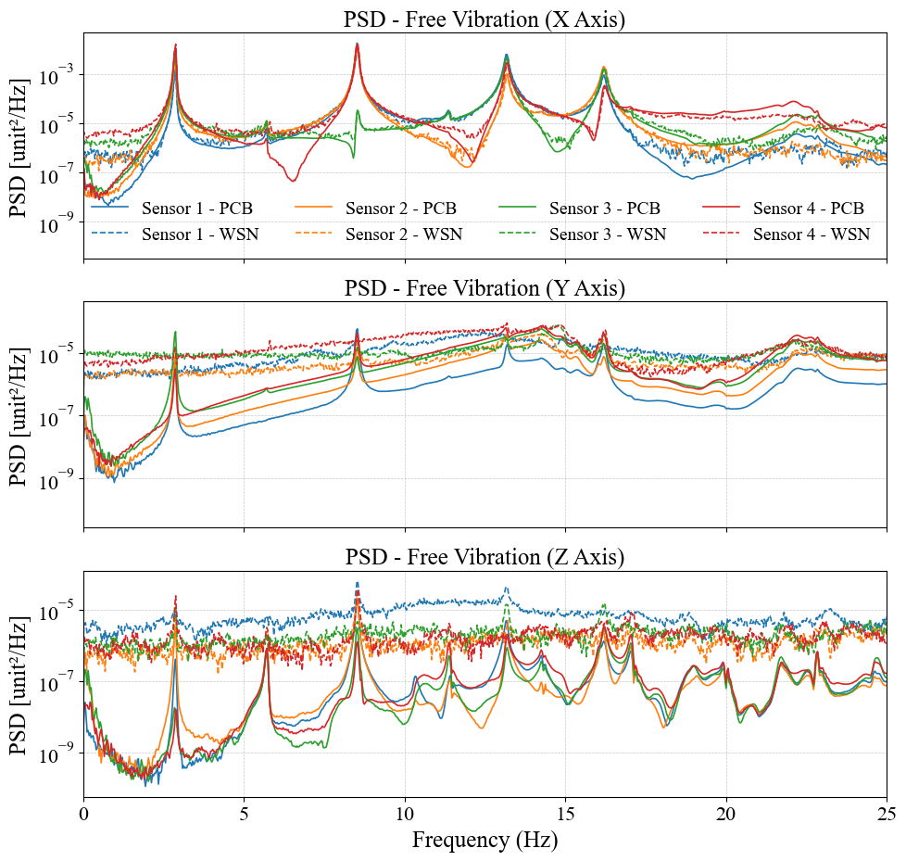
Notes:
HARDWARE

Slide 7
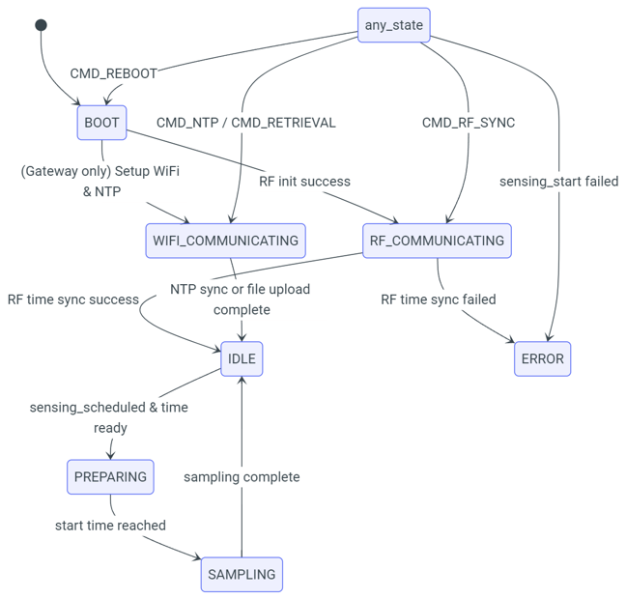
Notes:
HARDWARE

Slide 8
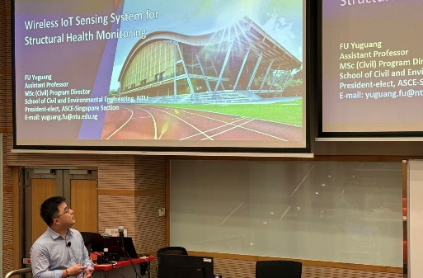
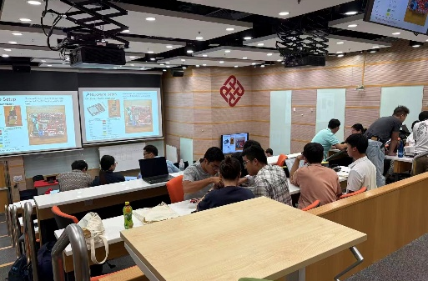
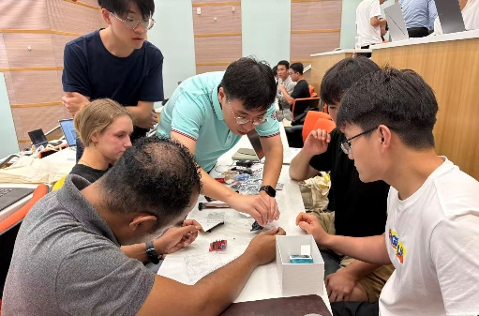
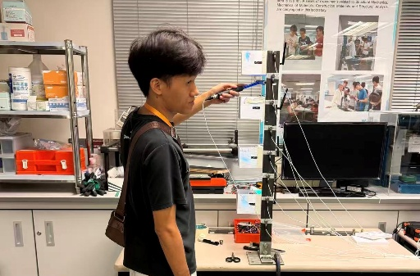
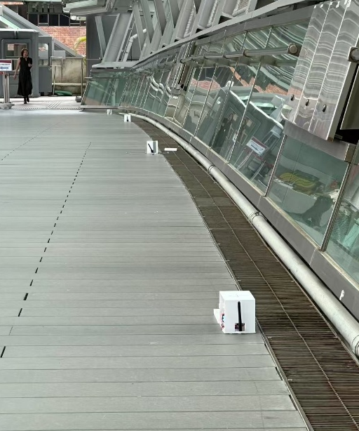

Stage I - Class
(a)
(b)
Stage II - Lab
(c)
(d)
Stage III - Field
(e)
(f)
Notes:
HARDWARE

Slide 9
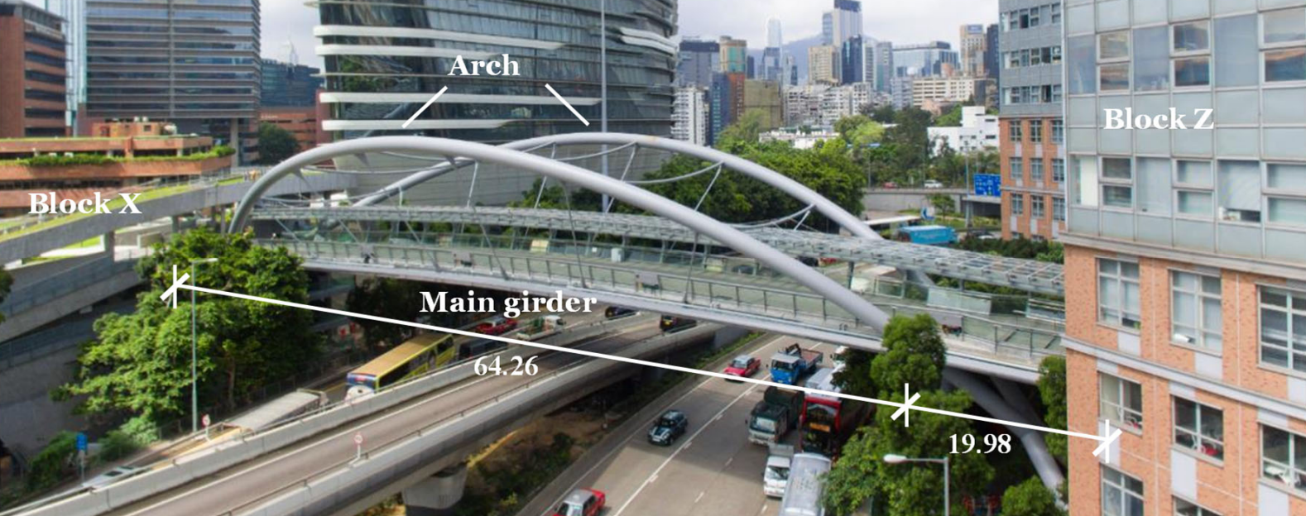
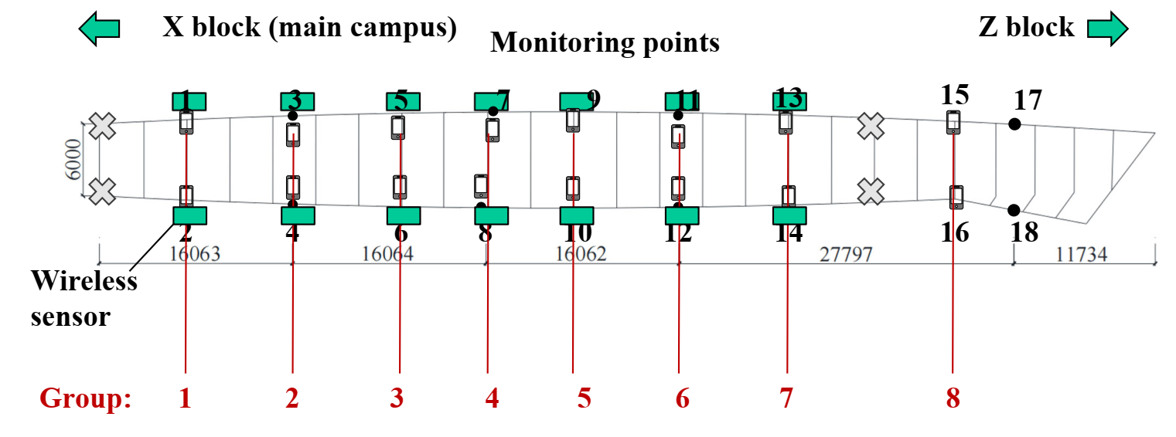
1
2
3
4
5
6
7
8
WSN
Notes:
HARDWARE

Slide 10
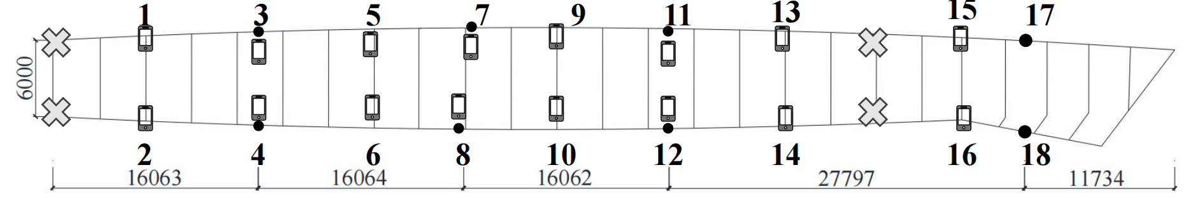



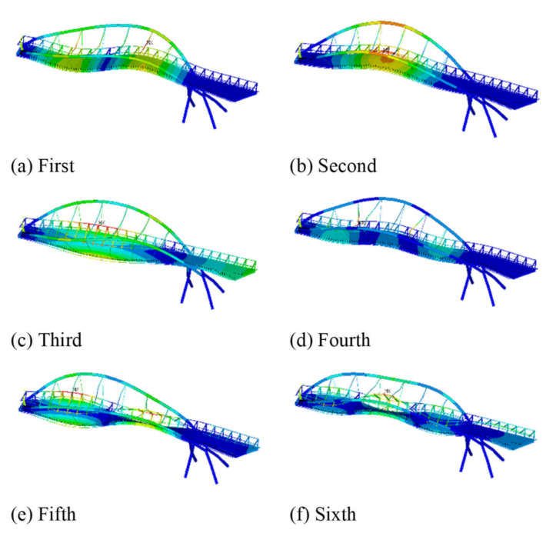
(a)
(b)
Builtin Sensor
Cell Phone
WSN
(c)
(d)
First 1.80 Hz
Second 2.55 Hz
Third 2.80 Hz
Forth 3.56 Hz
Fifth 3.67 Hz
Sixth 5.9 Hz
Notes:
HARDWARE

Slide 11

Notes:
HARDWARE

Slide 12
Notes:
HARDWARE

Slide 13
INTERACTION
POWER SYSTEM
MAIN CONTROL
PERCEPTION
COMMUNICATION
Notes:
HARDWARE ABSTRACTION

Slide 14











Communication
Local
Network
BT
Zigbee
Internet
Connection
WIFI
Cellular
Power System
Main Control
Timer/ RTC
Interaction
Battery / Power Outlet
Micro Controller
Unit
RAM/ROM
Command Input
Power Management System
SPI/I2C/UART/ADC/DAC/…
Large Volume Storage
Status Monitoring
Perception
Vibration
Strain
Temperature &Humidity
Camera
…
Notes:
HARDWARE ABSTRACTION

Slide 15
INTERACTION
POWER SYSTEM
MAIN CONTROL
PERCEPTION
COMMUNICATION
Notes:
HARDWARE ABSTRACTION

Slide 16
Communication
Local
Network
BT
Zigbee
Internet
Connection
WIFI
Cellular
Power System
Main Control
Timer/ RTC
Interaction
Battery / Power Outlet
Micro Controller
Unit
RAM/ROM
Command Input
Power Management System
SPI/I2C/UART/ADC/DAC/…
Large Volume Storage
Status Monitoring
Perception
Vibration
Strain
Temperature &Humidity
Camera
…
Notes:
HARDWARE ABSTRACTION

Slide 17
APPLICATION LAYER
Application Specific Code
SYSTEM SERVICE LAYER
Edge Intelligence Library for SHM Applications - TinySHM
TS Damage Detection
TS Notification
…
TS Measurement
TS System Identification
TS Math
TS DSP
TS AI
TS Config
TS Sense
TS File
TS Network
File System
TCP/IP & MQTT
Digital Signal Processing
Edge AI Framework
Real-time Operating System
PLATFORM ABSTRACTION LAYER
Startup Code
Hardware Abstraction Drivers (Register-Level)
Board Support Packages
(Board-Level)
HARDWARE LAYER
Main
Control
Peripheral Components
Sensing / Communication / Interaction / Power Supply
Notes:
SOFTWARE ARCHITECTURE

Slide 18
Notes:
CODE ARCHITECTURE

Slide 19
Control
Perception
Communication
Interfacing
Power
Notes:
HARDWARE ABSTRACTION [DEPRECATED]

Slide 20
Control
Perception
Communication
Interfacing
Notes:
HARDWARE ABSTRACTION [DEPRECATED]

Slide 21
Application Specific Code
APPLICATIONS
Edge Intelligence Library for SHM Applications - TinySHM
TS Damage Detection
TS Notification
…
TS Measurement
TS System Identification
SYSTEM
SERVICES
TS Math
TS DSP
TS AI
TS Config
TS Sense
TS File
TS Network
File System
TCP/IP & MQTT
Digital Signal Processing
Edge AI Framework
Real-time Operating System
Startup Code
Hardware Abstraction Drivers (Register-Level)
Board Support Packages
(Board-Level)
PLATFORM
ABSTRACTION
Main
Control
Peripheral Components
Sensing / Communication / Interaction / Power Supply
HARDWARE

