Slide 1
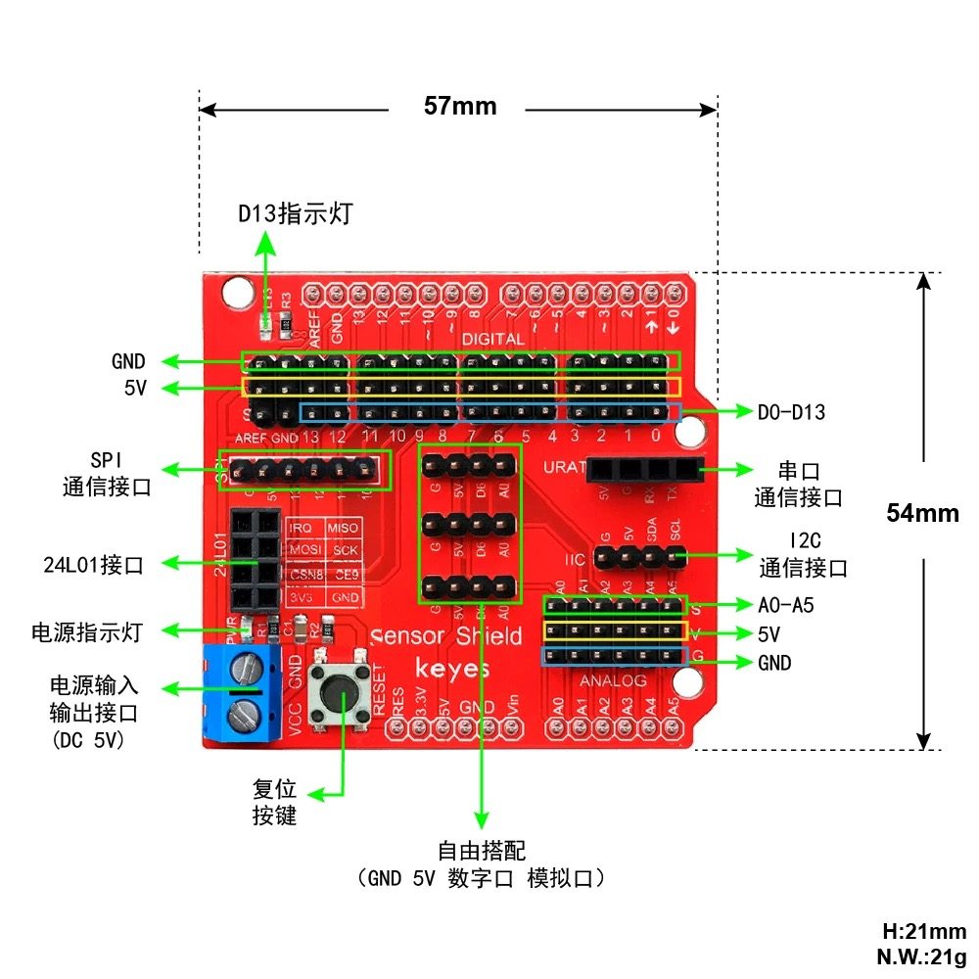

Slide 2
LED
UART
power indicator
power IO
reset
for customized uses
GND 5V Digital IO Analog IO

Slide 3
