Slide 1

CV1711 ENGINEERING DRAWING & 3D BUILD INFO MODEL (LAB)

Slide 2
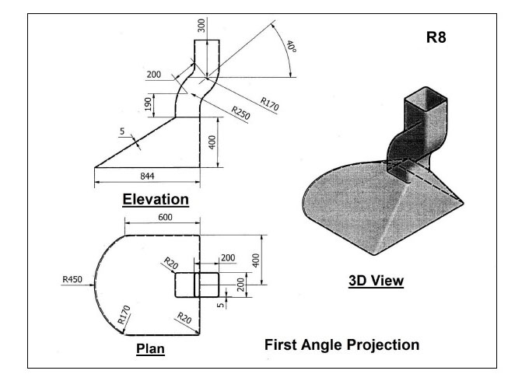
WEEK 10 –Revit Handson
R8

Slide 3
WEEK 10 –Revit Handson
Sweep
Blend + Void Blend

Slide 4
WEEK 10 –Revit Handson
Tutorial Video
https://youtu.be/HO8zCxEeGnw

Slide 5
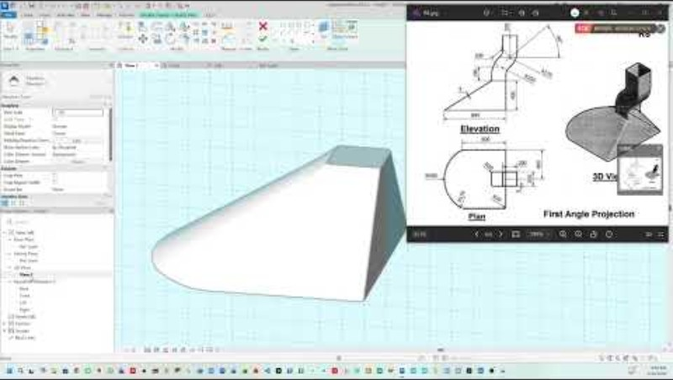

Slide 6
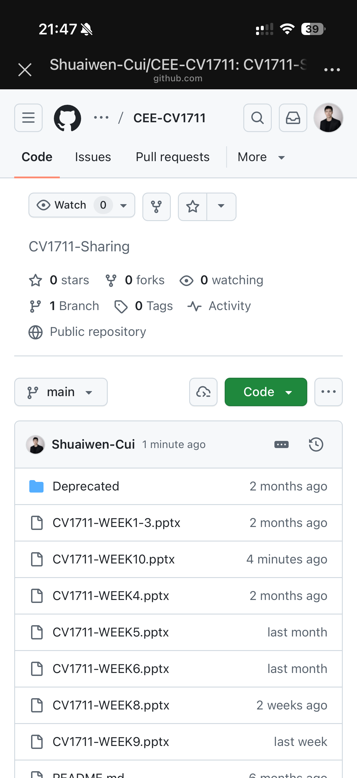
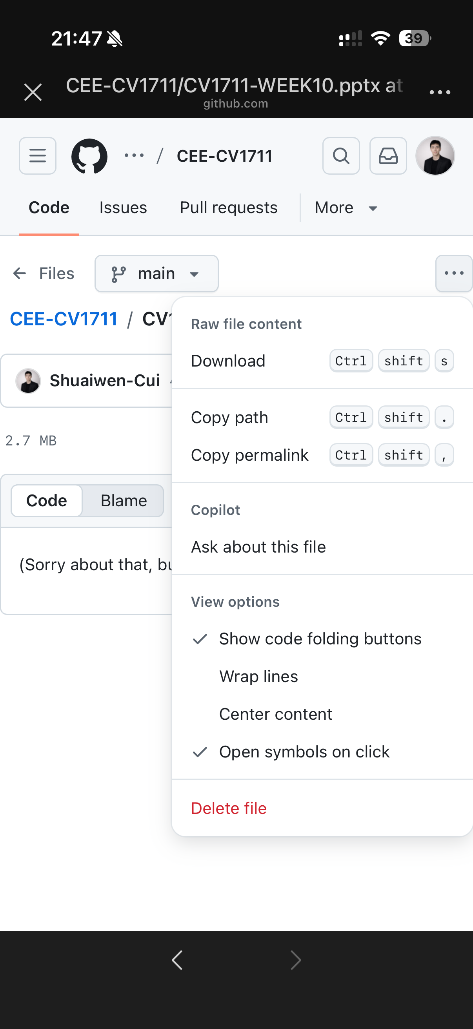

SCAN TO DOWNLOAD THE SLIDES

