Slide 1

CV1711 ENGINEERING DRAWING & 3D BUILD INFO MODEL (LAB)

Slide 2
Instructor Information
NAME: CUI SHUAIWEN (SHAUN)
EMAIL: SHUAIWEN001@e.ntu.edu.sg
TEL: 83071903
Any questions? Feel free to reach out!

Slide 3
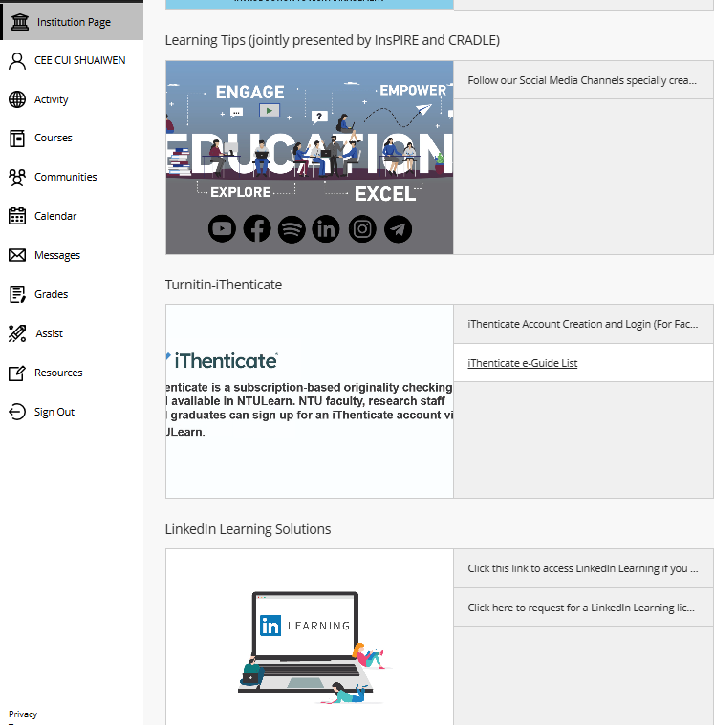
WEEK 1 & 2 – CAD Basics
Learn AutoCAD basics on NTULearn
Submit E2 by the end of week 2
After that, move on to week 3, 4, …
Linkedin Video Access Issue?
Mark your attendance before leaving
Save files & sign out before leaving
Any questions? Feel free to reach out

Slide 4
WEEK 3 – CAD Basics
Follow the instructions and videos on NTULearn
Submit E3 & E5 by the end of week 3
After that, move on to week 4 (orthographic projection), week 5 (auxiliary projection), week 6 … much more difficult, please preview the material before class.
Mark your attendance at the end of class
Save files & sign out before leaving
Any questions? Feel free to reach out

Slide 5

WEEK 4 – Orthographic Projection
Let’s watch this youtube video for basic understandings.
https://youtu.be/heIobpUVZqc?si=No0iEweG8M1roWwM

Slide 6
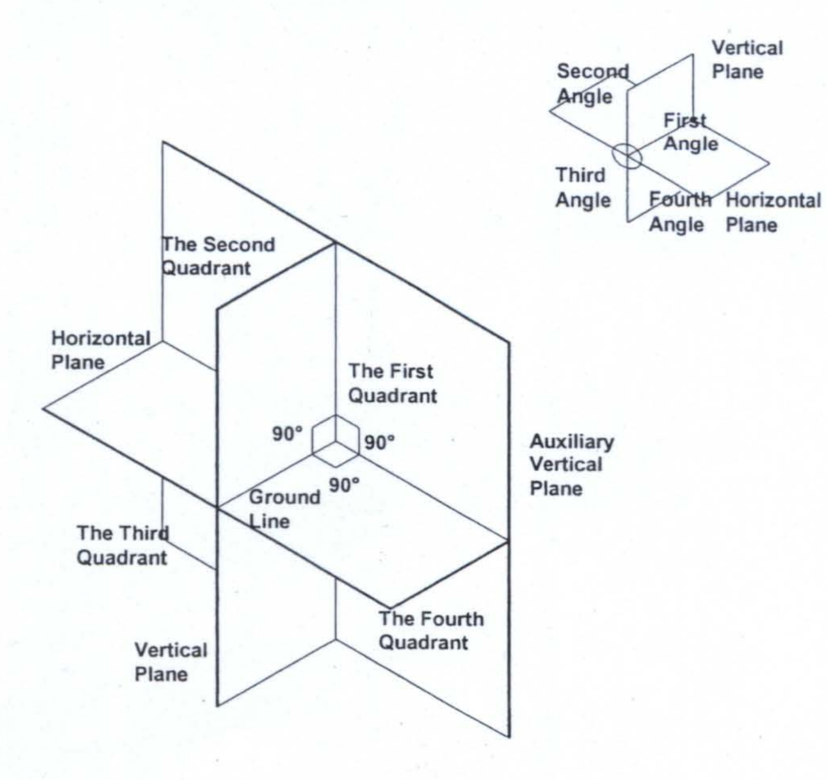
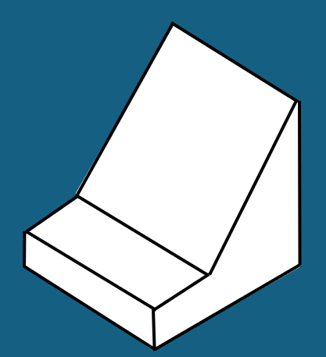
Quadrant System and Orthographic Projection
First Angle Projection
Third Angle Projection

Slide 7

Quadrant System and Orthographic Projection
First Angle Projection
Third Angle Projection
The Projection is behind the object.
The Projection is in front of the object.

Slide 8
First-angle projection:
T = elevation / front
S = end / side
P = plan / top
Unfold such that elevation view is adjacent to / center of other views.
First-angle projections are behind the object.
P
End 1
Elevation
End 2
Base
S2
Vertical partition
Lid
Vertical partition
Base
Horizontal partition
Horizontal partition
Plan
Lid
S1
T
Elevation is always on the vertical partition of the box.
Plan is always on the horizontal partition of the box.

Slide 9
First-angle projection:
Comment:
Notice that P may not be given, because plan view is always from above.
Variation 1
S
T
Not required
Lid
Vertical partition
Base
Horizontal partition
S
T

Slide 10
First-angle projection:
Variation 2
Comment:
The object is rotated.
Comment:
The layout stays the same because the object is simply rotated.
Not required
S
T
Lid
Vertical partition
Base
Horizontal partition
S
T

Slide 11
First-angle projection:
Comment:
The other end view is requested.
Variation 3
Comment:
Take note that the layout is different now. Because first-angle projections are behind the object.
Take note of the hidden line.
S
T
Not required
Lid
Vertical partition
Base
S
Horizontal partition
T

Slide 12
First-angle projection:
Comment:
The other end view is requested.
Comment:
Take note that the layout is different now. Because first-angle projections are behind the object.
Take note of the hidden line.
Variation 4
S
T
Not required
Lid
Vertical partition
Base
Horizontal partition
S
T

Slide 13
Third-angle projection:
T = elevation / front
S = end / side
P = plan / top
Unfold such that elevation view is adjacent to / center of other views.
Third-angle projections are in between the object and the viewer / in front of the object.
P
Plan
Horizontal partition
Base
S2
Horizontal partition
Lid
Vertical partition
Base
Vertical partition
End 1
Elevation
End 2
Lid
S1
T
Elevation is always on the vertical partition of the box.
Plan is always on the horizontal partition of the box.
Same as first-angle, even the locations of End 1 and End 2.

Slide 14
Third-angle projection:
Comment:
Remember, projections are in front of the object for the third angle.
Comment:
Notice that P may not be given, because plan view is always from above.
Variation 1
T
S
Horizontal partition
Lid
Vertical partition
Base
Not required
S
T

Slide 15
Third-angle projection:
Variation 2
Comment:
The object is rotated.
Comment:
The layout stays the same because the object is simply rotated.
T
S
Horizontal partition
Lid
Vertical partition
Base
Not required
S
T

Slide 16
Third-angle projection:
Variation 3
Comment:
Take note that the layout is different now. Third-angle projections are in front of the object.
Take note of the hidden line.
S
Comment:
The other end view is requested.
T
S
Horizontal partition
Lid
Vertical partition
Base
Not required
T

Slide 17
Third-angle projection:
Variation 4
Comment:
The final drawings are the same as Variation 1.
S
Comment:
The elevation view of the question has changed.
T
Horizontal partition
Lid
Vertical partition
Base
Not required
S
T

Slide 18

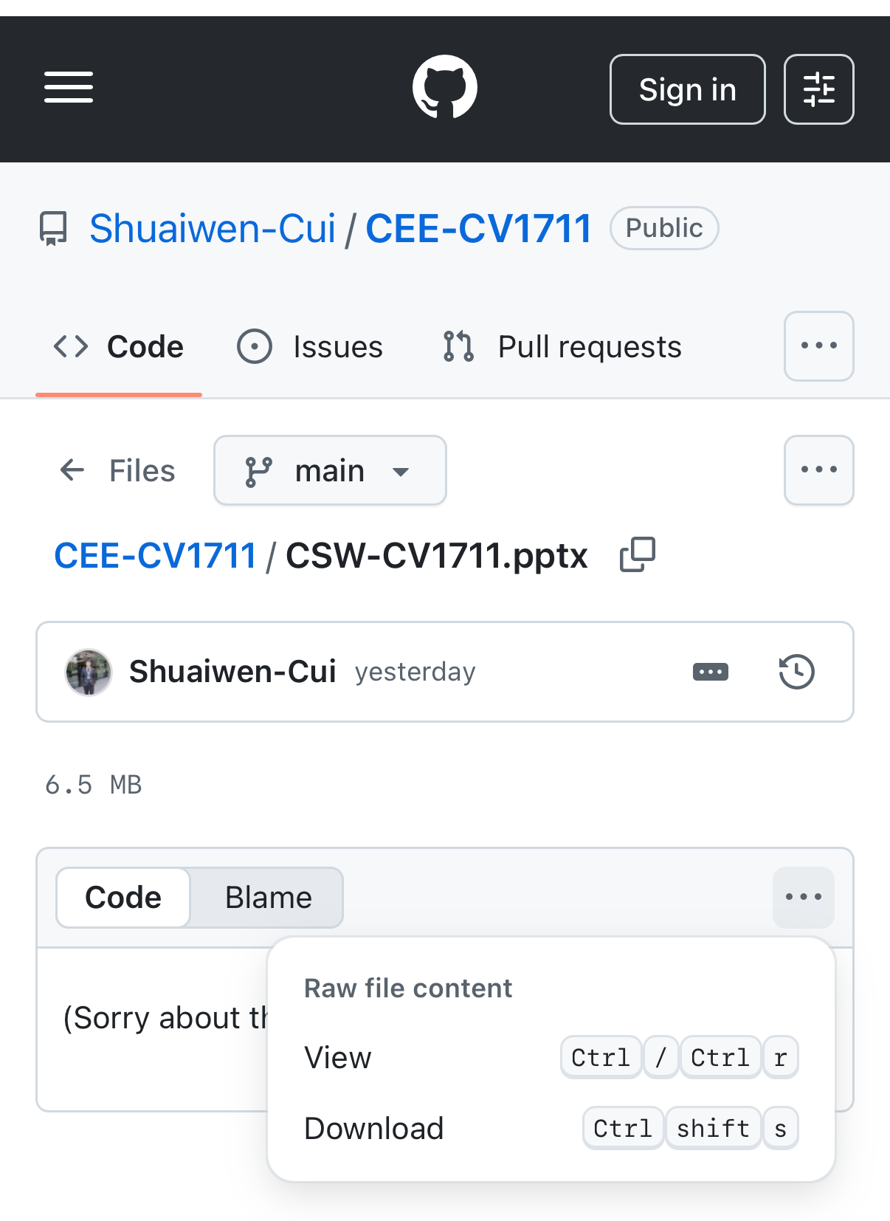
SCAN TO DOWNLOAD THE SLIDES

Slide 19
WEEK 4 – Orthographic Projection
First Quadrant
Plan is always below elevation
Project the view at the back of project
Plan is always above elevation
Project the view in front of the object plane
Third Quadrant
Direction T
Elevation View (first to draw)
Direction S
End of View
Distance from Horizontal & Vertical Plan must be equal for projecting points, lines &surface measurements from one view to another views
https://www.youtube.com/watch?v=heIobpUVZqc

Slide 20
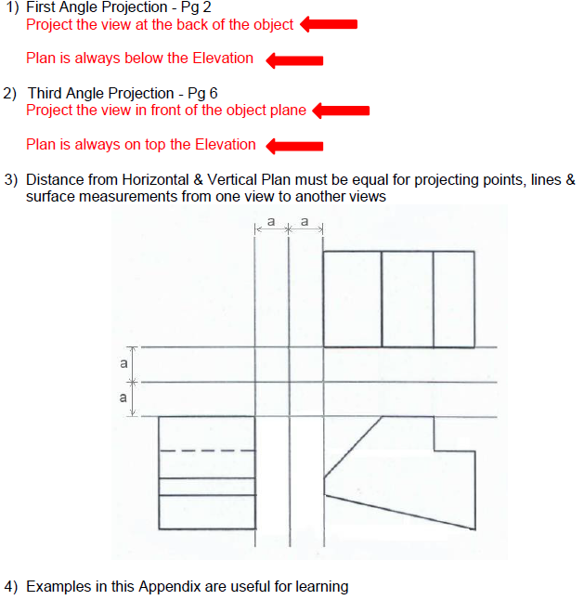
WEEK 4 – Orthographic Projection

Slide 21
WEEK 5 – Auxiliary Projection
Very Import, Please Pay Close Attention!

Slide 22
WEEK 5 – Auxiliary Projection – Recap
First Angle Projection
Third Angle Projection

Slide 23
WEEK 5 – Auxiliary Projection – Terms
First (Primary) Auxiliary Projection: A view projected onto a plane that is perpendicular to one principal view, used to show an inclined surface in its true size and shape.
First / Primary: The projection obtained by rotating once from a principal view (front, top, or side). Not First Quadrant.

Slide 24
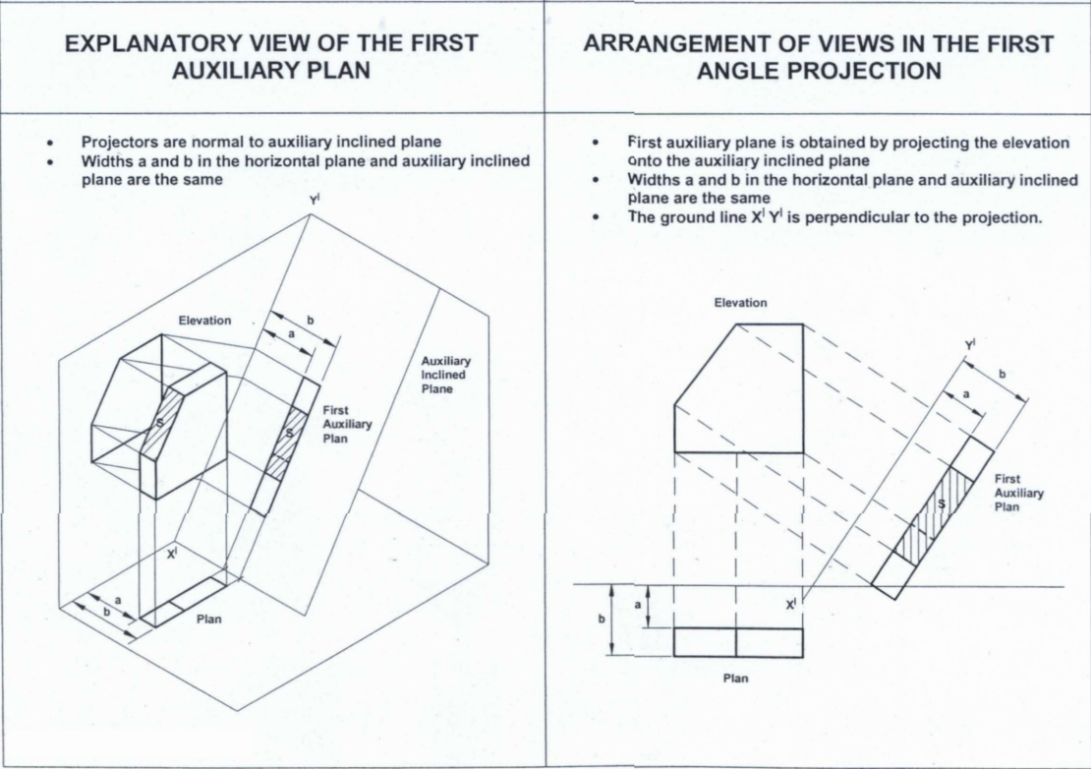
WEEK 5 – Auxiliary Projection – Auxiliary Plan
Some Kind of Plan:
– More Like Plan
– Perpendicular to Elevation View

Slide 25
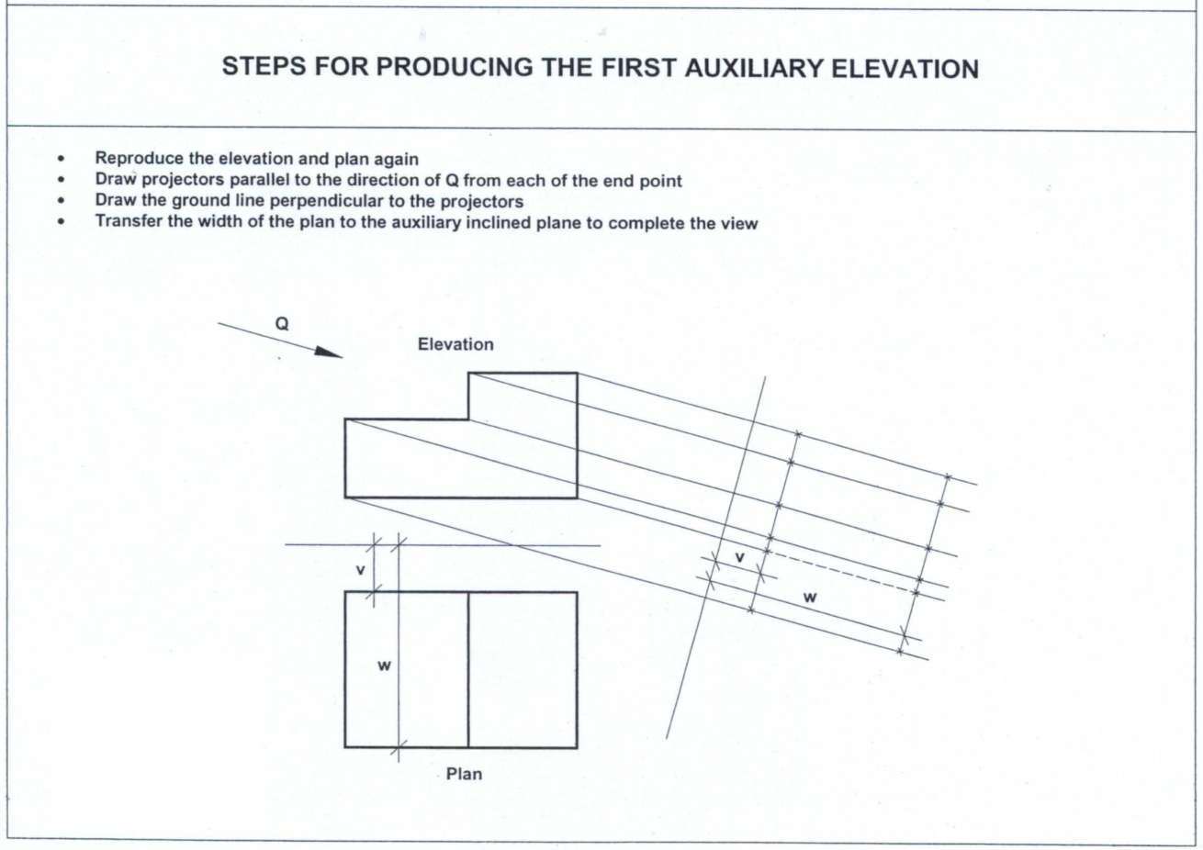
PLAN

Slide 26
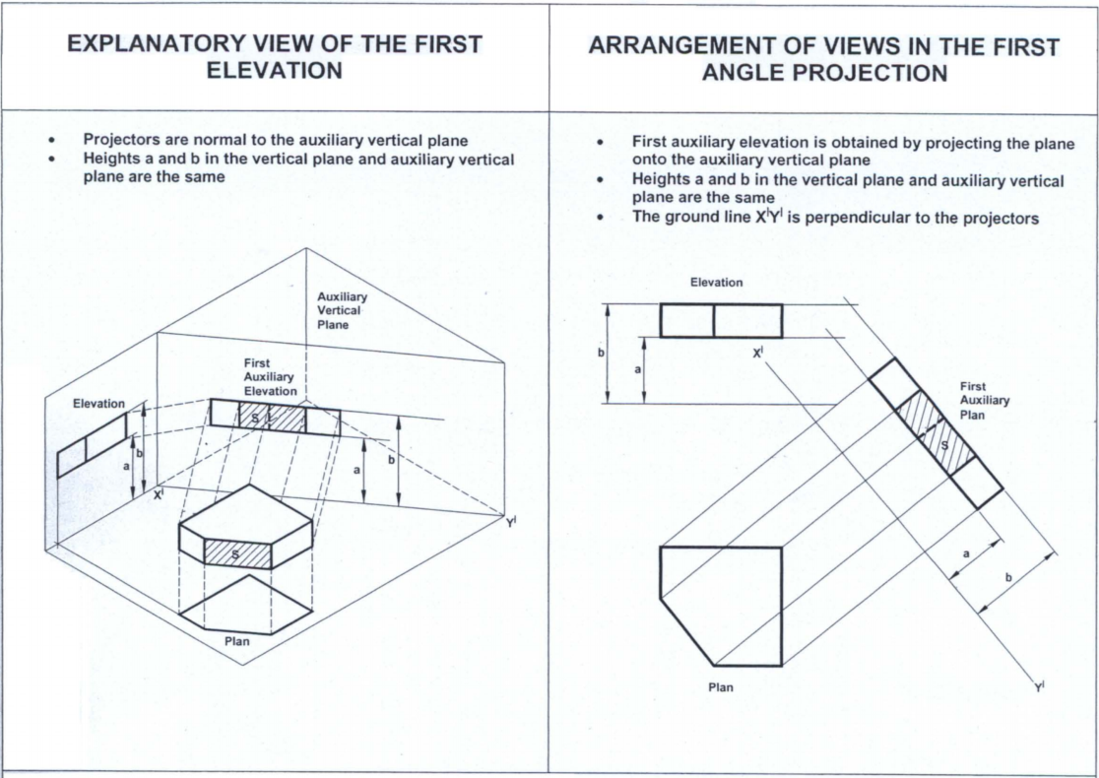
WEEK 5 – Auxiliary Projection – Auxiliary Elevation
Some Kind of Elevation:
– More Like Elevation
– Perpendicular to Plan View

Slide 27
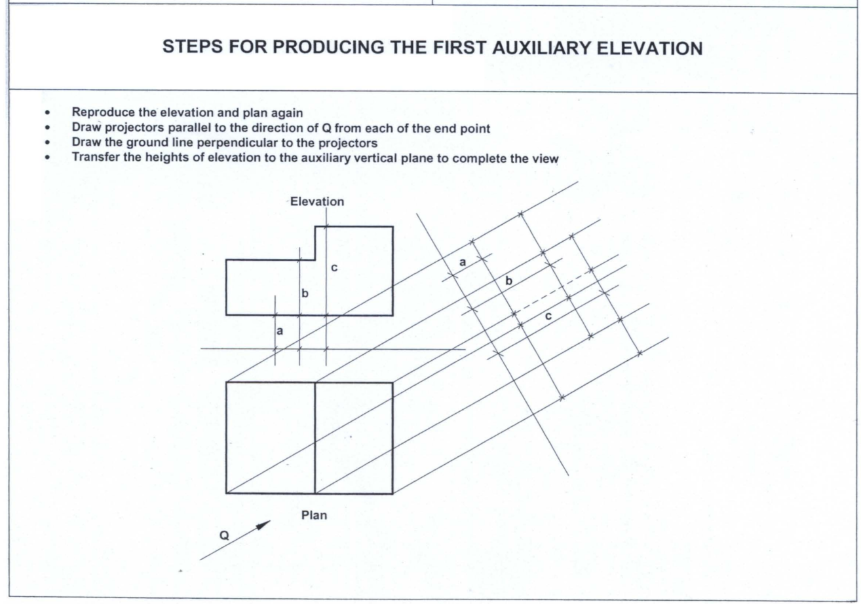
WEEK 5 – Auxiliary Projection

Slide 28
WEEK 5 – Auxiliary Projection
First Quadrant (Angle)
Auxiliary Plan
Third Quadrant (Angle)
Auxiliary Elevation

Slide 29
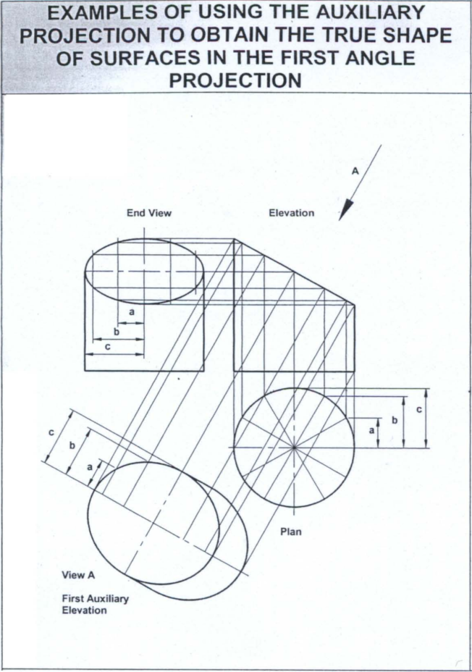
Example
- First Angle
- First Auxiliary Plan
Features:
- Projection behind the Object
- Perpendicular to Elevation View Projection

Slide 30
Example
- First Angle
- First Auxiliary Elevation
Features:
- Projection behind the Object
- Perpendicular to Plan View Projection

Slide 31
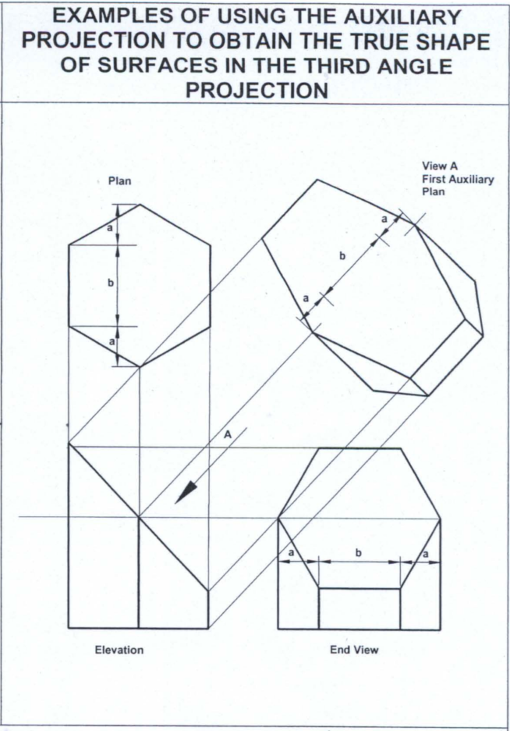
Example
- Third Angle
- First Auxiliary Plan
Features:
- Projection before the Object
- Perpendicular to Elevation View Projection

Slide 32
Example
- Third Angle
- First Auxiliary Elevation
Features:
- Projection before the Object
- Perpendicular to Plan View Projection

Slide 33
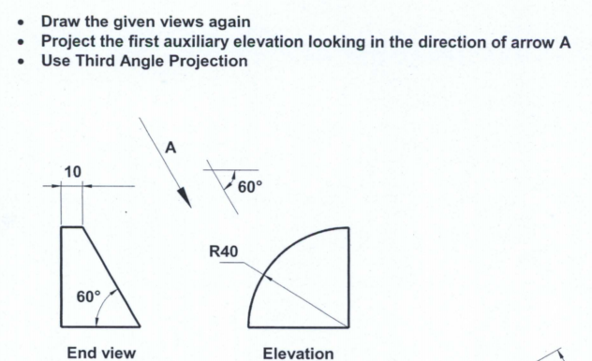
EXAMPLE 1

Slide 34
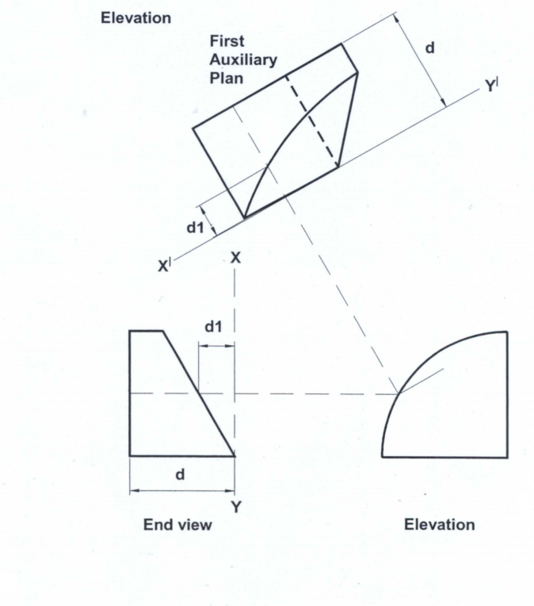
EXAMPLE 1

Slide 35
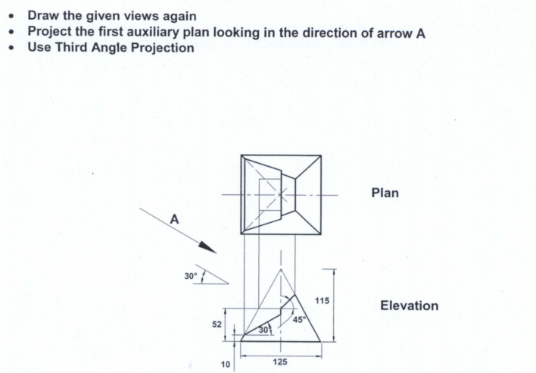
EXAMPLE 2

Slide 36
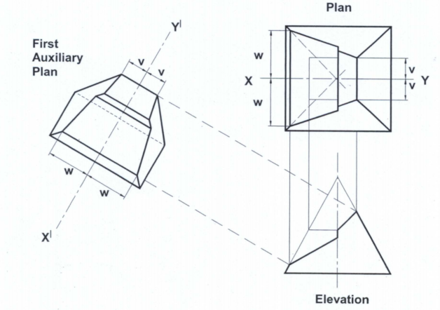
EXAMPLE 2

Slide 37
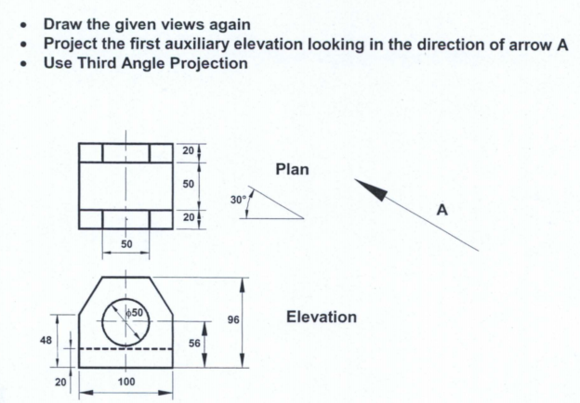
EXAMPLE 3

Slide 38
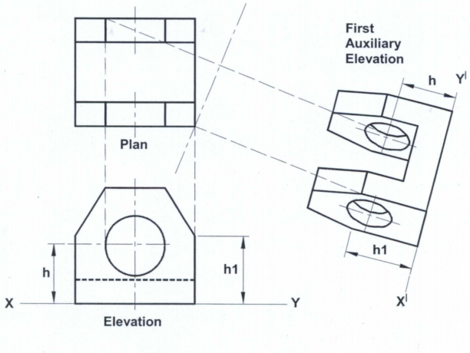
EXAMPLE 3
hidden line missed!

Slide 39
EXAMPLE 3

Slide 40
SCAN TO DOWNLOAD THE SLIDES

Slide 41
WEEK 6 - AUXILIARY PROJECTION

Slide 42
AUXILIARY PROJECTION - PRECEDURES
1. Reproduce the principal views
2. Projectors parallel to the given direction from end points
3. Ground line perpendicular to the projectors
4. Transfer heights/widths

Slide 43
AUXILIARY PROJECTION – CURVES APPROXIMATION
How many points ? Up to you
Rule of thumb

Slide 44
AUXILIARY PROJECTION – FURTHEST POINTS

Slide 45
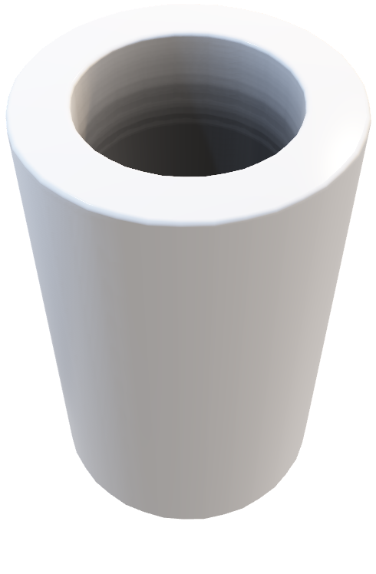
AUXILIARY PROJECTION – EDGE OF COLUMNS

Slide 46
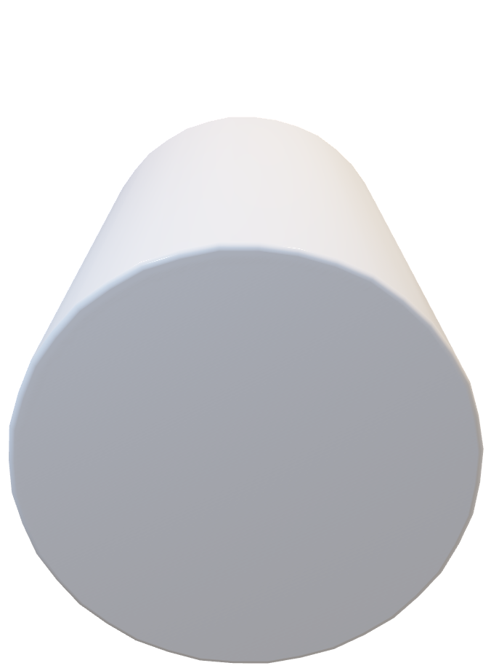
AUXILIARY PROJECTION – HIDDEN LINES
CMD - Break

Slide 47
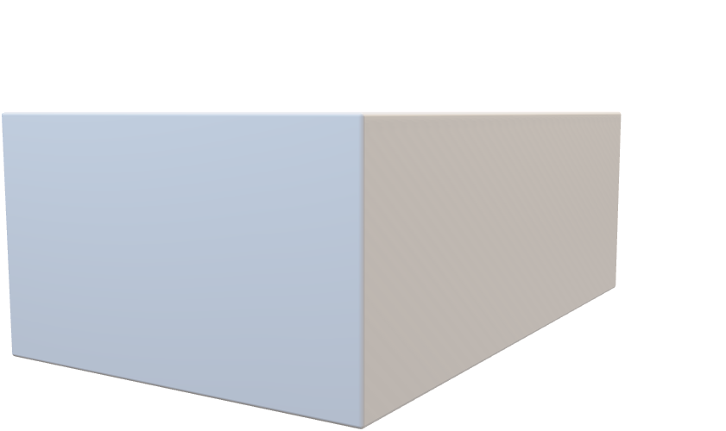
AUXILIARY PROJECTION – HIDDEN LINES

Slide 48
QUIZ
SEATING – Every Other Column
QUIZ PAPER (cannot be taken out) – Write down Name + Matr.No.
NO INTERNET CONNECTION, ONLY NTULearn Access
DWG + PDF – Learn how to export them

Slide 49
SCAN TO DOWNLOAD THE SLIDES

Slide 50
WEEK 8 – BIM & Autodesk Revit Basics
Building Information Modeling (BIM)
BIM is an intelligent digital process that uses 3D models enriched with multidisciplinary data to support the planning, design, construction, and lifecycle management of buildings and infrastructure, enabling collaboration, efficiency, and informed decision-making across stakeholders.
Autodesk Revit
Autodesk Revit is the most widely used BIM software, enabling architects, engineers, and construction professionals to collaboratively design, visualize, and manage building projects across their lifecycle.

Slide 51
WEEK 8 – BIM & Autodesk Revit Basics
Following NTLearn and Linkedin videos to learn Revit basic operations
Submit R1-4 by the end of week 8.

Slide 52
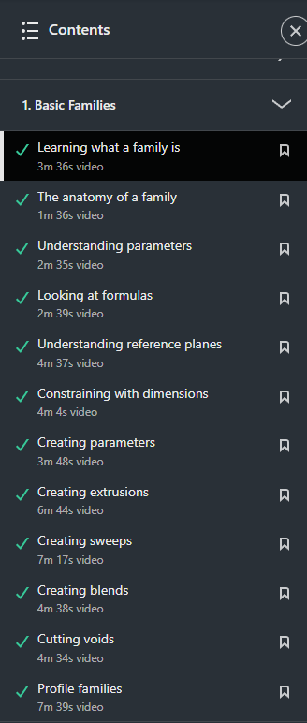
WEEK 8 – Families
System Families – inherent to Revit
Components Families – loaded into your model and can host to system families
In-place Families – within the project, based on existing geometries

Slide 53
WEEK 9 – Recap & Handson
Recap:
Family – System/Component/In-place
Family Anatomy – Reference/Dimension/Parameter/3D Mass
Basic Operations – Extrusions/Sweeps/Blends/Voids/Profile
For sweeping, two phases – I Path / II Profile
Week 9:
Finish R5 R6 R7, Submit R7 by the weekend.

Slide 54
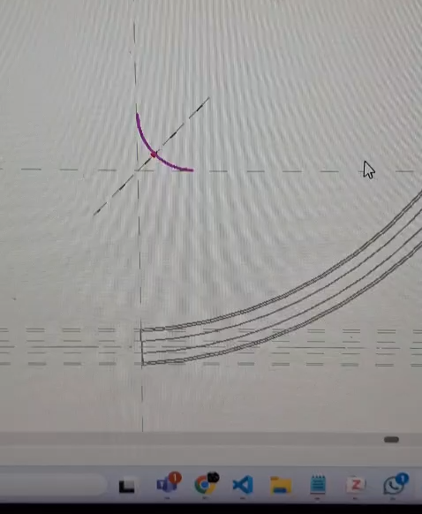
WEEK 9 – Recap & Handson
Tip for R7 – Relocate the origin for profile

Slide 55
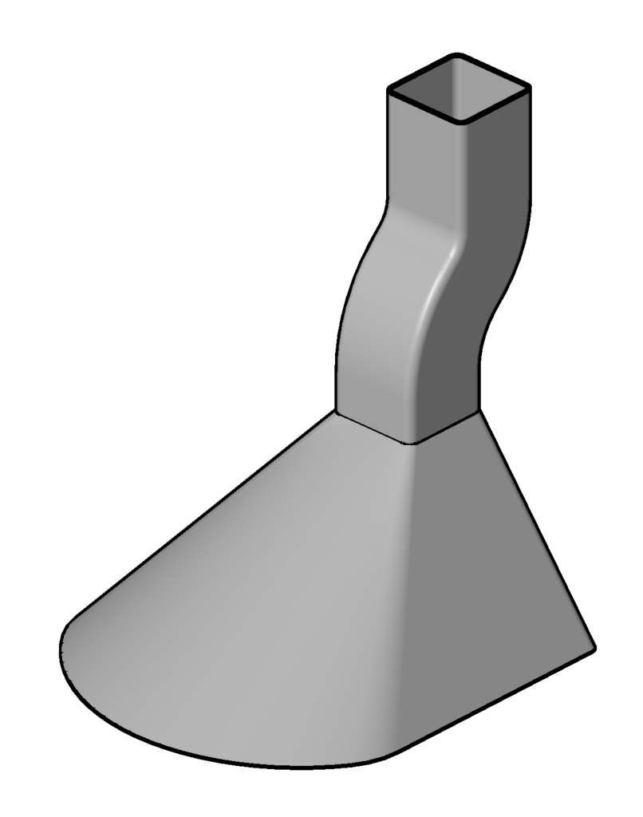
WEEK 10
Finish and Submit R8
Sweep
Blend + Void Blend
Smoke Hood

Slide 56
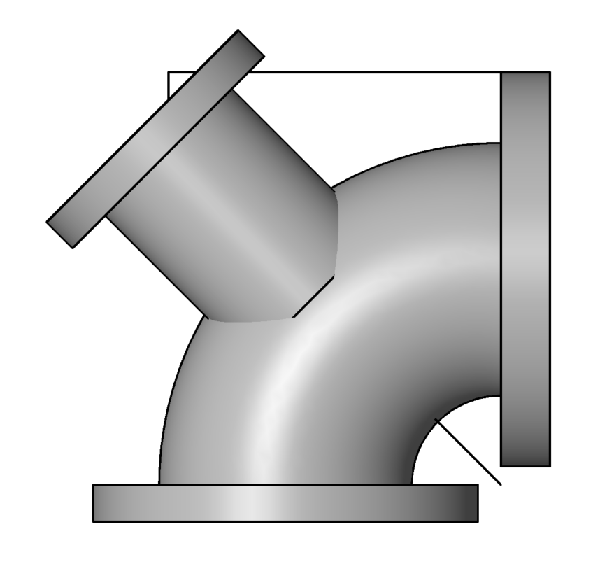
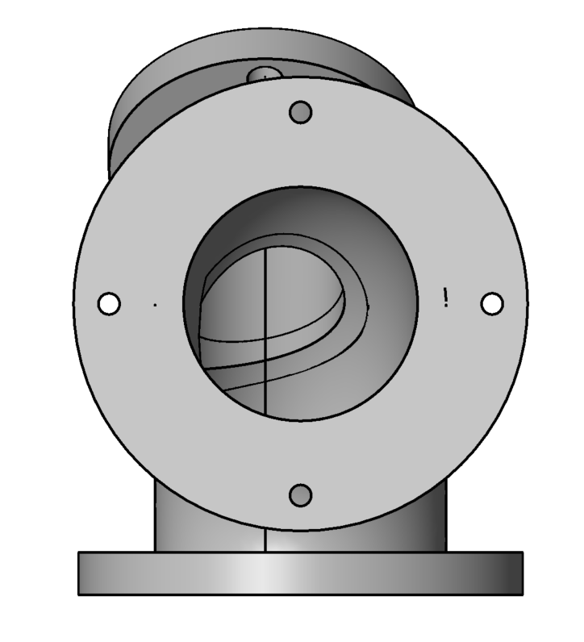
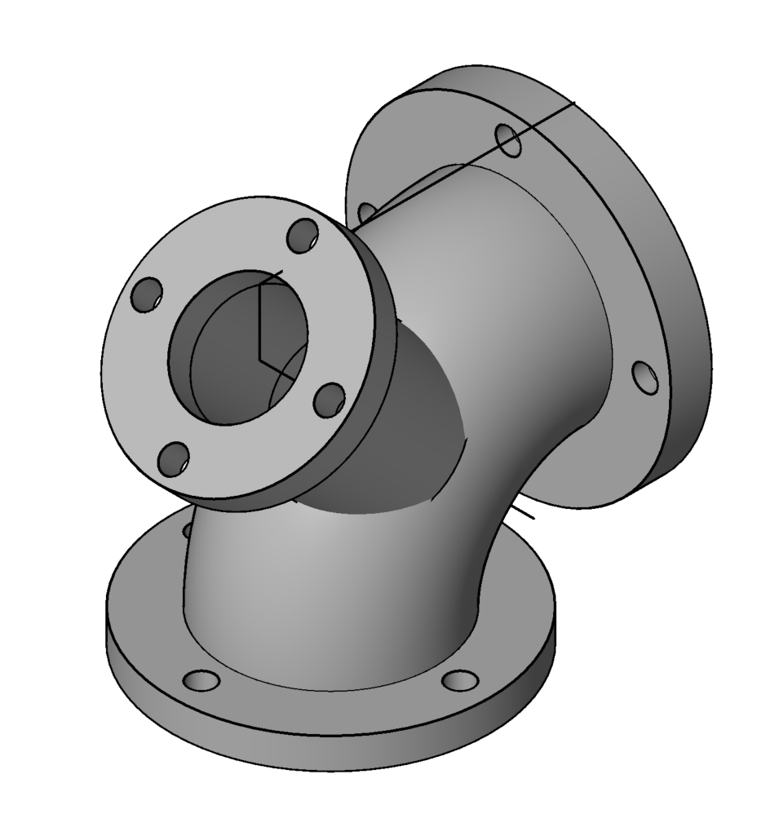
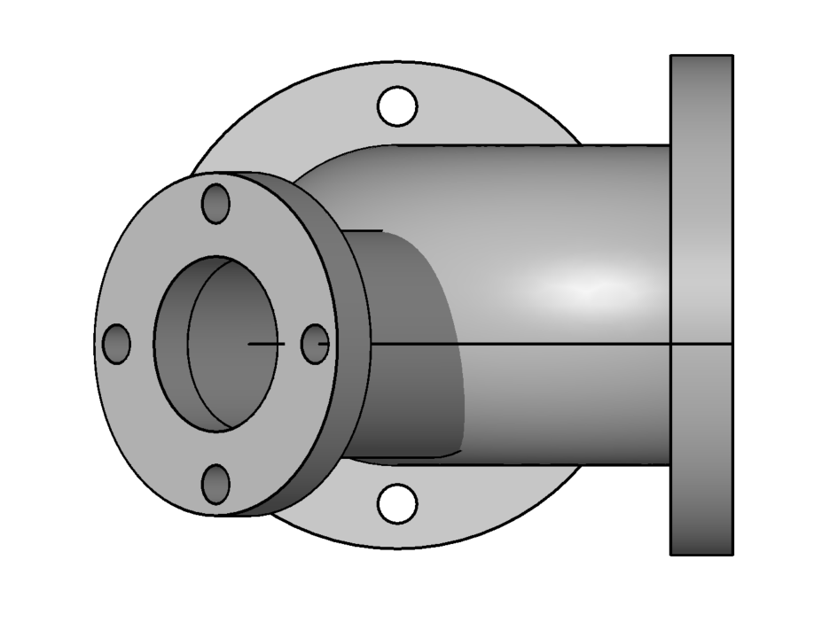
WEEK 11
Finish and Submit R9
Elevation
End
Plan

Slide 57
WEEK 11
Finish and Submit R9
4TH STEP
NO NEW EXERCISE FOR WEEK12, PLEASE PREPARE FOR QUIZ2 IN WEEK13
3RD STEP
2ND STEP
1st STEP

Slide 58
SCAN TO DOWNLOAD THE SLIDES (Updates by Week)

Slide 59
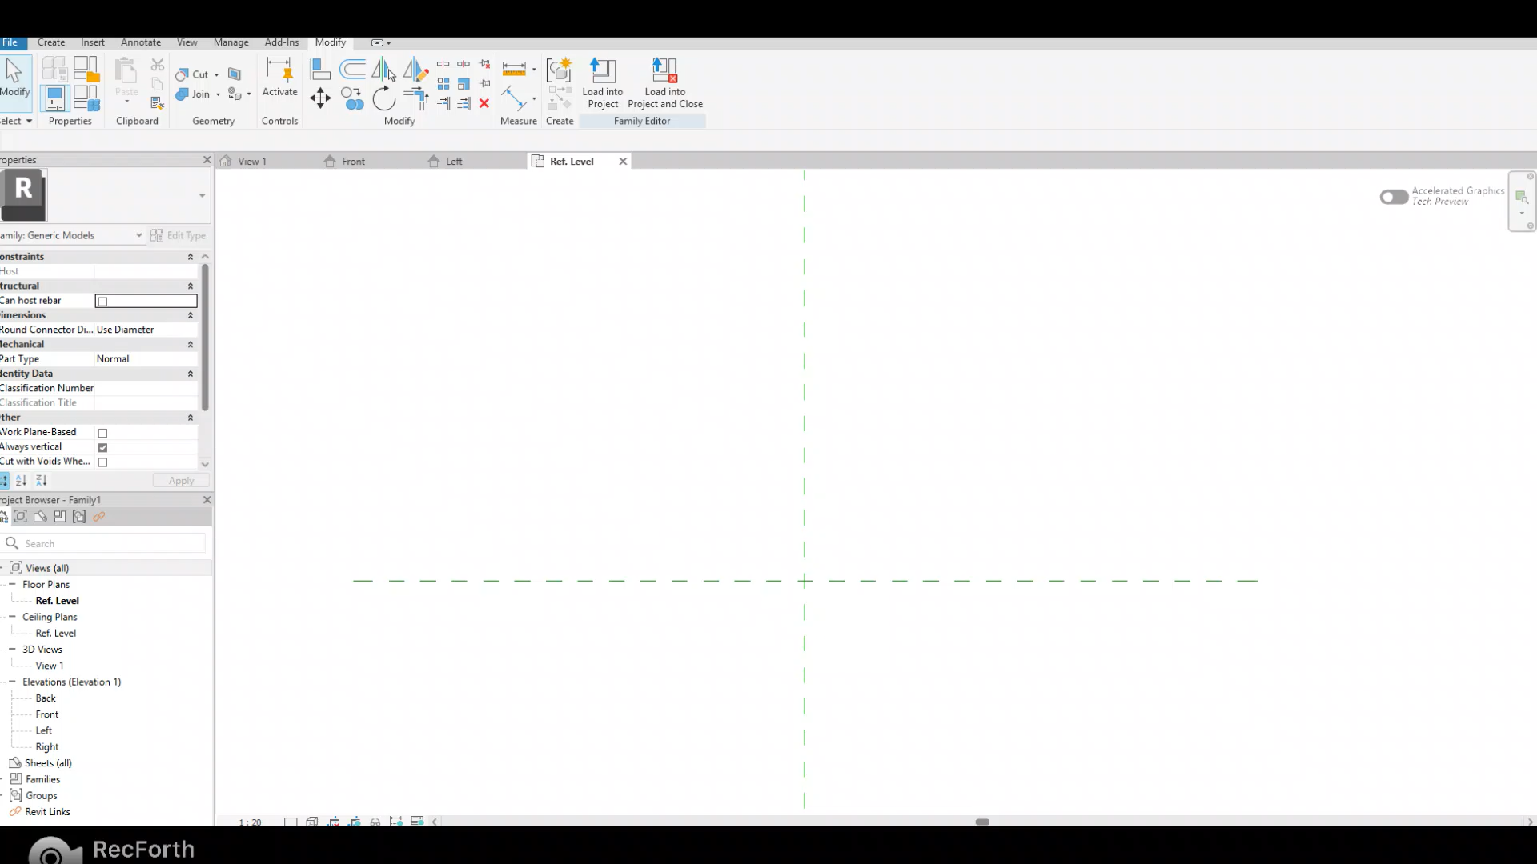
RECAP
Extrusion: Create a 3D solid by extruding a 2D shape (profile)
Example: Create a cylinder with diameter of 50mm and height of 100mm

Slide 60
RECAP
Extrusion: Create a 3D solid by extruding a 2D shape (profile)
Example: Create a cylinder with diameter of 50mm and height of 100mm
On Elevation Front, create a reference line to mark the desired height
Under Create tab, select Extrusion. Go to the Ref Level and draw a circle with radius of 25mm. Select Finish.
Go to Elevation Front and check the height. Use Align or simply drag the arrow to bring the object to the desired height
If you draw the 2D profile on Elevation plane and extrude from there, CHECK REF LEVEL and align the drawing to the correct width after you tick Finish

Slide 61
RECAP
Sweep: create a 3D shape by sweeping a 2D profile along a path
Procedure:
Make sure you are on the correct working plane where you want to sketch path (VERY IMPORTANT FOR R5)
Sketch the path (Remarks: Sometimes, Pick Path will not work; use Sketch Path instead)
Before finishing the path, drag the cross section to the desired position. Then Finish edit mode
Select profile > Edit Profile > Draw the 2D profile on the correct plane
Finish edit mode

Slide 62
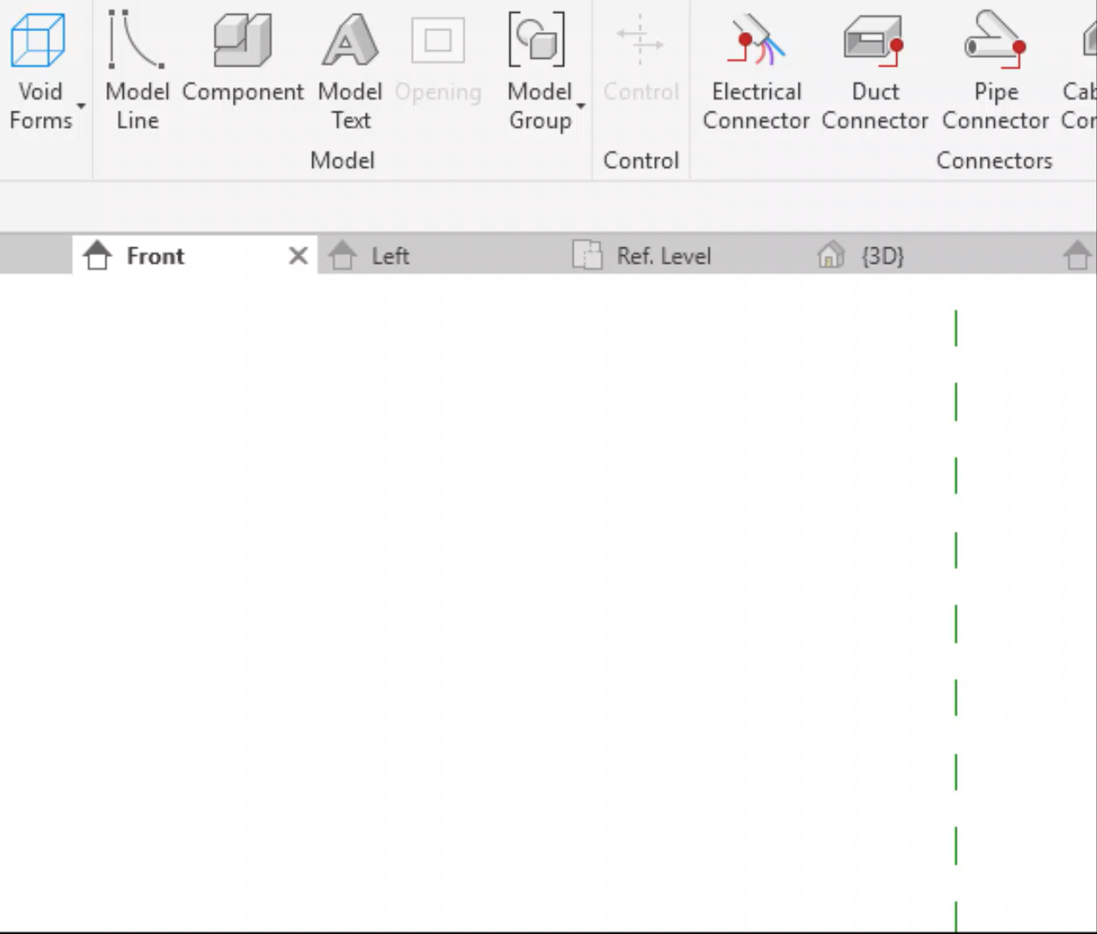
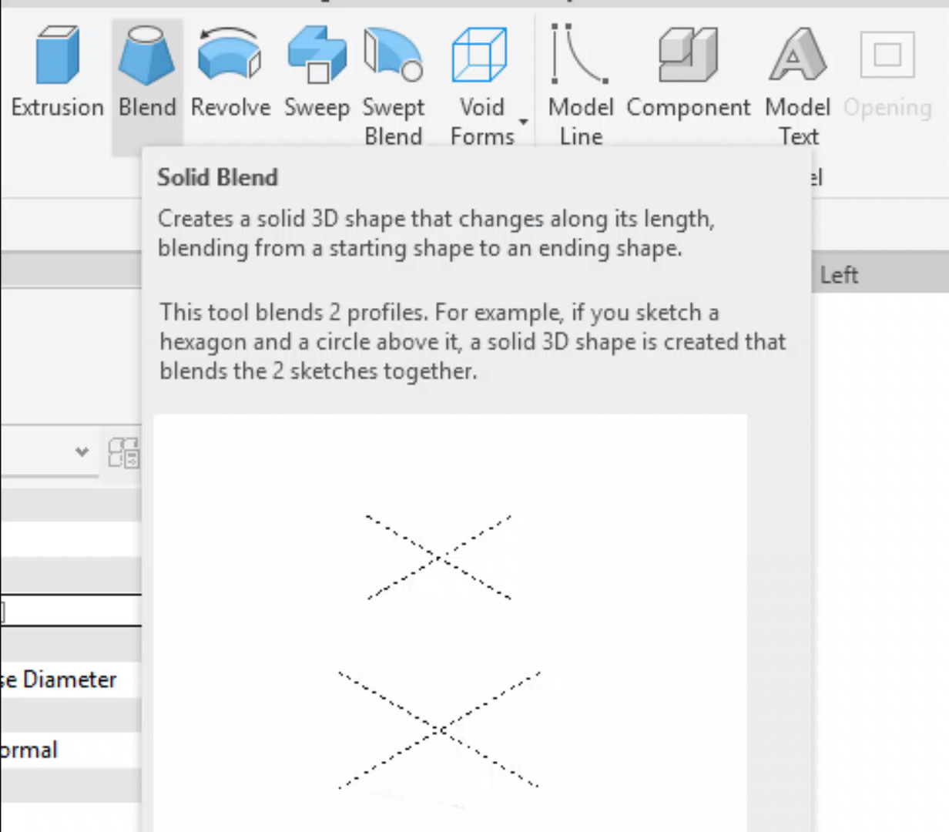
RECAP
Void: Remove material from the existing 3D shape
Blend: Create a solid 3D shape that changes along its length, blending from a starting shape to an ending shape

Slide 63
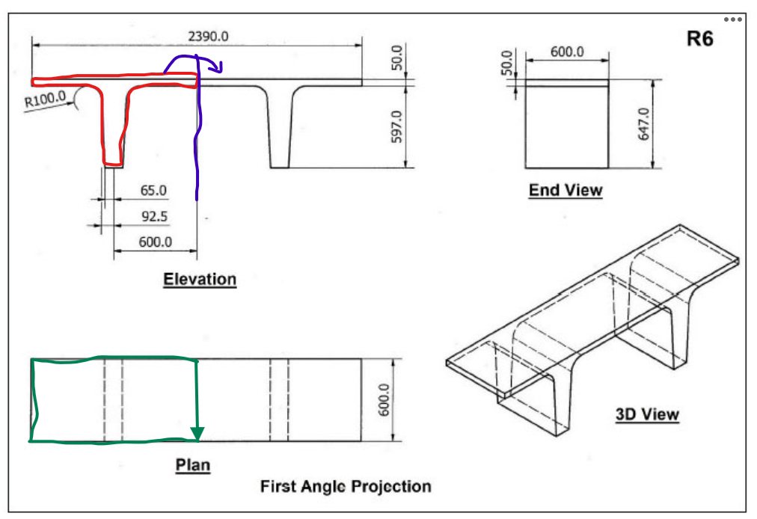
R6 instructions
R6
/2
On Elevation Front and Ref Level, use Create similar to mark all necessary dimensions (blue dashes)
On Elevation Front, select Extrusion and draw the 2D profile (red)
On Ref Level, align to the correct shape (green). Check 3D view
On Elevation Front, select the 2D shape. Under tab Modify, select Mirror. Click on the axis (purple)
3D View. Under tab Modify, select Join. Click on 2 objects to join

Slide 64
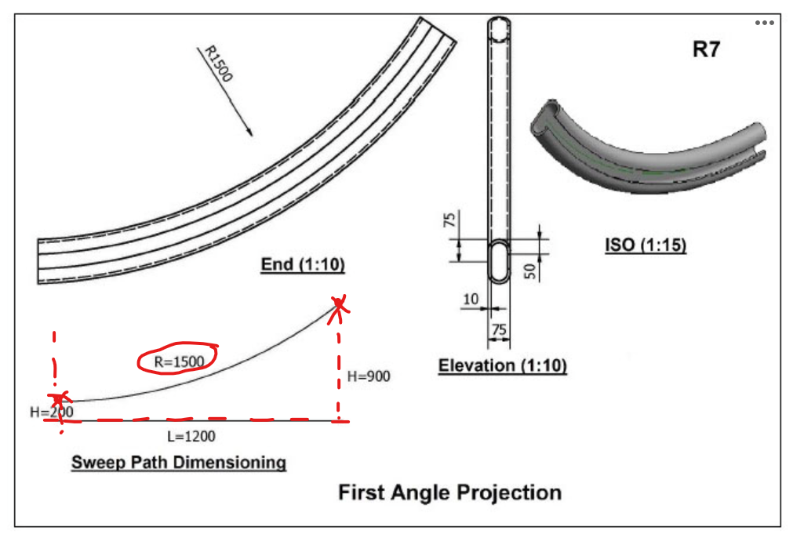
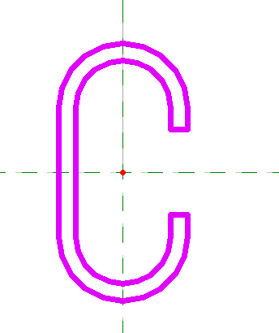
R7 instructions
R7
On Elevation Right, use Create similar to mark all necessary dimensions (red dashes)
On Elevation Right, select Sweep and draw the 2D profile using Start-End-Radius Arc. Drag the cross section to the Start of the arc. Finish sketching
Select Profile > Edit Profile. Go to Elevation Front
Draw the C cross section profile (orange) (remarks: the fillet radius is not given, so you can use any radius as you want. The screenshot given here is for R=37.5)
Finish edit mode

Slide 65
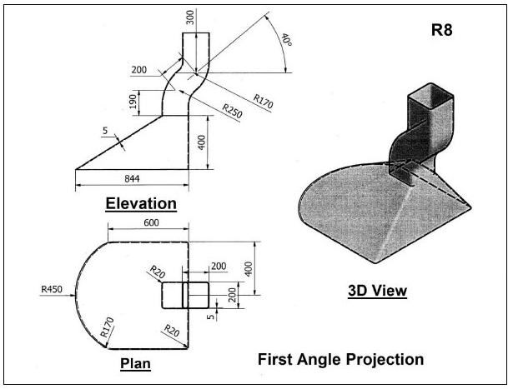
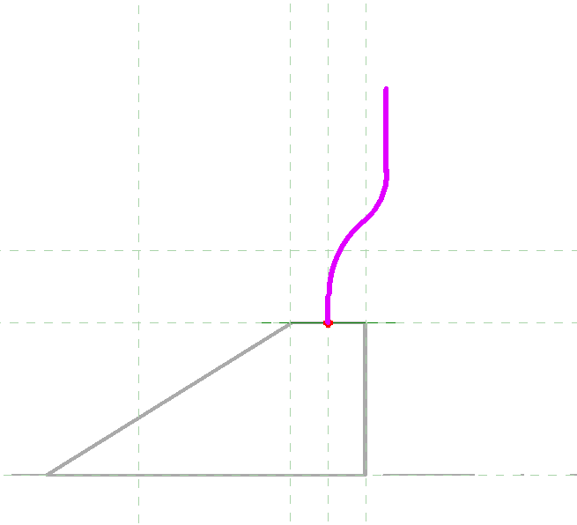
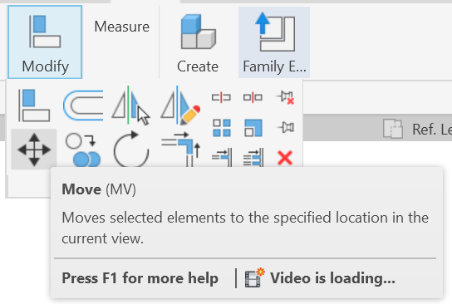
R8
Notes
You need to use Blend, Sweep and Void to do this exercise
Remember to fillet the corners
Sweep: draw the path in the middle instead of on the edge like in the video. If the Sweep object is off from the Blend base, you can use Move to align the 2 parts after you finish
Move function
Sweep path

Slide 66
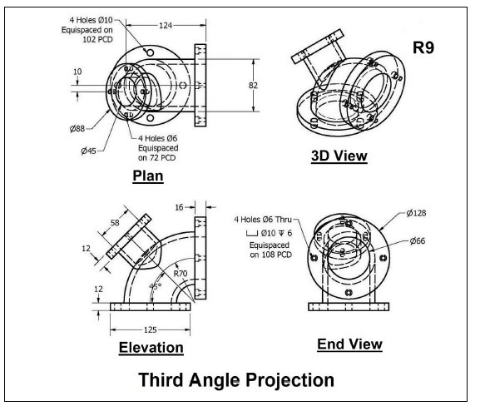
R9
R9
Notes
There are multiple ways to do this exercise. You can use Extrusion/Sweep/Void
Remember select the correct working plane for the small tube!!!
In the last step in the solution video, they use Void Revolve, but you can also use Void Sweep

