Slide 1

CV1711 ENGINEERING DRAWING & 3D BUILD INFO MODEL (LAB)

Slide 2
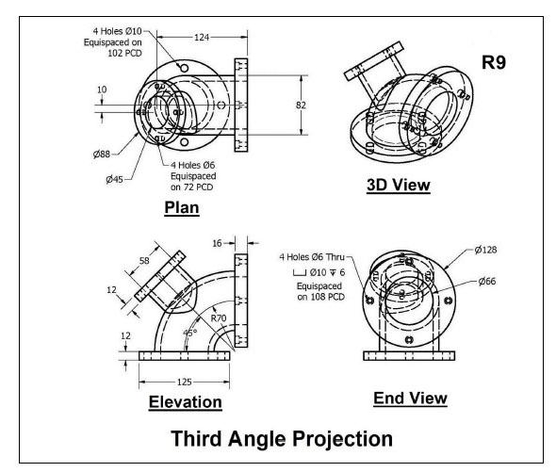
WEEK 11 –Revit Handson
R9

Slide 3
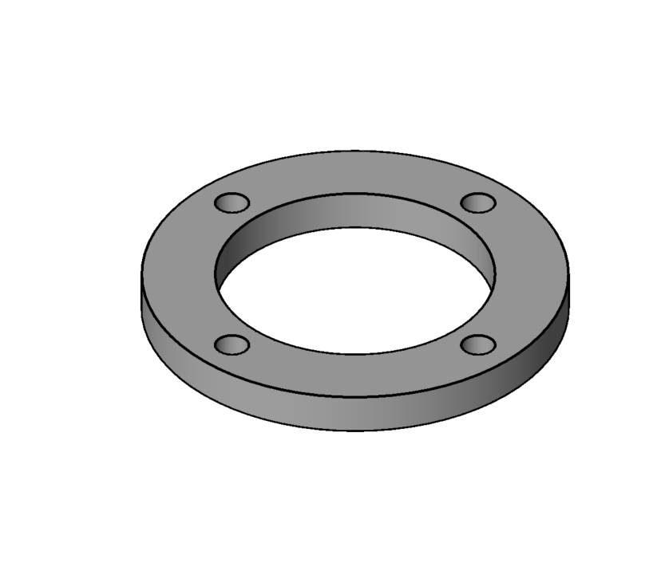
WEEK 11 –Revit Handson
R9
Extrusion

Slide 4
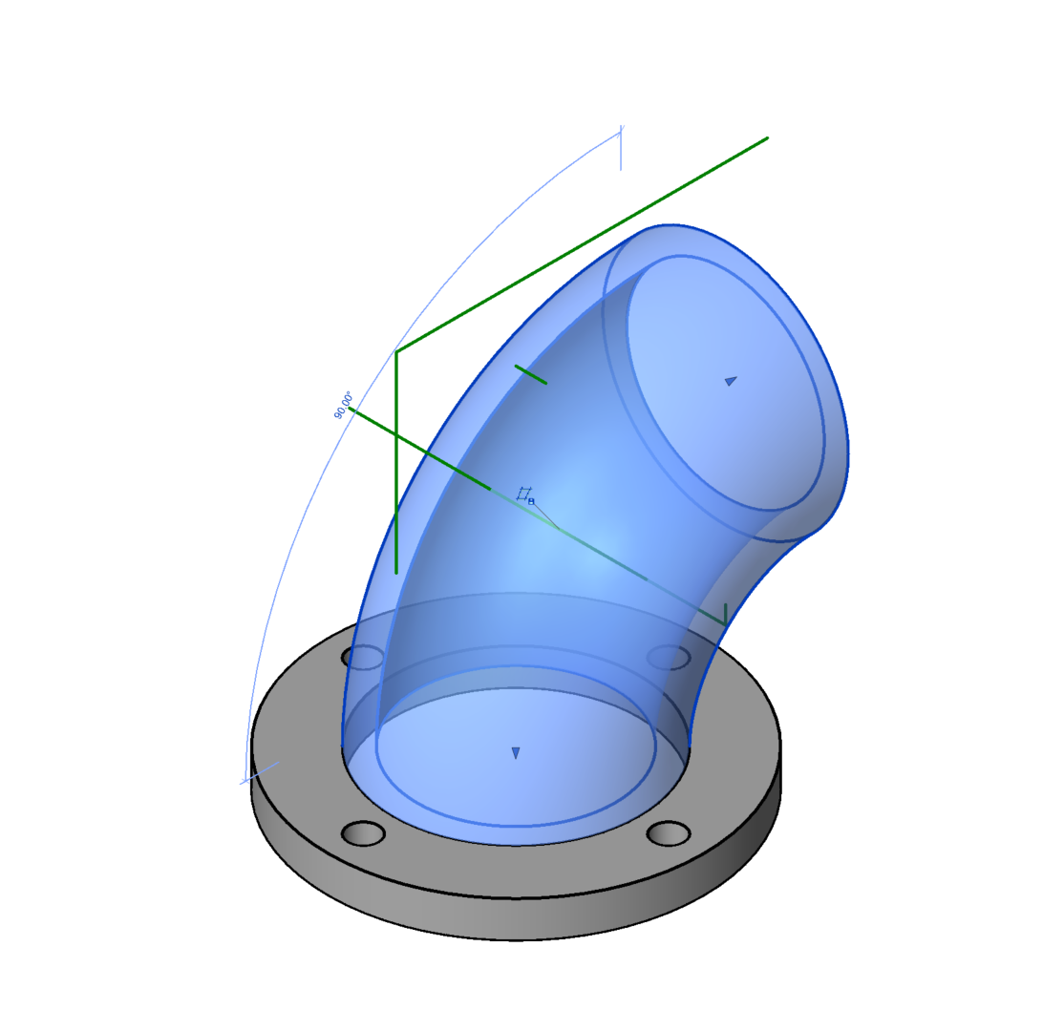
WEEK 11 –Revit Handson
R9
Revolve

Slide 5
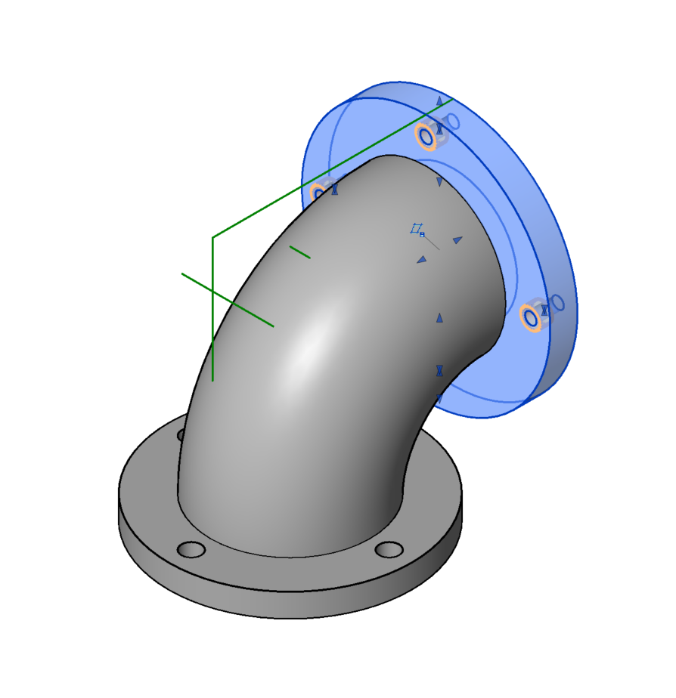
WEEK 11 –Revit Handson
R9
Extrusion (Blue)
Void Extrusion (Orange)

Slide 6
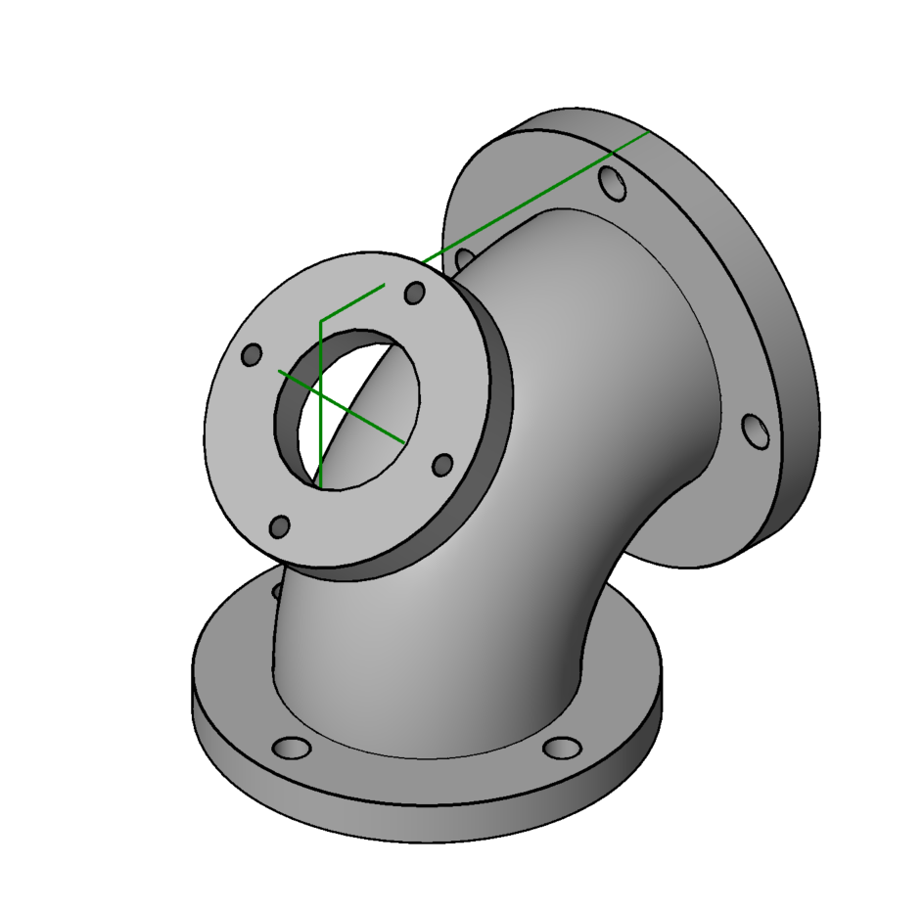
WEEK 11 –Revit Handson
R9
Must know how to draw the inclined reference plane first, refer to NTULearn video！
‘Inclined Reference Plane’
may appear in Quiz 2
Extrusion

Slide 7
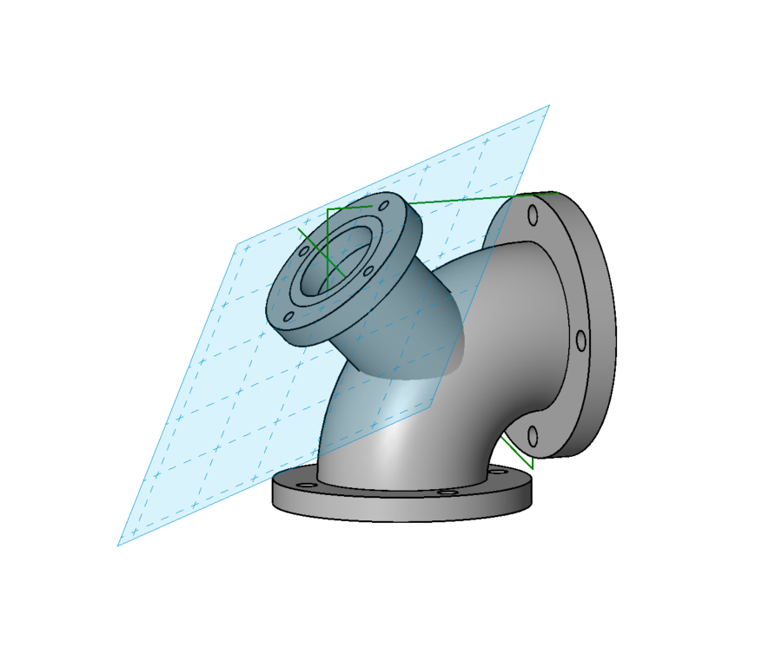
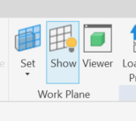
WEEK 11 –Revit Handson
Setup the work reference plane
show the current reference plane
Example Inclined Reference Plane

Slide 8
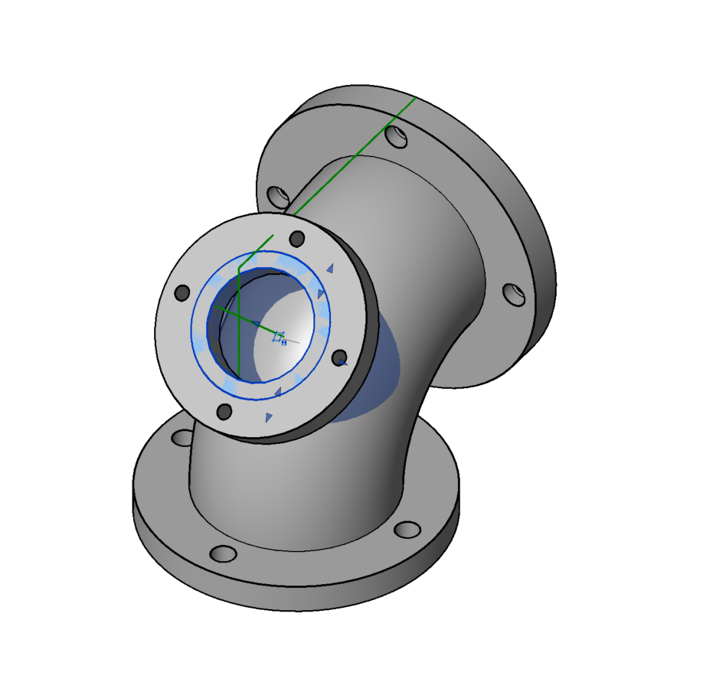
WEEK 11 –Revit Handson
R9
Extrusion

Slide 9
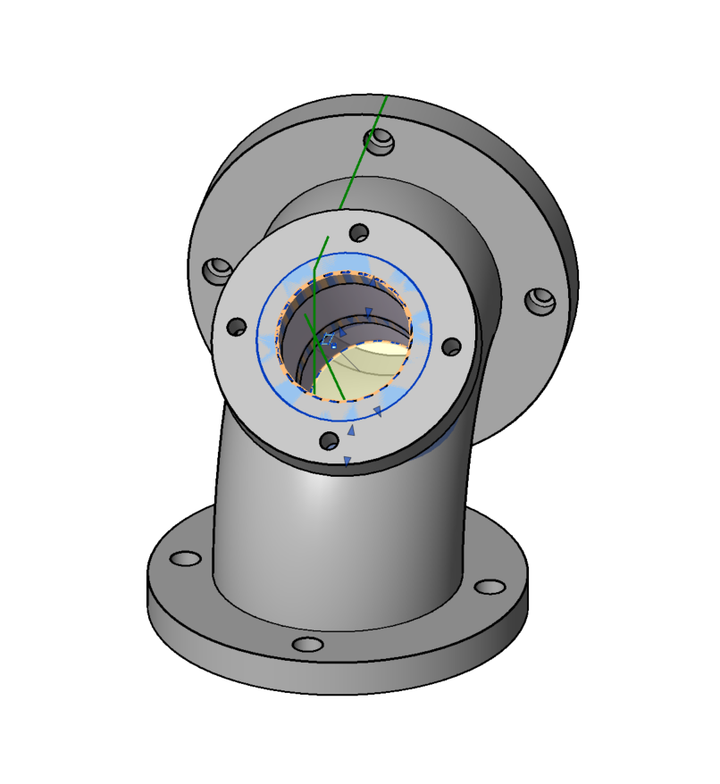
WEEK 11 –Revit Handson
R9
Void Extrusion

Slide 10
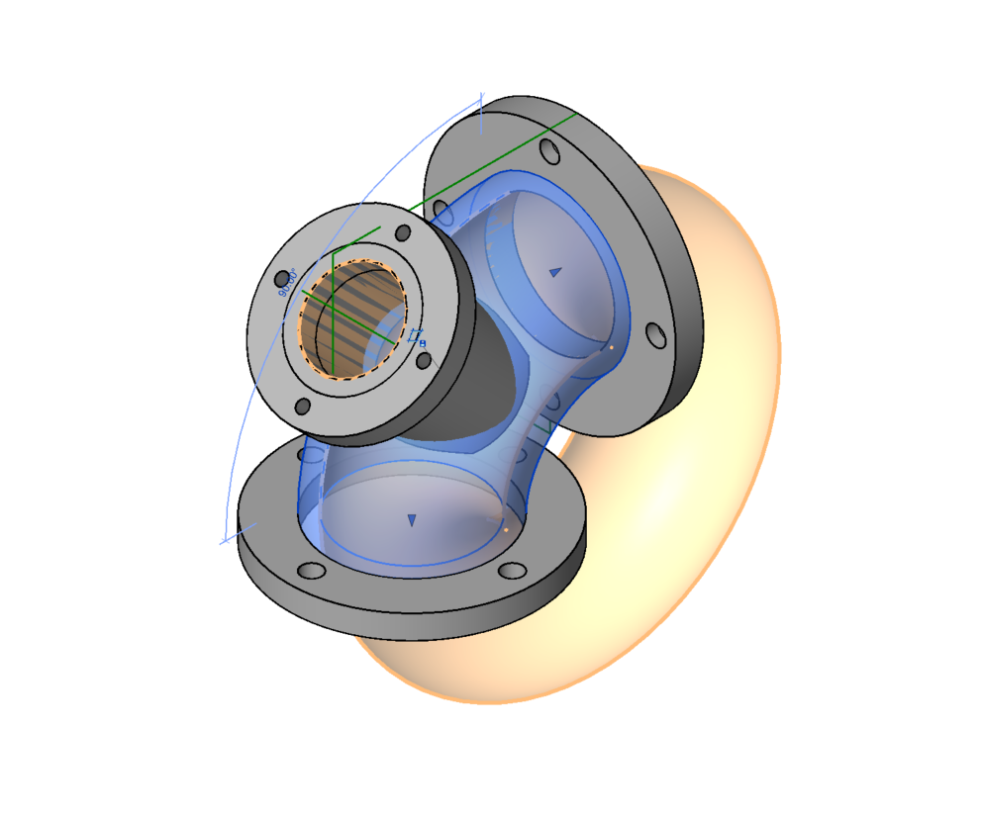
WEEK 11 –Revit Handson
R9
Void Revolve

Slide 11
NOTE: Week 12 (next week) will be home-based learning and there are no assignments.
You may review the materials and work on exercises at home to prepare for Quiz 2 in Week 13.
If you wish, you are also welcome to come to the EST Lab for practice.

Slide 12
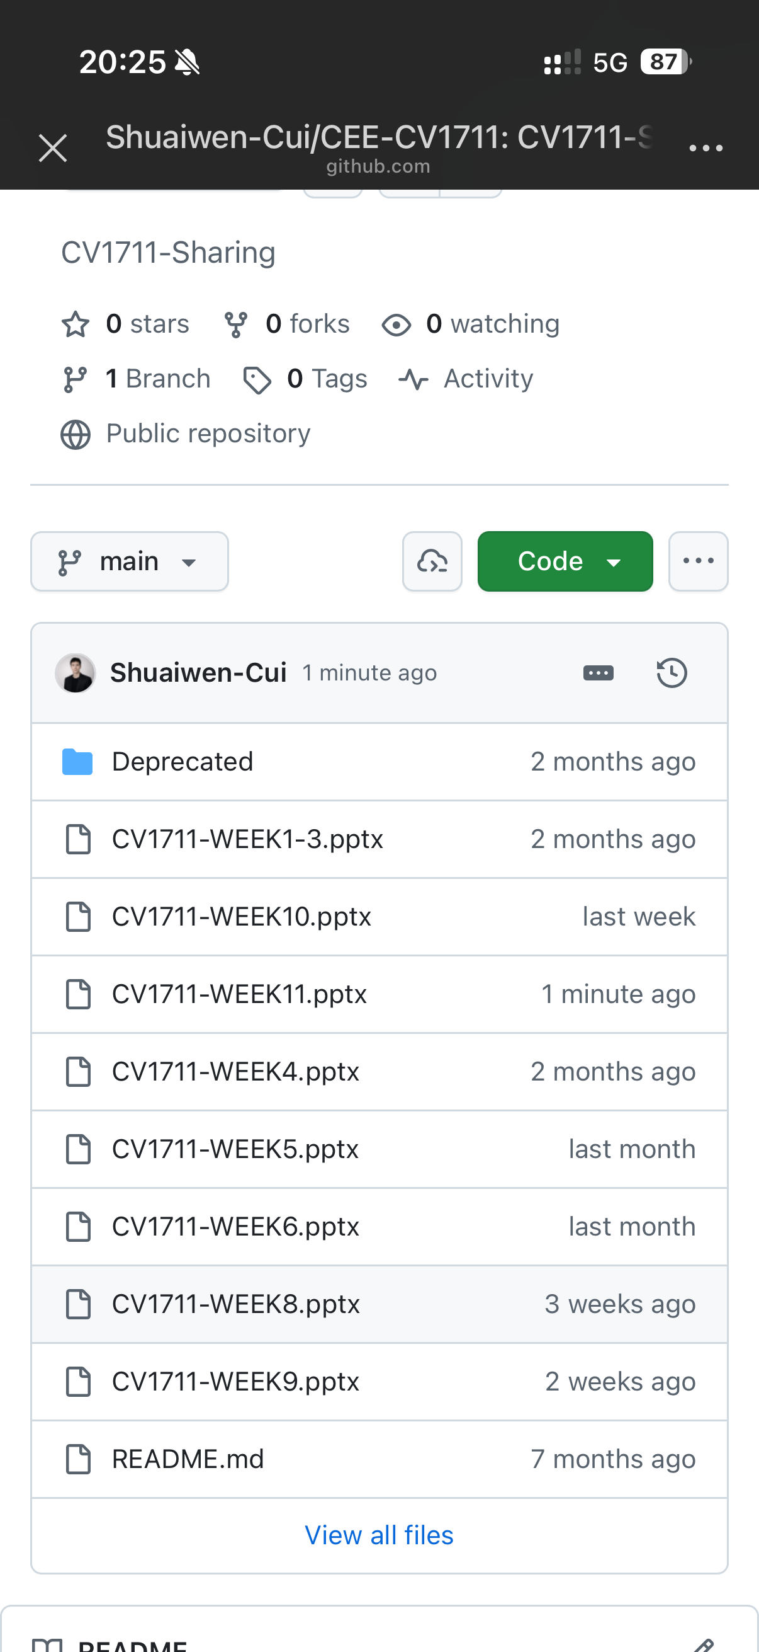
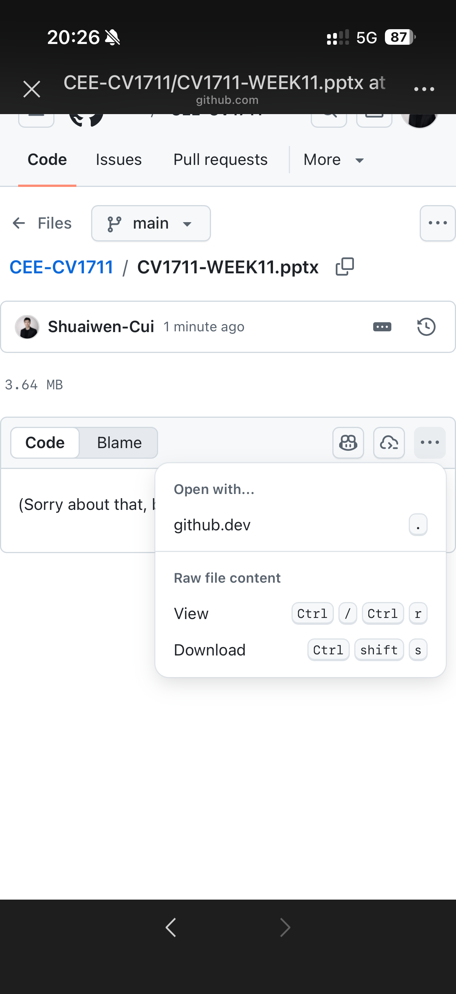

SCAN TO DOWNLOAD THE SLIDES

