Slide 1

CV1711 ENGINEERING DRAWING & 3D BUILD INFO MODEL (LAB)

Slide 2
WEEK 8 – BIM & Autodesk Revit Basics
Building Information Modeling (BIM)
BIM is an intelligent digital process that uses 3D models enriched with multidisciplinary data to support the planning, design, construction, and lifecycle management of buildings and infrastructure, enabling collaboration, efficiency, and informed decision-making across stakeholders.
Autodesk Revit
Autodesk Revit is the most widely used BIM software, enabling architects, engineers, and construction professionals to collaboratively design, visualize, and manage building projects across their lifecycle.

Slide 3
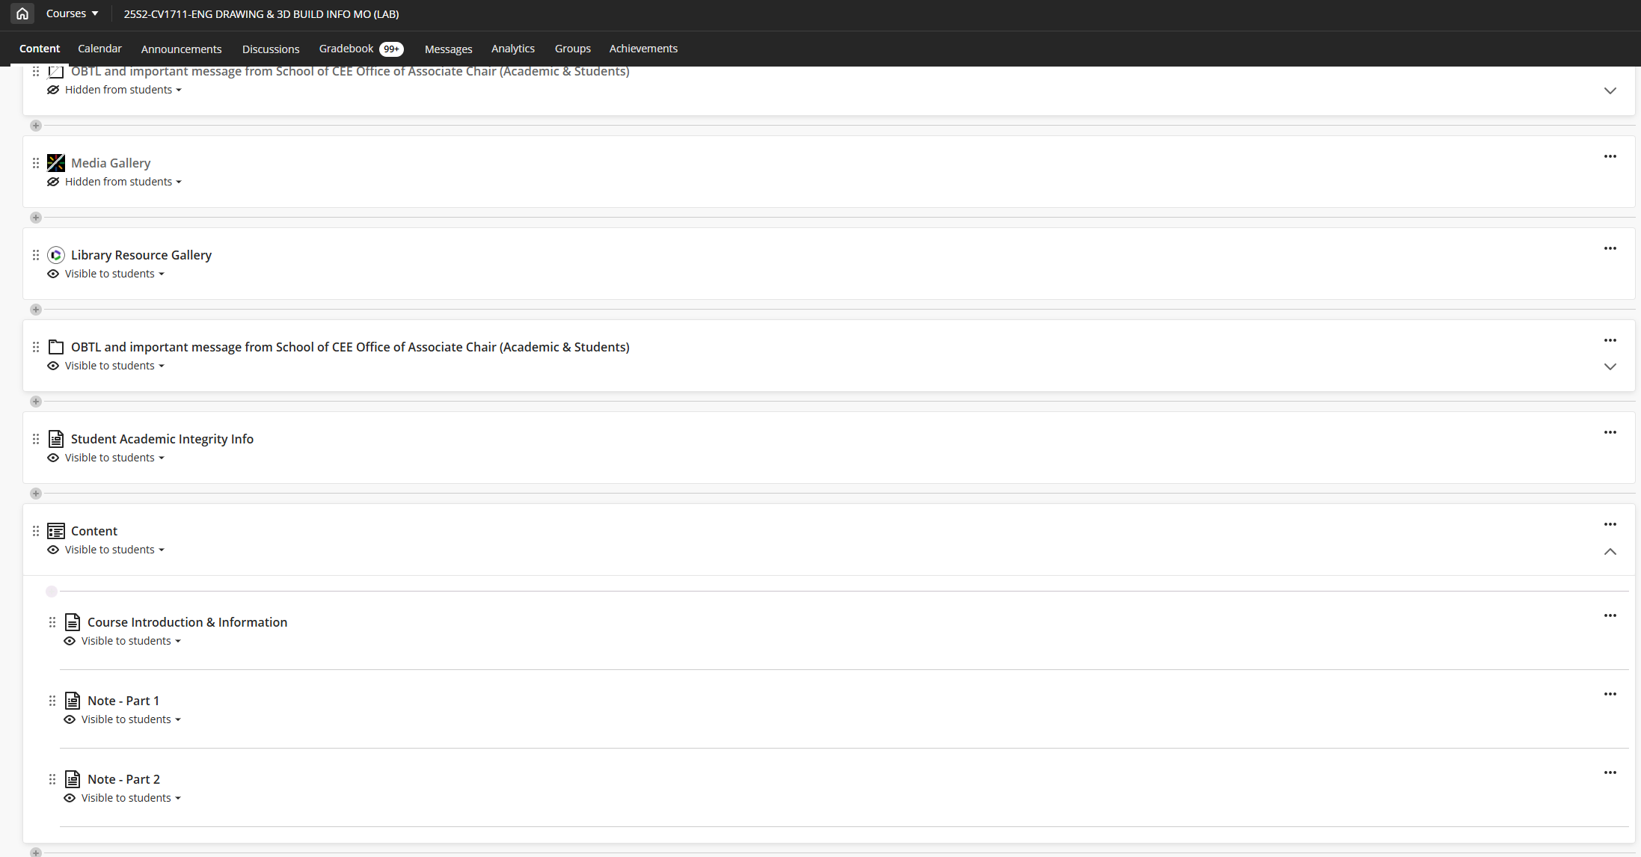
WEEK 8 – BIM & Autodesk Revit Basics
Follow the material to learn BIM & Revit

Slide 4
WEEK 8 – BIM & Autodesk Revit Basics
Following NTLearn and Linkedin videos to learn Revit basic operations. You only need to watch the videos required in the study material in the previous slide.
Submit R1-4 by the end of week 8.

Slide 5
WEEK 8 – Key Points
Family Categories – System/Component/In-place
Family Anatomy – Reference/Dimension/Parameter/3D Mass
Basic Operations – Extrusions/Sweeps/Blends/Voids/Profile
For sweeping, two phases – I Path / II Profile

Slide 6
WEEK 8 – Scope For Quiz 2
BASICS
3D MASS
3D VOID
1-REFERENCE
EXTRUSION
EXTRUSION
“FAMILY”
2-DIMENSION
SWEEP
SWEEP
3-LABEL
BLEND
BLEND
4-3D MASS/VOID

Slide 7
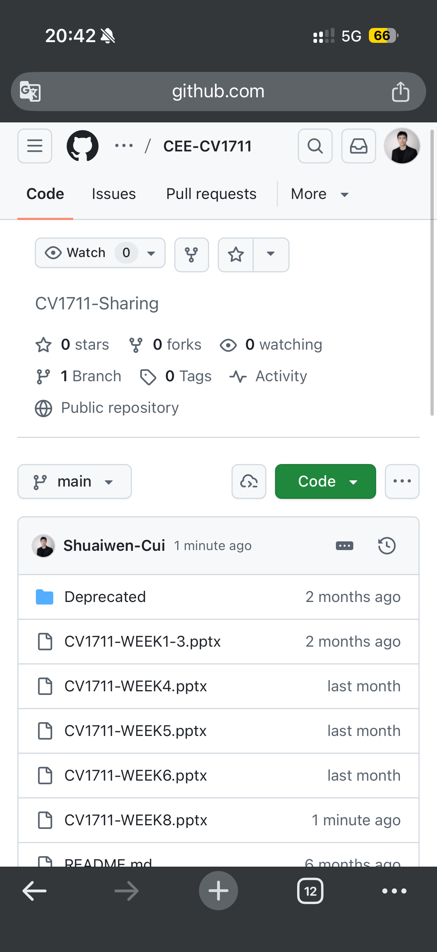
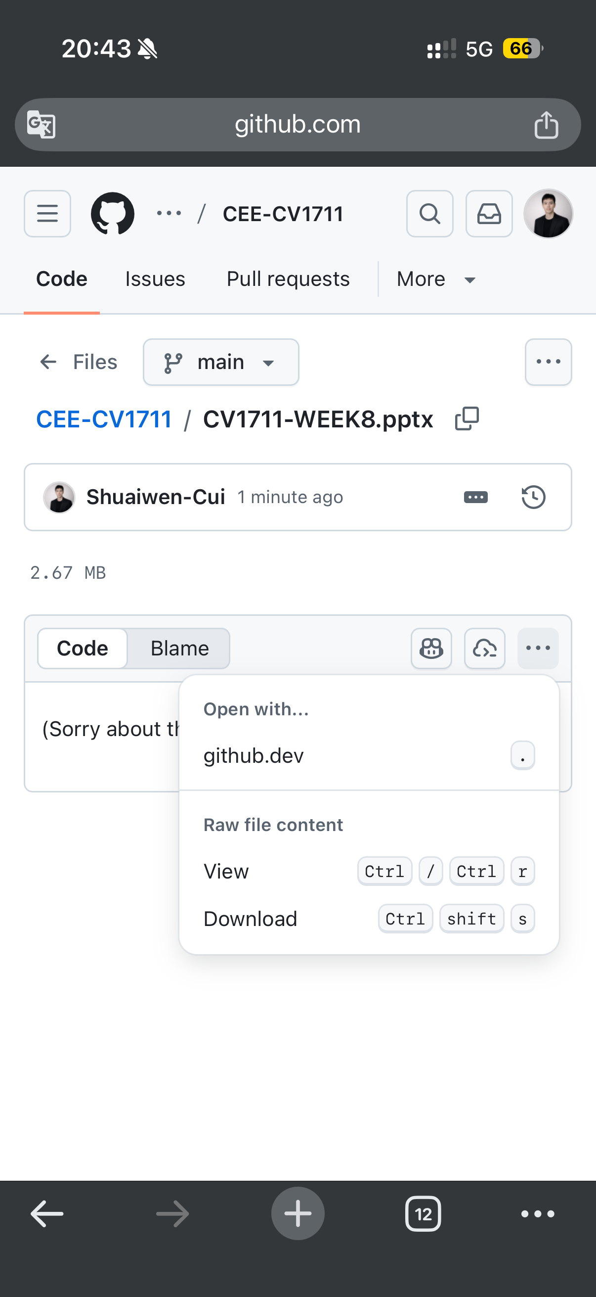
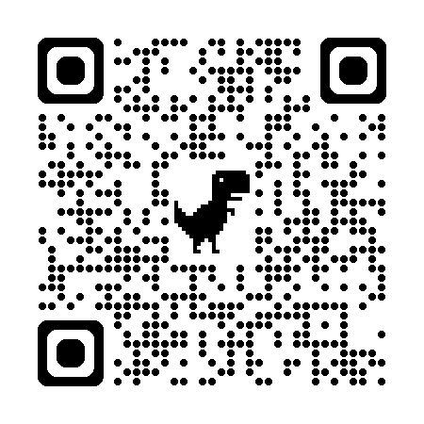
SCAN TO DOWNLOAD THE SLIDES

