Slide 1

CV1711 ENGINEERING DRAWING & 3D BUILD INFO MODEL (LAB)

Slide 2
WEEK 9 –Revit Handson
Exercises: R5, R6, R7
Submission: R5

Slide 3
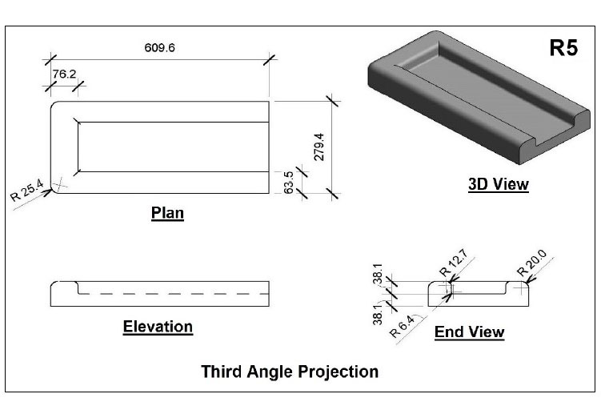
WEEK 9 –Revit Handson
R5
Extrusion
Sweep
Void Sweep
Path & Profile

Slide 4
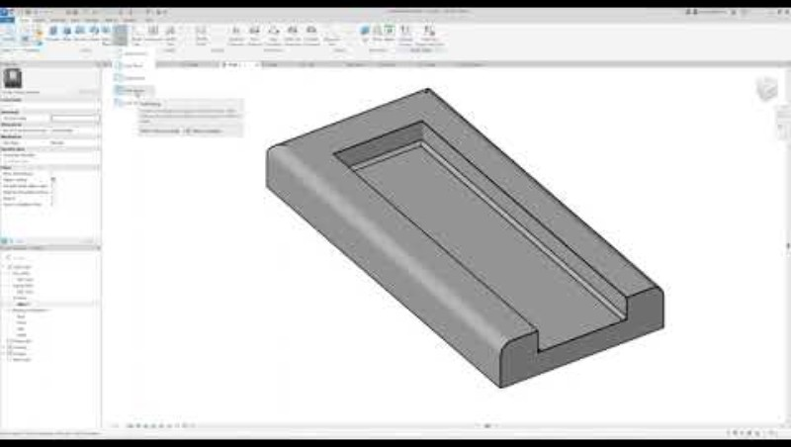
WEEK 9 –Revit Handson
R5

Slide 5
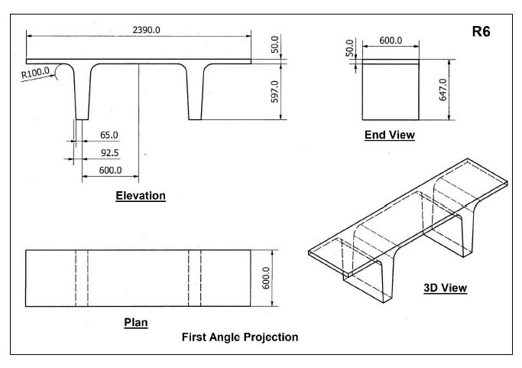
WEEK 9 –Revit Handson
R6
Extrusion
Symmetry

Slide 6
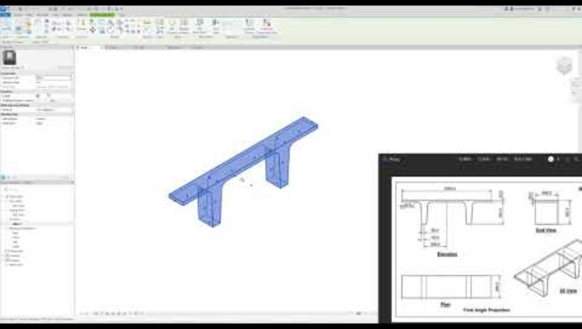
WEEK 9 –Revit Handson
R6

Slide 7
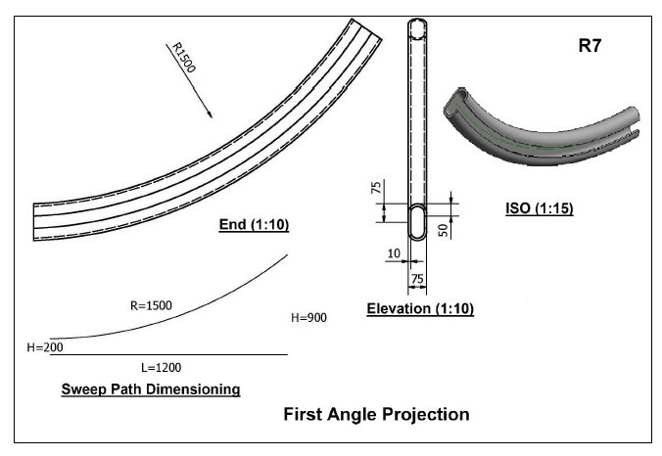
WEEK 9 –Revit Handson
R7
Sweep
Reference Planes
Symmetry

Slide 8
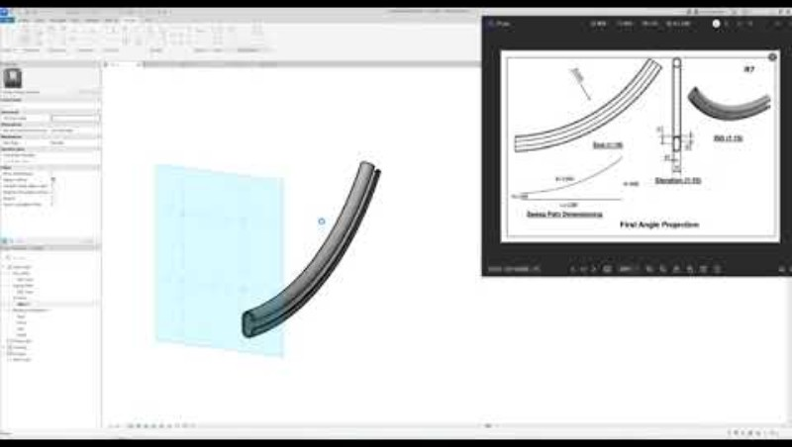
WEEK 9 –Revit Handson
R7

Slide 9
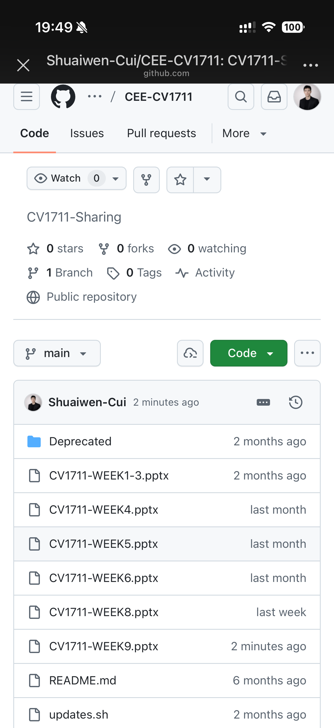
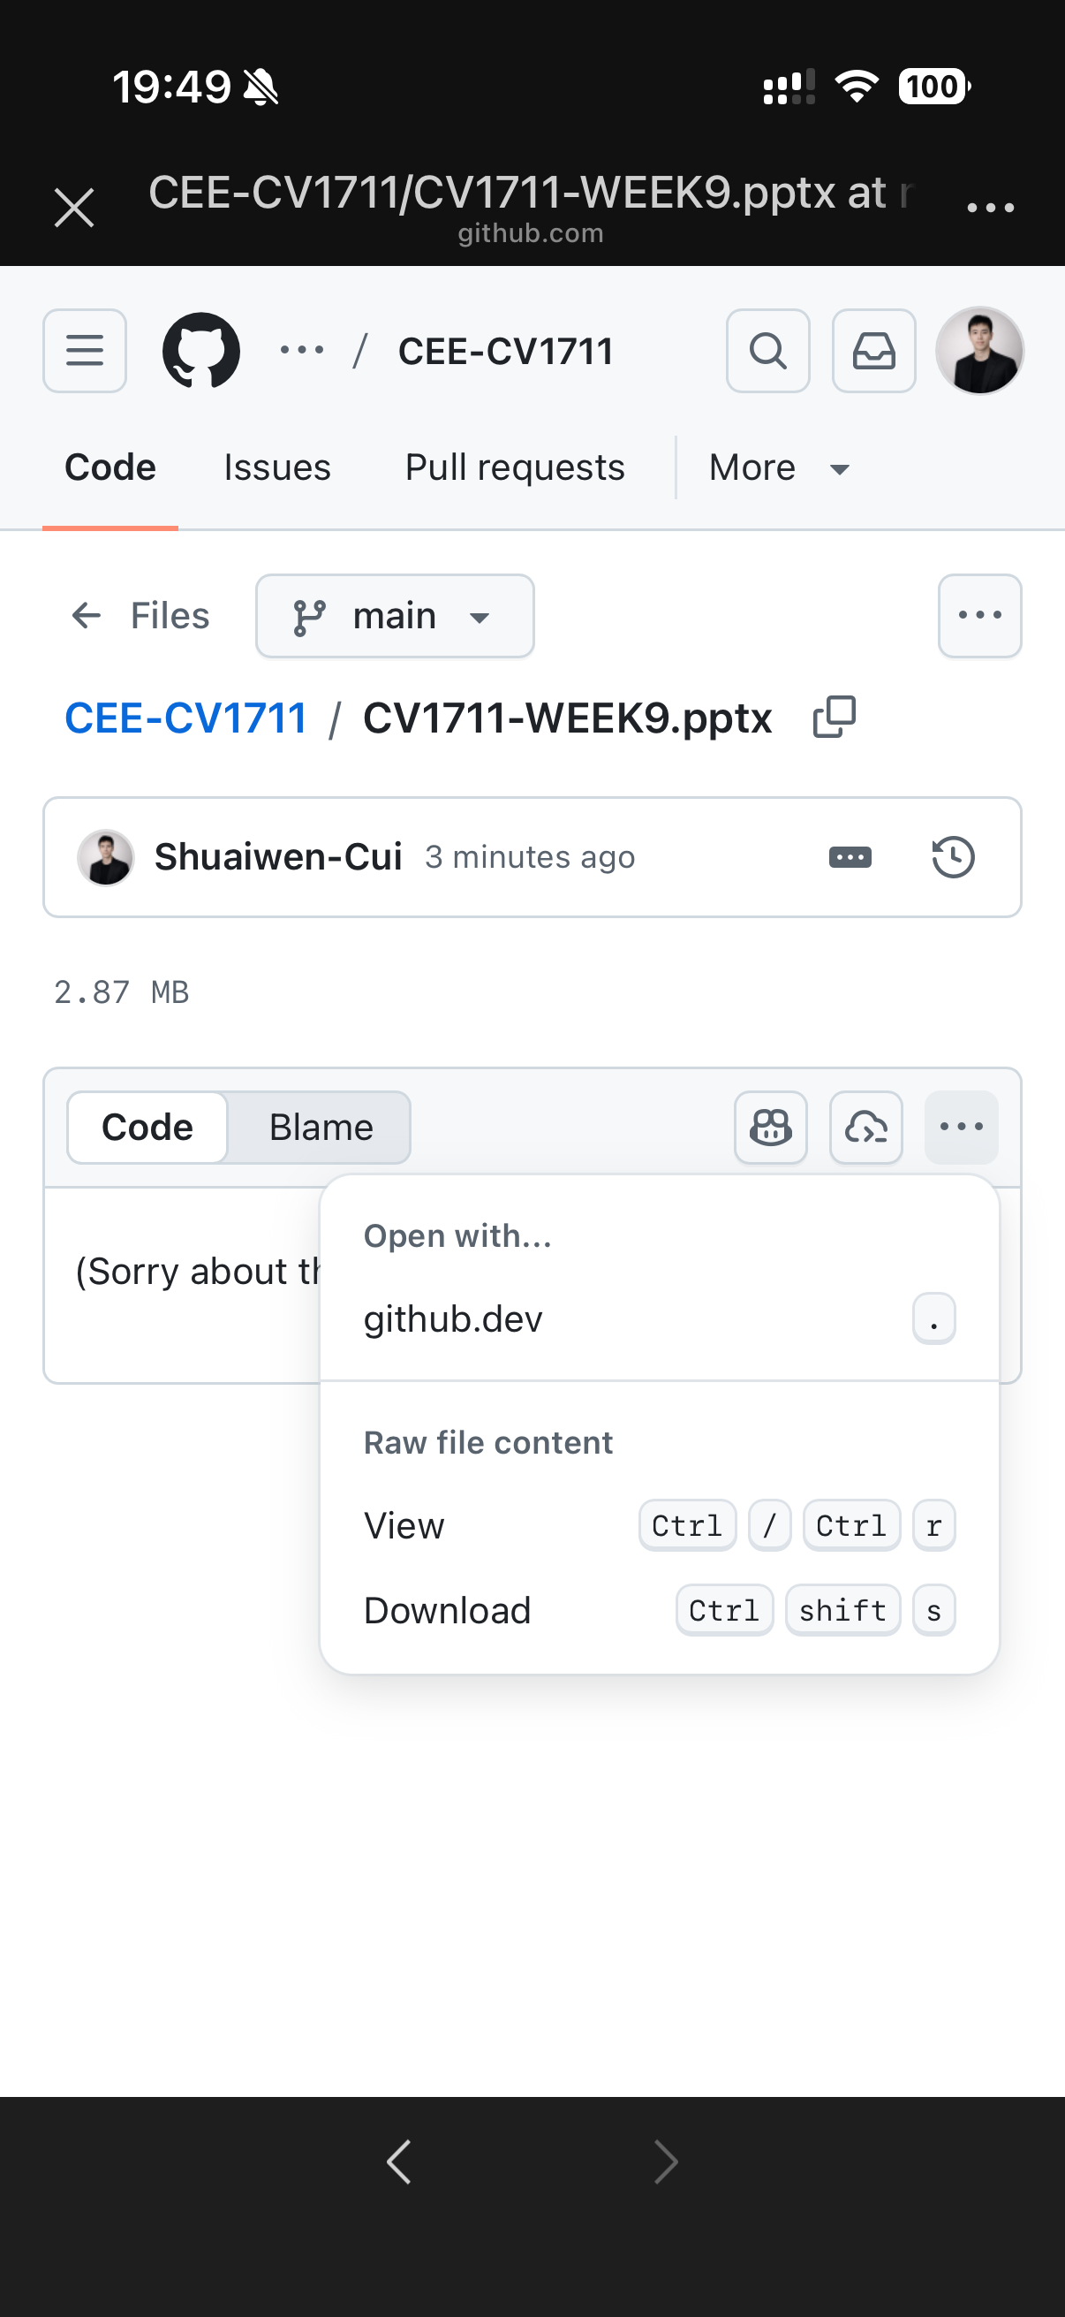

SCAN TO DOWNLOAD THE SLIDES

