Slide 1

CV1711 ENGINEERING DRAWING & 3D BUILD INFO MODEL (LAB)

Slide 2
WEEK 6 – Prepare for Quiz 1 in Week 7

Slide 3
WEEK 6 – Q&A
Q: Scope of Quiz 1?
A: Auxiliary Projection

Slide 4
WEEK 6 – Q&A
Q: Exercises to pay attention?
A: E9, E10, E11

Slide 5
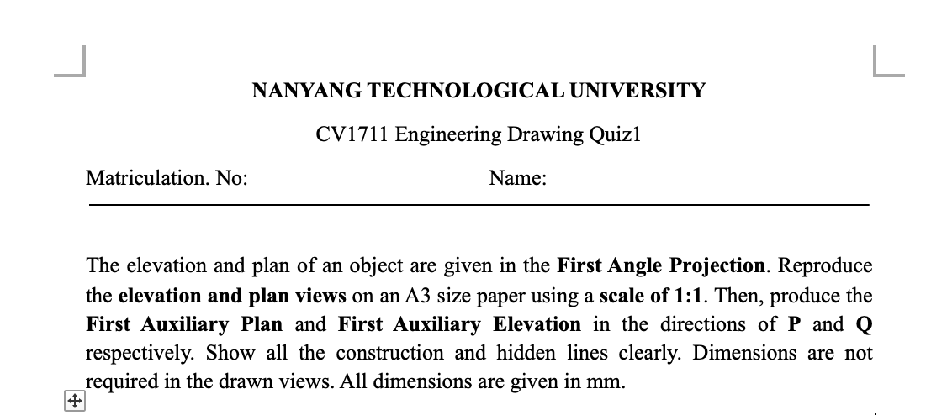
WEEK 6 – Q&A
Q: How does the quiz question look like?
Just draw in the level1 template as usual

Slide 6
WEEK 6 – Q&A
Q: Time and Venue for Quiz 1?
A: Same as usual classes.

Slide 7
WEEK 6 – Q&A
Q: Openbook quiz?
A: You can only access NTULearn for previous exercises.

Slide 8
WEEK 6 – Q&A
Q: What files to upload to NTULearn?
A: dwg file and pdf file, both required.

Slide 9
WEEK 6 – Q&A
Q: How to export dwg and pdf file?
A: ‘FILE’> ‘Save As’>’.dwg’, see next slide

Slide 10
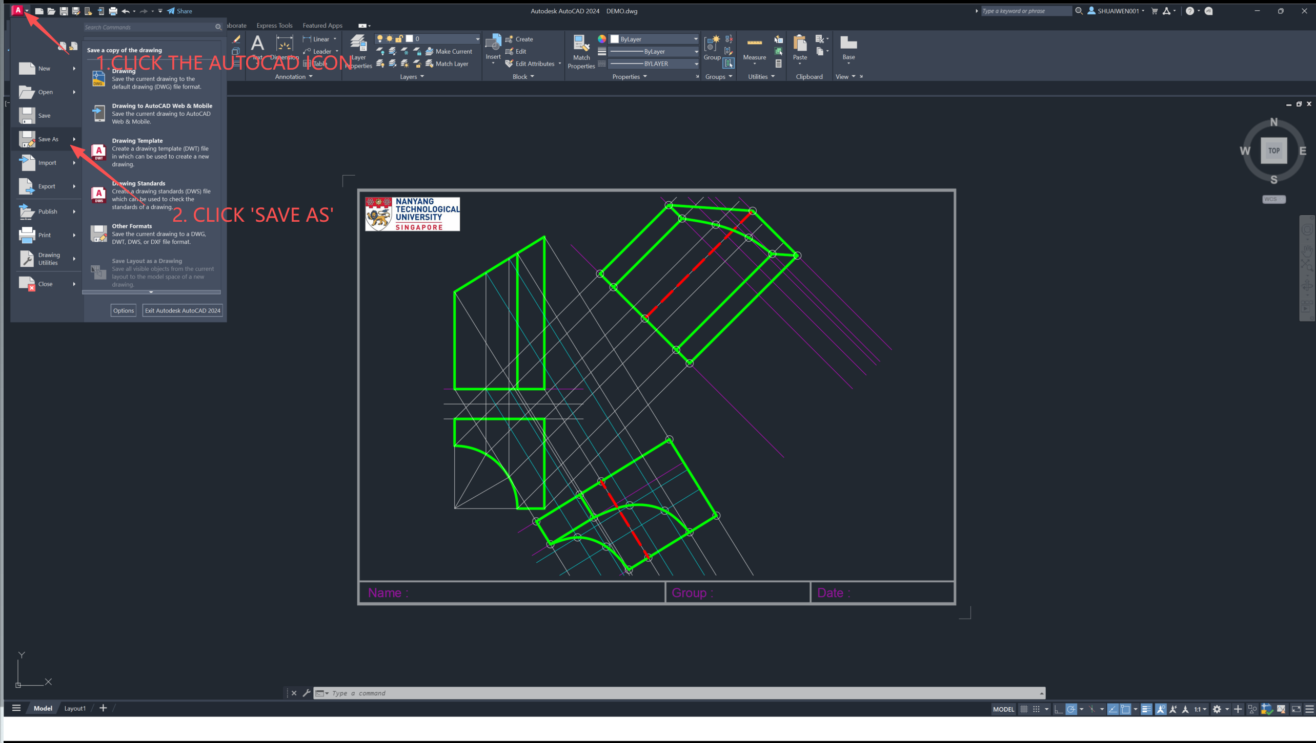

Slide 11
WEEK 6 – Q&A
Q: How to export dwg and pdf file?
A: Click TAB ‘Layout’ at the bottom, type in command ‘print’, select the printer ‘Microsoft print to pdf’ in the dropdown menu, click preview to check, press ‘ESC’ to exit preview, click ’OK’ to save pdf. See next two slides

Slide 12
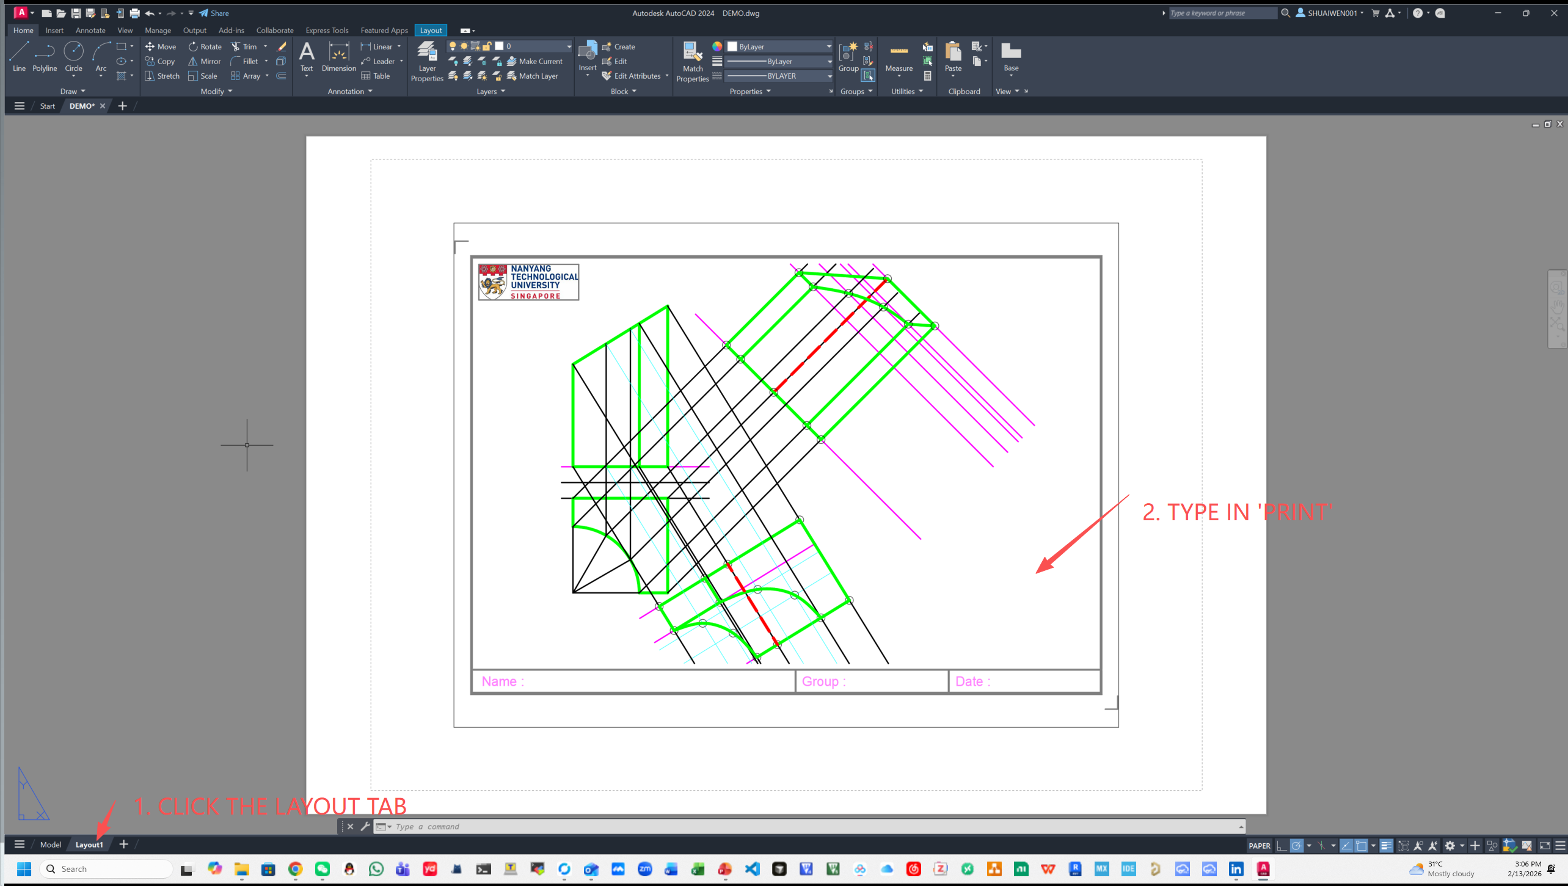

Slide 13
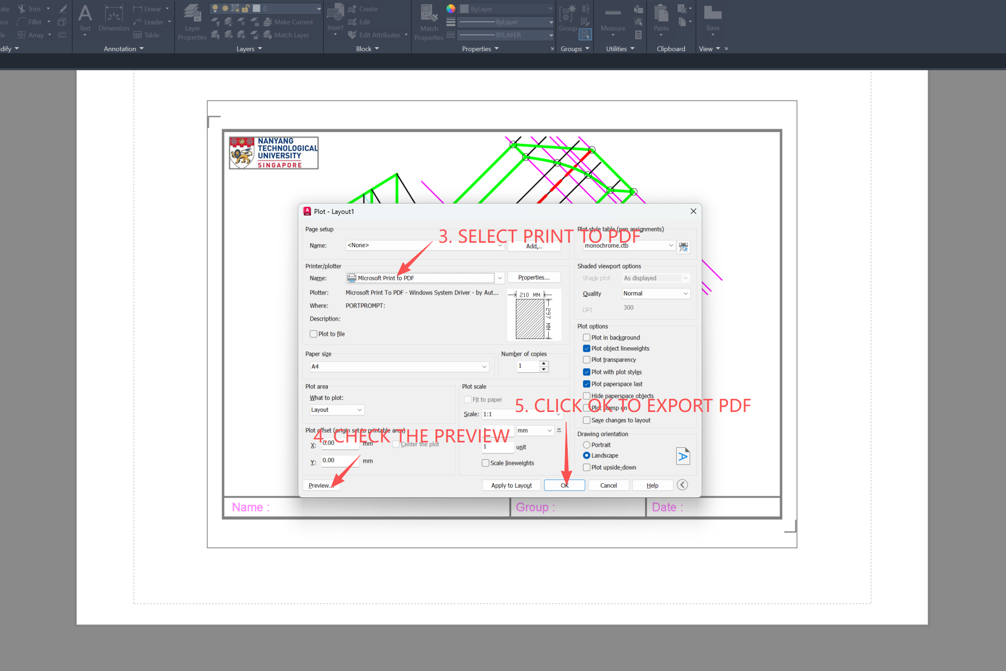

Slide 14
WEEK 6 – RECAP - AUXILIARY PROJECTION - PRECEDURES
1. Reproduce the principal views
2. Projectors parallel to the given direction from end points
3. Ground line perpendicular to the projectors
4. Transfer heights/widths

Slide 15
WEEK 6 – RECAP - AUXILIARY PROJECTION - CURVES APPROXIMATION
How many points ? Up to you, usually two in the middle for a quarter of a circle.
Way 1
Way 2
30°
30°
30°
R/3
R/3
R/3
No need to be exact, e.g., when R=20, you can use 7+7+6

Slide 16
AUXILIARY PROJECTION – FURTHEST POINTS OF A CYLINDER
Pay attention to these furthest points, usually you need a line (visible – solid; invisible - dashed) to indicate them. See next slide.

Slide 17

Pay attention to these furthest points, usually you need a line (visible – solid; invisible - dashed) to indicate them.
AUXILIARY PROJECTION – EDGE OF COLUMNS

Slide 18
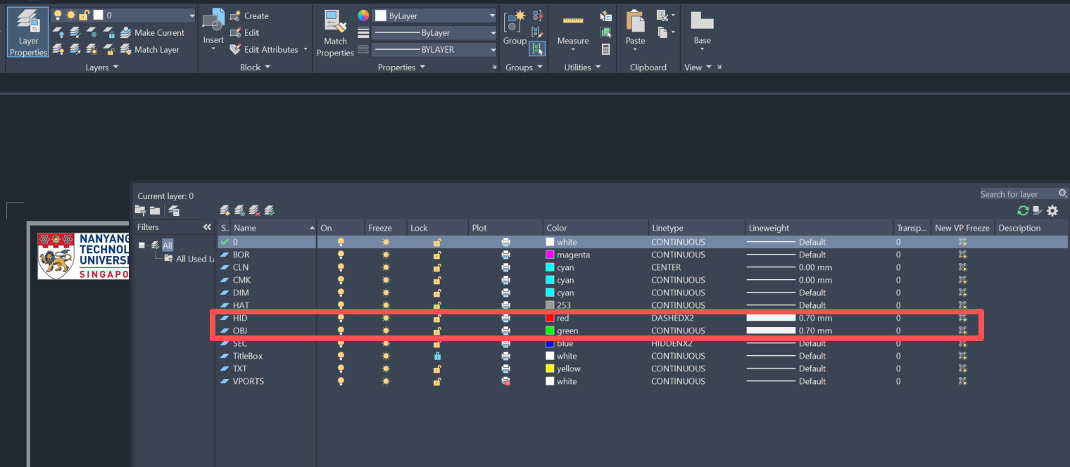
AUXILIARY PROJECTION – HIDDEN LINES
For visible lines or curves, use solid lines or curves;
For invisible lines or curves, use dashed lines or curves.
Better make the linewidth 0.7 mm

Slide 19
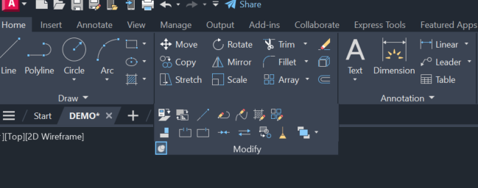
AUXILIARY PROJECTION – BREAK AT A POINT
! You can use this to break a line/curve at a point, making it into two parts

Slide 20
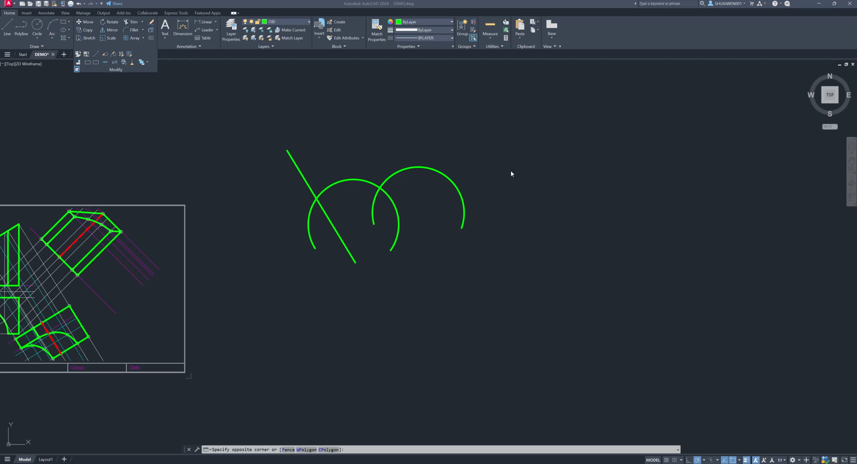
AUXILIARY PROJECTION – HIDDEN LINES & BREAK AT A POINT – EXAMPLE - Video

Slide 21
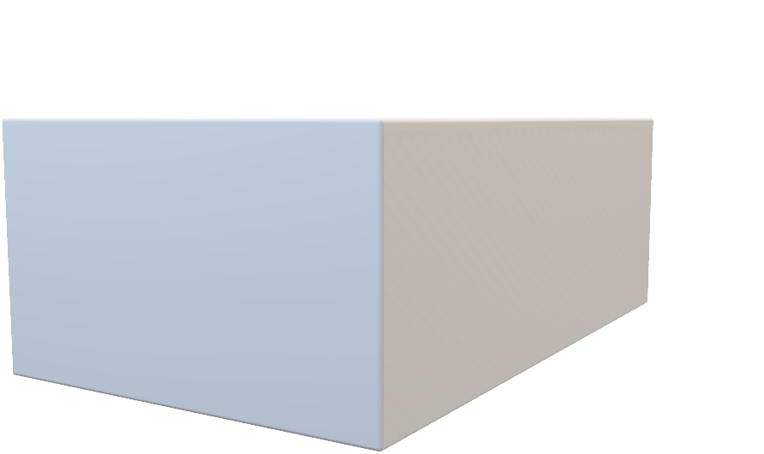
AUXILIARY PROJECTION – HIDDEN LINES
When a hidden line coincide with a solid line, only keep the solid line.

Slide 22
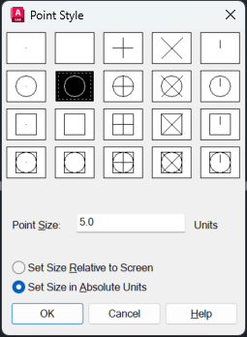
AUXILIARY PROJECTION – HIDDEN LINES
For point type, better to use option 2 – absolute units.

Slide 23
Good luck with Quiz 1!

Slide 24
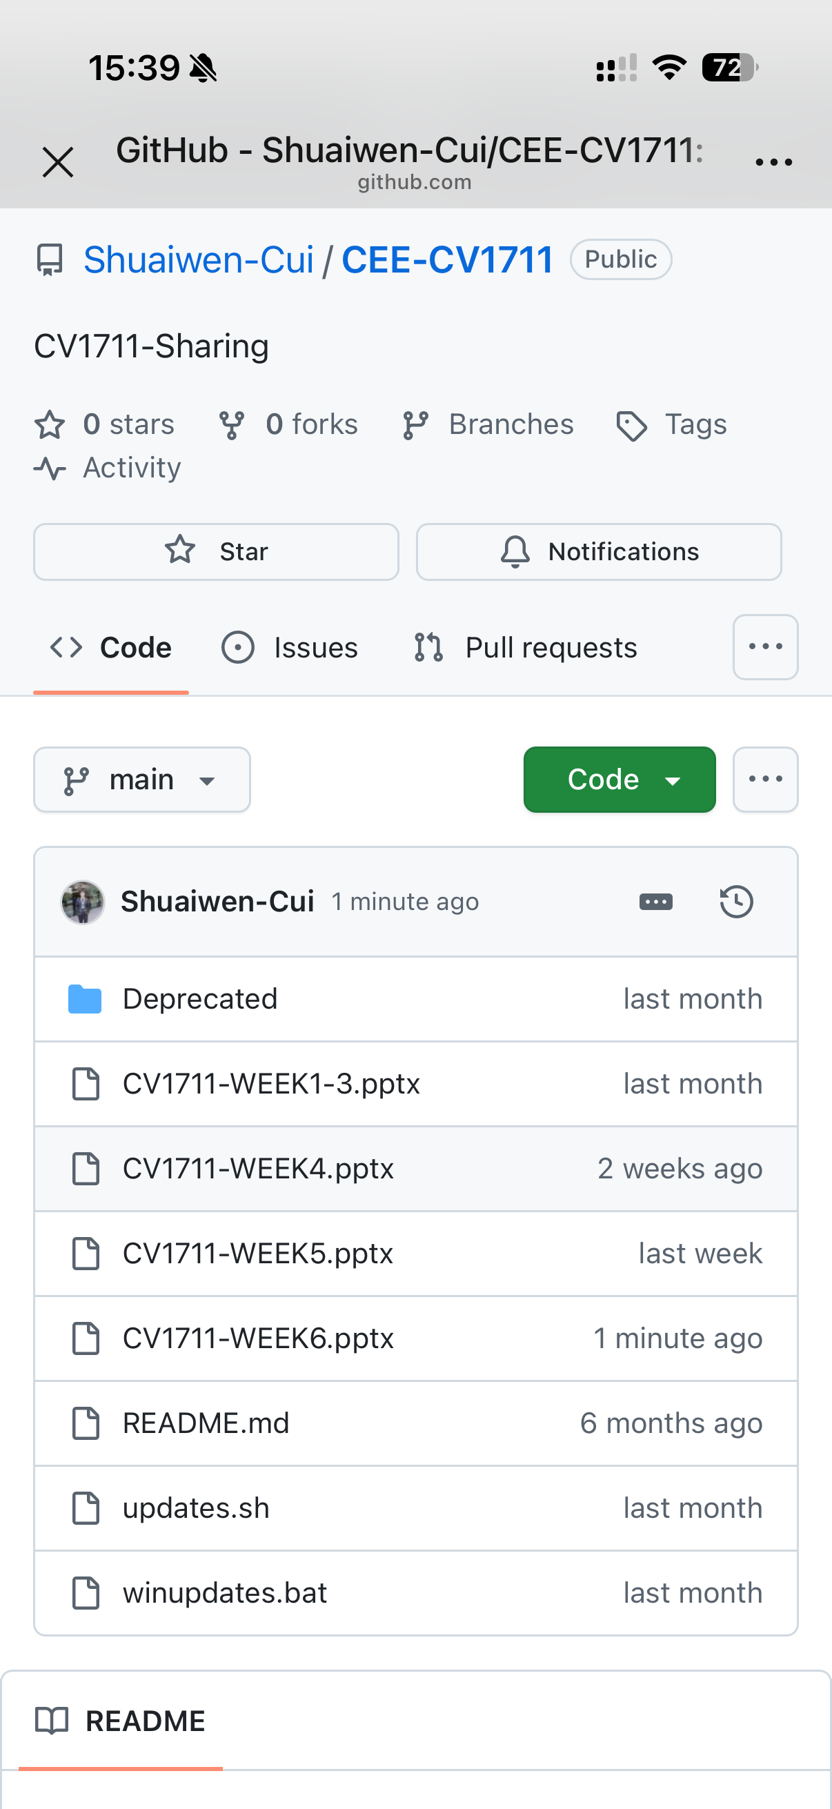
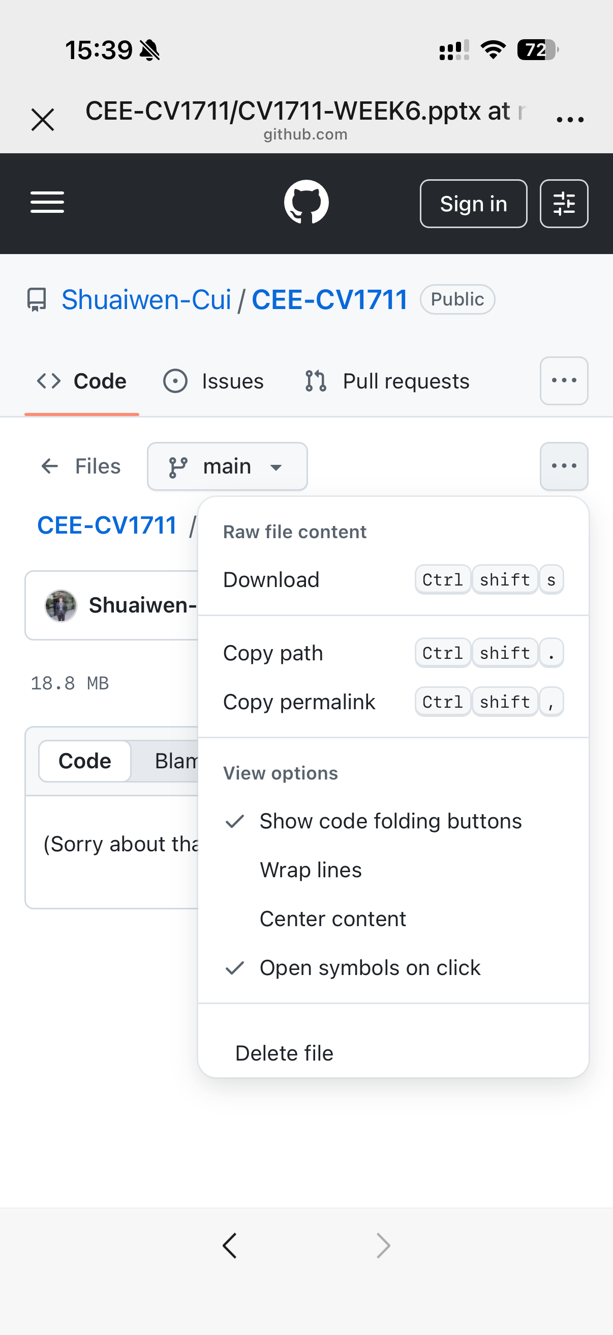

SCAN TO DOWNLOAD THE SLIDES

