Slide 1
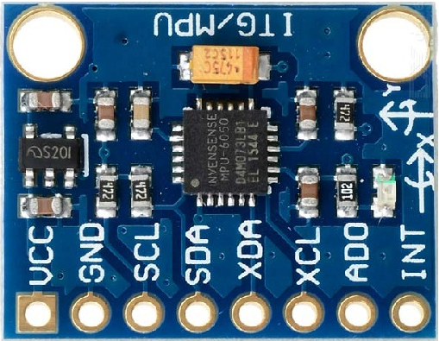
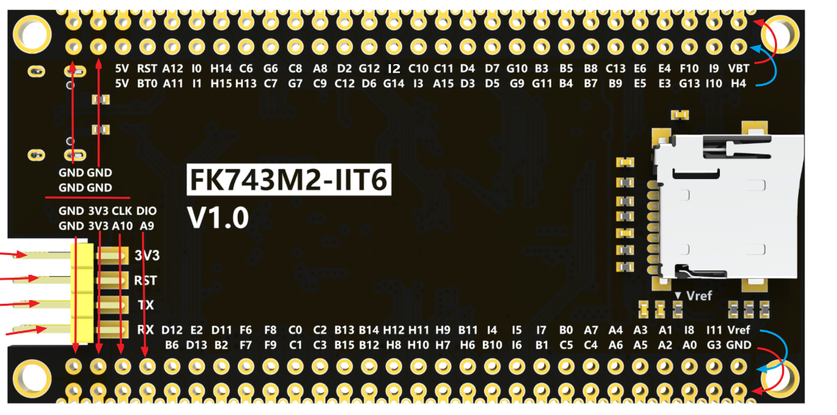
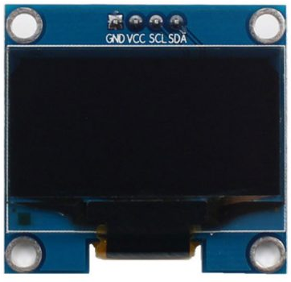
VCC
GND
PH4
VCC
GND
PB7
PB11
PB6

Slide 2
PB7
PB6
VCC
GND

Slide 3
VCC
GND
PH4
PB11

