Slide 1
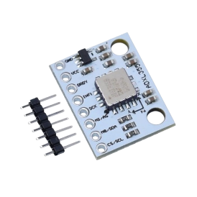
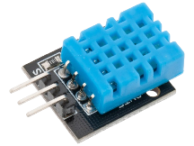
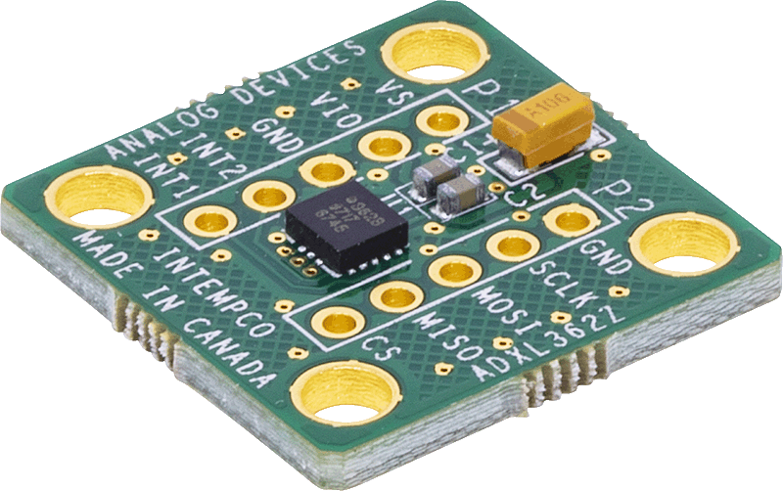
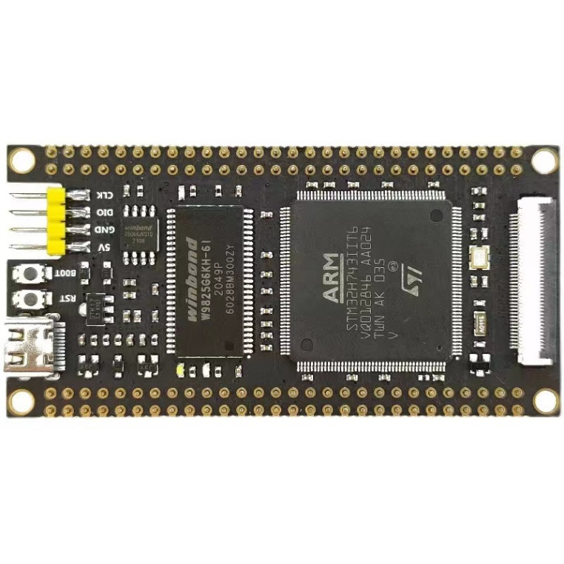
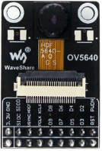
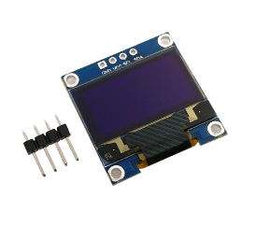
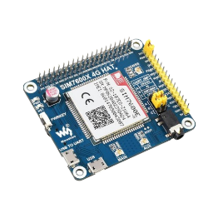
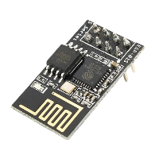
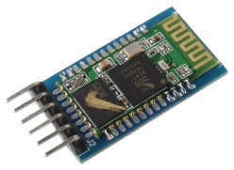
HARDWARE SETUP
ready
in progress
main control
peripherals
MAIN CONTROL BOARD
PERIPHERALS
SENSING - ACC
MAIN CONTROL
STM32H743IIT6
480MHz
RAM:
SRAM: 1 Mb (built-in)
SDRAM: 32 Mb
ROM:
FLASH: 2 Mb (built-in)
QSPI FLASH 8 Mb
NAND FLASH Slot
TF Card
Up to 32 GB
IO:
97 pins
Type-C
1 rst button; 1 boot button
SWD Debug
Serial Communication
LED
1 power indication
1 user programmable
DHT11
ADXL362
ADXL355
ENV SENSING
temperature
relative humidity
LOW POWER ACC
12 bit
idle - 270nA/ sensing – 3uA
HIGH RESOLTUION ACC
20 bit
idle – 21uA / sensing – 150uA
SENSING - VISION
INTERFACING
OV5640
VISUAL SENSING
resolution: 2592x1944
idle – 20uA/ sensing – 140mA
OLED Scree
0.96 inch
COMMUNICATION
WIFI
ESP8266
BT
HC-05
CELLULAR
SIM-7600

Slide 2
SOFTWARE FRAMEWORK
SOFTWARE ARCHITECTURE
FEATURES
APPLICATION-SPECIFIC CODE
INTERFACE
LED
Serial Communication (UART)
APPLICATION
LAYER
STORAGE AND FILE MANAGEMENT
External Storage Driver (SD Card using SDMMC)
File System - FATFS
FATFS
RTOS
X-CUBE-AI
MIDDLEWARE
LAYER
EDGE COMPUTING RELATED
External RAM 32 Mb Driver (SDRAM using FMC)
Memory Management Driver for External RAM
CMSIS-DSP for Digital Signal Processing
USER DRIVERS
DRIVER
LAYER
STM32 HAL (Hardware Abstraction Layer)
EDGE INTELLIGENCE
CMSIS-NN
X-CUBE-AI
MAIN CONTROL
PERIPHERALS
HARDWARE
LAYER
UNDER DEVELOPMENT
FreeRTOS
Drivers for Peripherals
Sensing (DHT11, ADXL362&255, OV5640)
Communication (ESP8266, HC-05, SIM-7600)
Interfacing (OLED)

