Slide 1
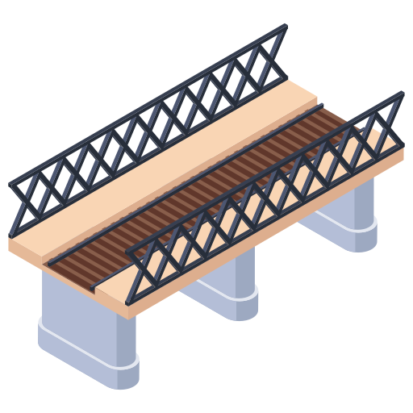

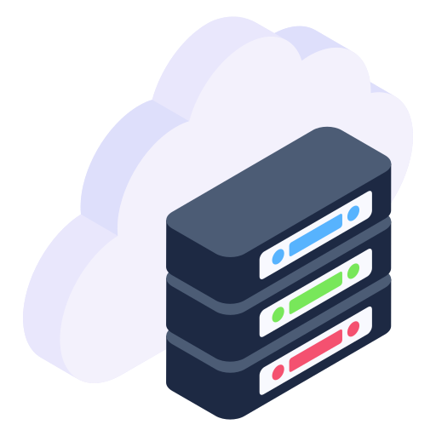


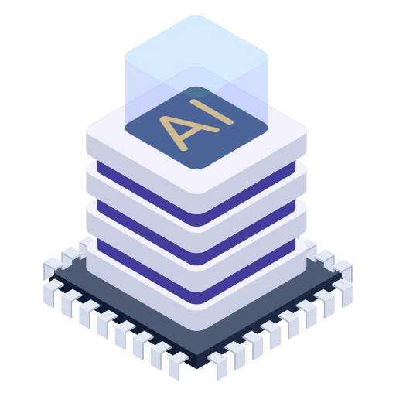
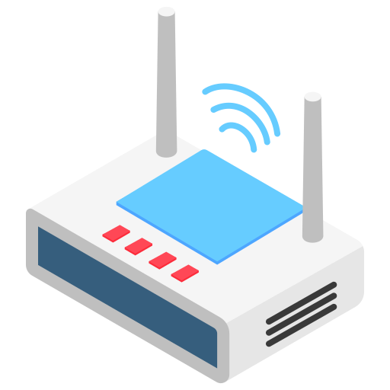




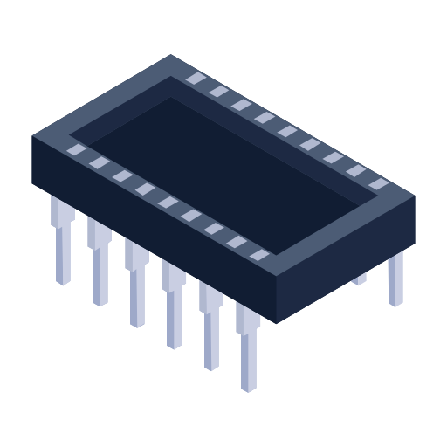
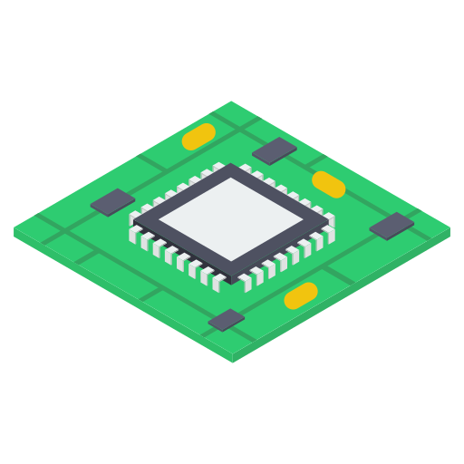

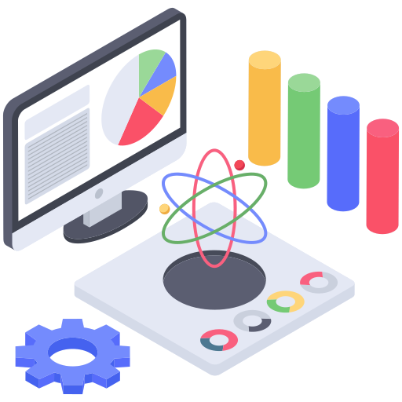

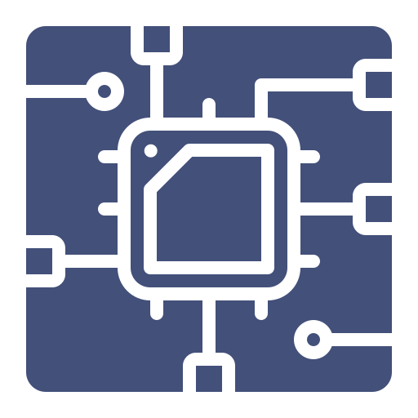

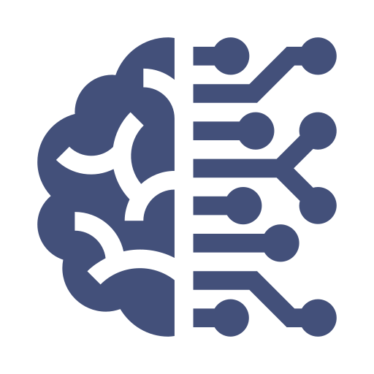









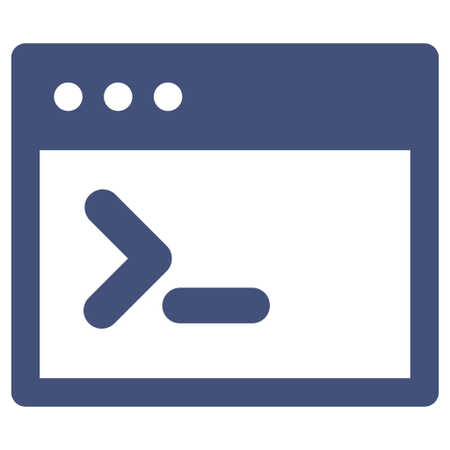

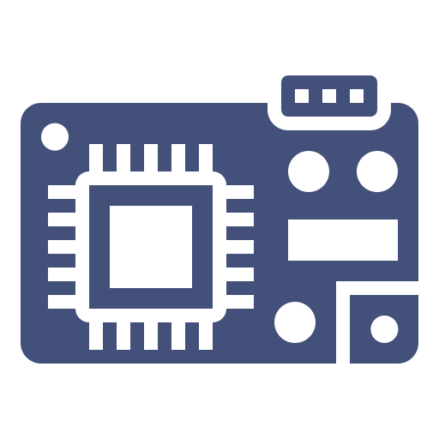
Distributed Intelligence Framework for Structural Health Monitoring
Computing Paradigm Shifting: Centralized to Distributed
Paradigm
Energy
Latency
Resources
centralized
distributed
To Accelerate the Shifting: Distributed Intelligence Framework
Sensor
Software
Framework
Uses
main control
application layer
math, DSP, AI
live streaming
sensing
middleware layer
anomaly detection
measurement
communication
driver layer
system identification
sudden damage alarm
interaction
power
hardware layer
damage assessment
CEE - CUI SHUAIWEN
Notes:
It’s still fresh in our minds that last year, the MRT East-West Line went down for a couple of days, causing great inconvenience and showing exactly why we need to monitor the infrastructures.
Nowadays, it is quite common to use the Internet of Things Technology (aka IoT) to monitor infrastructures. As shown here, typically, there are several sensors for raw data collection, a gateway node for data transmission, and a remote cloud server for computation and storage. Conventionally, the data is computed at the remote server, but this centralized computing paradigm suffers from high latency and high power consumption due to the long distance between the sensors and the cloud server. So nowadays, we are shifting the computation from the cloud back to the edge, standing for a distributed computing paradigm. As we migrating from the centralized computing to the distributed computing, we can harness the advantages of low power consumption and low latency. However, there is no free lunch, and the trade-off is the limited onboard computing resources at the edge.
My research is to accelerate this paradigm shifting by developing a distributed intelligence enabling framework for IoT-based structural health monitoring. To facilitate the development, we first prototyped an IoT sensor. The sensor hardware features a main control and four subsystems. To drive the sensor, we have further developed a software stack with four layers. Both the sensor hardware and software are to facilitate the development of the distributed intelligence enabling framework, which is embodied as a library residing in the middleware layer. The foundation of this frame is a series of lightweight mathematical, signal processing, and AI algorithms that can be used for typical structural health monitoring tasks. Till today, we have successfully used this solution for several use cases, including acceleration live streaming, data anomaly detection, and sudden damage alarming, and all show good performance and great potential.

