Slide 1



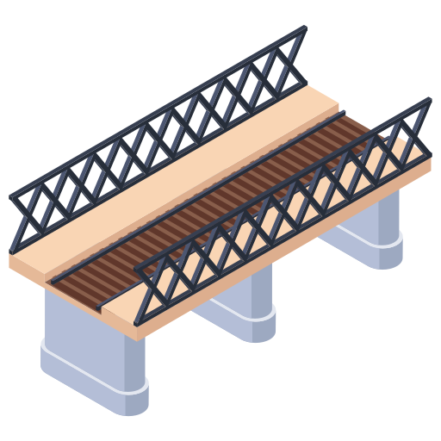


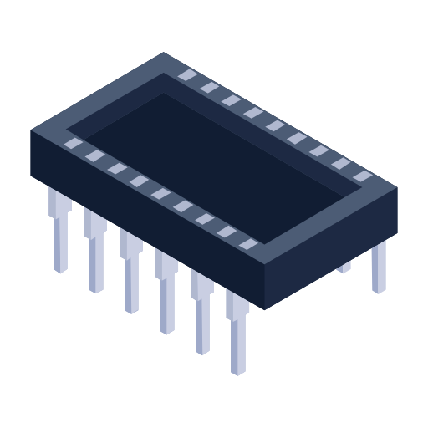
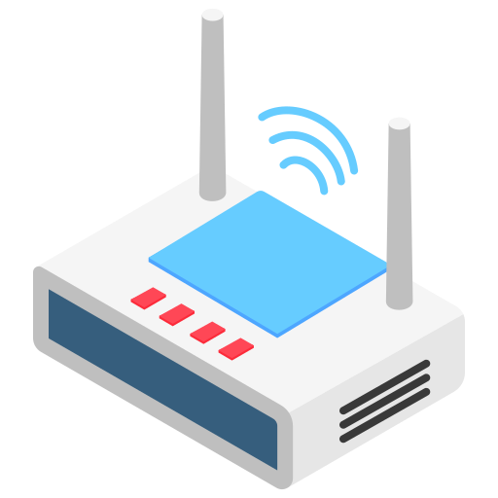







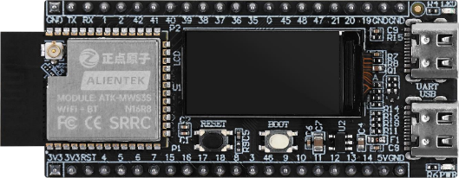












Structures
Distributed Edge Intelligence Enabling Framework for Internet-of-Things-based Structural Health Monitoring - TinySHM
Resources
Latency
Sensors
Software
Power
Edge
Gateway
Application Layer
IoT-based Structural Health Monitoring
Middleware Layer
Driver Layer
Server
Hardware Layer
Resources
Cloud
Measurement
Main Control
Latency
Perception
Localization
Communication
Evaluation
Power
Interaction
TinySHM
Power System
Hardware
SHUAIWEN CUI
NANYANG TECHNOLOGICAL UNIVERISITY | SINGAPORE
School of Civil and Environmental Engineering SHUAIWEN CUI

