Slide 1
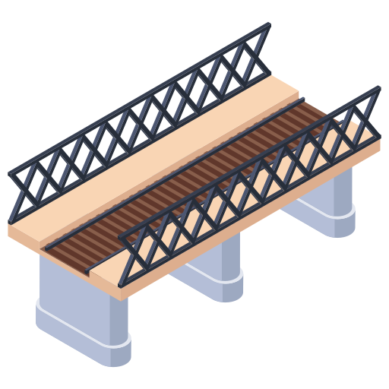





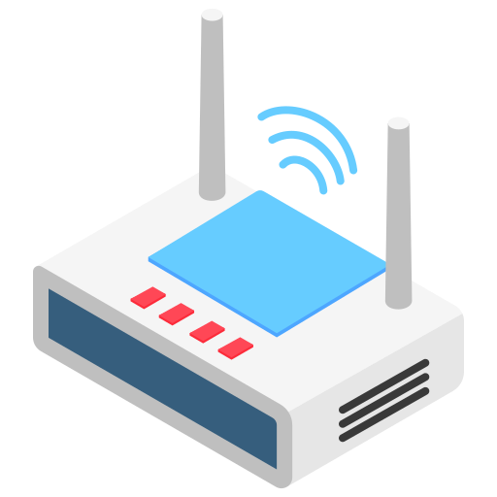




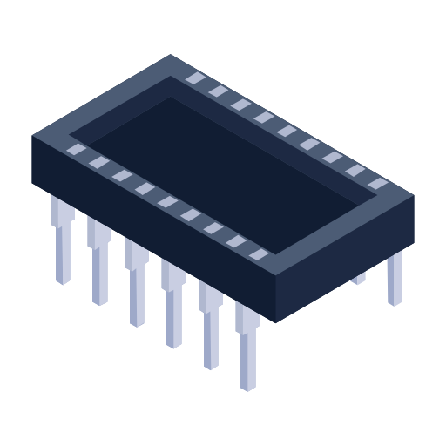
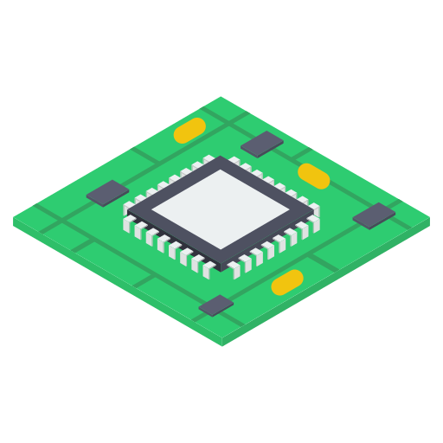

















Distributed Intelligence Framework for Structural Health Monitoring
Computing Paradigm Shifting: Centralized to Distributed
Paradigm
Energy
Latency
Resources
centralized
distributed
To Accelerate the Shifting: Sensor Prototyping and Framework Development
Sensor
Software
Framework
Uses
main control
application layer
measurement
live streaming
sensing
middleware layer
system identification
anomaly detection
communication
driver layer
damage assessment
sudden damage alarm
interaction
power
hardware layer
CEE - CUI SHUAIWEN

