Slide 1
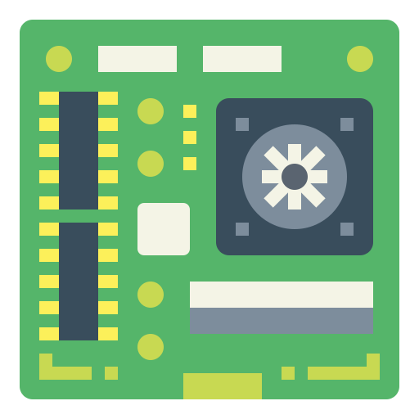




INTERACTION
POWER SYSTEM
MAIN CONTROL
PERCEPTION
COMMUNICATION
Notes:
HARDWARE ABSTRACTION

Slide 2

















Communication
Local
Network
BT
Zigbee
Internet
Connection
WIFI
Cellular
Power System
Main Control
Timer/ RTC
Interaction
Battery / Power Outlet
Micro Controller
Unit
RAM/ROM
Command Input
Power Management System
SPI/I2C/UART/ADC/DAC/…
Large Volume Storage
Status Monitoring
Perception
Vibration
Strain
Temperature &Humidity
Camera
…
Notes:
HARDWARE ABSTRACTION

Slide 3
INTERACTION
POWER SYSTEM
MAIN CONTROL
PERCEPTION
COMMUNICATION
Notes:
HARDWARE ABSTRACTION

Slide 4
Communication
Local
Network
BT
Zigbee
Internet
Connection
WIFI
Cellular
Power System
Main Control
Timer/ RTC
Interaction
Battery / Power Outlet
Micro Controller
Unit
RAM/ROM
Command Input
Power Management System
SPI/I2C/UART/ADC/DAC/…
Large Volume Storage
Status Monitoring
Perception
Vibration
Strain
Temperature &Humidity
Camera
…
Notes:
HARDWARE ABSTRACTION

Slide 5
Notes:
HARDWARE

Slide 6
APPLICATION LAYER
Application Specific Code
SYSTEM SERVICE LAYER
Edge Intelligence Library for SHM Applications - TinySHM
TS Damage Detection
TS Notification
…
TS Measurement
TS System Identification
TS Math
TS DSP
TS AI
TS Config
TS Sense
TS File
TS Network
File System
TCP/IP & MQTT
Digital Signal Processing
Edge AI Framework
Real-time Operating System
PLATFORM ABSTRACTION LAYER
Startup Code
Hardware Abstraction Drivers (Register-Level)
Board Support Packages
(Board-Level)
HARDWARE LAYER
Main
Control
Peripheral Components
Sensing / Communication / Interaction / Power Supply
Notes:
SOFTWARE ARCHITECTURE

Slide 7
Notes:
CODE ARCHITECTURE

Slide 8
Control
Perception
Communication
Interfacing
Power
Notes:
HARDWARE ABSTRACTION [DEPRECATED]

Slide 9
Control
Perception
Communication
Interfacing
Notes:
HARDWARE ABSTRACTION [DEPRECATED]

Slide 10
Communication
Interfacing
Perception
Power System
Main Control
Notes:
HARDWARE ABSTRACTION [D]

Slide 11
Application Specific Code
APPLICATIONS
Edge Intelligence Library for SHM Applications - TinySHM
TS Damage Detection
TS Notification
…
TS Measurement
TS System Identification
SYSTEM
SERVICES
TS Math
TS DSP
TS AI
TS Config
TS Sense
TS File
TS Network
File System
TCP/IP & MQTT
Digital Signal Processing
Edge AI Framework
Real-time Operating System
Startup Code
Hardware Abstraction Drivers (Register-Level)
Board Support Packages
(Board-Level)
PLATFORM
ABSTRACTION
Main
Control
Peripheral Components
Sensing / Communication / Interaction / Power Supply
HARDWARE

