Slide 1



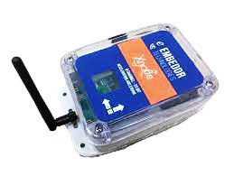
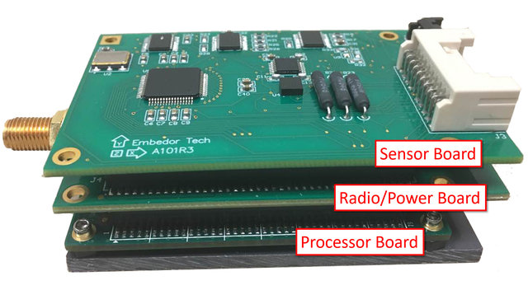


local host
users
wireless sensor nodes
gateway node
cloud server

