Slide 1
Yeast Motif Conservation Project
Shuang Li
Dohlman Lab
Department of Pharmacology
School of Medicine
University of North Carolina at Chapel Hill
2022.12.08

Slide 2
ORFs included for Single Gene analysis:
Sequences of 6015 non-redundant ORFs of 1011 Saccharomyces cerevisiae were downloaded from the“1002 Yeast Genome” website (http://1002genomes.u-strasbg.fr/files/) -allReferenceGenesWithSNPsAndIndelsInferred.tar.gz file.
S288C sequence downloaded from SGD (2021.07) was integrated, which makes the total number of Saccharomyces cerevisiae strain to be 1012.
To simplify our analysis the 239 intron-containing ORFs were not considered, leaving 5776 ORFs.

Slide 3
Paralog pairs included for Paralog analysis:
There are 550 pairs of paralogs (1097 ORFs) in Saccharomyces cerevisiae
The website includes 479 pairs (958 ORFs) that both ORFs are within the 5776 ORFs from Single Gene analysis so that conservation scores can be calculated.

Slide 4
Multi-Sequence Alignment – Clustal Omega 1.2.4:
command line run as below:
clustalo -i ${seq_in} -o ${co_out} --seqtype=Protein --infmt=fasta --outfmt=fasta --guidetree-out=${tree_out} --use-kimura --iter=2 --force

Slide 5
Needleman–Wunsch global Alignment
From Biostrings package (3.16) in R:
command line run as below:
pairwiseAlignment(pattern=seqb, subject = seqa,
type='global’, substitutionMatrix = 'BLOSUM62',
gapOpening=10, gapExtension=0.5, scoreOnly=F)

Slide 6
Motif match:
input pattern is matched using gregexpr() in the base R package, with perl=T, and the (?=...), positive look-ahead assertion – motif will be converted to (?=motif) for matching
do not support flexible length regular expression search currently
some common use examples
[ABC] – matches A or B or C
[^ABC] – matches anything except A, B, or C
. – matches anything once

Slide 7
Motif match:
for further details please refer to the following links:
https://stat.ethz.ch/R-manual/R-devel/library/base/html/regex.html
https://cran.r-project.org/web/packages/stringr/vignettes/regular-expressions.html
https://www.pcre.org/current/doc/html/pcre2syntax.html

Slide 8
Gap Penalty:
Calculate the number of nonstandard amino acids (such as ‘‘–’’, ‘‘X’’, ‘‘Z’’, ‘‘B’’) at the alignment position – NS
Divided NS by the number of strains in the database (=1012) to get the percentage of nonstandard amino acids at this alignment position – P-NS
Gap penalty corrected conservation score = non-corrected score x P-NS
All entropy-based scores can incorporate gap penalty. Substitution matrix inherently calculated based on how the algorithm works. Therefore, the choice of gap penalty would affect all scores but not substitution matrix.

Slide 9
Insertion:
Only calculated if the motif match in the reference strain is split by gap sign ‘-’ in the multi-sequence alignment results (match return ‘QQ - - Q’ instead of ‘QQQ’). This indicates there is at least one insertion event happens within the motif among the 1012 strains in the database.
Insertion score is the percentage of strains that has insertion event (a strain has ‘QQSTQ’ compared with reference strain ‘QQ - - Q’) within the motif among all strains in the database.

Slide 10
Conservation Score:
Symbol Frequency
Entropy
Stereochemically Sensitive Entropy
Phylogeny
Substitution Matrix

Slide 11
Background:
Amino acid sequences of ~6000 genes among 1012 strains (1011 + S288C)
For each gene, amino acid sequences are aligned with Clustal Omega (insertion, deletion, mutation)
Phylogeny of 1012 strains is calculated based on the SNPs distance
Reference frequency and substitution matrix is BLOSUM62

Slide 12
Conservation Score – Symbol Frequency
The frequency of each amino acid among the 1012 strains.
Only amino acid that has at least 1 occurrence at selected sites are shown in results. Others are removed for clarity.

Slide 13

Conservation Score – Entropy
Shannon Entropy:
the entropy of a random variable is the average level of "information", "surprise", or "uncertainty" inherent in the variable's possible outcomes.
Elegantly captures amino acid diversity/variation
All (A) = All (W) = All (L) = 1.0
equally distributed among 20 aas (pure random) = 0.0
https://onlinelibrary.wiley.com/doi/10.1002/j.1538-7305.1948.tb01338.x
https://doi.org/10.1002/prot.340090107

Slide 14
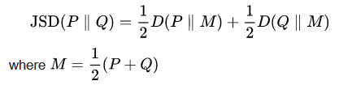
Conservation Score – JSD
Jensen–Shannon divergence:
measure the similarity between two probability distributions
use BLOSUM62 as background distribution
quantify the similarity between (amino acids among the 1012 strains) and (the background BLOSUM62 distribution)
https://doi.org/10.1093/bioinformatics/btm270
Notes:
blosum:
very conserved regions of protein families (that do not have gaps in the sequence alignment) and then counted the relative frequencies of amino acids and their substitution probabilities

Slide 15
Conservation Score – JSD
Jensen–Shannon divergence:
capture diversity with biology information integrated
fully conserved rare aas score higher than that of common aas:
1>All (W) > All (A) > All (L)
pure random > 0.0
BLOSUM62 background distribution = 0.0

Slide 16
Conservation Score – stereochemically sensitive entropy
stereochemical entropy:
Shannon entropy based on stereochemical aas group:
VLIM, FWY, ST, NQ, HKR, DE, AG, P, C
capture diversity with biochemical information integrated
All (S) = All (T) = All (S/T) = All (V) =1.0
pure random > 0.0
equally distributed among stereochemical group = 0.0
https://doi.org/10.1006/jmbi.1999.2911

Slide 17
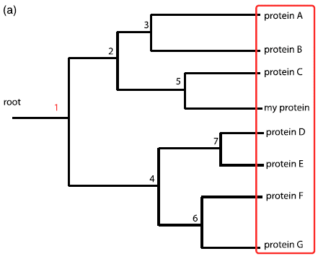
Conservation Score – phylogeny
Phylogeny entropy:
based on a pre-built phylogenetic tree
summing Shannon entropies on the groups created by cutting the tree at different nodes
https://doi.org/10.1016/j.jmb.2003.12.078

Slide 18
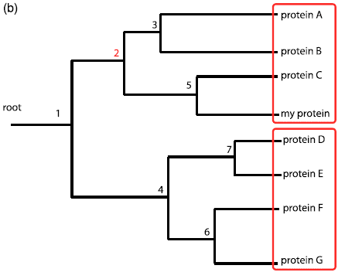
Conservation Score – phylogeny
Phylogeny entropy:
based on a pre-built phylogenetic tree
summing Shannon entropies on the groups created by cutting the tree at different nodes

Slide 19
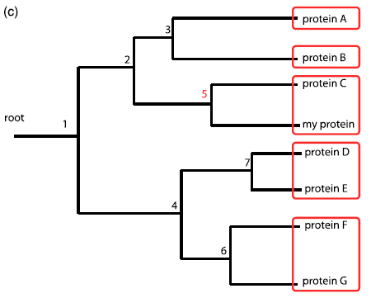
Conservation Score – phylogeny
Phylogeny entropy:
based on a pre-built phylogenetic tree
summing Shannon entropies on the groups created by cutting the tree at different nodes

Slide 20
Conservation Score – phylogeny
Phylogeny ZOOM entropy:
based on a pre-built phylogenetic tree
summing Shannon entropies on the group that contains the target created by cutting the tree at different nodes
https://doi.org/10.1016/j.jmb.2003.12.078

Slide 21
Conservation Score – phylogeny
Phylogeny (ZOOM) entropy:
capture diversity with evolutionary information integrated
All (A) = All (L) = All (W) = 1.0
diversity in closely related strain is penalized more than that in distantly related strain
There is only one S to Q change, the score is lower if it happens in a very closely related strain than if it happens in a very distantly related strain
pure random -> 0.0

Slide 22
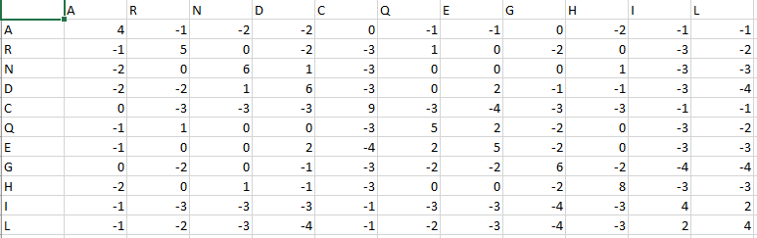
Conservation Score – substitution matrix
substitution matrix:
sum the weights set for each mutation pair – BLOSUM62:
a positive score is given to the more likely substitutions while a negative score is given to the less likely substitutions
https://doi.org/10.1128/jb.178.7.1881-1894.1996

Slide 23
Conservation Score – substitution matrix
substitution matrix:
substitution/mutation based
distinguish between wildtype and mutant (entropy based algo does not)
background distribution dependent
All (A) = All (L) = All (W) = 1.0
rare substitution is penalized more than common substitution
pure random > 0.0
All (the most unlikely substitution) = 0.0

Slide 24
Conservation Score:
Symbol Frequency – count frequencies for each aas
Entropy – quantify diversity
JSD – quantify diversity with biology info
Stereochemically Sensitive Entropy – quantify diversity with biochemical info
Phylogeny – quantify diversity weighted by evolutionary distance
Substitution Matrix – quantify likeliness of existing substitution
https://doi.org/10.1186/1471-2105-11-388

Slide 25
Conservation Score:
Symbol Frequency – count frequencies for each aas
Entropy – quantify diversity
JSD – the similarity of diversity with BLOSUM62 (relaxed)
Stereochemically Sensitive Entropy – stereochemical property of the diversity
Phylogeny – whether the diversity happens close to ref strain in evolution
Substitution Matrix – likeliness of existing substitution

Slide 26
Reference strains:
For Single Gene analysis, selection includes all 1012 Saccharomyces cerevisiae
For Paralogs analysis, reference strain is set to S288C for paralogs information is acquired from SGD for S288C.

Slide 27
Results csv Tables:
For Single Gene analysis, the ‘group’ column contains information about each matched site:
Match_SP_3 – third occurrence (either ‘S’ or ‘P’) of matches with motif ‘SP’
Match_1 – first position match (input Positions ‘8,20’ and Motif length 2. Sites within this group should be position 8 or 9)

Slide 28
Results csv Tables:
For Paralogs analysis,
‘paralog.pair’ shows the counting of matched paralogs’ sites
‘ORF’ shows the ORF name within each paralog.pair

Slide 29
Further questions:
Refer to Materials and Methods section of this paper:
Shuang Li, Henrik G. Dohlman
Evolutionary conservation of sequence motifs at sites of protein modification
Journal of Biological Chemistry 2023
Emails: hdohlman@med.unc.edu;
shuang9@email.unc.edu

Slide 30
Welcome suggestions for further functions!
hdohlman@med.unc.edu
shuang9@email.unc.edu

