Slide 1
Yeast Motif Conservation Project
Shuang Li
Dohlman Lab
Department of Pharmacology
School of Medicine
University of North Carolina at Chapel Hill
2021.08.30

Slide 2
Motif match:
input pattern is matched using gregexpr() in the base R package, with perl=T, and the (?=...), positive look-ahead assertion – motif will be converted to (?=motif) for matching
do not support flexible length regular expression search currently
some common use examples
[ABC] – matches A or B or C
[^ABC] – matches anything except A, B, or C
. – matches anything once

Slide 3
Motif match:
for further details please refer to the following links:
https://stat.ethz.ch/R-manual/R-devel/library/base/html/regex.html
https://cran.r-project.org/web/packages/stringr/vignettes/regular-expressions.html
https://www.pcre.org/current/doc/html/pcre2syntax.html

Slide 4
Gap Penalty:
Calculate the number of nonstandard amino acids (such as ‘‘–’’, ‘‘X’’, ‘‘Z’’, ‘‘B’’) at the alignment position – NS
Divided NS by the number of strains in the database (=1012) to get the percentage of nonstandard amino acids at this alignment position – P-NS
Gap penalty corrected conservation score = non-corrected score x P-NS
All entropy-based scores can incorporate gap penalty. Substitution matrix inherently calculated based on how the algorithm works. Therefore, the choice of gap penalty would affect all scores but not substitution matrix.

Slide 5
Insertion:
Only calculated if the motif match in the reference strain is split by gap sign ‘-’ in the multi-sequence alignment results (match return ‘QQ - - Q’ instead of ‘QQQ’). This indicates there is at least one insertion event happens within the motif among the 1012 strains in the database.
Insertion score is the percentage of strains that has insertion event (a strain has ‘QQSTQ’ compared with reference strain ‘QQ - - Q’) within the motif among all strains in the database.

Slide 6
Conservation Score:
Symbol Frequency
Entropy
Stereochemically Sensitive Entropy
Phylogeny
Substitution Matrix

Slide 7
Background:
Amino acid sequences of ~6000 genes among 1012 strains (1011 + S288C)
For each gene, amino acid sequences are aligned with Clustal Omega (insertion, deletion, mutation)
Phylogeny of 1012 strains is calculated based on the SNPs distance
Reference frequency and substitution matrix is BLOSUM62

Slide 8
Conservation Score – Symbol Frequency
The frequency of each amino acid among the 1012 strains.

Slide 9

Conservation Score – Entropy
Shannon Entropy:
the entropy of a random variable is the average level of "information", "surprise", or "uncertainty" inherent in the variable's possible outcomes.
Elegantly captures amino acid diversity/variation
All (A) = All (W) = All (L) = 1.0
equally distributed among 20 aas (pure random) = 0.0
https://onlinelibrary.wiley.com/doi/10.1002/j.1538-7305.1948.tb01338.x
https://doi.org/10.1002/prot.340090107

Slide 10
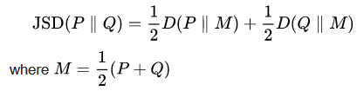
Conservation Score – JSD
Jensen–Shannon divergence:
measure the similarity between two probability distributions
use BLOSUM62 as background distribution
quantify the similarity between (amino acids among the 1012 strains) and (the background BLOSUM62 distribution)
https://doi.org/10.1093/bioinformatics/btm270
Notes:
blosum:
very conserved regions of protein families (that do not have gaps in the sequence alignment) and then counted the relative frequencies of amino acids and their substitution probabilities

Slide 11
Conservation Score – JSD
Jensen–Shannon divergence:
capture diversity with biology information integrated
fully conserved rare aas score higher than that of common aas:
1>All (W) > All (A) > All (L)
pure random > 0.0
BLOSUM62 background distribution = 0.0

Slide 12
Conservation Score – stereochemically sensitive entropy
stereochemical entropy:
Shannon entropy based on stereochemical aas group:
VLIM, FWY, ST, NQ, HKR, DE, AG, P, C
capture diversity with biochemical information integrated
All (S) = All (T) = All (S/T) = All (V) =1.0
pure random > 0.0
equally distributed among stereochemical group = 0.0
https://doi.org/10.1006/jmbi.1999.2911

Slide 13
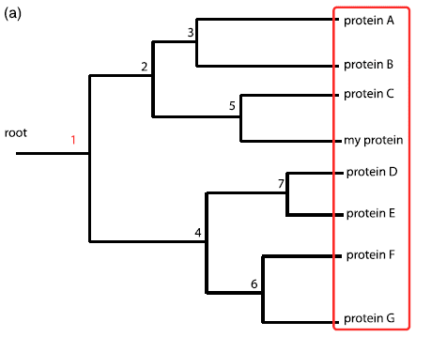
Conservation Score – phylogeny
Phylogeny entropy:
based on a pre-built phylogenetic tree
summing Shannon entropies on the groups created by cutting the tree at different nodes
https://doi.org/10.1016/j.jmb.2003.12.078

Slide 14
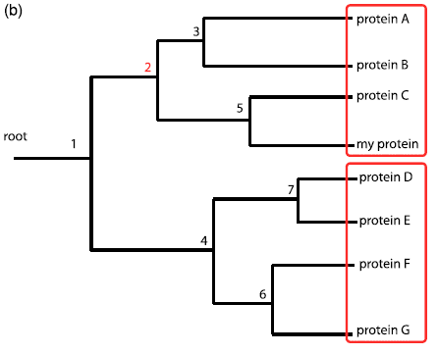
Conservation Score – phylogeny
Phylogeny entropy:
based on a pre-built phylogenetic tree
summing Shannon entropies on the groups created by cutting the tree at different nodes

Slide 15
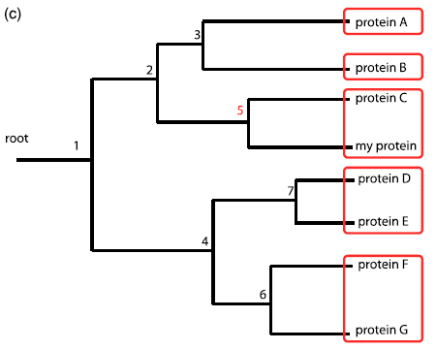
Conservation Score – phylogeny
Phylogeny entropy:
based on a pre-built phylogenetic tree
summing Shannon entropies on the groups created by cutting the tree at different nodes

Slide 16
Conservation Score – phylogeny
Phylogeny ZOOM entropy:
based on a pre-built phylogenetic tree
summing Shannon entropies on the group that contains the target created by cutting the tree at different nodes
https://doi.org/10.1016/j.jmb.2003.12.078

Slide 17
Conservation Score – phylogeny
Phylogeny (ZOOM) entropy:
capture diversity with evolutionary information integrated
All (A) = All (L) = All (W) = 1.0
diversity in closely related strain is penalized more than that in distantly related strain
There is only one S to Q change, the score is lower if it happens in a very closely related strain than if it happens in a very distantly related strain
pure random -> 0.0

Slide 18
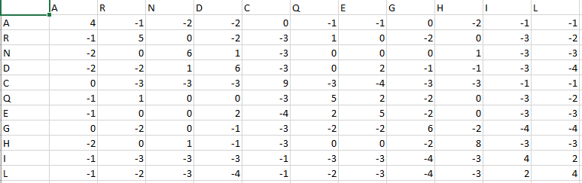
Conservation Score – substitution matrix
substitution matrix:
sum the weights set for each mutation pair – BLOSUM62:
a positive score is given to the more likely substitutions while a negative score is given to the less likely substitutions
https://doi.org/10.1128/jb.178.7.1881-1894.1996

Slide 19
Conservation Score – substitution matrix
substitution matrix:
substitution/mutation based
distinguish between wildtype and mutant (entropy based algo does not)
background distribution dependent
All (A) = All (L) = All (W) = 1.0
rare substitution is penalized more than common substitution
pure random > 0.0
All (the most unlikely substitution) = 0.0

Slide 20
Conservation Score:
Symbol Frequency – count frequencies for each aas
Entropy – quantify diversity
JSD – quantify diversity with biology info
Stereochemically Sensitive Entropy – quantify diversity with biochemical info
Phylogeny – quantify diversity weighted by evolutionary distance
Substitution Matrix – quantify likeliness of existing substitution
https://doi.org/10.1186/1471-2105-11-388

Slide 21
Conservation Score:
Symbol Frequency – count frequencies for each aas
Entropy – quantify diversity
JSD – the similarity of diversity with BLOSUM62 (relaxed)
Stereochemically Sensitive Entropy – stereochemical property of the diversity
Phylogeny – whether the diversity happens close to ref strain in evolution
Substitution Matrix – likeliness of existing substitution

Slide 22
Welcome suggestions for further functions!
shuang9@email.unc.edu

