Slide 1
Presentation on
IPL Auction
Created By: Shubhangi Pandey
Course Name: Data Science
Institute : Internshala Trainings

Slide 2
From IPL Dataset, created two tables : IPL_ball and IPL_matches
– creating table ipl_ball
create table ipl_ball (id integer,inning integer, over integer, ball integer, batsman varchar, non_strike varchar, bowler varchar,batsman_runs integer,extra_runs integer, total_runs integer, is_wicket integer, dismissal_kind varchar, player_dismissed varchar,fielders varchar, extras_type varchar, batting_team varchar, bowling_team varchar);
– query for copying data from ipl dataset
copy ipl_ball from 'C:\Data Science\SQL\SQL Final Project Content\IPL Dataset\IPL_Ball.csv' delimiter',' CSV HEADER;
– query to retrieve data
Select * from ipl_ball;

Slide 3
– creating table ipl_matches
create table ipl_matches (id integer, city varchar, date date, player_of_match varchar, venue varchar,neutral_venue integer, team_1 varchar, team_2 varchar,toss_winner varchar, toss_decision varchar, winner varchar,result varchar, result_margin integer,eliminator varchar,method varchar,umpire_1 varchar,umpire_2 varchar);
– query for copying data from ipl dataset
copy ipl_matches from 'C:\Data Science\SQL\SQL Final Project Content\IPL Dataset\IPL_matches.csv.csv' delimiter',' CSV HEADER;
– query to retrieve data
Select * from ipl_matches;

Slide 4
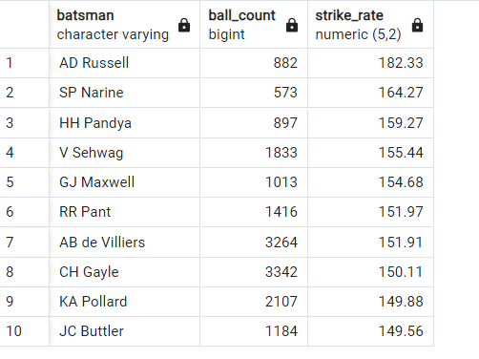
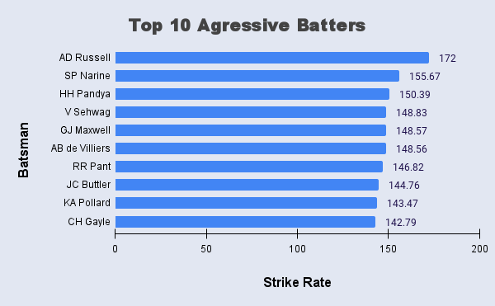
Q1. Your first priority is to get 2-3 players with high S.R who have faced at least 500 balls.And to do that you have to make a list of 10 players you want to bid in the auction so that when you try to grab them in auction you should not pay the amount greater than you have in the purse for a particular player.
SELECT batsman, count(ball) as Ball_count, cast(cast(sum(batsman_runs) as float)/cast(count(case when extras_type<>'wides' then ball end) as float)*100 as numeric (5,2)) AS Strike_rate
FROM ipl_ball
GROUP BY batsman having count(ball)>=500 and cast(sum(batsman_runs) as float)/cast(count(case when extras_type<>'wides' then ball end) as float)*100 >130
ORDER BY Strike_rate desc limit 10;

Slide 5
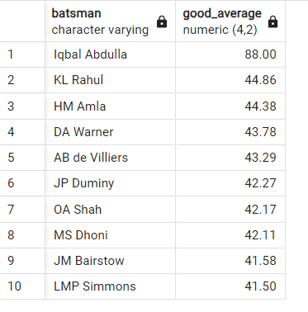
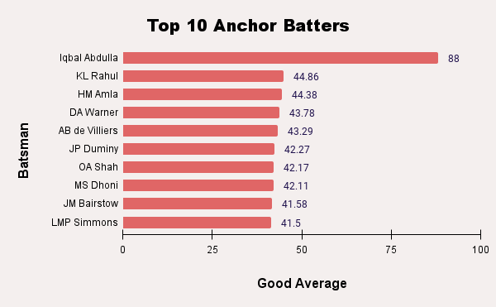
Q2.Now you need to get 2-3 players with good Average who have played more than 2 ipl seasons. And to do that you have to make a list of 10 players you want to bid in the auction so that when you try to grab them in auction you should not pay the amount greater than you have in the purse for a particular player.
SELECT a.batsman,cast(cast(sum(a.batsman_runs)as float)/cast(sum(case when a.is_wicket=1 and a.player_dismissed=a.batsman then 1 else 0 end)as float)as numeric (4,2)) AS Good_average
FROM ipl_ball a
left join
(select id, date, extract(year from date) as Year from ipl_matches) b on a.id=b.id
GROUP BY a.batsman having sum(case when a.is_wicket=1 and a.player_dismissed=a.batsman then 1 else 0 end)>0 and count(distinct b.year)>=2
ORDER BY Good_average desc limit 10;

Slide 6
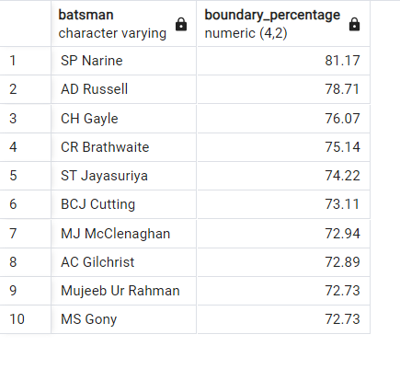
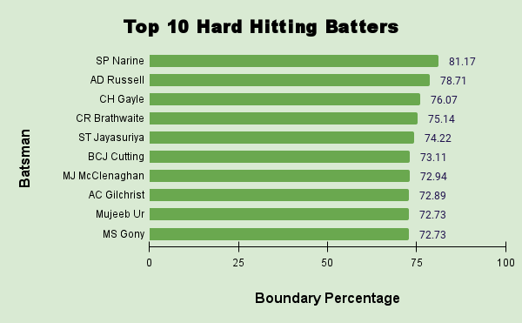
Q3.Now you need to get 2-3 Hard-hitting players who have scored most runs in boundaries and have played more the 2 ipl season. To do that you have to make a list of 10 players you want to bid in the auction so that when you try to grab them in auction you should not pay the amount greater than you have in the purse for a particular player
SELECT a.batsman, cast(cast(sum(CASE WHEN a.batsman_runs=6 or a.batsman_runs=4 then a.batsman_runs else 0 END) as float)/cast(sum(batsman_runs) as float)*100 as numeric (4,2)) AS Boundary_percentage
FROM ipl_ball as a
left join (select id, date, extract(year from date) as Year from ipl_matches) as b on a.id=b.id
GROUP BY a.batsman having sum(a.batsman_runs)>0 and count(distinct b.year)>2
ORDER BY Boundary_percentage desc limit 10;

Slide 7
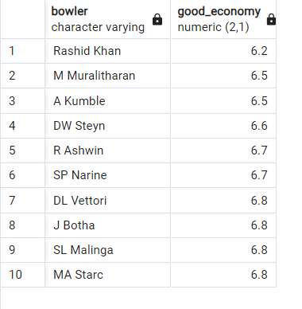
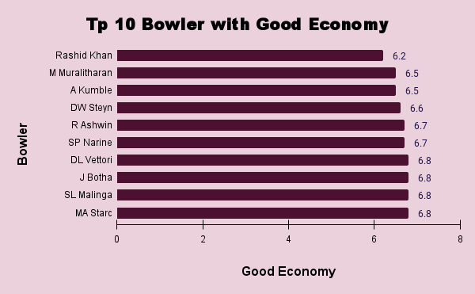
Q4.Your first priority is to get 2-3 bowlers with good economy who have bowled at least 500 balls in IPL so far.To do that you have to make a list of 10 players you want to bid in the auction so that when you try to grab them in auction you should not pay the amount greater than you have in the purse for a particular player
SELECT bowler,cast(cast(sum( case when extras_type='byes' or extras_type= 'legbyes' or extras_type= 'penalty' then 0 else total_runs end )as float)/cast(count(ball)/6 as float) as numeric(2,1)) AS good_economy
FROM ipl_ball
GROUP BY bowler having count(ball)>=500
ORDER BY good_economy limit 10;

Slide 8
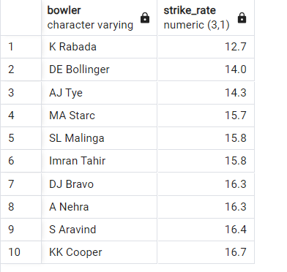
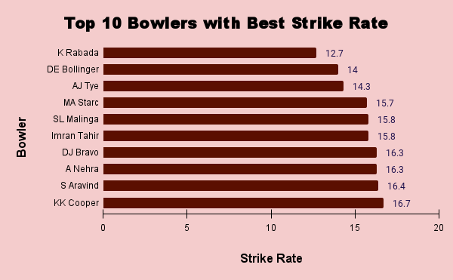
Q5.Now you need to get 2-3 bowlers with the best strike rate and who have bowled at least 500 balls in IPL so far.To do that you have to make a list of 10 players you want to bid in the auction so that when you try to grab them in auction you should not pay the amount greater than you have in the purse for a particular player.
SELECT bowler,cast(cast(count(ball)as float)/cast(sum(is_wicket) as float) as numeric(3,1)) AS strike_rate
from ipl_ball
GROUP BY bowler having sum(is_wicket)>0 and count(ball) >=500
ORDER BY strike_rate limit 10;

Slide 9
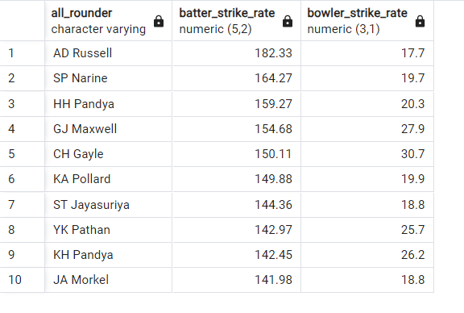
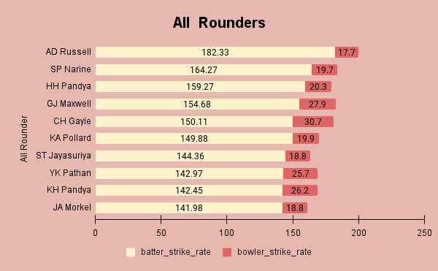
Q6.Now you need to get 2-3 All_rounders with the best batting as well as bowling strike rate and who have faced at least 500 balls in IPL so far and have bowled minimum 300 balls.To do that you have to make a list of 10 players you want to bid in the auction so that when you try to grab them in auction you should not pay the amount greater than you have in the purse for a particular player.
SELECT a.batsman as all_rounder, a.batter_strike_rate, b.bowler_strike_rate from (select batsman, count(ball) as Ball_count, cast(cast(sum(batsman_runs) as float)/cast(count(case when extras_type<>'wides' then ball end) as float)*100 as numeric (5,2))AS batter_strike_rate FROM ipl_ball
GROUP BY batsman having count(ball)>=500 and cast(sum(batsman_runs) as float)/cast(count(case when extras_type<>'wides' then ball end) as float)*100 >130
ORDER BYbatter_strike_rate desc)as a inner join (select bowler,cast(cast(count(ball)as float)/cast(sum(is_wicket) as float) as numeric(3,1)) AS bowler_strike_rate from ipl_ball GROUP BY bowler having sum(is_wicket)>0 and count(ball) >=300
ORDER BY bowler_strike_rate )as b on a.batsman=b.bowler limit 10;

Slide 10
Q7. WICKET KEEPER
Should have been played more than 2 IPL seasons
Explanation: A wicket keeper should have atleast 2 years of experience to judge where the ball will go after it crosses batsman
Should have a batting Strike Rate 130+
Explanation: As mentioned, the wicket keeper is expected to contribute to the team's run total with aggressive batting.So, I have taken the criteria for aggressive batters where I have taken strike rate > 130 as high S.R . In general, in T20 cricket a strike rate above 130 is considered high
Should have bowling economy in the range of 6-8 and strike rate between 20-25.
Explanation:In general,a wicket keeper while bowling is expected to slow down runs scored by the batsman and if possible, take wickets. Keeping this point in mind I have taken the economy range of 6-8 and strike rate between 20-25.
Should have good fielding skills with quick response.
Being a cricketer and playing for the IPL,a wicket keeper should have good fielding skills .

Slide 11
Additional Questions for Final Assessment
– creating deliveries table using ipl_ball data
CREATE table Deliveries (id integer,inning integer, over integer, ball integer, batsman varchar, non_strike varchar, bowler varchar,batsman_runs integer,extra_runs integer, total_runs integer, is_wicket integer, dismissal_kind varchar, player_dismissed varchar,fielders varchar, extras_type varchar, batting_team varchar, bowling_team varchar);
– query to copy data
copy deliveries from 'C:\Data Science\SQL\SQL Final Project Content\IPL Dataset\IPL_Ball.csv'delimiter',' CSV HEADER;
– query to retrieve data
SELECT * FROM deliveries;

Slide 12
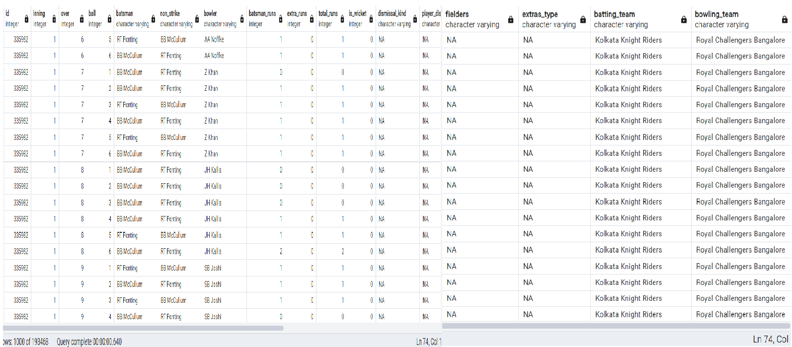

Slide 13
– creating matches table using ipl_matches data
CREATE table matches (id integer, city varchar, date date, player_of_match varchar, venue varchar,neutral_venue integer, team_1 varchar, team_2 varchar,toss_winner varchar, toss_decision varchar, winner varchar,result varchar, result_margin integer,eliminator varchar,method varchar,umpire_1 varchar,umpire_2 varchar);
– query to copy data
copy matches from 'C:\Data Science\SQL\SQL Final Project Content\IPL Dataset\IPL_matches.csv.csv'delimiter',' CSV HEADER;
– query to retrieve data
SELECT * FROM matches;

Slide 14
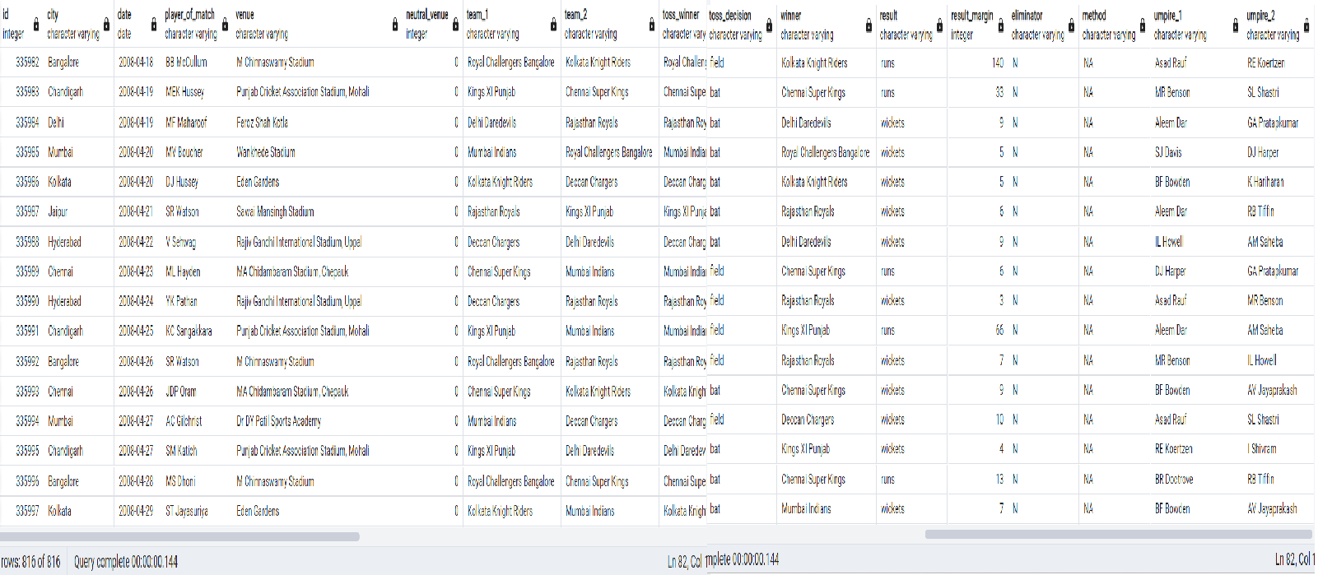

Slide 15

Q1.Get the count of cities that have hosted an IPL match
SELECT distinct count(city) FROM matches;

Slide 16
Q2.Create table deliveries_v02 with all the columns of the table ‘deliveries’ and an additional column ball_result containing values boundary, dot or other depending on the total_run
CREATE table deliveries_v02 AS (SELECT *, case when total_runs=0 then 'dot' when total_runs>=4 then 'boundary' else 'other' end as ball_result FROM deliveries);
SELECT * from deliveries_v02;

Slide 17
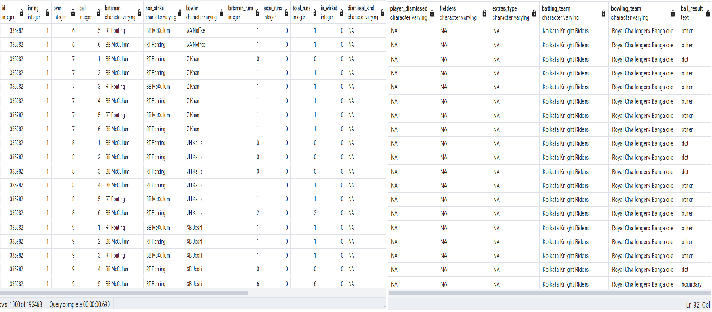

Slide 18
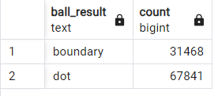
Q3. Write a query to fetch the total number of boundaries and dot balls from the deliveries_v02 table.
SELECT ball_result,count(ball_result) FROM deliveries_v02 WHERE ball_result='boundary' or ball_result='dot' GROUP BY ball_result;

Slide 19
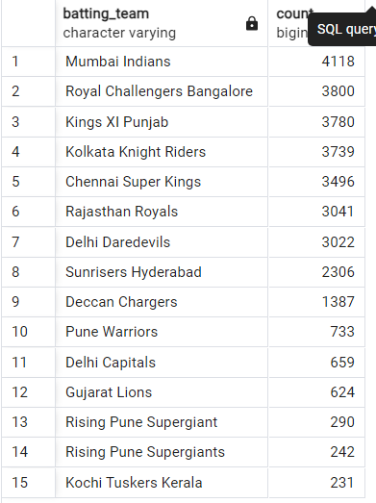
Q4. Write a query to fetch the total number of boundaries scored by each team from the deliveries_v02 table and order it in descending order of the number of boundaries scored.
SELECT batting_team, count(ball_result) FROM deliveries_v02 WHERE ball_result='boundary' GROUP BY batting_team ORDER BY count(ball_result) desc;

Slide 20
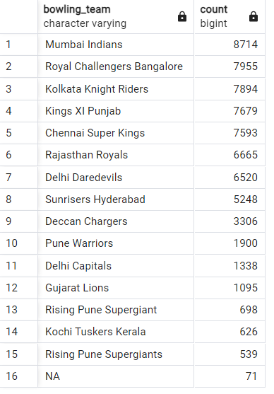
Q5.Write a query to fetch the total number of dot balls bowled by each team and order it in descending order of the total number of dot balls bowled.
SELECT bowling_team, count(ball_result) FROM deliveries_v02 WHERE ball_result='dot' GROUP BY bowling_team ORDER BY count(ball_result) desc;

Slide 21
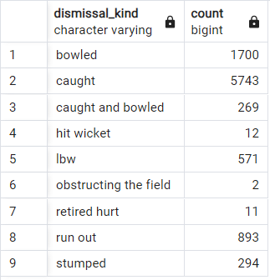
Q6.Write a query to fetch the total number of dismissals by dismissal kinds where dismissal kind is not NA
SELECT dismissal_kind,count(dismissal_kind) FROM deliveries_v02 WHERE NOT dismissal_kind ='NA' GROUP BY dismissal_kind;

Slide 22
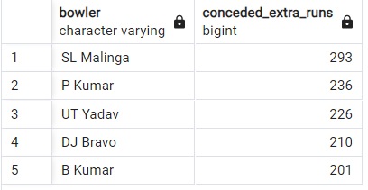
Q7.Write a query to get the top 5 bowlers who conceded maximum extra runs from the deliveries table
SELECT bowler, sum(extra_runs) AS conceded_extra_runs FROM deliveries_v02 GROUP BY bowler ORDER BY sum(extra_runs) desc limit 5;

Slide 23
Q8.Write a query to create a table named deliveries_v03 with all the columns of deliveries_v02 table and two additional column (named venue and match_date) of venue and date from table matches
CREATE table deliveries_v03 as (SELECT a.*, b.venue,b.date FROM deliveries_v02 AS a left join matches AS b on a.id=b.id);
ALTER table deliveries_v03 RENAME date to match_date;
SELECT * FROM deliveries_v03;

Slide 24
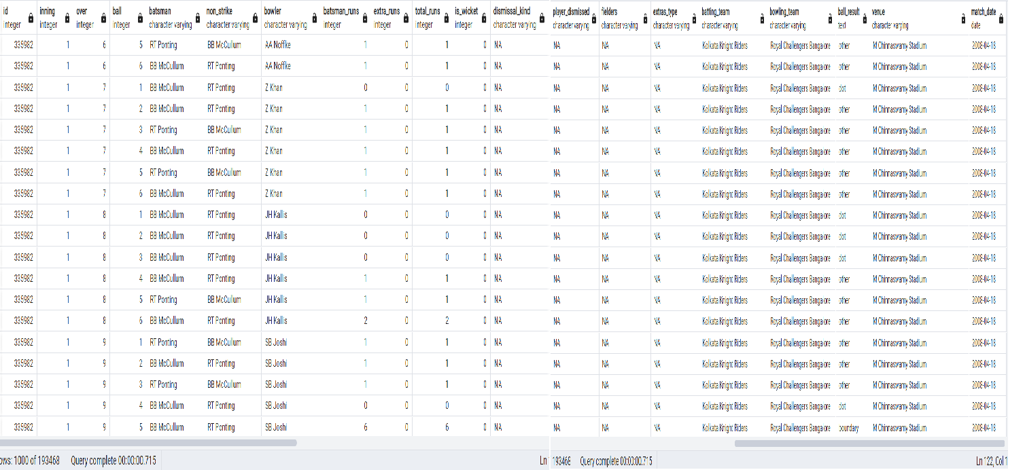

Slide 25
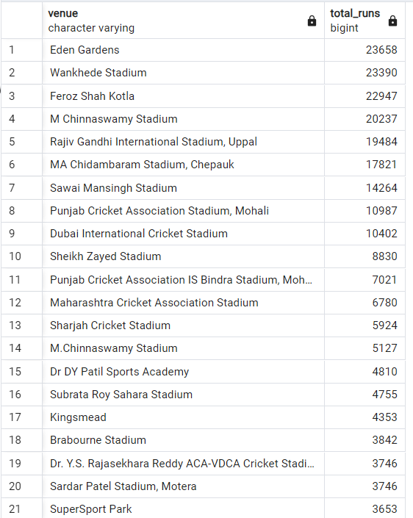
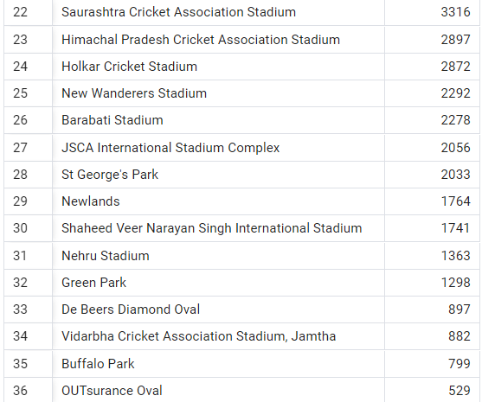
Q9.Write a query to fetch the total runs scored for each venue and order it in the descending order of total runs scored.
SELECT venue, sum(total_runs) AS total_runs FROM deliveries_v03 GROUP BY venue ORDER BY sum(total_runs) desc;

Slide 26
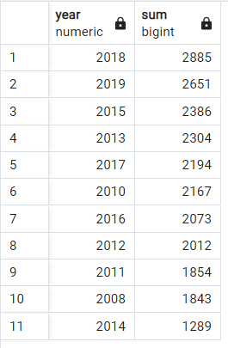
Q10.Write a query to fetch the year-wise total runs scored at Eden Gardens and order it in the descending order of total runs scored.
SELECT extract(year from match_date) AS Year,sum(total_runs) FROM deliveries_v03 WHERE venue='Eden Gardens' GROUP BY extract(year from match_date) ORDER BY sum(total_runs) desc;

Slide 27
Thank You

