Slide 1
Terraform
Shantanu Mahajan
Sr engg devops

Slide 2
Infrastructure as a code (Iaac)
Generally we create infra in cloud using the management console option provided by the cloud service provider.
But whenever we have to work on a huge infra and manage infra for multiple clients and there projects, its not recommended approach, as its slow, confusing and most importantly time consuming
We can do one thing here to avoid such issues, that is write our infra in the form of some script so that it is beneficial in referencing, maintain, collaborating and sharing.
In simple words we are creating, maintaining, modifying, destroying our infra through code.
This is called as IAAC

Slide 3
IAAC
Lets consider we wrote our infra with the help of shell scripts of may be python scripts.
But here these scripts may become too complicated, difficult to understand.
One might need high level of programming language knowledge and experience, and some advanced development skills.
One more issue with this approach is there is a lot of logical we need to adapt to and this code file will not be reusable.
Reusability in one of the most important aspect when it comes to cloud or any technology that is around in IT.
Thus in todays modern IT world, we make use of some highly easy and advanced tools for creating, configuring and maintaining our infra.

Slide 4
Types of IAAC tools
Docker
Ansible
Terraform
Cloud formation
Salt
Puppet
Packer
Vagrant

Slide 5
IAAC
Above such tools offer many advantages
They are easy to learn
Human readable
Predefined set of modules and commands
Easy to maintain
Declarative approach
These tools are further classified into
Server templating tools – Docker, packer, vagrant
Provisioning tools -- cloud formation, terraform
Configuration management tools --- ansible, puppet, salt

Slide 6
Provisioning tools
These are used to provision infra in cloud envs using simple declarative syntax.
Can create infra in multiple cloud service platforms
They also deploy immutable infra resources.

Slide 7
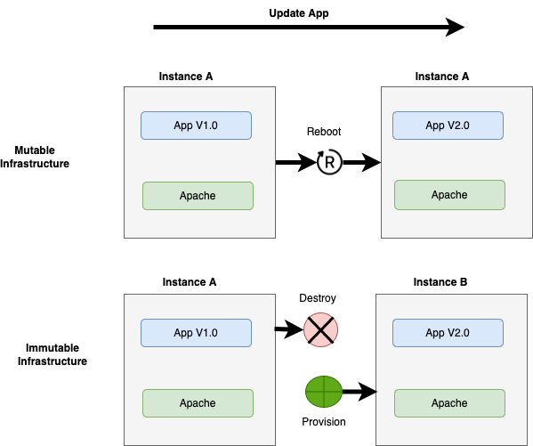
Mutable vs immutable infra
https://www.hashicorp.com/resources/what-is-mutable-vs-immutable-infrastructure

Slide 8
Terraform -- by hashicorp
One of the most popular IAAC tool
Free
Open source tool
Easy to install, setup.
Allows us to quickly build, install, manage, destroy cloud infra in mins
One of the most popular advantage is it can help create infra in multiple platforms

Slide 9
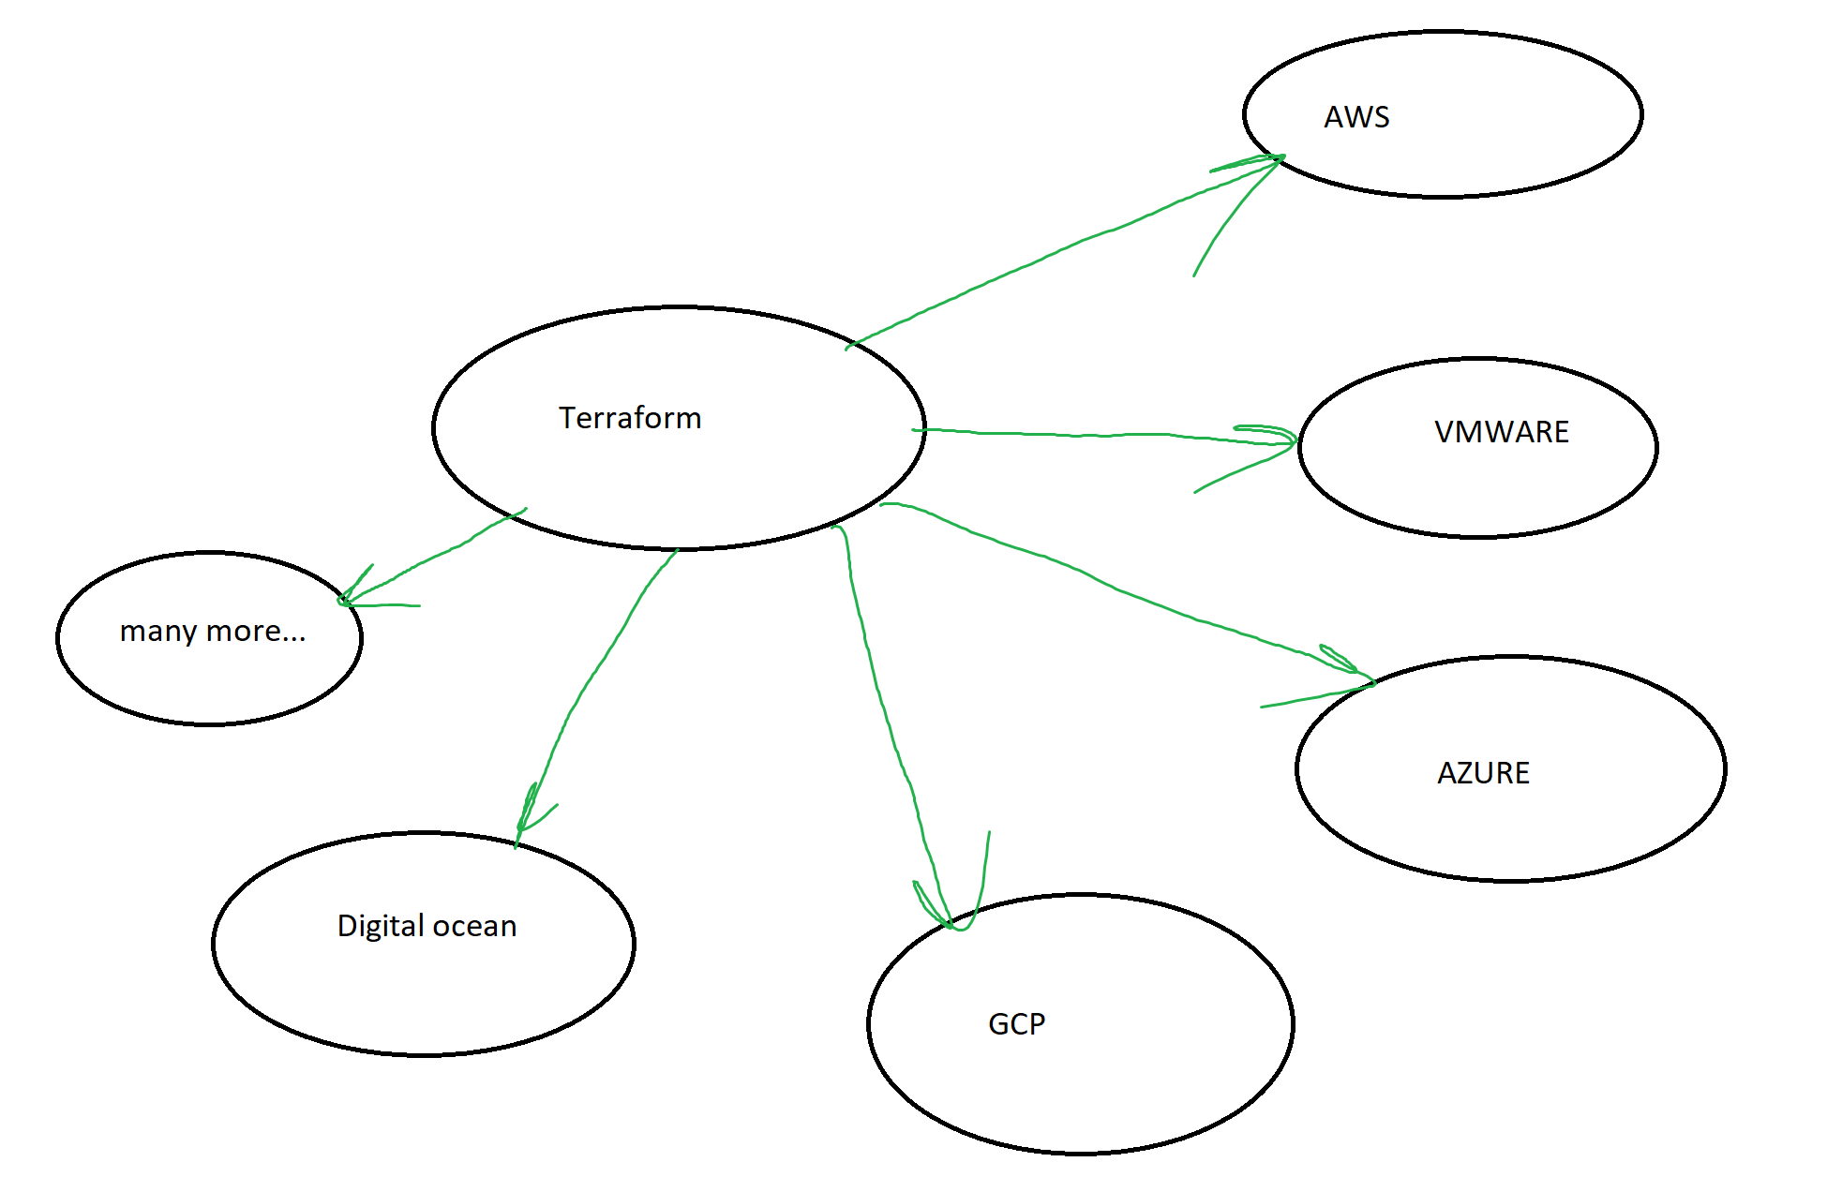

Slide 10
Terraform concepts
PROVIDERS
HCL SYNTAX
RESOURCE
RESOURCE TYPES
RESOURCE NAME
ARGUMENTS
TERRAFORM COMMANDS
TERRAFORM STATE
VARIABLES
RESOURCE REFERANCE ATTRIBUTES
RESOURCE DEPENDANCIES
OUTPUT AND MORE…..

Slide 11
PROVIDERS
A provider in terraform is nothing but a plugin or a simple software that helps terraform manage 3rd party platform with the help of platform’s API.
Terraform relies on plugins called providers to interact with cloud providers, SaaS providers, and other APIs.
Terraform configurations must declare which providers they require so that Terraform can install and use them.
Providers enable terraform manage cloud platform like aws, azure, gcp, also other networking, monitoring and DB platforms as well.

Slide 12
Providers and its registry
We can view all the providers in the terraform registry below
https://registry.terraform.io/
https://registry.terraform.io/browse/providers
Terraform officially supports around 130 providers as of 08-Jun-2022

Slide 13
Types of terraform providers
Official providers:-
Providers are a logical abstraction of an upstream API. They are responsible for understanding API interactions and exposing resources.
official providers are owned and maintained by hashicorp
Verified providers:- owned and maintainer by 3rd party tech company like bigip, digital ocean.
Community providers:- created by individual contributers

Slide 14
HCL (hashicorp configuration lang.)
The HashiCorp Configuration Language (HCL) is a configuration language authored by HashiCorp.
HCL is used with HashiCorp’s cloud infrastructure automation tools, such as Terraform.
https://github.com/hashicorp/hcl/blob/main/hclsyntax/spec.md
Here we are using HCL as it’s a declarative language to define infra resources to be provisioned as a block of code.
Here in case of HCL we need to create a .tf file and define all the configuration with .tf extension.
HCL has a easy to read/write syntax

Slide 15
HCL basics
The HCL is a simple file consisting of blocks and arguments
Block:- A block is nothing but a container of other content, a block always has multiple parameters and there arguments
<block> <parameters> {
key1 = value1
key2 = value2 ##these are the arguments in key value pair
}
https://developer.hashicorp.com/terraform/language/syntax/configuration

Slide 16
HCL basics
A block is defined in curly braces which contains a set of arguments in key value pair format representing the configuration data.
In terraform block contains the information about the infra platform and the resources within that infra platform
Eg in aws which infra resources we created like vpc, ec2 etc and its configuration resources
Here the concept is to create a terraform configuration directly and in that directory create a .tf i.e is the terraform config file.

Slide 17
HCL basics
RESOURCE:- Resources are the most important element in the Terraform language.
Each resource block describes one or more infrastructure objects, such as virtual networks, compute instances, or higher-level components such as DNS records.

