Slide 1
kubernetes
Shantanu Mahajan (Velocity)
Sr Engg DevOps

Slide 2
Monolithic vs microservices
Consider an application with multiple features, all these features are developed by multiple developers and development teams sometimes.
An application whenever developed and deployed follows multiple strategies.
These strategies are implemented depending upon the requirement of clients.
In case of monolithic architecture, all the features are developed and archived in a single package, also deployed as a single unit on a server.
This being an older approach there are multiple disadvantages of adapting the monolithic architecture.
Below are some of the disadvantages.

Slide 3
Disadvantages
Dependency management.
Configuration of individual features is difficult.
Complex architecture
Features dependent and logically connected.
Individual scalability, optimization of resources for every feature is not possible
Complex application structure

Slide 4
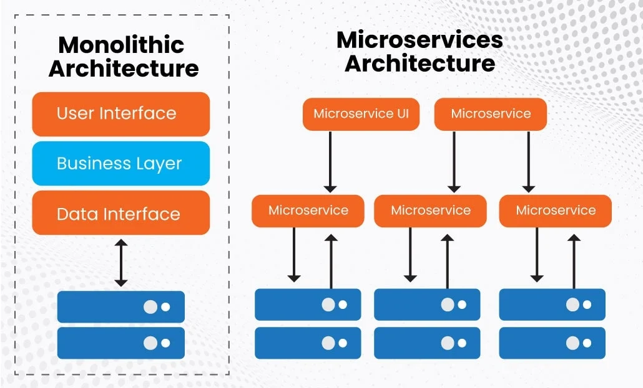

Slide 5
microservices
In microservices instead of developing and deploying application as a single package, for each feature the application is developed and deployed seperately as a single service called as micro-service.
Microservice is a development and deployment architecture multiple microservices and developed and deployed and they are working In a loosely coupled manner.
Here independent features running are connected via API and can be accessed through API gateway
Here as the microservice can work independently so we can deploy them independently with own deployment config, server and DB config.
Microservices are deployed in loosely isolated containers.

Slide 6
Advantages of microservices
https://about.gitlab.com/blog/2022/09/29/what-are-the-benefits-of-a-microservices-architecture/
https://www.javatpoint.com/advantges-and-disadvantages-of-microservices

Slide 7
Kubernetes
Kubernetes is a portable, extensible, open source platform for managing containerized workloads and services, that facilitates both declarative configuration and automation.
In the micro services architecture we need to manage multiple containers, scale them as per requirement, create clusters which is impossible to do manually.
Hence we need a tool for it.
Such tool which servers the purpose is k8s.

Slide 8
Why you need Kubernetes and what it can do
Containers are a good way to bundle and run your applications. In a production environment, you need to manage the containers that run the applications and ensure that there is no downtime.
For example, if a container goes down, another container needs to start. Wouldn't it be easier if this behavior was handled by a system?
That's how Kubernetes comes to the rescue! Kubernetes provides you with a framework to run distributed systems resiliently.
It takes care of scaling and failover for your application, provides deployment patterns, and more.
For example: Kubernetes can easily manage a canary deployment for your system.

Slide 9
Features of k8s
Orchestration
Autoscaling
Auto-healing
Load balancing
Platform independent
Provides high availability and fault tolerance
Automated rollout and Rollback
Monitoring
Scheduling
https://kubernetes.io/docs/concepts/overview/

Slide 10
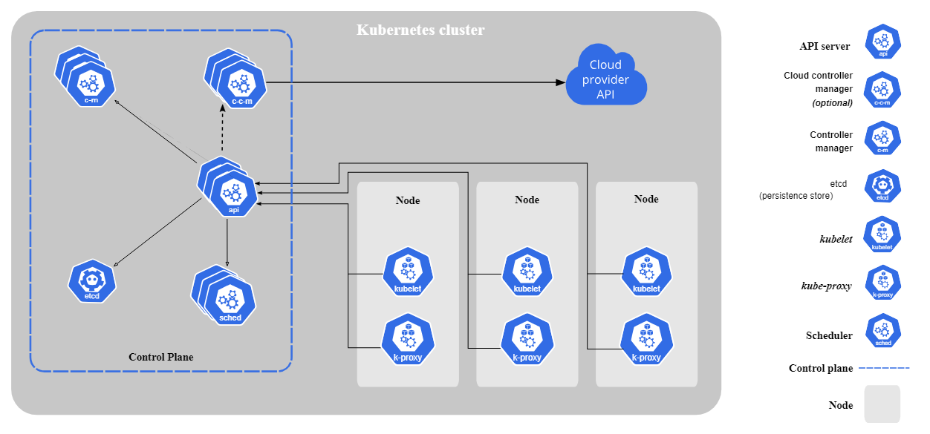
Architecture of k8s

Slide 11
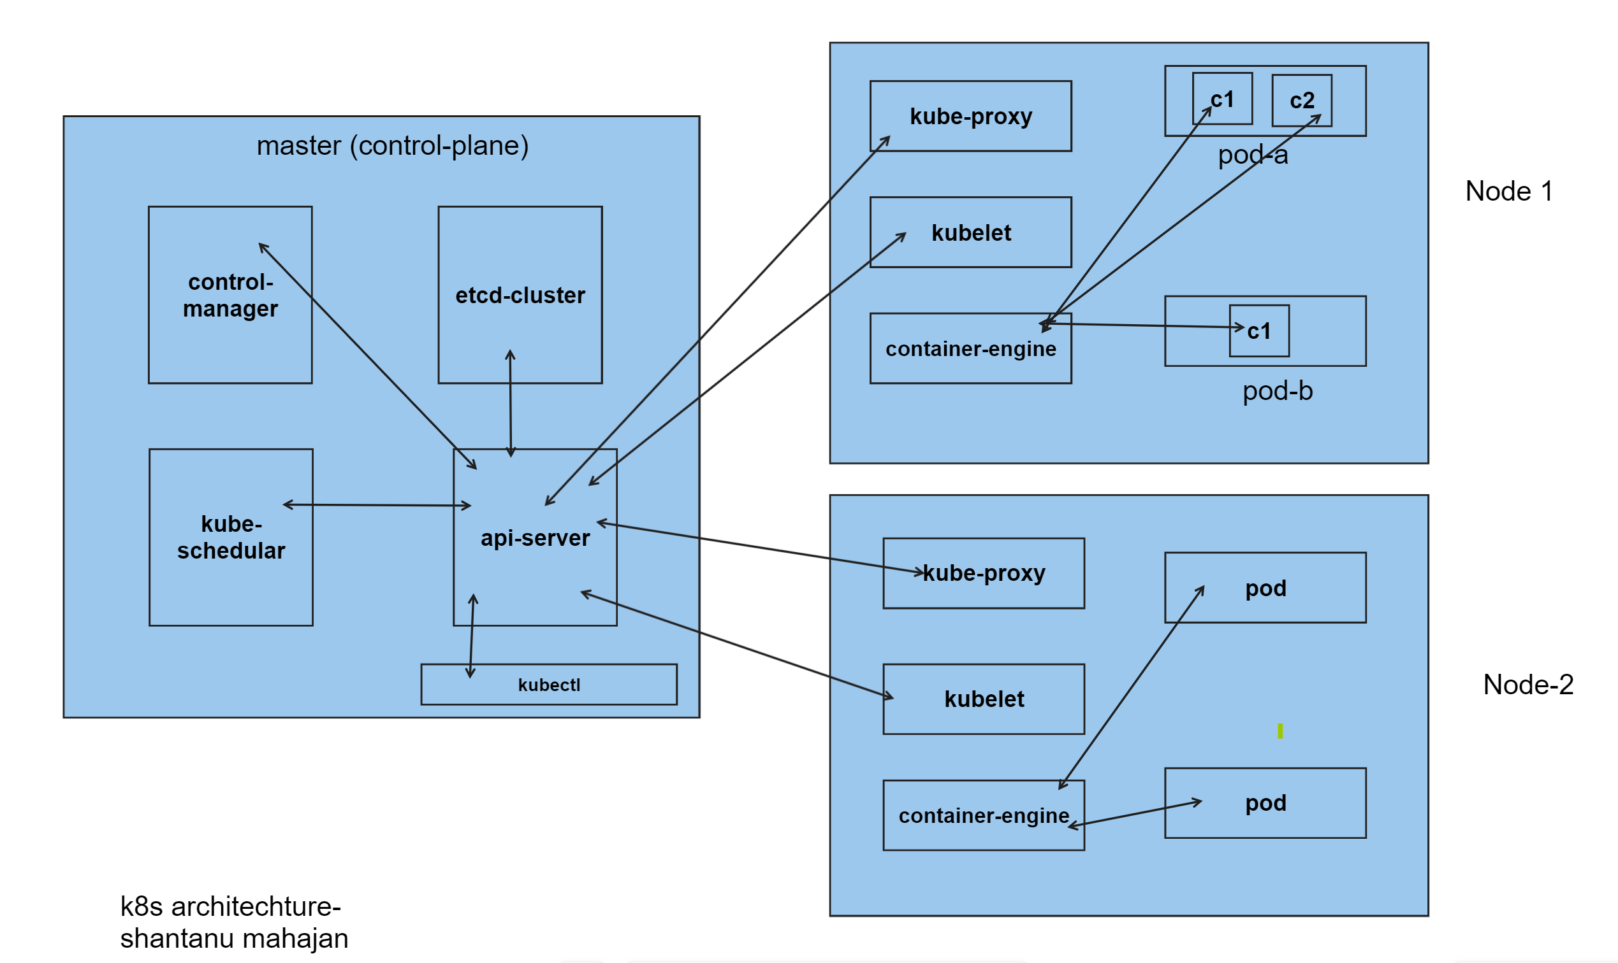

Slide 12
K8s components (master) https://kubernetes.io/docs/concepts/overview/components/https://kubernetes.io/docs/concepts/overview/components/
kube-apiserver
Api servers job is to communicate with all the components of k8s.
The Kubernetes API server validates and configures data for the api objects which include pods, services, replicationcontrollers, and others.
The API Server services REST operations and provides the frontend to the cluster's shared state through which all other components interact.
ETCD Cluster
Consistent and highly-available key value store used as Kubernetes' backing store for all cluster data.
If your Kubernetes cluster uses etcd as its backing store, make sure you have a back up plan for the data.
It’s a key-value database that contains data about your cluster state and configuration.
Etcd is fault tolerant and distributed.

Slide 13
K8s components (master)
kube-scheduler
This component is responsible for scheduling pods on specific nodes according to automated workflows and user defined conditions, which can include resource requests, concerns like affinity and taints or tolerations, priority, persistent volumes (PV), and more.
Control plane component that watches for newly created Pods with no assigned node, and selects a node for them to run on.
Factors taken into account for scheduling decisions include: individual and collective resource requirements, hardware/software/policy constraints, affinity and anti-affinity specifications, data locality, inter-workload interference, and deadlines
Control-manager
The Kubernetes controller manager is a control loop that monitors and regulates the state of a Kubernetes cluster.
It receives information about the current state of the cluster and objects within it, and sends instructions to move the cluster towards the cluster operator’s desired state.
The controller manager is responsible for several controllers that handle various automated activities at the cluster or pod level, including replication controller, namespace controller, service accounts controller, deployment, statefulset, and daemonset.

Slide 14
Control-manager
Kubectl
Kubectl is a command line tool used to run commands against Kubernetes clusters.
It does this by authenticating with the Master Node of your cluster and making API calls to do a variety of management actions.
Control plane component that runs controller processes.
Logically, each controller is a separate process, but to reduce complexity, they are all compiled into a single binary and run in a single process.
There are many different types of controllers. Some examples of them are:
Node controller: Responsible for noticing and responding when nodes go down.
Job controller: Watches for Job objects that represent one-off tasks, then creates Pods to run those tasks to completion.
EndpointSlice controller: Populates EndpointSlice objects (to provide a link between Services and Pods).
ServiceAccount controller: Create default ServiceAccounts for new namespaces.

Slide 15
K8S COMPONENTS (NODE) HTTPS://KUBERNETES.IO/DOCS/CONCEPTS/OVERVIEW/COMPONENTS/HTTPS://KUBERNETES.IO/DOCS/CONCEPTS/OVERVIEW/COMPONENTS/
Kube-Proxy
A network proxy running on each Kubernetes node.
It is responsible for maintaining network rules on each node. Network rules enable network communication between nodes and pods.
Assignment of IP to pods etc is done by kubeproxy
Kubelet
The Kubelet is responsible for managing the deployment of pods to Kubernetes nodes.
It receives commands from the API server and instructs the container runtime to start or stop containers as needed.
Agent running on node which creates pods on request

Slide 16
K8S COMPONENTS (NODE) HTTPS://KUBERNETES.IO/DOCS/CONCEPTS/OVERVIEW/COMPONENTS/HTTPS://KUBERNETES.IO/DOCS/CONCEPTS/OVERVIEW/COMPONENTS/
Pod
Smallest unit of k8s.
Its group of one or more containers
Container-Runtime
The software layer responsible for running containers.
There are several container runtimes supported by Kubernetes, including Containerd, CRI-O, Docker, and other Kubernetes Container Runtime Interface (CRI) implementations.

Slide 17
Kubernetes configuration
Single node configuration:-
Here the master and worker node is on the same machine(VM). This is basically used to learn k8s and in dev envs.
Eg: minikube
2. Single Master, Single ETCD, and Multiple Node installation:-
Basically used for test envs and sometimes for light production envs as well.
3. Single node ETCD, Multi Master, Multi Node:-
Used for 24 * 7 production envs.

