Slide 1
MadhuTwin
A hybrid digital twin for Type 2 Diabetes that fuses EHR and wearable data to warn doctors up to 2 hours before glucose spikes and lows
MODEL
SYNC
SIMULATE
Team: TODO(team) · College / incubator: TODO(team)
Happiest Health Digital Twin Challenge 2026 · Phase 1
Notes:
Introduce the team. MadhuTwin, from Madhumeha, the classical Indian name for diabetes, is a living virtual replica of each patient: it models their physiology, stays synchronised with their CGM, and simulates the next hours to warn the care team early.

Slide 2
Diabetes care in India is reactive
101 million
A quarterly HbA1c describes the past
It cannot warn about tonight's low on a sulfonylurea or premixed insulin, or tomorrow's illness-driven rise.
adults in India live with diabetes
Post-meal spikes go unseen
Rice- and roti-heavy meals, late dinners and festival sweets drive excursions that clinic visits never capture.
136 million
more have prediabetes
Data exists, attention does not
CGMs and smartwatches stream thousands of readings a day; no care team can watch hundreds of patients' streams.
Source: ICMR-INDIAB, Lancet Diabetes & Endocrinology 2023
Notes:
Set the scene: India's diabetes burden is enormous, care is visit-based and reactive. The dangerous moments, post-meal spikes, nocturnal lows, illness, happen between visits. Wearables now capture them, but clinicians need the signal, not the stream.

Slide 3
MadhuTwin: a living virtual replica of each patient
Not just a predictor: the three defining properties of a digital twin
MODEL
Personalised glucose–insulin physiology
An extended minimal model with meals, exercise, sleep, dawn effect and Indian therapies, fitted to each patient with EHR-based priors.
SYNC
Continuously updated from live data
An Unscented Kalman Filter re-estimates hidden insulin state and a drifting insulin sensitivity every 5 minutes.
SIMULATE
Run forward to predict and explore
Causal 2-hour forecasts and what-ifs: a different meal, a walk after dinner, a short night, an illness.
On top: TwinNet, a physics-gated network that fuses both data streams with the twin's own forecast, and explains every alert in plain language.
Notes:
Explain why this is a digital twin and not just a classifier: model, sync, simulate. TwinNet adds machine learning on top of the twin, and learns how much to trust the physics.

Slide 4
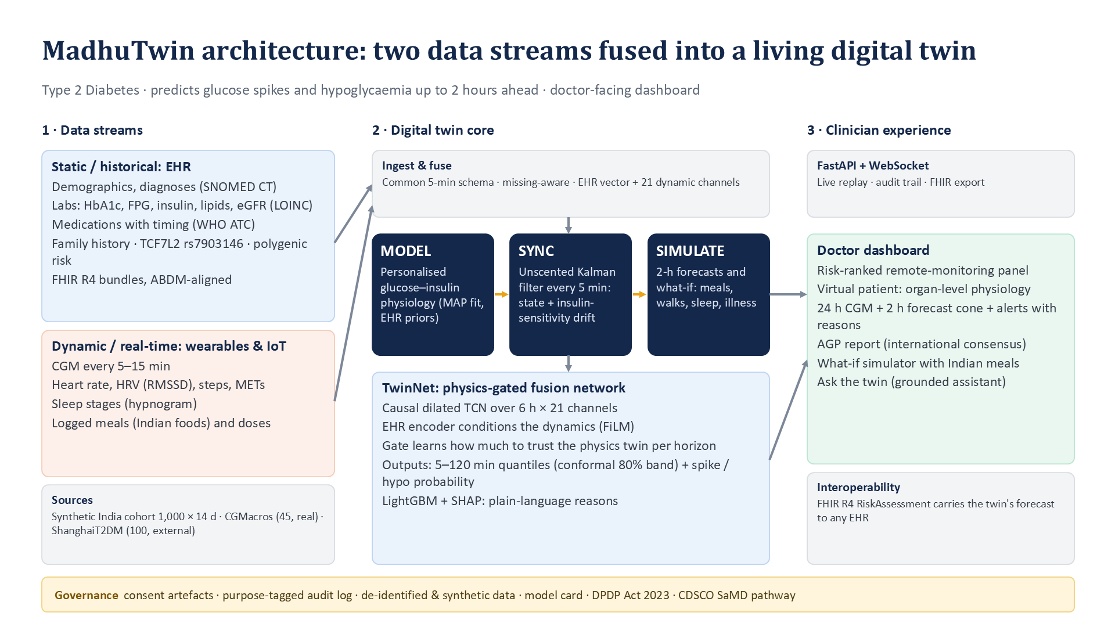
Architecture: two data streams fused into the twin
Notes:
Walk left to right: EHR and wearable streams are ingested into one schema; the twin core models, syncs and simulates; TwinNet produces forecasts and alerts; the clinician sees them in the dashboard and any EHR can receive them as FHIR. Governance spans everything.

Slide 5
Two data streams, three open or synthetic sources
Sandbox rules respected: no real Indian patient data is used
Static / historical: EHR
Demographics · diagnoses (SNOMED CT) · labs incl. HbA1c, fasting glucose & insulin, lipids, eGFR (LOINC) · medications with timing (WHO ATC) · 2-year lab history · family history · TCF7L2 rs7903146 genotype · polygenic risk score
1,000 × 14 days
Synthetic India-calibrated patients
ICMR-INDIAB mix, regional diets, Indian prescribing; streams generated by the same physiology
45 people
CGMacros (PhysioNet)
Real CGM, Fitbit, meals, labs; healthy to T2D (USA)
Dynamic / real-time: wearables & IoT
CGM (5- or 15-min) · heart rate · HRV (RMSSD) · steps & METs · sleep stages · logged meals from an Indian food table · insulin and tablet doses
100 patients
ShanghaiT2DM (Figshare)
External: rice-based diet, insulin users, no wearables
Notes:
The EHR stream follows India's ABDM stack and exports as FHIR R4. Wearable streams come from CGM, smartwatch and logs. We use three sources: a synthetic India-calibrated cohort for scale, CGMacros as real-world validation, and ShanghaiT2DM as an external population with no wearables.

Slide 6
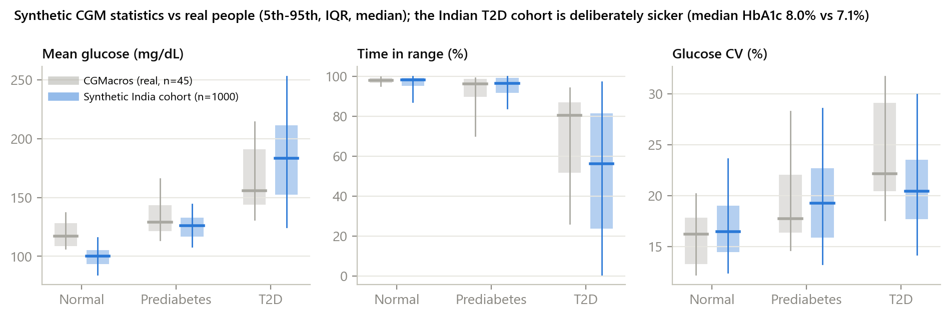
Synthetic Indian cohort, causally linked streams
Status mix, South-Asian BMI phenotype, comorbidities and prescribing calibrated to Indian clinics: premixed 30/70 insulin, gliclazide, teneligliptin
Regional meals from IFCT 2017: idli-sambar, roti-sabzi, ragi mudde, biryani, chai with sugar, festival sweets
Wearables are simulated by the same physiology, and labs are measured from the simulated body (HbA1c from mean glucose)
Realistic imperfection: unlogged meals, carb misestimation, CGM noise and compression lows, missed doses, illness and stress days
Physiology parameters are sampled from relationships measured by fitting twins to 45 real people, so synthetic glucose behaves like real glucose.
Notes:
The key design choice: the synthetic EHR and wearables are not two independent random tables. Both are generated from one simulated body, so a fusion model can learn genuine cross-stream relationships. Statistics match real CGM data by glycaemic status.

Slide 7
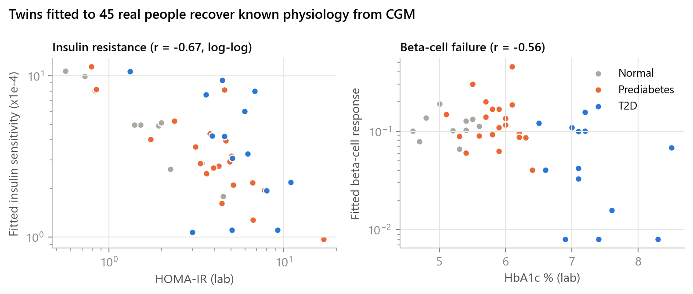
MODEL: twins recover real physiology from CGM
MODEL
SYNC
SIM
37.7 → 26.6
mg/dL twin error, EHR prior → personalised (45 real people, 1–4 h windows)
29% lower
error once the twin is fitted to the individual
Fitted insulin sensitivity tracks lab HOMA-IR and beta-cell response tracks HbA1c, without the model ever seeing those relationships during fitting.
Notes:
The twin's five personal parameters are fitted from a week of CGM, meals and activity, with priors from the EHR. On 45 real people, the fitted parameters line up with laboratory measures: evidence the twin is physiologically meaningful, not a curve fit.

Slide 8
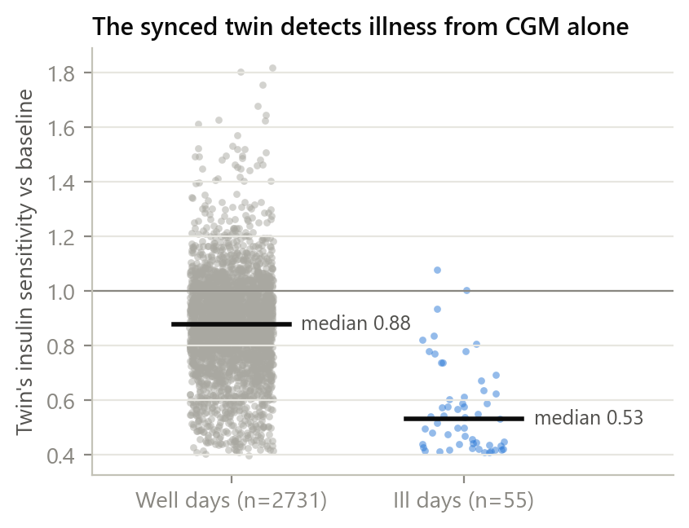
SYNC: the twin notices illness from CGM alone
MODEL
SYNC
SIM
0.89
AUROC for identifying ill days from the synced insulin-sensitivity trace (55 ill days, 2786 patient-days)
0.57× vs 0.87×
insulin sensitivity relative to baseline on ill vs well days
The Unscented Kalman Filter tracks a drifting insulin-sensitivity factor every 5 minutes. A sustained drop prompts the dashboard insight: check for infection, stress or steroid use.
Notes:
Synchronisation is what keeps a twin alive. Besides glucose and insulin, the filter estimates how insulin sensitivity is drifting. On held-out synthetic patients it separates ill days from well days without any symptom input.

Slide 9
SIMULATE: TwinNet fuses both streams with the twin
MODEL
SYNC
SIM
6 h × 21 channels: CGM, HR, HRV, steps, sleep, carbs/insulin on board
Causal dilated TCN
Glucose 5–120 min: median + 80% band (conformal)
EHR vector: labs, therapy, comorbidities, genetics
MLP → FiLM conditions the TCN
Fusion
P(spike > 180) · P(hypo < 70) in 2 h
Physics twin forecast + synced hidden state
MLP
Gate: trust in physics per horizon
Learned trust in the physics twin rises with horizon: 0.71 at 30 min, 0.82 at 60 min, 0.92 at 2 h. Modality dropout during training lets the same model run without wearables or EHR. Pretrained on synthetic patients, fine-tuned on real ones.
Notes:
TwinNet: the dynamic stream goes through a causal temporal convolution, the EHR conditions it through FiLM, and the twin's forecast enters through a gate. The gate is interpretable: the network leans on physics more at longer horizons, where data-driven extrapolation is weakest.

Slide 10
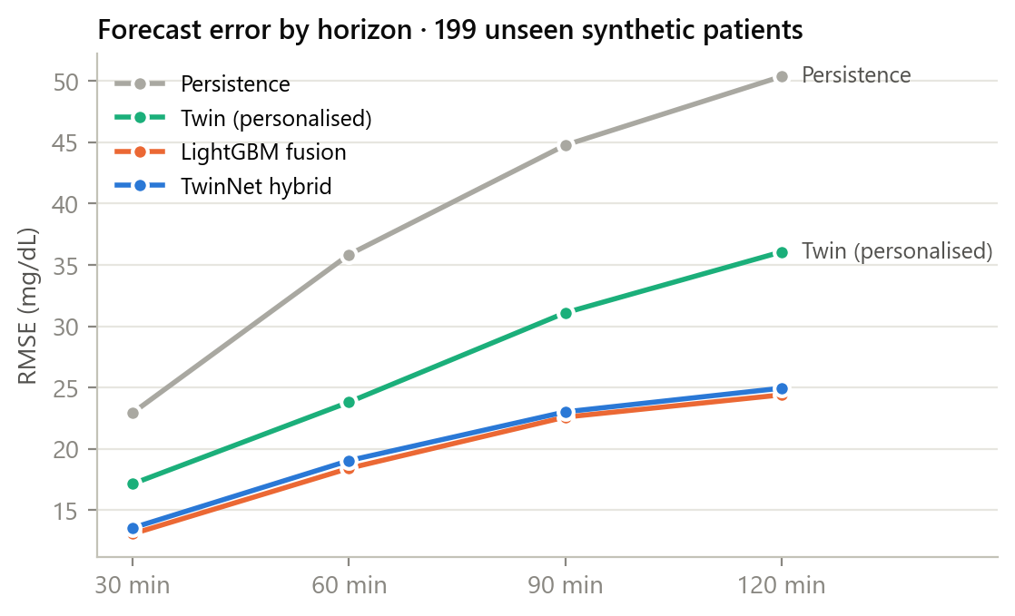
Accurate 2-hour glucose forecasts on unseen patients
199 held-out patients · days 8–14 after personalisation · 1,29,956 forecasts
19.0 mg/dL
60-min error (RMSE); persistence 35.8 · LightGBM 18.4
99.4%
of 60-min forecasts in Clarke zones A+B (clinically acceptable)
80%
of outcomes inside the 80% interval (target 80%)
Notes:
Error grows with horizon for every method, but the hybrid stays well below simply assuming glucose stays flat. Clarke Error Grid zones A and B are clinically acceptable. Conformal calibration keeps the 80% band honest.

Slide 11
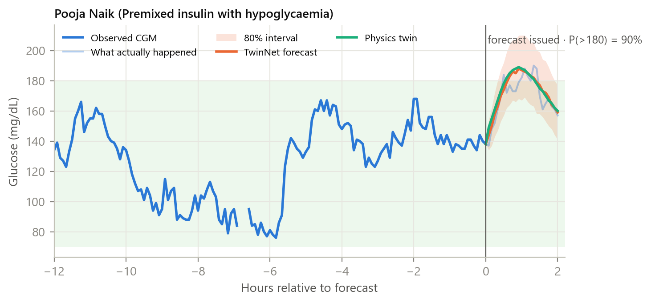
Early warnings with lead time a clinician can act on
86%
100 min
0.45
0.97
of sustained spikes (>180) flagged in advance
median warning before the spike begins
false alert episodes per patient-day
hypoglycaemia AUROC (spike AUROC 0.96)
Every alert carries its reasons from the event model, e.g. carbohydrate still absorbing, a rising trend, insulin sensitivity below baseline, or a sedentary hour after a meal.
Notes:
Alert metrics are at a threshold chosen on validation data, with hysteresis so a flickering probability doesn't page anyone repeatedly. The lead time is measured from the first alert to the start of the sustained excursion.

Slide 12
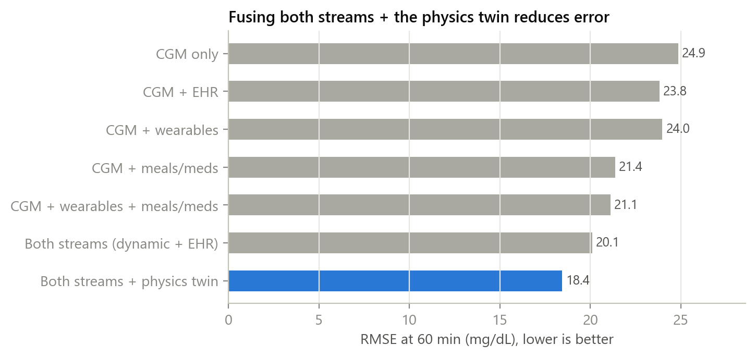
Fusing both streams matters; the twin adds most
CGM alone: 24.9 mg/dL at 60 min; spike AUROC 0.92
Both streams (wearables + meals/meds + EHR): 20.1; AUROC 0.95
+ physics twin: 18.4; AUROC 0.96
Each stream helps; the EHR helps most in combination, telling the model whose body the wearables describe
Notes:
This is the core ask of the challenge: does fusing the static and dynamic streams help? The same model was retrained on each combination of streams; the full hybrid wins on both forecast error and event discrimination.

Slide 13
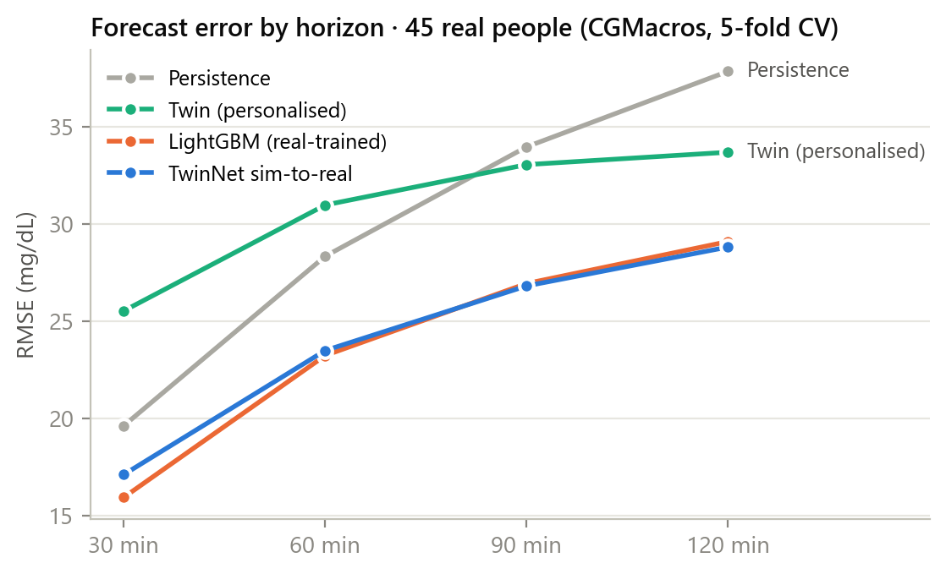
It transfers to real people and to an external population
60-min RMSE (mg/dL) | CGMacros | Shanghai
Persistence | 28.3 | 27.5
TwinNet, synthetic only | 26.4 | 32.9
TwinNet, sim-to-real | 23.5 | 22.3
Clarke A+B, sim-to-real | 99.4% | 98.9%
45 CGMacros participants (5-fold patient cross-validation) and 109 ShanghaiT2DM recordings from a different country, sensor and diet, with no wearables at all.
Notes:
Real-world evidence: pretraining on the synthetic Indian cohort and fine-tuning on a few real patients (sim-to-real) is the regime we recommend for deployment. Shanghai shows the model still works when a whole modality is missing.

Slide 14
CGM-light: one week of CGM, then fingersticks
An affordability mode for India: the twin keeps estimating continuous glucose after the sensor comes off
6.4%
95%
±3.8 pp
twin MARD vs true glucose (carry-forward fingersticks: 23.8%)
of twin estimates within 20% of true glucose (carry-forward: 56%)
error in weekly time-in-range (fingersticks alone: ±5.4 pp)
How it works
Week 1 personalises the twin on CGM. In week 2 only 4 fingerstick checks a day remain; the Unscented Kalman Filter fuses them with logged meals, doses and smartwatch activity to estimate glucose in between. Evaluated on 199 held-out synthetic patients against their true glucose; because the simulator shares the twin's structure this is an upper bound until tested on real CGM-off data.
Notes:
CGM sensors are expensive for many Indian families. A short CGM period teaches the twin the person's physiology; afterwards the twin uses cheap fingersticks and smartwatch data to keep an estimate of continuous glucose and time in range.

Slide 15
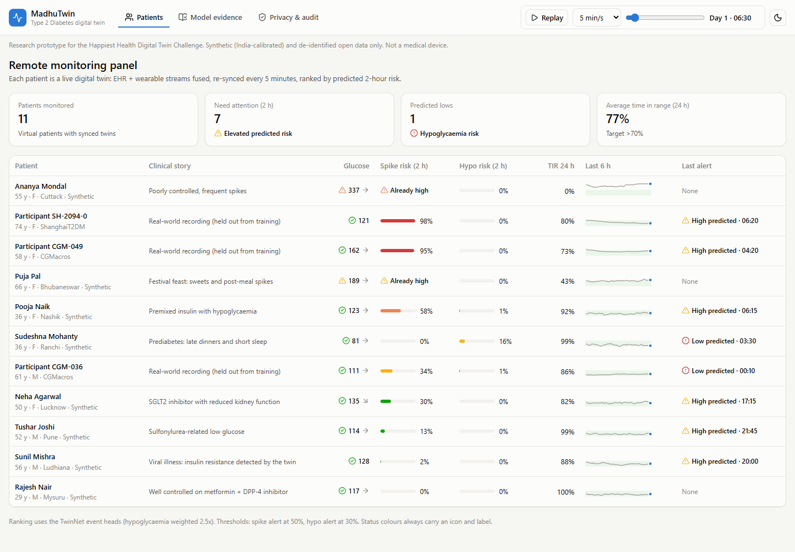
The doctor's view: a risk-ranked panel
Notes:
Every patient on the panel is a live twin. Current lows first, then predicted lows, patients already high, and predicted new spikes. Status always uses an icon and a label, never colour alone.

Slide 16
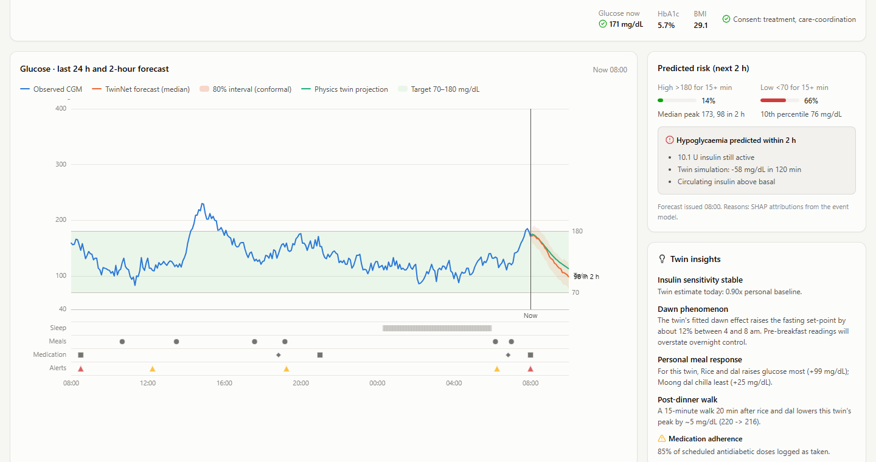
Virtual patient: forecast, reasons, physiology
Notes:
The glucose chart shows 24 hours of CGM, the 2-hour forecast cone and the physics twin's projection, with meals, medication and sleep lanes below. The risk card explains the alert. The virtual-patient panel turns fitted parameters into organ-level physiology a clinician recognises.

Slide 17
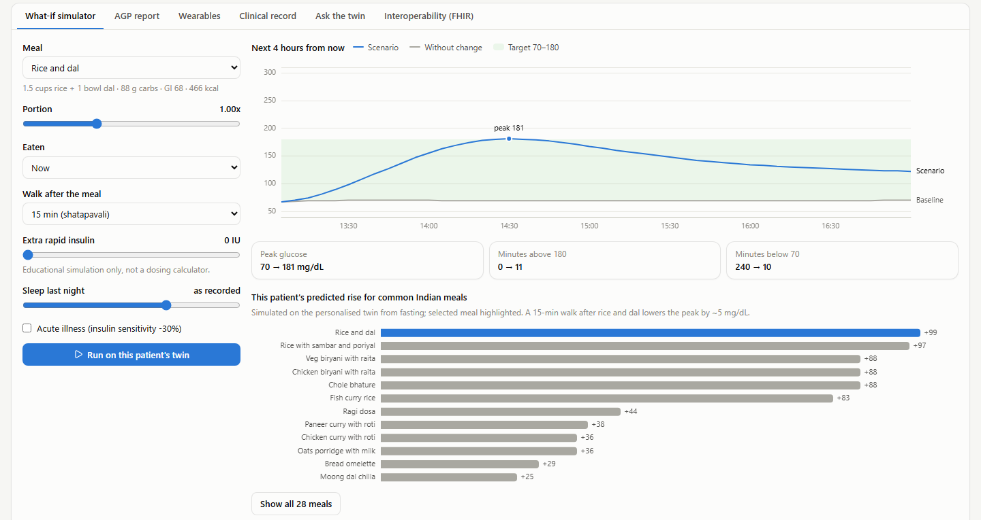
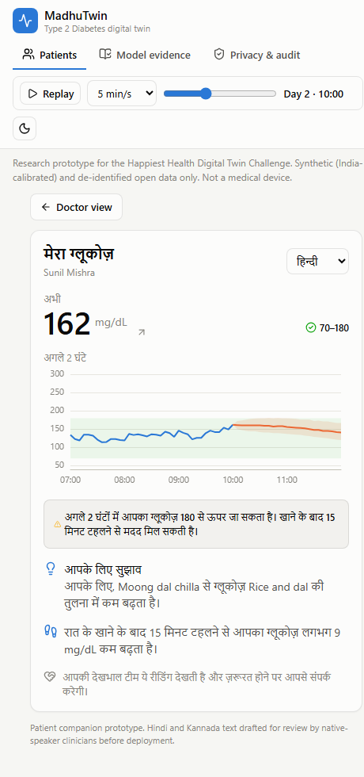
What-if on their twin, nudges in their language
Notes:
The doctor tests a meal swap or a walk on this patient's twin and sees the predicted peak change. Personal meal ranking shows which Indian meals suit this body. The patient companion delivers simple nudges in Hindi, Kannada or English.

Slide 18
Responsible by design
1
DPDP Act 2023
Consent artefacts, purpose limitation, data minimisation, purpose-tagged audit trail; synthetic and de-identified data only
2
ABDM-ready interoperability
FHIR R4 with SNOMED CT, LOINC, WHO ATC; CGM as SampledData; the forecast exported as a RiskAssessment
3
Explainable
Reasons on every alert (SHAP), a visible trust-in-physics gate, organ-level physiology, AGP report
4
Honest evaluation
Patient-level splits, external validation, bootstrap CIs, model card with limitations
5
Regulatory path
Decision support, not autonomous treatment: CDSCO Software as a Medical Device route with prospective validation
Notes:
Health data is the most sensitive personal data. The design follows the DPDP Act and ABDM, every answer is explainable, and the evaluation states its limits plainly.

Slide 19
From proof of concept to Indian clinics
Now
Proof of concept
Twin, TwinNet, dashboard, FHIR; validated on synthetic, US and Chinese data
3 months
Co-design
Diabetologist review of alerts and thresholds; native-speaker review of patient text
6 months
Pilot
50–100 people with T2D in Bengaluru clinics: CGM + smartwatch + ABDM-linked EHR
12 months
Validation
Prospective accuracy and outcome study; CDSCO SaMD submission
Impact we are aiming for
Fewer nocturnal hypoglycaemia episodes in people on sulfonylureas and premixed insulin, more time in range through personalised meal and activity advice, and a care team that sees risk before it becomes an emergency.
Notes:
Close with the path forward: clinical co-design, a pilot in Bengaluru, then prospective validation. The goal is measurable: fewer lows, more time in range, earlier action.

Slide 20
Thank you
MadhuTwin: model · sync · simulate, for every person living with diabetes
Code, data pipeline, evaluation and dashboard: GitHub repository TODO(team) · Apache-2.0
Team: TODO(team)
Notes:
Thank the jury and invite questions.

