Slide 1
GLOBAL LUXURY AUTOMOBILE ANALYTICS
Power BI Executive Dashboard & Comprehensive Business Case Study
Scope: 457 Invoices | $31.70M Revenue | 7 Brands | 6 Countries | 2012–2015
Stack: Microsoft Power BI Desktop, DAX Measure Engine, Power Query (M-Code)

Slide 2
AUTOMOBILE BUSINESS INTELLIGENCE CASE STUDY
Executive Scorecard & Multi-Year Performance
GROSS SALES
$31.70M
457 Invoices
NET PROFIT
$10.24M
32.3% Margin
TOP MAKE
Aston Martin
$10.69M (33.7%)
TOP MODEL
DB9
$5.42M Gross
CORE MARKETS
UK & USA
86.4% Global Share
• Rapid Multi-Year Growth: Revenue expanded by +369% from $3.19M in 2012 to a record $14.97M in 2015.
• High-Margin Vehicle Mix: Dealership network generated a robust 32.3% net profit margin across 457 units.
• Cash Cow Brands: Aston Martin ($10.7M sales, $3.7M profit) and Rolls Royce ($7.4M sales, $3.1M profit) generate 66.4% of total profit.
• Client Retention: 31 high-net-worth accounts generate an average of $1.02M revenue per purchasing client.

Slide 3
AUTOMOBILE BUSINESS INTELLIGENCE CASE STUDY
Business Intelligence Architecture & Pipeline
1. POWER QUERY ETL
Data Hygiene
Verified data types
Created TotalCost custom column
Null & anomaly validation
2. STAR SCHEMA MODEL
1:* Dimension
DAX Calendar table (2012-2015)
Sorted MonthName by MonthNo
Single direction cross-filtering
3. DAX CALCULATIONS
20+ Measures
Time intelligence (YTD, YoY %)
Ranking & Top-N logic
Margin & Target variances
4. EXECUTIVE UI DESIGN
3-Tier Suite
Executive Overview (P1)
Financial Dynamics (P2)
Regional Analysis (P3)

Slide 4
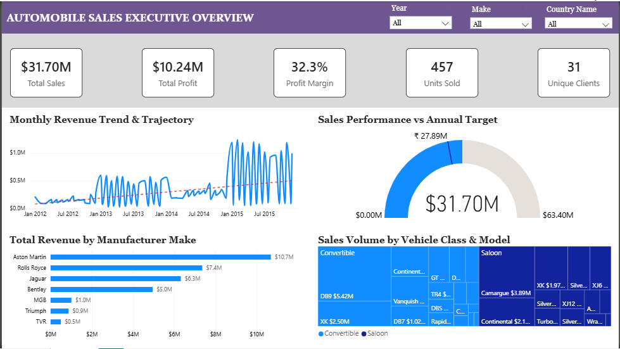
AUTOMOBILE BUSINESS INTELLIGENCE CASE STUDY
Dashboard Page 1: Executive Sales & KPI Overview
Executive Overview Insights:
✔ KPI Cards: Real-time visibility into $31.7M Sales, $10.24M Profit, and 457 Units.
✔ Monthly Trendline: Clear upward revenue trajectory with seasonal mid-year peaks.
✔ Target Gauge: Visualizes actual sales surpassing $27.89M budget target (+13.6%).
✔ Make Bar Chart: Highlights Aston Martin ($10.7M) and Rolls Royce ($7.4M) as revenue anchors.
✔ Class Treemap: Demonstrates heavy customer preference for Coupe and Saloon styles.

Slide 5
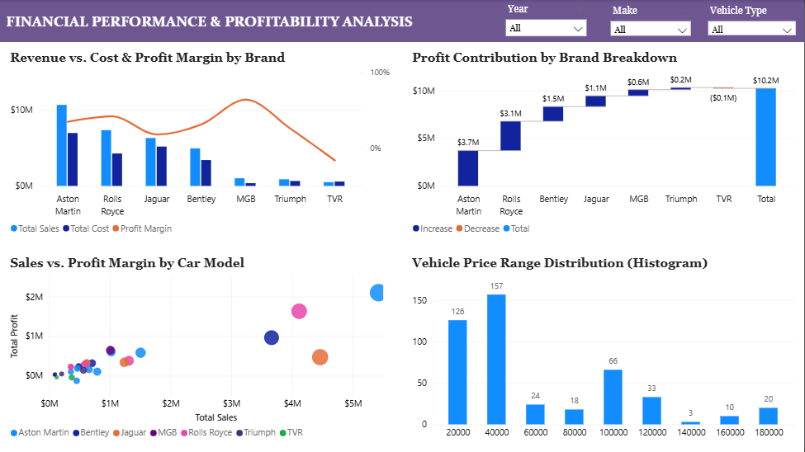
AUTOMOBILE BUSINESS INTELLIGENCE CASE STUDY
Dashboard Page 2: Financial Performance & Profitability
Financial Highlights:
✔ Combo Chart: Tracks revenue vs cost bars alongside the margin percentage line.
✔ Profit Waterfall: Breaks down positive profit contributions to the $10.2M total.
✔ Model Scatter Plot: Identifies superstar models (DB9, Camargue, Continental).
✔ Price Tier Histogram: Shows bimodal customer clusters ($20k–$40k vs $100k+).
✔ TVR Diagnostic: Uncovers -$0.1M operating loss due to high labor & parts overhead.

Slide 6
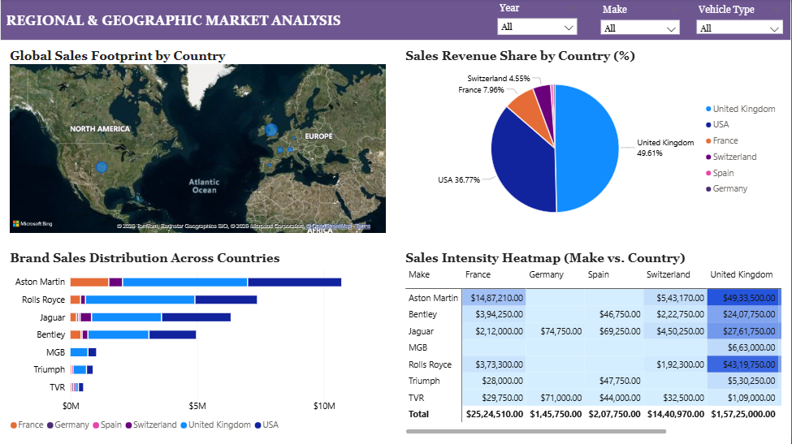
AUTOMOBILE BUSINESS INTELLIGENCE CASE STUDY
Dashboard Page 3: Regional & Geographic Analysis
Geographic Highlights:
✔ Global Map Visual: Interactive Bing map plotting regional sales volume bubbles.
✔ Market Share Donut: UK commands 49.61% and USA commands 36.77% of sales.
✔ Stacked Bar Chart: Cross-analyzes brand popularity within each destination country.
✔ Heatmap Matrix: Highlights intense $4.93M Aston Martin & $4.32M Rolls Royce demand in UK.
✔ European Frontiers: Identifies expansion upside in France ($2.52M), Germany ($146k), Spain ($208k).

Slide 7
AUTOMOBILE BUSINESS INTELLIGENCE CASE STUDY
Strategic Recommendations & Action Plan
1. TVR PROFIT RESTRUCTURING
Eliminate Loss
Re-evaluate labor rate allocation and parts markup to turn TVR profitable.
2. PRIORITIZE MARQUEE INVENTORY
DB9 & Camargue
Allocate guaranteed supply to Aston Martin DB9 and Rolls Royce Camargue.
3. EUROPEAN GEOGRAPHIC EXPANSION
Germany & Spain
Expand dealership presence in Frankfurt and Madrid to tap luxury EU markets.
4. VIP CLIENT LOYALTY CONCIERGE
31 Key Buyers
Establish customized bespoke programs for the 31 high-net-worth client accounts.

Slide 8
AUTOMOBILE BUSINESS INTELLIGENCE CASE STUDY
Case Study Summary & Executive Takeaways
1. Revenue Outperformance: Generated $31.70M gross revenue, beating the cost-plus annual benchmark ($27.89M) by +13.6%.
2. Margin Resilience: Achieved an aggregate net operating margin of 32.3% ($10.24M profit) driven by strong brand equity in Aston Martin and Rolls Royce.
3. Portfolio Concentration: Top 2 brands drive 56.9% of total sales; Top 2 models (DB9 & Camargue) account for $9.54M (30.1% of global revenue).
4. Operational Rectification: Identified TVR operational deficit (-$0.1M), establishing a clear turnaround path via workshop rate adjustment and parts re-pricing.
5. Growth Roadmap: Expanding into underserved continental European hubs (Frankfurt, Madrid) represents an estimated $3.5M–$5.0M annual revenue opportunity.

Slide 9
Thank You!

