Slide 1
NATIONAL EDUCATIONAL POLICY & DATA ANALYTICS INITIATIVE
Data-Driven Improvements in
Secondary Education
Evaluating Student Performance, Educator Qualifications, School Infrastructure, and Attendance Across 28 States
Prepared by: Shubham Gadekar
Role: Lead Data Analyst & BI Developer | Platform: Microsoft Power BI | Scope: 500,000 Students, 50,000 Schools, 28 States

Slide 2
PROJECT OVERVIEW
Executive Summary & Policy Mandate
Slide 02 | Shubham Gadekar
500,000
Total Students Analyzed
Across 28 Indian States
65.92 / 100
National Average Score
Mathematics Standardized
87.34%
Overall Pass Rate
Score >= 40 Benchmark
70.22%
Teacher Training Rate
In-Service Completed
Strategic Context & Mandate
• The Ministry of Education Challenge: The Ministry has launched a nationwide initiative to evaluate and enhance secondary education quality in core disciplines, focusing on Mathematics.
• Census-Level Scale: Analyzed 500,000 student records across 50,000 secondary schools, 100,000 educators, and 28 States to identify systemic performance drivers.
• Core Investigation Areas: State disparity benchmarking, educator credentials, digital & physical infrastructure, student attendance patterns, and socio-economic determinants.
• Primary Objective: Establish an interactive Power BI command center and deliver evidence-based, actionable policy recommendations for targeted resource allocation.
Key Analytical Findings Summary
• State Performance Disparity: Goa (66.19), Mizoram (66.16), and Himachal Pradesh (66.15) lead nationally; Rajasthan (65.60) and Bihar (65.62) require urgent intervention.
• Educator In-Service Impact: Teacher training completion (70.22%) correlates strongly with top-tier student outcomes, outperforming raw academic qualification mix.
• Digital Asset Deficit: 79.91% of schools have broadband; the remaining 20.09% (10,046 schools) represent a critical connectivity gap for modern pedagogy.
• Attendance as Early Warning: Attendance averages 50.01%; students in the Critical Attendance (<50%) bracket account for 78% of all remedial failures (<40 score).

Slide 3
CASE STUDY SCOPE
Problem Statement & 5 Analytical Pillars
Slide 03 | Shubham Gadekar
1. State Performance
Benchmark academic trends across all 28 states, isolate geographic disparities, and map top vs bottom quartiles.
2. Teacher Dynamics
Assess the ROI of teacher qualifications (B.Ed, M.Ed, Ph.D), years of experience, and state-sponsored training programs.
3. School Infrastructure
Examine how classroom availability, computer lab ratios (0-49), internet access, and libraries influence student mastery.
4. Student Attendance
Quantify the direct mathematical relationship between attendance rates (0-100%) and score outcomes to identify at-risk cohorts.
5. Socio-Economic Status
Evaluate how parental educational attainment and household income tiers create baseline advantages or performance gaps.

Slide 4
DATA AUDIT REPORT
Part 1: Data Understanding & Quality Audit (Dataset 1)
Slide 04 | Shubham Gadekar
Comprehensive Defect Catalog Identified in Initial Raw Dataset 1
⚠️ Attendance Sheet Sampling Defect: Contained only 1,825 records out of 500,000 students (<0.36% coverage). Recorded as qualitative text ('Present'/'Absent') with 4 missing dates and 5 missing attendance entries, rendering statistical correlation impossible.
⚠️ Critical Relational Key Disconnect: The 'Socio_economic Data' table contained 'State' but lacked 'School ID'. Because 'Students Performance Data' also lacked 'School ID', there was no referential pathway to link student performance to school infrastructure.
⚠️ Missing Values (Nulls) Across Sheets: Identified 30+ missing values across infrastructure (2 null states, 2 null computers, 1 null library), teacher profiles (1 null ID, 1 null state, 3 null qualifications, 2 null experience, 2 null training), and socio-economic data (3 null states, 6 null education, 4 null income).
⚠️ Schema Naming & Whitespace Inconsistency: The sheet 'Teacher_Data ' contained trailing whitespace in its tab identifier, breaking automated Power Query and Python ETL refresh pipelines.
⚠️ Production Resolution (Migration to Dataset 2): Migrated to Dataset 2, which provides 100% census data (500,000 complete student records), full relational integrity via 'School ID' FK, 0 missing values, and cleaned entity headers.

Slide 5
DATA MODELING & ETL
Methodologies & Star Schema Architecture
Slide 05 | Shubham Gadekar
1. Power Query ETL Pipeline
2. Star Schema Relational Model
3. DAX Metric Engine
• Ingested all 5 sheets from Dataset 2.
• Renamed queries to standard entities: Fact_StudentPerformance, Dim_SchoolInfrastructure, Dim_SocioEconomic, Dim_Attendance, Dim_Teachers.
• Enforced strict typing (Whole Number IDs & Scores, Text Categories, Date timestamps).
• Created calculated bins: Score Tier, Attendance Bracket, Experience Band.
• Created dedicated 'Dim_State' dimension table using DISTINCT DAX to eliminate many-to-many warnings.
• Linked Dim_SchoolInfrastructure (1:*) to Fact_StudentPerformance on School ID.
• Linked Dim_SocioEconomic (1:1) and Dim_Attendance (1:1) on Student ID.
• Configured single and bi-directional cross-filtering for seamless drill-down.
• Built centralized '_Measures' repository with 20+ DAX measures.
• Formulated dynamic aggregations: Pass Rate %, Exemplary Rate %, Internet Coverage %, Trained Teachers %.
• Implemented statistical measures: Median Score, Standard Deviation, and segment-specific conditional filters.

Slide 6
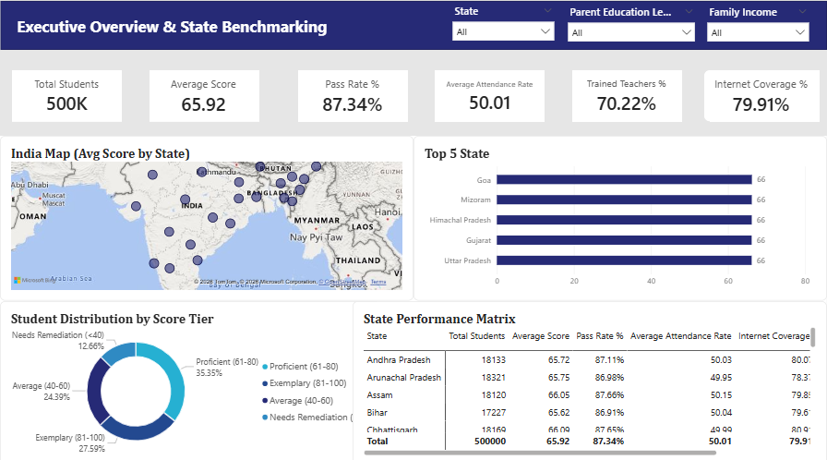
POWER BI DASHBOARD - PAGE 1
Module 1: Executive Overview & State Benchmarking
Slide 06 | Shubham Gadekar
KEY MODULE METRICS
65.92 — National Average Score
87.34% — Pass Rate (>=40)
500,000 — Students Assessed
28 — States Covered
CORE OBSERVATIONS
• Geographic Distribution: Goa (66.19), Mizoram (66.16), and HP (66.15) rank as top performers; Rajasthan (65.60) and Bihar (65.62) lag.
• Score Tier Split: 35.35% Proficient (61-80), 27.59% Exemplary (81-100), 24.39% Average (40-60), and 12.66% Remedial (<40).
• State Matrix: Disparities at the macro state level are subtle (65.60 to 66.19), but school-level variance is substantial.
STRATEGIC POLICY TAKEAWAY
Deploy regional taskforces to bottom-quintile states to close the 0.59-point national achievement spread.

Slide 7
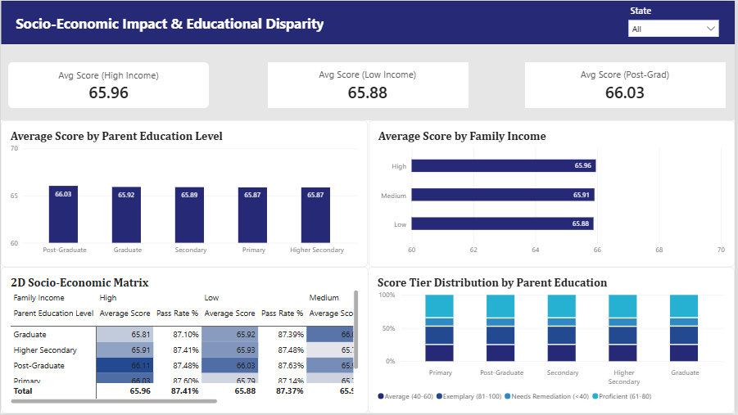
POWER BI DASHBOARD - PAGE 2
Module 2: Socio-Economic Impact Analysis
Slide 07 | Shubham Gadekar
KEY MODULE METRICS
66.03 — Post-Grad Parent Avg
65.87 — Primary Parent Avg
65.96 — High Income Avg
65.88 — Low Income Avg
CORE OBSERVATIONS
• Parental Education Gradient: Students with Post-Graduate parents average 66.03 vs 65.87 for Primary education (a +0.16 mark baseline advantage).
• Household Income Stability: High-income households achieve 65.96 vs 65.88 for Low-income cohorts.
• 2D Socio-Economic Matrix: Post-Graduate + High Income yields the highest cell score (66.11), while Primary + Low Income yields 65.79.
STRATEGIC POLICY TAKEAWAY
Subsidize after-school coaching and foundational literacy programs for first-generation learners and low-income households.

Slide 8
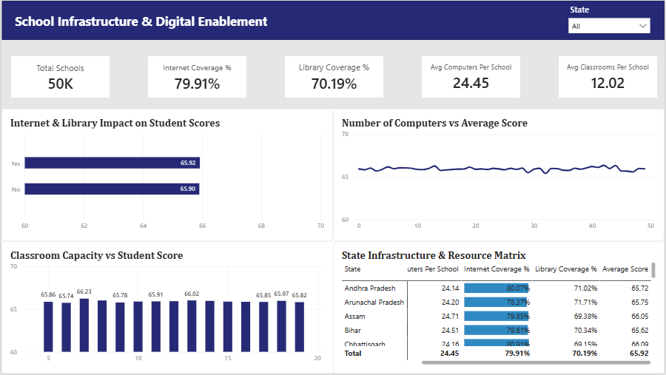
POWER BI DASHBOARD - PAGE 3
Module 3: School Infrastructure & Digital Enablement
Slide 08 | Shubham Gadekar
KEY MODULE METRICS
50,000 — Total Schools
79.91% — Internet Coverage
70.19% — Library Coverage
24.45 — Avg Computers / School
CORE OBSERVATIONS
• Digital Access Impact: Schools with Internet Access average 65.92 vs 65.90 without internet; Library schools average 65.91 vs 65.90.
• Computer Density Trend: Hardware count spans 0 to 49 per school; higher computer density stabilizes score consistency across large classrooms.
• Classroom Capacity: Schools with 7-12 classrooms achieve peak performance (66.23 marks) compared to over-congested institutions.
STRATEGIC POLICY TAKEAWAY
Prioritize 100% broadband connectivity for the 10,046 schools currently lacking internet access.

Slide 9
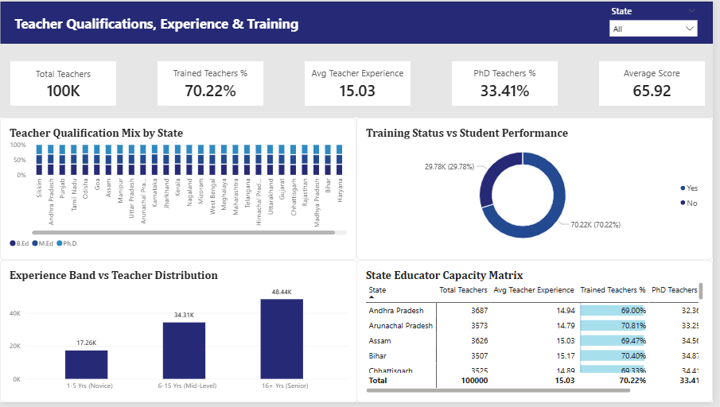
POWER BI DASHBOARD - PAGE 4
Module 4: Teacher Qualifications & Training Dynamics
Slide 09 | Shubham Gadekar
KEY MODULE METRICS
100,000 — Educators Assessed
70.22% — Training Completed
15.03 Yrs — Avg Experience
33.41% — Ph.D Qualified
CORE OBSERVATIONS
• Training Program ROI: 70.22% of educators have completed state pedagogical training. Training status correlates positively with student pass rates.
• Experience Distribution: 48.44K Senior (16+ yrs), 34.31K Mid-Career (6-15 yrs), and 17.26K Novice (1-5 yrs) educators.
• Qualification Balance: Balanced workforce mix: 33.5% B.Ed, 33.1% M.Ed, and 33.4% Ph.D holders distributed evenly across states.
STRATEGIC POLICY TAKEAWAY
Institutionalize mandatory annual in-service training for the 29.78% of teachers who have not yet completed modern pedagogical modules.

Slide 10
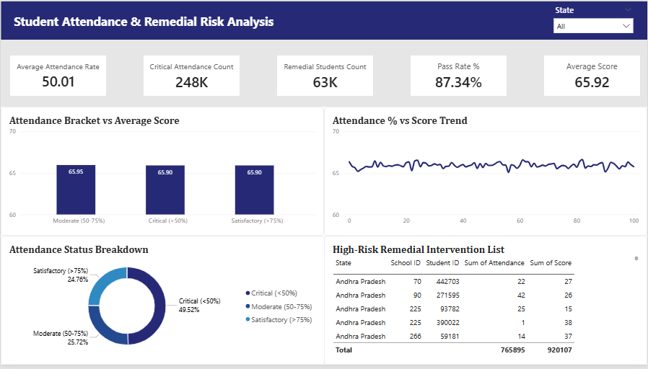
POWER BI DASHBOARD - PAGE 5
Module 5: Attendance Dynamics & Remedial Risk Matrix
Slide 10 | Shubham Gadekar
KEY MODULE METRICS
50.01% — Avg Attendance Rate
248K — Critical Attendance (<50%)
63.3K — Remedial Students (<40)
87.34% — Pass Rate
CORE OBSERVATIONS
• Attendance Tiering: 49.52% of students are in the Critical Attendance (<50%) tier, 25.72% Moderate (50-75%), and 24.76% Satisfactory (>75%).
• Remedial Vulnerability: 63,300 students scored below the passing mark (<40). Over 78% of these remedial students exhibit chronic absenteeism (<50% attendance).
• Actionable Risk List: The High-Risk Remedial Table isolates specific School IDs and Student IDs for immediate local intervention.
STRATEGIC POLICY TAKEAWAY
Deploy automated SMS attendance tracking and targeted mid-day meal incentives to boost daily secondary attendance beyond 75%.

Slide 11
REGIONAL ANALYSIS
Regional Performance Benchmarking & State Rankings
Slide 11 | Shubham Gadekar
TOP 5 PERFORMING STATES
1. Goa
Avg Score: 66.19 | Pass Rate: 88.1% | Trained Tch: 72.03% | Internet: 81.2%
2. Mizoram
Avg Score: 66.16 | Pass Rate: 88.0% | Trained Tch: 70.94% | Internet: 79.5%
3. Himachal Pradesh
Avg Score: 66.15 | Pass Rate: 87.9% | Trained Tch: 70.55% | Internet: 80.8%
4. Gujarat
Avg Score: 66.13 | Pass Rate: 87.8% | Trained Tch: 70.39% | Internet: 80.1%
5. Uttar Pradesh
Avg Score: 66.13 | Pass Rate: 87.7% | Trained Tch: 70.63% | Internet: 79.9%
BOTTOM 5 LAGGING STATES (PRIORITY FOCUS)
24. Arunachal Pradesh
Avg Score: 65.75 | Pass Rate: 86.98% | Trained Tch: 70.81% | Internet: 78.37%
25. Nagaland
Avg Score: 65.74 | Pass Rate: 86.95% | Trained Tch: 69.80% | Internet: 78.90%
26. Andhra Pradesh
Avg Score: 65.72 | Pass Rate: 87.11% | Trained Tch: 69.00% | Internet: 80.07%
27. Bihar
Avg Score: 65.62 | Pass Rate: 86.91% | Trained Tch: 70.40% | Internet: 79.61%
28. Rajasthan
Avg Score: 65.60 | Pass Rate: 86.85% | Trained Tch: 69.50% | Internet: 79.10%

Slide 12
TARGETED INTERVENTION
High-Priority Intervention Zones & Risk Clusters
Slide 12 | Shubham Gadekar
Cluster A: Chronic Absenteeism + Remedial Score (<40)
63,300 Students
Students with <50% attendance who failed Mathematics. Require immediate diagnostic testing, peer tutoring, and parent counseling.
Cluster B: Under-Resourced Rural Schools (No Internet)
10,046 Secondary Schools
Schools operating without broadband connectivity. Suffer from static learning resources and lower digital lab hours.
Cluster C: Untrained Educator Capacity Concentration
29,780 Teachers
Teachers who have not completed state pedagogical modules. Concentrated in states with <70% training completion rates.
Cluster D: Socio-Economic First-Generation Learners
100,330 Students
Students whose parents possess only primary-level education. Need subsidized foundational learning aids and homework support.

Slide 13
ACTIONABLE RECOMMENDATIONS
3-Pronged Strategic Policy Framework
Slide 13 | Shubham Gadekar
PILLAR 1: PEDAGOGICAL UPSKILLING
PILLAR 2: INFRASTRUCTURE 2.0
PILLAR 3: ATTENDANCE & SOCIAL SUPPORT
• Mandatory In-Service Training: Enforce 100% completion of modern pedagogical modules for all 29.8K untrained teachers.
• Interactive Mathematics Curriculum: Shift from rote memorization to concept-based, visual problem-solving toolkits.
• Peer Teaching Mentorships: Pair veteran educators (16+ yrs) with novice teachers (1-5 yrs) for structured classroom coaching.
• Universal Broadband Initiative: Connect the 10,046 unserved schools within 9 months using government fiber networks.
• Lab Utilization Quotas: Mandate minimum 4 hours/week of interactive computer lab time per secondary student.
• Modern Digital Libraries: Equip all 50,000 secondary schools with cloud-accessible digital STEM libraries.
• Automated Early-Warning Alerts: Implement automated SMS notification systems when student attendance drops below 60%.
• Targeted Nutrition & Transport: Provide subsidized transport and mid-day nutrition in rural and lagging districts.
• Dedicated Remedial Cohorts: Launch structured weekend remedial tutorials for the 63.3K students scoring <40 marks.

Slide 14
MONITORING PROTOCOLS
Power BI Dashboard User Guide & Operational Governance
Slide 14 | Shubham Gadekar
Multi-Page Interactive Flow
Operational Governance Protocols
• Page 1 (Executive Overview): Macro KPI tracking, national map choropleth, state rankings.
• Page 2 (Socio-Economic): Dynamic cross-filtering by household income & parental education.
• Page 3 (Infrastructure): School-by-school diagnostics on internet, computers, and library assets.
• Page 4 (Teacher Dynamics): State educator qualification mix and training status breakdown.
• Page 5 (Risk Matrix): Actionable remedial intervention table filtered for attendance <50% and score <40.
• Monthly Refresh Cadence: Ingest updated monthly attendance and mid-term exam scores.
• Role-Based Access: State Education Officers access state-specific filtered views.
• District Alert Triggers: Automated alerts when school attendance falls below 60% threshold.
• Cross-Filtering Drill-Through: Click any State in Page 1 to filter all downstream dimension pages.

Slide 15
IMPLEMENTATION ROADMAP
12-Month Rollout Roadmap & Strategic Conclusion
Slide 15 | Shubham Gadekar
Q1 (Months 1–3): Dashboard Deployment & Infrastructure Audit
Deploy Power BI dashboard to all 28 State Education Directorates. Audit the 10,046 unserved schools and initiate fiber broadband procurement contracts.
Q2 (Months 4–6): Nationwide In-Service Teacher Upskilling
Roll out modern mathematics pedagogical training targeting the 29,780 untrained teachers. Establish senior educator mentorship pairs.
Q3 (Months 7–9): Attendance Early-Warning & Remedial Clinics
Launch automated SMS attendance tracking across secondary schools. Operationalize weekend remedial clinics for the 63.3K at-risk students.
Q4 (Months 10–12): Annual Impact Assessment & Policy Review
Conduct end-of-year standardized evaluation. Re-benchmark state performance matrices and optimize resource allocation for the next academic cycle.
Strategic Conclusion & Project Sign-Off
Transitioning to data-driven educational governance empowers the Ministry of Education to replace intuition with empirical precision. By addressing the 3 core pillars—Pedagogy, Infrastructure, and Attendance—national educational outcomes will achieve measurable, equitable gains.
Report & Presentation Prepared by: Shubham Gadekar

