Slide 1

POWER BI PROJECT
Uber Rides Analytics
Dashboard
Turning raw ride-hailing data into decision-ready business insights
Home • Overview • Vehicle • Revenue • Customer • Location

Slide 2




Project Objective
Why this dashboard was built
Consolidate the data
Surface KPIs instantly
Quantify operational risk
Show practical BI skill
Bring bookings, revenue, vehicle, and customer data into a single connected model.
Give stakeholders at-a-glance visibility into performance without digging through spreadsheets.
Track cancellations, lost revenue, and completion rates, not just totals.
Demonstrate real Power Query, DAX, and report-design workflow end to end.

Slide 3

Tools & Technologies
What powers this report
Power BI Desktop
Data modeling, DAX measures, and end-to-end report design.
Power Query (M)
Cleaning, shaping, and transforming raw ride data.
DAX
Calculated measures and KPI logic driving every card and chart.
Custom Visuals & Icons
A consistent, branded look across all six report pages.

Slide 4




Dashboard Structure
Six focused pages, one connected story
Home
Overview
Vehicle
Navigation hub for the report
High-level KPIs at a glance
Performance by vehicle type
Revenue
Customer
Location
Trends and growth drivers
Behavior & segmentation
Geographic demand hotspots

Slide 5
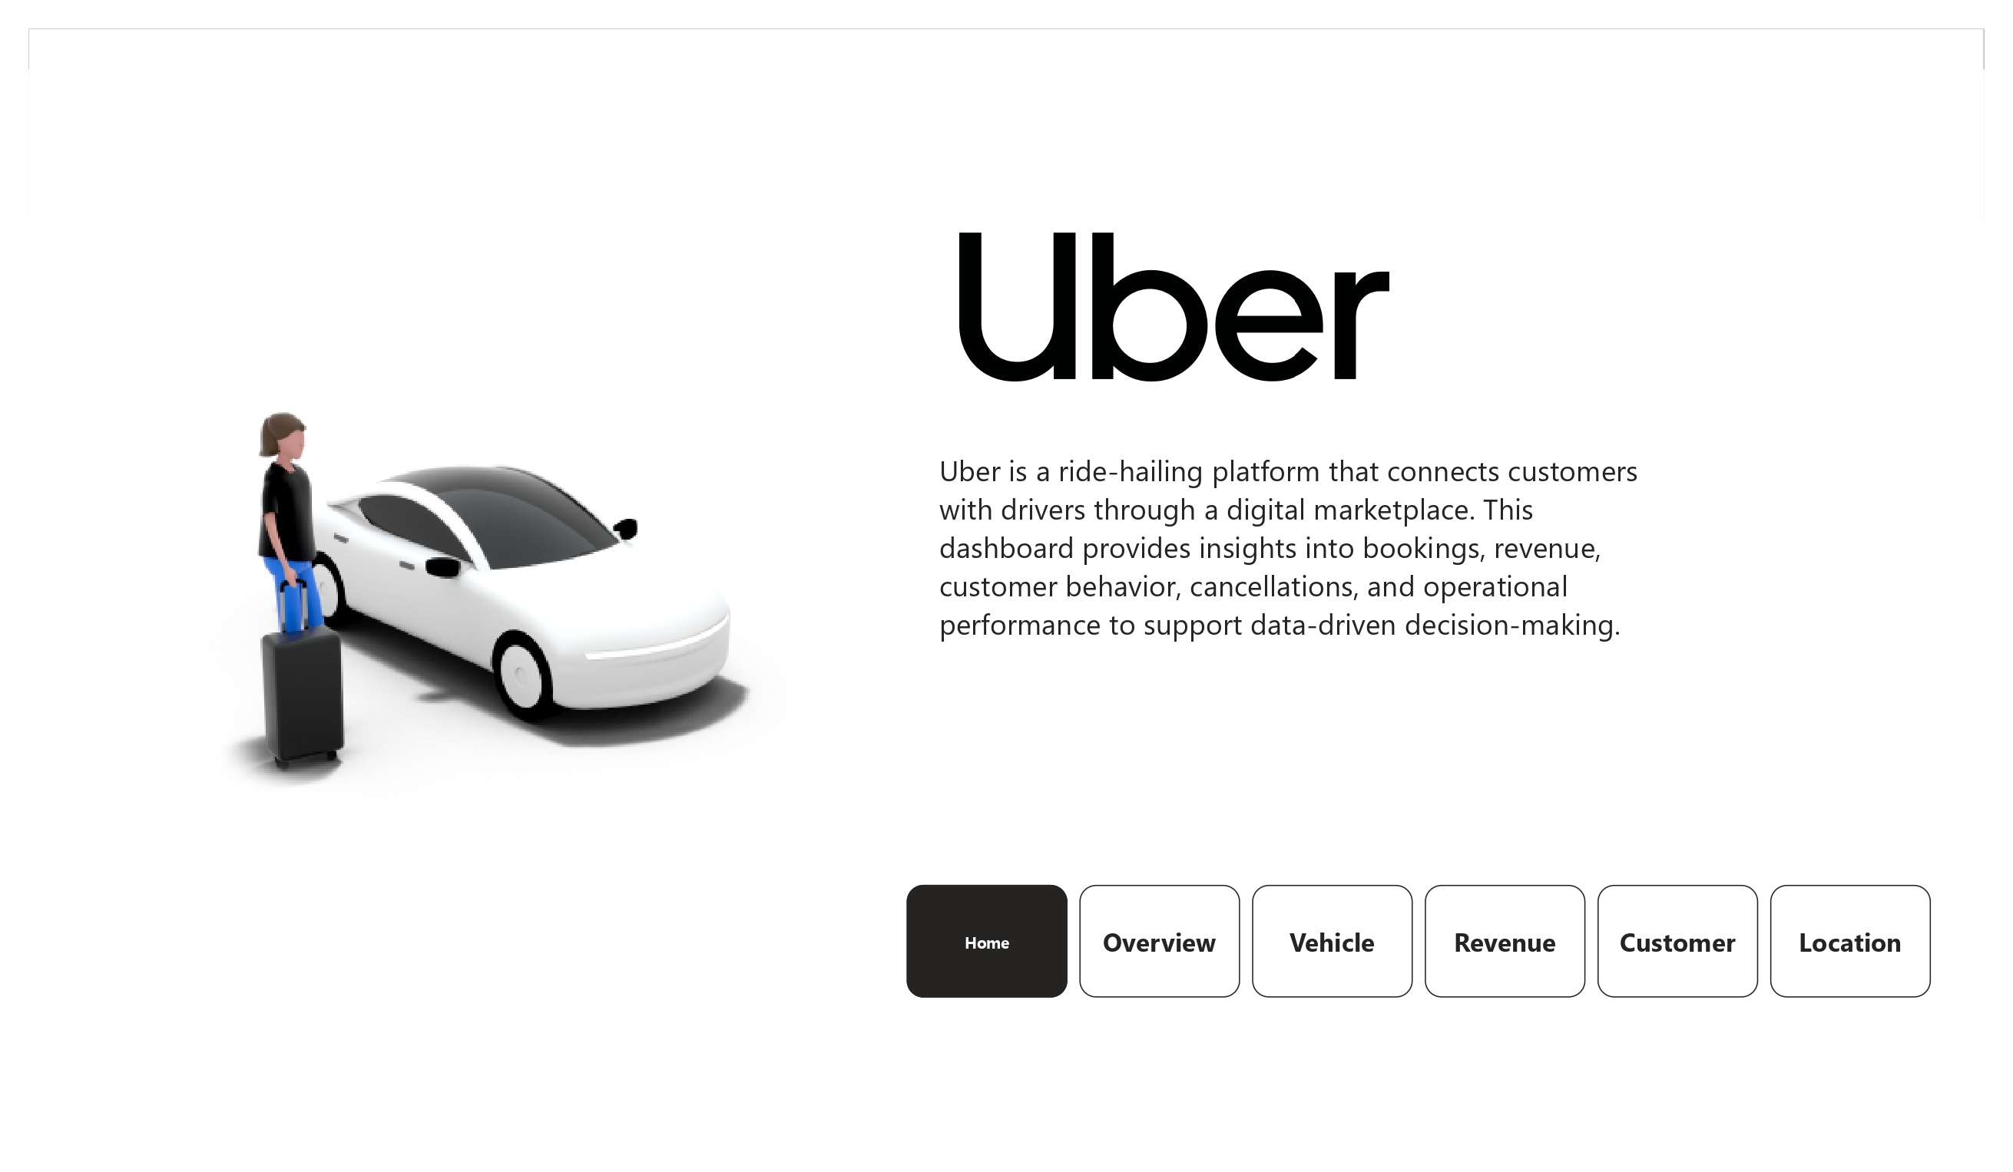
Home
Landing page & navigation
Clean landing page introducing the project scope
One-click navigation to all 5 analysis pages
Sets context: bookings, revenue, cancellations, and performance

Slide 6
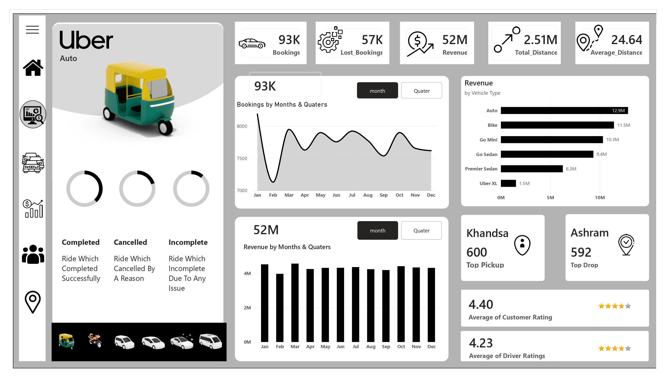
Overview
High-level KPIs at a glance
93K Bookings, 57K Lost Bookings, 52M Revenue
2.51M total distance, 24.64 avg distance per trip
Monthly booking & revenue trend charts
Revenue by vehicle type, top pickup/drop points
4.40 avg customer rating, 4.23 avg driver rating

Slide 7
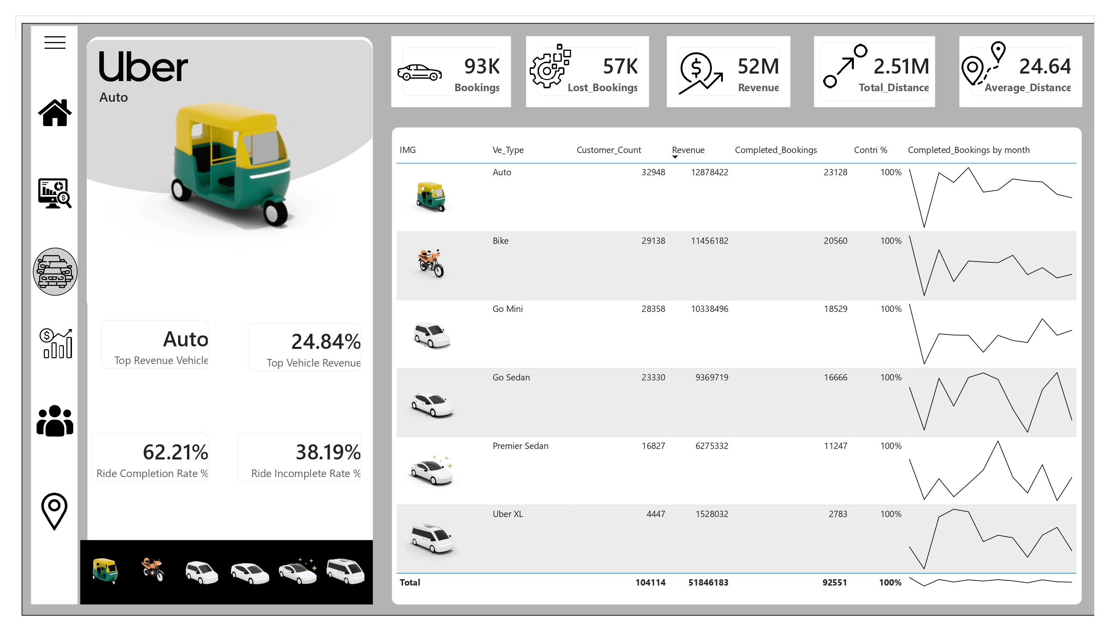
Vehicle
Performance by vehicle type
Auto is the top revenue vehicle at 24.84% share
Full breakdown: customers, revenue, bookings per type
62.21% ride completion rate vs. 38.19% incomplete
Per-vehicle monthly trend sparklines

Slide 8
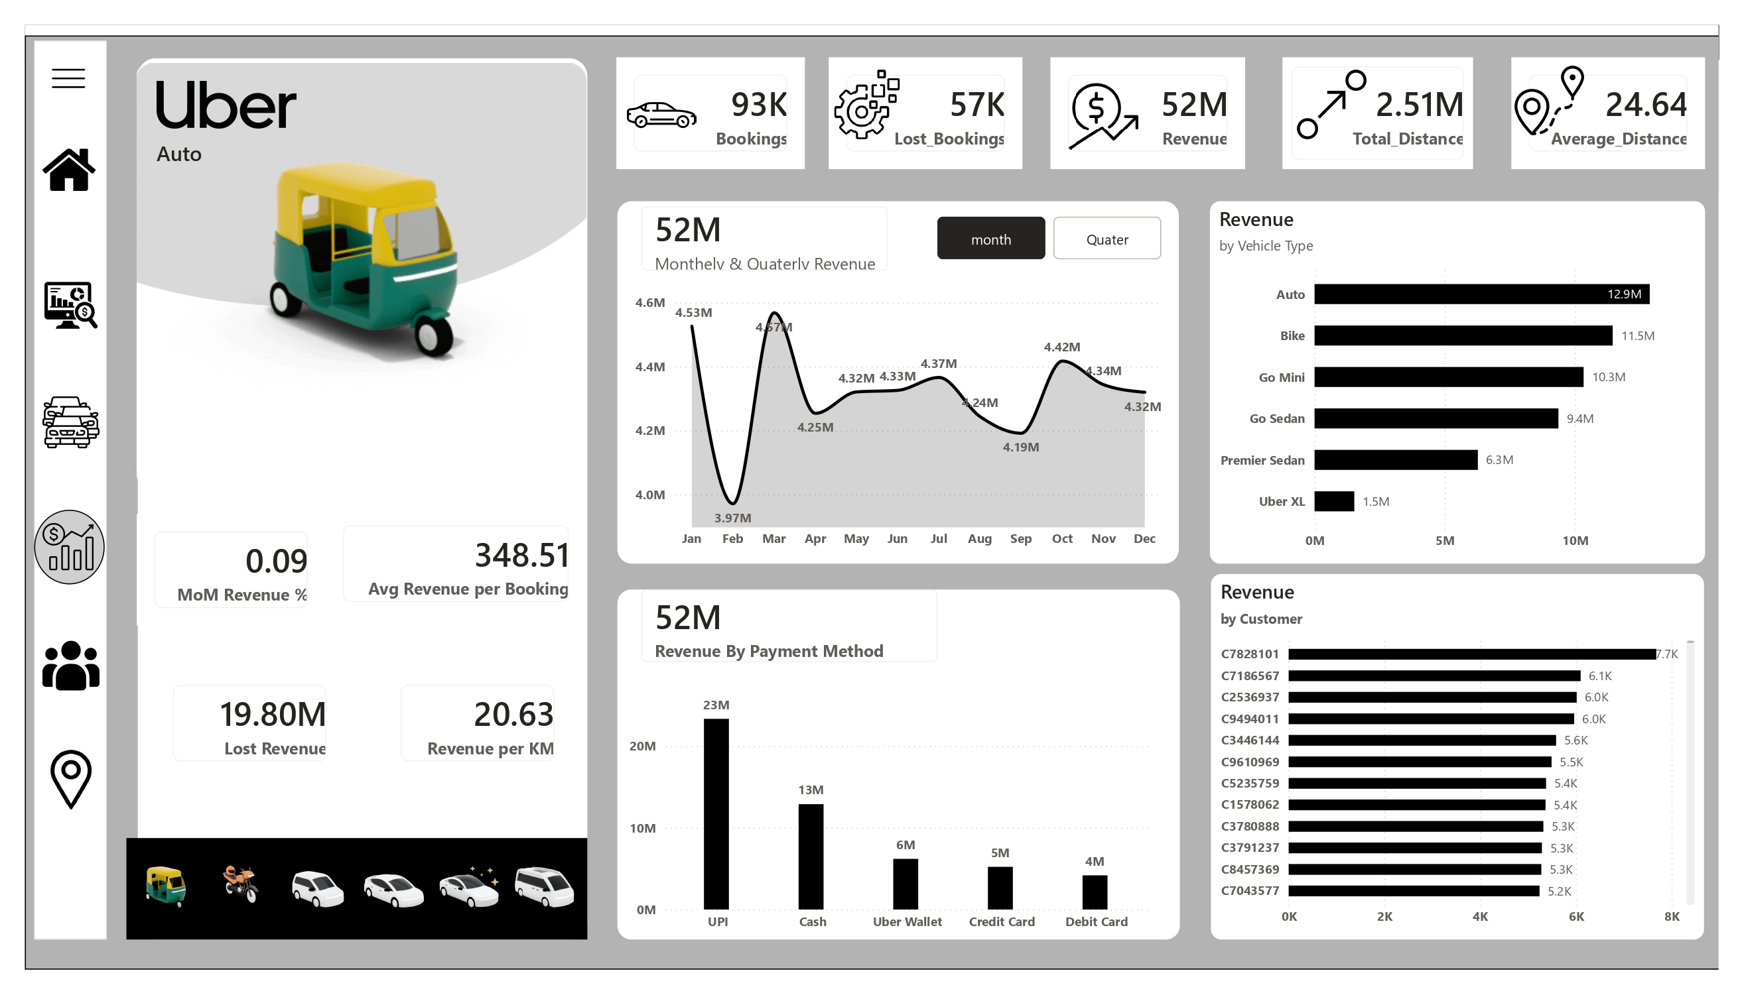
Revenue
Trends & unit economics
UPI leads payment methods at 23M in revenue
Avg revenue per booking: 348.51
Revenue per KM: 20.63 | Lost revenue: 19.80M
Top revenue-contributing customers ranked

Slide 9
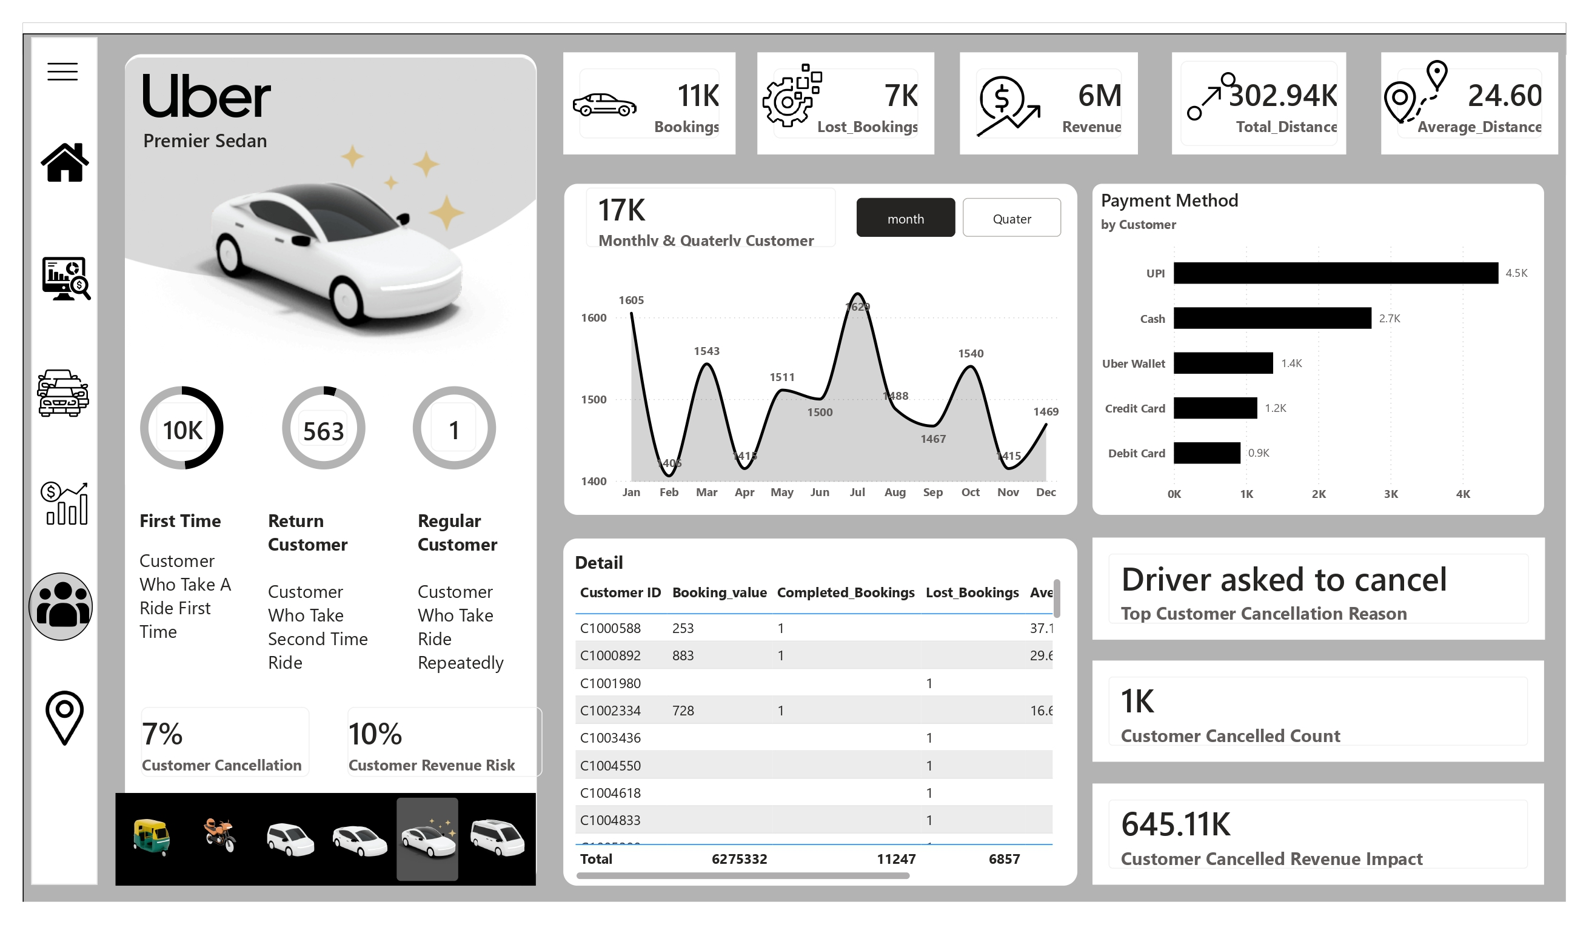
Customer
Segmentation & cancellation risk
First-time, return, and regular customer segments
7% customer cancellation rate, 10% revenue at risk
645.11K revenue impact from customer cancellations
"Driver asked to cancel" is the top cancel reason

Slide 10
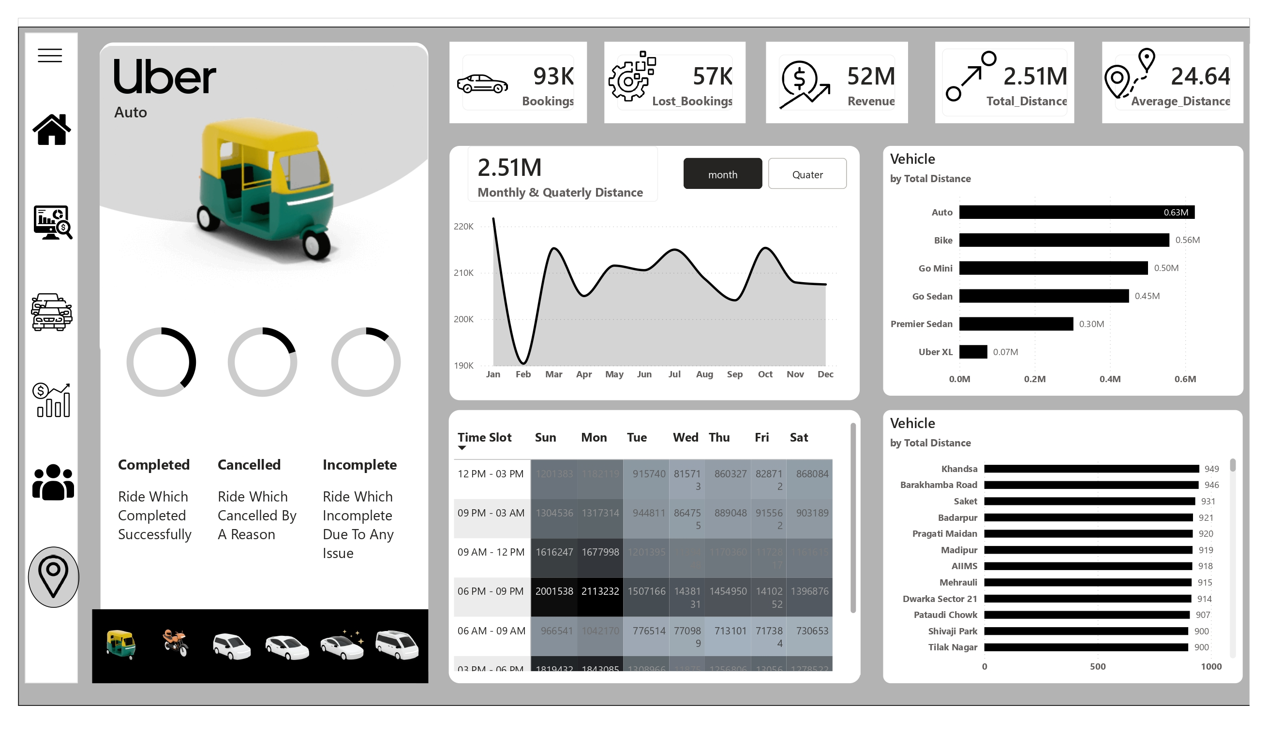
Location
Geographic demand & timing
Distance travelled by vehicle type and by location
Khandsa and Barakhamba Road are top demand areas
Day-of-week × time-slot heatmap for demand
Peak demand window: 6 PM – 9 PM

Slide 11
Key Insights
What the data reveals
Auto drives the most revenue (24.84% share) — Bike and Go Mini follow closely
38.19% of rides go incomplete — a major lever for operational improvement
UPI is the dominant payment method, more than all others combined
Customer cancellations put 10% of revenue at risk (645.11K impact)
Demand peaks 6–9 PM, concentrated around a handful of top locations

Slide 12

Consolidating bookings, revenue, vehicle, and customer data into one interactive report enables faster, evidence-based decisions.
Business Value
Reallocate driver supply toward Auto and Bike, the top revenue vehicle types
From dashboard to decisions
Investigate the 38% incomplete-ride rate and "driver asked to cancel" pattern
Plan surge pricing and staffing around the 6–9 PM demand peak

Slide 13
Thank You
Full project — including the .pbix file — available on GitHub
Let's connect — open to feedback and opportunities in data analytics.

