Slide 1


CHE 629: AI in Systems Biology
DLPRB
Deep Learning for Protein-RNA Binding
Learning Intrinsic Protein-RNA Binding Preferences
Using CNN & RNN Architectures
Notes:
1.7.2013
1
‹#›

Slide 2
The Biological Problem
Protein-RNA Binding
Computational Challenge
RBPs regulate splicing, translation, and gene expression
Infer protein-specific RNA-binding models from high-throughput data
In vitro: RNAcompete measures binding of 1 protein to 240,000+ short RNAs
Both RNA sequence AND secondary structure determine binding
In vivo: CLIP-seq experiments capture binding in living cells
Manual feature engineering is labor-intensive; DL can auto-extract
In vivo data is noisy with low signal-to-noise so we avoid training on this data.
Goal: Predict binding intensity for any new RNA transcript
Notes:
1.7.2013
2
‹#›

Slide 3
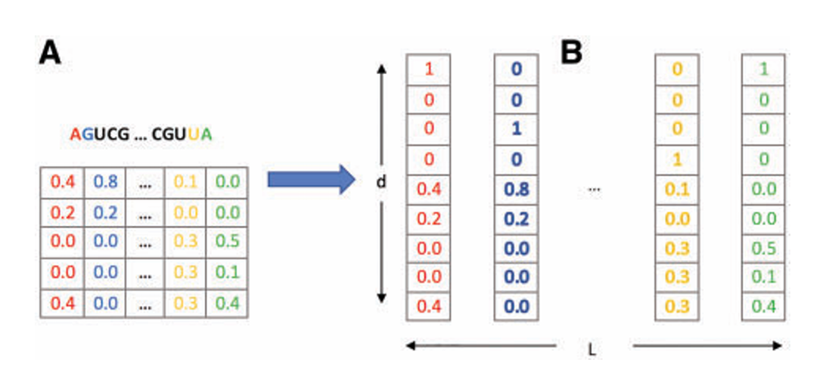

Dataset & Data Pipeline
RNAcompete (in vitro)
RNA Structure
9 proteins
RNAplfold predictions
~120,000 short RNAs each
5 structural contexts:
30–40 nucleotides
Hairpin, Inner, Multi,
Quantitative binding intensity
External, Paired
Set A → train, Set B → test
Probability vector / position
→ Data flows into the network as: One-Hot Sequence [4-dim] + Structure Probabilities [5-dim] = 9-dim vector per nucleotide position → shape: (N, L, 9)
Notes:
1.7.2013
3
‹#›

Slide 4
Input Representation to the Network
RNA Sequence Encoding (4-dim)
RNA Structure Encoding (5-dim)
One-hot encoding over alphabet {A, G, C, U}
Probabilities sum to 1 per position (RNAplfold):
Nucl. | A | G | C | U
A | 1 | 0 | 0 | 0
G | 0 | 1 | 0 | 0
C | 0 | 0 | 1 | 0
U | 0 | 0 | 0 | 1
Hairpin Loop: 0.60
Inner Loop: 0.15
Multi Loop: 0.05
External: 0.10
Shape: (N_sequences, L_max, 4) — shorter seqs are zero-padded
Paired: 0.10
Final input per position: concat( one-hot[4] + structure[5] ) = 9-dim vector
Total input shape:
(N, L, 9) → Conv1D / BiGRU
Notes:
1.7.2013
4
‹#›

Slide 5
CNN Architecture — DLPRB
Convolutional Neural Network for in vitro Binding Prediction
Input
Conv1D ×2
GlobalMaxPool
Concat
Dense(128)
(N, L, 9)
RNA seq + struct
128 filters @ len-5
128 filters @ len-11
ReLU activation
L2 regularization
Max per filter
→ 128 values
Merge outputs
of both filter
sizes
→ dim 256
FC hidden
ReLU
Dropout 0.3
L2 reg
Dense(1) → Binding Intensity Score
Architecture Hyperparameters (from paper + grid search)
Filters: 256 total (128@len-5 + 128@len-11)
Optimizer: Adam | LR = 0.0001
Loss: Mean Squared Error (MSE)
Batch Size: 128
Regularization: L2 weight decay
Stopping: Early stopping on val Pearson r
Epochs: Up to 60, 3-fold CV for tuning
Dropout: 0.3 on FC layer
Notes:
1.7.2013
5
‹#›

Slide 6
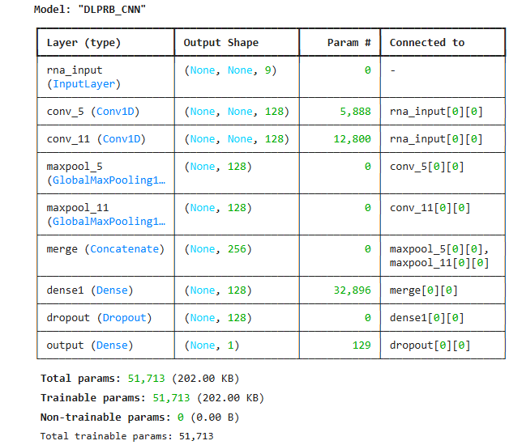
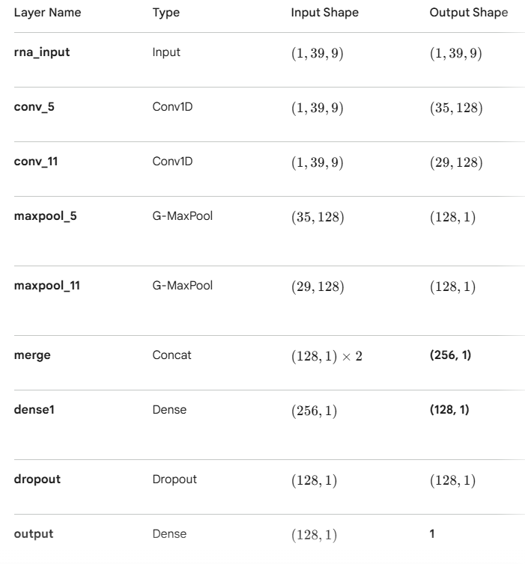
CNN Architecture — PARAMETRS

Slide 7
CNN Results — in vitro Binding Prediction
0.682
0.830
0.683
Avg Pearson r
(CNN seq+struct)
Best Protein (HuR)
Pearson r
Avg Pearson r
(RNN seq+struct)
Protein | CNN (seq+struct) | RNN (seq+struct)
Fusip | 0.7089 | 0.7210
HuR | 0.8301 | 0.8458
PTB | 0.5780 | 0.5943
RBM4 | 0.8089 | 0.8325
SF2 | 0.7382 | 0.7402
SLM2 | 0.7131 | 0.7415
U1A | 0.6910 | 0.6939
VTS1 | 0.6361 | 0.5487
YB1 | 0.4379 | 0.4301
MEAN | 0.6825 | 0.6831
Notes:
1.7.2013
6
‹#›

Slide 8
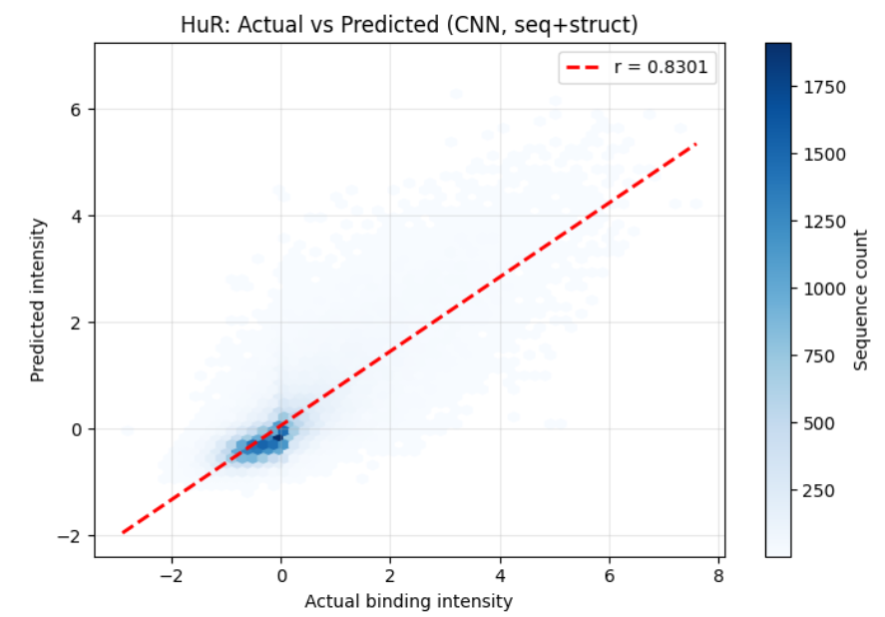
Benchmark Comparison — CNN vs Prior Methods
Key Findings: Our CNN achieves avg Pearson r = 0.682 vs RCK = 0.46 and DeepBind = 0.41 on in vitro data. Improvement is significant.Our CNN also tops in vivo prediction with median AUC = 0.657 vs DeepBind = 0.648.
Notes:
1.7.2013
7
‹#›

Slide 9
RNN Architecture — Bidirectional GRU
Recurrent Neural Network for capturing sequential dependencies in RNA
Input
→ Forward GRU
← Backward GRU
Concat → 128
Dense(128)
(N, L, 9)
per-position
vectors
GRU units=64
Captures past
GRU units=64
Captures future
BiGRU output
Fwd + Bwd
concatenated
FC + ReLU
Dropout 0.3
Dense(1) → Score
Why Bidirectional GRU?
RNN vs CNN — Key Difference
• CNN: local motif detection
• Captures both 5'→3' and 3'→5' dependencies
• RNN: sequential, long-range dependencies
• Position-dependent interactions occur in binding sites
• RNN ≈ CNN on in vitro (avg r 0.683 vs 0.682)
• GRU: fewer params than LSTM, similar performance
• RNN slightly better per-protein on many proteins
• Cell size 64 (128 total after BiDirectional merge)
Notes:
1.7.2013
8
‹#›

Slide 10
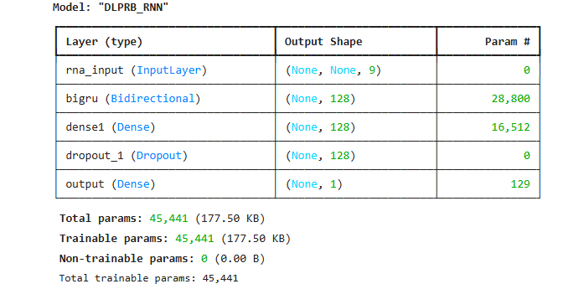
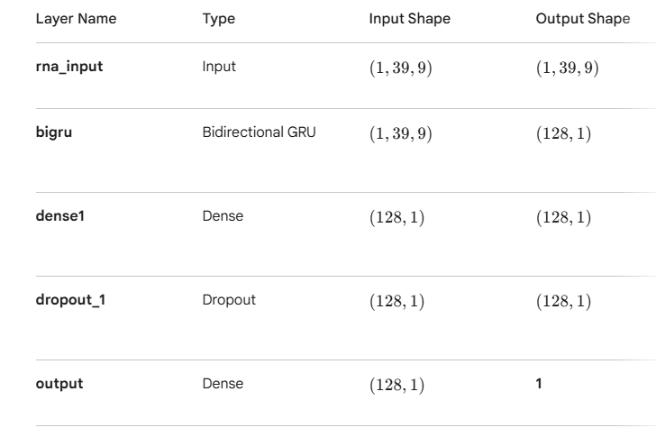
RNN Architecture — Bidirectional GRU
Trainable parameters

Slide 11
Performance Evaluation & Metrics
Pearson r
Primary metric for in vitro. Measures linear correlation between predicted and measured binding intensities.
0.682 (CNN)
0.683 (RNN)
Additional Metrics & Training Details
Loss Function: MSE (Mean Squared Error) for in vitro intensity regression
Ablation: CNN seq-only avg r = 0.671 vs seq+struct = 0.682 (Δ = +0.011, p = 0.006)
Structure gain (vitro): Every single protein shows improvement when structure is added — consistent across 9 proteins
Notes:
1.7.2013
9
‹#›

Slide 12
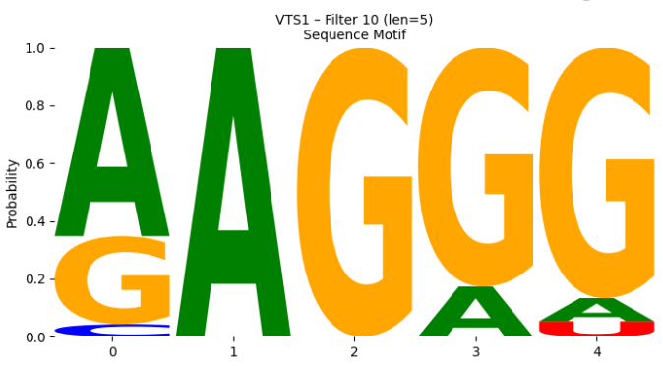
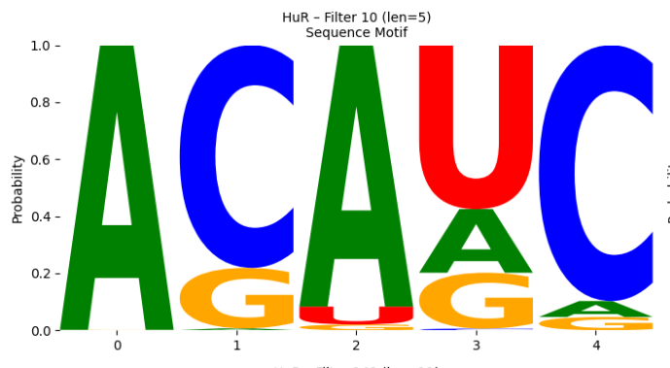
Results & Structure Logos — Biological Insights
How CNN Filters Are Interpreted
Each CNN filter acts as a motif detector.
Vts1
HuR
Notes:
1.7.2013
10
‹#›

Slide 13
Conclusions
DLPRB CNN avg Pearson r = 0.682 and RNN = 0.683 on RNAcompete — far exceeding RCK (0.46) and DeepBind (0.41). RNN approaches the biological replicate ceiling of 0.581.
Adding RNA secondary structure (5 structural contexts from RNAplfold) gives statistically significant improvement over sequence-only (Δr = +0.011, p = 0.006). Experimentally-measured structure improves in vivo prediction further.
CNN filters act as motif detectors. Logos for Pum2, Vts1, HuR show strong concordance with known binding sites discovered by independent methods on different datasets.
Multi-protein joint learning; higher quality in vivo data; improved interpretability; testing on additional organisms; hyperparameter novelty extensions.
Notes:
1.7.2013
11
‹#›

