Slide 1

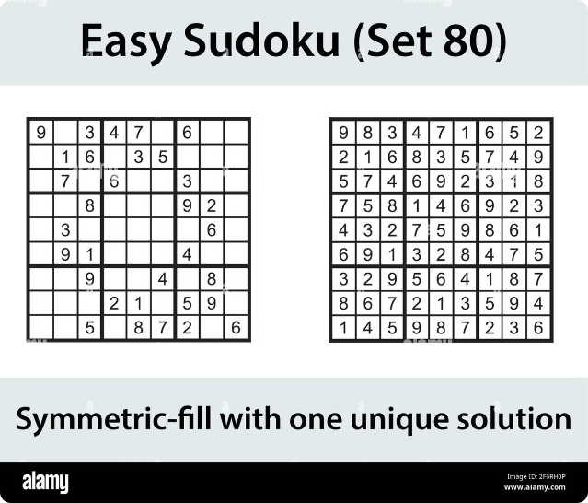
Introduction to Sudoku Solver
Welcome to the world of Sudoku solvers! This presentation will guide you through the fascinating process of solving Sudoku puzzles using a backtracking algorithm. We'll explore the key concepts, visualize the algorithm in action, and delve into the implementation details. Join us on this journey!
by Shubham Singh

Slide 2

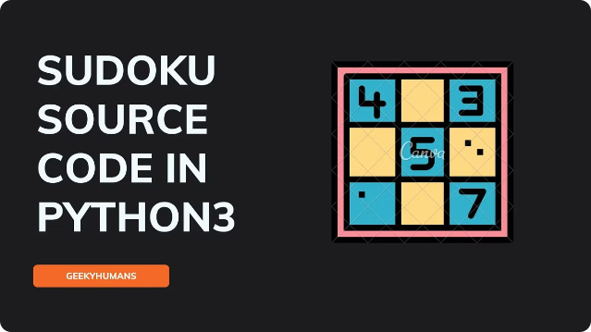
Representing the Sudoku Board
A 2D array or matrix can be used to represent the Sudoku board. Each element represents a cell, with 0 indicating an empty cell.
Rows and columns are indexed from 0 to 8, with each cell having its own unique index.
This representation allows easy access and manipulation of cells during the solving process.

Slide 3

Example: Solving a Sudoku Puzzle
Let's apply the backtracking algorithm to solve a Sudoku puzzle step by step. We'll start with an empty board and fill in the numbers one by one, considering the constraints and backtracking when needed. Follow along as we uncover the solution!

Slide 4

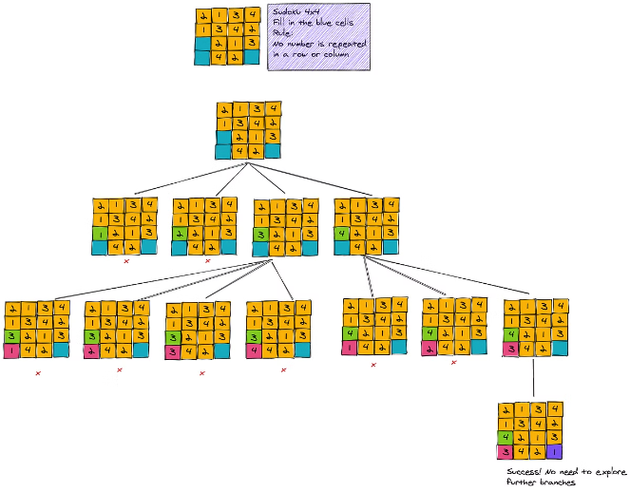
Backtracking Algorithm Explained
1
Exploration
The backtracking algorithm systematically explores all possible solutions by trying different values for empty cells.
2
Constraints
Each step involves checking if the chosen value violates the Sudoku rules (rows, columns, and 3x3 blocks).
3
Backtracking
If a conflict arises, the algorithm backtracks to the previous step and tries a different value.
4
Solution
The process continues until a valid solution is found, or all possibilities are exhausted.

Slide 5

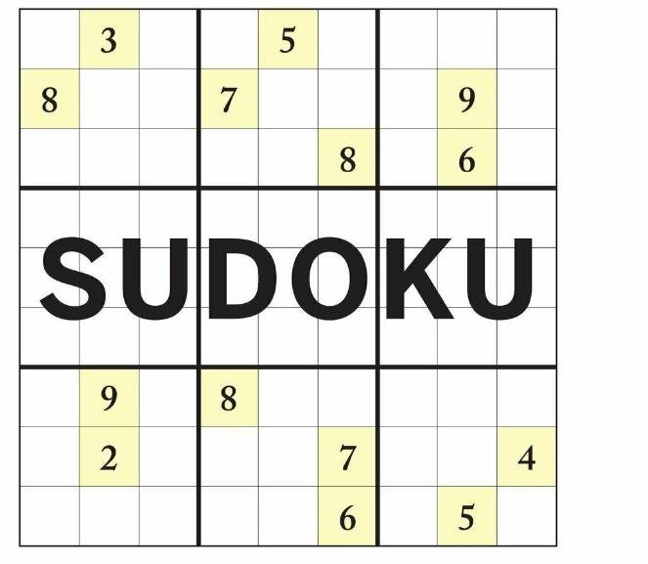
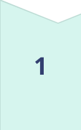
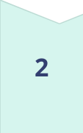
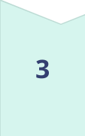

Visualizing the Backtracking Process
Initial State
Start with an empty cell and consider all possible values.
First Attempt
Try a value and check for conflicts with existing numbers in the row, column, and block.
Conflict Detected
If a conflict occurs, backtrack to the previous cell and try a different value.
Solution Found
Continue this process until all cells are filled without conflicts, resulting in a solution.

Slide 6

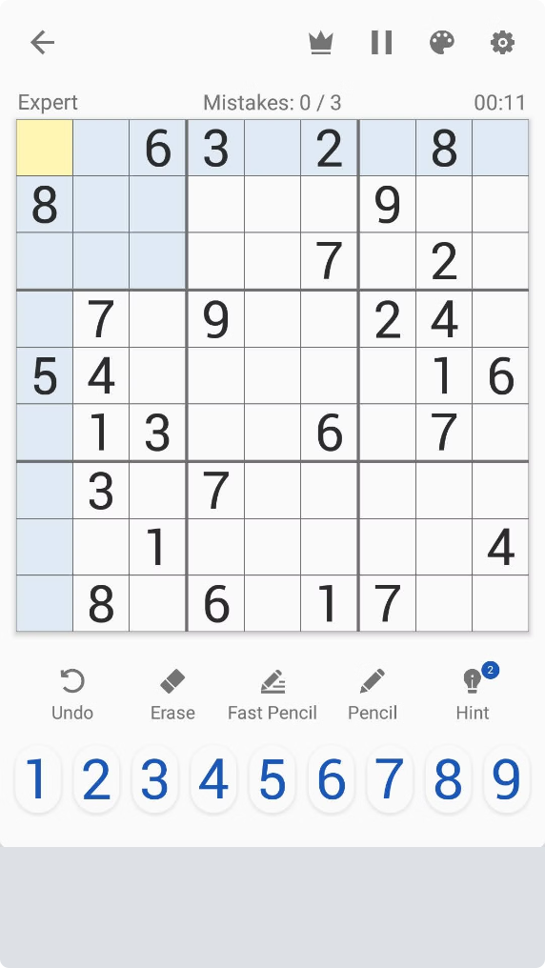
Implementing the Solver Function
1
Recursive Function
A recursive function is commonly used to implement the backtracking algorithm.
2
Base Case
The function stops when a solution is found or all possibilities are exhausted.
3
Iteration
The function iterates through possible values for each empty cell.
4
Recursive Call
For each value, the function recursively checks if the value is valid and continues the search.

Slide 7
Handling Empty Cells and Constraints
Empty Cells
Constraints
Validation
The solver must identify empty cells on the board.
The solver enforces the rules of Sudoku.
A function is used to check if a value is valid for a given cell.
This is typically done by iterating through the matrix and checking if a cell contains a 0.
It checks if the chosen value violates the rules of the same row, column, and 3x3 block.
This function ensures that the value does not conflict with existing numbers in the same row, column, and 3x3 block.

Slide 8
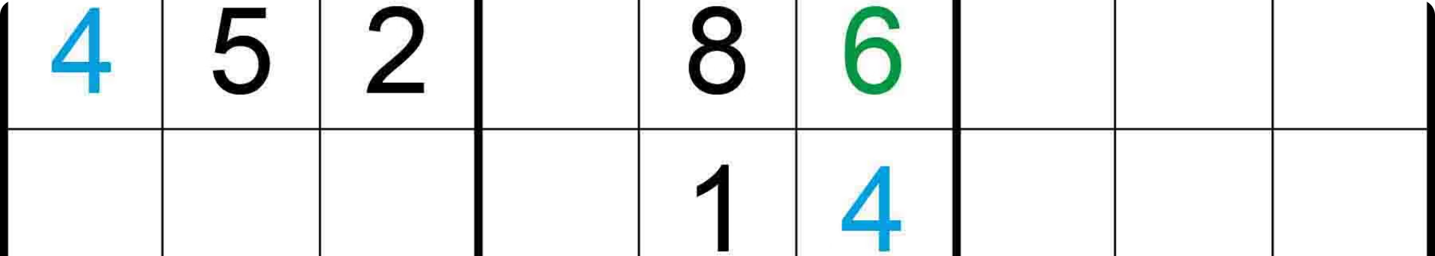




Visualizing the Step-by-Step Solution
Start
Iteration
Backtracking
Solution
The solver begins with an empty board and selects the first empty cell.
The solver tries different values for the cell, checking for conflicts.
If a conflict arises, the solver backtracks and tries a different value.
The solver continues until all cells are filled without conflicts, resulting in a solved board.

Slide 9


Conclusion and Potential Enhancements
Efficiency
The backtracking algorithm can be optimized for performance by using techniques like constraint propagation and heuristics.
User Interface
A user interface could be created to allow users to input their own Sudoku puzzles and visualize the solution process.
Difficulty Levels
The solver could be adapted to handle different difficulty levels by varying the number of pre-filled cells.

