Slide 1
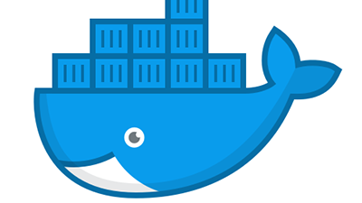

Docker

Slide 2
VON Introduction
Docker is a tool designed to make it easier to create, deploy, and run applications by using containers. Containers allow a developer to package up an application with all of the parts it needs, such as libraries and other dependencies, and ship it all out as one package.

Slide 3
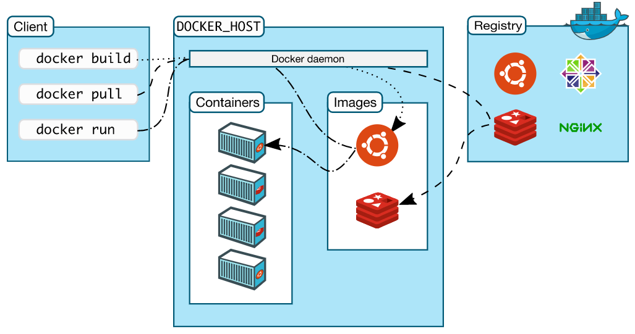
VON Architecture
Docker daemon
The Docker daemon (dockerd) listens for Docker API requests and manages Docker objects such as images, containers, networks, and volumes. A daemon can also communicate with other daemons to manage Docker services.
Docker client
The Docker client (docker) is the primary way that many Docker users interact with Docker. When you use commands such as docker run, the client sends these commands to dockerd, which carries them out. The docker command uses the Docker API. The Docker client can communicate with more than one daemon.
Docker registries
A Docker registry stores Docker images. Docker Hub is a public registry that anyone can use, and Docker is configured to look for images on Docker Hub by default. You can even run your own private registry.

Slide 4
VON Why Docker?
Lighter weight: Unlike VMs, containers don’t carry the payload of an entire OS instance—they include only the OS processes and dependencies necessary to execute the code.
Greater resource efficiency: With containers, you can run several times as many copies of an application on the same hardware as you can using VMs. This can reduce your cloud spending.
Improved developer productivity: Compared to VMs, containers are faster and easier to deploy, provision, and restart. This makes them ideal for use in continuous integration and continuous delivery (CI/CD) pipelines and a better fit for development teams adopting Agile and DevOps practices.

Slide 5
VON Installation
apt-get update
apt-get install apt-transport-https ca-certificates curl gnupg lsb-release -y
curl -fsSL https://download.docker.com/linux/ubuntu/gpg | sudo gpg --dearmor -o /usr/share/keyrings/docker-archive-keyring.gpg -y
echo "deb [arch=amd64 signed-by=/usr/share/keyrings/docker-archive-keyring.gpg] https://download.docker.com/linux/ubuntu $(lsb_release -cs) stable" | sudo tee /etc/apt/sources.list.d/docker.list > /dev/null
apt-get update
apt-get install docker-ce docker-ce-cli containerd.io -y
docker run hello-world
Alternate:- use below command to download the script and execute it : curl -L https://raw.githubusercontent.com/ShubamTondare/docker/master/docker_script.sh --output docker_script.sh
Note:
You can also follow the official document:- https://docs.docker.com/engine/install/ubuntu/

