Slide 1

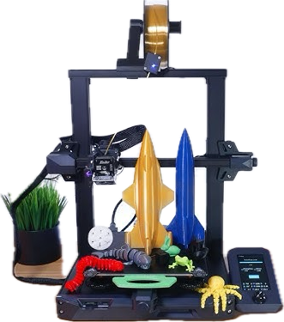






For beginners with No Prior
3D Printing Experience!
Introduction
to the world of
3D-Printing
with the help of
Creality Ender 3
Assembly
Configuration
Printing
Quality & Tuning
Troubleshooting
By Anvay, Shuban Lawliet and Julius

Slide 2





Guide Overview
1
2
3
Assembly & Initial Setup
First-Time Configuration
Printing Basics
Unboxing, frame build, belt tensioning, wiring, first power-on checks and safety.
Bed levelling, Z-offset, loading filament, and navigating the control menu.
Slicing in Cura, SD card transfer, starting a print, and safe print removal.
4
5
Achieving High-Quality Prints
Troubleshooting
Temperatures, layer height, speed, infill, and two essential calibration prints.
Diagnose and fix 8 common problems: no adhesion, stringing, clogged nozzle, and more.

Slide 3
PART 1
Printer Assembly
& Initial Setup
Build a solid foundation, a well-assembled printer
produces consistently better results.
Belt Tensioning
Wiring
Power-On Checks
Build Frame

Slide 4
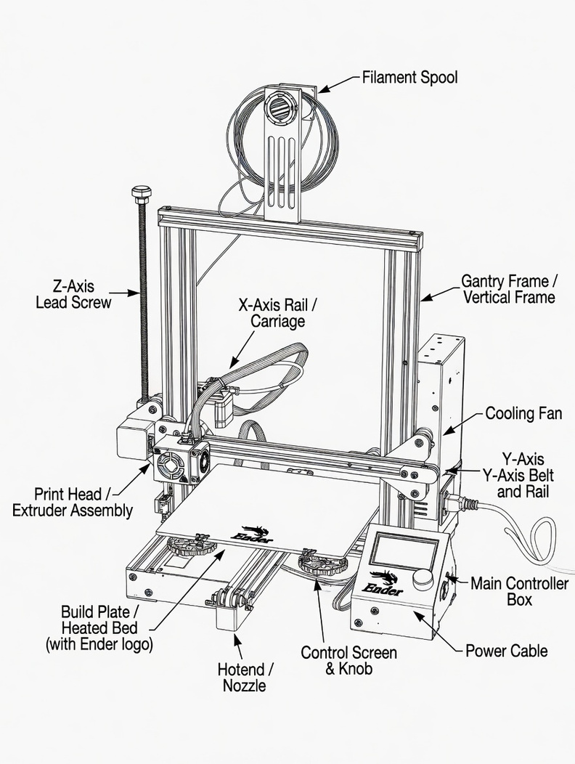
Part 1 Assembly: Step-by-Step
1
Build the Vertical Frame
Slide uprights into base. Insert M5 bolts finger-tight first, then tighten. Measure diagonals they must be equal for a square frame.
2
Z-axis Lead Screw & Motor
Attach the Z stepper to the left upright. Fit the lead screw into the coupling. Tighten both grub screws. Attach the Z limit switch at mid-height.
3
Gantry & X-axis
Slide the gantry down from the top. Thread the lead screw through the brass nut carefully. Attach the top support bracket.

Slide 5
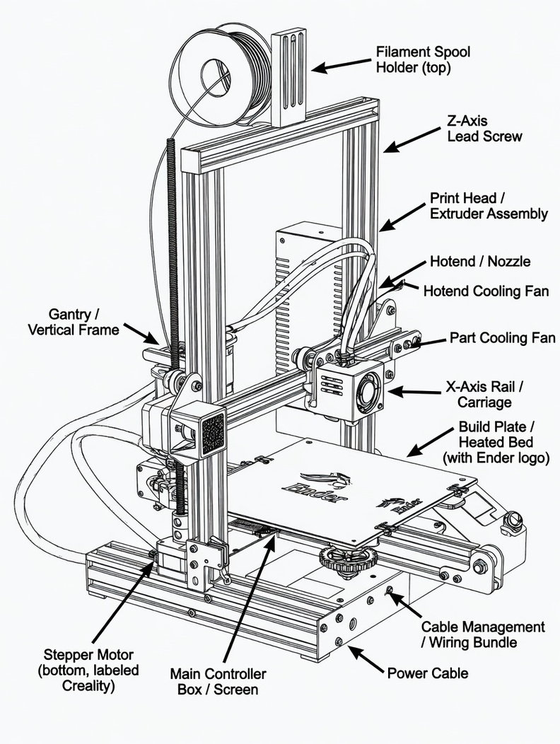
Part 1 Assembly: Step-by-Step
4
Belt Tensioning
X and Y belts should feel like a stretched elastic band firm, with slight give. Too loose = ghosting. Too tight = binding.
5
Wiring & Cables
Route cables through clips. Connect all stepper motors, heated bed, limit switches, and LCD. Check PSU voltage switch (230 V for UK).
6
First Power-On
LCD should light up. Run Auto Home and watch all axes. Confirm free movement with Disable Steppers.

Slide 6

Part 1 Wiring, Safety & First Power-On
CRITICAL! VOLTAGE SELECTOR
Before plugging in, check the red switch on the back of the PSU: set to 230 V for UK/Europe, 115 V for North America. Wrong voltage = instant damage to the PSU.
A Quick Pre-Power Checklist
✔ All stepper motors connected
✔ LCD screen cable attached
Keyed connectors, one way only
Ribbon cable, handle gently
✔ Heated bed cable connected
✔ All cables in clips
Large red/black wires to bed terminal
Nothing crossing moving paths
✔ Limit switches wired
✔ No pinched wires
X, Y, and Z end-stops to control board
Check along the frame and bed carriage

Slide 7
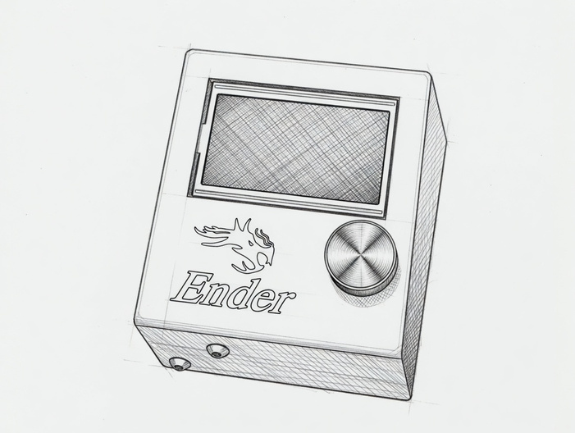
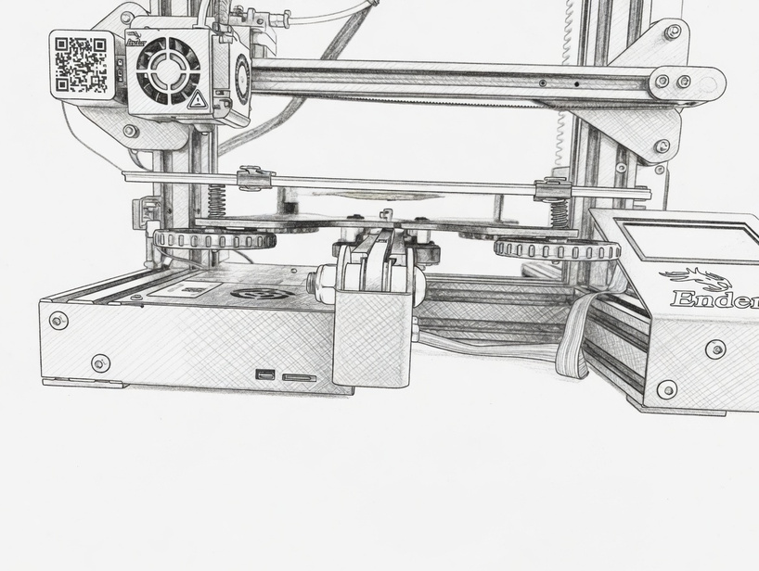
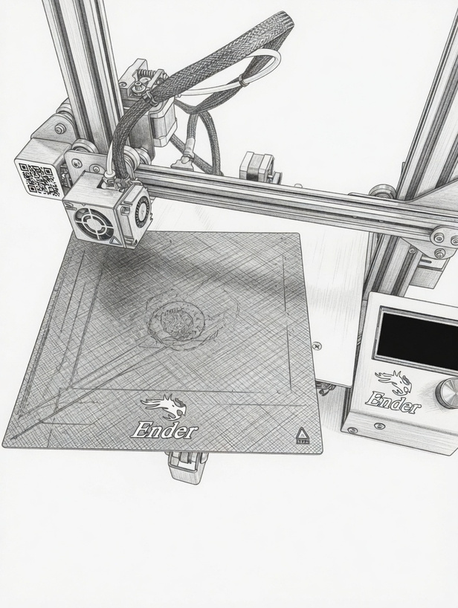
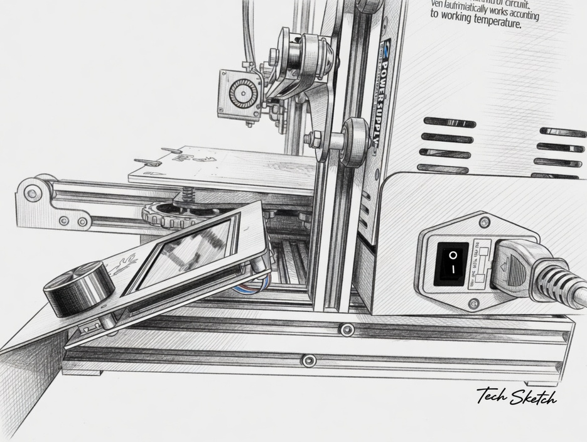
Photo Guide

Slide 8
PART 2
First-Time
Configuration
Calibrate before you print this is
where quality is won or lost.
Z-Offset
Load Filament
Menu Navigation
Bed Levelling

Slide 9
Part 2 Manual Bed Levelling (The Paper Method)
Why it matters: If the nozzle is too far from the bed, filament won't stick. Too close, and the nozzle scrapes or clogs. The goal: 0.1–0.2 mm gap (the thickness of a sheet of A4 paper).
1
Heat the bed
4
Front-Left Corner
Set to 60 °C via Prepare > Preheat PLA. Always level hot, the bed expands when warm.
Place paper under nozzle. Adjust wing nut until you feel slight resistance dragging the paper.
2
Auto Home
5
Repeat all corners
Run Prepare > Auto Home to move all axes to their start positions.
Front-Right → Back-Right → Back-Left → Centre. Repeat the full sequence 2–3 times.
3
Disable Steppers
Test with a line
6
Prepare > Disable Steppers so you can slide the print head by hand.
Run a short print and inspect the first layer before leaving the machine.

Slide 10
Part 2 Z-Offset & Loading Filament
Z-Offset Quick Reference
Filament not sticking, gaps between lines
Lower nozzle: decrease Z-offset value
Nozzle dragging or scratching bed
Raise nozzle: increase Z-offset value
First layer flat and squished
Raise nozzle slightly
Lines visible, well-fused, good adhesion
✔ Correct and no adjustment needed
Loading Filament
1
Place spool on holder. Feed filament through PTFE guide at top of frame.
2
Heat nozzle to 200 °C: Prepare > Preheat PLA > Preheat Hotend.
3
Press extruder lever, push filament down until you feel resistance at the hot end.
4
Move Axis > Extruder +10 mm until clean, smooth plastic extrudes from the nozzle.

Slide 11
PART 3
Printing Basics
From digital file to finished print,
the complete first-print workflow.
SD Card Transfer
Start & Monitor
Print Removal
Slicing in Cura

Slide 12
Part 3 Slicing Your Model in UltiMaker Cura
Hat TIP Download UltiMaker Cura free from ultimaker.com and select 'Creality Ender 3' when it asks for your printer model.
1
Import .STL
2
Position Model
3
Set Profile
Click the folder icon in Cura to load your model file.
Use Move/Scale/Rotate (left toolbar) to place the model on the build plate.
Choose Standard Quality (0.2 mm) and PLA preset.
4
Click Slice
5
Preview Layers
6
Save to SD
Cura processes the file and shows print time + material use.
Switch to Preview tab to inspect each layer visually.
Save the .gcode file to the root of the SD card.

Slide 13






Part 3 Recommended Cura Settings for Your First Print
Layer Height
Print Speed
Nozzle Temp
0.2 mm
50 mm/s
200 °C
Good balance of quality and print time. (0.1 mm = finer; 0.3 mm = faster)
Reliable for PLA. Set outer wall to 30 mm/s for better surface quality.
Starting point for PLA. Tune with a temperature tower (Section 4).
Bed Temp
Infill
Adhesion
60 °C
15–20 %
Skirt
Good adhesion for PLA on glass or PEI surfaces.
For decorative prints. Use 40 %+ for functional parts that need strength.
Traces the outline before printing to prime the nozzle. Recommended for beginners.

Slide 14
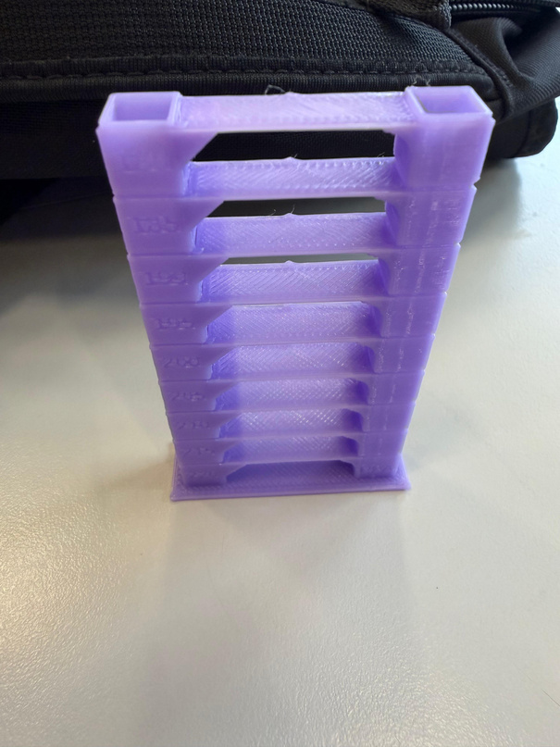
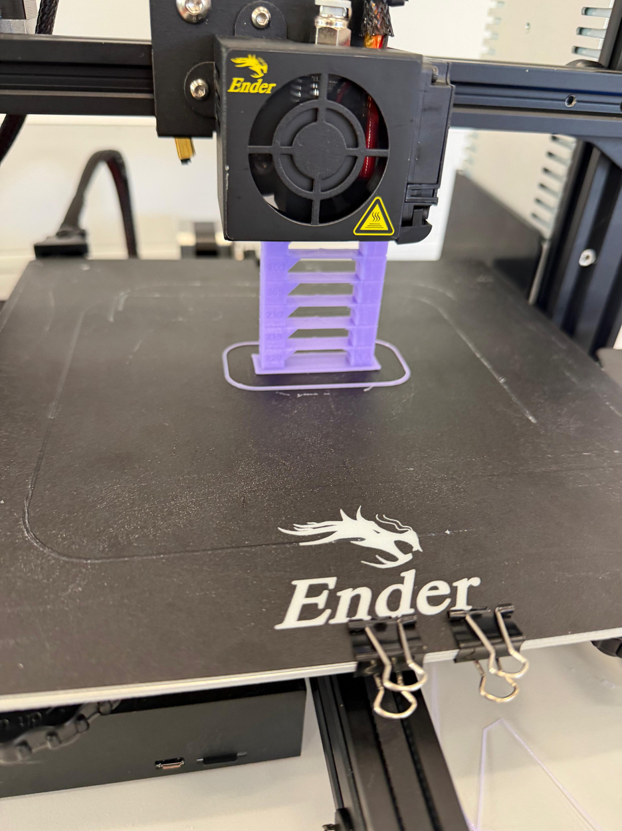

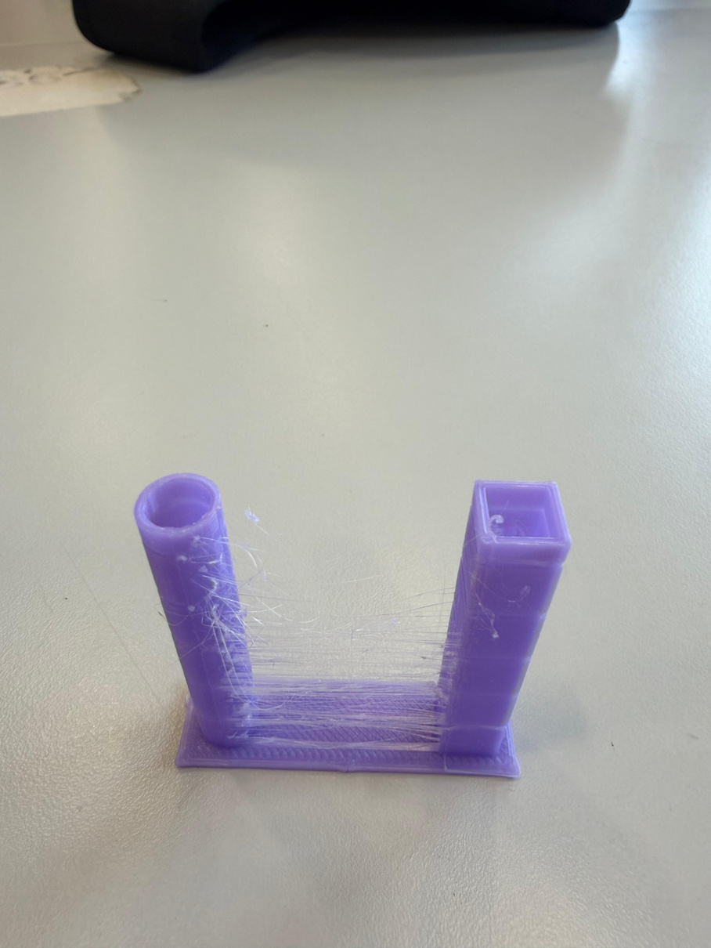
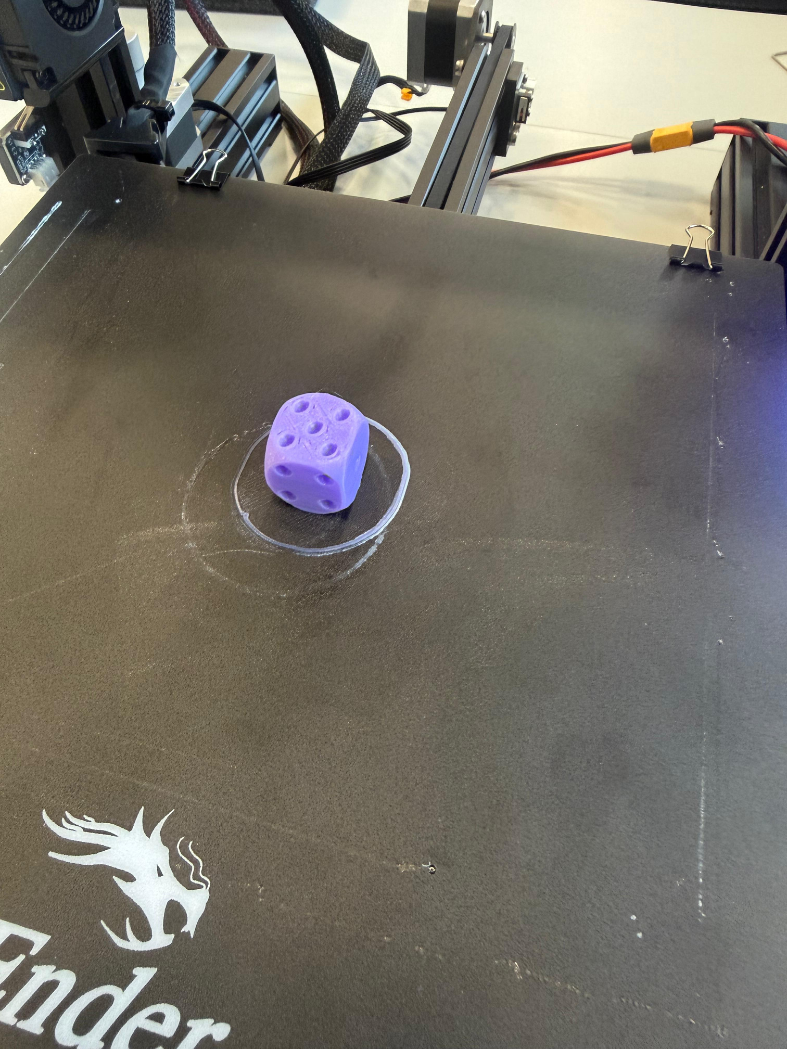
Recommended Tests
A Temperature Tower is a calibration print that tests different nozzle temperatures across multiple layers to find the optimal printing temperature for your filament. Each section of the tower is printed at a different temperature, allowing you to visually compare surface quality, bridging performance, and layer adhesion to determine the best setting for your specific filament.
A Retraction Test consists of two or more towers with open gaps between them, designed to reveal stringing, the thin unwanted threads of filament left behind as the nozzle travels between sections. By adjusting retraction distance and speed settings in your slicer, you can eliminate stringing and achieve cleaner, more professional-looking prints.
The Calibration Cube (or XYZ cube) is a small test print used to verify the dimensional accuracy of your 3D printer across all three axes. By measuring the printed cube with calipers and comparing it to the intended 20×20×20mm dimensions, you can identify and correct any scaling or step calibration issues in your printer's settings.

Slide 15
PART 4
Achieving
High-Quality Prints
Understand the settings that matter.
Run calibration prints. Tune to perfection.
Layer Height
Speed & Infill
Calibration Prints
Temperatures

Slide 16
Part 4 Temperatures, Layer Height & Infill Explained
PLA Temperature Reference
Layer Height
0.1 mm
Fine detail — miniatures & display models. Slow.
Nozzle
195–210 °C
Start at 200 °C
Bed
55–65 °C
Start at 60 °C
0.2 mm
Standard — best balance for most prints.
Fan
100%
Full after 1st layer
0.3 mm
Draft — fast prototypes. Less detail.
Enclosure
Not needed
PLA prints open-air
Infill Density
10–20 %
Decorative objects: saves time and material
30–40 %
General use: good strength for most parts
50–80 %
Functional / load-bearing components
Hat TIP Run a Temperature Tower to find the perfect nozzle temperature for each new brand of filament. Temperatures can vary by up to 15 °C between manufacturers.
100 %
Maximum strength: rarely needed

Slide 17
Part 4 Two Essential Calibration Prints
Calibration Print 1
Calibration Print 2
Temperature Tower
20 mm Calibration Cube
What it is:
What it is:
A tall test model printed in sections, each section at a different nozzle temperature (e.g. 195, 200, 205, 210 °C).
A simple 20 mm × 20 mm × 20 mm cube printed and measured with calipers to check dimensional accuracy.
How to read results:
How to read results:
Stringing between features
→ temperature too high
Layer lines not bonding
→ temperature too low
Clean overhangs, smooth surface
→ use that section's temperature
Off by > 0.3 mm on X or Y
→ adjust Steps/mm in Control > Motion
Walls too thin or thick
→ check extrusion multiplier
Consistent 20 mm ± 0.2 mm
→ printer is well calibrated
Hat TIP Search 'temperature tower' on Printables.com for a ready-made model with automatic temperature changes via G-code.
NOTE Always save Control > Store Settings after any calibration change so it persists after power-off.

Slide 18
PART 5
Trouble
shooting
Diagnose and fix the 8 most common
problems you will encounter.

Slide 19
Part 5 Troubleshooting: Common Problems & Fixes
Print not sticking to bed
Stringing between features
Causes: Bed not level • Nozzle too high • Bed not warm
Causes: Nozzle too hot • Low retraction
Fix: Re-level bed. Lower Z-offset. Check bed temp (60 °C for PLA). Clean surface.
Fix: Lower nozzle temp by 5 °C. Increase retraction to 5–6 mm. Run temp tower.
Clogged nozzle
Layer shifting
Causes: Wrong temp • Debris in filament • Cold pull needed
Causes: Loose belt • Print speed too fast • Obstruction
Fix: Heat to 220 °C and push filament through. Do a cold pull. Replace nozzle if blocked.
Fix: Tension X and Y belts. Reduce speed to 40 mm/s. Check for obstructions.
Warping / corners lifting
Under-extrusion
Causes: Bed too cold • PLA cooling too fast • No adhesion
Causes: Extruder skipping • Partial clog • Temp too low
Fix: Increase bed temp to 65 °C. Add brim in Cura. Clean bed with IPA.
Fix: Check extruder tension spring. Clean PTFE tube. Raise nozzle temp 5 °C.
Elephant's foot (1st layer spreads)
Visible layer lines / poor surface
Causes: Nozzle too close to bed • Bed too hot
Causes: Layer height too high • Speed too fast
Fix: Raise Z-offset slightly. Lower bed temp to 55 °C.
Fix: Reduce layer height to 0.1–0.15 mm. Slow outer walls to 25–30 mm/s.

Slide 20
Do NOT Forget!
PLA Temperatures
Starter Print Settings
Key Menu Paths
Nozzle:
200 °C
Layer Height:
0.2 mm
Auto Home:
Prepare > Auto Home
Bed:
60 °C
Print Speed:
50 mm/s
Preheat PLA:
Prepare > Preheat PLA
Fan:
100% (after L1)
Infill:
15–20%
Bed Level:
Prepare > Bed Levelling
Enclosure:
Not needed
Walls:
3 (1.2 mm)
Save Settings:
Control > Store Settings
Safety Rules
✔ DO
Always level the bed with the bed at printing temperature
✔ DO
Store Settings after every calibration change
✔ DO
Monitor the first few layers of every print
✔ DO
Let the bed cool before removing prints
✘ DON'T
Never load/unload filament with a cold nozzle
✘ DON'T
Never touch the nozzle or bed during printing
✘ DON'T
Don't force anything — if it resists, check alignment
✘ DON'T
Don't leave printing overnight without monitoring first

Slide 21
You're Ready to Print!
Assembled & Wired
Calibrated
First Print Done
Quality Tuned
Ready to Troubleshoot
Frame built square, belts tensioned, wiring tidy and voltage checked.
Bed levelled, Z-offset set, filament loaded and purged.
Model sliced in Cura, saved to SD, printed and removed safely.
Temperature tower and calibration cube printed and adjusted.
Know how to identify and fix the 8 most common problems.

