Slide 1
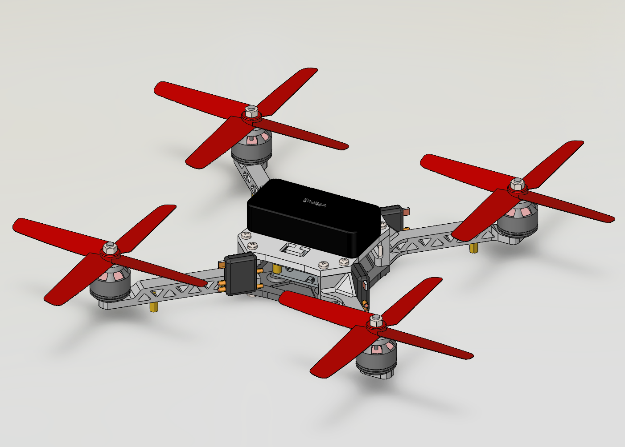
QUADCOPTER DRONE
A lightweight racing and military‑grade quadcopter – key components and their functions
Battery and Electronics
High-capacity LiPo battery powers all systems.
Flight controller and ESCs manage motor speed and stability etc.
FRAME & CHASSIS
Frame is made from lightweight aluminum and carbon fiber composite.
Provides structural integrity and mounting for all components etc.
INTERNAL CIRCUIT
Complex Printed Circuit Board (PCB) integrates flight controller, power distribution, ESCs, and sensors.
Manages data, power flow, and communication between all components for stable flight and control etc.
PROPELLERS
Four red polymer propellers generate lift. Spin at high RPM co provide thrust and maneuverability etc.
MOTORS
Brushless DC motors drive each propeller. ETCETCETC.

Slide 2
Render view

Slide 3
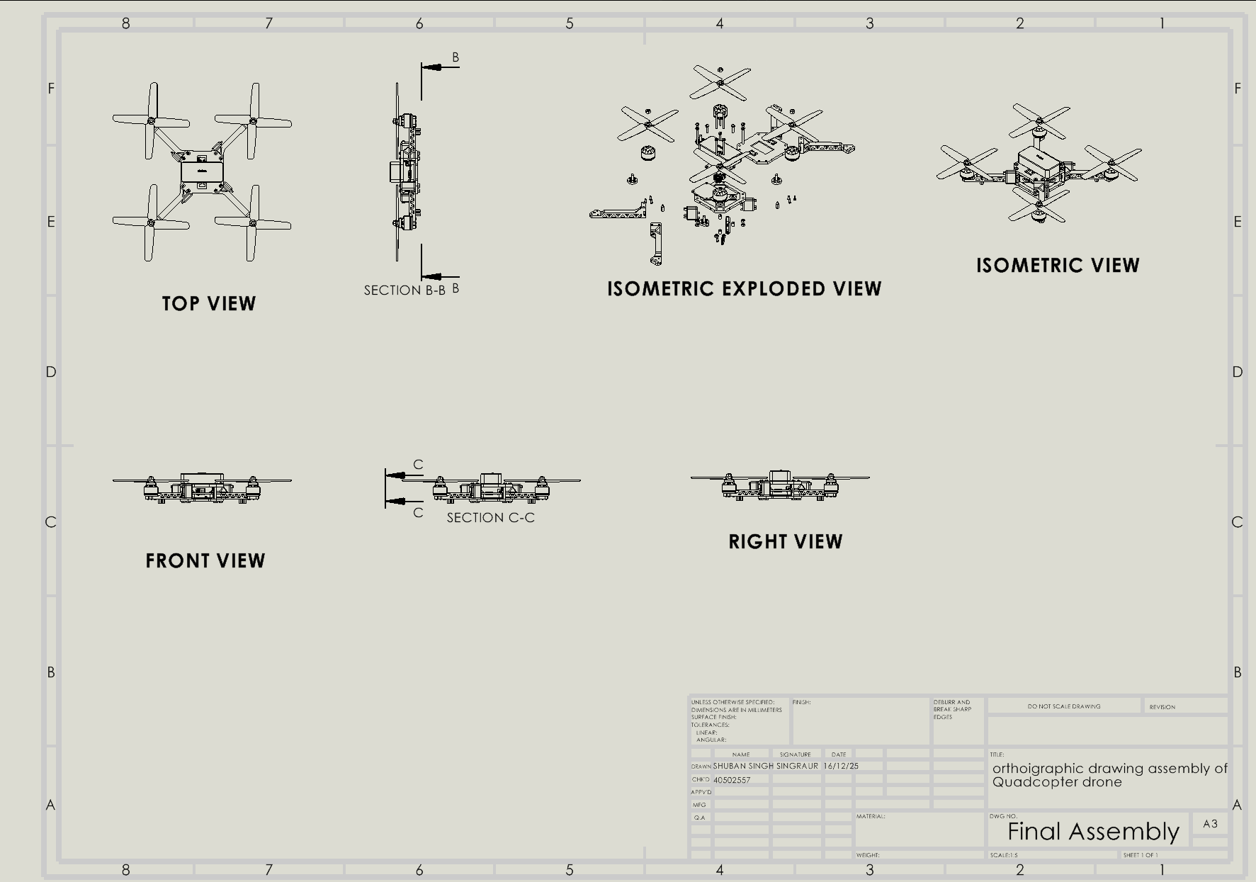

Slide 4
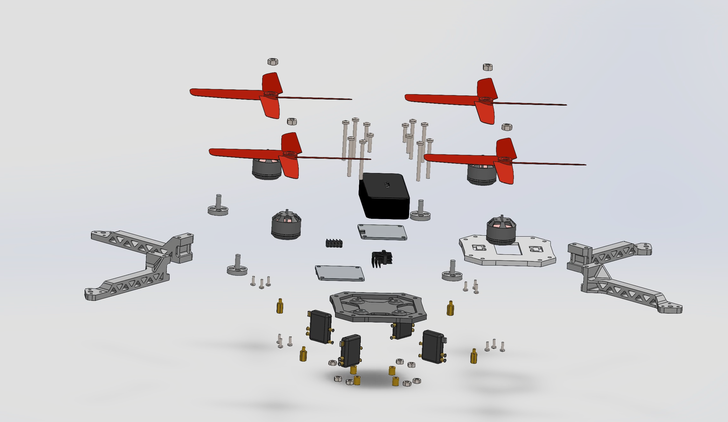
Exploded View of the drone

Slide 5
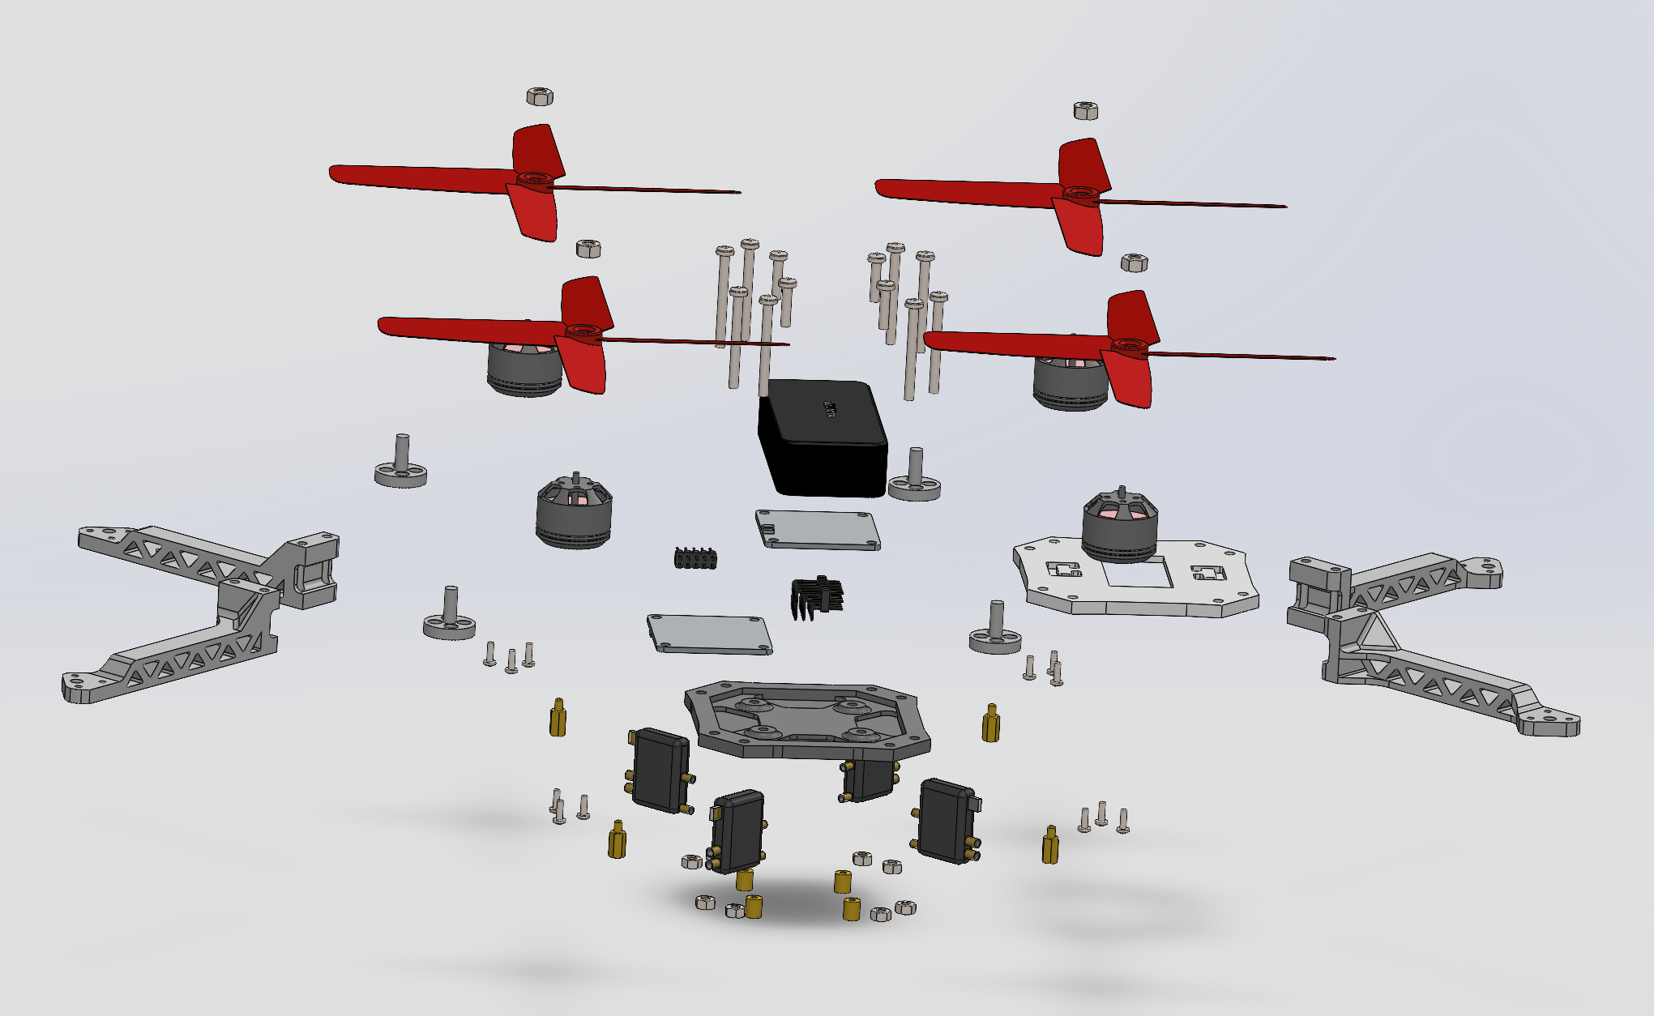
9
11
5
2
4
12
3
6
1
8
7

Slide 6
No. | PART | MATERIAL | NUMBER
1 | Drone Base | Thornel VCB-20 Carbon Cloth | X1
2 | Drone Top | Thornel VCB-20 Carbon Cloth | X1
3 | Distribution Board | E-Glass Fiber | X2
4 | Drone Arm | Aluminum Alloy 7075-T6 (SN) | X4
5 | Spinner | Aluminum Alloy 7075-T6 (SN) | X4
6 | Spacer | POM Acetal Copolymer | X4
7 | Electrical connector | Copper | X4
8 | Piller | Aluminum Alloy 6063 – T6 | X4
9 | Fan | Nylon 6/10 | X4
10 | Motor | Aluminum Alloy 6061 – T6 (SS) | X4
11 | Battery | Aluminum Alloy 6061 – T6 (SS) | X1
12 | Electrical Unit | Beryllium Copper, UNS C17000 | X2

Slide 7
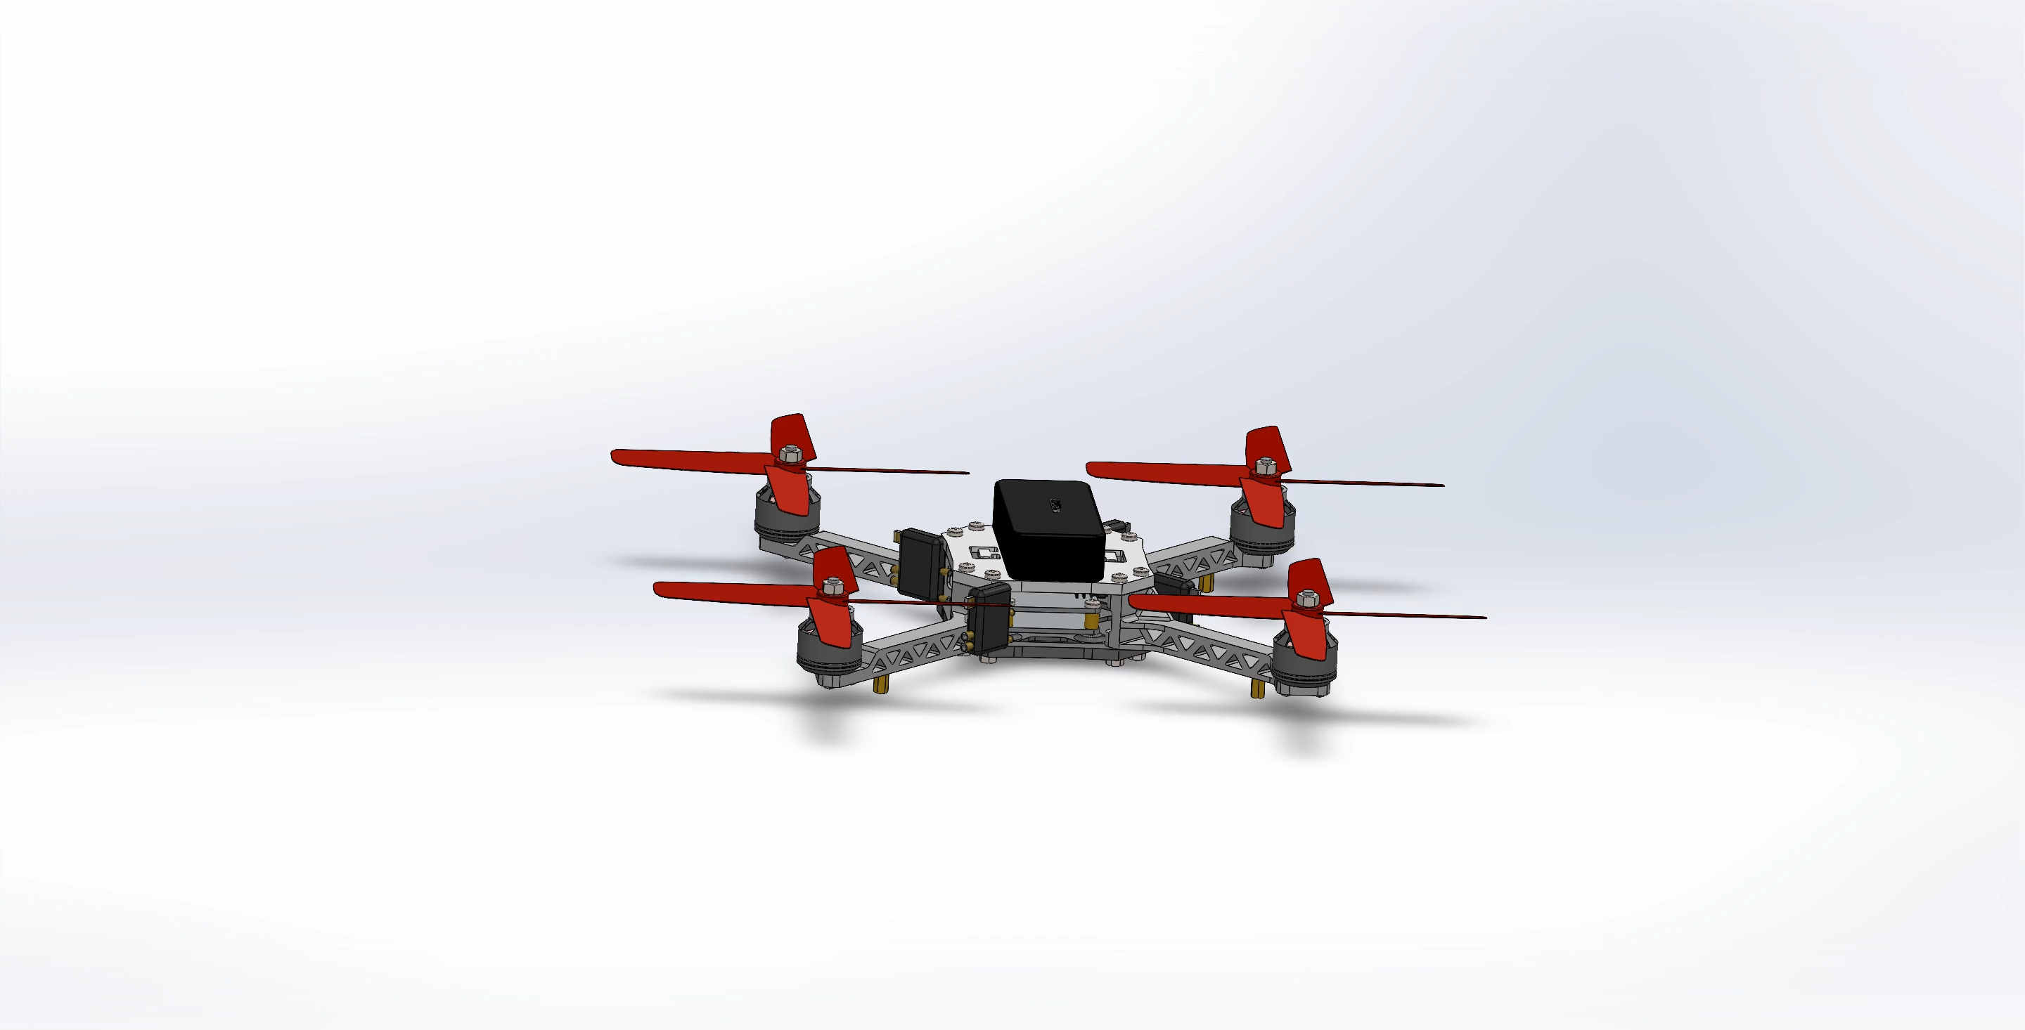
Animated Exploded View

Slide 8
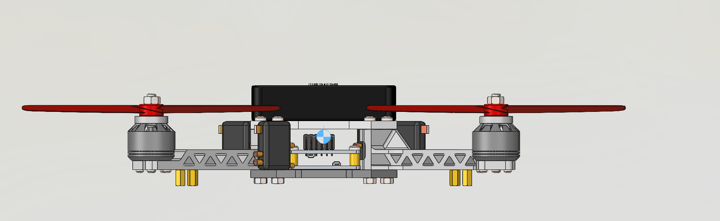
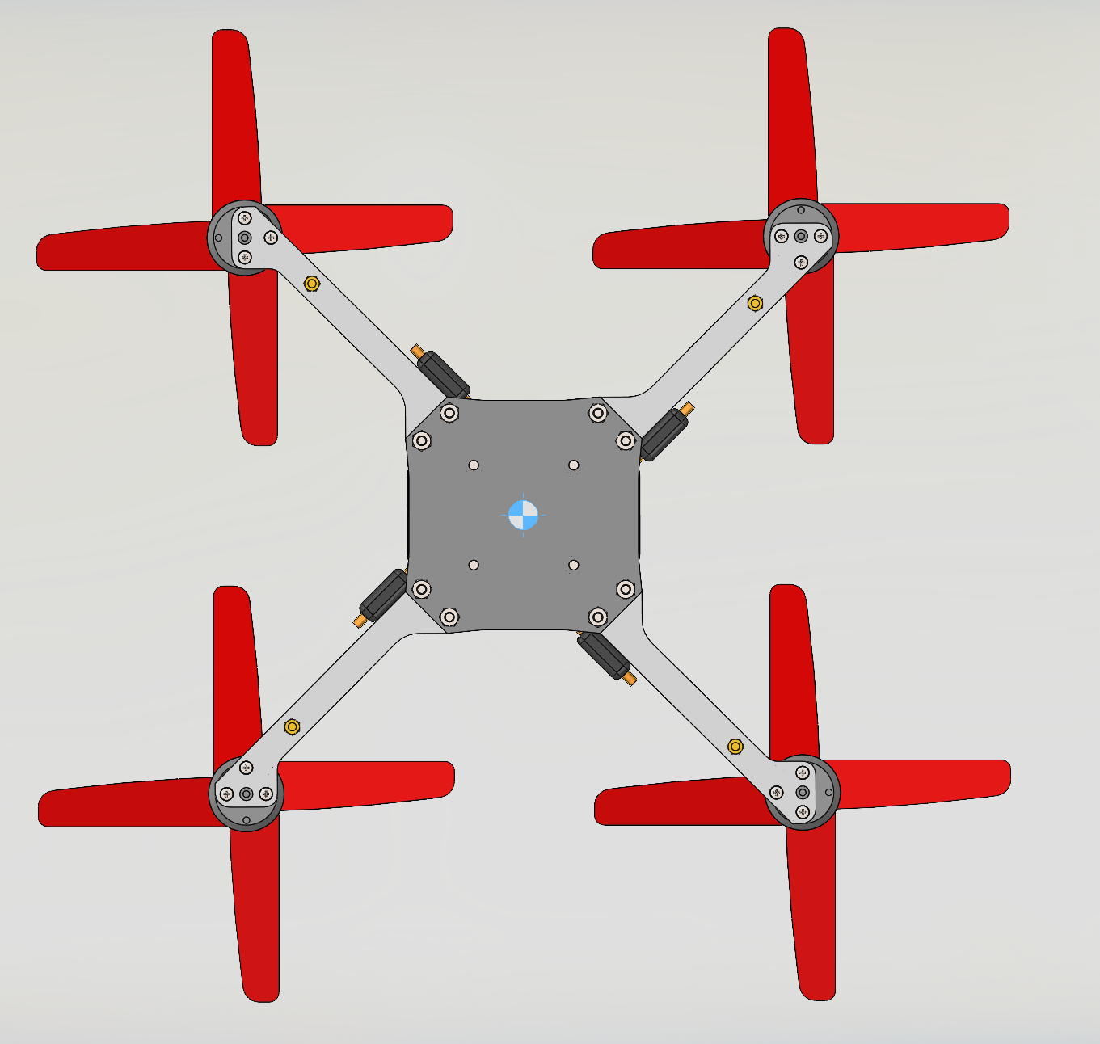
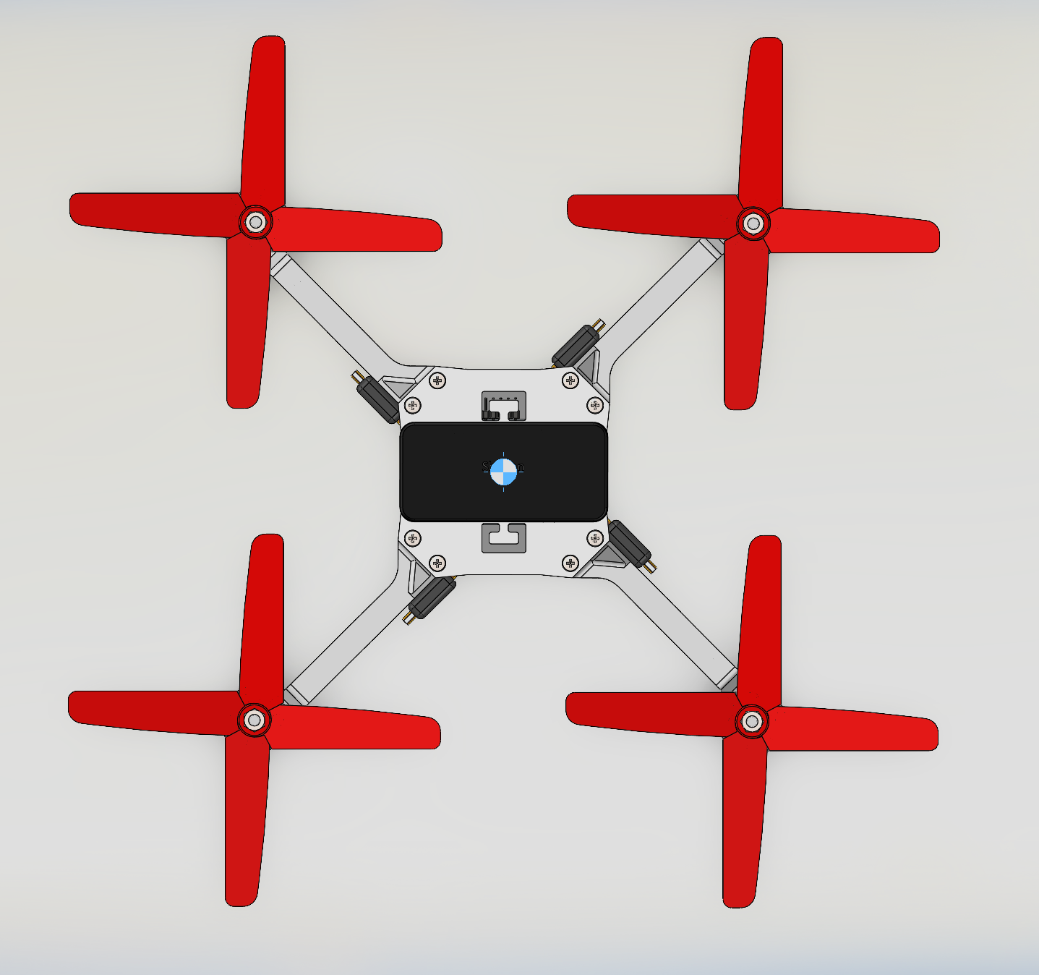
Centre of Gravity
Center of mass: (millimeters )
X = -0.10
Y = 888.42
Z = -0.11
Center of mass: ( millimeters )
X = -0.10, Y = 888.42, Z = -0.11

Slide 9
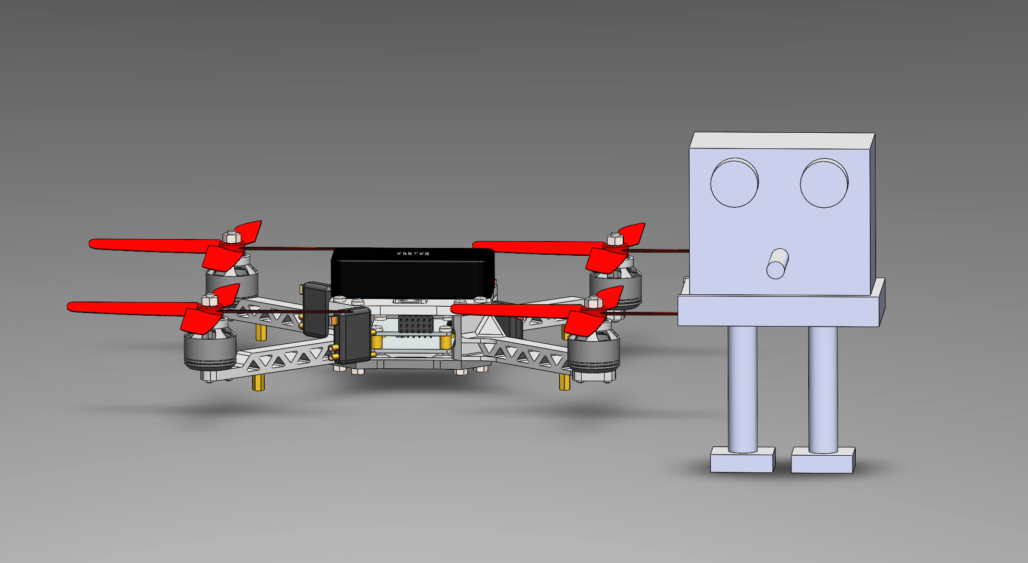
Person beside assembly for scale
1.5m/4.9ft

Slide 10
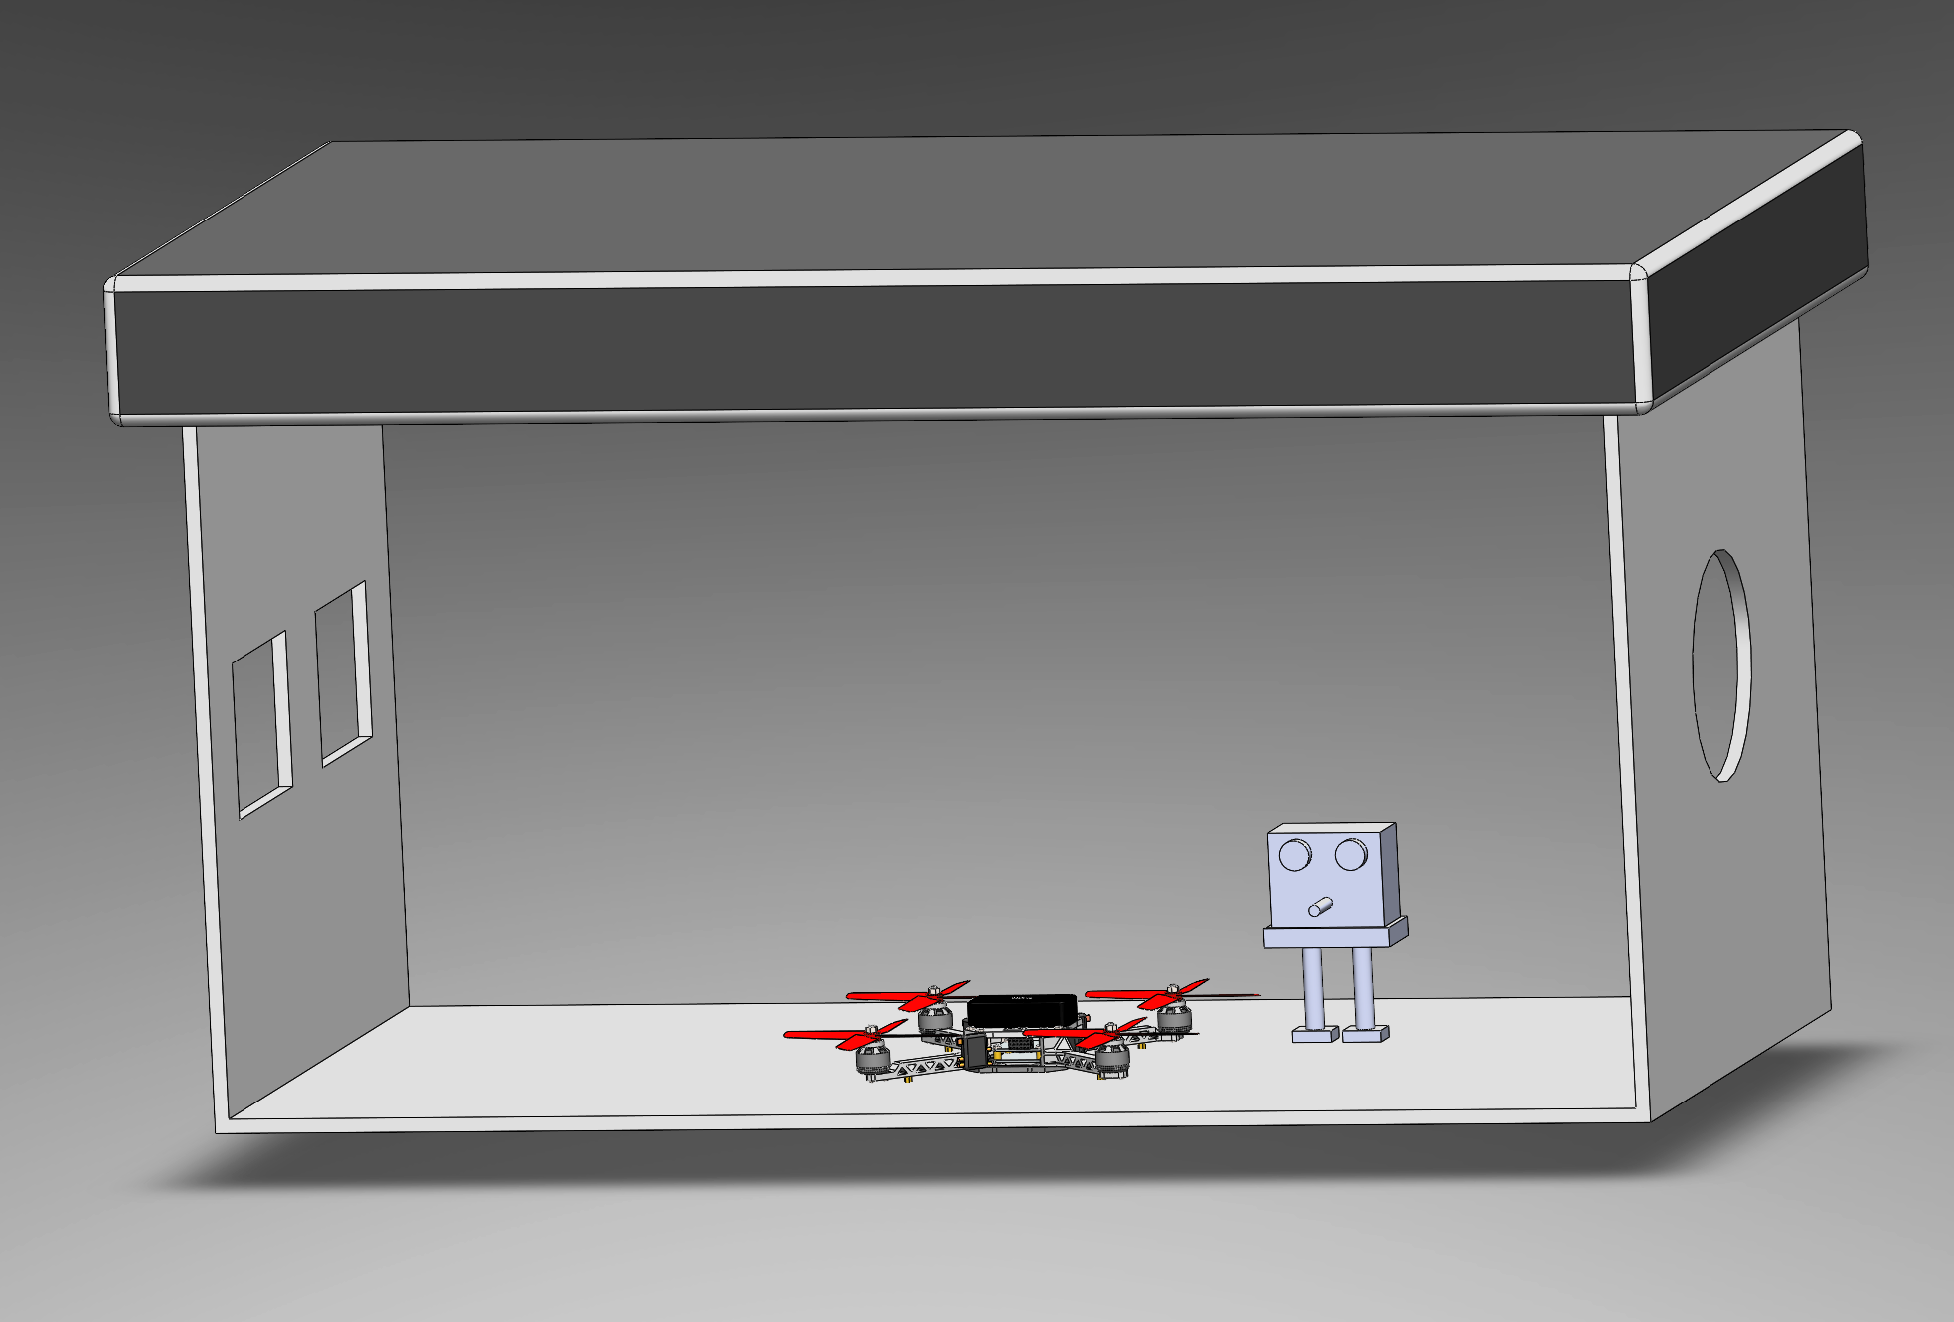
Drone in a factory

Slide 11
Reference Description | Link/Source
How to draw drone | https://youtu.be/S63-oIvJGlw?si=b-Ex8X7R6VFaKXF1
Creating Exploding View | https://youtu.be/S63-oIvJGlw?si=0cQx6Ps7nmZuYFN7
How to add center of mass | https://youtu.be/uKR4L9UuHhM

