Slide 1




⭐⭐⭐⭐⭐
5-stars
Star Rating System

Slide 2





1
Shubhranil Karmakar
UNI.ROLL:11771024059
Team
2
SK Dilraj Mahammad
UNI.ROLL: 11771024061
3
Surjendu Nandi
UNI.ROLL:11771024069

Slide 3
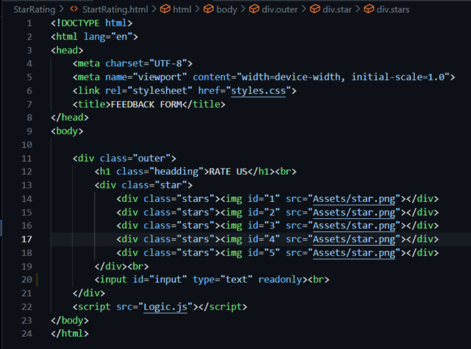
HTML
1

Slide 4
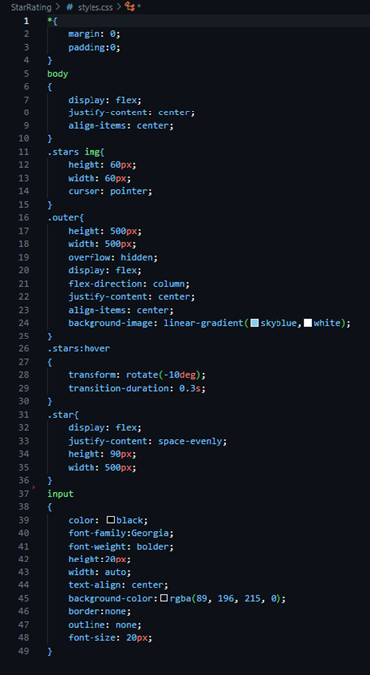
2
CSS

Slide 5
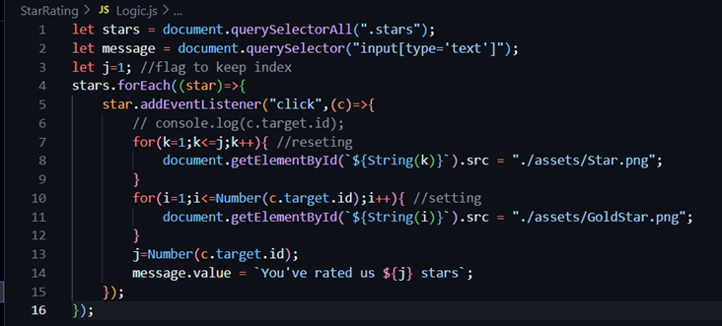
Java Script
3

Slide 6

Introduction
The star rating system is a widely adopted user interface component designed to allow users to provide feedback on products, services, or experiences by assigning a rating, typically on a scale of one to five stars. Developed as part of our Mobile and Web Development paper, this star rating webpage leverages HTML for structure, CSS for styling, and JavaScript for interactivity to create an intuitive and responsive feedback mechanism. The system enables users to visually express their satisfaction level, making it a critical tool for businesses and service providers to gauge user sentiment and improve offerings.

Slide 7
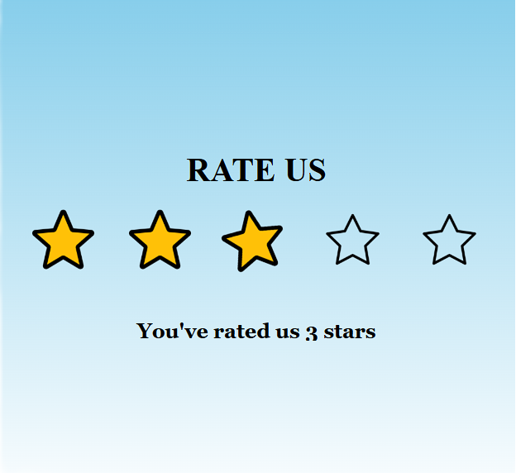
Need For Star Ratings?
User Feedback Collection: It provides a simple, standardized method for users to share their opinions, reducing the complexity of feedback submission.
Service Quality Assessment: Businesses require measurable data to evaluate customer satisfaction and identify areas for improvement.
User Engagement: An interactive and familiar interface encourages users to engage with the platform, increasing participation rates.

Slide 8
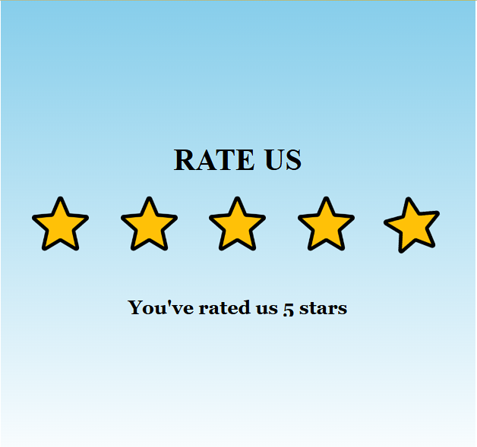
Use Of Star Rating System
E-Commerce: Allows customers to rate products, aiding others in purchase decisions (e.g., Amazon, eBay).
Service Industries: Used in hospitality, ride-sharing, and food delivery apps (e.g., Uber, Airbnb) to evaluate service quality.
Content Platforms: Enables rating of movies, music, or articles (e.g., IMDb, Spotify) to reflect user preferences.

Slide 9
Changes Brought By Star Rating
Improved Service Quality: Real-time feedback enables businesses to address issues promptly, leading to enhanced customer experiences.
Increased Transparency: Publicly visible ratings foster trust by showcasing authentic user opinions, influencing consumer behavior.
Competitive Advantage: Services with higher ratings attract more customers, pushing providers to maintain high standards.

Slide 10
Thanks for rating us

