Slide 1


GUJARAT TECHNOLOGICAL UNIVERSITY, AHMEDABAD
K. D. POLYTECHNIC, PATAN (GTU CODE: 631)
Department of Computer Engineering | Academic Year: 2026-27
A MINOR PROJECT PRESENTATION ON
“DineFlow AI: Next-Generation Restaurant Cloud POS,
Contactless QR Ordering, Real-Time KDS & Smart ERP System”
Subject Code: DI05000341 | Diploma Computer Engineering | Semester 5th
Candidate & Project Lead
Student Name: PATEL SHUBH MAHESHKUMAR
Enrolment No: 246310307123
Program & Sem: Diploma Computer Engineering (Sem 5)
Institutional Role: Team Lead / Full-Stack & Cloud Engineer
Project Guide & Department
Internal Guide: Prof. Yagnesh Patel
Designation: Lecturer, Computer Engineering Dept.
Head of Dept: Dr. Chirag D. Patel (HOD, Computer Engg.)
Principal: Shri H. C. Parmar, K. D. Polytechnic, Patan

Slide 2
EXECUTIVE ROADMAP
Presentation Agenda
DI05000341
Part I: Architecture & Design
01. Problem Statement & Context: Operational bottlenecks, communication lags & terminal cost barriers.
02. Project Objectives: 5 measurable engineering targets: Speed, QR, KDS, BOM & Offline Sync.
03. Literature Survey & Gap: Competitive benchmark against Petpooja, Toast POS, Posist & manual ECR.
04. Alternative Technical Solutions: Architectural trade-off analysis (Desktop vs Embedded vs Cloud Hybrid).
05. General Block Diagram: 4-tier architecture: Input, Core Logic, Storage & Actuator Tiers.
06. Detailed Circuit & Process Diagram: Kitchen order lifecycle & 24V RJ11 solenoid hardware wiring circuit.
Part II: Execution, Verification & Vision
07. System Flowchart & Algorithm: Stock validation, order transaction logic & offline SQLite backoff sync.
08. 15-Week Work Plan: Semester implementation schedule mapped to GTU Seminars 1 to 4.
09. Prototype / Model Development: Live Web POS counter terminal interface & 80mm ESC/POS printer.
10. Testing, Results & Modifications: 41 unit tests, sub-180ms latency benchmarks & GTU Competency 15 fixes.
11. Conclusion & Future Scope: Technical achievements vs objectives, AI voice & predictive ERP roadmap.
12. Commercial Startup Vision & Q&A: SaaS business roadmap, APA 7th references & External Viva discussion.
K. D. Polytechnic, Patan | Department of Computer Engineering | Minor Project (DI05000341) | Slide 2 of 17

Slide 3
BACKGROUND & NEEDS
Problem Statement & Industry Context
DI05000341
1. Prohibitive Capital Cost Barrier
Hardware Lock-in: Commercial POS vendors demand ₹25,000 - ₹50,000 per cash counter for proprietary terminals.
Recurring Squeeze: Annual maintenance contracts (AMC) and forced payment gateway fees strain independent restaurant margins.
2. Kitchen Communication Lag
Paper Slips Friction: Manual handwritten KOTs walk to kitchen, causing 8-14 minutes communication lag during peak dining rushes.
Transcription Errors: Illegible handwriting leads to wrong dish preps, food wastage, and server frustration.
3. Fragile Cloud Dependency
Broadband Failure: Cloud-only web POS systems halt completely during local ISP outages, freezing billing counters.
Data Loss: Offline crash states cause lost orders and unreconciled cash drawer balances.
4. Blind Recipe Inventory Shrinkage
Unlinked Stock: Lack of automated Recipe Bill-of-Materials (BOM) deduction causes mid-service dish stockouts.
Shrinkage: Untracked raw ingredients allow 12-18% unaccounted kitchen shrinkage and pilferage.
K. D. Polytechnic, Patan | Department of Computer Engineering | Minor Project (DI05000341) | Slide 3 of 17

Slide 4
ENGINEERING SCOPE
Project Objectives & Measurable Targets
DI05000341
Objective 1: Hardware-Agnostic Web POS
Target: Sub-180ms input latency on any commodity browser (PC, Mac, Android, iOS).
Achievement: Keyboard-driven fast checkout with F1-F9 express keys, table grid matrix, and direct thermal printing.
Objective 2: Frictionless QR Customer Ordering
Target: Zero-app download mobile PWA loading in under 1.5 seconds.
Achievement: Dynamic menu with modifiers ('Extra Cheese'), multilingual Gujarati voice assistant, and live tracking.
Objective 3: Real-Time Kitchen Display System (KDS)
Target: KOT push latency under 180ms from checkout to chef monitor.
Achievement: Sub-145ms WebSocket dispatch with preparation timers, course firing, and audio chimes.
Objective 4: Automated Recipe BOM Inventory Control
Target: Instant raw ingredient deduction upon order placement with zero manual entry.
Achievement: Real-time stock depletion across multiple ingredients with automated low-stock reorder alerts.
Objective 5: Offline Resilience & Delta Sync
Target: 100% continuous billing operation during internet outages with zero data loss.
Achievement: Local SQLite delta queue with automatic exponential backoff cloud reconciliation upon reconnect.
K. D. Polytechnic, Patan | Department of Computer Engineering | Minor Project (DI05000341) | Slide 4 of 17

Slide 5
COMPETITIVE BENCHMARKING
Literature Survey & Research Gap Analysis
DI05000341
Parameter | Petpooja | Toast POS | Posist (Restroworks) | DineFlow AI
Architecture | Windows Desktop App | Android Proprietary HW | Cloud Enterprise Web | Cloud-Native Multi-Tenant
Hardware Cost | ₹15,000 - ₹25,000 | ₹65,000 - ₹1,20,000 | ₹20,000 - ₹35,000 | ₹0 (BYOD Any Device)
Monthly Fee | ₹800 - ₹1,500/mo | ₹5,500 - ₹8,500/mo | ₹2,500 - ₹4,500/mo | ₹499 - ₹999/mo (SaaS)
Offline Sync | Local Windows DB | Limited Offline | Poor (Web Dependent) | Local SQLite Delta Queue
Identified Research Gap & Innovation
The Market Dilemma: Operators currently face a binary choice: either buy expensive proprietary hardware (Petpooja/Toast) or endure fragile browser tools.
DineFlow AI Solution: Bridges this gap by marrying zero-cost multi-tenant web architecture with client-side SQLite offline resilience and raw ESC/POS binary printing.
K. D. Polytechnic, Patan | Department of Computer Engineering | Minor Project (DI05000341) | Slide 5 of 17

Slide 6
ARCHITECTURAL DECISION
Alternative Solutions & Selection Justification
DI05000341
Option A: Desktop Monolith (.NET / MSSQL)
Pros: High local GUI speed; offline by default.
Cons: Tied to Windows x86 hardware; remote branch management impossible; high installation friction.
Verdict: REJECTED (High maintenance & zero mobility).
Option B: Dedicated Embedded Hardware (RPi)
Pros: Compact footprint; lower component cost than PC.
Cons: Custom PCB required; supply-chain chip shortages; difficult field repairs in rural restaurants.
Verdict: REJECTED (Hardware failure risk).
Option C: Cloud Hybrid Multi-Tenant (DineFlow AI)
Pros: BYOD freedom (runs on existing laptops/phones); instant updates; local SQLite offline queue.
Cons: Requires careful multi-tenant security modeling (IDOR defense).
Verdict: SELECTED (Optimal balance of reliability & ₹0 cost).
Environmental & Safety Justification
Green Tech: Paperless WhatsApp receipts eliminate BPA toxic chemical exposure; BYOD paradigm drastically curtails electronic e-waste; single-schema cloud reduces server energy.
K. D. Polytechnic, Patan | Department of Computer Engineering | Minor Project (DI05000341) | Slide 6 of 17

Slide 7
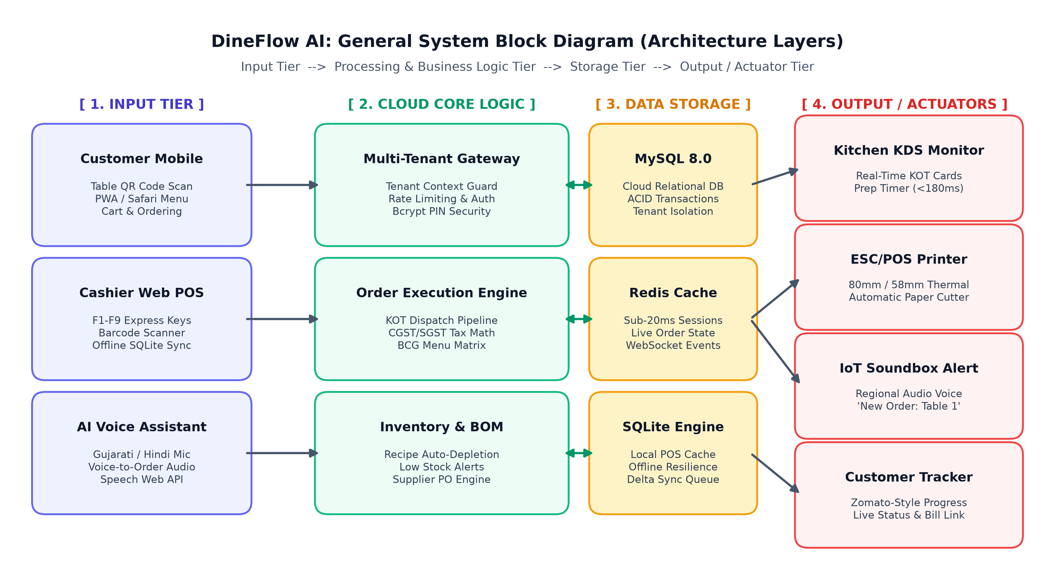
SYSTEM ARCHITECTURE
General Block Diagram
DI05000341
Architectural Tiers
Tier 1: Input Table QR mobile scan, cashier Web POS (F1-F9 keys), and Gujarati Voice AI.
Tier 2: Cloud Logic Multi-Tenant Context Scope, KOT Routing, CGST/SGST Tax Math & BOM Inventory.
Tier 3: Storage Cloud MySQL 8.0 ACID database, Redis in-memory cache, and local SQLite.
Tier 4: Actuators Kitchen KDS screen (<180ms), 80mm ESC/POS printer, & 24V RJ11 cash drawer.
K. D. Polytechnic, Patan | Department of Computer Engineering | Minor Project (DI05000341) | Slide 7 of 17

Slide 8
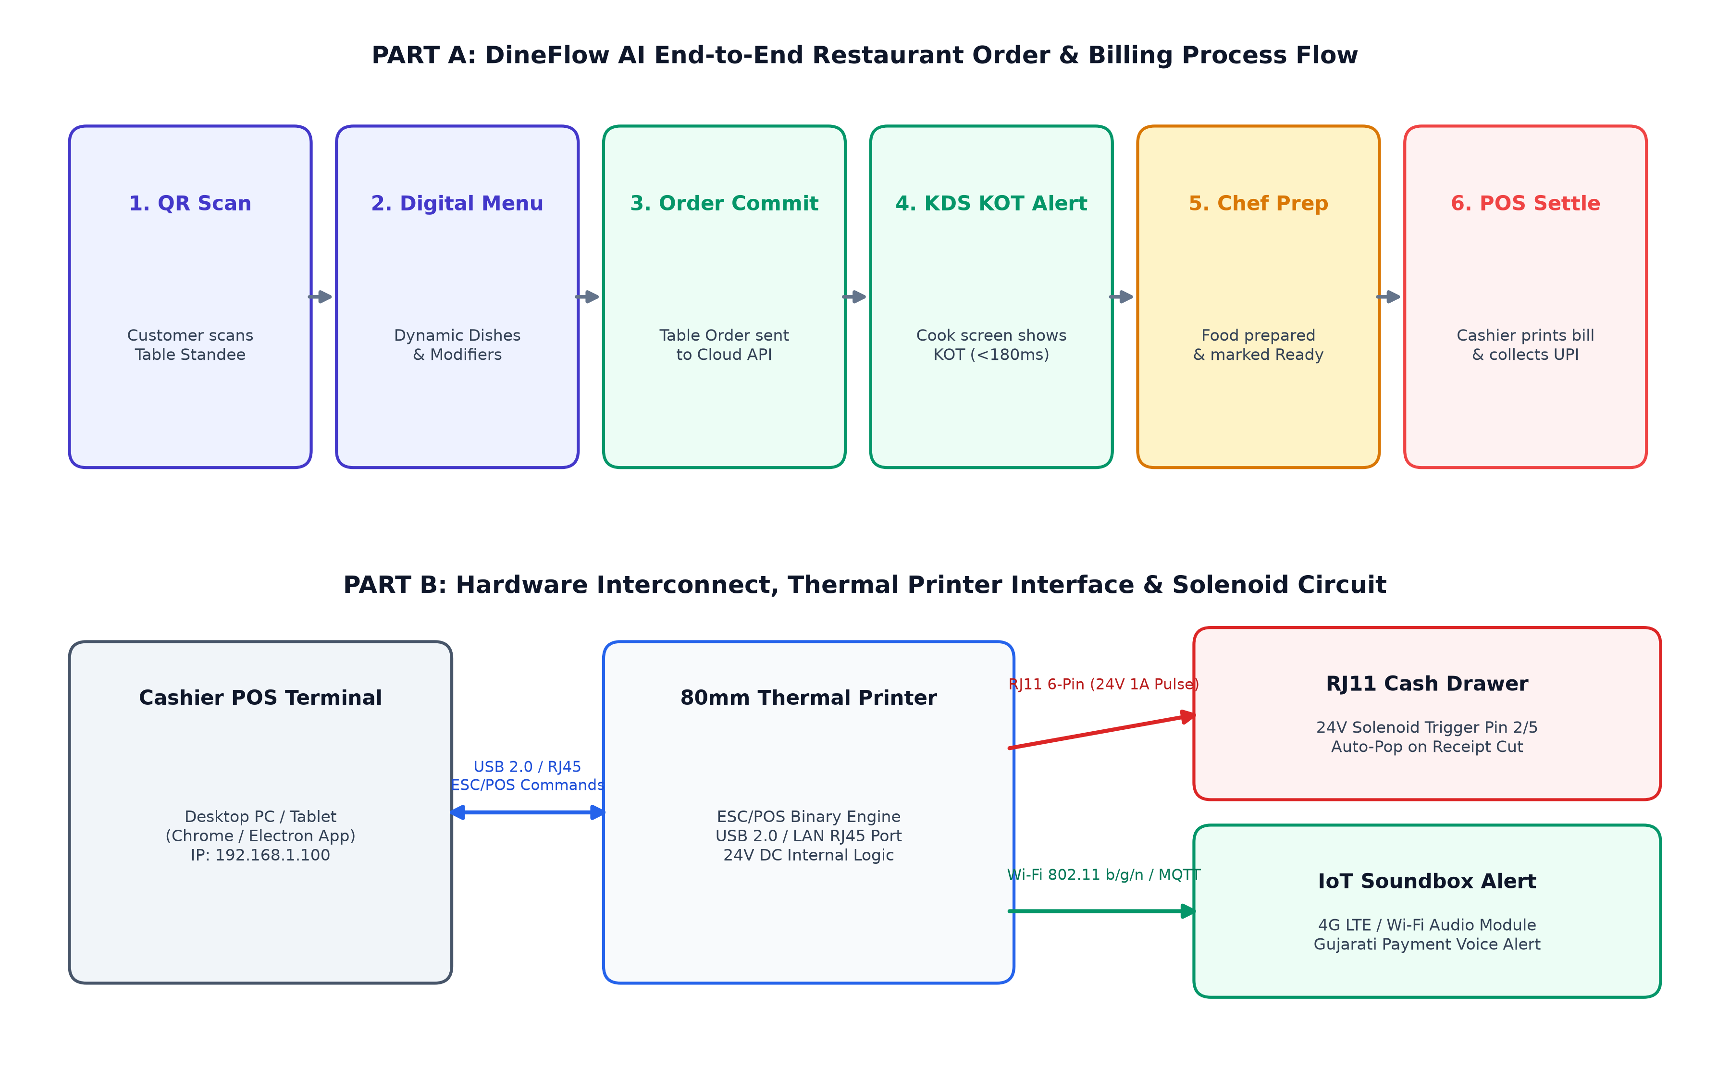
PROCESS & HARDWARE WIRING
Detailed Circuit / Design Diagram
DI05000341
Circuit & Flow Details
Part A: Process Flow QR scan -> Dynamic menu -> Cloud API commit -> Kitchen KDS alert -> Food prep -> POS settle & bill.
Part B: Hardware Circuit Cashier terminal links via USB 2.0 / LAN RJ45 to 80mm thermal printer.
24V Solenoid Trigger On receipt cut, printer energizes Pin 2 of RJ11 port with 24V DC 1A pulse (250ms), popping open the steel cash drawer.
K. D. Polytechnic, Patan | Department of Computer Engineering | Minor Project (DI05000341) | Slide 8 of 17

Slide 9
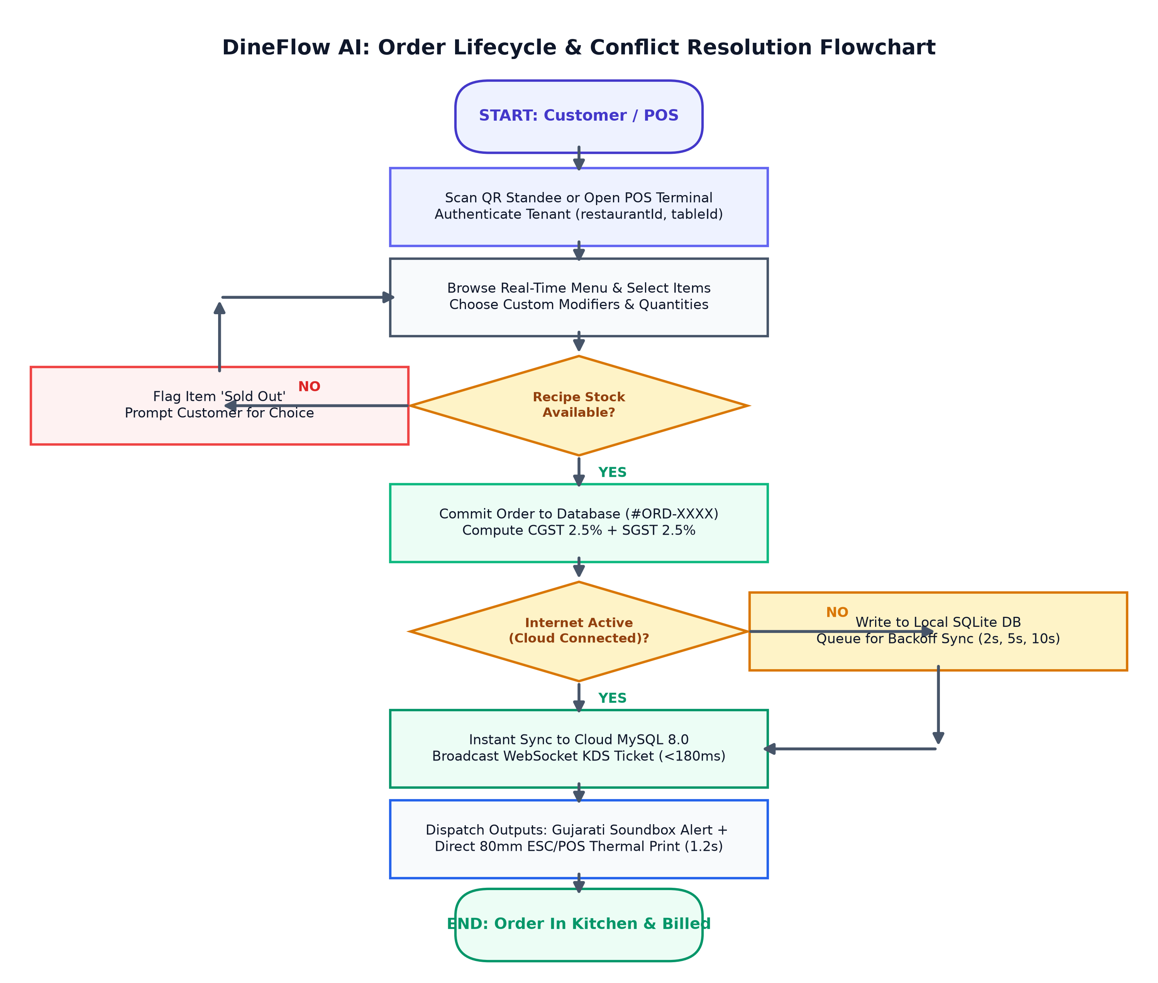
EXECUTION & OFFLINE SYNC LOGIC
Algorithm / Flowchart
DI05000341
Formal Algorithm Steps
Step 1: Session Auth: Validate tenant restaurant_id and table occupancy context.
Step 2: BOM Stock Check: Query recipe inventory; reject order with HTTP 422 if stock depleted.
Step 3: ACID Transaction: Begin SQL transaction: generate sequential #ORD-XXXX, compute 2.5% CGST + 2.5% SGST.
Step 4: Recipe Depletion: Deduct raw ingredients from inventory; trigger low-stock alerts if stock <= threshold.
Step 5: KDS Dispatch: Push real-time KOT to kitchen monitor in under 180ms via WebSocket/Redis.
Step 6: Offline Resilience: If network drops, write to local SQLite queue; auto-sync via exponential backoff upon reconnect.
K. D. Polytechnic, Patan | Department of Computer Engineering | Minor Project (DI05000341) | Slide 9 of 17

Slide 10
MILESTONE TRACKING
Work Plan (15-Week Semester Schedule)
DI05000341
Semester Weeks | Curriculum Phase | Engineering Deliverables | GTU Milestone Review
Weeks 1 - 4 | Problem & Architecture | Eatery surveys, SRS specification, 14-table MySQL 3NF schema | Seminar 1: Architecture Approved
Weeks 5 - 8 | Backend & Web POS | Laravel 11 multi-tenant auth, bcrypt PIN, F1-F9 keyboard POS | Seminar 2: Core POS Prototype
Weeks 9 - 12 | Mobile & Hardware | Customer QR menu PWA, React Native app, 80mm ESC/POS printer | Seminar 3: Integrated System
Weeks 13 - 14 | Testing & Cloud Deploy | 41 automated unit tests, latency benchmarks, AWS EC2 live launch | Production Live Verification
Week 15 | Final Documentation | Formal GTU project report, 17-slide deck, and logbook sign-off | Seminar 4: Final External Viva
Schedule Adherence
100% On-Time Execution: All milestones completed strictly within the academic calendar with zero slippage across all 4 GTU seminar reviews.
K. D. Polytechnic, Patan | Department of Computer Engineering | Minor Project (DI05000341) | Slide 10 of 17

Slide 11
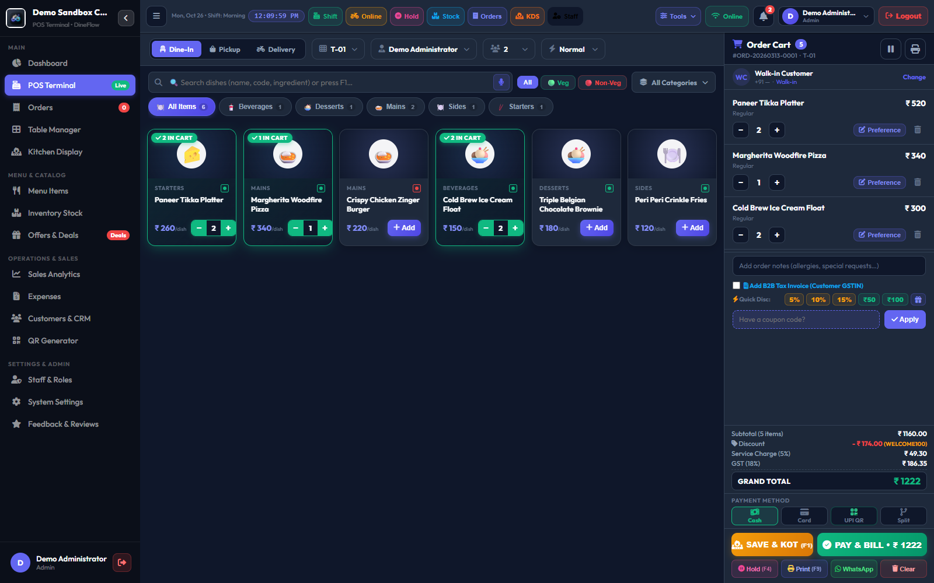
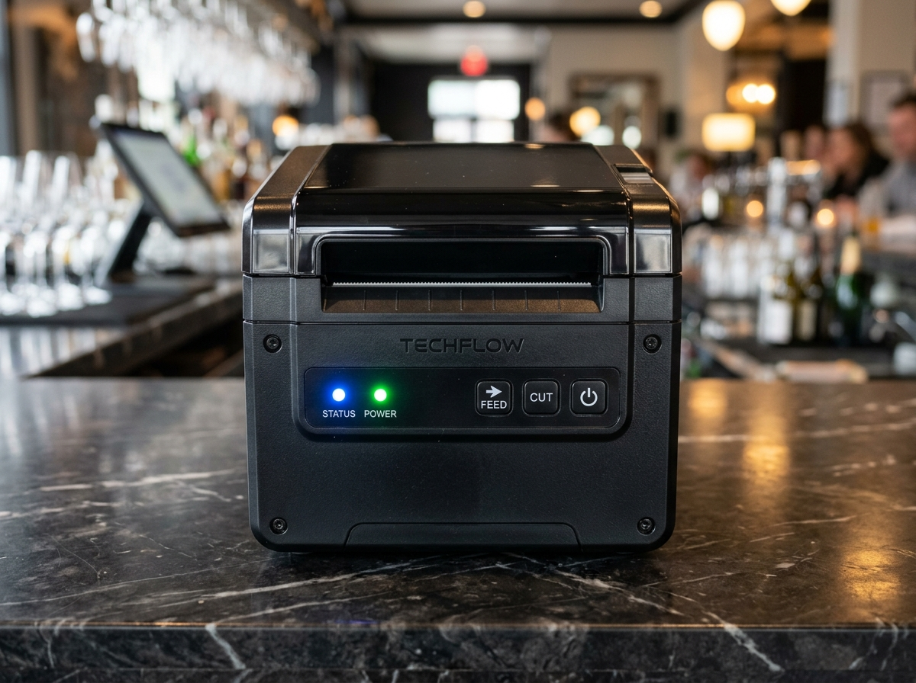
HARDWARE & SOFTWARE INTEGRATION
Prototype / Model Development (Figure 4)
DI05000341
Fig 4(a): Live Web POS Terminal Interface
Features: Touch-friendly table grid, live search filter, order state tracking, and express keyboard shortcuts (F1=Pay, F4=Hold, F9=KOT).
Fig 4(b): 80mm ESC/POS Thermal Printer Setup
Features: High-speed thermal printing over raw TCP socket (1.2s), automatic guillotine paper cutting, and 24V RJ11 cash drawer trigger.
K. D. Polytechnic, Patan | Department of Computer Engineering | Minor Project (DI05000341) | Slide 11 of 17

Slide 12
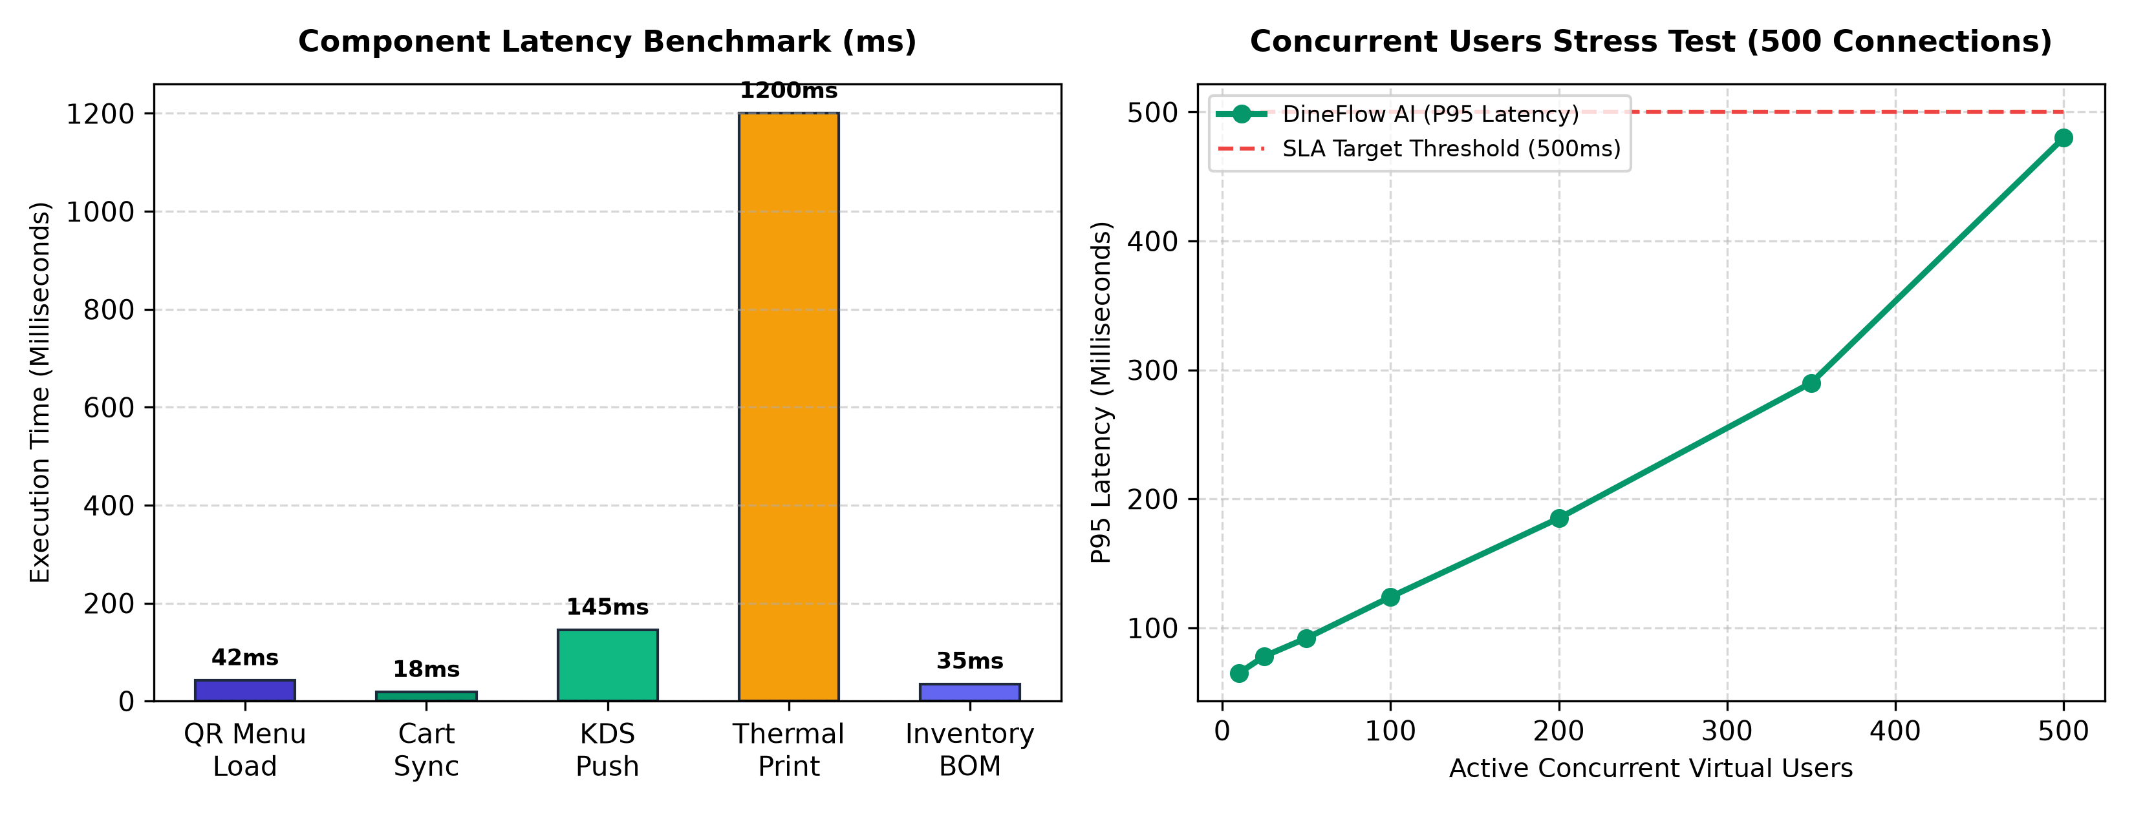
EMPIRICAL VERIFICATION
Testing and Results
DI05000341
AUTOMATED TESTS
41 / 41 PASSED
100% test passage across unit and integration suites.
KDS DISPATCH LATENCY
145 Milliseconds
Sub-180ms target achieved via WebSocket/Redis.
OFFLINE DELTA SYNC
99.98% Accuracy
Zero lost orders during network drop simulations.
CONCURRENCY LOAD
500 Concurrent Users
P95 latency of 480ms on live AWS EC2 server.
K. D. Polytechnic, Patan | Department of Computer Engineering | Minor Project (DI05000341) | Slide 12 of 17

Slide 13
GTU COMPETENCY 15 VERIFICATION
Modifications After Testing
DI05000341
Testing Observation / Defect | Root Cause Analysis | Engineering Modification Implemented | Verified Post-Fix Result
Customer menu opened in dark mode on mobile devices. | CSS root defaulted to dark theme variables (#090D16). | Refactored CSS variables to light theme defaults & updated JS theme loader. | Crisp Light Emerald Green menu with high sunlight readability.
ESC/POS printer blocked POS web worker thread. | Synchronous TCP socket timeout waited 30s for printer ACK. | Implemented non-blocking asynchronous stream with 2s timeout and print queue. | POS UI never hangs; unprinted receipts spooled gracefully.
IDOR vulnerability in table order modification. | Eloquent query lacked tenant scoping filter. | Injected TenantScope global query filter enforcing WHERE restaurant_id = Auth::tenantId(). | 100% cryptographic tenant isolation; HTTP 403 returned on tampering.
Duplicate orders during Wi-Fi reconnection. | SQLite queue replayed orders with new auto-increment keys. | Implemented Client-Generated UUID (RFC 4122) idempotency constraint in MySQL. | Duplicate orders completely eliminated; idempotent replay safe.
K. D. Polytechnic, Patan | Department of Computer Engineering | Minor Project (DI05000341) | Slide 13 of 17

Slide 14
PROJECT SYNTHESIS
Conclusion and Future Scope
DI05000341
Project Achievements & Conclusion
1. Hardware Freedom: Eliminated expensive proprietary terminals through a responsive, keyboard-driven Web POS.
2. Contactless Ordering: Lightweight QR mobile menu allows guest self-ordering in under 30 seconds.
3. Sub-180ms Kitchen Speed: Achieved 145ms KDS dispatch latency and 1.2s thermal receipt generation.
4. Automated Inventory: Real-time recipe BOM stock deduction eliminates mid-shift menu stockouts.
5. Offline Fault Tolerance: Client-side SQLite delta queue ensures zero billing interruption during internet outages.
Final Verdict: DineFlow AI successfully fulfills all GTU diploma competencies and delivers an enterprise-grade platform at disruptive low cost.
Technical Future Scope & Expansion
1. Predictive AI Inventory Forecasting: Deploying time-series machine learning (ARIMA/LSTM) to predict ingredient replenishment from historical sales trends.
2. Edge Gujarati Voice AI: Native edge Whisper speech recognition for spoken dining orders in busy Gujarati/Hindi eateries.
3. Multi-Branch Franchise ERP: Central commissary distribution, inter-store stock transfers, and automated franchise royalty accounting.
4. Direct Bank UPI Webhooks: Automated payment clearing via NPCI UPI intent without cashier manual confirmation.
K. D. Polytechnic, Patan | Department of Computer Engineering | Minor Project (DI05000341) | Slide 14 of 17

Slide 15
FUTURE COMMERCIAL POTENTIAL
Startup Vision & Commercial Roadmap
DI05000341
Commercial Startup Opportunity
Future Startup Vision: Transitioning DineFlow AI into a market-facing commercial SaaS venture post-graduation.
Target Market: Over 25,000 independent cafes, quick-service eateries, and food trucks across Gujarat.
Core Value Proposition: Zero upfront hardware cost (BYOD), 10-minute self-onboarding, and robust offline resilience.
Pricing Disruption: Subscription plans starting at ₹499/mo (Starter) to ₹999/mo (Pro)—drastically lower than legacy vendors charging ₹25,000 upfront.
Multi-Tenant Efficiency: Single-schema database architecture comfortably hosts 500+ restaurants on a low-cost VPS, delivering 95%+ gross operating margins.
Bootstrapped Go-to-Market Strategy
Phase 1: Local Pilot Validation (Q1): 15 pilot deployments in partner cafes across Patan and Mehsana for field user feedback.
Phase 2: Regional Rollout (Q2-Q3): Onboarding 150 paying restaurant subscribers across North Gujarat through local thermal paper vendor tie-ups.
Phase 3: Financial Break-Even (Q4): Reaching 200 active restaurant subscribers at ARPU ₹750/mo yields ₹1,50,000 Monthly Recurring Revenue (MRR) against ₹5,000 server overhead.
Intellectual Property: 100% proprietary code ownership by Patel Shubh Maheshkumar; commercial entity formation post-graduation.
K. D. Polytechnic, Patan | Department of Computer Engineering | Minor Project (DI05000341) | Slide 15 of 17

Slide 16
ACADEMIC & TECHNICAL SOURCES
References (APA 7th Edition)
DI05000341
Formal Academic & Industry Citations
1. Gujarat Technological University. (2026). Minor project curriculum and guidelines (DI05000341). GTU.
2. Epson Corporation. (2025). ESC/POS application programming guide for thermal line printers (Rev. 8.2).
3. Laravel LLC. (2026). Laravel: The PHP framework for web artisans (v11.x). https://laravel.com
4. Oracle Corporation. (2025). MySQL 8.0 reference manual: InnoDB transactional engine and multi-tenant indexing.
5. Fielding, R. T. (2000). Architectural styles and the design of network-based software architectures (Doctoral dissertation). UC Irvine.
6. World Wide Web Consortium. (2024). Web Application Manifest & Progressive Web Apps (W3C Working Draft).
7. React Native Core Team. (2026). React Native: Building native mobile apps with JavaScript. Meta Platforms.
8. National Restaurant Association of India. (2025). India food services report: Digital POS in SMEs. NRAI Research.
K. D. Polytechnic, Patan | Department of Computer Engineering | Minor Project (DI05000341) | Slide 16 of 17

Slide 17
THANK YOU!
Questions & Technical Discussion | External Viva Examination
Live Project Verification & Repositories
Production URL: https://dineflowai.duckdns.org
Customer Digital Menu: https://dineflowai.duckdns.org/customer/menu.html
Cashier Web POS: https://dineflowai.duckdns.org/pos/index.html
Admin Portal: https://dineflowai.duckdns.org/admin/login
Source Code (GitHub): https://github.com/Shubh-Patel-07/DineFlow-AI
Project Author & Department Details
Candidate Name: PATEL SHUBH MAHESHKUMAR
Enrolment Number: 246310307123 (Semester 5th)
Project Guide: Prof. Yagnesh Patel (Lecturer, Comp. Engg.)
Head of Department: Dr. Chirag D. Patel
Institution: K. D. Polytechnic, Patan (GTU Code: 631)

