Slide 1
Security
Module 6
Notes:
In this module, you will learn about security at AWS. This includes the shared responsibility model, AWS Identity and Access Management, AWS Organizations, and compliance.

Slide 2

Module 6 objectives
In this module, you will learn how to:
Explain the benefits of the shared responsibility model
Describe multi-factor authentication (MFA)
Differentiate among the AWS Identity and Access Management (IAM) security levels
Explain AWS Organizations benefits
Describe security policies
Summarize the benefits of compliance with AWS
Explain additional AWS security services
Notes:
In this module, you will learn how to:
Explain the benefits of the shared responsibility model
Describe multi-factor authentication (MFA)
Differentiate between the AWS Identity and Access Management (IAM) security levels
Explain the main benefits of AWS Organizations

Slide 3
Shared responsibility model
Notes:
Throughout this course, you have learned about a variety of resources that you can create in the AWS Cloud. These resources include Amazon EC2 instances, Amazon S3 buckets, and Amazon RDS databases. Who is responsible for keeping these resources secure: you (the customer) or AWS?
The answer is both. The reason is that you do not treat your AWS environment as a single object. Rather, you treat the environment as a collection of parts that build upon each other. AWS is responsible for some parts of your environment and you (the customer) are responsible for other parts. This concept is known as the shared responsibility model.

Slide 4
Shared responsibility model
Customers
Customer Data
Platform, Applications, Identity and Access Management
Operating Systems, Network and Firewall Configuration
Client-side Data Encryption
Server-side Encryption
Networking Traffic Protection
AWS
Software
Compute
Storage
Database
Networking
Hardware/AWS Global Infrastructure
Regions
Availability Zones
Edge Locations
Notes:
The shared responsibility model divides into customer responsibilities (commonly referred to as “security in the cloud”) and AWS responsibilities (commonly referred to as “security of the cloud”).
You can think of this model as being similar to the division of responsibilities between a homeowner and a homebuilder. The builder (AWS) is responsible for constructing your house and ensuring that it is solidly built. As the homeowner (the customer), it is your responsibility to secure everything in the house by ensuring that the doors are closed and locked.
This section examines the shared responsibility model in greater detail, beginning with customers’ responsibilities.

Slide 5
Customers: Security IN the cloud
Customers
Customer Data
Platform, Applications, Identity and Access Management
Operating Systems, Network and Firewall Configuration
Client-side Data Encryption
Server-side Encryption
Networking Traffic Protection
Examples of customer responsibilities include:
Instance operating system
Applications
Security groups
Host-based firewalls
Account management
Notes:
Customers are responsible for the security of everything that they create and put in the AWS Cloud.
When using AWS services, you, the customer, maintain complete control over your content. You are responsible for managing security requirements for your content, including which content you choose to store on AWS, which AWS services you use, and who has access to that content. You also control how access rights are granted, managed, and revoked.
The security steps that you take will depend on factors such as the services that you use, the complexity of your systems, and your company’s specific operational and security needs. Steps include selecting, configuring, and patching the operating systems that will run on Amazon EC2 instances, configuring security groups, and managing user accounts.

Slide 6
AWS: Security OF the cloud
AWS
Software
Compute
Storage
Database
Networking
Hardware/AWS Global Infrastructure
Regions
Availability Zones
Edge Locations
Examples of AWS responsibilities include:
Physical security of data centers
Hardware and software infrastructure
Network infrastructure
Virtualization infrastructure
Notes:
AWS is responsible for security of the cloud.
AWS operates, manages, and controls the components at all layers of infrastructure. This includes areas such as the host operating system, the virtualization layer, and even the physical security of the data centers from which services operate.
AWS is responsible for protecting the global infrastructure that runs all of the services offered in the AWS Cloud. This infrastructure includes AWS Regions, Availability Zones, and edge locations.
AWS manages the security of the cloud, specifically the physical infrastructure that hosts your resources, which include:
Physical security of data centers
Hardware and software infrastructure
Network infrastructure
Virtualization infrastructure
Although you cannot visit AWS data centers to see this protection firsthand, AWS provides several reports from third-party auditors. These auditors have verified its compliance with a variety of computer security standards and regulations.

Slide 7
Review: Shared responsibility model
Are these tasks the responsibilities of customers or AWS?
Configuring security groups on Amazon EC2 instances
Maintaining network infrastructure
1. Configuring security groups on Amazon EC2 instances
2. Maintaining network infrastructure
Customers
AWS
Implementing physical security controls at data centers
Patching software on Amazon EC2 instances
3. Implementing physical security controls at data centers
4. Patching software on Amazon EC2 instances
AWS
Customers
Maintaining servers that run Amazon EC2 instances
Setting permissions for Amazon S3 objects
5. Maintaining servers that run Amazon EC2 instances
6. Setting permissions for Amazon S3 objects
AWS
Customers
Notes:
Suppose that you are the owner of the coffee shop. Each item on this slide represents an aspect of running the coffee shop’s website. For each item, determine if it is your (the customer’s) responsibility or an AWS responsibility.
Items that are filled in with pink are the responsibility of AWS; those that are filled in with purple are the responsibility of the customer.

Slide 8
AWS Identity and Access Management (IAM)
Notes:
One area included in customers’ responsibilities is identity and access management. You will explore this topic so you can understand the role that it plays in keeping your AWS resources secure.

Slide 9

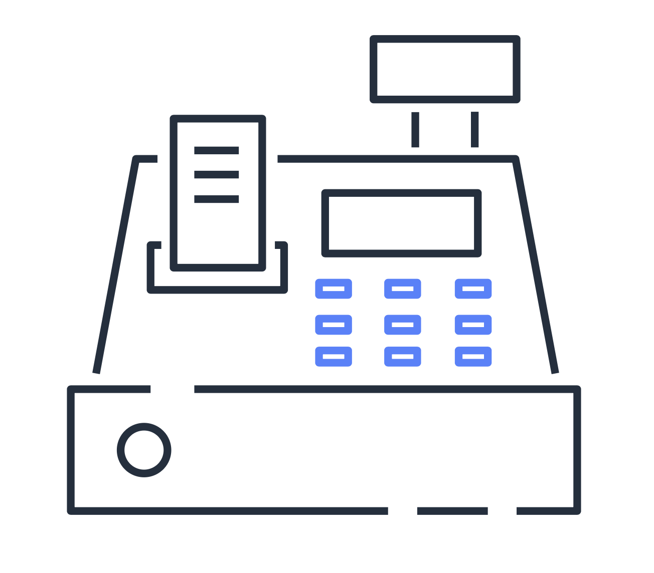


Security in the coffee shop
A new cashier begins working at the coffee shop.
The cashier is given an account that has permission to access the point of sale system.
The cashier uses their account to access the point of sale system.
Notes:
The coffee shop uses a computer system for its point of sale system, inventory system, and employee records. When a new employee begins working at the coffee shop, they are given their own account within the computer system.
Each employee’s account has been assigned permissions that allow them to carry out only the tasks that relate to their specific job. For example, a cashier’s account allows them to access the point of sale system, but not employee records or the inventory system.
This type of functionality also exists in AWS. To create user identities and assign permissions, you use AWS Identity and Access Management (IAM).

Slide 10




IAM
IAM features
IAM user
IAM policy
AWS Identity and Access Management (IAM) allows you to manage access to AWS services and resources.
IAM group
IAM role
Multi-factor authentication
Notes:
AWS Identity and Access Management (IAM) allows you to manage access to AWS services and resources securely.
IAM gives you the flexibility to configure access based on your company’s specific operational and security needs. You do this by using a combination of IAM features, which are explored in detail in this lesson:
IAM users, groups, and roles
IAM policies
Multi-factor authentication
You will also learn best practices for each of these features.

Slide 11



AWS account root user
Log in as the new IAM user and continue to create other users.
Create an AWS account. This establishes your root user identity.
Create your first IAM user and give it permissions to create other users.
Only access the root user for a limited number of tasks.
Notes:
When you first create an AWS account, you begin with an identity that is known as the root user.
The root user is accessed by signing in with the email address and password that you used to create your AWS account. You can think of the root user as being similar to the owner of the coffee shop. It has complete access to all of the AWS services and resources within the account.
Do not use the root user for everyday tasks. Instead, use the root user to create your first IAM user and assign it permissions to create other users.
Then, continue to create other IAM users, and access those identities for performing regular tasks throughout AWS. Only use the root user when you need to perform a limited number of tasks that are only available to the root user. Examples of these tasks include changing your root user email address and changing your AWS Support plan.

Slide 12
IAM users
An IAM user is an identity that represents a person or application that interacts with AWS services and resources.
Best practice: Create individual IAM users for each person who needs to access AWS.
IAM user
Notes:
An IAM user is an identity that you create in AWS. It represents the person or application that interacts with AWS services and resources. It consists of a name and credentials.
By default, when you create a new IAM user in AWS, it has no permissions associated with it. To allow the IAM user to perform specific actions in AWS, such as launching an Amazon EC2 instance or creating an Amazon S3 bucket, you must grant the IAM user the necessary permissions.
As a best practice, create individual IAM users for each person who must access AWS.
Even if you have multiple employees who require the same level of access, you should create individual IAM users for each of them. This provides additional security by allowing each IAM user to have a unique set of security credentials.

Slide 13
IAM policies
An IAM policy is a document that grants or denies permissions to AWS services and resources.
Best practice: Follow the security principle of least privilege.
IAM policy
Notes:
An IAM policy is a document that allows or denies permissions to AWS services and resources.
IAM policies allow you to customize users’ levels of access to resources. For example, you can allow users to access all of the Amazon S3 buckets within your AWS account, or only a specific bucket.
As a best practice, follow the security principle of least privilege when granting permissions.
By following this principle, you help to prevent users or roles from having more permissions than needed to perform their tasks.
For example, if an employee needs access to only a specific bucket, specify the bucket in the IAM policy. Do this instead of granting the employee access to all of the buckets in your AWS account.

Slide 14
Example: IAM policy
This sample IAM policy allows permission to view a list of objects in the Amazon S3 bucket with ID awsdoc-example-bucket, and also access them.
{
"Version": "2012-10-17",
"Statement": {
"Effect": "Allow",
"Action": ["s3:ListObject", "s3:GetObject"],
"Resource": ["arn:aws:s3::: awsdoc-example-bucket", "arn:aws:s3::: awsdoc-example-bucket/*"]
}
}
Notes:
Here’s an example of how IAM policies work. Suppose that the coffee shop owner has created an IAM user for a newly hired cashier. The cashier needs access to the receipts that are kept in an Amazon S3 bucket with the ID: awsdoc-example-bucket.
The coffee shop owner uses the following IAM policy to grant the cashier access to the awsdoc-example-bucket bucket in Amazon S3:
{
"Version": "2012-10-17",
"Statement": {
"Effect": "Allow",
"Action": ["s3:ListObject", "s3:GetObject"],
"Resource": ["arn:aws:s3::: awsdoc-example-bucket", "arn:aws:s3::: awsdoc-example-bucket/*"]
}
}
In this example, the IAM policy is allowing specific actions within Amazon S3: ListObject and GetObject. The policy also mentions a specific bucket ID: awsdoc-example-bucket. When the owner attaches this policy to the cashier’s IAM user, it will allow the cashier to view a list of the objects in the awsdoc-example-bucket bucket and also access them.
If the owner wants the cashier to be able to access other services and perform other actions in AWS, the owner must attach additional policies to specify these services and actions.
Now, suppose that the coffee shop has hired a few more cashiers. Instead of assigning permissions to each individual IAM user, the owner places the users into an IAM group.

Slide 15
IAM groups
An IAM group is a collection of IAM users.
Best practice: Attach IAM policies to IAM groups, rather than to individual IAM users.
Members inherit the policies assigned to the group.
“Cashiers” IAM group
Cashier 1
Cashier 2
Cashier 3
Notes:
An IAM group is a collection of IAM users. When you assign an IAM policy to a group, all users in the group are granted permissions specified by the policy.
Here’s an example of how this might work in the coffee shop. Instead of assigning permissions to cashiers one at a time, the owner can create a “Cashiers” IAM group. The owner can then add IAM users to the group and then attach permissions at the group level.
Assigning IAM policies at the group level also makes it easier to adjust permissions when an employee transfers to a different job. For example, if a cashier becomes an inventory specialist, the coffee shop owner removes them from the “Cashiers” IAM group and adds them into the “Inventory Specialists” IAM group. This ensures that employees have only the permissions that are required for their current role.
What if a coffee shop employee hasn’t switched jobs permanently, but instead, rotates to different workstations throughout the day? This employee can get the access they need through IAM roles.

Slide 16
IAM roles
An IAM role is an identity that you can assume to gain temporary access to permissions.
“Cashier” role
“Cashier” role
“Inventory” role
The owner gives the employee permissions to switch to specific roles.
The employee assumes the “Cashier” role.
This grants them access to the cash register system.
The employee assumes the “Inventory” role.
This grants them access to the inventory system and revokes their access to the cash register system.
Notes:
In the coffee shop, an employee rotates to different workstations throughout the day. Depending on the staffing of the coffee shop, this employee might perform several duties: work at the cash register, update the inventory system, process online orders, and so on.
When the employee needs to switch to a different task, they give up their access to one workstation and gain access to the next workstation. The employee can easily switch between workstations, but at any given point in time, they can have access to only a single workstation. This same concept exists in AWS with IAM roles.
An IAM role is an identity that you can assume to gain temporary access to permissions.
Before an IAM user, application, or service can assume an IAM role, they must be granted permissions to switch to the role. When someone assumes an IAM role, they abandon all previous permissions that they had under a previous role and assume the permissions of the new role. (Note: When an IAM user is assuming a role, they remain logged into the AWS Management Console through their IAM user account and can switch back to their IAM user permissions at any time.)
IAM roles are the preferred method for interacting with AWS services. As a best practice, IAM roles are ideal for situations in which access to services or resources needs to be granted temporarily, rather than long term.
Consider this example of how IAM roles could be used in the coffee shop.
First, the owner gives the employee permissions to switch to a role for each workstation in the coffee shop.
The employee begins their day by assuming the “Cashier” role. This grants them access to the cash register system.
Later in the day, the employee needs to update the inventory system. They assume the “Inventory” role. This grants the employee access to the inventory system and also revokes their access to the cash register system.
The final aspect of IAM that we will examine is multi-factor authentication.

Slide 17

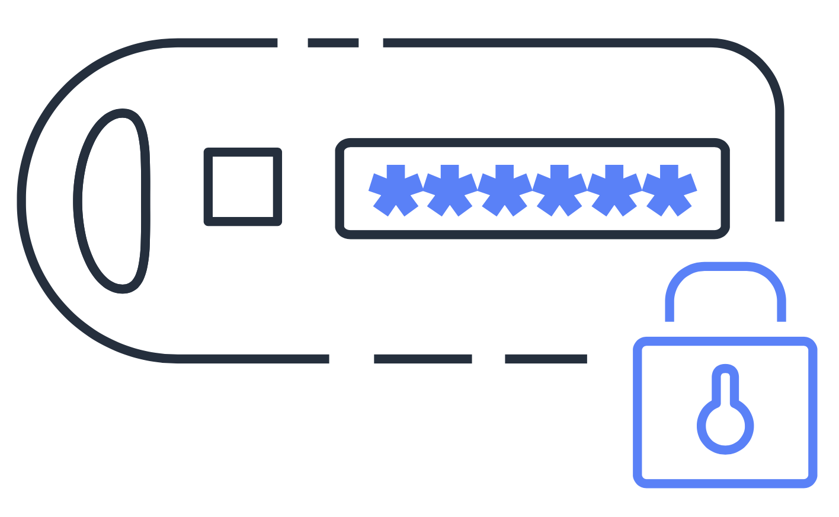

Multi-factor authentication
Multi-factor authentication provides an extra layer of protection for your AWS account.
IAM user ID:
AIDACKCEVSQ6C2EXAMPLE
Password:
**********************
To sign in to an AWS website, a user enters their IAM user ID and password.
The user is prompted to provide an authentication response from their AWS MFA device.
The user is successfully authenticated and can access the requested AWS services or resources.
Notes:
Have you ever logged into a website that required you to provide multiple pieces of information to verify your identity? You might have needed to provide your password and then a second form of authentication, such as a random code sent to your phone. This is an example of multi-factor authentication.
In IAM, multi-factor authentication (MFA) provides an extra layer of security for your AWS account.
First, when a user signs into an AWS website, they enter their IAM user ID and password.
Next, the user is prompted for an authentication response from their AWS MFA device. This device could be a hardware security key, a hardware device, or an MFA application on a device such as a smartphone.
When the user has been successfully authenticated, they are able to access the requested AWS services or resources.
MFA can be enabled for the root user and IAM users. As a best practice, you should enable MFA for the root user and all IAM users in your account, since this will help to keep your AWS account safe from unauthorized access.

Slide 18
AWS Organizations
Notes:
In the previous section, you learned several ways to use AWS Identity and Access Management to create a separation of duties in your AWS account.
Suppose that your company has multiple AWS accounts. You can use AWS Organizations to consolidate and manage multiple AWS accounts in a central location.

Slide 19

AWS Organizations
AWS Organizations helps customers consolidate and manage multiple AWS accounts in a central location.
Use service control policies (SCPs) to centrally control permissions for the accounts in your organization.
Root
Account 1
Account 2
Account 3
Notes:
AWS Organizations helps you consolidate and manage multiple AWS accounts within a central location.
When you create an organization, AWS Organizations automatically creates a root, which is the parent container for all the accounts in your organization.
In AWS Organizations, you can centrally control permissions for the accounts in your organization by using service control policies (SCPs). SCPs help you place restrictions on the AWS services, resources, and individual API actions that the users and roles in each account can access.
You can also apply SCPs to the root. For example, you might apply an SCP that requires that multi-factor authentication (MFA) is enabled before an IAM user or role can perform specific actions, such as stopping or terminating an Amazon EC2 instance.
(Note: Consolidated billing is another feature of AWS Organizations. You will learn about consolidated billing in a later module.)

Slide 20
Example: Organizational units
Root
OU
AWS account 1:
Finance
AWS account 2:
IT
AWS account 3:
HR
AWS account 4:
Legal
Notes:
In AWS Organizations, you can group accounts into organizational units (OUs) to make it easier to manage accounts with similar business or security requirements. When you apply a policy to an OU, all the accounts in the OU automatically inherit the permissions specified in the policy.
By organizing separate accounts into OUs, you can more easily isolate workloads or applications that have specific security requirements. For instance, if your company has accounts that can access only the AWS services that meet certain regulatory requirements, you can put these accounts into one OU. Then, you can attach a policy to the OU that blocks access to all other AWS services that do not meet the regulatory requirements.
Imagine that your company has separate AWS accounts for the finance, information technology (IT), human resources (HR), and legal departments. You decide to consolidate these accounts into a single organization so that you can administer them from a central location. When you create the organization, this establishes the root.
In designing your organization, you consider the business, security, and regulatory needs of each department. You use this information to decide which departments group together in OUs.
The finance and IT departments have requirements that do not overlap with those of any other department. You bring these accounts into your organization to take advantage of benefits such as consolidated billing, but you do not place them into any OUs.
The HR and legal departments need to access the same AWS services and resources, so you place them into an OU together. Placing them into an OU allows you to attach policies that apply to both the HR and legal departments’ AWS accounts.
Even though you have placed these accounts into OUs, you can continue to provide access for users, groups, and roles through IAM.
By grouping your accounts into OUs, you can more easily give them access to the services and resources that they need. You also prevent them from accessing any services or resources that they do not need.

Slide 21

Knowledge check
A customer is configuring service control policies (SCPs) in AWS Organizations. Which identities and resources can SCPs be applied to? (Select TWO.)
IAM users
IAM groups
An individual member account
IAM roles
An organizational unit (OU)
Notes:
You are configuring service control policies (SCPs) in AWS Organizations. Which identities and resources can SCPs be applied to? (Select TWO.)
IAM users
IAM groups
An individual member account
IAM roles
An organizational unit (OU)

Slide 22
Knowledge check
A customer is configuring service control policies (SCPs) in AWS Organizations. Which identities and resources can SCPs be applied to? (Select TWO.)
IAM users
IAM groups
An individual member account (correct)
IAM roles
An organizational unit (OU) (correct)
Notes:
The correct response options are:
C. An individual member account
E. An organizational unit (OU)
In AWS Organizations, you can apply service control policies (SCPs) to the organization root, an individual member account, or an OU. An SCP affects all IAM users, groups, and roles within an account, including the AWS account root user.
You can apply IAM policies to IAM users, groups, or roles. You cannot apply an IAM policy to the AWS account root user.

Slide 23
Compliance
Notes:
The final section of this module focuses on AWS compliance resources.

Slide 24



AWS Artifact
AWS Artifact provides on-demand access to security and compliance reports and select online agreements.
Access AWS compliance reports on demand
Review, accept, and manage agreements with AWS
Access compliance reports from third-party auditors
Notes:
Depending on your company’s industry, you might need to uphold specific standards. An audit or inspection will ensure that the company has met those standards.
AWS Artifact is a service that provides on-demand access to AWS security and compliance reports and select online agreements. AWS Artifact consists of two main sections: AWS Artifact Agreements and AWS Artifact Reports.
Suppose that your company needs to sign an agreement with AWS regarding your use of certain types of information throughout AWS services. You can do this through AWS Artifact Agreements.
In AWS Artifact Agreements, you can review, accept, and manage agreements for an individual account and for all your accounts in AWS Organizations. Different types of agreements are offered to address the needs of customers who are subject to specific regulations, such as the Health Insurance Portability and Accountability Act (HIPAA).
Next, suppose that a member of your company’s development team is building an application and needs more information about their responsibility for complying with certain regulatory standards. You can advise them to access this information in AWS Artifact Reports.
AWS Artifact Reports provide compliance reports from third-party auditors. These auditors have tested and verified that AWS is compliant with a variety of global, regional, and industry-specific security standards and regulations. AWS Artifact Reports remains up to date with the latest reports released. You can provide the AWS audit artifacts to your auditors or regulators as evidence of AWS security controls.

Slide 25
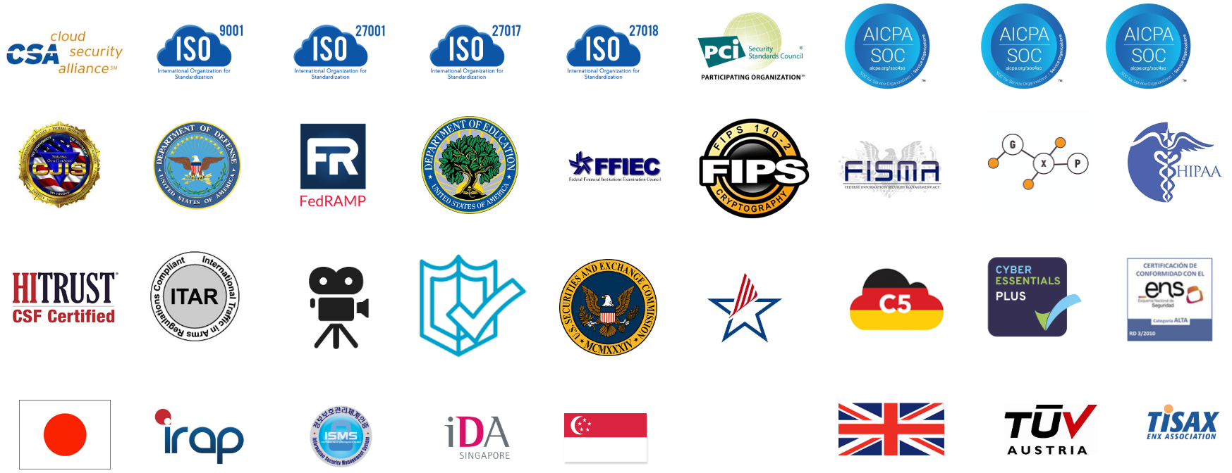
Assurance programs
Global
USA
Europe
Asia Pacific
Notes:
These are some of the compliance reports and regulations that you can find in AWS Artifact. Each report includes a description of its contents and the reporting period for which the document is valid.
Another resource to explore is the Customer Compliance Center.

Slide 26



Customer Compliance Center
The Customer Compliance Center contains resources to help you learn more about AWS compliance.
Discover compliance stories from companies in regulated industries
Access compliance technical papers and documentation
Complete the auditor learning path
Notes:
The Customer Compliance Center contains resources to help you learn more about AWS compliance.
In the Customer Compliance Center, you can read customer compliance stories to discover how companies in regulated industries have solved various compliance, governance, and audit challenges.
You can also access compliance whitepapers and documentation on topics such as:
AWS answers to key compliance questions
An overview of AWS risk and compliance
An auditing security checklist
Additionally, the Customer Compliance Center includes an auditor learning path. This learning path is designed for individuals in auditing, compliance, and legal roles who want to learn more about how their internal operations can demonstrate compliance using the AWS Cloud.

Slide 27
Knowledge check
Which tasks can you complete in AWS Artifact? (Select TWO.)
Access AWS compliance reports on-demand
Consolidate and manage multiple AWS accounts in a central location
Create users to allow people and applications to interact with AWS services and resources
Set permissions for accounts by configuring service control policies
Review, accept, and manage agreements with AWS
Notes:
Which tasks can you complete in AWS Artifact? (Select TWO.)
Access AWS compliance reports on-demand.
Consolidate and manage multiple AWS accounts within a central location.
Create users to allow people and applications to interact with AWS services and resources.
Set permissions for accounts by configuring service control policies (SCPs).
Review, accept, and manage agreements with AWS.

Slide 28
Knowledge check
Which tasks can you complete in AWS Artifact? (Select TWO.)
Access AWS compliance reports on-demand (correct)
Consolidate and manage multiple AWS accounts in a central location
Create users to allow people and applications to interact with AWS services and resources
Set permissions for accounts by configuring service control policies
Review, accept, and manage agreements with AWS (correct)
Notes:
The correct response options are:
A: Access AWS compliance reports on-demand.
E: Review, accept, and manage agreements with AWS.
The other response options are incorrect because:
B. Consolidate and manage multiple AWS accounts within a central location- This task can be completed in AWS Organizations.
C. Create users to allow people and applications to interact with AWS services and resources. This task can be completed in AWS Identity and Access Management (IAM).
D. Set permissions for accounts by configuring service control policies (SCPs)- This task can be completed in AWS Organizations.

Slide 29
Application security
Notes:
Throughout this course, you have learned about a wide variety of services and resources that you can use to develop and deploy applications. How can you keep these applications secure? The next aspect of security that you will examine is application security.
This section begins with AWS Web Application Firewall, a service that provides network security capabilities.

Slide 30




AWS WAF
Request from a customer
Malicious request from a hacker
I would like to access the application.
I would like to access the application.
You are coming from an IP address that is NOT blocked. You may enter!
You are coming from an IP address that IS blocked. You cannot enter.
Packet
AWS WAF
Packet
AWS WAF
Notes:
AWS WAF is a web application firewall that lets you monitor network requests that come into your web applications.
AWS WAF works together with Amazon CloudFront and an Application Load Balancer. Recall the network access control lists that you learned about in an earlier module. AWS WAF works in a similar way to block or allow traffic. However, it does this by using a web access control list (ACL) to protect your AWS resources.
Here’s an example of how you can use AWS WAF to allow and block specific requests.
Suppose that your application has been receiving malicious network requests from several IP addresses. You want to prevent these requests from continuing to access your application, but you also want to ensure that legitimate users can still access it. You configure the web ACL to allow all requests except those from the IP addresses that you have specified.
When a request comes into AWS WAF, it checks against the list of rules that you have configured in the web ACL. If a request did not come from one of the blocked IP addresses, it allows access to the application.
However, if a request came from one of the blocked IP addresses that you have specified in the web ACL, it is denied access.
Two types of application attacks that you might need to mitigate are denial of service and distributed denial of service attacks.

Slide 31


DoS and DDoS attacks
Denial of service attack
Distributed denial of service attack
Hacker
Target
Hacker
Target
Bots
The attack originates from a single source.
The attack originates from multiple sources.
Notes:
Customers can call the coffee shop to place their orders. After answering each call, a cashier takes the order and gives it to the barista.
However, suppose that a prankster is calling in multiple times to place orders but is never picking up their drinks. This causes the cashier to be unavailable to take other customers’ calls. The coffee shop can attempt to stop the false requests by blocking the phone number that the prankster is using.
In this scenario, the prankster’s actions are similar to a denial of service attack.
A denial of service (DoS) attack is a deliberate attempt to make a website or application unavailable to users. For example, an attacker might flood a website or application with excessive network traffic until the targeted website or application becomes overloaded and is no longer able to respond. If the website or application becomes unavailable, this denies service to users who are trying to make legitimate requests.
Now, suppose that the prankster has enlisted the help of friends.
The prankster and their friends repeatedly call the coffee shop with requests to place orders, even though they do not intend to pick them up. These requests are coming in from different phone numbers, and it’s impossible for the coffee shop to block them all. Additionally, the influx of calls has made it increasingly difficult for customers to be able to get their calls through. This is similar to a distributed denial of service attack.
In a distributed denial of service (DDoS) attack, multiple sources are used to start an attack that aims to make a website or application unavailable. This can come from a group of attackers, or even a single attacker. The single attacker can use multiple infected computers (also known as “bots”) to send excessive traffic to a website or application.
To help minimize the effect of DoS and DDoS attacks on your applications, you can use AWS Shield.

Slide 32

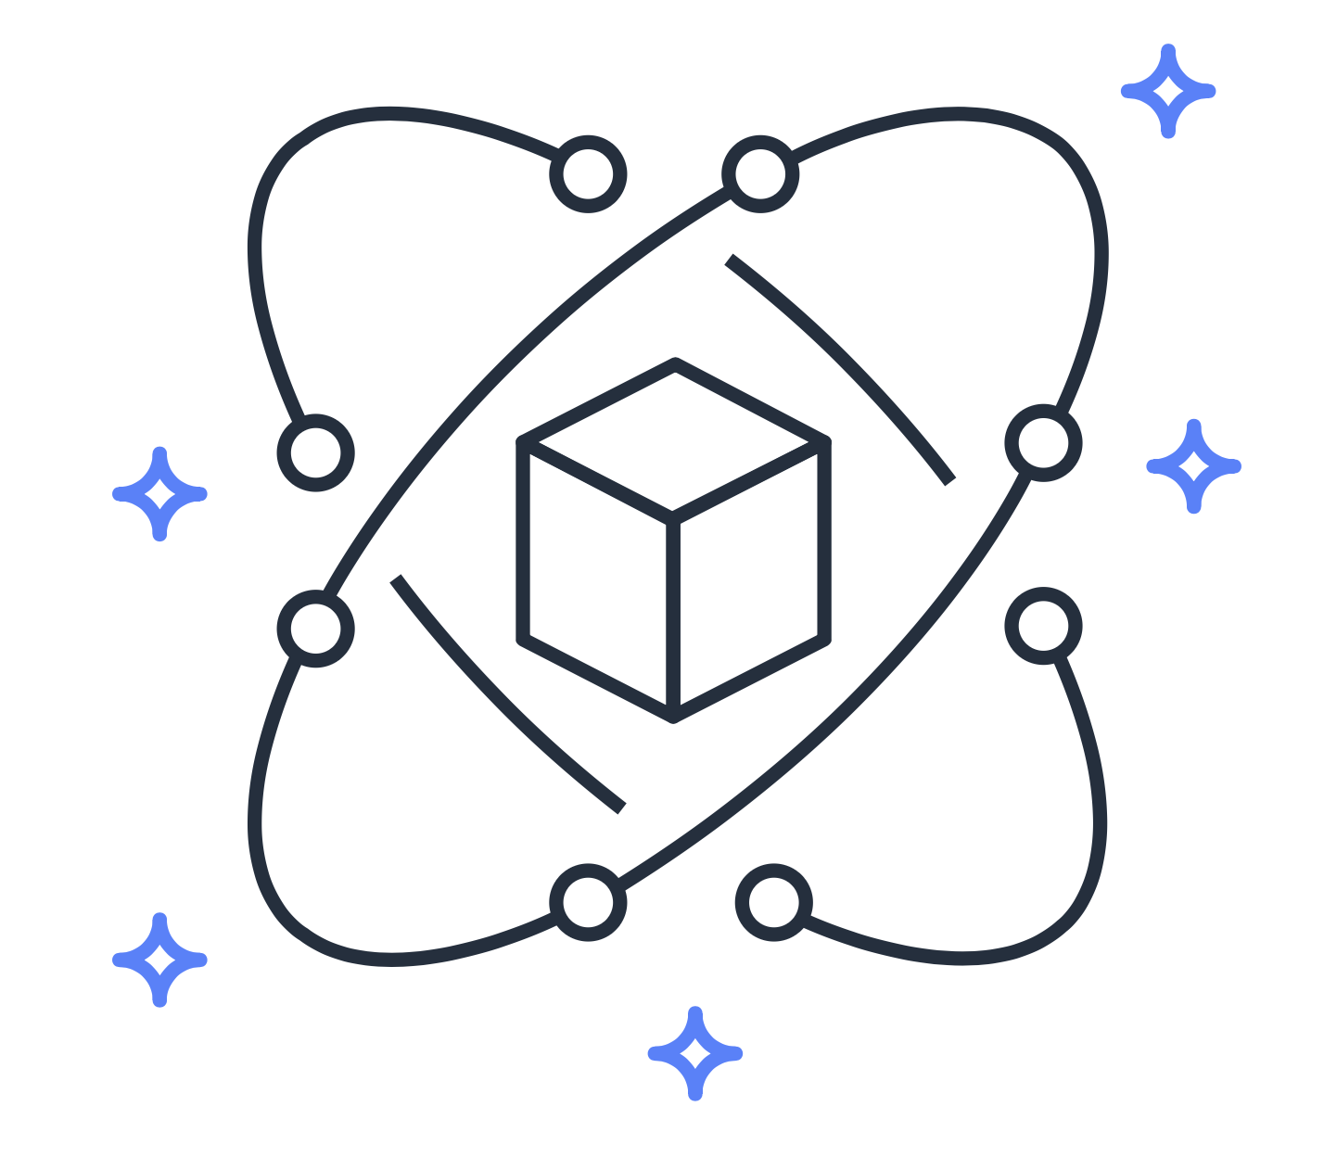
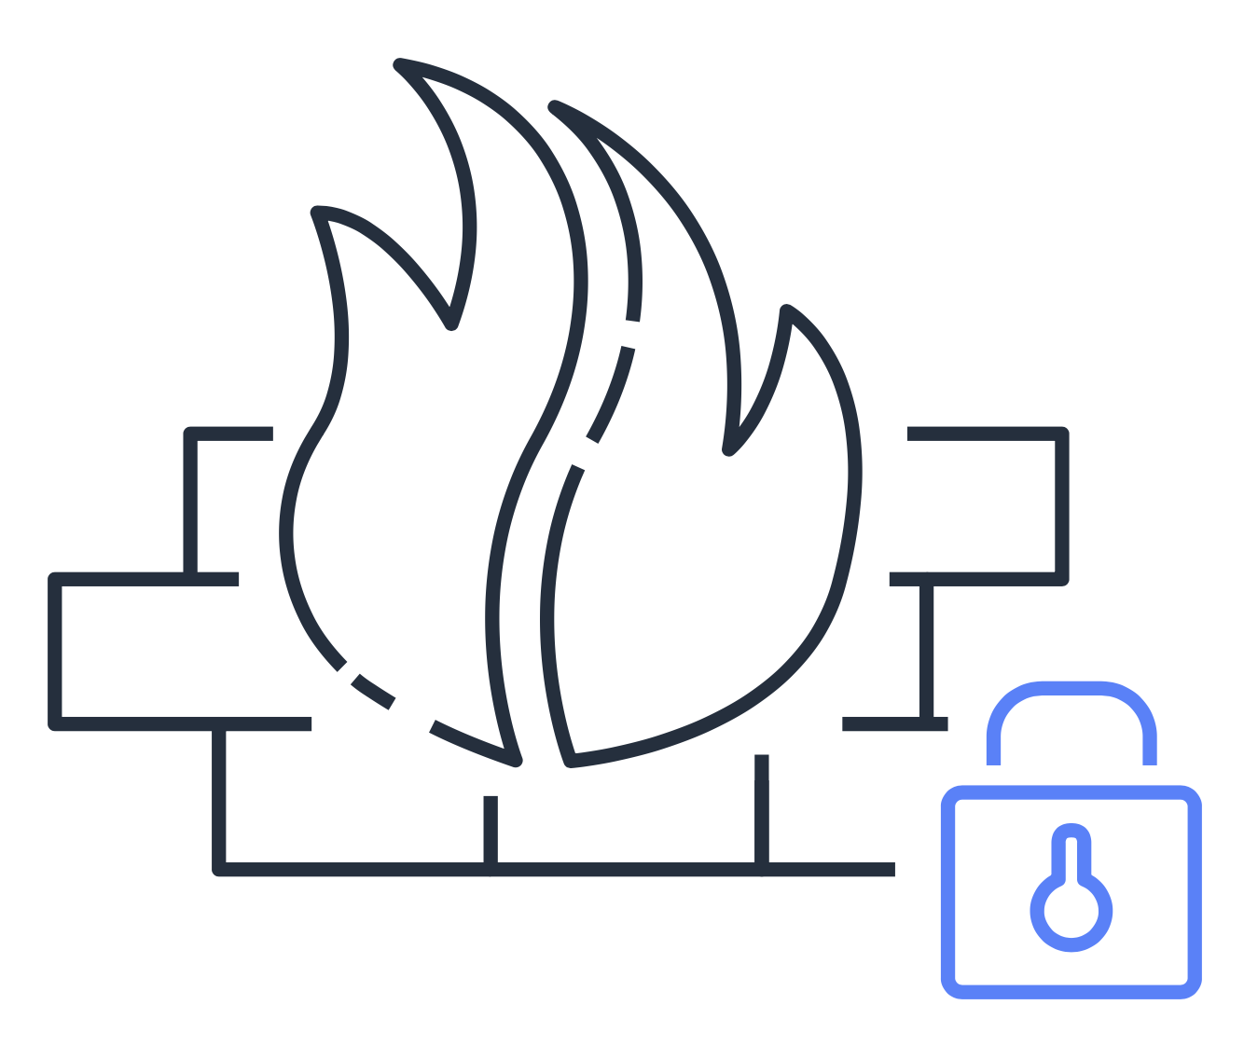
AWS Shield
AWS Shield provides protection against distributed denial of service (DDoS) attacks.
Protect applications against DDoS attacks
Integrate AWS Shield Advanced with other AWS services
Write custom web ACL rules with AWS WAF to mitigate complex DDoS attacks
Notes:
AWS Shield is a service that protects applications against DDoS attacks. AWS Shield provides two levels of protection: Standard and Advanced.
AWS Shield Standard automatically protects all AWS customers at no cost. It protects your AWS resources from the most common, frequently occurring types of DDoS attacks. As network traffic comes into your applications, AWS Shield Standard uses a variety of analysis techniques to detect malicious traffic in real time and automatically mitigates it.
AWS Shield Advanced is a paid service that provides detailed attack diagnostics and the ability to detect and mitigate sophisticated DDoS attacks. It also integrates with other services such as Amazon CloudFront, Amazon Route 53, and Elastic Load Balancing.
Additionally, you can integrate AWS Shield with AWS WAF by writing custom rules to mitigate complex DDoS attacks.
Next, you will explore Amazon Inspector.

Slide 33



Amazon Inspector
Amazon Inspector allows you to perform automated security assessments on your applications.
Automatically conduct application security assessments
Identify security vulnerabilities and deviations from best practices
Receive recommendations for how to fix security issues
Notes:
Suppose that the developers at the coffee shop are developing and testing a new ordering application. They want to make sure that they are designing the application in accordance with security best practices. However, they have several other applications to develop, so they cannot spend much time conducting manual assessments. To perform automated security assessments, they decide to use Amazon Inspector.
Amazon Inspector helps to improve the security and compliance of applications by running automated security assessments. It checks applications for security vulnerabilities and deviations from security best practices, such as open access to Amazon EC2 instances and installations of vulnerable software versions.
After Amazon Inspector has performed an assessment, it provides you with a list of security findings. The list prioritizes by severity level, including a detailed description of each security issue and a recommendation for how to fix it. However, AWS does not guarantee that following the provided recommendations resolves every potential security issue. Under the shared responsibility model, customers are responsible for the security of their applications, processes, and tools that run on AWS services.

Slide 34
Additional security services
Notes:
The final section of this module examines two additional security services: AWS Key Management Service and Amazon GuardDuty.
Throughout this module, you explored the shared responsibility model, IAM, organizational security, and application security. Another aspect of security is data encryption. This can include the data in resources such as Amazon S3 buckets and Amazon RDS databases. When your data is being stored or sent, how can you ensure that it remains secure from unauthorized access?
AWS Key Management Service offers encryption capabilities, as you will see in an next example from the coffee shop.

Slide 35

AWS Key Management Service
AWS Key Management Service (AWS KMS) helps customers perform encryption operations through the use of cryptographic keys.
You can choose the specific levels of access control that you need for your keys.
AWS KMS
Notes:
The coffee shop has many items, such as coffee machines, pastries, money in the cash registers, and so on. You can think of these items as data. The coffee shop owners want to ensure that all of these items are secure, whether they’re sitting in the storage room or being transported between shop locations.
In the same way, you must ensure that your applications’ data is secure while in storage (encryption at rest) and while it is transmitted, known as encryption in transit.
AWS Key Management Service (AWS KMS) allows you to perform encryption operations through the use of cryptographic keys. A cryptographic key is a random string of digits used for locking (encrypting) and unlocking (decrypting) data. You can use AWS KMS to create, manage, and use cryptographic keys. You can also control the use of keys across a wide range of services and in your applications.
With AWS KMS, you can choose the specific levels of access control that you need for your keys. For example, you can specify which IAM users and roles are able to manage keys. Alternatively, you can temporarily disable keys so that they are no longer in use by anyone. Your keys never leave AWS KMS, and you are always in control of them.

Slide 36


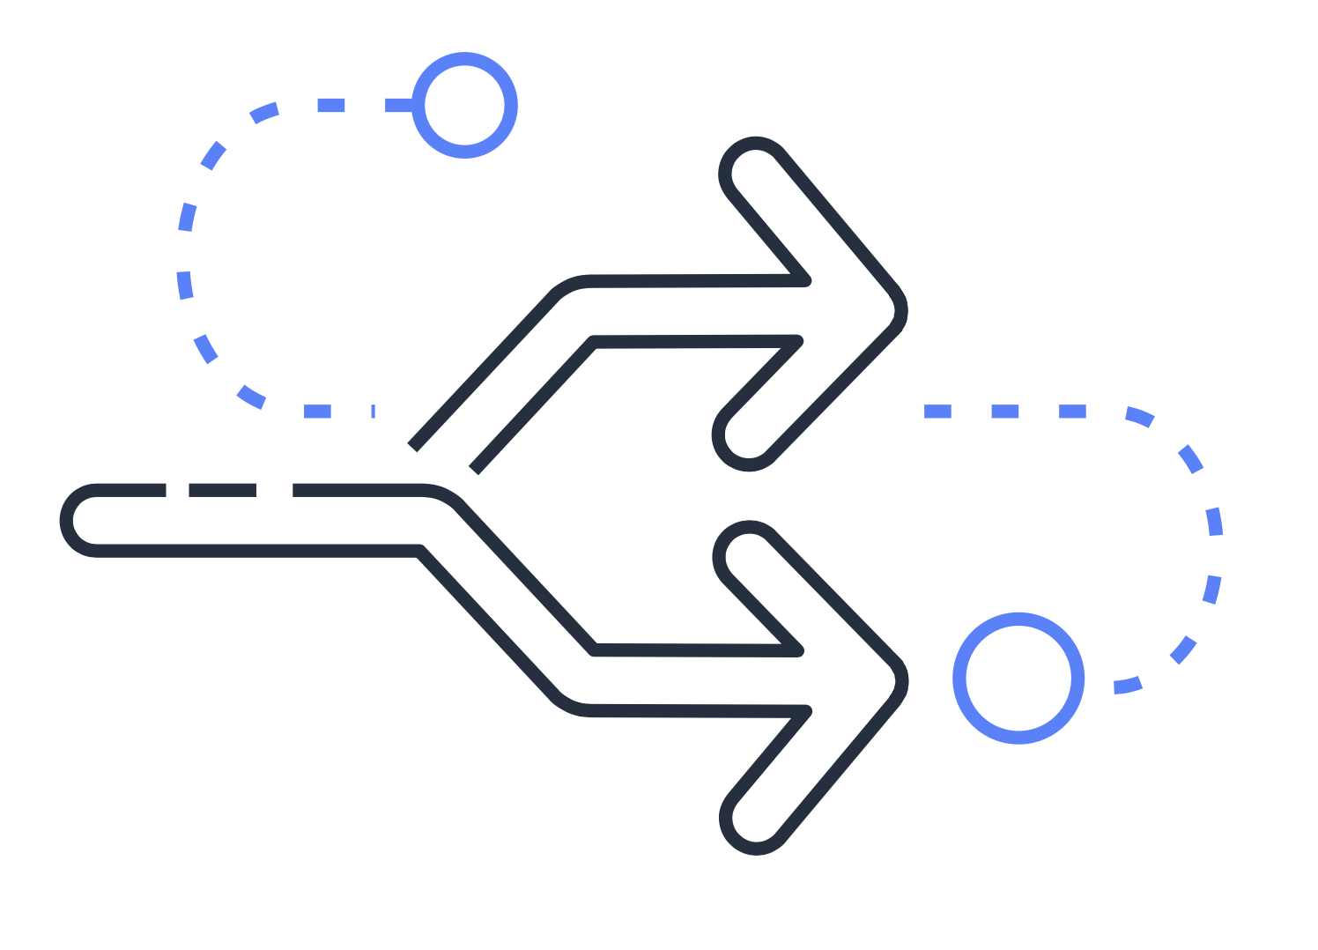

Amazon GuardDuty
Amazon GuardDuty provides intelligent threat detection for AWS products and services.
Enable Amazon GuardDuty.
GuardDuty continuously analyzes network and account activity.
Review detailed findings and take action.
GuardDuty intelligently detects threats.
Notes:
Amazon GuardDuty is a service that provides intelligent threat detection for your AWS infrastructure and resources. It identifies threats by continuously monitoring the network activity and account behavior within your AWS environment.
After you enable GuardDuty for your AWS account, GuardDuty begins monitoring your network and account activity. You do not have to deploy or manage any additional security software. GuardDuty then continuously analyzes data from multiple AWS sources, including VPC Flow Logs and DNS logs.
If GuardDuty detects any threats, you can review detailed findings about them from the AWS Management Console. Findings include recommended steps for remediation. You can also configure AWS Lambda functions to take remediation steps automatically in response to GuardDuty security findings.

Slide 37
Knowledge check
Module 6
Notes:
There are no notes on this slide.

Slide 38
Knowledge check question 1
Which statement describes an IAM policy?
An authentication process that provides an extra layer of protection for your AWS account
A document that grants or denies permissions to AWS services and resources
An identity that you can assume to gain temporary access to permissions
The identity that is established when you first create an AWS account
Notes:
Which statement describes an IAM policy?
An authentication process that provides an extra layer of protection for your AWS account
A document that grants or denies permissions to AWS services and resources
An identity that you can assume to gain temporary access to permissions
The identity that is established when you first create an AWS account

Slide 39
Knowledge check answer 1
Which statement describes an IAM policy?
An authentication process that provides an extra layer of protection for your AWS account
A document that grants or denies permissions to AWS services and resources (correct)
An identity that you can assume to gain temporary access to permissions
The identity that is established when you first create an AWS account
Notes:
The correct response option is B. A document that grants or denies permissions to AWS services and resources.
IAM policies provide you with the flexibility to customize users’ levels of access to resources. For instance, you can allow users to access all the Amazon S3 buckets in your AWS account or only a specific bucket.
The other response options are incorrect because:
A – Multi-factor authentication (MFA) is an authentication process that provides an extra layer of protection for your AWS account.
C – An IAM role is an identity that you can assume to gain temporary access to permissions.
D – The root user identity is the identity that is established when you first create an AWS account.

Slide 40
Knowledge check question 2
An employee requires temporary access to create several Amazon S3 buckets. Which option should be used for this task?
AWS account root user
IAM group
IAM role
Service control policy
Notes:
An employee requires temporary access to create several Amazon S3 buckets. Which option should be used for this task?
AWS account root user
IAM group
IAM role
Service control policy (SCP)

Slide 41
Knowledge check answer 2
An employee requires temporary access to create several Amazon S3 buckets. Which option should be used for this task?
AWS account root user
IAM group
IAM role (correct)
Service control policy
Notes:
The correct answer is C: IAM role.
An IAM role is an identity that you can assume to gain temporary access to permissions. When someone assumes an IAM role, they abandon all permissions that they had under a previous role and assume the permissions of the new role. IAM roles are ideal for situations in which access to services or resources needs to be granted temporarily instead of long-term.
The other response options are incorrect because:
A. The AWS account root user is established when you first create an AWS account. As a best practice, do not use the root user for everyday tasks.
B. Although you can attach IAM policies to an IAM group, this would not be the best choice for this scenario because the employee only needs to be granted temporary permissions.
D. Service control policies (SCPs) allow you to centrally control permissions for the accounts in your organization. An SCP is not the best choice for granting temporary permissions to an individual employee.

Slide 42
Knowledge check question 3
Which option describes the concept of least privilege?
Adding an IAM user into at least one IAM group
Granting only the permissions that are needed to perform specific tasks
Checking a packet’s permissions against an access control list
Performing a denial of service attack that originates from at least one device
Notes:
Which of the following descriptions best describes the concept of least privilege?
Adding an IAM user into at least one IAM group
Granting only the permissions that are needed to perform specific job tasks
Checking a packet’s permissions against an access control list
Performing a denial of service attack that originates from at least one device

Slide 43
Knowledge check answer 3
Which option describes the concept of least privilege?
Adding an IAM user into at least one IAM group
Granting only the permissions that are needed to perform specific tasks (correct)
Checking a packet’s permissions against an access control list
Performing a denial of service attack that originates from at least one device
Notes:
The correct response option is B: Granting only the permissions that are needed to perform specific job tasks.
When you grant permissions by following the principle of least privilege, you prevent users or roles from having more permissions than needed to perform specific job tasks. For example, cashiers in the coffee shop should be given access to the cash register system. As a best practice, grant IAM users and roles a minimum set of permissions and then grant additional permissions as needed.

Slide 44
Knowledge check question 4
Which service helps protect your applications against distributed denial of service (DDoS) attacks?
Amazon GuardDuty
Amazon Inspector
AWS Artifact
AWS Shield
Notes:
Which service helps protect your applications against distributed denial of service (DDoS) attacks?
Amazon GuardDuty
Amazon Inspector
AWS Artifact
AWS Shield

Slide 45
Knowledge check answer 4
Which service helps protect your applications against distributed denial of service (DDoS) attacks?
Amazon GuardDuty
Amazon Inspector
AWS Artifact
AWS Shield (correct)
Notes:
The correct response option is D. AWS Shield.
As network traffic comes into your applications, AWS Shield uses a variety of analysis techniques to detect potential DDoS attacks in real time and automatically mitigates them.
The other response options are incorrect because:
A – Amazon GuardDuty is a service that provides intelligent threat detection for your AWS infrastructure and resources. It identifies threats by continuously monitoring the network activity and account behavior within your AWS environment.
B – Amazon Inspector checks applications for security vulnerabilities and deviations from security best practices, such as open access to Amazon EC2 instances and installations of vulnerable software versions.
C – AWS Artifact is a service that provides on-demand access to AWS security and compliance reports and select online agreements.

Slide 46
Knowledge check question 5
Which task can AWS Key Management Service (AWS KMS) perform?
Configure multi-factor authentication (MFA)
Update the AWS account root user password
Create cryptographic keys
Assign permissions to users and groups
Notes:
Which task can AWS Key Management Service (AWS KMS) perform?
Configure multi-factor authentication (MFA).
Update the AWS account root user password.
Create cryptographic keys.
Assign permissions to users and groups.

Slide 47
Knowledge check answer 5
Which task can AWS Key Management Service (AWS KMS) perform?
Configure multi-factor authentication (MFA)
Update the AWS account root user password
Create cryptographic keys (correct)
Assign permissions to users and groups
Notes:
The correct response option is C. Create cryptographic keys.
AWS KMS allows you to perform encryption operations through the use of cryptographic keys. A cryptographic key is a random string of digits used for locking (encrypting) and unlocking (decrypting) data. You can use AWS KMS to create, manage, and use cryptographic keys. You can also control the use of keys across a wide range of services and in your applications.
The other response options are incorrect because:
A – You can configure multi-factor authentication (MFA) in AWS Identity and Access Management (IAM).
B – You can update the AWS account root user password in the AWS Management Console.
D – You can assign permissions to users and groups in AWS Identity and Access Management (IAM).

Slide 48
Module 6 summary
In this module, you learned about:
Shared responsibility model
AWS Identity and Access Management features
Methods of managing multiple accounts in AWS Organizations
AWS services for application security and encryption
AWS compliance resources
Notes:
In this module, you learned about the AWS responsibility model, which consists of customers’ responsibilities (“security in the cloud”) and AWS responsibilities (”security of the cloud”).
You learned about features of AWS Identity and Access Management, including:
AWS account root user
IAM users
IAM policies
IAM groups
IAM roles
Multi-factor authentication
In the section on AWS Organizations, you learned how to use organizational units and SCPs to centrally manage multiple AWS accounts.
You also explored several AWS services for application security and encryption:
AWS Web Application Firewall
AWS Shield
Amazon GuardDuty
Amazon Inspector
AWS Key Management Services
Finally, you learned about AWS compliance resources: AWS Artifact and the Customer Compliance Center.
The next module explores AWS services for monitoring and analytics.

