Slide 1


Hotel Booking Demand
By
SHUBHAM SURYAWANSHI

Slide 2
Data Clean Up Process
Collected data for last three years i.e. 2015, 2016 and 2017.
Read csv file for each year and created data frames with only required columns i.e. Country, HOTEL , IS CANCELLED , PEAK TIME.
Renamed columns to make them uniform across all years
Checked for missing values and dropped rows with missing values
Renamed sub-regions to concise into region WITH LABLE ENCODING
REMOVE NULL VALUES with the help of replace
DROP UNNECESSARY COLUMNS
Apply machine learning algorithems

Slide 3
Goal: determine whether or not a reservation would cancel given different details of a guest and their reservation.
his dataset contain information of hotel booking, We will perform exploratory data analysis to get insight from the data.
We will try to analyze the important factors that governs the bookings in the following steps:
1. We will try to find out the
Total number of Hotel Bookings that were get Cancelled.
2. Then we will find the Booking Ratio between Resort Hotel and City Hotel.
3. Now We will find Hotel Booking Pecentage for Each Year.
4. After all of these We'll try to get Most busiest month for the Hotel.
5. Find out the Country From which we get Most number of guests.
6. We will try to get for How Long People Stay in the hotel.
7. At last will try to get the Most booked accommodation type (Single, Couple, Family/Friends).

Slide 4
OPERATION PERFORM ON DATA
IMPORT DATASET FROM KAGGLE
IMPORT LIBRARIES FOR DATA PREPARATION AND VISUALIZATION
REMOVE NULL VALUES
PERFORM EDA AND FIND INFORMATION
FIND CORRELATION AND DESCRIBE DATA
VISUALIZATION
FIND OUTLIRE WITH THE HELP OF BOX PLOT
CONVERT CATEGORICAL TO NUMERICAL WITH LABEL ENCODER
SPLIT DATASET
APPLY MACHINE LEARNING ALGORITHEMS
EVALUATE THE MODEL
CHECK ACCURACY

Slide 5
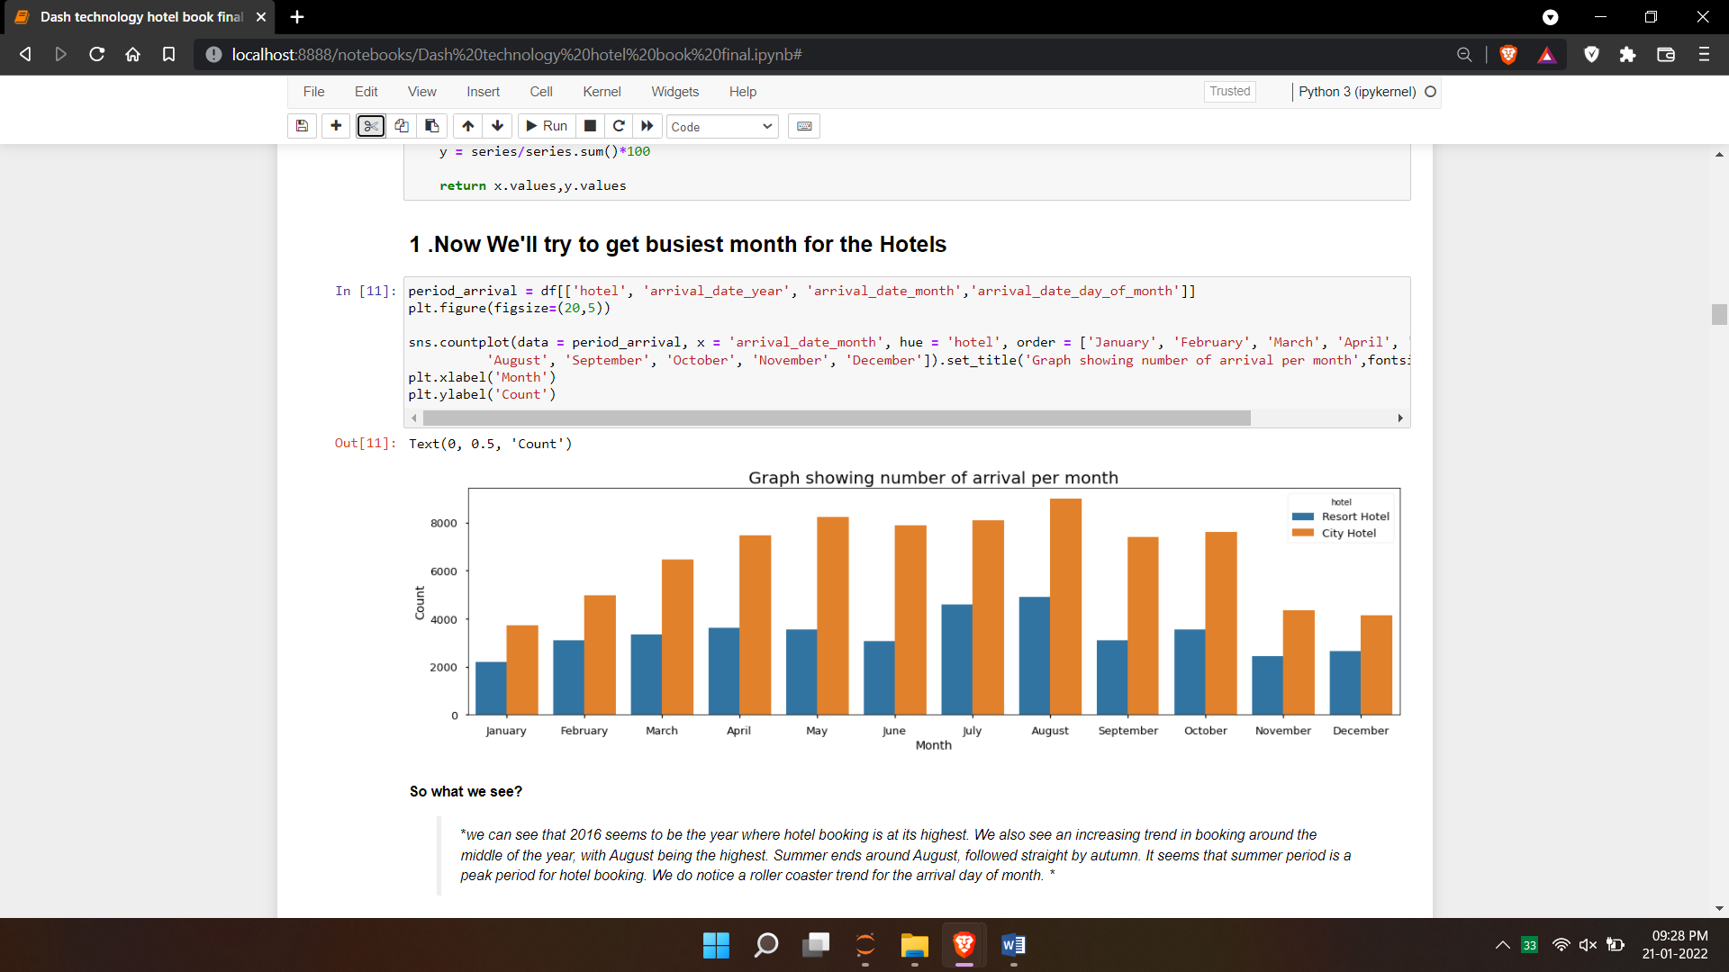
1 .Now We'll try to get busiest month for the Hotels
we can see that 2016 seems to be the year where hotel booking is at its highest. We also see an increasing trend in booking around the middle of the year, with August being the highest. Summer ends around August, followed straight by autumn. It seems that summer period is a peak period for hotel booking.
We do notice a roller coaster trend for the arrival day of month.

Slide 6
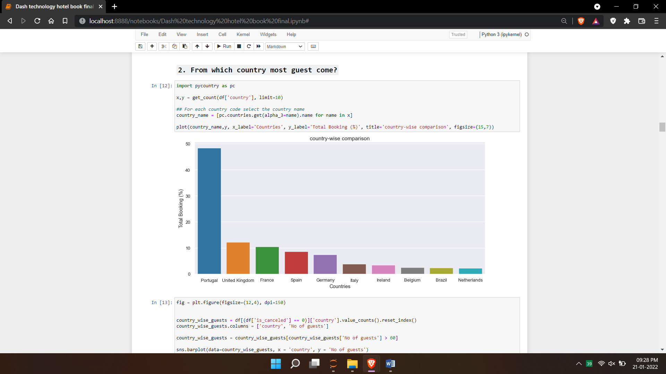
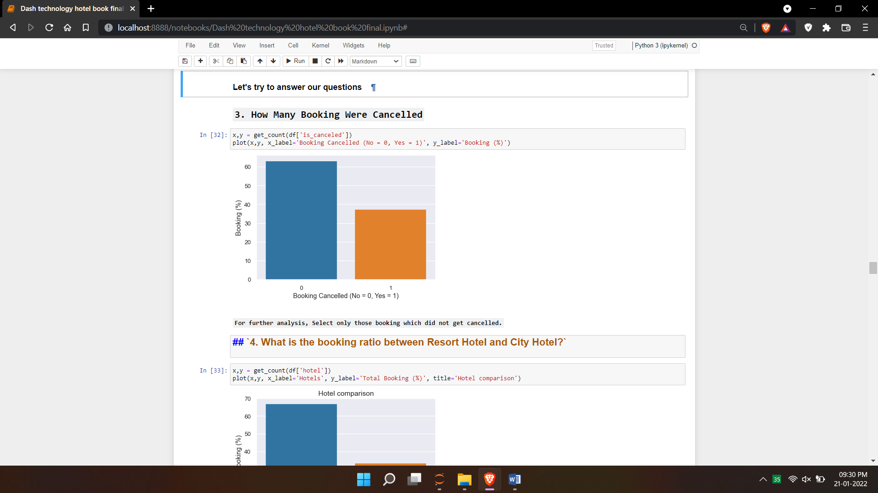
2. From which country most guest come?
3. How Many Booking Were Cancelled?

Slide 7
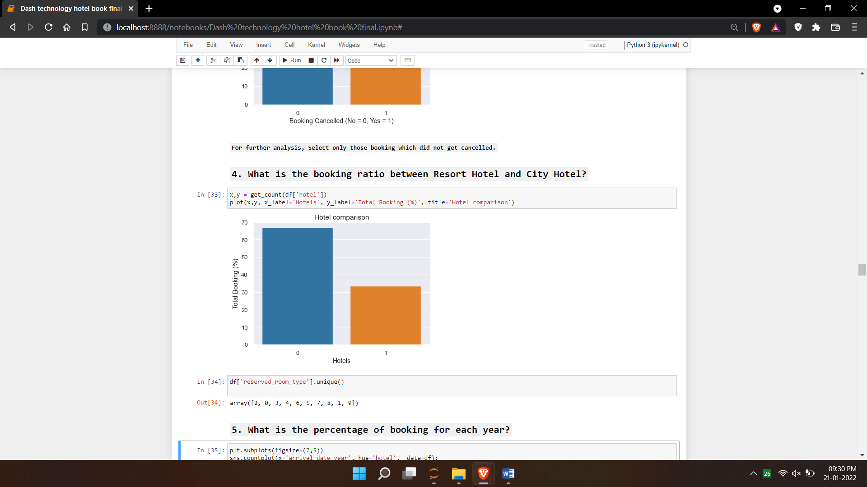
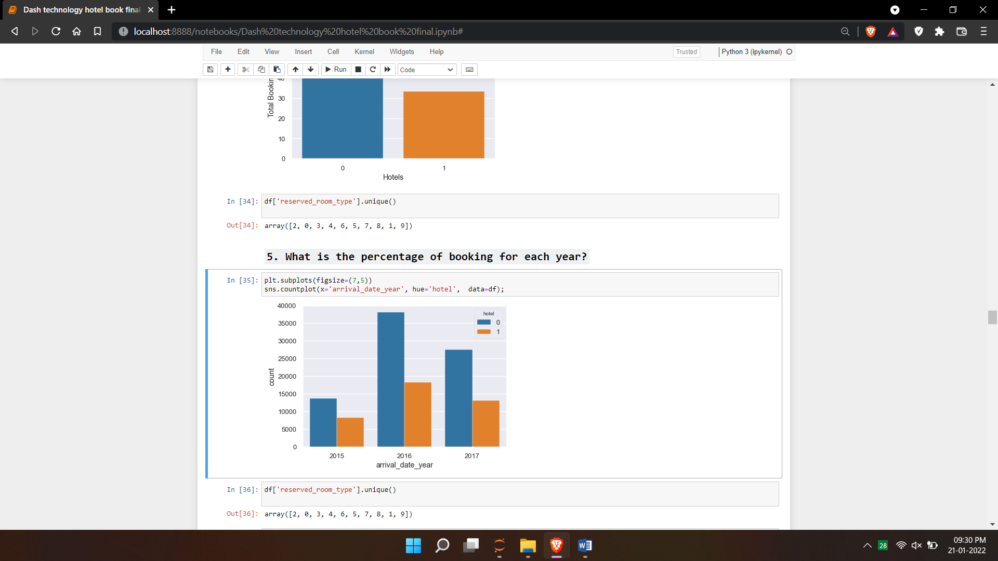
4. What is the booking ratio between Resort Hotel and City Hotel?
5. What is the percentage of booking for each year?

Slide 8
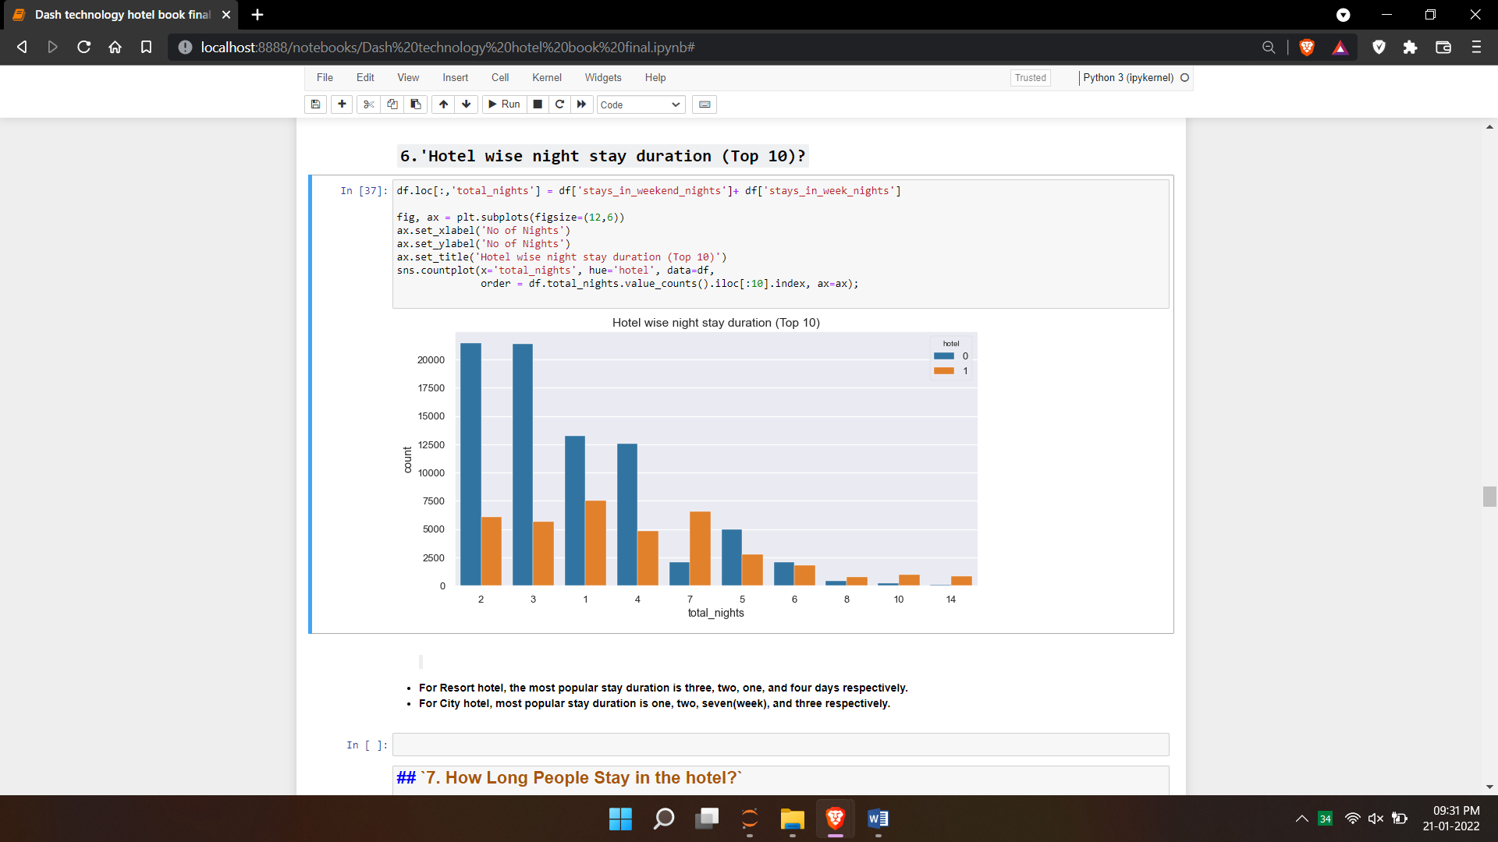
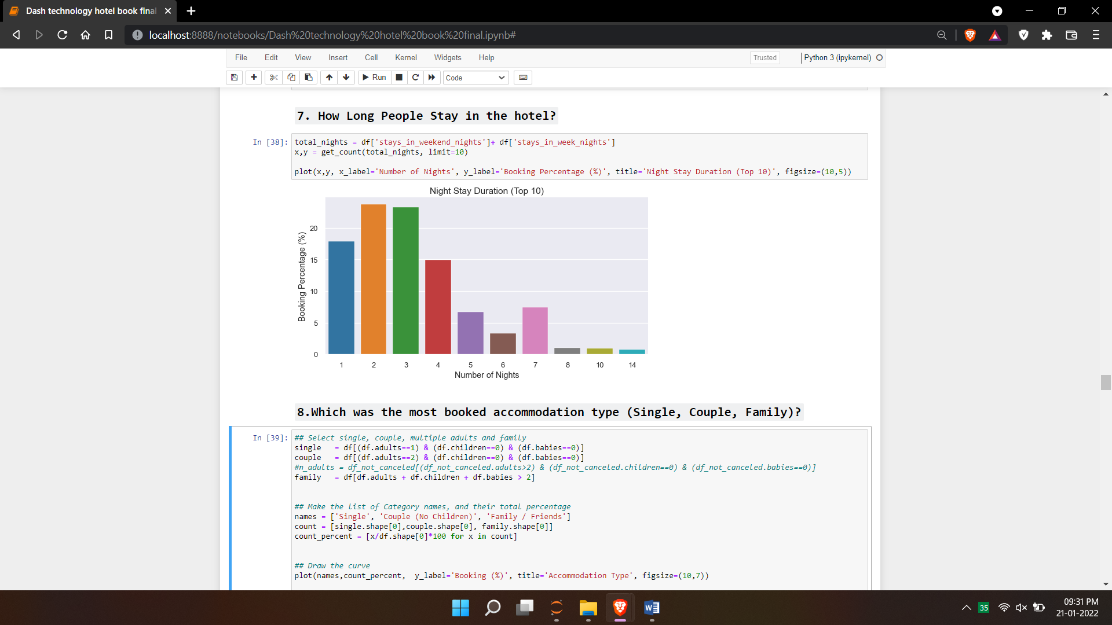
6.'Hotel wise night stay duration (Top 10)?
7. How Long People Stay in the hotel?

Slide 9
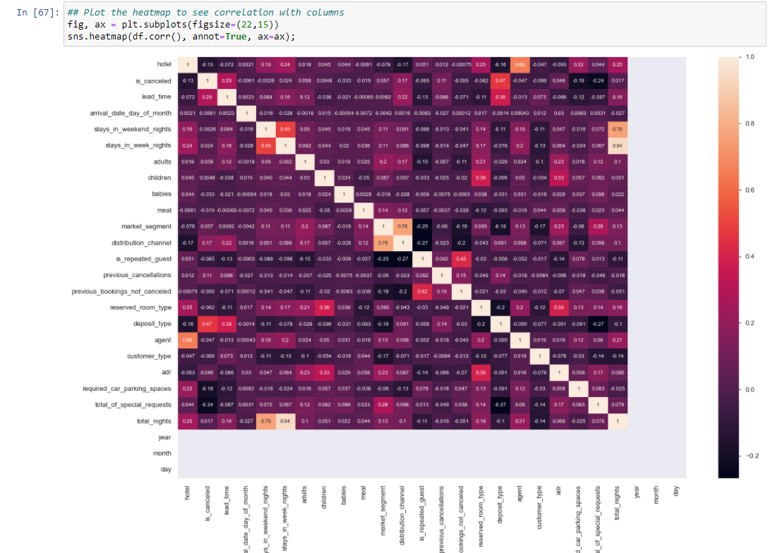
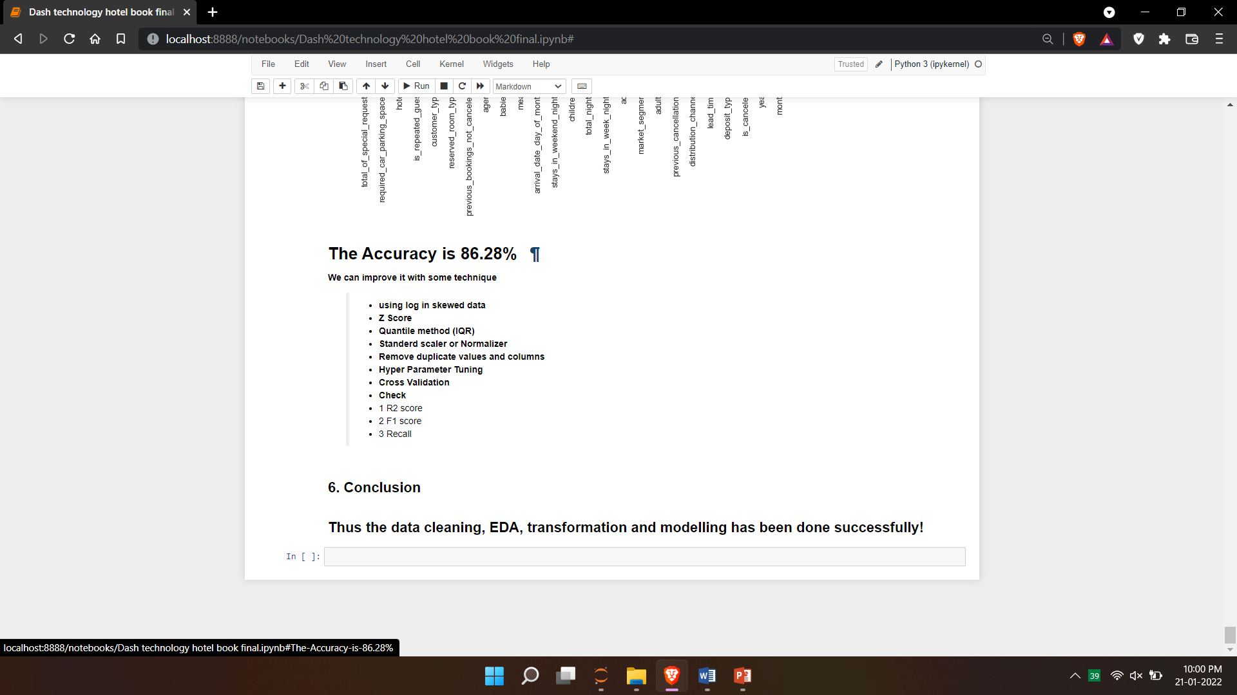
CORRELATION IN DATA
FINAL ACCURACY OF MODEL

Slide 10
THANK YOU

