Slide 1

Amazon
Product Review Data Analysis
Team members:
Mr. Periyasamy K
Mr. M Saad Tariq
Mr. Shubham Mahajan
Mr. Vigneshwar M
Under the guidance of:
Mr. Gaurav mishra
01

Slide 2
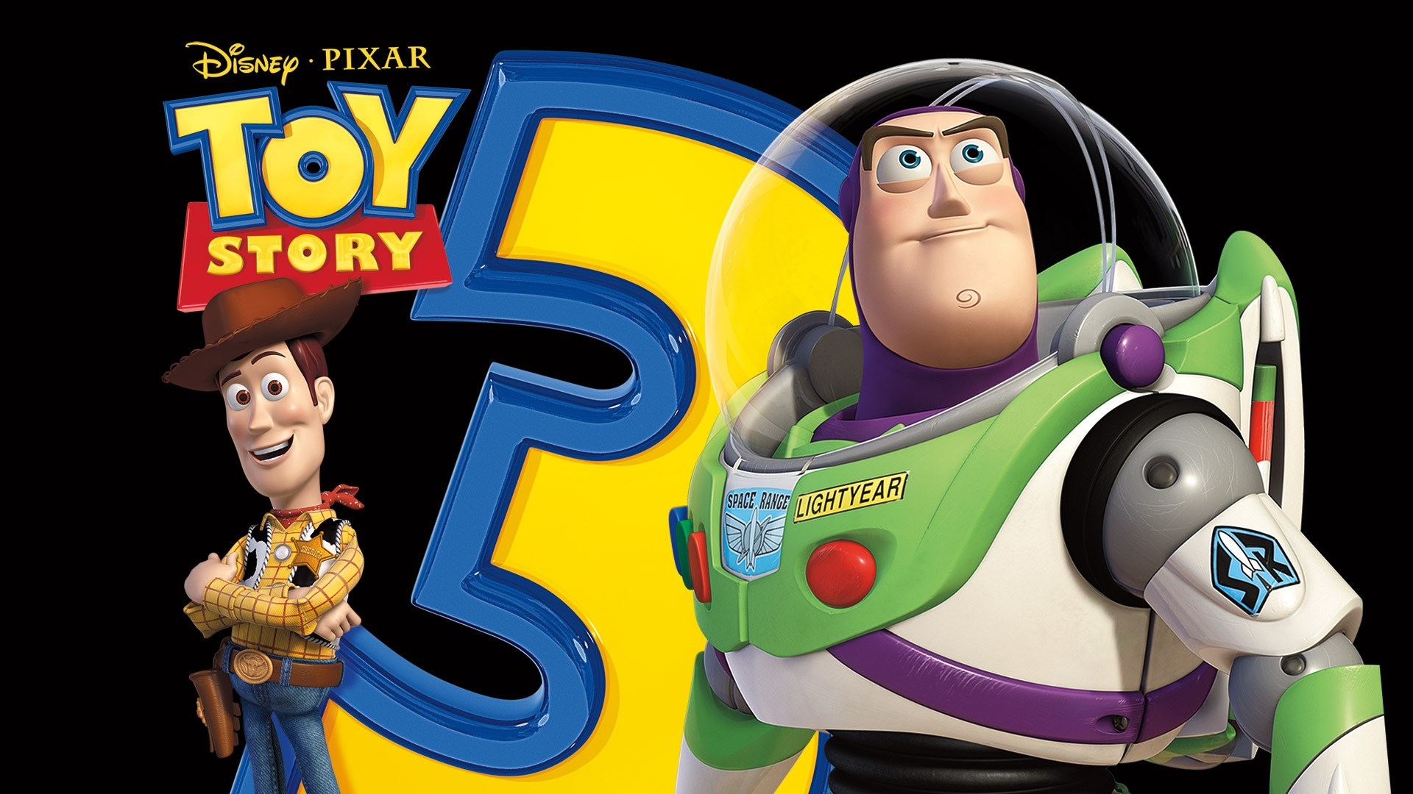
Table of Content:
Introduction
Business objective
About the data set
Sentiment analysis.
Exploratory data analysis (EDA).
Clustering data.
Time series analysis.
Machine learning classification modelling.
Conclusion
Recommendations
02

Slide 3
Introduction:
With the quick growth of internet and it’s Increasing accessibility, e-commerce has developed rapidly in the last few years.
Amazon is a multinational technology company and one of the world's largest online marketplaces.
It was founded by Jeff Bezos in 1994 and originally started as an online bookstore.
Over the years, Amazon has expanded its product offerings to include a wide range of items such as electronics, clothing, household goods, and more.
The company is known for its customer-centric approach and focus on providing a seamless shopping experience.
It has played a significant role in shaping consumer behavior and the way people shop online.
03

Slide 4
Business objective:
Identifying the customer reaction and sentiment in order to better understand and improve the business.
Exploring the data on the bases of sentiment and ratings.
Utilizing clusters to develop algorithms and filters to highlight or recommend relevant reviews to customers.
Forecast customer sentiments to provide valuable insights into understanding future trends.
Building a text classification machine learning model to predict the customer sentiment of new product reviews.
04

Slide 5

About the data set:
Data source: https://jmcauley.ucsd.edu/data/amazon/
Products reviews between years 1996 and 2018.
Information on the data sets used:
Toy dataset
No of observations : 1 lakh Video game dataset
No of observations : 1 lakh
05

Slide 6
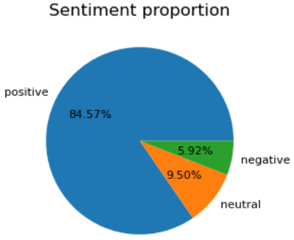
Sentiment analysis (Toy dataset)
A polarity score below 0 usually indicates negative sentiment, and approximately 5.92% of customers exhibit this negative sentiment.
A polarity score of 0 typically indicates neutral sentiment, and approximately 9.50% of customers exhibit this neutral sentiment.
A polarity score greater than 0 typically indicates positive sentiment, and approximately 84.57% of customers exhibit this positive sentiment.
06

Slide 7
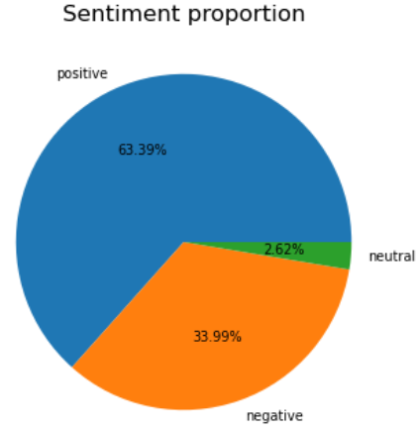
Sentiment analysis (Video game dataset )
A polarity score below 0 usually indicates negative sentiment, and approximately 33.99% of customers exhibit this negative sentiment.
A polarity score of 0 typically indicates neutral sentiment, and approximately 2.62% of customers exhibit this neutral sentiment.
A polarity score greater than 0 typically indicates positive sentiment, and approximately 63.39% of customers exhibit this positive sentiment.
07

Slide 8
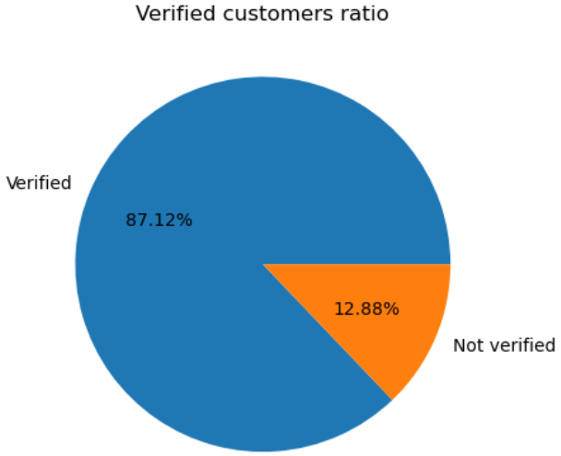
Verified customers ratio analysis (Toy Dataset)
87.12% of reviews are from Verified customers.
12.88% of reviews are from Non-verified customers.
09

Slide 9
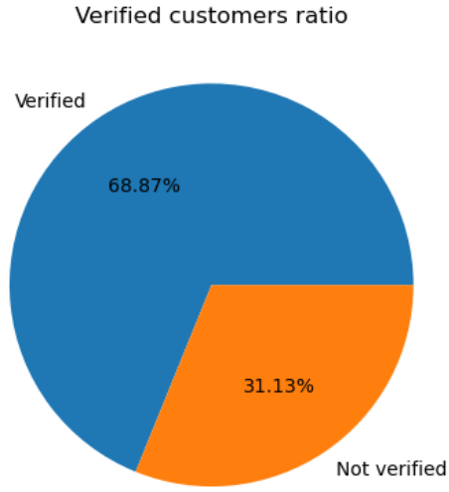
Verified customers ratio analysis (Video Dataset)
68.87% of reviews are from Verified customers
31.13% of reviews are from Non-verified customers.
08

Slide 10
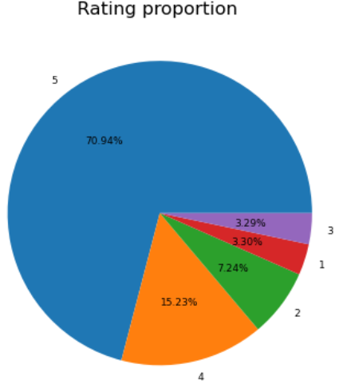
Customer Rating proportion analysis (Toy Dataset )
86.17% of customers have provided product ratings of 5 and 4, indicating higher level of satisfaction.
3.3% of customers have rated product with grade 3, suggesting neutral level of satisfaction.
10.6% of customers have rated the product as grade 2 and less which reflects the lower satisfaction of service.
10

Slide 11
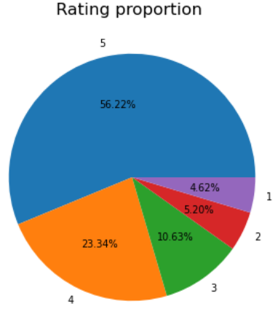
Customer Rating proportion analysis (Video Dataset )
79.56% of customers have provided product ratings of 5 and 4, indicating higher level of satisfaction.
10.6% of customers have rated product with grade 3, suggesting neutral level of satisfaction.
9.8% of customers have rated the product as grade 2 and less which reflects the lower satisfaction of service.
11

Slide 12
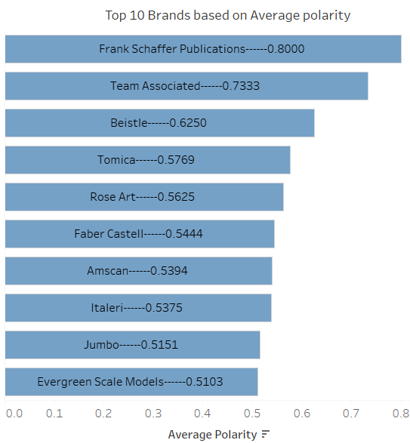
Top 10 Brands based on average polarity (Toy dataset)
Frank Schaffer Publications is identified as a top brand with its average polarity at 0.80
Evergreen Scale Models has the lowest average polarity score of 0.5103 among the top 10 brands, indicating it is the least preferred brand.
Among the top 10 brands, the polarity scores range from 0.51 to 0.80, indicating a generally positive sentiment across these brands.
12

Slide 13
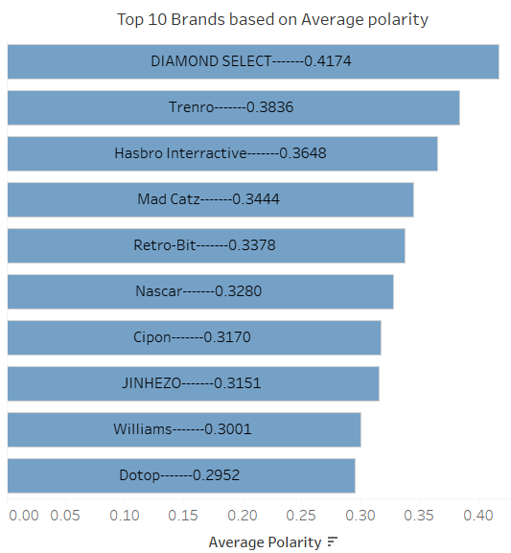
Top 10 Brand wise average polarity (Video game dataset)
Diamond Select is identified as a top brand with its average polarity at 0.417
Dotop has the lowest average polarity score of 0.2952 among the top 10 brands, indicating it is the least preferred brand.
Among the top 10 brands, the polarity scores range from 0.2952 to 0.417, indicating a range of sentiment levels.
13

Slide 14
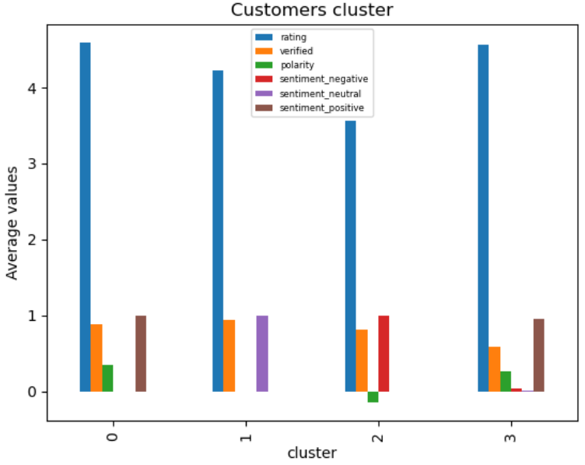
Clustering the Toy dataset using K-Means method
Cluster 0 represents "Loyal customers“, as average rating is 4.59, 87% verified customers with average polarity score of 0.35 and majority of customers in positive reviews.
Cluster 1 represents "Average customers“, has an average rating of 4.23, 93% verified customers with average polarity score of 0 and majority of customers in neutral sentiment.
Cluster 2 represents " Frustrated customers“, has an average rating of 3.56, 82% verified customers , a polarity score of -0.14 and majority of customers in negative sentiment.
Cluster 3 represents "Impassive customers”, has an average rating of 4.56, 56% verified customers, a polarity score of 0.26 and majority of mixed sentiment.
15

Slide 15
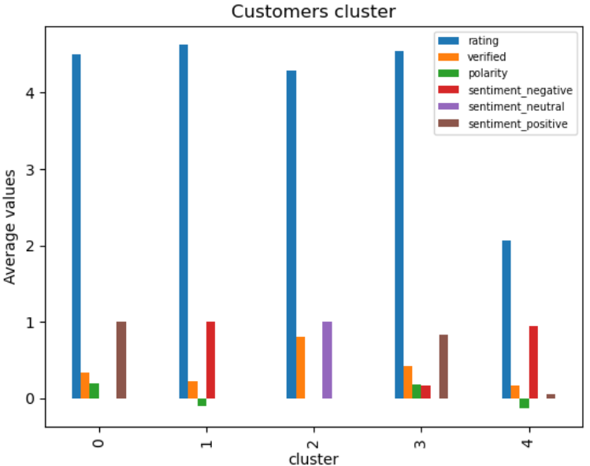
Clustering the Video dataset using K-Means method
Cluster 0 represents "Loyal customers“, has an average rating of 4.50, 34% verified customers with average polarity score of 0.19 and positive sentiment.
Cluster 1 represents " Frustrated customers“, has an average rating of 4.62, 23% verified customers , a polarity score of -0.09 and negative sentiment.
Cluster 2 represents "Average customers“, has an average rating of 4.29, 82% verified customers, a polarity score of 0 and a neutral sentiment.
Cluster 3 represents “ satisfied customers “, has an average rating of 4.55, 42% verified customers, a polarity score of 0.17 and a relatively positive sentiment.
Cluster 4 represents "Impassive customers”, has an average rating of 2.01, 16% verified customers, a polarity score of -0.13, and a relatively negative sentiment.
16

Slide 16
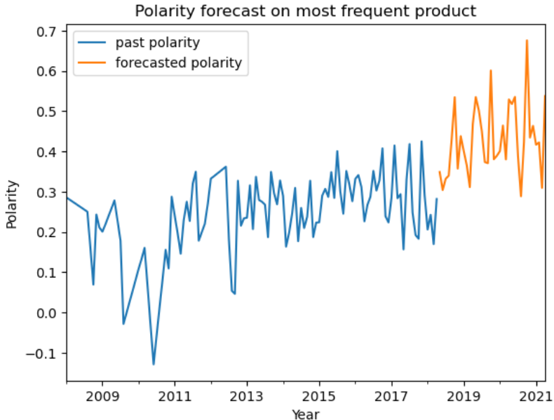
Time Series Forecasting for Toy dataset
The SARIMA model shows that polarity score for most frequent sold product tend to go up from year 2011 and it follows a positive trend.
This positive trend suggests that the sentiment and perception towards the product are consistently favorable.
Thus the forecast indicates its sustained popularity and positive reception among customers.
17

Slide 17
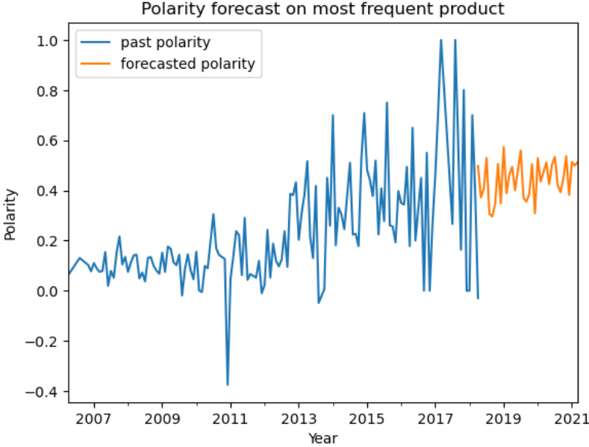
Time Series Forecasting for Video dataset
The SARIMA model shows that polarity score for most frequent product tend to go up from year 2011 and it follows a positive trend similar to toy data set
The positive trend suggests that the sentiment and perception towards the product are consistently favorable.
But the forecast indicates a flat sustained popularity and positive reception among customers is showing a slow growth in the next 3 years.
18

Slide 18
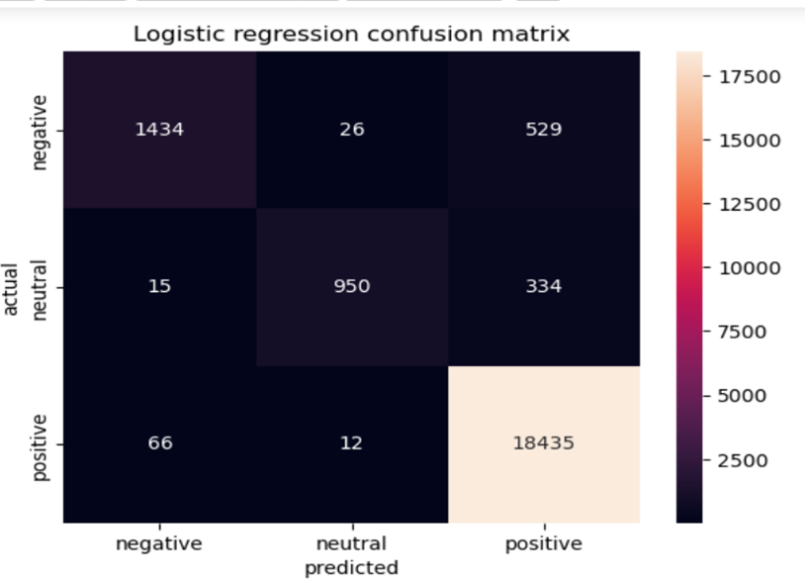
Text classification model for Toy dataset
We have used 4 classification model’s Logistic regression, Naive Bayes, KNN and Ada Boost.
Logistic regression with multiclass one-vs-rest classifier is the best model as accuracy is 96%, precision is 95%, recall 95% and f1 score also 95%.
Majority of actual positive values(18.4k) have return positive from the prediction model
This is the same in case of neutral and negative predictions.
19

Slide 19
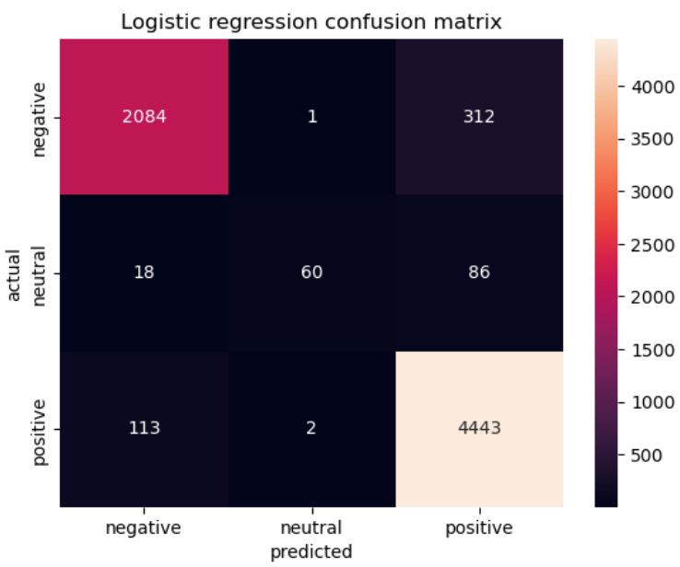
Text classification model for Toy dataset
We have used 4 classification model Logistic regression, Naive Bayes, KNN and Ada Boost.
Logistic regression with multiclass one-vs-rest classifier is the best model as accuracy (95%), precision score(92%), recall score(92%) and f1 score(92%).
Majority of actual positive values(4.45k) have return positive from the prediction model.
This is the same in case of neutral and negative predictions.
20

Slide 20
Conclusion:
Among the sentiment analysis results, it is observed that approximately 76% customers have a positive sentiment and rest of them have negative and neutral sentiment about the product.
Based on customer rating proportion nearly 84% of product have 5 and 4 ratings.
Cluster analysis helps in segmenting customers based on customer behaviors "Loyal customers“, "Angry customers“, "Average customers“, “Satisfied customers“, "Impassive customers“.
Timeseries forecasting indicates a flat sustained popularity and positive reception among customers that’s showing a slow growth in the next 3 years.
On text classification Logistic regression model is the best performing model with 96% accuracy.
21

Slide 21

Recommendation:
Amazon should analyze where the actual flaws are, whether they are in Products or they are in quality of service including user interfaces.
We can also conclude that so much irrelevant reviews are making more helpful reviews unfindable. So reviewers should review properly so that it can add value to someone's purchases.
Encourage customers to leave detailed and helpful reviews by offering incentives or rewards.
Amazon should Implement mechanisms to verify the authenticity of reviews and take action against fake or manipulated reviews.
There is a significant number of customers, approximately 40k, who fall into the neutral and negative sentiment categories. It is advisable to focus on addressing the concerns and improving the experience for these customers in order to enhance overall satisfaction and sentiment
22

Slide 22
Thank you
23

