Slide 1
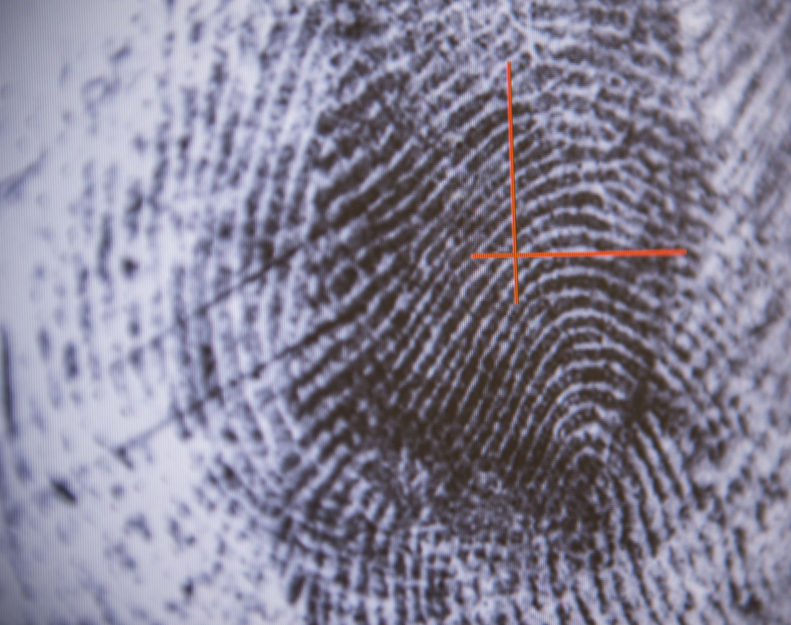
Hate Speech Detection
To : Data Glacier
By : Shubh Goyal
Batch : LISUM 20
Date : 29 June 2023
Internship Domain : Data Science

Slide 2

Outline
Problem Statement
System Architecture
Result Evaluation
Conclusion

Slide 3

PROBLEM STATEMENT
Hate speech refers to any form of verbal, written, or behavioral communication that targets and employs derogatory or discriminatory language against individuals or groups based on their religion, ethnicity, nationality, race, color, ancestry, sex, or other identity factors. In this project, we aim to develop a hate speech detection model using Machine Learning and Python.
The objective of hate speech detection is to classify text and determine whether it contains hate speech. This task falls under sentiment classification, where the model is trained to differentiate between different sentiments expressed in text. To accomplish this, we will train a model using data specifically labeled for sentiment classification.
In the context of this hate speech detection model, we will utilize Twitter tweets as the data source. By analyzing these tweets, we aim to identify instances that contain hate speech. Through the training process, the model will learn to distinguish between hateful and non-hateful content, allowing it to accurately classify hate speech in text.

Slide 4
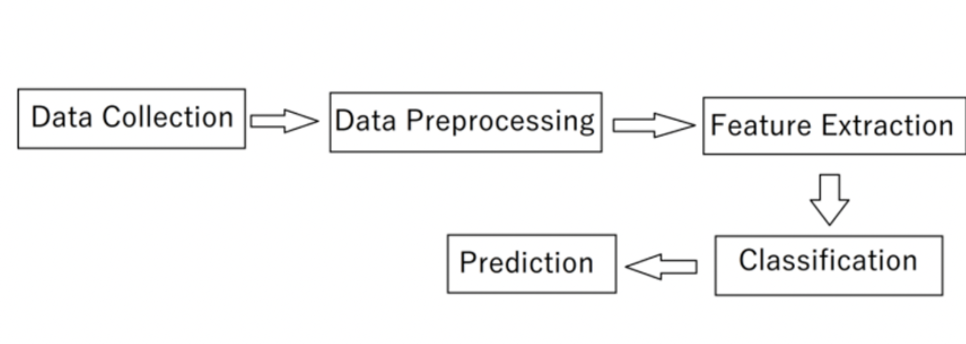
SYSTEM ARCHITECTURE

Slide 5

DATA COLLECTION
The Data is about Twitter hate Speech taken from Kaggle [1] which contains the 3 number of features and 31962 number of observations. Dataset using Twitter data, it was used to research hate-speech detection. The text is classified as: hate-speech, offensive language, and neither. Due to the nature of the study, it is important to note that this dataset contains text that can be considered racist, sexist, homophobic, or offensive

Slide 6

DATA PREPROCESSING
Text Cleaning
▪ Lowercase
▪ Remove Punctuation
▪ Remove URLs
▪ Remove @tags
▪ Remove Special Characters
Preprocessing Operations
Tokenization
Removing Stop Words
Lemmatization

Slide 7

FEATURE EXTRACTION
TF-IDF Model
Creating the histogram
Frequent words from dictionaries
TF Matrix
IDF Matrix
TF-IDF Calculation

Slide 8
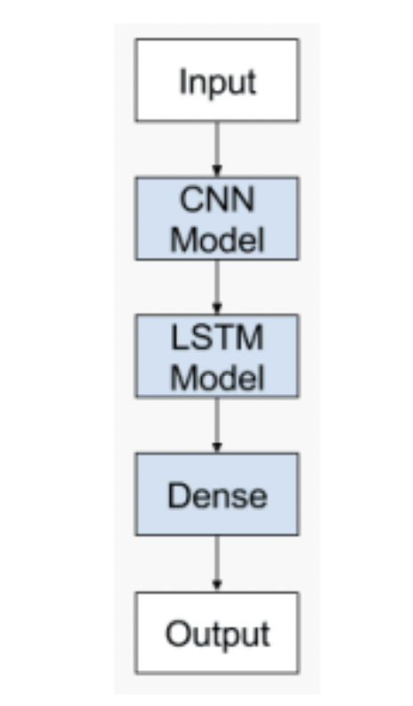
DEEP LEARNING MODEL
CNN with LSTM Model

Slide 9
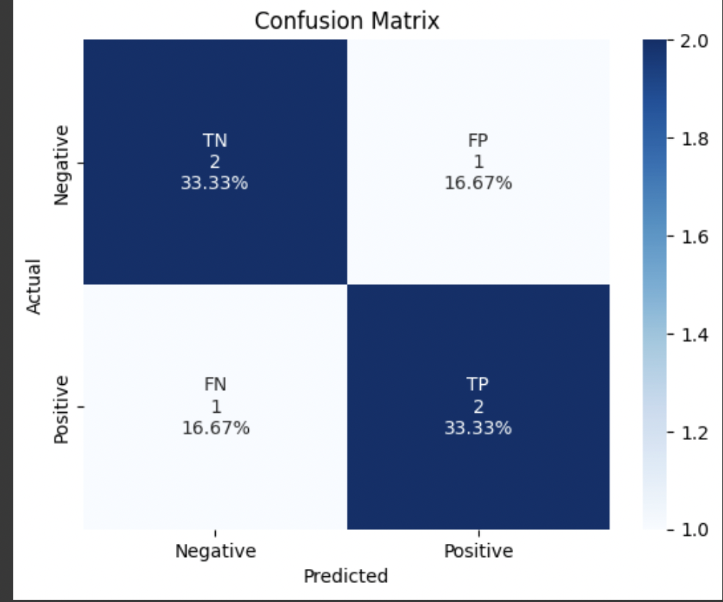
Result Evaluation
Confusion Matrix Visualization

Slide 10
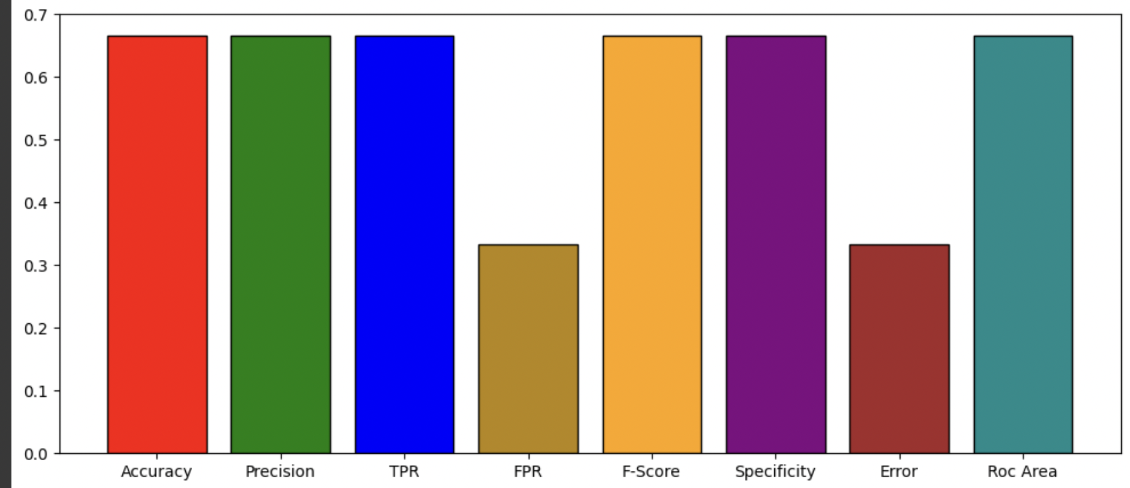
• Result Visualization

Slide 11
CONCLUSION
The primary goal of this project was to explore various methods and configurations that could be employed to improve the accuracy of hate speech detection on Twitter. While the model developed demonstrates promising results, it is important to note that the error rate is not zero, and there is a possibility of misclassifying certain instances of hate speech as non-hateful or vice versa.
Despite the achieved accuracy, the model still has room for improvement. In future iterations, we plan to enhance the performance by implementing two specific techniques: Temporal Convolutional Network (TCN) and Random Multimodel Deep Learning (RMDL).

