Slide 1


NETWORK & SERVICE AUTOMATION USING GCP
Name: Shubham Tiwari, 101916126, 4CS12
Org. Name: Ericsson India Global Services Private Limited, Noida
Jan 25th , 2023 - July 25th , 2023
Faculty Mentor:
Dr. Shashank Sheshar Singh
Professor
TIET, Patiala
Industrial Mentor:
Mr. Ashish Priydarshi
Product Area Manager
EGI, Noida
GCP – Google Cloud Platform

Slide 2
TABLE OF CONTENTS:
Company Introduction
Project Background
Scope & Utility of Project
Architecture of the Project
Technology Background
Some snapshots
7. Learnings: Professional & Technical
8. Key Highlights of Project
9. Feedback about the Project Semester

Slide 3
1. COMPANY INTRODUCTION
Swedish base MNC, founded in 1876, headquarters - Stockholm.
Operates in over 180 countries, Employs 100,000+ people worldwide.
AREA OF EXPERTISE:
Networks: Ericsson is a leader in designing, deploying, and managing advanced communication networks, including 5G and beyond.
Digital Services: The company offers a range of digital solutions to help businesses and governments accelerate their digital transformation.
Managed Services: Ericsson provides comprehensive managed services to optimize network performance and operational efficiency.
Emerging Technologies: Ericsson explores emerging technologies such as Internet of Things (IoT), artificial intelligence, and cloud computing.
Ref - https://www.ericsson.com/en

Slide 4

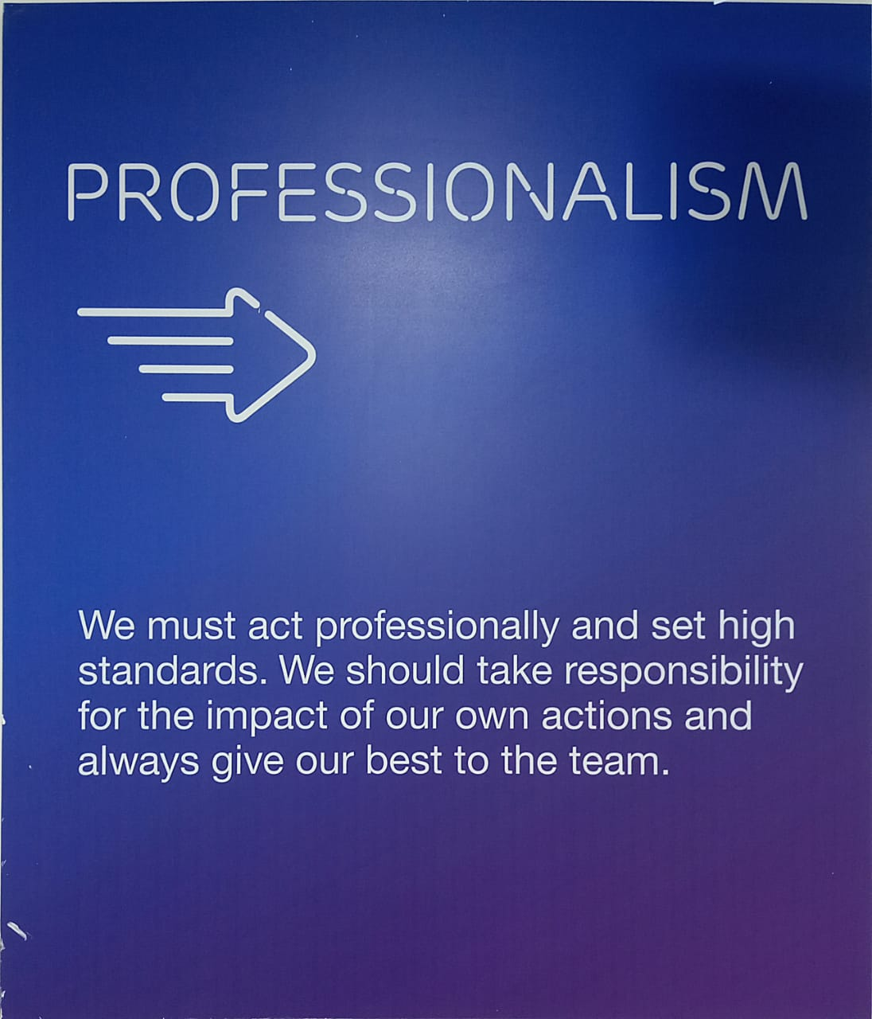
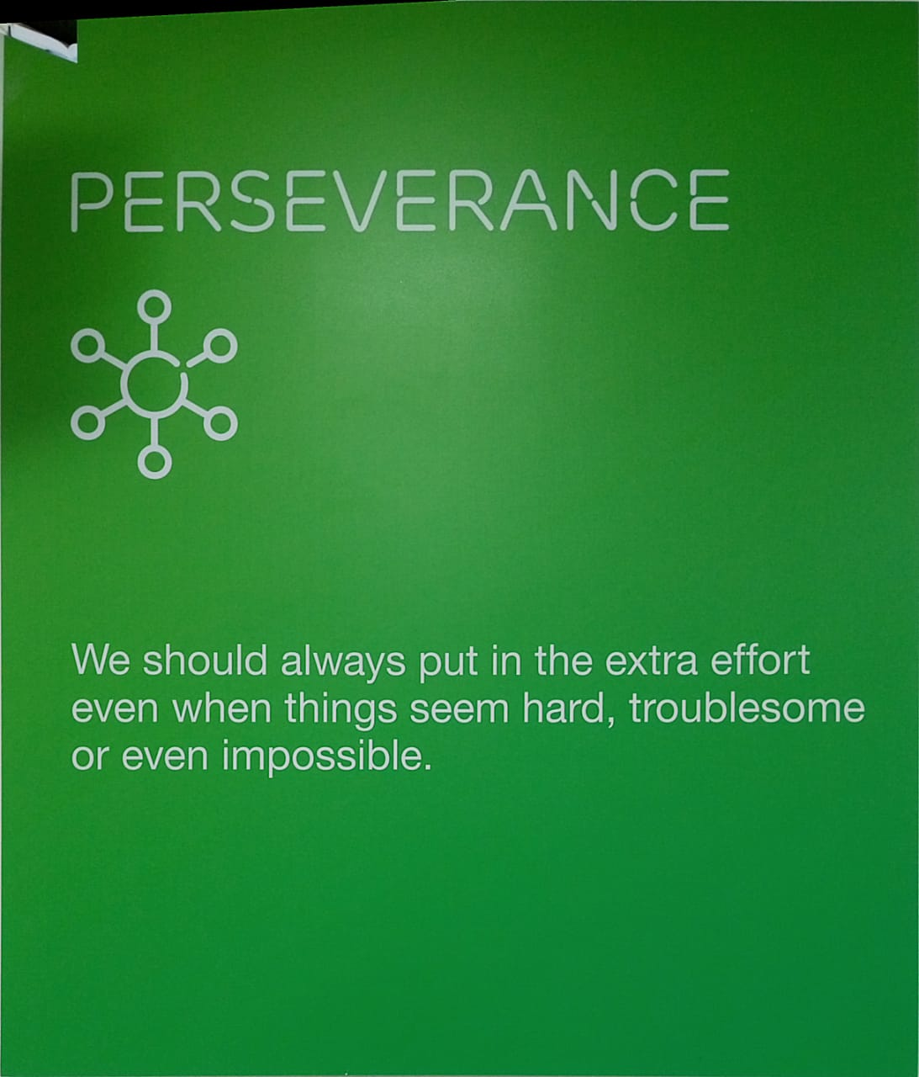
1. COMPANY INTRODUCTION
CORE VALUES
Ref - https://www.ericsson.com/en/careers/working-here

Slide 5
2. PROJECT BACKGROUND
OBJECTIVES:
Develop Data Ingestion Automation – To reduce error, time, manual effort
Make Lightweight Architecture of the existing one to cut the costs and company can offer service in budget for small customers. (Note – This is an internal tool so discussion on this is limited)
Better utilization of available cloud resources i.e., computation power, storage etc
NEED:
Manual effort elimination for updation, deletion, insertion into table
Cost reduction of cloud resources usage
Better usage of GCP features

Slide 6



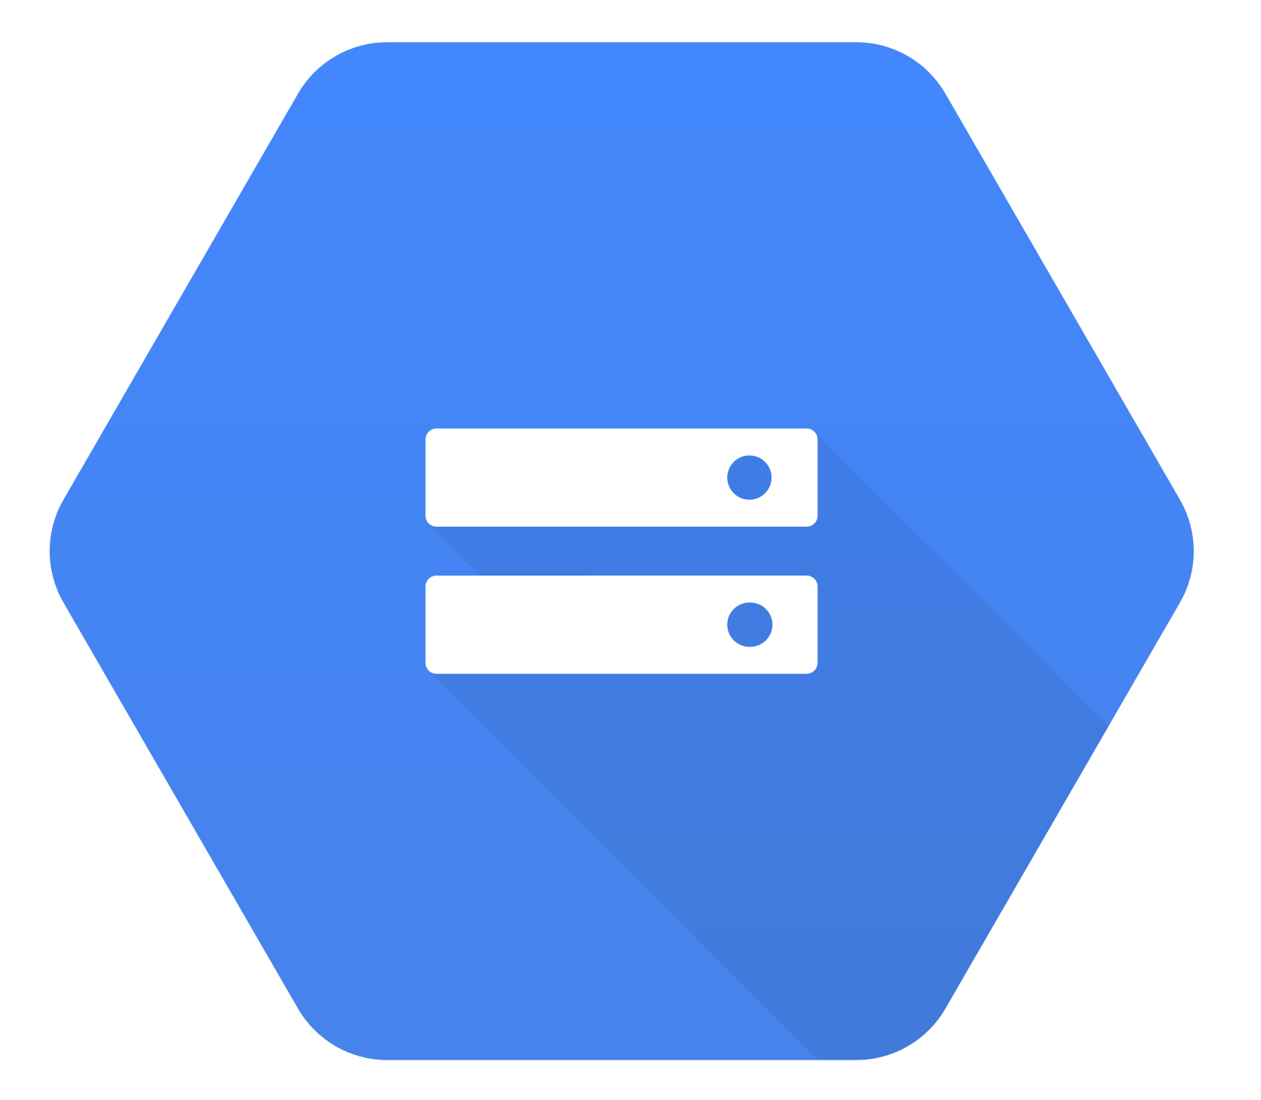

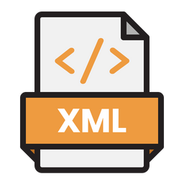
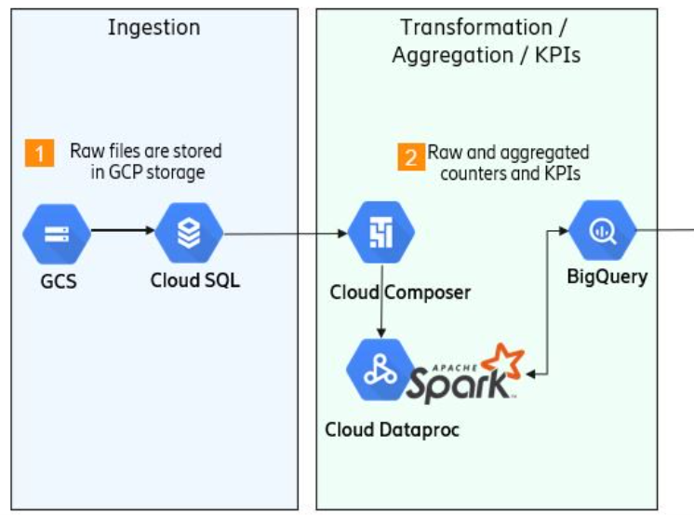
2. PROJECT BACKGROUND
BigQuery table
Customer
Manual effort for
Data preparation
GCS Bucket
Manual ingestion
Fig. 1) Old Data ingestion Automation
Need to eliminate manual efforts
Fig. 2) Old Architecture of GCP:
Need to eliminate red circled component which is too costly.
Ref - https://www.pngwing.com/en/free-png-zkjkf

Slide 7
3. SCOPE & UTILITY OF PROJECT
SCOPE:
As today is the era of cloud technology so working on this project which is based on Google Cloud Platform give great exposure to corporate.
Variety of automation is needed in industry and one learning inspire other learning exposure.
This data ingestion automation enables businesses to efficiently handle large volumes of data from various sources
UTILITY:
Cost & error reduction for ingestion system
Faster updation in BigQuery table no manual updation, insertion or deletion
By automation tasks such extraction, transformation & loading, Org. have improved efficiency, time saving, enhanced data quality and consistency.

Slide 8

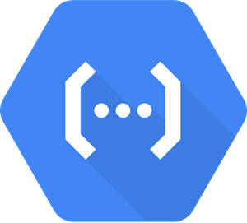
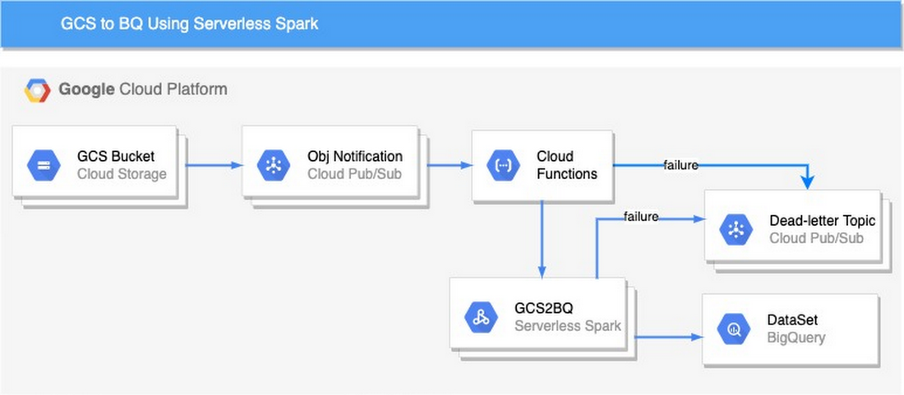
4. ARCHITECTURE OF THE PROJECT
4.1 DATA INGESTION AUTOMATION
GCS Bucket
Pub/Sub
Cloud function
BigQuery table
Customer

Slide 9
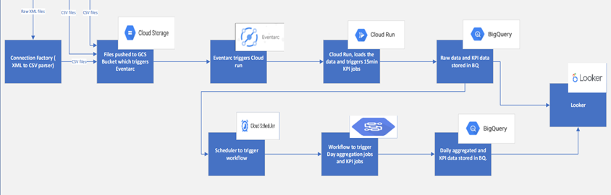
4. ARCHITECTURE OF THE PROJECT
4.2 NEW LIGHT WEIGHT ARCHITECTURE OF GCP
Fig. - New light weight architecture of GCP

Slide 10

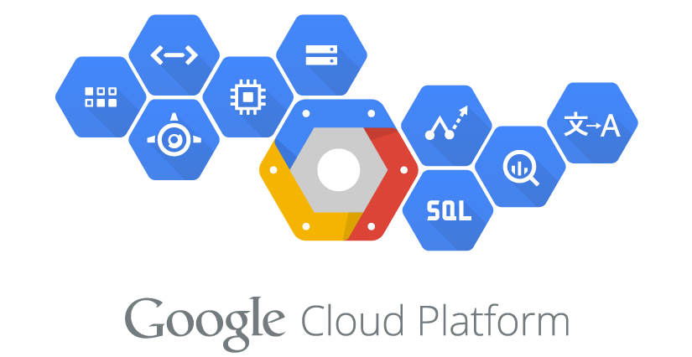
5. TECHNOLOGY BACKGROUND
Development Need:
Programming language – Python 3.10
Modules – Pandas, JSON, Google cloud BigQuery, google cloud storage, Flask, Jinja2, Sqlite3
Database – GoogleSQL (Because it supports broadest domain)
Tools: Excel, VS code, Docker-Container
GCP Components – BigQuery, GCS Bucket, Cloud Function, Cloud Run etc.
And some Ericsson’s internal tool
Fig. Python Logo
Ref - https://commons.wikimedia.org/wiki/File:Python-logo-notext.svg, https://www.pinterest.com/pin/296393219209598164/

Slide 11
5. TECHNOLOGY BACKGROUND
GCP Component | Brief Description
BigQuery | Data warehouse/analytics
Pub/Sub | Global real time messaging
Composer | Managed workflow orchestration service
Dataproc | Managed Apache Hadoop
GCS Bucket | Globally unique container for storing and organizing data objects in Google Cloud Storage
Google Cloud Function | Event-driven serverless compute platform for building and connecting cloud services.
Eventarc | Fully managed event ingestion and delivery service for event-driven architectures.
Cloud Run | Fully managed serverless platform for deploying and running containerized applications.
Cloud scheduler | Fully managed cron job scheduler for automating recurring tasks in the cloud.
Ref - https://console.cloud.google.com/

Slide 12
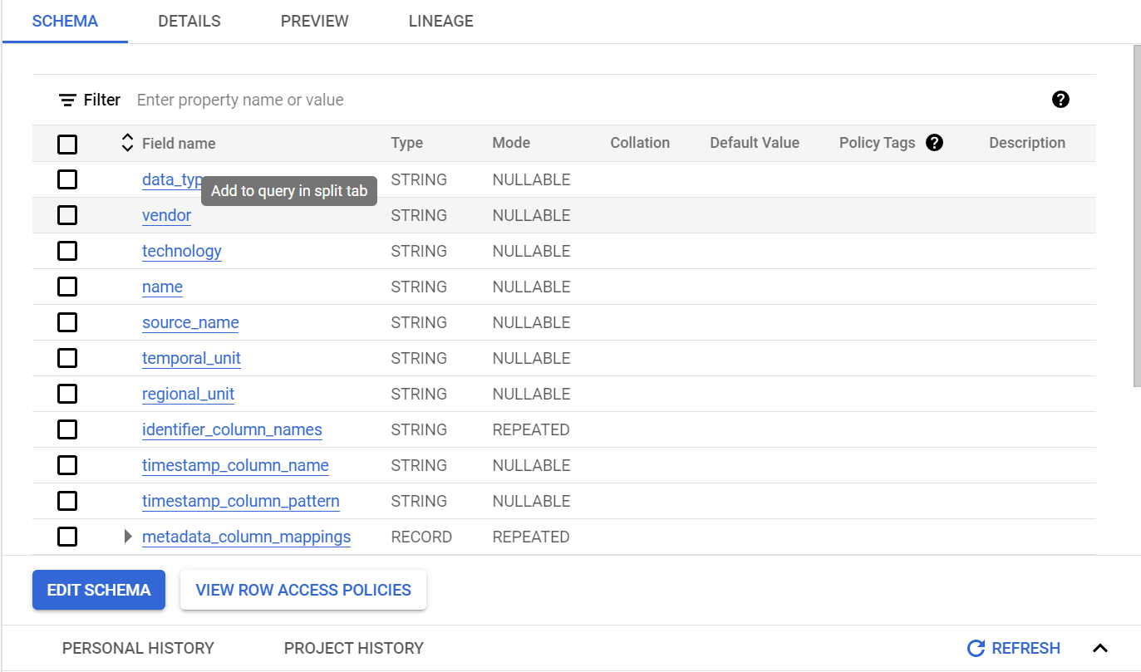
6. SOME SNAPSHOTS
In the above table we can see that all of our data is loaded with the correct schema that we require for mapping our data in the table. The schema can consist of different types of data such as string, records( arrays of struct) etc. as we have loaded into our JSON files by running the Python scripts.
These entries have to be entered with correct mode in schema such as nullable or repeated so that our BigQuery operation works correctly and data is entered.

Slide 13
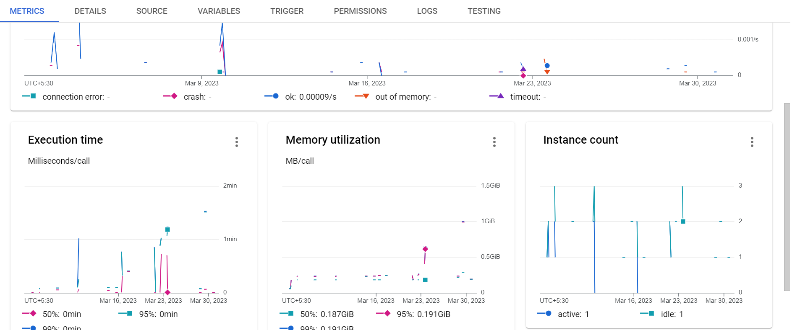
6. SOME SNAPSHOTS
In above table, we see that after we have deployed the Cloud Function using the trigger, we can use Metrics tab to study the performance of our function such as the memory utilized by our function, the execution time and so on. The same can be seen in Logs tab also. We can study these and further enhance our codes to improve the performance.

Slide 14
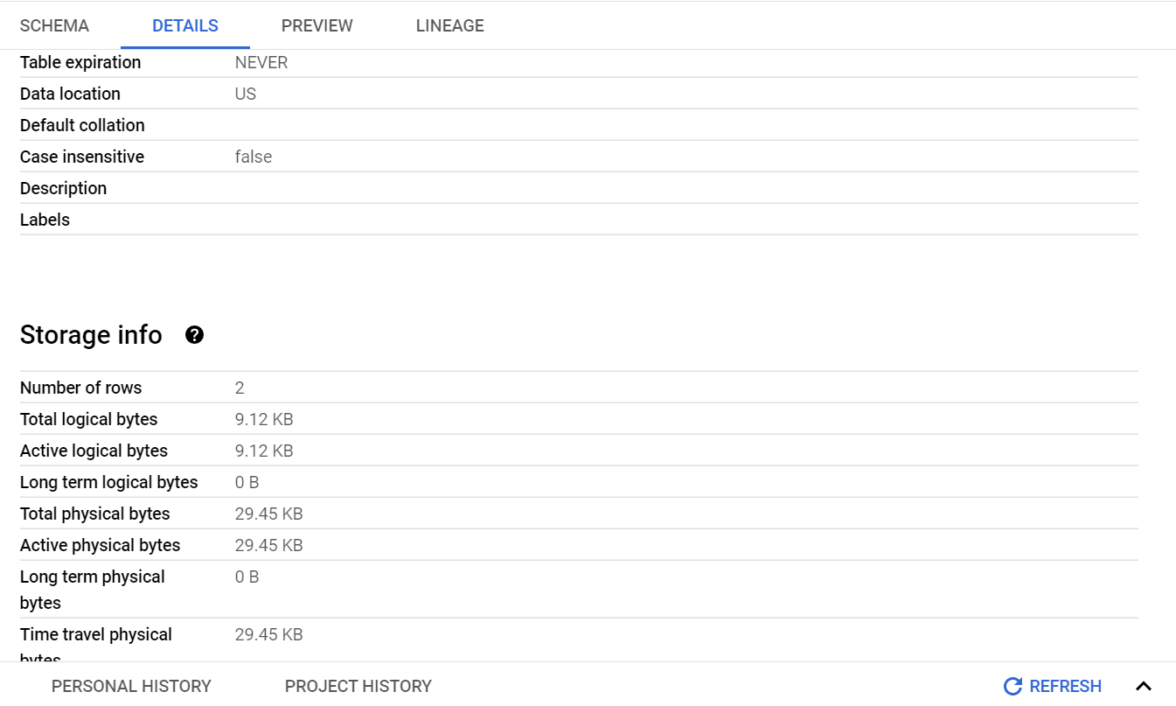
6. SOME SNAPSHOTS
In above table, we see that on the BigQuery tab in GCP, we can view the details of our table in terms of memory, rows etc.
We can view the entire table under the Preview tab.

Slide 15
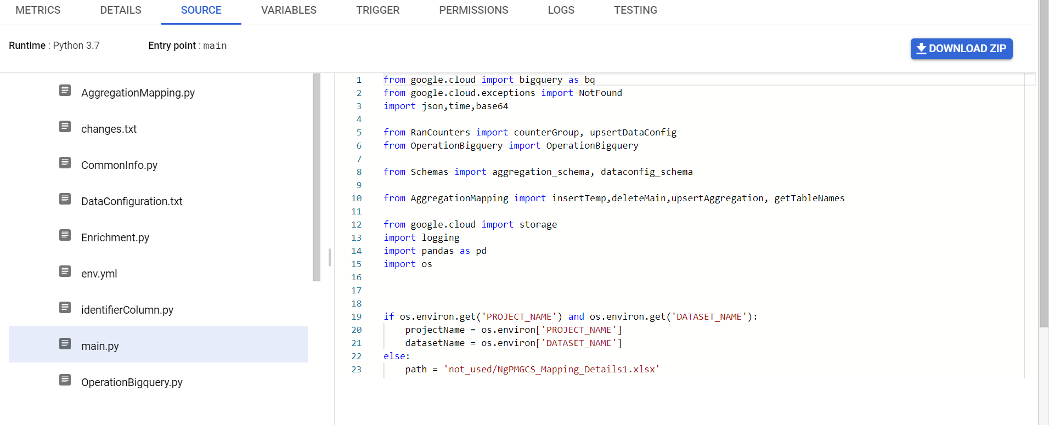
6. SOME SNAPSHOTS
Above Figure shows us all of our codes and files that we have uploaded onto the function under the Source tab. These codes get executed in the function. We generally call different functions in the main.py code to run and it becomes more organised.

Slide 16
7. LEARNING: TECHNICAL & PROFESSIONAL
TECHNICAL:
Telecom fundamentals
Debugging, testing and preparing documentation
Preparing Dynamic SQL using BigQuery
Familiarity of Cloud platform with Realtime project
CI/CD with GCP and it’s component
Coding Skill enhancement and gained better understanding
PROFESSIONAL:
Teamwork, Time management, Project Development, Professionalism
Critical thinking, Logic building,
Work in streamlined hierarchical manner for an MNC corporate setup.
Code of business Ethics, Prevention of Sexual Harassment,

Slide 17
8. KEY HIGHLIGHTS OF PROJECTS
E2E product development and deployment – Data ingestion Automation
This Product reduces manual effort by 80%.
With built-in connectors and event-driven architecture, organizations can seamlessly ingest data while ensuring data quality through validation and transformation.
GCP's cost optimization features allow for efficient resource utilization, making data ingestion both reliable and cost-effective.
Hands on experience in telecom sector as well as google cloud platform which is industry-oriented.
Ref - https://www.ericsson.com/en

Slide 18

9. FEEDBACK FOR PROJECT SEMESTER
The college's organization of the project semester is exceptional, providing a structured and efficient platform for students to excel.
The project semester organized by the college was a valuable learning experience, fostering collaboration and innovation among industry experts.
Practical and hands-on approach to education, preparing us for real-world challenges.
Faculty visit was nice, he asked about new learning and advised us for horizontal exploration then vertical exploration. I think that was best advise.

Slide 19
REFERENCES
https://en.wikipedia.org/
https://www.ericsson.com/en
https://console.cloud.google.com/run
https://console.cloud.google.com/storage
https://console.cloud.google.com/compute
https://console.cloud.google.com/functions
https://www.pngwing.com/en/search?q=thank+you

