Slide 1
Mechatronics AEZG511
Lecture

Slide 2
Introduction

Slide 3
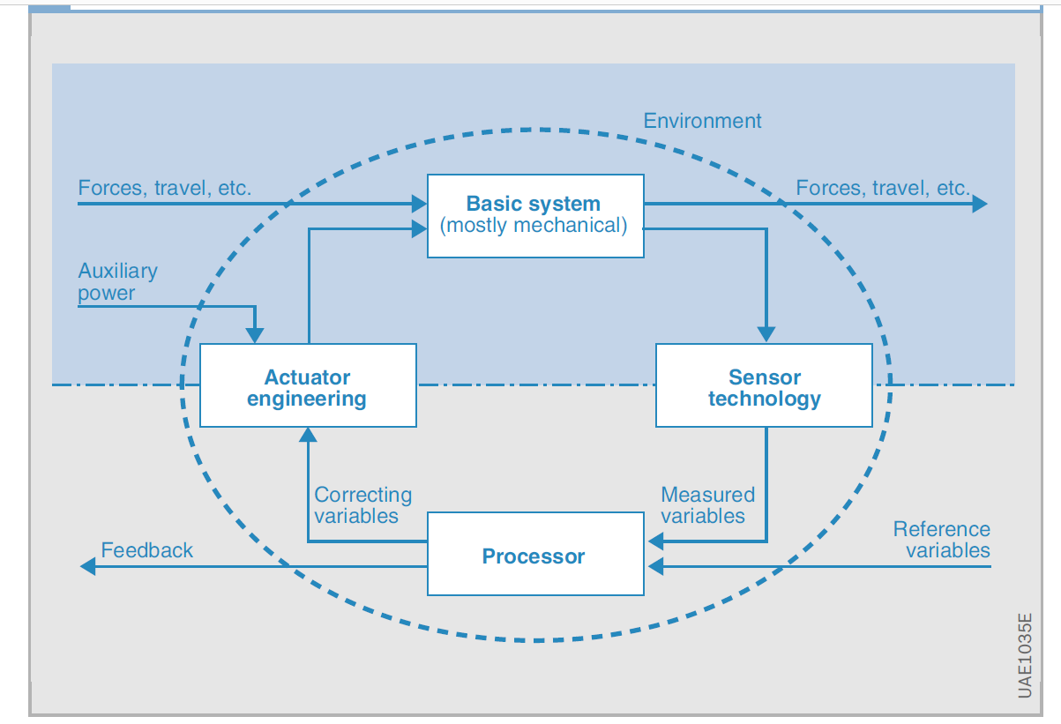
What is it?

Slide 4
Applications
Automobiles
Robots
Machine tools
What not!!!!

Slide 5
Engine control
Task of engine control:
calculate amount of fuel and
exact moment of injection
Dependencies:
pedal (driver)
load of the engine
temperature
etc.
Sensors and actuators:
position of crankshaft
valves
Relevance:
avoid mechanical damage
provide quality of control (e.g. fuel efficiency)
Crankshaft (red), pistons (grey) in their
cylinders (blue), and flywheel (black)
Notes:
<reference>[Kopetz 98], Section 1.7.2</reference>
2nd task: the exact moment at which the fuel must be injected in the combustion chamber of each cylinder.
Up to 100 concurrently executing software tasks must cooperate in tight synchronization (for engine control) to achieve the desired goal,
a smoothly running and efficient engine with a minimal output of pollution!

Slide 6
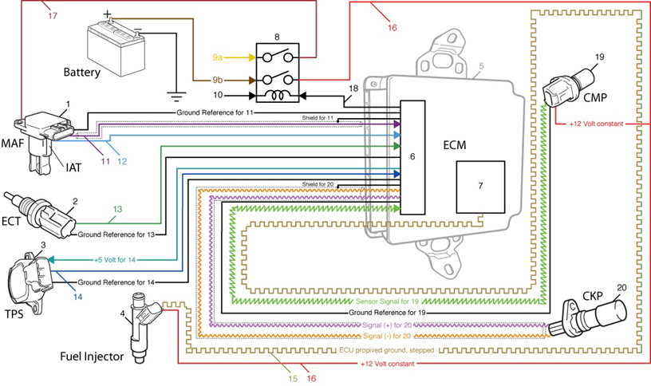
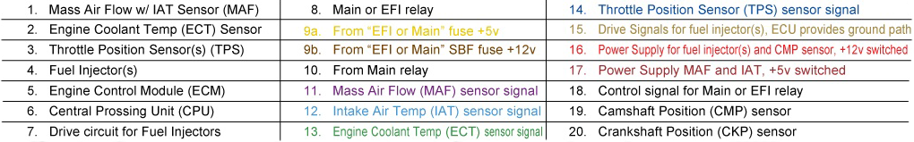
Building blocks - Systems

Slide 7
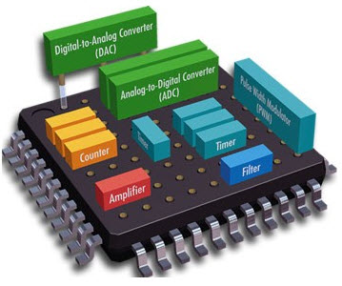
Building blocks - Systems
Embedded systems
Microcontrollers
Modelling of systems
Output Response is not instantaneous to input
May not be linear
Predict the system response

Slide 8
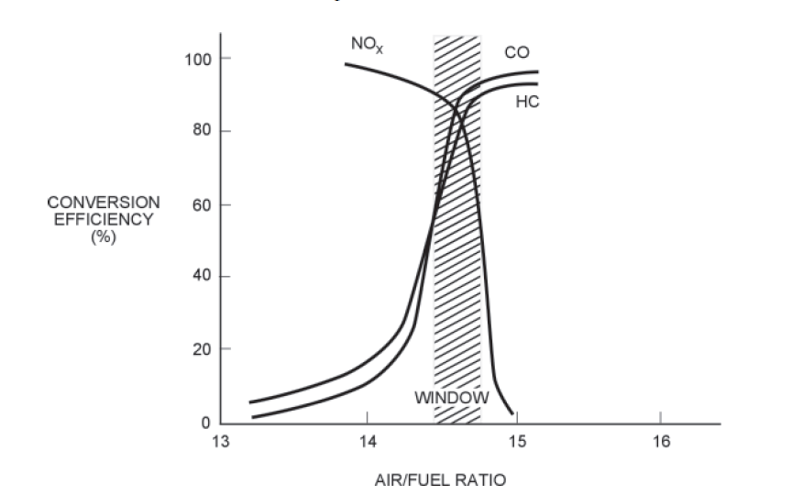
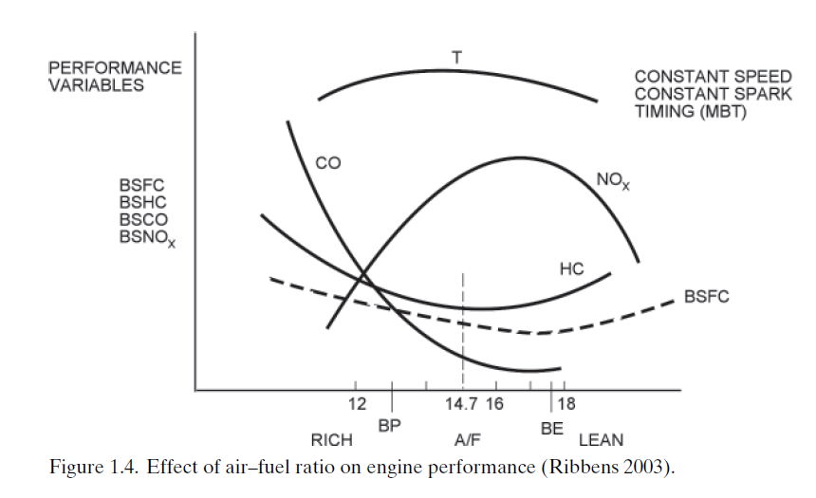
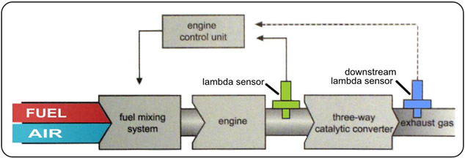
Building blocks - Controls

Slide 9
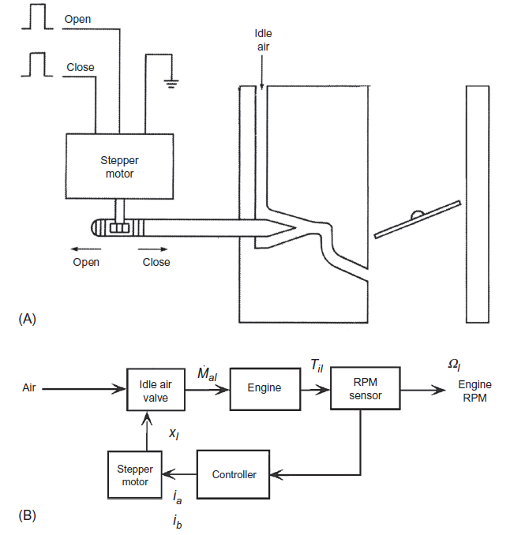
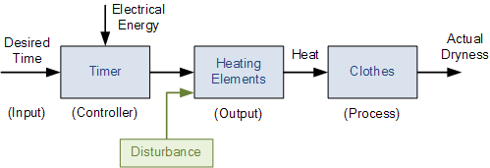
Building blocks – Open , Closed loops
Desired RPM

Slide 10
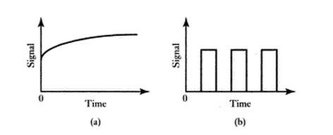
Building blocks - Signals
Analogue | Digital
Advantages | Advantages
Produces a more 'faithful' reproduction of the physical quantity. | Can be very immune to noise
Usually simple | Signal can be transmitted over long distances.
Disadvantages | Disadvantages
Noise and distortion problems | Output subject to quantity errors from sampling
 | Can be complex
Analog signal Digital signal

Slide 11
Thank you

