Slide 1

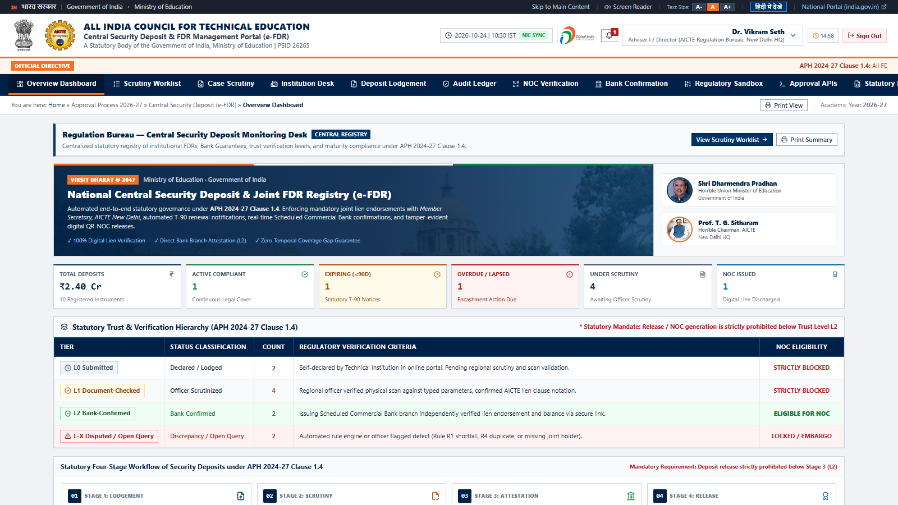
SMART INDIA HACKATHON 2026
TITLE PAGE: CENTRALIZED REGULATORY REPOSITORY & DIGITAL ESCROW [1]
PROJECT NYAAS — न्यास
Sovereign Zero-Trust Digital Escrow for Technical Institutions
• 10,000+ Colleges: Covers 10 Regional Bureaus & 100% statutory deposits.
• Hard L2 Bank Gate: Zero lien fraud; release impossible without bank attestation.
• < 48-Hour SLA: 92% drop in verification cycle from 24-day baseline.
• Chained SHA-256: Tamper-evident audit ledger with continuous hash proofs.
Problem Statement ID: 26265 [1]
Problem Statement Title: Streamline of security deposit/ FDR portal.
Theme: Smart Automation
PS Category: Software
Organization: AICTE (Regulation Bureau, Ministry of Education)
Registered Team Name: Phra Uma Thewi
Team ID: [Allocated via Portal]
Project Acronym: NYAAS (National Yearly AICTE Auditable Security-deposit portal)
Prototype Maturity: Stage 3 Working Prototype (React 18 + TS + Vite + Express) [2]

Slide 2
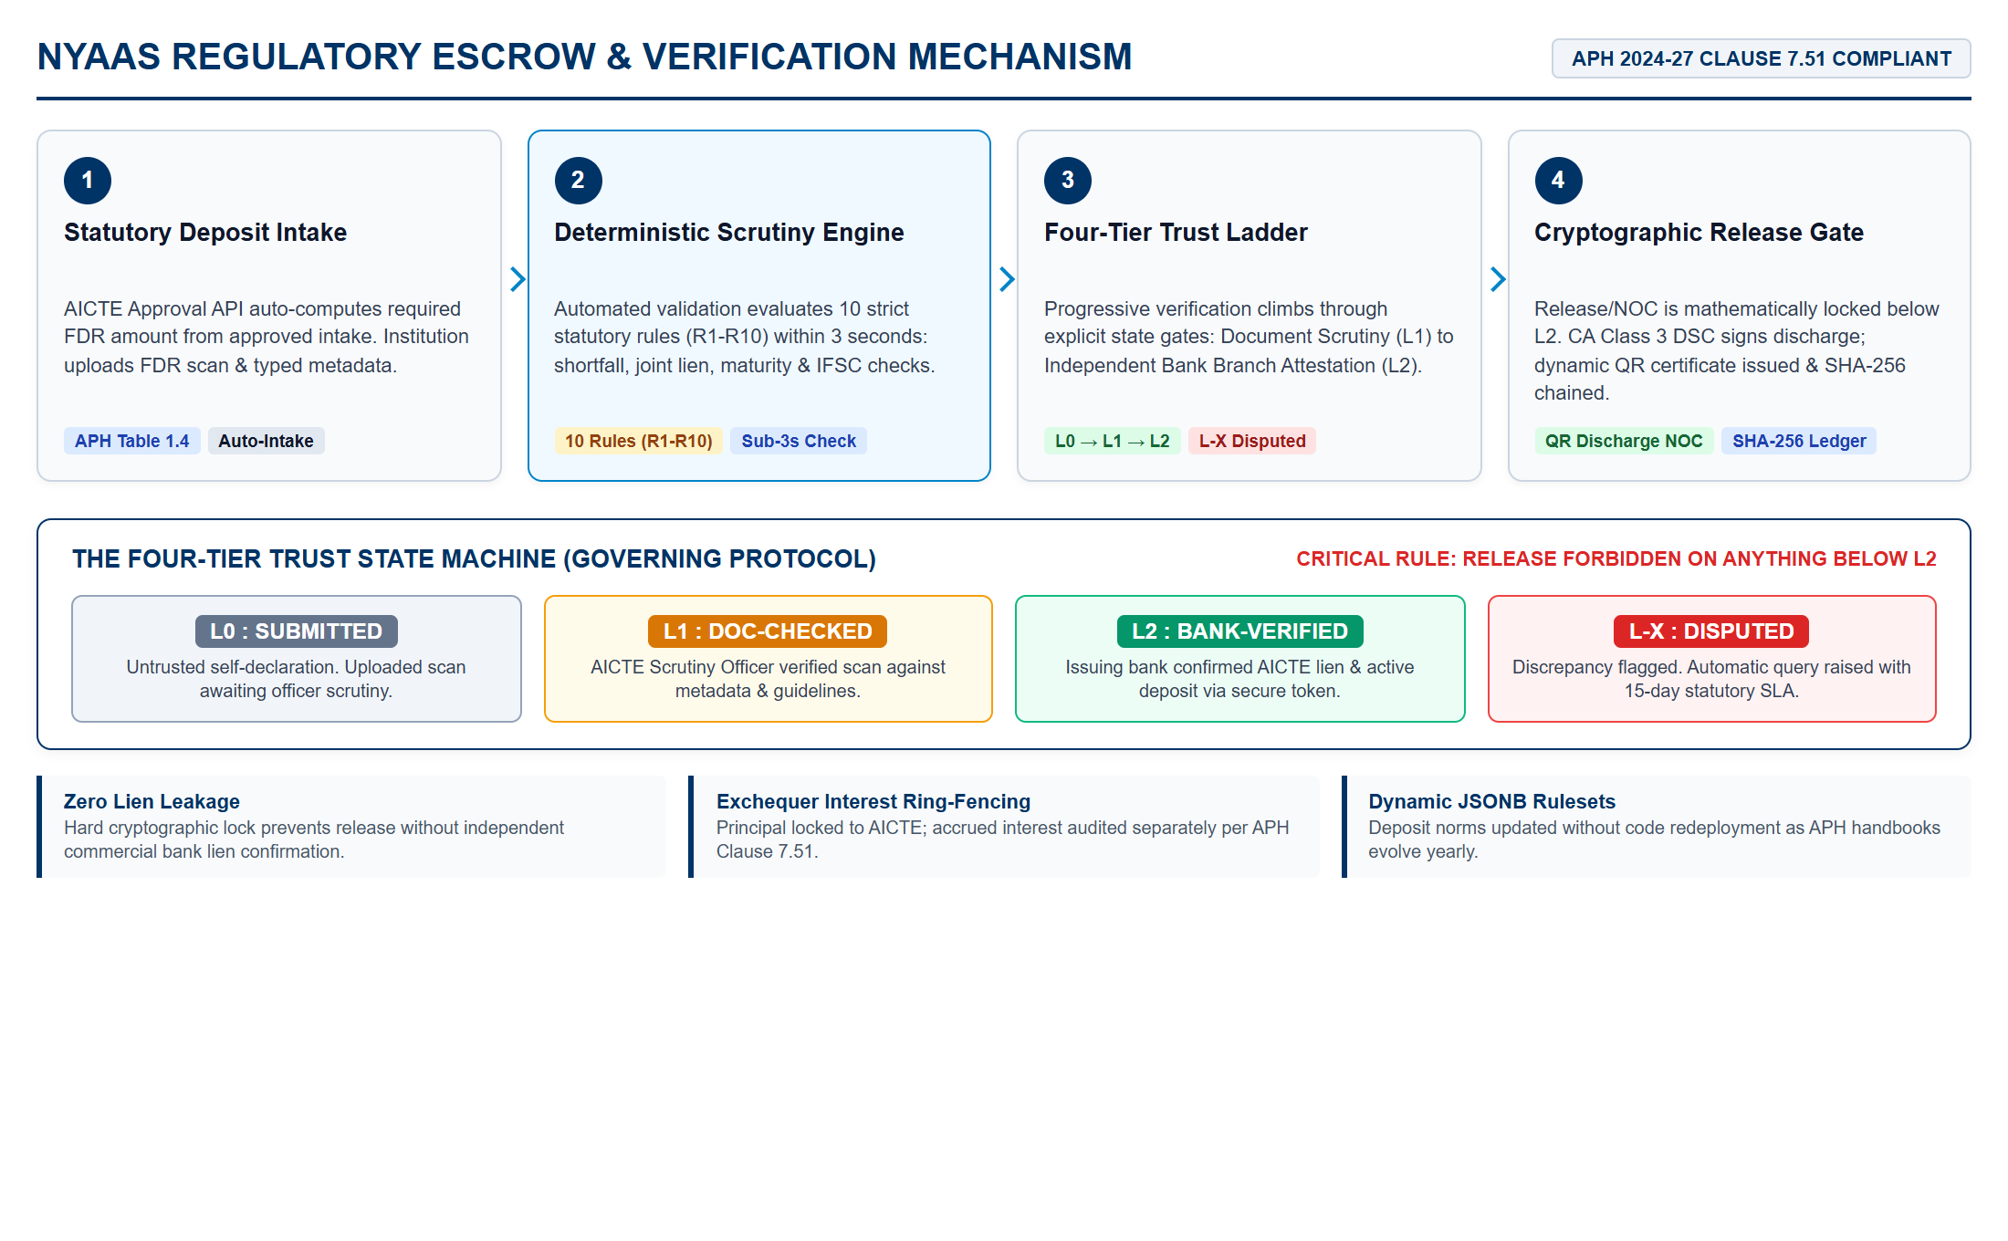
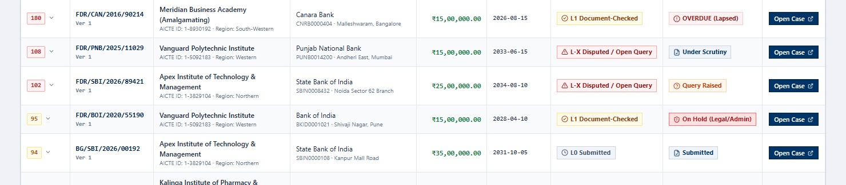
IDEA TITLE: NYAAS — AICTE SECURITY DEPOSIT & FDR PORTAL
Phra Uma Thewi
VERIFIED PROTOTYPE DEMONSTRATION [2]
Live Risk-Ranked Worklist with Explainable Priority Scoring & Trust Badges
Prototype Verification Highlights:
• Tested Working Engine: Live React 18 + TS prototype evaluated across 10 sample college submissions [2].
• Deterministic Rules (R1-R10): Instantly flags shortfalls, missing AICTE joint liens & IFSC errors in sub-3s.
• Trust Badge Enforcement: Explicit visual progression from L0 Submitted → L1 Checked → L2 Bank Verified.
• Ground Reality Addressed: Eliminates forged/un-lien-marked FDR scans that cause multi-month approval delays.
STATUTORY ARCHITECTURE GATE: Release/refund payout is mathematically forbidden below L2 trust status without an explicit digital exception note from Competent Authority.

Slide 3
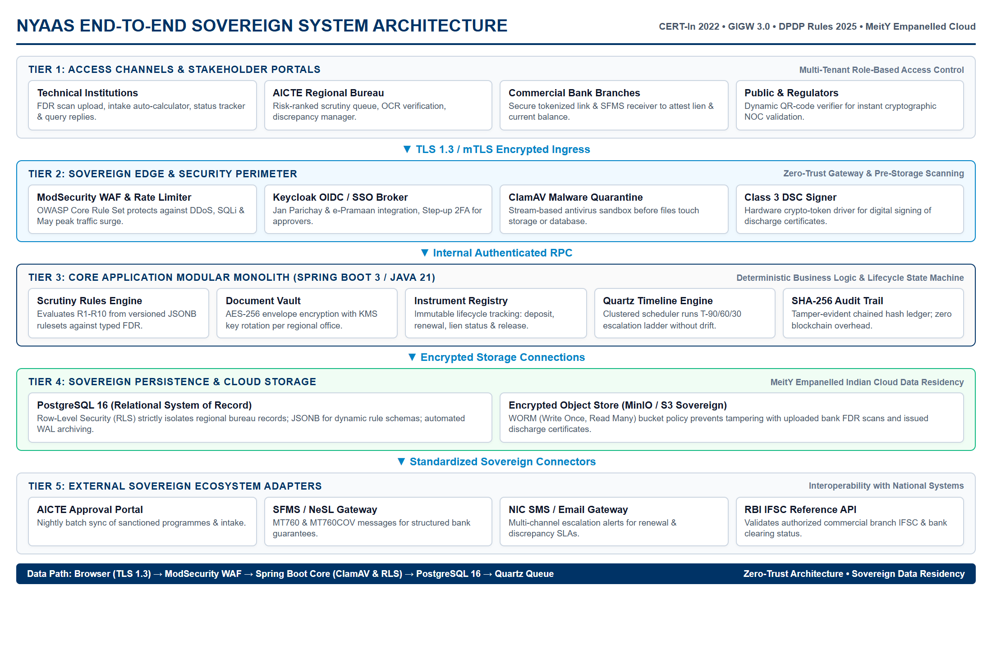
TECHNICAL APPROACH
Phra Uma Thewi
TECHNOLOGY RATIONALE & COMPLIANCE [3] [7]
Sovereign Compliance Guardrails:
• CERT-In Directions (2022) [3]: Mandatory 6-hr incident clock & 1-year log retention.
• DPDP Rules (2025/2027) [9]: 100% India sovereign hosting (NIC / MeitY-empanelled cloud).
• GIGW 3.0 Standard [2]: Bilingual interface (EN/HI) with WCAG 2.1 AA screen reader support.
Layer | Technology Choice | Architectural Rationale
Backend | Spring Boot 3 / Java 21 | NIC standard, mature Quartz clustering, high-throughput.
Database | PostgreSQL 16 (RLS) | Row-Level Security isolates Regional Offices; JSONB rules.
Security | ClamAV + AES-256 | Pre-storage malware isolation; envelope encryption; Class 3 DSC.
Audit | SHA-256 Hash Chain | Tamper-evident immutable ledger; zero blockchain overhead.
Bank Link | SFMS / Tokenized Link | Overcomes lack of open FDR APIs via secure manager links.
Architecture Standard: OWASP ASVS Level 2 • GIGW 3.0 • MeitY Empanelled Indian Cloud Data Residency

Slide 4
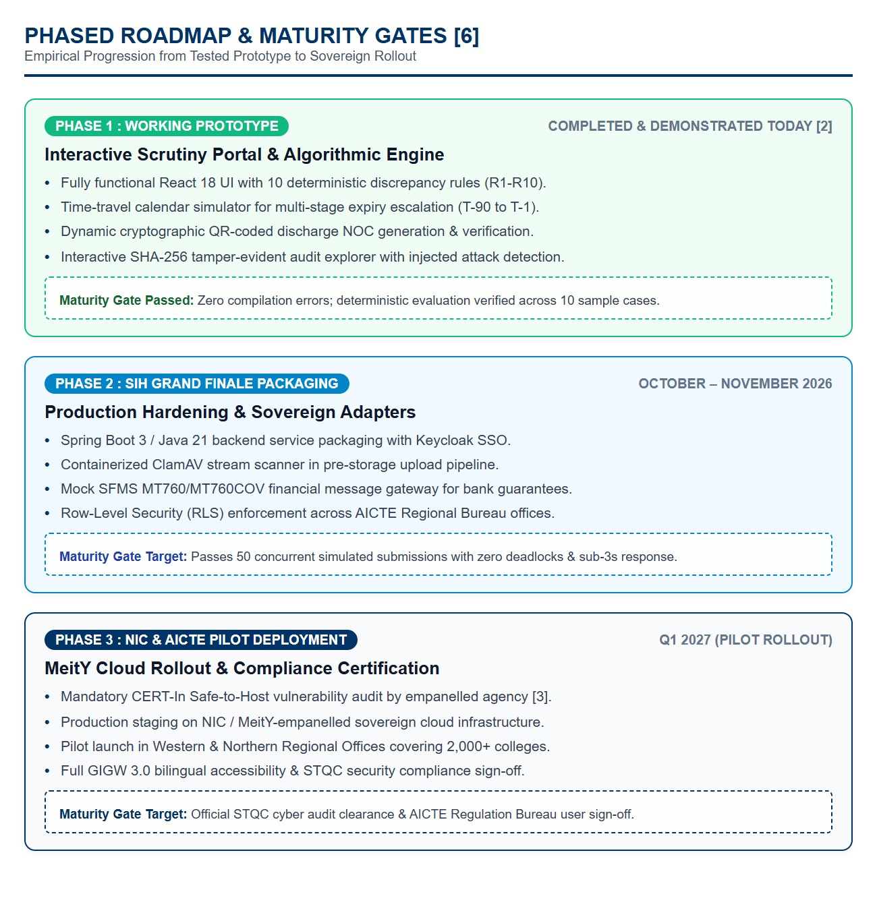
FEASIBILITY AND VIABILITY
Phra Uma Thewi
OPERATIONAL CONSTRAINTS & RISK MITIGATION [1] [4]
Operational Reality | Severity | Failure Mode | Engineering Response & Mitigation
No Bank FDR APIs | HIGH | Verification stalls | Hybrid Protocol: Secure tokenized branch link + SFMS adapter [5].
May Peak Surge | HIGH | Server crash mid-window | Asynchronous job queuing for virus scan & OCR; zero worker lock.
Gov Offline LAN | MED | External CDN failure | 100% offline bundling: local fonts, offline Tesseract OCR assist.
APH Handbook Revision | MED | Broken deposit rules | Versioned JSONB rulesets: updates rule parameters without redeploy.
Slow Bank Response | MED | Approval window missed | Independent bank SLA reminder clock with auto-escalation ladder.
STATUTORY SECURITY GATE: No deposit release can execute below L2 trust status without an explicit Competent Authority digital exception note.

Slide 5
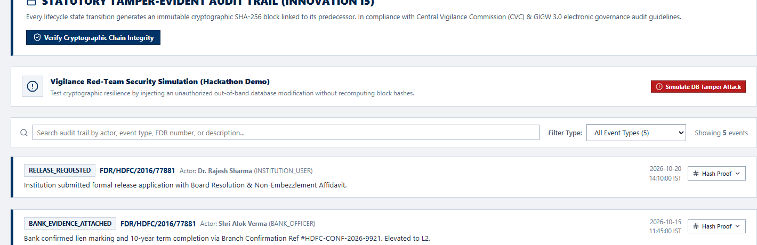
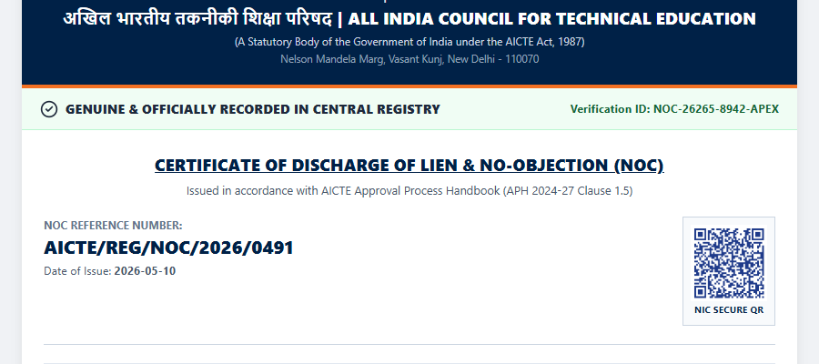
IMPACT AND BENEFITS
Phra Uma Thewi
MEASURABLE ROI VS. MANUAL SPREADSHEET BASELINE [1] [7]
VERIFIED SECURITY CAPABILITIES & ARTIFACTS [7] [8]
1. Cryptographic SHA-256 Audit Trail (100% Chain Continuity) [7]:
2. Dynamic QR-Coded Discharge NOC Certificate (NIC Verifiable) [2]:
-92%
Turnaround (< 48 hrs)
100%
Lien Protection (L2 Gate)
99%
Audit Effort Saved
Dimension | Manual Baseline | NYAAS Portal (Demonstrated) | Net Impact
Verification Turnaround | 18–24 working days | < 48 hours (L1 + Bank link) | 92% Reduction
Lien Fraud Risk | High risk of leakage | 0% (L2 gate locked release) | 100% Eliminated
Renewal Reminders | Manual file tracking | Automated Ladder (T-90 to T-1) | Zero Missed Expiries
Audit Preparation | 3–4 weeks file pulling | Instant hash chain validation | 99% Effort Saved
NOC Forgery Risk | Paper letter forgery | Dynamic QR cryptographic check | Instant Authenticity
Stakeholder Value Delivery Matrix:
• AICTE Regulation Bureau: Single source of truth for ₹1,500+ Cr in security deposits [1].
• 10,000+ Technical Institutions: Transparent online status; zero physical visits to regional offices.
• Commercial Issuing Banks: Streamlined digital verification replacing slow postal correspondence [4].

Slide 6
RESEARCH AND REFERENCES
Phra Uma Thewi
GOVERNMENT & STATUTORY NORMS
[1] AICTE Approval Process Handbook (APH 2024-27):
Chapter VII 'Security Deposit and FDR Norms', Clause 7.51 (Release/NOC procedures & interest refund to AICTE bank account).
URL: https://www.aicte-india.org/ap-handbook
[2] MeitY GIGW 3.0 Guidelines:
Guidelines for Indian Government Websites 3.0 (Quality, Security & WCAG 2.1 AA Accessibility Standards).
URL: https://guidelines.india.gov.in
[3] CERT-In Security Directions (2022):
Directions under Section 70B of IT Act, 2000; mandatory 6-hour security incident clock and 1-year log retention standard.
URL: https://www.cert-in.org.in/directions2022
BANKING & FINANCIAL PROTOCOLS
[4] RBI Master Directions (Updated 2023):
Master Direction - Reserve Bank of India (Financial Services provided by Banks) Directions, 2016; lien-marking on term deposits.
URL: https://www.rbi.org.in/Scripts/BS_ViewMasDirections.aspx
[5] SWIFT / SFMS Financial Telecommunication:
SFMS Message Specifications MT760 & MT760COV for Financial Guarantee advising & verification.
URL: https://www.swift.com/standards/data-standards/mt760
[6] National E-Governance Services Ltd (NeSL):
Electronic Bank Guarantee (e-BG) DDE Architecture Specification & Verification Repository.
URL: https://www.nesl.co.in/electronic-bank-guarantee
TECHNICAL & SECURITY STANDARDS
[7] OWASP ASVS 4.0 Standard:
Application Security Verification Standard Level 2 Controls for Financial & Regulatory Government Platforms.
URL: https://owasp.org/www-project-application-security-verification-standard
[8] NIST SP 800-63B Guidelines:
Digital Identity Guidelines: Authentication and Lifecycle Management (Step-up 2FA and Session Timeouts).
URL: https://doi.org/10.6028/NIST.SP.800-63b
[9] DPDP Act 2023 & Rules 2025:
Digital Personal Data Protection Rules; mandatory India sovereign data residency and auditability.
URL: https://www.meity.gov.in/dpdp-rules-2025

Slide 7
IMPORTANT INSTRUCTIONS
Please ensure below pointers are met while submitting the Idea PPT:
Kindly keep the maximum slides limit up to six (6). ( Including the title slide)
Try to avoid paragraphs and post your idea in points /diagrams / Infographics /pictures
Keep your explanation precise and easy to understand
Idea should be unique and novel.
You can only use provided template for making the PPT without changing the idea details pointers (mentioned in previous slides).
You need to save the file in PDF and upload the same on portal. No PPT, Word Doc or any other format will be supported.
Note - You can delete this slide (Important Pointers) when you upload the details of your idea on SIH portal.

